Slide 1
Let’s Revise Previous lecture ....
Hawthorne Experiment Conducted at the Hawthorne Plant of the Western Electric Company in Chicago from 1924 – 1932
conducted by Prof. Elton Mayo
Conducted in 4 phases - Illumination experiments ,Relay assembly test room experiments ,Mass Interviewing phase ,Bank wiring observation
Findings - Social and psychological factors, Informal relations, Effective communication , Employees perform better when given freedom to participate in decision making

Slide 2
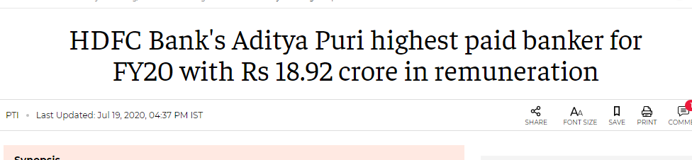
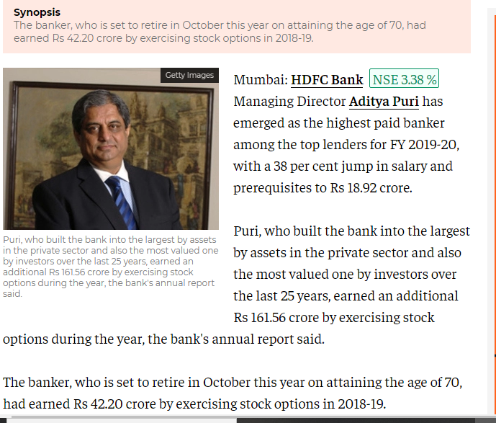

Slide 3

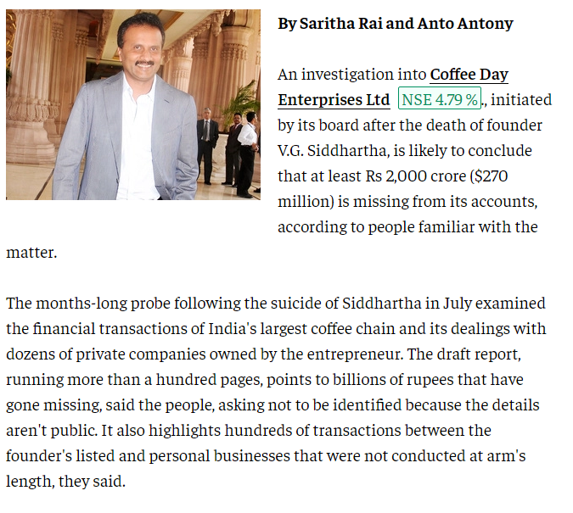

Slide 4

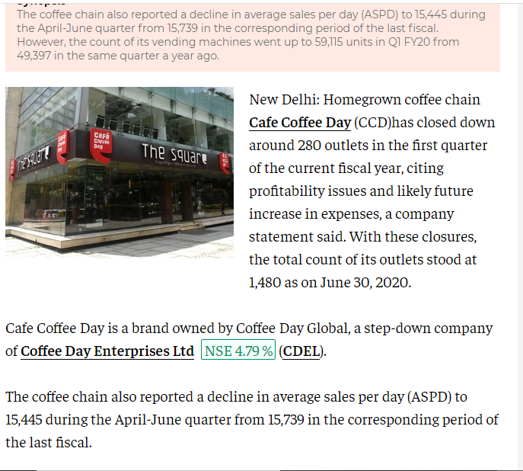

Slide 5

Modern Management Approach
Peter Drucker's Dimensions of Management

Slide 6
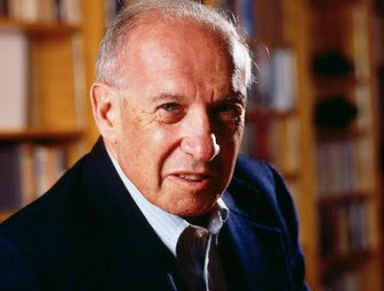
Peter Druckers
Born in 1909 in Vienna
Educated in Austria and England
Started as newspaper correspondents in 1929
Worked as an economist for international bank
Professor of Management in New York University in 1950
Best book – The Practice of Management -1956
Introduced Management BY Objectives (MBO) – 1954

Slide 7

Management Dimensions of Drucker
Purpose and Mission
Reflects purpose and philosophy
Organisation exits for a specific purpose and mission
Business and Non – business have different mission
Business Exits only for economic performance

Slide 8

2. Productive work and Worker Achievement
Work productive is essential function
To make worker perform productive work
Work to achieve productivity
Importance to human resources
Consider employees as human being not machine

Slide 9
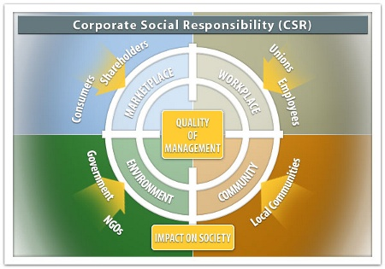
3. Social Impacts and Social Responsibilities
Part of the society
Sources of social development
CSR towards stakeholders –
Customers
employees
Shareholders
Government
society etc.

Slide 10
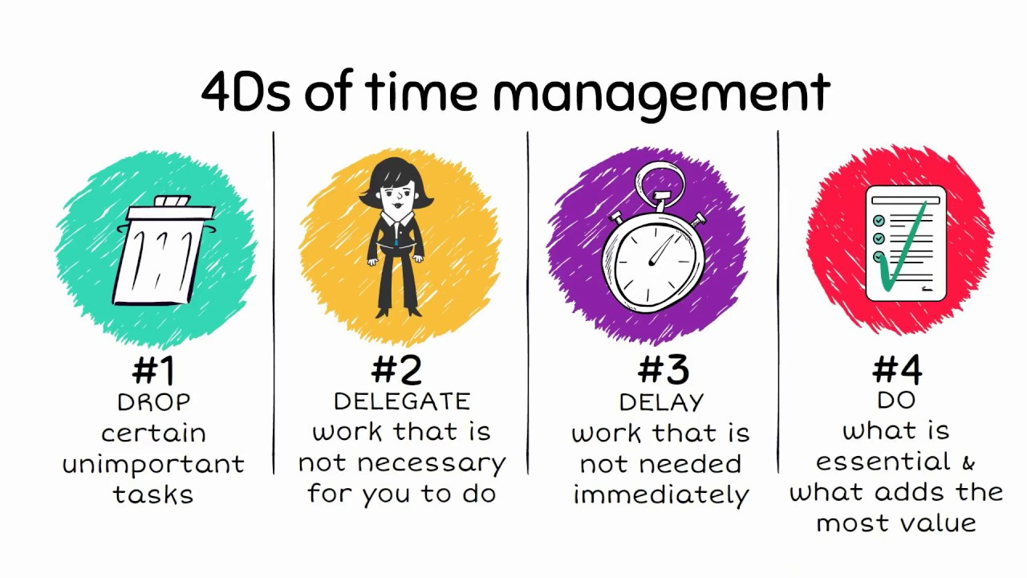
4. Time Dimension
Consider present and Future
To make enterprise perform in future
To make use of resources
Plan for long term

Slide 11

5. Administration and Entrepreneurship
Manager needs to administer
Manage and improve existing business
Optimum use of human, physical and financial resources
Need to be an entrepreneurship
Promote and create something new
Development of new technology
Introduction of new product
Entry in new market

Slide 12
Summary ....
Peter Ferdinand Drucker Management Dimensions
An Austrian-born American management consultant, educator, and author
Best book – The Practice of Management -1956
Introduced Management BY Objectives (MBO) – 1954
Five Management Dimensions
Purpose and Mission
Productive work and Worker Achievement
Social Impacts and Social Responsibilities
Time Dimension
Administration and Entrepreneurship

Slide 13


