Slide 1

Welcome to the session on
“International Banking & Finance”
By Akash Deshmukh

Slide 2

Topic:
International Monetary Systems

Slide 3
International Monetary System
The international monetary system refers to the operating system of the financial environment, which consists of financial institutions, multinational corporations, and investors. The international monetary system provides the institutional framework for determining the rules and procedures for international payments, determination of exchange rates, and movement of capital.

Slide 4
Evolution
Bimetallism
Before 1870
Gold Standard
1870-1932
Bretton Woods
1946-1971
1978 onwards
Flexible Exchange Rate System

Slide 5
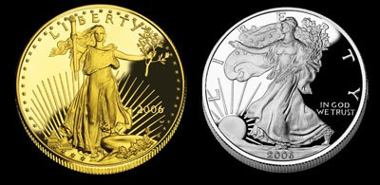
Bimetallism
Before 1870, the international monetary system consisted of bimetallism, where both gold and silver coins were used as the international modes of payment.
The exchange rates among currencies were determined by their gold or silver contents. Some countries were either on a gold or a silver standard.

Slide 6

Gold standard
Gold Standard was the first universally implemented exchange rate system in the world
The system was promoted by Bank of England and established in 1870

Slide 7
Features of gold standard
Every country was required to establish a Central Bank to function as custodian of country’s monetary reserves
Every Central Bank was to be provided the sole (exclusive) authority to issue paper money within the area under its jurisdiction
Every Central Bank was required to establish a fixed official price for gold in terms of domestic currency
Every Central Bank was required to provide an irrevocable promise on each paper note to redeem the same on demand I terms of specified quantity of gold
Each Central Bank was required to provide an unconditional guarantee to buy and sell unlimited quantity of gold at the fixed official price
The total amount of money supply in circulation by way of Bank Notes was required to be limited to the extent of the monetary gold reserves with the Central Monetary Authority

Slide 8
Mint Par of Exchange
The mechanism for establishing exchange rates between currencies under the Gold Standard was called as the “Mint Par of Exchange”
The Exchange rate between two currencies was represented by the ratio of the official gold prices for the two currencies
Example:
1 ounce of Gold in USA = USD 400
1 ounce of Gold in Germany = DEM 600
Then, 1 USD = 600/400 = DEM 1.5000
Exchange rates established under this system are called as “Central Exchange Rates” or “Mint Parities”

Slide 9
Gold Points
The arbitrage between the exchange rates provided a room for trading to exchange rate, thus providing the upper and lower gold points.
Example:
1 ounce of Gold in USA = USD 400
1 ounce of Gold in Germany = DEM 600
Then, 1 USD = 600/400 = DEM 1.5000
So if the demand for US Dollar increased the new exchange rate will be
1 USD = DEM 1.6000
So if a person wants to remit USD 400, then
400*1.6000= DEM 640 instead of 400*1.5000= DEM 600

Slide 10
Gold Points
If the cost of arbitrage is 10 per ounce of gold. Then the rate of exchange will be
1 USD = 600/400 = DEM 1.5000 (Initial Rate)
1 USD = 610/400 = DEM 1.5250 (Upper Gold Points)
1 USD = 590/400 = DEM 1.4750 (Lower Gold Points)
Settling of Demand and Supply of currencies between two countries through currencies.

Slide 11
Price Specie Adjustment Mechanism
The net imbalances between countries would be settled through the transfer of gold reserves
This would result in reduction of money supply and commodity prices in the deficit country and increased money supply and inflation in surplus country
Thus commodities will be attractive in deficit country and remove trade imbalance and achieve equilibrium

Slide 12
Advantages of Gold Standard
Easy system of operate
Provide high level of stability in exchange rate promoting trade and investments
In-built trade equilibrium mechanism- Price Specie Adjustment Mechanism
Secured system of payment and settlements

Slide 13
Disadvantages of Gold Standard
Increase in the cost of manufacturing gold led to stoppage of gold production
Countries with persistent trade deficit suffered from recessions
Lack of flexibility to adjust money supply during the times of crisis
Neutralization of Reserves

Slide 14
Types of Gold Standard:
Gold Coin Standard
Gold coin standard or gold currency standard or gold species standard or orthodox gold standard or traditional gold standard is the oldest form of gold standard.
Gold coin standard is also regarded as full gold standard because under this standard full- bodies standard coins made of gold were circulated. Other forms of money are redeemable into gold.
This was prevalent in pre-World War I phase. According to Crowther – “A currency system in which gold coins either form the whole circulation or else circulate equally with notes is known as the full-gold standard.”

Slide 15
Types of Gold Standard:
Gold Bullion Standard
After World War I, Gold standard was revived in some countries of Europe not on gold currency basis but on gold bullion basis. It was adopted by Great Britain in 1925. Gold bullion standard is a modified version of gold coin standard in which there was no gold coinage and the currency is convertible into gold bullion (i.e., gold bars).

Slide 16
Types of Gold Standard:
Gold Exchange Standard
Gold exchange standard refers to a system in which there is neither a gold currency in circulation not gold reserves held for external purposes. Under this system, the domestic currency of a country (which is composed of token coins and paper notes) is not converted into gold for meeting internal needs, but is converted into the currency of some foreign payments.
It was first adopted by Holland in 1877 and then by Austria, Hungary, Russia and India during the last decade of the 19th century. India abandoned this standard in 1926 on the recommendations Of the Hilton Young Commission.

Slide 17
Types of Gold Standard:
Gold Reserve Standard
After the breakdown of gold standard, a new monetary system called gold reserve standard, was developed in 1936 mainly to ensure stability in exchange rates. In 1936, Great Britain, the U.S.A. and France entered into a Tripartite Monetary Agreement according to which free flow of gold or foreign currency was allowed to stabilize exchange rates and promote foreign trade without affecting the internal value of the domestic currency.
For this purpose, Exchange Equalization Funds were created. The gold reserve standard functioned successfully for three years and came to an end with the outbreak of World War II.

Slide 18
Types of Gold Standard:
Gold Parity Standard
In essence, gold parity standard is the modern version of the gold standard. It came into force with the establishment of the International Monetary Fund (IMF) in 1946. Under this standard, every member country has to define the par value of its currency in terms of gold in order to determine the exchange rate. The gold parity standard aims at maintaining stable exchange rates without interfering into the domestic monetary system of the member countries.

Slide 19
Bretton Woods Conference
The Bretton Woods system of international monetary management established the rules for commercial and financial relations among the world's major industrial states.
The Bretton Woods system was the first example of a fully negotiated monetary order intended to govern monetary relations among independent nation-states.
Preparing to rebuild the international economic system as World War II was still raging, 730 delegates from all 44 Allied Nations gathered at the Mount Washington Hotel in Bretton Woods, New Hampshire for the United Nations Monetary and Financial Conference in United States of America. The delegates deliberated upon and signed the Bretton Woods Agreements during the first three weeks of July 1944.

Slide 20
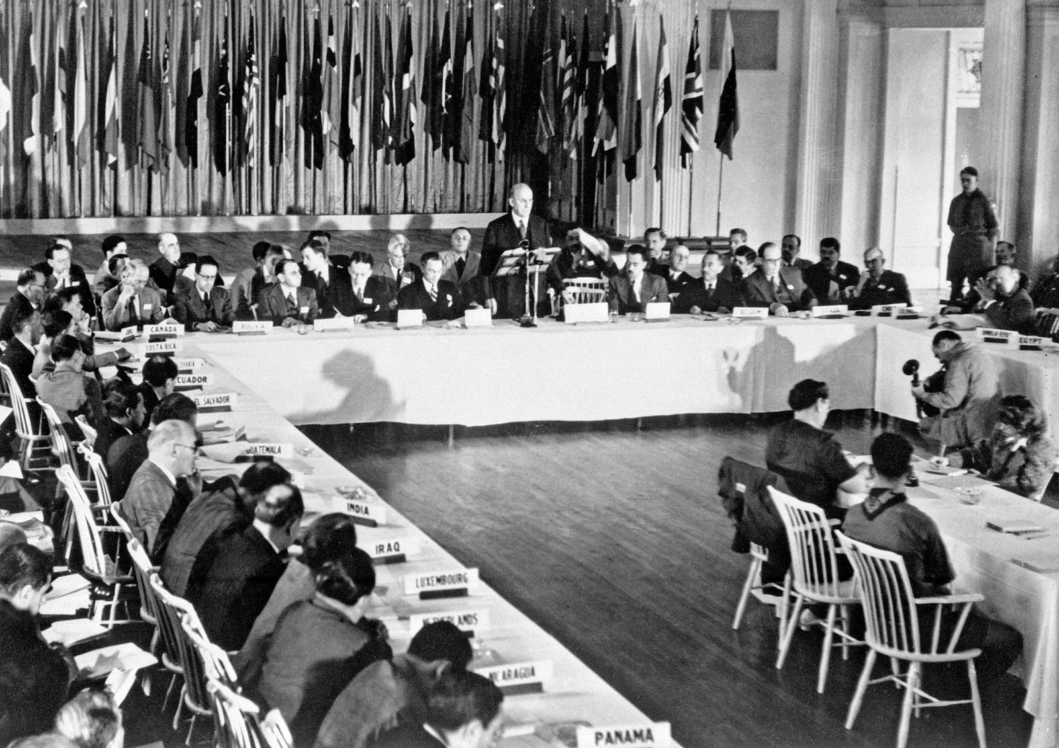
Setting up a system of rules, institutions, and procedures to regulate the international monetary system, the planners at Bretton Woods established the following institutions:
A. The International Bank for Reconstruction and Development (IBRD) (now one of five institutions in the World Bank Group) for long-term capital requirements
B. The International Monetary Fund (IMF) for short-term capital requirements
C. International Trade Organization (ITO) which was to define and supervise trade practices but didn’t materialize

Slide 21
Bretton Woods Conference
These organizations became operational in 1946 after a sufficient number of countries had ratified the agreement.
The chief features of the Bretton Woods system were an obligation for each country to adopt a monetary policy that maintained the exchange rate of its currency within a fixed value—plus or minus one percent—in terms of gold; and the ability of the IMF to bridge temporary imbalances of payments.
In the face of increasing strain, the system collapsed in 1971, following the United States' suspension of convertibility from dollars to gold. Until the early 1970s, the Bretton Woods system was effective in controlling conflict and in achieving the common goals of the leading states that had created it, especially the United

Slide 22
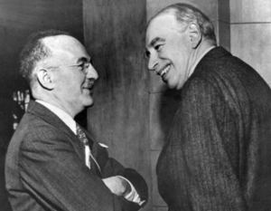
Bretton Woods System/
IMF’s Fixed Exchange Rate System
The system was implemented in 1946 which was promoted by International Monetary Fund
At the Bretton Woods conference, Harry Dexter White (on the left)negotiating on behalf of the US was the architect of the IMF, while John Maynard Keynes (on the right) negotiating on behalf of the UK proposed an alternative which he called the International Clearing Union.

Slide 23
Features of Bretton Woods System
United States Dollar (USD) was given status of Universal Reserve Asset (with gold reserves, countries could use domestic money against USD reserves).
The value of USD was fixed at 1 ounce of Gold = USD 35
US Federal Reserve Bank provided unconditional guarantee to buy and sell unlimited quantity of gold and at this price is Gold Convertibility Clause.
No other country was required to provide for redemption of its currency against gold nor they were required to fix an official price.
United States Dollar (USD) functioned as the Universal Vehicle Currency.

Slide 24
Parity Value
The fixing of value for a currency as a multiple of another currency is called as Pegging.
Each country was supposed to fix the value of currency against USD = Parity Value.
The equality between Gold, USD and domestic currency was called as Par Value Mechanism.
Variation range of +/- 1% was allowed for every cross rate defined which was called Intervention points/Support points.

Slide 25
Parity Values
Parity 1: USD 1 = DEM 1.75
Parity 2: USD 1 =GBP 0.50
GBP 0.50 = DEM 1.75
GBP 1 = DEM 1.75/0.50
GBP 1 = DEM 3.50
GBP 1 = DEM 3.5350 (upper support level)
GBP 1 = DEM 3.4650 (lower support level)

Slide 26
Features of Bretton Woods System
Every currency was redeemable in terms of USD and only USD was redeemable in terms of Gold. (Gold Exchange Standard)
The introduction of concept of “Central Bank Intervention” (Proactive participation of Central Bank in domestic markets with the intention of influencing exchange rate movement)
Adjustable Peg System provided flexibility to the system in case structural imbalances in the Balance of Payments, member countries could devalue their currencies
The concept of dual exchange rates was abolished
All member countries accepted IMF as the supervisory authority with respect to exchange rate management and domestic foreign exchange market

Slide 27
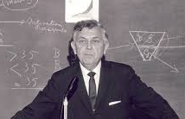
Triffin dilemma/Triffin paradox
The Triffin dilemma or Triffin paradox is the conflict of economic interests that arises between short-term domestic and long-term international objectives for countries whose currencies serve as global reserve currencies.
This dilemma was identified in the 1960s by Belgian-American economist Robert Triffin, who pointed out that the country whose currency, being the global reserve currency, foreign nations wish to hold, must be willing to supply the world with an extra supply of its currency to fulfill world demand for these foreign exchange reserves, thus leading to a trade deficit.

Slide 28
Testifying before the U.S. Congress in 1960, economist Robert Triffin exposed a fundamental problem in the international monetary system.
If the United States stopped running balance of payments deficits, the international community would lose its largest source of additions to reserves. The resulting shortage of liquidity could pull the world economy into a contractionary spiral, leading to instability.
If U.S. deficits continued, a steady stream of dollars would continue to fuel world economic growth. However, excessive U.S. deficits (dollar glut) would erode confidence in the value of the U.S. dollar. Without confidence in the dollar, it would no longer be accepted as the world's reserve currency. The fixed exchange rate system could break down, leading to instability.
Triffin proposed the creation of new reserve units. These units would not depend on gold or currencies, but would add to the world's total liquidity. Creating such a new reserve would allow the United States to reduce its balance of payments deficits, while still allowing for global economic expansion.

Slide 29
Reasons for failure of the Bretton Woods System
No revision of gold prices which led to suspension of gold prices
No revaluation of parities which benefitted West Germany and Japan
No revision of gold prices in terms of USD leading to problem with devaluation of a currency
Continued trade deficit of the led to reduced acceptability of USD

Slide 30
Smithsonian Agreement
G-10 Countries (USA, UK, West Germany, France, Japan, Canada, Italy, Sweden, Belgium and Holland) met Smithsonian Institute in Washington in December 1971
The aim was to re-introduce Bretton Woods System
Major Amendments
US exempted from Gold Convertibility Clause
USD devalued to 1 ounce of Gold = USD 38
Revalued parities for all member G-10 countries
Variation range increased to (+/-) 2.25%
All the counties to revise and fix new parities with USD
The system was abandoned in 1973

Slide 31
Changes in the world post
Snake in the Tunnel
Rise of European Markets
Reconsideration of wider variation zone for trade
Parity Grid in 1979
Rise of European Monetary Unit – Single Currency “Euro” in 1999
Dollar Standard
The standard which grew between 1968-1973 where the US Administration was not committed to redeem currency

Slide 32

Any Doubts/Questions/
Clarifications/ Feedback required

Slide 33


