Slide 1

THAKUR COLLEGE OF SCIENCE & COMMERCE
DEPARTMENT OF COMMERCE
SUBJECT : ADVERTISING I
MODULE I
( INTRODUCTION TO ADVERTISING )

Slide 2
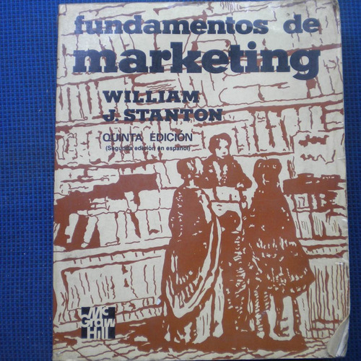
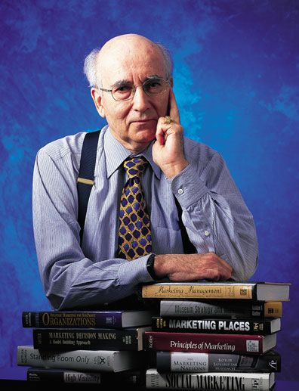
INTEGRATED MARKETING COMMUNICATION
WILLAIM STANTON
Defined IMC “as the element in an organization’s marketing mix that is used to inform , persuade and remind the market regarding the organization and its products”.

Slide 3
FEATURES
OF IMC
(INTEGRATED MARKETING COMMUNICATION)
Process
Main Objectives
Continuous in Nature
Elements of IMC
Creativity
Art and Science
Target Audience
Influences Diverse Groups

Slide 4
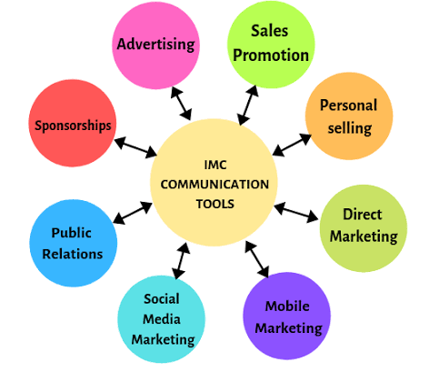

Slide 5
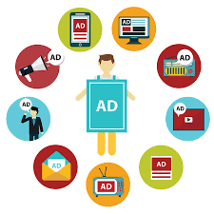
ADVERTISING
It is any paid form of non-personal presentation & promotion of ides , goods & services by an identified sponsor .The advertising messages are communicated through various media such as newspapers, magazines, radio , television, direct mail, internet and so on.
Advertising plays important role in
Integrated Marketing
Communication mix:
Awareness
Attitude
Brand image
Brand loyalty
Claims of the competitors

Slide 6
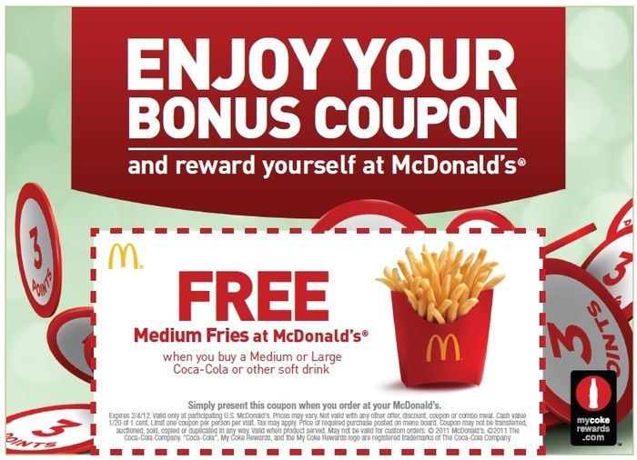


SALES PROMOTION
It includes various techniques that induce a desired response on the part of target customers & intermediaries
COUPONS
DISCOUNTS
CONTEST

Slide 7

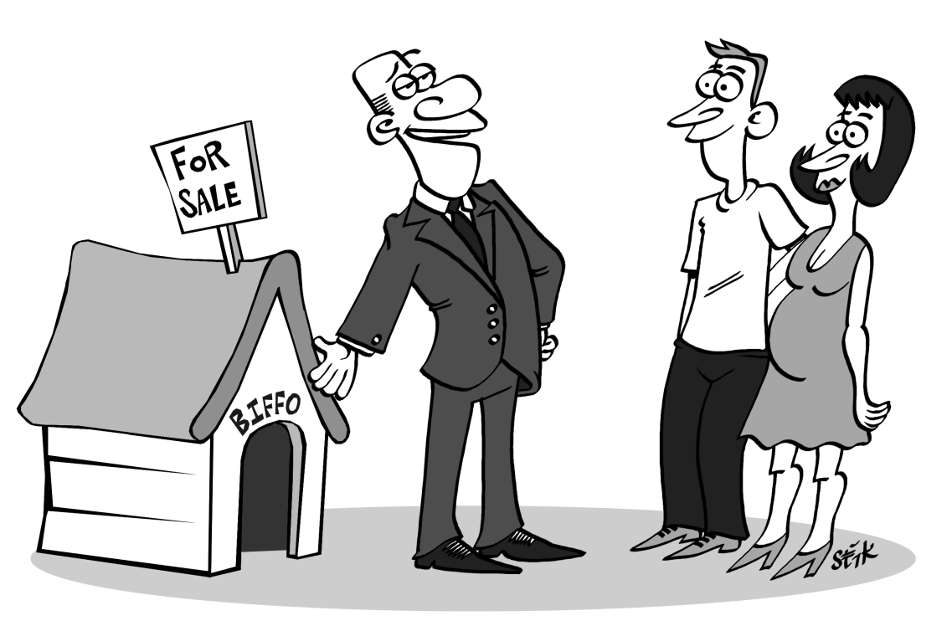
PERSONAL SELLING
It involves face-to-face communication between the firm’s representative & the prospect . It is the oldest form of promotional effort to sell products

Slide 8
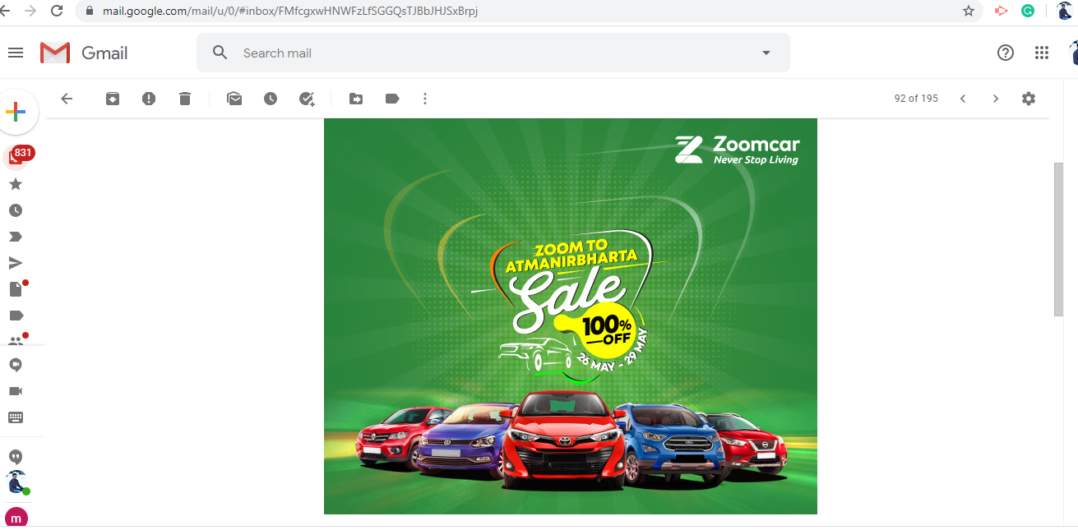
DIRECT MARKETING
Direct Marketing involves several techniques to sell product directly to the customers, such as yellow pages ,direct mails internet & telemarketing

Slide 9

MOBILE MARKETING
Mobile marketing is a multi-channel, digital marketing strategy aimed at reaching a target audience on their smartphones, tablets, and/or other mobile devices, via websites, email, SMS and MMS, social media, and apps

Slide 10
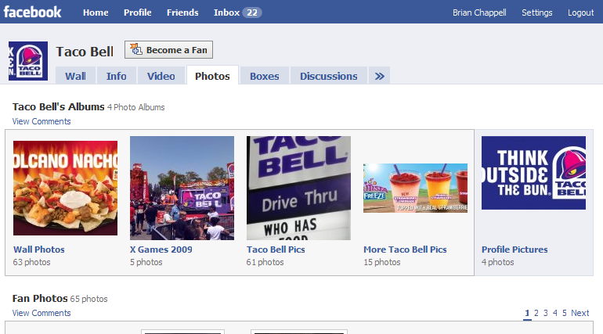
SOCIAL MEDIA MARKETING
Social media marketing is the use of social media platforms to connect with your audience to build your brand, increase sales, and drive website traffic. This involves publishing great content on your social media profiles, listening to and engaging your followers, analyzing your results, and running social media advertisements.

Slide 11
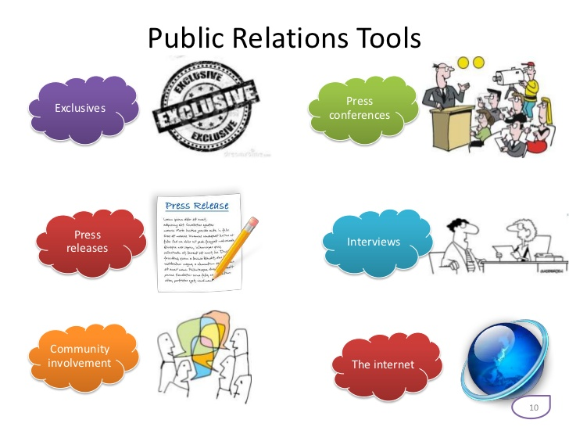
PUBLIC RELATIONS
Professional firms are concerned about the effects of their actions on the public. A firm should understand concerns of the public & communicate to them its goals & interests. Otherwise , the public may misinterpret, distort, or be openly hostile to the firm’s actions

Slide 12

SPONSORSHIP
Advertising that seeks to establish a deeper association and integration between an advertiser and a publisher, often involving coordinated beyond-the-banner placements

Slide 13
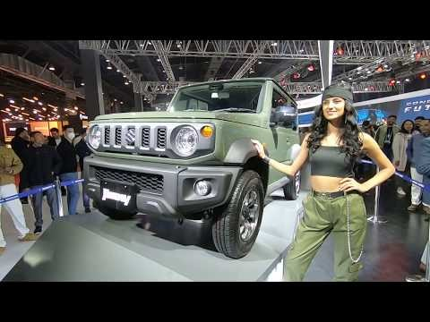
TRADE FAIRS & EXHIBITIONS
A trade fair is the chance for a company to become instantly visible in that particular market place.
To take part in an exhibition, is to create the opportunity of coming into human, physical, contact with clients, suppliers and partners.
Maruti JIMMY new launch in India during Auto Expo 2020

Slide 14
ROLE OF ADVERTISING IN IMC
Advertising and Sales Promotion
Advertising and Public Relation
Advertising and Direct Marketing
Advertising and Sponsorships
Advertising and Personal Selling
Advertising and Packaging
Advertising and Exhibition
Advertising and Publicity

Slide 15
Case study on IMC
#1 - Microsoft
#2 - Emirates
#3 - Wells Fargo
#4 - Taco Bell
https://www.paperflite.com/blogs/integrated-marketing-communication-case-studies

Slide 16

PHILIP KOTLER
“Advertising is any paid form of non-personal presentation and promotion of ideas, goods, or services by an identified sponsor”
DERIVED FROM
LATIN WORD ADVERTERE – “TO TURN THE MIND TOWARD”

Slide 17
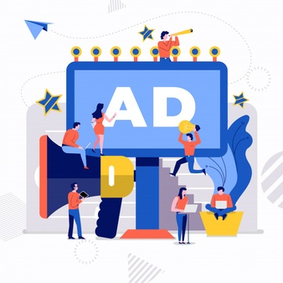
INTRODUCTION TO ADVERTISING
FEATURES OF ADVERTISING
Process
Paid/controlled form
Non-personal presentation
Ideas, goods and services
Identified sponsors
Arts, science and profession
Elements of promotion mix
Universal choice
Objectives of advertising
Consumer choice
Target audience
Creativity
Influences diverse group

Slide 18
OBJECTIVES OF ADVERTISING
To stimulate demand
To gain competitive advantage
To act as a reminder
To enhance corporate image
Increase standard of living

Slide 19
OBJECTIVES OF ADVERTISING
To create awareness
To differentiate the product
To develop and reinforce attitude
To develop brand image
To persuade customers

Slide 20
EVOLUTION OF ADVERTISING
Early of Advertising
Trade Marks
Town Criers
Sign Boards
Birth of Printing Press
Handbills
Newspaper Advertising
Magazine Advertising
Birth of Advertising Agency
Radio Advertising
Television Advertising
Other Forms
Growth of Advertising Organisations
Internet

Slide 21
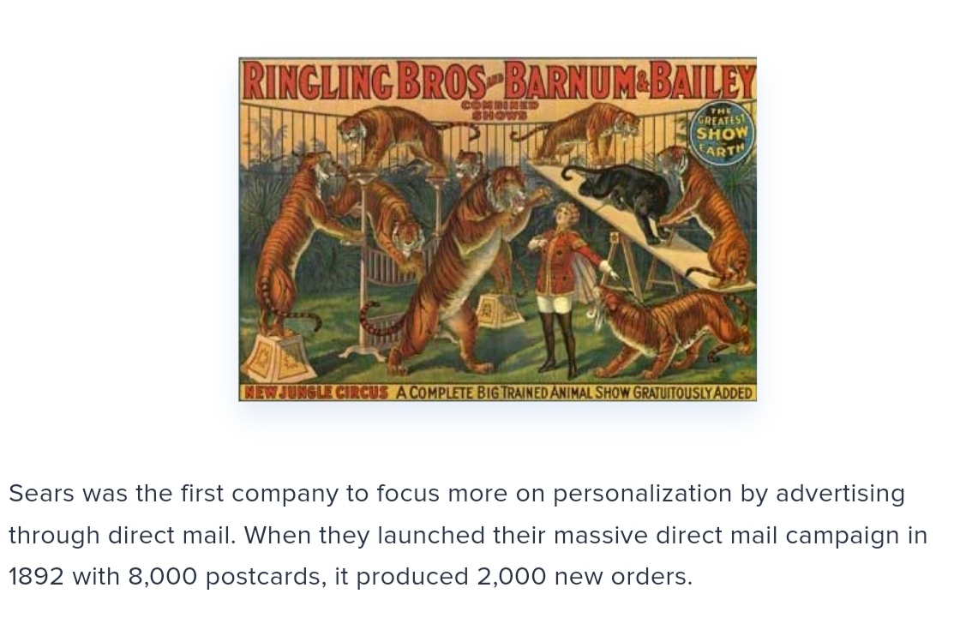
EARLY FORMS OF ADVERTISING

Slide 22
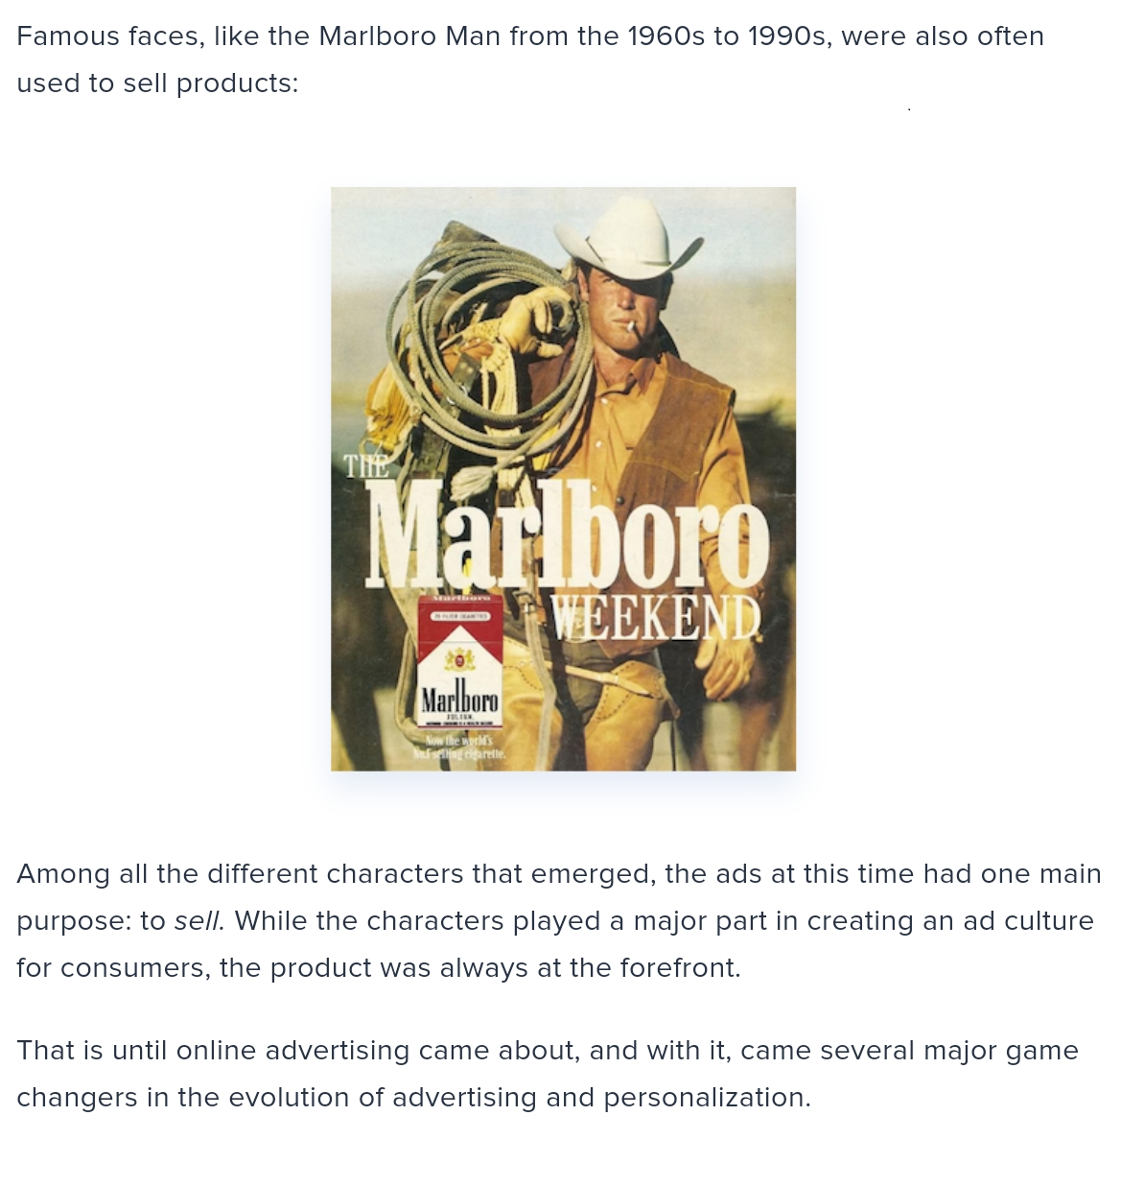

Slide 23
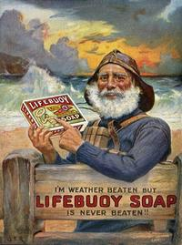
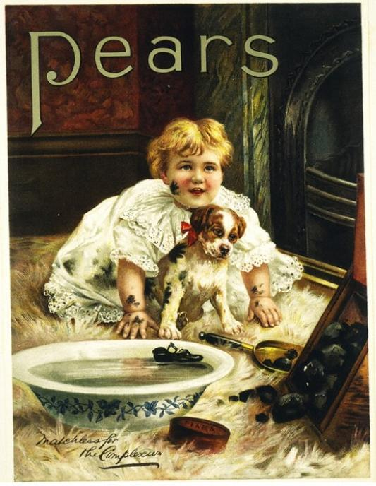

Slide 24
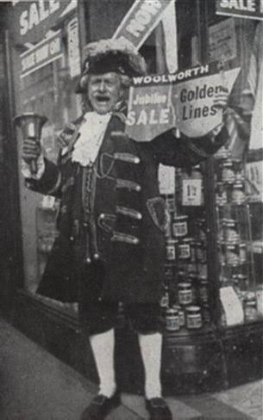
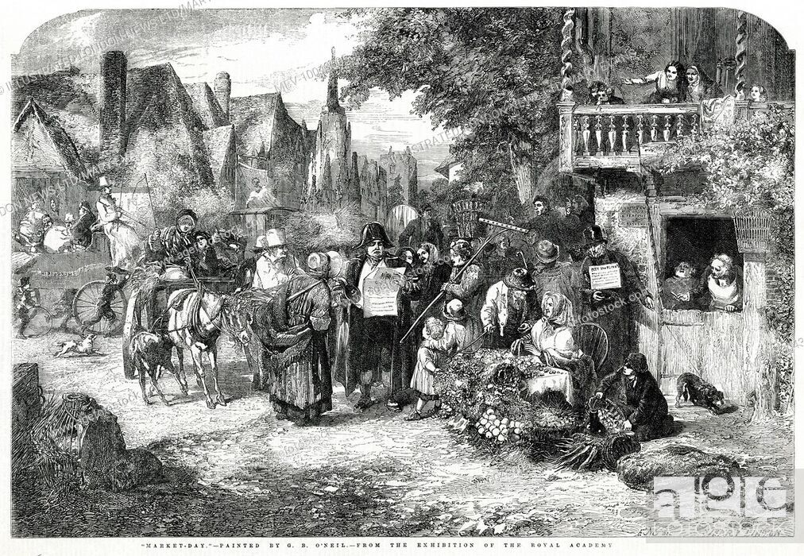
TOWN CRIERS

Slide 25
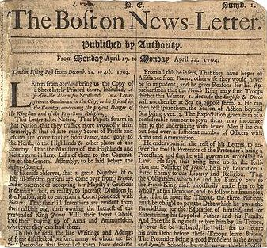
1704 - FIRST NEWSPAPER

Slide 26

FIRST ADVERTISEMENT ON TELEVISION-BULOVA WATCHES

Slide 27
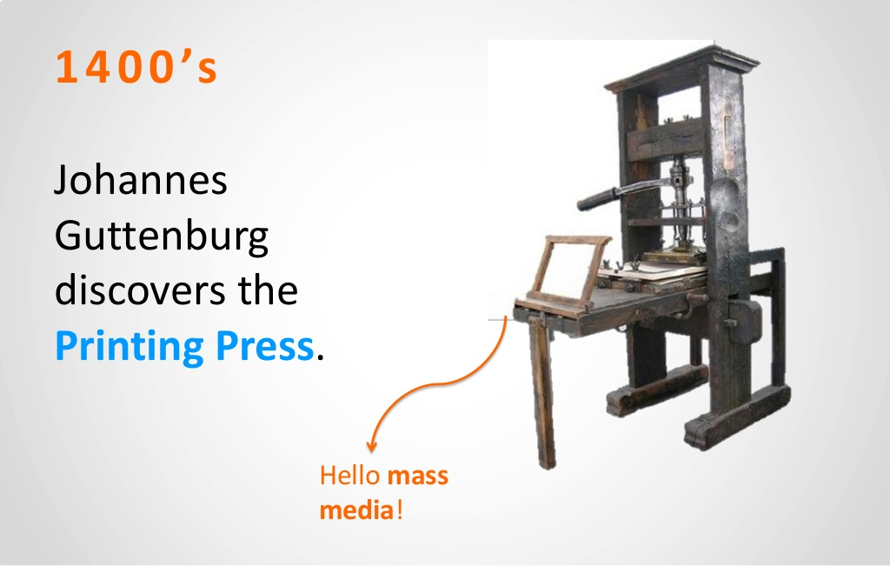
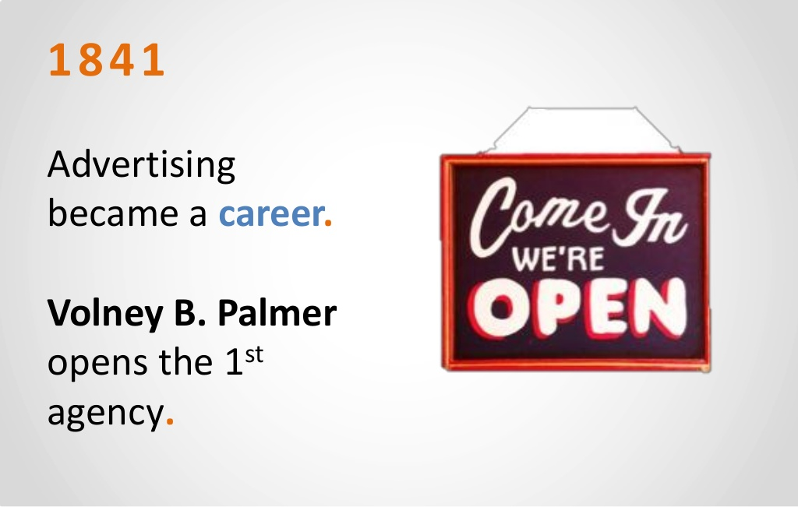

Slide 28
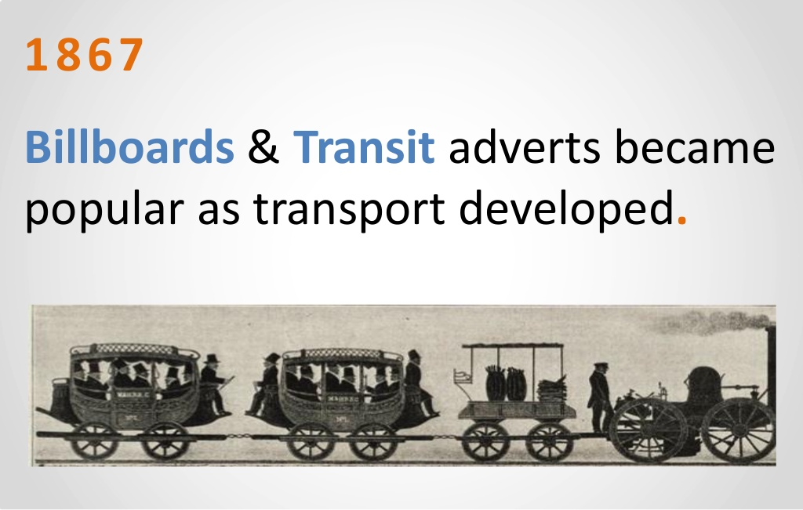
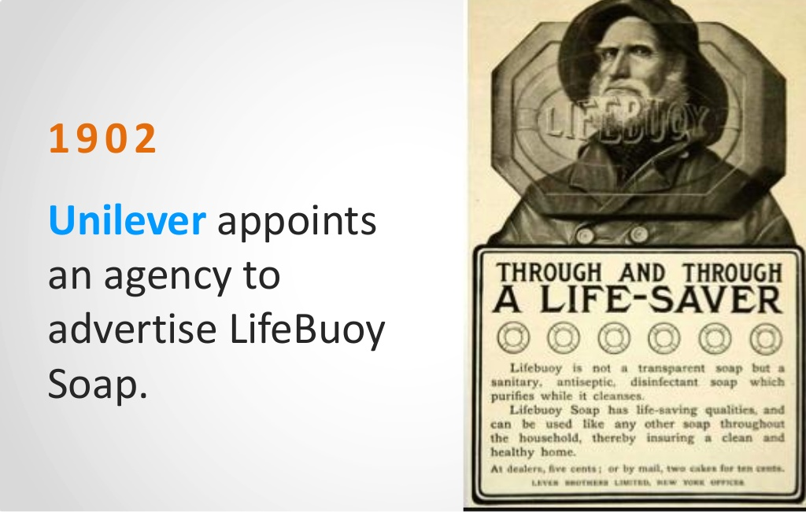

Slide 29
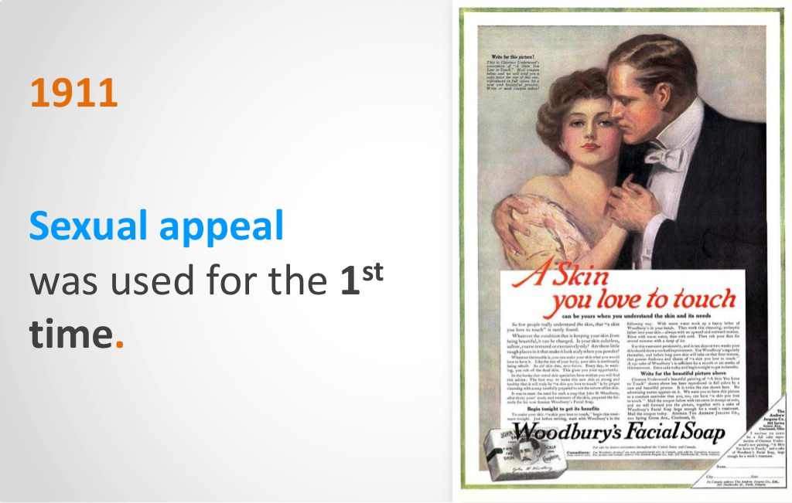

Slide 30
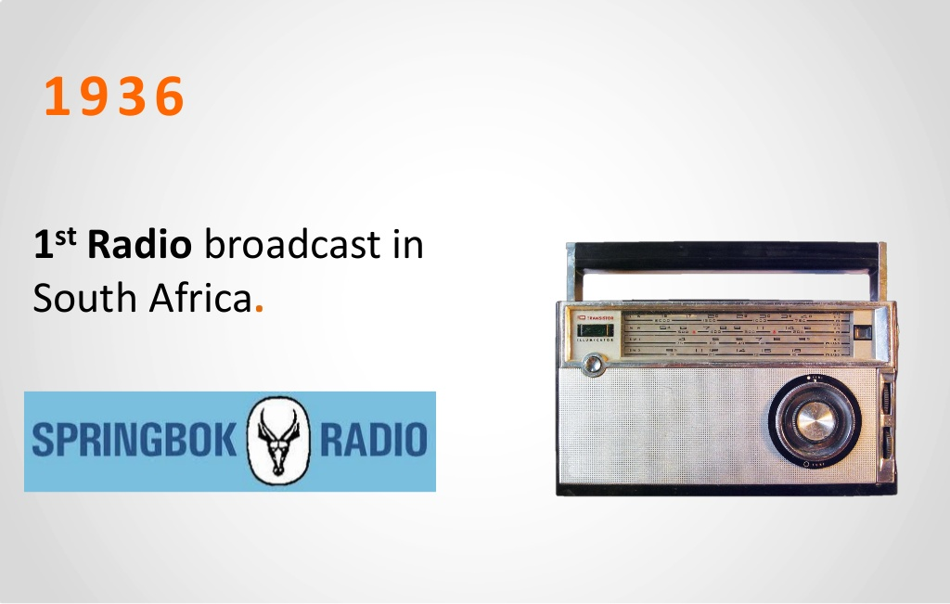
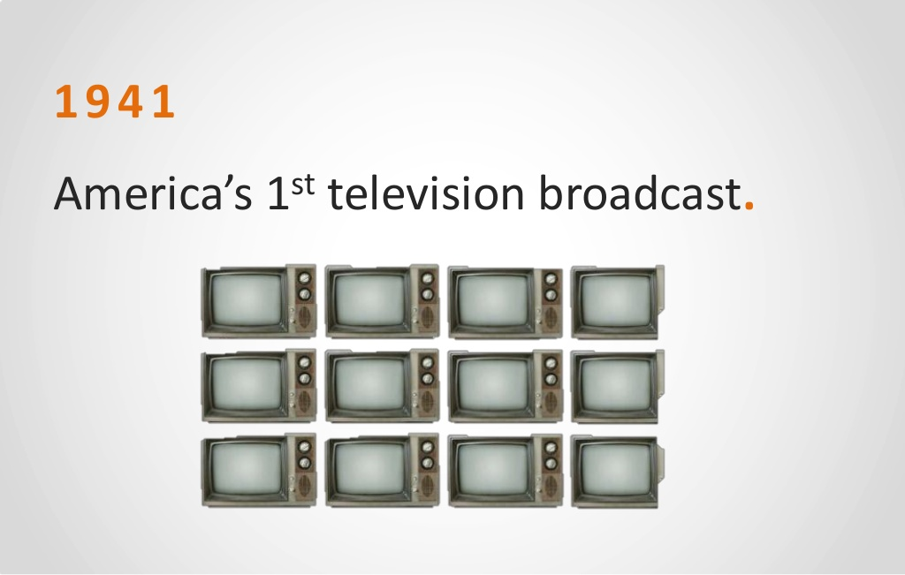

Slide 31
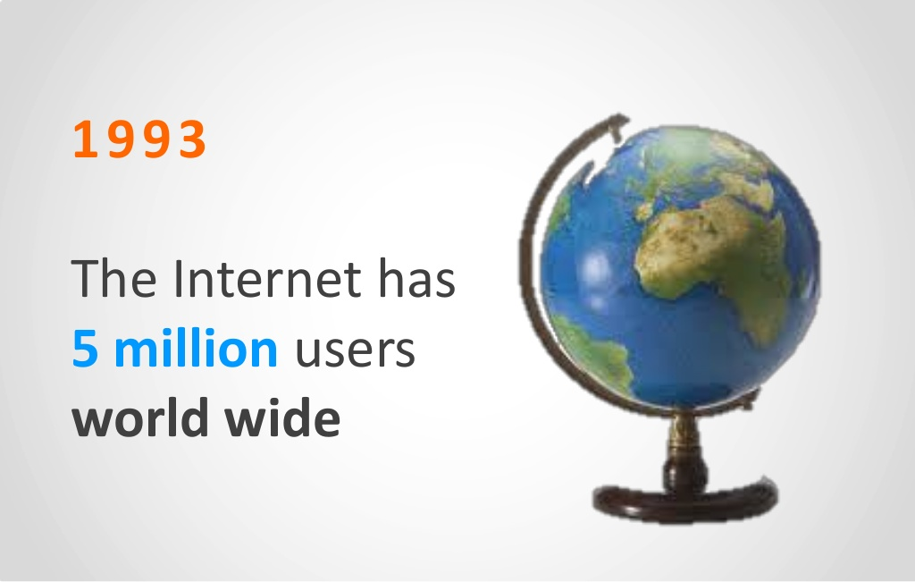
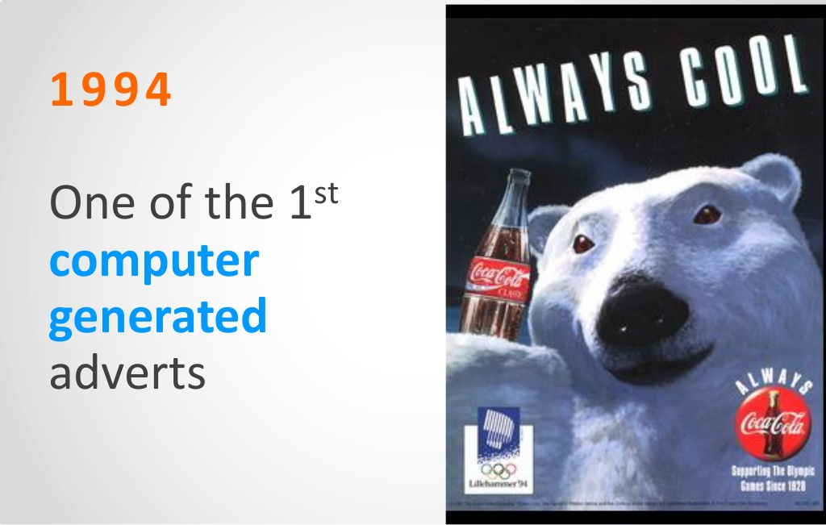
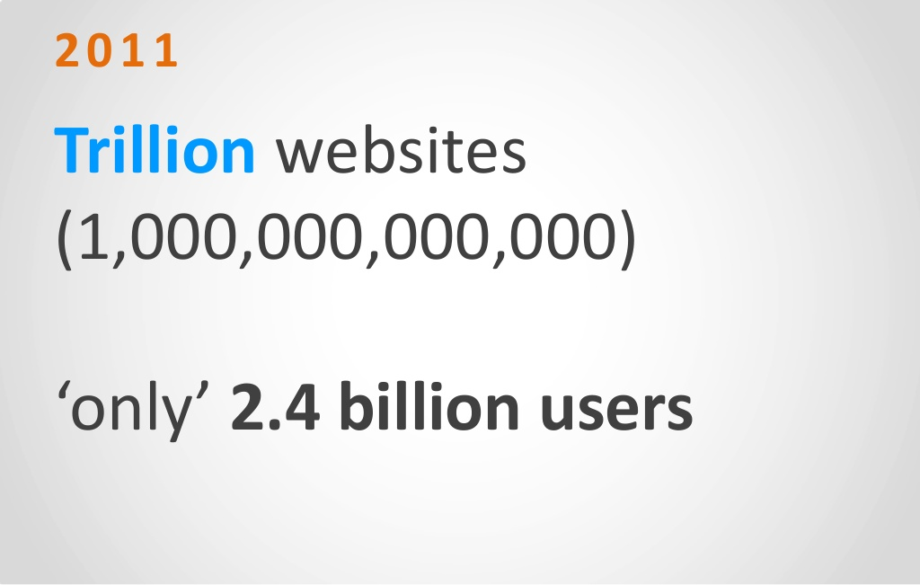
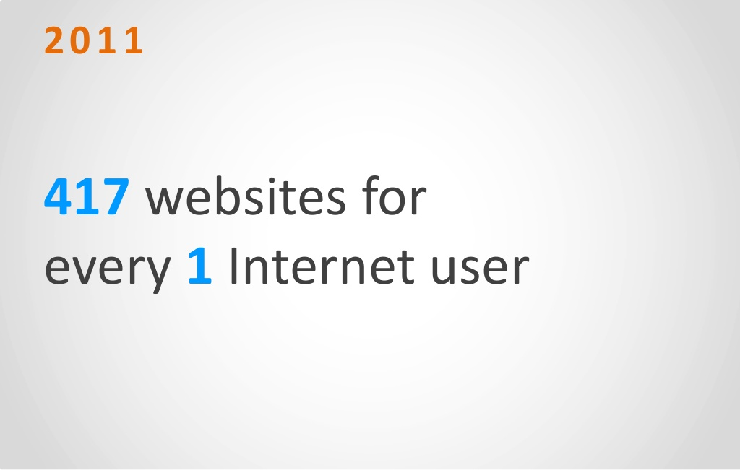

Slide 32
ACTIVE PARTICIPANTS
Advertisers
Advertising Agency
Audience
Advertising Media
Advertising Production Firms
Government Authorities
Research Firms
Self – Regulatory Bodies

Slide 33
BENEFITS OF ADVERTISING
TO BUSINESS FIRMS
TO CONSUMERS
- Introduction of product
- Modifies Attitude
- Builds Image
- Builds Loyalty
- Market Expansion
- Corporate Image
- Economies of Scale
- Improvement in Quality
- Avoids Seasonal Sales Fluctuations
- Facilitates Distribution
- Information
- Act as Reminder
- Lowers Product Prices
- Better Quality Products
Higher standard of living
- Guards Against Substitute
- Education to Customers
- Modifying Attitudes
- Consumer Satisfaction
- Saves Time in Shopping

Slide 34





CLASSIFICATION OF ADVERTISING
GEOGRAPHIC AREA
MEDIA
TARGET AUDIENCE
FUNCTIONS
  LOCAL
  REGIONAL
  NATIONAL
  INTER –
  NATIONAL
  PRINT
  BROAD-
  CASTING
  OUTDOOR
  INTERNET
  CONSUMER
  INDUSTRIAL
  TRADE
  PROFESSIO –
  NAL
DIRECT ACTION
& INDIRECT
ACTION
PRIMARY &
SELECTIVE
PRODUCT &
INSTITUTIONAL

Slide 35
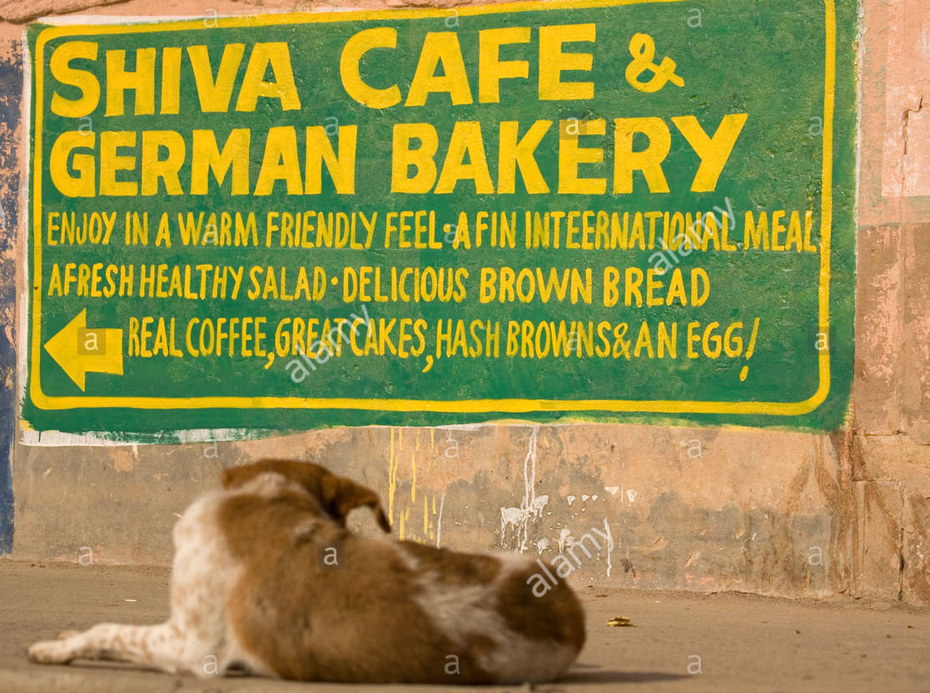

When the advertisements of a particular product are broadcasted within a local area. These advertisements must be according to local tastes and preferences
Local Advertising also called as Retail Advertising
LOCAL

Slide 36
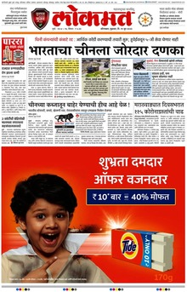
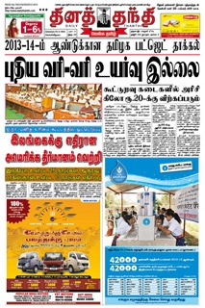
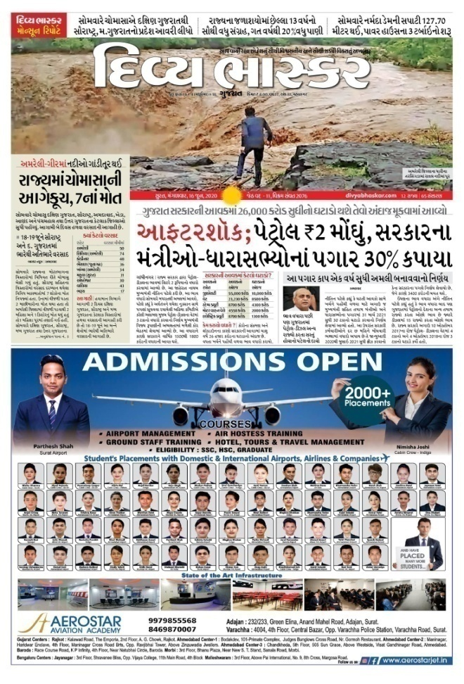
Regional Advertising covers a specific region which could be one state or an area covered by people speaking one language.
  REGIONAL

Slide 37
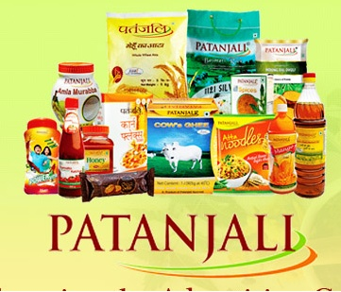
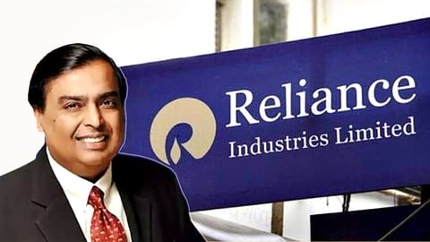



When the advertisement is broadcasted across
the country it is called national
advertising.
Through this advertisement, the company can build the brand image in our country and as well as increase the growth of a particular business.
  NATIONAL

Slide 38



These types of advertisements are broadcasted throughout the world and it is the process of providing information about persuading the customers and reminding the customers about the brands which are available at the global level. So, International advertising is also known as global advertising.
  INTER – NATIONAL

Slide 39


Print Media is an advertising media that has been running for a long time. There are two main things are used to complete this advertisement, first is newspapers and second is magazines.
PRINT

Slide 40
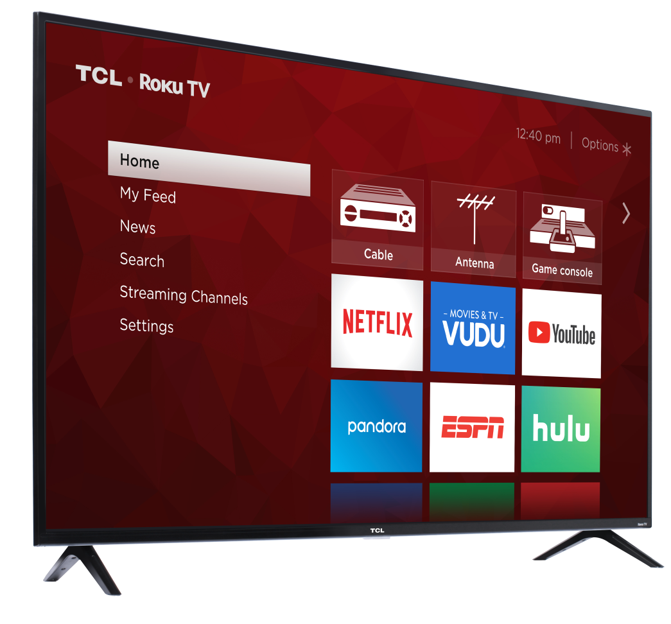
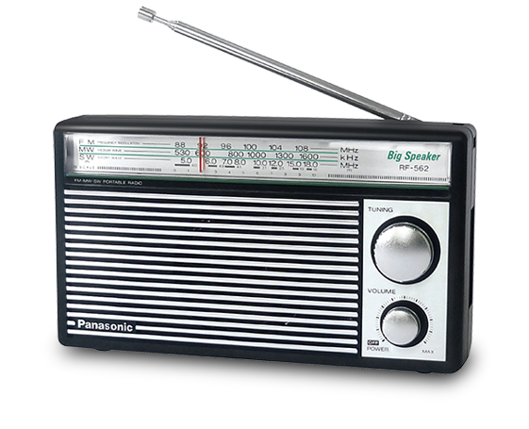
It includes advertising on Radio & Television. In India, television advertising has gained importance & is ranked second in terms of advertising expenditure after newspaper
BROADCASTING

Slide 41
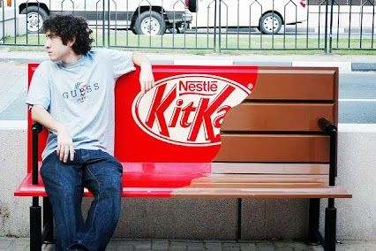
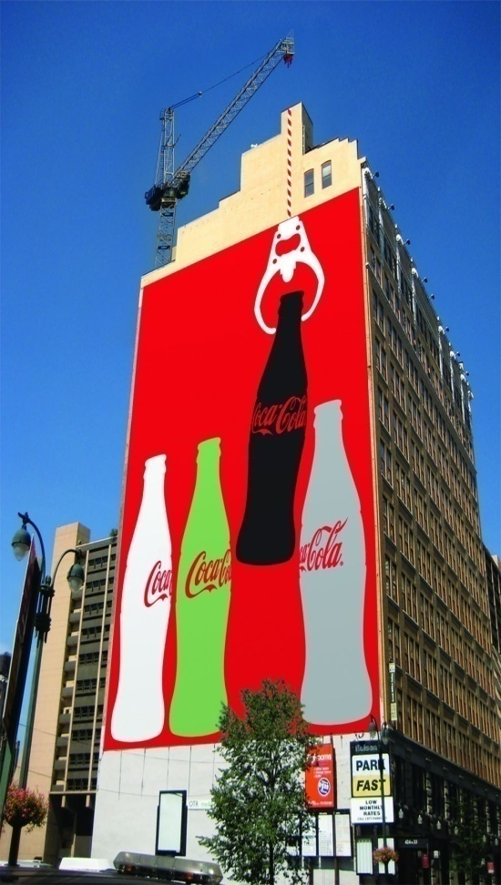
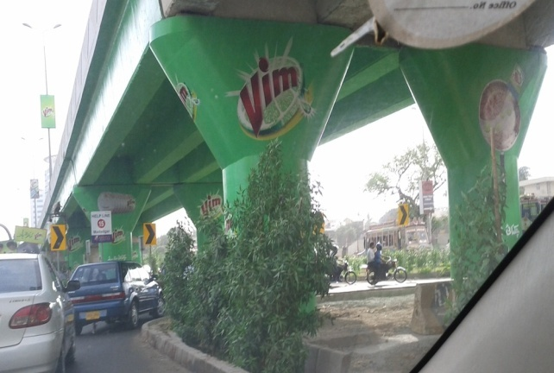
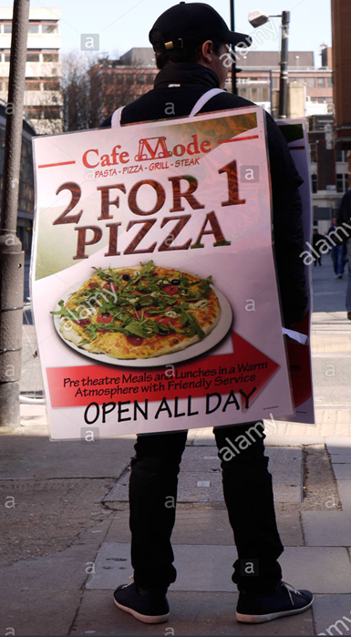
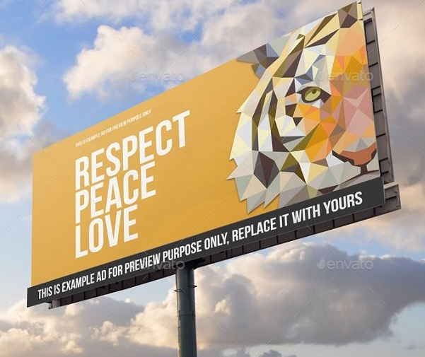
Outdoor Advertising means giving the advertising message to the consumers when they are out of their homes
OUTDOOR

Slide 42

Online media is a very popular advertising and we also know it as internet advertising. This advertisement helps to promote the products in social media tools.
INTERNET

Slide 43

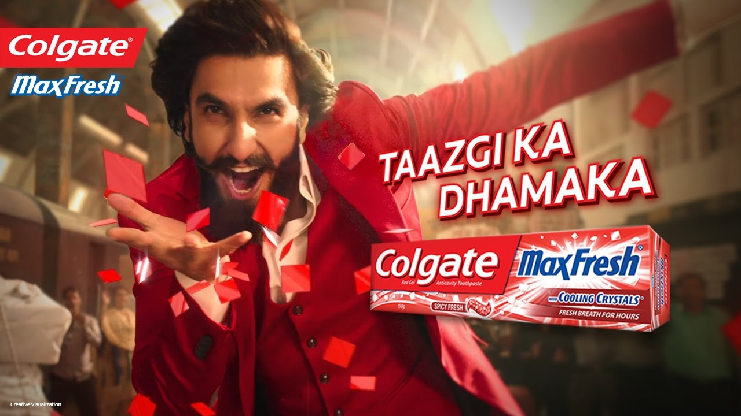

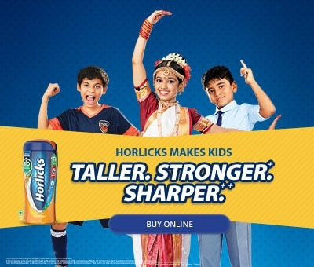
This advertising is based on promoting products because it defines the consumer’s personal consumption. In these advertisements, the company focuses on the daily use of products which are used by the customers.
CONSUMERS

Slide 44

This advertisement is focused on to promote industrial products such as raw materials capital items, and operating supplies. However, the industrial products are totally focused on the business to business activity.
INDUSTRIAL

Slide 45






Manufacturer
Retailer
Customer
Advertising done by manufacturers to influence dealers to stock product
Giving discounts to retailers or dealers if they in bulk quantity.
Schemes are being introduced by various manufacturers to influence retailers to stock more products like providing extra quantity in same price
TRADE

Slide 46
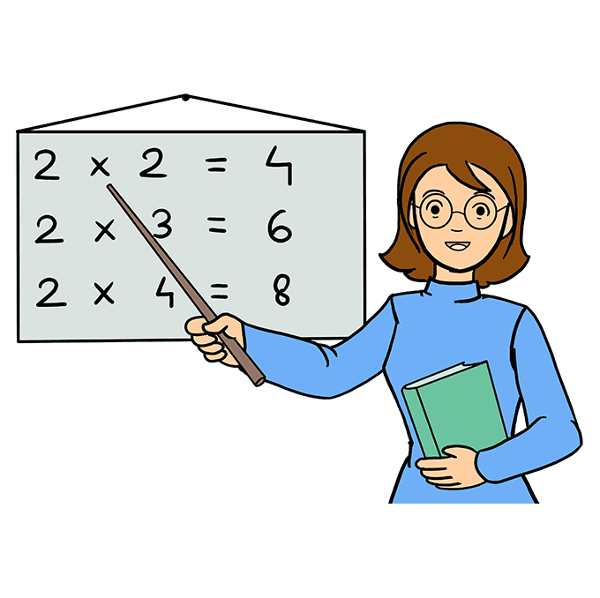




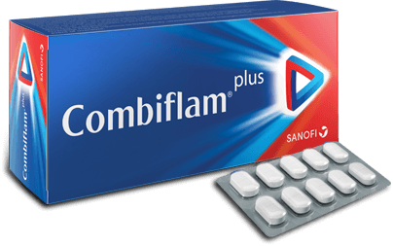
This kind of advertising is undertaken to influence the professionals from a particular category.
PROFESSIONAL

Slide 47
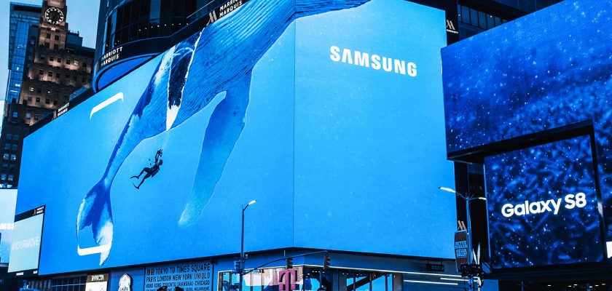

DIRECT ACTION
To get immediate response or action direct action advertisements is done
DIRECT ACTION
&
INDIRECT ACTION
INDIRECT ACTION
Indirect advertising is done to influence the target audience to prefer his brand over competitors whenever buying decision arises in future.

Slide 48


PRIMARY
& SELECTIVE
PRIMARY
Undertaken by trade association or cooperative group to increase the demand of product or services, It is also called generic advertising , it educates the consumer base about the benefits of an entire product class
SELECTIVE
Undertaken by marketers of branded products.
Intention is to create demand for selective product.

Slide 49

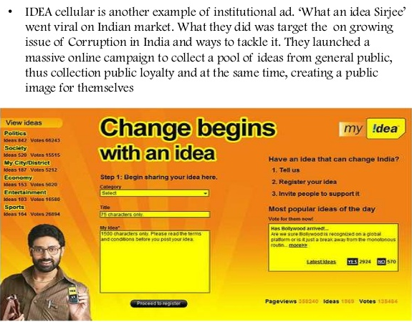
PRODUCT
Any advertising undertaken to promote the sale of products will be categorized as product advertising
PRODUCT
&
INSTITUTIONAL
INSTITUTIONAL
Undertaken by marketers to build a brand name and goodwill in the market

