Slide 1
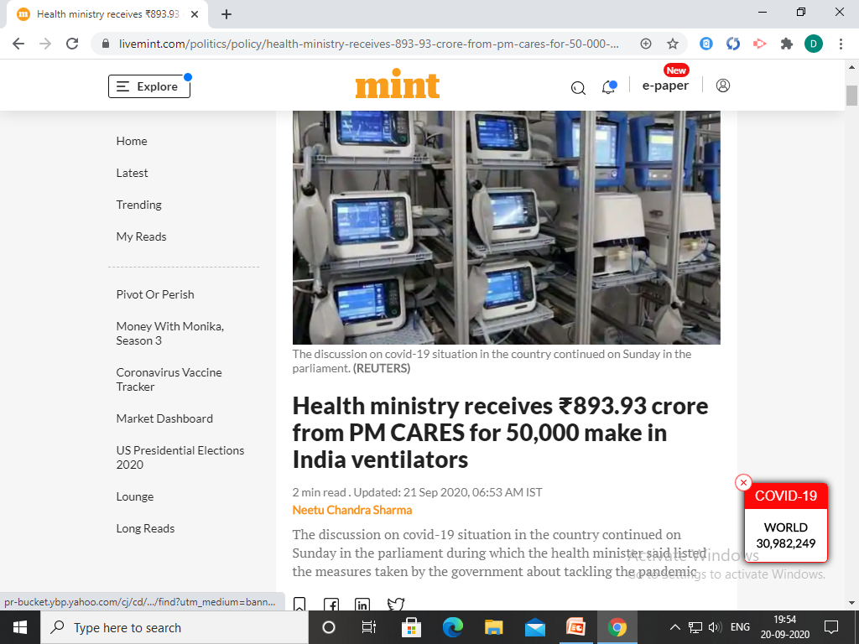

Slide 2
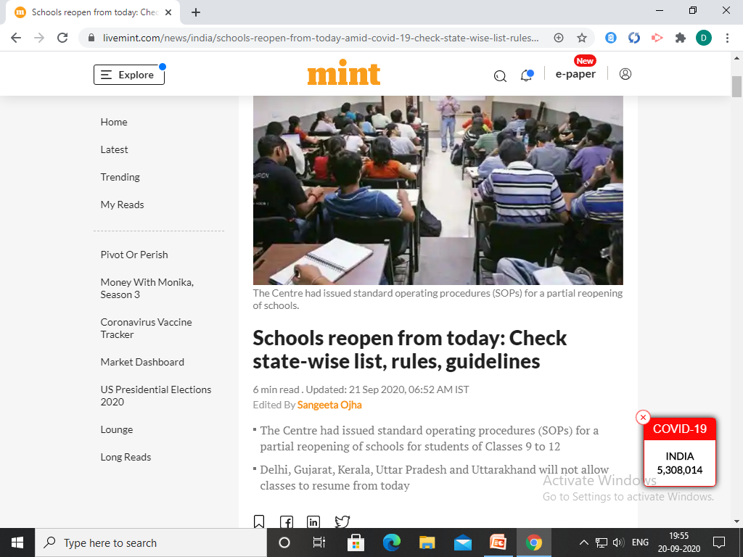

Slide 4

https://youtu.be/0qM5YYWaRC4

Slide 5
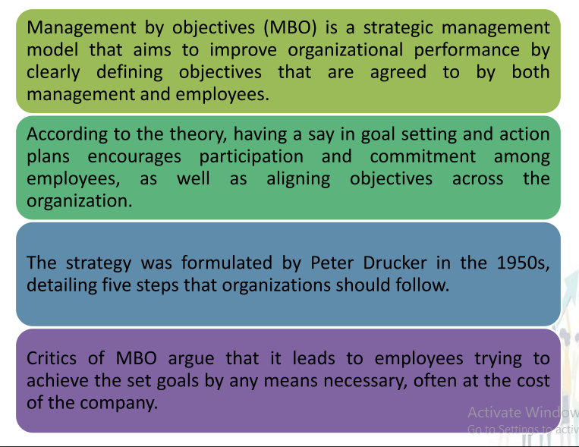

Slide 6
MBO PROCESS

Slide 7

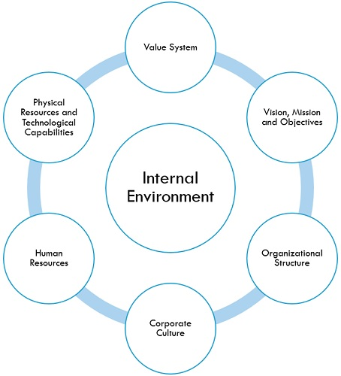
1. Analysis of Internal Environment(SWOT)
To identify strengths and weaknesses
It consists
manpower,
mission of organisation
machines,
material,
Management labour relationship etc.

Slide 8
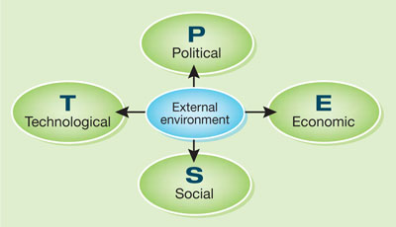
2. Analysis of External Environment
To identify opportunities and challenges
It consists
Customer preferences
Govt policies
Competitors
Social Conditions
Economic conditions

Slide 9
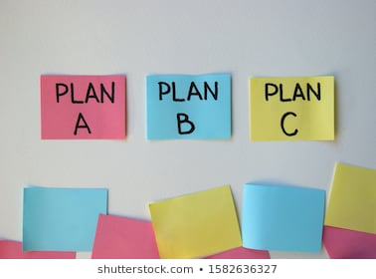
3. Collectively formulating Plans
Superior and subordinate jointly formulate action plans
For eg. To increase sell alternative plans such as
Plan A - Increase advertisement
Plan B– Product modification
Plan C – offers and discount on products

Slide 10

4. Evaluating Alternative Plans
Superior and subordinate evaluate each alternative plan
Cost benefit Analysis
For eg. To increase sell alternative plans such as
Plan A - Increase advertisement – More cost & More benefit
Plan B– Product modification – More cost & less benefits
Plan C – offers and discount on products - Less cost & More benefits

Slide 11


5. Selecting Best Plan
Superior and subordinate Select efficient plan
Maximum benefits -minimum cost
For eg. To increase sell alternative plans such as -
X Plan A - Increase advertisement – More cost & More benefit - X
X Plan B– Product modification – More cost & less benefits - X
Plan C – offers and discount on products - Less cost & More benefits -

Slide 12
6. Implementation of Plan
Subordinate implement the plan with guidance of superior
Organize resources
Implement plan
For eg. To increase sell alternative plans such as -
Plan C – offers and discount on products
Actually advertise the offer

Slide 13
7. Measurement and Comparison of performance
Superior and Subordinate periodically measures the actual performance. implement the plan with guidance of superior
Compare actual performance with planned performance
For eg. To increase sell alternative plans such as
Plan C – offers and discount on products
Compare sell before discount and after discount
For eg. Planned sell – 10000
Actual sell – 8000
Shortage of sell - 2000

Slide 14
8. Causes of deviation
Superior and Subordinate study causes of short falls in target
For eg. To increase sell alternative plans such as
For eg. Planned sell – 10000
Actual sell – 8000
Shortage of sell – 2000
Causes of deviation – customers not aware about discount offered

Slide 15
9. Corrective Measures
Superior and Subordinate list out corrective measures to overcome deviation
For eg. To increase sell alternative plans such as
For eg. Planned sell – 10000, Actual sell – 8000
Shortage of sell – 2000
Causes of deviation – customers not aware about discount offered
Corrective Measures- Advertise discount offered

Slide 16
10. Follow up
Superior and Subordinate Cross check the result of corrective measures
Expected result or not
For eg. To increase sell alternative plans such as
For eg. Planned sell – 10000, Actual sell – 8000
Shortage of sell – 2000
Causes of deviation – customers not aware about discount offered
Corrective Measures- Advertise discount offered
Result – Sell increased 10000 units

