Slide 1
FYBAF
Commerce -I

Slide 2
Concept of Business
Business is activity relating to production and distribution of goods and services for economic gain (profit).
It is called commercial activity. It is the activity of producing and distributing the goods and services for money
In simple language business means to get something or produce something at low cost and sell it at higher cost
The only purpose of business is to earn profit
It is a human activity directed towards producing or acquiring wealth through buying and selling acivities.

Slide 3
Definitions
“Business is an institution organised and operated to provide goods and services to society under the incentive of private gain.”
B.O.Wheeler
“Business is an organised efforts by individual to produce goods & services, to sell these goods & services in market place, and to reap some reward for this effort”
Keith Davis.
The above definition are traditional definition as they emphasis on profit

Slide 4
But in the today's global world the definition of business has changed
The business that focuses on not only on profit but also on customer satisfaction & social interest, can survive in the today's competitive world.
Thus we can defined Business as follows
“ Business is an organised activity to identify or anticipate, customer requirements; and to design & supply goods & services to satisfy customers and to serve the interest of all the other stakeholders”

Slide 5
Characteristics of Business
Organised activity
Economic activity
Buying and selling
Profit motive
Degree of scale
Regularity in dealings
Risks & uncertainties
Societal interest
Social responsibility / Social activity
Business functions
Customer satisfaction
Creative & dynamic
Govt. control
Optimum utilization of resources.

Slide 6
Organised activity:-
Business is an organized activity
It identify requirement of customer
Produces and supplies product to customer
Obtains feedback
Modify and innovate product to enhance company’s growth and goodwill
Economic activity
Business is economic activity of production & distribution of Goods and services
it provides employment opportunities in different sectors like banking, insurance, transportation,industries,trade etc.

Slide 7
Buying and selling
The basic activity of any business is trading
It involves buying of raw material, plant & machinery, property etc and convert it RM in to finished goods
Selling the finished goods to consumer, wholesalers , retailers etc
Making available the goods for different sections of the society.
Profit motive
The primary objective of any business is to earn profit.
It is a reward for the efforts undertaken by a business firm
Profit is the indicator of success of business
Profit is required for survival, growth expansion of the business

Slide 8
Degree of scale
Business can be undertaken at varied degree of scale
Some firms such as sole trading concerns undertake small scale business
Some firms like joint stock companies undertake large scale business activities.
Regularity in dealings
Business is not a single time activity
It is continuous process of production & distribution of goods & services

Slide 9
Risks & uncertainties
Business is subject to risks and uncertainties
Business may suffer loss
Certain risks can be minimised through insurance.
Societal interest
Now a days business place emphasis on the societal concept of business
Try to achieve balance between profit, consumer satisfaction, public interest
So produces eco friendly products.

Slide 10
Social responsibility / Social activity
Business firm try to fulfill their social responsibility towards various stake holders such as employees, customers, govt, shareholder, competitor, society
Business functions
Business involves a number of activities right from production to distribution of goods and services.
It includes production activity, marketing activity, finance activity, personnel activity etc

Slide 11
Customer satisfaction
Now a days business adopts consumer oriented approach
Customer satisfaction has become ultimate aim of the business
The purpose is to create and retain the customers.
Creative & dynamic
Modern business is creative and dynamic in nature.
Business has to come up with creative ideas , approaches and concept for production n distribution of goods & services
One cannot satisfy the customer by providing same type of goods and services.

Slide 12
Govt. control
Business firms are subject to govt control.
They have to follow rules and regulation provided by govt.
Optimum utilization of resources.
It facilitates optimum utilization of countries resources and achieves economic progress and satisfy wants and need of the customer
Quality focus
Business firm focuses on quality product to gain competitive advantage

Slide 13
Functions of business
SALES
PURCHASE & STORE KEEPING
MARKETING
PRODUCTION
PUBLIC RELATION
FUNCTIONS
FINANCE
REASEARCH & DEVELOPMENT
PERSONNEL

Slide 14
Production function –
Production means conversion of raw material into finished product .
It creates form utility
Production department includes various functions such as
production planning & control
Quality control
R&D
Inventory control
Maintenance of plant & machinery

Slide 15
Inventory management(Purchase & Store keeping)
Inventory management refers to management of inventory such as finished good , semi-finished goods , raw materials, parts& other items of inventory.
Proper inventory has to be maintained.
Over inventory or under inventory must be avoided.
It involves the following activity
Materials planning
Purchasing of material & other inputs
Monitoring inventory of items
Store keeping
Issuing of material & other inputs.
this dept task is to make sure that everything is organized to carry out the business.

Slide 16
Marketing function
The success & survival of the business is influenced by marketing department.
The marketing departmt is communicating the value of a product or a services to a customer.
It involves the following activity
Marketing research
Pricing of products
Promotion mix
Product distribution
Product packaging
Product positioning

Slide 17
Sales function
The sales activities are performed by sales department.
Sales deptmt is involved in selling the product & services offered by business.
Visit & talk to customer.
It works in close co-ordination with the marketing department.
It receives or books order from dealers or customers & distributes the goods through the distribution channels
The department may undertakes follow up of sales in case of consumer durables or industrial goods.
Keep customer informed about new products and services
Keeps record of how much has been sold.

Slide 18
Finance function
Finance is considered as the life line of modern business.
Every business firm, large or small requires finance for the efficient conduct of its activities.
It is concerned with planning obtaining, utilizing, & controlling of funds in a business.
It impt functions are
Determining the right sources of funds
Application of funds
Proper mngt of working capital.
Proper mngt of fixed capital.
Monitoring income / revenue
Monitoring expenditure
Preparing accounts etc

Slide 19
Human Resource management(HRM)
It is concerned with management of people in the organisation.
The success & survival of the firm depends upon the quality of people.
It involves the following activity
Manpower planning
Recruitment & selection
Training of manpower
Performance appraisal
Promotion & transfers
Compensation to employees.

Slide 20
Research & development
Now a days large firm set up separate department to look after R&D activities.
R&D department plays an impt role in product modifications & product development
In today’s business firms needs to allocate a good amount of money for R&D activities.
At present in India the R&D expenditure is very negligible.
Even large firms in India allocates hardly 1 % of their sales revenue towards R&D activities.

Slide 21
Public relations
Large firms maintains separate department to look after public relations.
There is need to maintain good public relation with various sections of public.
This department may handles public queries, media queries or interviews, complaints from NGOs, customers & other authorities
It is the work of this department to manage corporate image of the firm & to develop good relation with various section of the public.

Slide 22
Customer services
Concerned with customer relationship . It includes the activities like
Providing information
Giving advice
Providing credit facilities
Delivering goods
Providing after sales services etc

Slide 23
Significance of business
Business plays an impt role in any economy. It Benefits to several sections of the society.
Significance to business firm
Achievement of objective
Corporate image
Customer satisfaction
Competitive Advantage
Efficiency of business
Expansion of business
Economies of scale
Optimum utilization of resources
Research & development
Enhance relations with society
Social status

Slide 24
Achievement of objective
Sound business helps the firm to achieve its objective
By producing quality goods & services providing proper after sales services that satisfies customers requirements, a firm can achieve its various objective
Increase in sales, increase in Market share, increase on profit, growth & expansion, improve corporate image etc
Corporate image
Good practices such as R&D, effective after sales service, fulfilling CSR responsibility
Helps firm to develop good corporate image in minds of stake holders

Slide 25
Customer satisfaction
Timely & effective after sales service
Good quality products
Maintaining good customer relationship
Effective sales promotion activities
Competitive advantage
Innovation in products & services enable a firm to gain competitive advantage in the market

Slide 26
Efficiency of business
Efficiency is relation between returns to costs.
A firm can be more efficient when it gets higher returns at lower costs
With help of R&D, Training & development, Technology upgradation etc
Expansion of business:
Sound business practices helps a businessman to expand his business .
Business strategies includes- market development, product development, market penetration, merger & takeover, Diversification of business etc

Slide 27
Economies of scale
Firms get economies of scale such as economies of production on bulk purchase of materials, distribution cost reduces bcoz of bulk shipment
Optimum utilization of resources
A firm would be able to make optimum use of its resources only when it is in a position to create dd for its goods & services
Research & development
R&D helps business to develop new products
Through marketing research, a firm can identify customer requirements. The market research findings can be used by product research & development team to introduce new & innovative products.

Slide 28
Relationships with society
A firm needs to adopt sound business practices
This would enable a firm to build , maintain & enhance relations with various sections of the society.
Social status
Businessmen who undertake sound business practices, enjoys a better status in the society.
Their presence motivates & influences members of the society to better their performance

Slide 29
Significance to Consumers
Availability of quality goods & services
Goods at good prices
Better facilities & Services
Customer satisfaction
Higher standard of living
Status to the customers

Slide 30
Significance to Society
Economic growth
Regional development
Revenue to govt
Social order
Employment
Capital formation
Standard of living
Competition benefits to society
Infrastructure development
Global relation/ international relations.

Slide 31

Economic growth
Business activities facilitates economic growth of the country.
Economic growth relates to increase in national income
National income increases when there is growth in
Various sectors like agriculture, industry & service
sector .
Sound business activities helps to promote industry’s
product including agro based ones.
Service sector also gets a boost due to good
performance of industry & agriculture
Thus growth in all sectors result in economic
growth of a nation

Slide 32

Regional development
Business firms help to bring about regional development in the country
Firms set up industries in backward area.
Govt also provide incentive for setting up industries in backward areas.
Thus business firm helps in regional development of the nation.

Slide 33
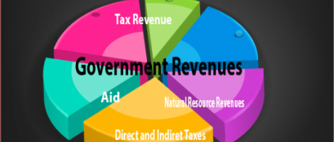

Revenue to govt
Business generates revenue to the govt in the form of taxes & duties
The govt imposes direct & indirect tax
Such as corporate tax, capital gains tax, excise duty, customs duty, service tax etc
Govt can also earn revenue by way of profit earned by public sector units
These revenue can be utilised for various development purposes

Slide 34

Employment
Business firm provides employment directly or indirectly.
Direct employment on account of growth of business firms
Growth of business results in increases in demand for labours
Indirect employment in supporting sectors like banking, insurance, transportation, telecommunication etc.

Slide 35
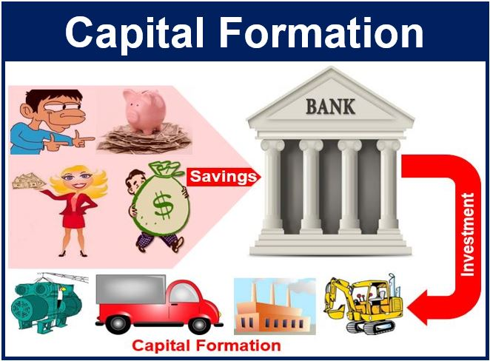
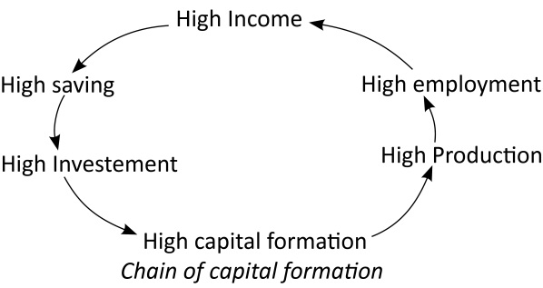
Capital formation
Business facilitates capital formation in the country
Capital formation results in economic growth of a nation.

Slide 36
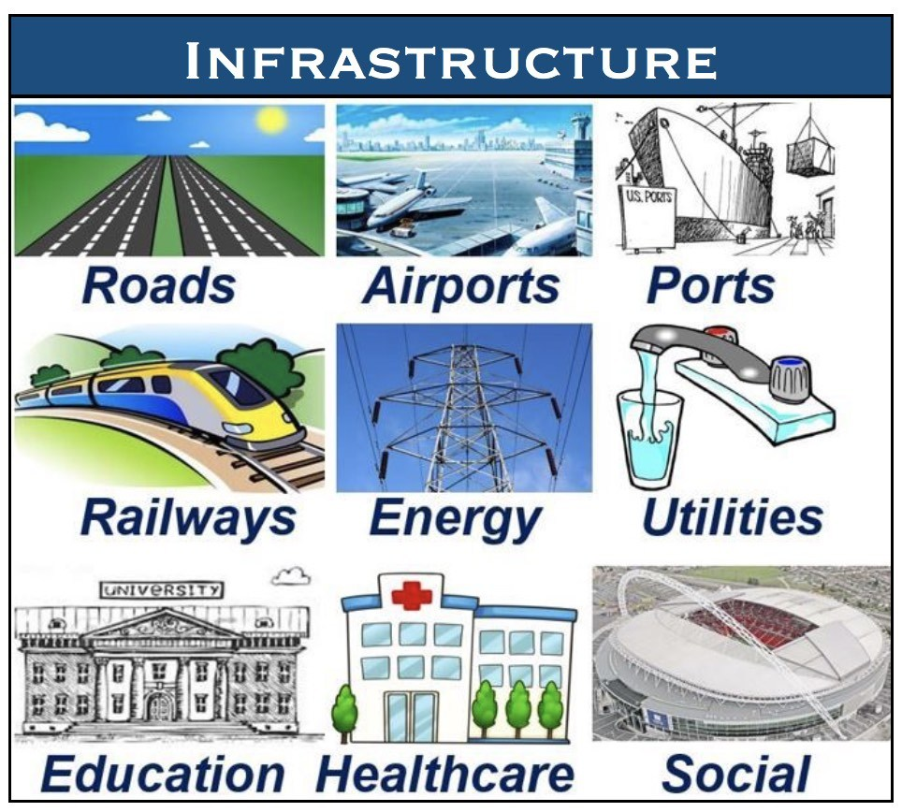
Infrastructure development
Business firms are responsible for infrastructure development.
Large business firms participates in infrastructure development projects such as construction of roads, irrigation projects ,dam , bridges, power generation etc
Nowadays business firms develop infrastructure through public – private partnership projects.

Slide 37

Social order
Business helps to maintain social order in the country
Due to employment people will not indulge in anti-social activities such as robbery, kidnapping , murder etc
If employment is not available there could have been law & order problems in the society.

Slide 38
Standard of living
Business firm generates employment .
Employment increases income level of the people
So purchasing power also increases
It results in higher consumption level of goods & services
Increase in consumption leads to higher standard of living.
Business also provides quality goods & services, which also improves standards of living of the consumers
Competition benefits to society
Competition among the business firm brings benefits to the society
in order to gain competitive advantage Business also undertakes social development activities like development of school, hospitals, provides donations to the community.

Slide 39

International relations
Business helps to maintain good & friendly relations with other countries
Foreign trade enables countries to be dependent on each other which in turn helps to develop good relation among participating countries.

Slide 40
Objective of Business
What is “objective”.
“Objectives are the goals , aims or purpose that organisation wish to achieve over varying period of time.”
Dalton E. McFarland
“Objective are goals established to guide efforts of the company and each of its components”
Louis A. Allen.

Slide 41
Steps in setting of objectives
Analysis of internal environment
The organisation needs to analyse internal envt.
It involves analysis of physical resources, financial resources, human resources marketing strategies, personnel policies, working condition etc.
It would reveal strengths & weakness of the organisation.
Analysis of external environment
The organisation also needs to analyse the external envt that affects the working of the firm.
It involves analysis of govt policies, competitors strategies, consumer tastes & preference, technological development, growth & performance of industry etc.
It reveals opportunities & threats.

Slide 42
Values & beliefs of top management
It is impt factor affecting setting of objective.
In some organisation top executives may believe in quality & innovation as means of success & in some organisation
Top executive may believe in volume & not on quality.
at this stage the mngt frames mission statement
Mission statement becomes the basis of setting objective.
Awareness of Past performance of the firm.
It provides direction in setting objective
Mngt needs to consider the past objective & development of the firm

Slide 43
Involvement of employees
There is need to involve employees in setting objective.
It will help to gain cooperation & commitment of subordinate in effective implementation of the various activities to achieve goals
Setting of objective
Mngt need to set the objective in all the functional areas
Certain essential needs to be considered such as
Specific & well defined
Measurable against standards
Attainable
Realistic &not imaginary
Time bound
Integration of objective

Slide 44
Implementation
After setting objective the mngt must plan & implement the target.
It involves organising resources, directing subordinates, motivating subordinates.
Review
There must be periodic review of activity.
This will help to know whether objective are achieved or not.

Slide 45
Classification of business objective
Business objective
Organic objective
Social objective
National objective
Economic objective
Human objective

Slide 46
A)Organic objective
Survival
Growth
Recognition & prestige
B)Economic objective
Profit
Creation of wealth
Creation of customer
Innovation
Utilization of resources
Increase in market share
Expansion of markets
Product introduction

Slide 47
C) Social objective
Towards employees
Towards customers
Towards shareholder
Towards government
Towards suppliers
Towards dealers
Towards media
Towards competitors

Slide 48
D) Human objective
Fair wages
Better working condition
Workers participation in mngt
Human resource development
Job satisfaction
Welfare facilities
E)National objective
Social justice
Development of small scale industry
Production as per national priorities.
Self sufficiency
Development of backward areas
Social welfare.
Creation of employment opportunities
National integration & communal harmony.

Slide 49
Reconciliation of economic and social objection
Business is a part of society & therefore, it has to meet its social obligation along with its economic objectives.
It has to meet its economic & social objective.
It has to balance its economic & social objective in order to satisfy the various parties/groups.
The economic & social objective can be reconciled as under .
Profit & consumer price
Profit & research & Development
Profit & after sale service
Profit & employees welfare
Profit & taxes
Profit & shareholders interest
Profit & social development
Business expansion & social interest
Business expansion & competition
Business expansion & suppliers.

Slide 50
Business environment

Slide 51
Concept of business environment
Business environment consist of all the internal & external forces or factors that influence the working of a business firm.
The internal factors comprises of firms strategies and policies, management- labour relation, resources like manpower, capital, machinery etc.
External environment comprise of micro factor & macro factors
Micro factor include customer, competitors, suppliers etc
Macro factors include economic envt, social envt, political envt, technical envt etc.

Slide 52
Analysis of internal environment helps a firm to identify its strengths & weakness
Analysis of external environment helps to identify opportunities & threats
Thus environment analysis helps to undertake the SWOT analysis
Swot is also called as SWOC.

Slide 53
Definitions
“Business environment means the aggregate of all conditions, events and influences that surround and affect it.”
Keith Davis

Slide 54
Features of business evnironment
Dynamic in nature
Business environment is dynamic in nature
Changes takes place in the external environment
Competitors may introduce new product designs, or change pricing, promotion & other strategies.
Customers tastes & preferences may change over a period of time
Govt may introduce policy change in respect to taxation, foreign investment, foreign trade etc
Firm needs make changes in its strategies to face challenges of dynamic evnt
When these changes are favorable brings opportunity for the organization & unfavorable envt bring threat to the organisation

Slide 55
Direct & indirect impact
Business environment may have direct & indirect impact on working of a business firm.
Micro – external factors like competition , govt policies, customer preferences etc can have direct effect on the working of a business firm
Macro external factors like social envt, economic evnvt, political may have indirect effect on the working of business firm.
Internal external environment
Internal & external factors influences activities of business firms
Internal factors are controllable in nature
External factors are beyond the control of a business firm.
Business firm need to adjust its strategies depending upon the changes in external factors

Slide 56
Inseparable part of business
Business firm cannot operates without envt.
Business firm cannot operate without customers , suppliers, & dealers
Even business firm depends on natural envt for the supply of raw material
Technological & other factors also influence the working of the business
Complex in nature
Business envt is complex & unpredictable
In olden days business envt was stable
Customer preferences were few, competition was limited, govt policies were stable & so on
But nowadays business envt is more complex due to heavy competition, growing customers expectation, drastic changes in govt policies.

Slide 57
Creates opportunities & obstacles
Opportunities may be termed as favorable situations which facilitates higher profits & growth of the business
Obstacles are the unfavorable situation which may adversely affects the organization’s profitability and growth.
Regulates scope of business
Eg govt regulation such as restrictions on advertising of liquor & cigarettes, restricts advertising of socially undesirable products
Reactive & proactive decisions
Business is able to take proactive or reactive decision due to business envt
Majority of the firms take reactive decision
Few firms take proactive decisions

Slide 58
Environment is multi dimensional
Changes in environment may have positive and negative impact on the working of business firms
Envtal changes may be favorable to some firms & unfavorable to other
Environment analysis & planning
The relationship between planning & envt analysis in inseparable .
The main purpose is to set goals or objectives.
Depending on the SWOT analysis , a firms sets its objectives

Slide 59
Multi-faceted
What shape an envt will assume depends on the perception of the observers.
A change in the envt is welcomed by one company while another company perceives it as a threat
New development can be viewed differently by different observers.
SWOT analysis
SWOT analysis facilitates , internal & external factors of analysis which have impact on the strength & weakness are often internal to the organization while opportunity & threat generally relates to external factors

Slide 60
Importance of business environment
Identification of strengths
Identification of weaknesses
Identification of opportunities
Identification of threats
Planning
Organizing resources
Motivating employees
Controlling
Survival & growth
Corporate image
Innovation
Efficiency

Slide 61
Interrelationship between business & environment
Business & Natural environment
Business & Economic environment
Business & Socio – Cultural environment
Business & Technological environment
Business & Demographic Environment
Business & Regulatory environment
Business & International environment
Business & Political environment

Slide 62
Constituents of business environment
The business environment can be broadly divided into two group
Internal environment & External environment
Internal environment
Proper analysis of internal environment reveals strength & weaknesses
It will help the businessman to strengthen its strength & reduce its weakness
The following are some of the important factors of internal environment
Mission & objective
Organization frame mission statement.
A mission statement reflects the vision, purpose & philosophy of the organization.
The organization must state its objective in the line with mission statement.
Eg if mission statement states ‘ we produce best quality drugs in the pharma industry. The objectives of the firm must place emphasis on R&D to innovate & improve quality of its products on continuous basis.

Slide 63
Plans & policies
The plans and policies of the firm must be in line with its objective.
Analysis of the plan & policies will enable the firm to find out their suitability to achieve the objective
If not the firm may reframe the plan or reset the objectives
Human resources
The survival and success of the firm largely depends on the quality of human resources.
Analysis of manpower HR would indicate the strengths & weaknesses of the employees.
Eg if employee's are not committed & dedicated, the management need to train & motivate them.

Slide 64
Physical resources
It includes machines, equipment's, building, office premises, furniture & fittings etc
Analysis will indicates the strengths & weaknesses of physical resources.
Financial resources
A firm need to obtain the funds from the right sources.
There must be proper application of funds towards fixed capital & working capital needs
Analysis indicates effectiveness of financial management.
It indicates whether or not the funds are obtained from the right sources, & right application of funds
It not firm need to take adequate measures to ensure effective management of financial resources.

Slide 65
Corporate image
Firm has to develop & maintain good corporate image in the mind of stakeholders
A firm should undertake analysis of corporate image
If finds problem then adequate measures need to be taken.
Labour –management relations
There must be good relation between labour – management
Proper analysis of labour- management relations indicates its effectiveness
If there are problems than necessary measures need to be taken to improve relation.

Slide 66
Organisational strategy
Strategy implies systematic plan of action to defend oneself or to defeat competitors . Strategy is a blue print of action. It indicates course of action to be followed to achieve objectives.
Organisational structure
Organisational structure relationship of superior & subordinates, composition of board of directors, attitude of management are important internal factors
The organisatioan structure differs according to nature & size of the business & organization philposophy.
Organisation structure should be flexible.

Slide 67
Marketing capability
It relates to 4ps
When company’s product have distinctive images it is strength
Price relates to decision about pricing strategy & fixation of price.
Promotion include advertising , publicity & sale promotion etc
Physical distribution includes channels of intermediaries who help in distributing the product to final customer.
management of supply chain effectively can be a company’s strength.

Slide 68
Operational capability
It is related to production aspect
It includes product design, production process, cost control, patent right and R&D related to the new product development.
If a company has cost advantage patent to manufacture a product .
It can be a company’s strength.
Personnel capability
It relates to human resources & skill
It includes various aspects like employees satisfaction,motivation, performance, efficiency & relationship between labour & management.
Having competent employees in an organization can be strength.

Slide 69
Financial capability
It relates financing , investing ,exploring right source of raising funds ,decision regarding pymt of dividend & retaining a part of profits.
Efficient fund management can be company’s strength.
Technical capability
It is important to improve the productivity & to upgrade the product
The companies spending on R&D helps in gaining technical strength.

Slide 70
II) External environment
There constant need to analyse the external envt
It reveals opportunities & threats
Proper analysis will enable the firm to grab the opportunities & defuse the threats
External envt can be further divided into 2 groups
Micro Environment
Macro Environment
Micro environment
Any changes in the micro environment can have direct impact on the working of a firm.
The micro environment factors includes :

Slide 71
The micro environment factors includes :
Customers
Competitors
Suppliers
Channel intermediaries
Society
Financial institutions & banks
Media
Government
Citizens action groups
General public

Slide 72
Macro environment
The various macro environment factors are briefly discussed as follows
Demographic environment
Economic environment
Natural environment
Technological environment
Political environment
Cultural environment
Financial environment
Legal environment
International environment

Slide 73


Slide 74
PESTAL ANALYSIS
PESTAL Analysis describes a framework of macro-environmental factor used in environmental scanning.
PESTAL stands for POLITICAL, ECONOMIC, SOCIAL, TECHNOLOGICAL, ENVIRONMENTAL and LEGAL.
PESTLE analysis, which is sometimes referred to as PEST analysis, is a concept in marketing principles. Moreover, this concept is used as a tool by companies to track the environment they’re operating in or are planning to launch a new project/product/service, etc.

Slide 75
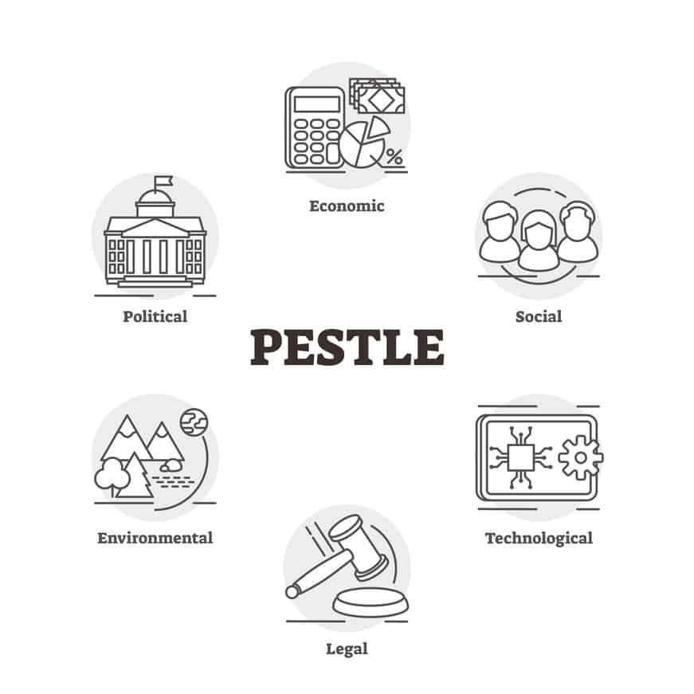

Slide 76
Political factor
These factors determine the extent to which a government may influence the economy or a certain industry.
For example, a government may impose a new tax or duty due to which entire revenue generating structures of organizations might change.
Political factors include tax policies, Fiscal policy, trade tariffs, labour laws , environmental regulation, trade restriction etc. that a government may levy around the fiscal year and it may affect the business environment (economic environment) to a great extent.
Government has great & important role play in the health , education & infrastructural growth in the economy.

Slide 77
Economic factors
These factors are determinants of an economy’s performance that directly impacts a company and have long term effects.
For example, a rise in the inflation rate of any economy would affect the way companies price their products and services.
Adding to that, it would affect the purchasing power of a consumer and change demand/supply models for that economy.
Economic factors include inflation rate, interest rates, foreign exchange rates, economic growth patterns, etc.
Theses factors have major impact on how business operates & make decisions
It also accounts for the FDI (foreign direct investment) depending on certain specific industries who’re undergoing this analysis.
Eg Exchange rate affects the cost of exporting goods & the supply & price of imported goods in an economy.

Slide 78
Social factors
Social factors include the cultural aspects & includes population growth rate , age , distribution career attitude & emphasis on safety.
Trends is social factors affects the dd for a company’s product & how company operates.
Eg an aging population may imply a smaller & less willing workforce.
Further companies social change various management strategies to adapt to these social trends

Slide 79
Technological factors
These factors pertain to innovations in technology that may affect the operations of the industry and the market favorably or unfavorably.
This refers to automation, research and development, and the amount of technological awareness that a market possesses.
Technological shifts can affects costs , quality & lead to innovation.
Environmental factors
These factors include all those that influence or are determined by the surrounding environment. This aspect of the PESTLE is crucial for certain industries particularly for example tourism, farming, agriculture, etc. Factors of a business environmental analysis include but are not limited to climate, weather, geographical location, global changes in climate, environmental offsets, etc.

Slide 80
Environmental factors
These factors include all those that influence or are determined by the surrounding environment.
This aspect of the PESTLE is crucial for certain industries particularly for example tourism, farming, agriculture, etc.
Factors of a business environmental analysis include but are not limited to climate, weather, geographical location, global changes in climate, environmental offsets, etc.
It includes environmental legislation, waste disposal, energy sources, energy availability & its cost.

Slide 81
Legal factors
Legal factors includes Consumer law, Employment Regulations, Minimum Wages Act & Health & Safety Laws.
These factors affects how a company operates ,its cost & dd for its products.

Slide 82
SWOT Analysis
SWOT analysis facilitates internal factors & external factors analysis, which have their impact on the business.
Strength & weakness are often internal to an organization , while opportunities and threats generally relates to external factors.
For this reason the SWOT analysis is sometime called as internal- external analysis & SWOT Matrix.
The strength & weakness exist within an organization can be matched with the opportunities & threats operating in the environments so that an effective strategy can be formulated.
An effective organizational strategy capitalizes on the opportunities through the use strengths & neutralizes the threats by minimizing the impact of weaknesses, to achieve pre-determined objectives.

Slide 83
SWOT analysis has several benefits like simple to use, low cost, flexible & can be adapted to varying situation , brings clarification of issues, development of goal oriented alternatives & useful as a starting point for strategic analysis.
Following are the 4 components of SWOT Analysis
Strength
Weaknesses
Opportunities
Threats

