Slide 1
Mutual Fund Organization and Management

Slide 2
EVOLUTION AND MEANING
A mutual fund is a type of financial vehicle made up of a pool of money collected from many investors to invest in securities like stocks, bonds, money market instruments, and other assets. A mutual fund has a common objective. Generally they are run by AMC (Asset Management Companies) who place a professional to manage the pool of money. The investment may be in equity or debt instruments. The investment is made keeping in mind the objective of the fund in view. The profits so generated is distributed amongst the investors after deducting the charges. Mutual funds are denoted in units and valued as per (daily) NAV
The first modern-day mutual fund, Massachusetts Investors Trust, was created on March 21, 1924. In India the first company that dealt in mutual funds was the Unit Trust of India. It was set up in 1963 as a joint venture of the Reserve Bank of India and the Government of India. The objective of the UTI was to guide small and uninformed investors who wanted to buy shares and other financial products in larger firms. The first non UT mutual fund was set up in Nov,1987. Soon Canara Bank, PNB, Indian Bank, LIC & GIC set up their own MFs

Slide 3
In 1993 the AUM was Rs 44000 crores. 11 private players were allowed between 1993 to 1996.Subsequently observing the growth in MF industry regulations were spelled out by SEBI Regulation Act, 1996.
In 1999 dividends received from MFs were declared tax exempt to increase volume of MFs. Thereafter the growth was steady. Global economic crisis hit financial markets in 2009. As returns nosedived, people’s confidence was shaken in MFs. Situation toughened with SEBI abolishing entry load.
In order to popularize MFs in tier 2 and tier 3 cities, SEBI began undertaking a series of initiatives to stabilize the industry, investor confidence and penetration of MFs.
From 2014, foreign inflows increased and again MFs became attractive investments.
Today MFs are managing assets in the tune of Rs 23 lakh crores. This figure may look attractive but considering annual domestic savings of 20-30 lakh crores, a lot more opportunities are in the way.

Slide 4
Main characteristics of a mutual funds are:
1. Managed by a qualified expert
2.Open ended and close ended funds according time frames of investment
3.Investments possible in both lumpsum and SIP route
4.No fixed returns
5.Operate with huge IT infrastructural support, fast acting by market information
6. Pooling of investment
7. MF investments are valued by NAVs and expressed in units. They change daily as per market.
8. Regulated by SEBI
9. Charges are deducted upfront and include fund manager’s fees, marketing expenses, transaction cost, regulatory costs, distributor’s fees etc. Expense ratio is declared to make it transparent.
10. Variety of investment options
11. No TDS is deductible. ELSS schemes give tax deductions also.
12. Withdrawal and reinvestment options.
13. Transparent

Slide 5
Advantages/ Disadvantages
Advantages
1. Expert’s guidance and decisions, close monitoring, fast churning of portfolios and disciplined investment
2. Liquidity. Its very easy to sell off (at any valuation) and receive money fast.
3. Investment risk minimized through diversification by investing in a range of companies/sectors
4.Flexibility of investing ( SIP or lumpsum), investing in very small amounts possible (Rs 500)
5. Less cost for bulk transactions
6.Transparent Before investing possible to get idea about fund performance, expense ratio, fund manager
7.Safe investment as it is overseen by SEBI, AMFI
8. Receiving maturity proceeds and investment from bank very easy and hassle free with no conditionalities
Disadvantages / Limitations
1. MFs are subject to market risks, so finantial planning may go wrong.
2. Change in fund manager/ resignation may disrupt performance and efficiency
3. Exit load and lock in periods are barriers to liquidity
4.Expenses may be higher and substantial for small investments
5. Diversification may dilute your profit earning capacity.

Slide 6
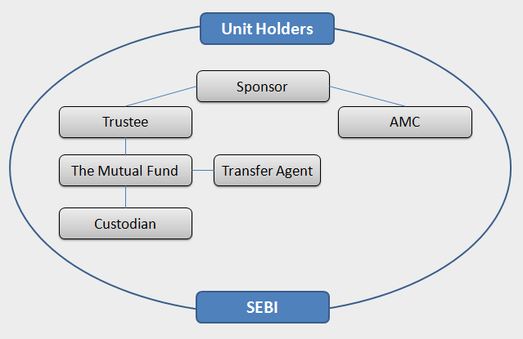
Structure of mutual fund

Slide 7
Sponsor, Trustee, AMC
The sponsor is the promoter of the mutual fund. The sponsor brings in capital and creates a mutual fund trust and sets up the AMC. The sponsor makes an application for registration of the mutual fund and contributes at least 40% of the net worth of the AMC. In other words, every MF needs a sponsor before it can commence operations. Among other requirements, the sponsor should also have a 5-year track record in the financial services business and should have made profit in at least 3 out of the 5 years. However SEBI approved a proposal in DEC 2020 that for AMCs having net worth Rs 100 crores, the criteria of profitability has been relaxed. The sponsors could be a bank, a corporate or a financial institution. The net worth of the sponsor in the immediate last year has to be greater than the Capital contribution of the AMC. It must have a positive net worth in last 3 years of applying as a sponsor. A sponsor is quite vital and must carry highest amount of credibility. The strict and rigorous norms define that the sponsor must have adequate liquidity as well as faithfulness to return the money of investors in case there is any financial crisis or meltdown.
After SEBI approval, the sponsor has to appoint the board of trustees. Every fund house must have at least four trustees. If a trustee company has been appointed, then that company would need to have at least four directors on the board. Two-thirds of the trustees should be independent. Trustees can be formed by two ways – a Trustee Company or a Board of Trustees. The primary objective of the trustees of the mutual fund is to hold its property for the benefit of the unit-holders. The board acts as a protector of unit-holders’ interests: it appoints a custodian for safe-keeping of assets and closely monitors the AMC. The trustees also have to spell out the responsibilities of the AMC, monitor any new scheme introduced and ensure full compliance with regulatory guidelines. The trustees work to monitor the activities of the Mutual Fund and check its compliance with SEBI (Mutual Fund) regulations. They also monitor the systems, procedures, and overall working of the asset management company. Without the trustees’ approval, AMC cannot float any scheme in the market. The trustees have to report to SEBI every six months about the activities of the AMC. Also, SEBI has established tightened transparency rules to avert any type of conflict of interest between the AMC and the sponsor.

Slide 8
Asset Management Companies are the third layer in the structure of Mutual Funds. Registered under SEBI, it is a type of company that is created under the Companies Act. An AMC is meant to float a variety of mutual fund schemes that are in compliance with the requirements of investors and the nature of a market. The asset management company acts as the fund manager or as an investment manager for the trust. A small fee is paid to the AMC for managing the fund. The AMC is responsible for all the fund-related activities. It initiates various schemes and launches the same. Furthermore, it also creates mutual funds with the sponsor and the trustee and regulate its development. The AMC is bound to manage funds and provide services to the investor. It solicits these services with other elements like brokers, auditors, bankers, registrars, lawyers, etc. and works with them by getting into an agreement together. To ensure that there is no conflict between the AMCs, there are certain restrictions imposed on the business activities of the companies.
A custodian is one such entity that is responsible for the safekeeping of the securities of the Mutual Fund. Registered under SEBI, they manage the investment account of the Mutual Fund, ensure the delivery and transfer of the securities. Also, custodians allow investors to upgrade their holdings at a specific point of time and assist them in monitoring their investments. They also collect and track the bonus issue, dividends & interests received on the Mutual Fund investment.

Slide 9
Registrar and Transfer Agents (RTAS)
RTAs act as an essential link between investors and fund managers. To the fund managers, they serve by keeping them updated with the details of investors. And, to the investors, they serve by delivering the advantages of the fund. Even they are registered under SEBI and execute a variety of tasks and responsibilities. These are the entities who provide services to Mutual Funds. RTAs are more like the operational arm of Mutual Funds. Since the operations of all Mutual Fund companies are similar, it is economical in scale and cost effective for all the 44 AMCs to seek the services of RTAs. CAMS, Karvy, Sundaram, Principal, Templeton, etc. are some of the well-known RTAs in India. Their services include:
Processing investors’ application,
Keeping a record of investors’ details,
Sending out account statements & periodic reports to the investors
Processing the payouts of the dividends
Updating the investor details i.e. adding new members and removing those who have withdrawn from the fund.

Slide 10
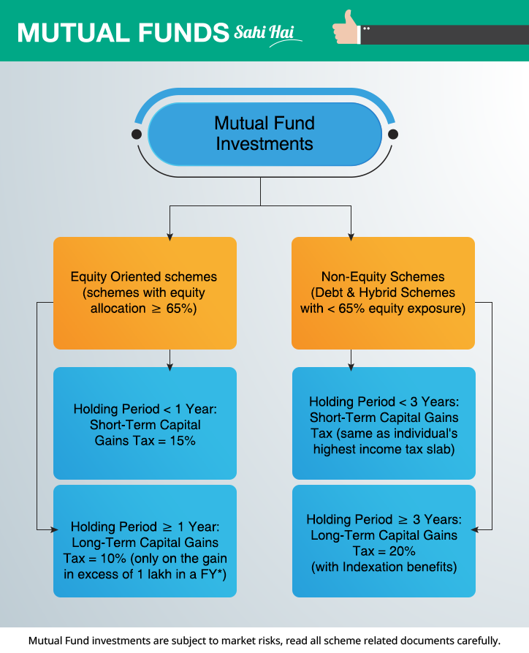

Slide 11
AMFI ( Association of Mutual Funds in India)
This non-profit association came into effect in 22nd August 1995. The sole purpose of AMFI is to work for the benefit of investors by offering them transparency in mutual fund practices. AMFI restores the faith of the investors in case they face any monetary issue in the Indian Mutual Fund Industry. Currently, AMFI comprises of 44 members out of which 42 are SEBI-registered AMCs.
It seeks to oversee the operations of AMCs and mutual fund agents and ensure that they follow the code of conduct, as well as encourage effective business practices
Intermediaries like brokers and advisors are also required to be registered with AMFI.
It ensure the ethical standard of mutual fund operations in India. Undertakes research work and updates the industry with valuable inputs and insights. It also plays a important role in spreading investor awareness and education. It has devised several audio and video campigns regarding MFs
https://www.youtube.com/watch?v=-g13ACl-87E
https://www.youtube.com/watch?v=cfpbjLaP54U
Every fund house, company or fund expert should seek permission from AMFI if they are involved in mutual fund operations and management
Issues NISM certificates which is required for generating the ARN number

Slide 12
NFO
Mutual fund schemes re introduced through New Fund Offerings (NFO)
A NFO gives details about the scheme objectives, lock in period details, fund manager nature of securities, cost and expense ratio and other details relevant for taking decisions.
Every NFO has a period during which one may invest . As per SEBI guidelines, it may exist for a maximum period of 30 days.
After an NFO closes, trading of the mutual fund unit may start in the secondary market. Hence it gives a good opportunity to investors in an NFO
An equity IPO is done by a single company, which often seeks capital for expansion. On the other hand, an NFO from a mutual fund collects money from investors and allocates that to a basket of securities (stocks or bonds or government securities and so on), based on a stated strategy.
NFO may be for 2 types : open ended funds and close ended funds.
Advantages include : lower NAV than market, close ended funds can be accessed easily, benefits of higher returns of close ended funds

Slide 13
SIP (Systematic Investment Plan)
Mutual Fund SIP accounts stood at 4.02 CRORE! And the total amount collected through SIP during June 2021 was ₹ 9,156 crore
Systematic Investment Plan (SIP) is an investment plan (methodology) offered by Mutual Funds wherein one could invest a fixed amount in a mutual fund scheme periodically, at fixed intervals – say once a month, instead of making a lump-sum investment.
The SIP instalment amount could be as little as ₹500 per month. SIP is similar to a recurring deposit where you deposit a small /fixed amount every month. Advantage over FD is that SIP may continue as long as you wish. A FDs give a fixed interest however SIP may give higher returns depending upon market performance.
SIP is a very convenient method of investing in mutual funds through standing instructions to debit your bank account every month, without the hassle of having to write out a cheque each time. ECS also ensure that same day NAV is received irrespective of the time when it is credited to MF account.
SIP has been gaining popularity among Indian MF investors, as it helps in Rupee Cost Averaging and also in investing in a disciplined manner without worrying about market volatility and timing the market. Systematic Investment Plans offered by mutual funds are easily the best way to enter the world of investments over the long term.
Common sense suggests that “Buying low and selling high” is perhaps the best way to get good returns on your investments. But this is easier said than done, even for the most experienced investors. There are many factors at play when it comes to any market - debt or equity, and all of them are inextricably linked.
SIP is a simpler approach to long term investing is disciplining and committing to a fixed sum for a fixed period and sticking to this schedule regardless of the conditions of the market.

Slide 14
RUPEE COST AVERAGING
Rupee cost averaging, as this practice is called, in a way ensures that you automatically buy more units when the NAV is low and fewer when the NAV is high…e.g., an SIP of ₹1000 gets you 50 units when the NAV is Rs. 20, but gets you 100 units when the NAV is Rs.10. The average cost for buying those 150 units would be Rs. 2000/150 units i.e. ₹ 13.33.
However, please remember that the Rupee cost averaging does not assure profit, nor does it protect one against investment losses in declining markets. It merely ensures disciplined & regular investment in stock markets, which helps overcome the natural impulse to stop investing in a falling or a depressed market or investing a lot, when markets are buoyant and euphoric.
THE POWER OF COMPOUNDING
There is a great advantage with long-term investments, namely, compounding which is considered one of the greatest mathematical discovery.
To put it in simple words, compounding is when the interest (or income) you earn is reinvested in the original corpus and accumulated corpus continues to earn (& grow). Every time this happens, your investment keeps growing, paving the way for a systematic accumulation of money, multiplying over time.
To illustrate, a small amount of ₹1000 invested every month at an interest rate of 8% for 25 years would give you ₹ 9.57 Lakh! That means your investment of just ₹ 3 Lakh would have grown three times over!

Slide 15
STARTING EARLY PAYS WELL
To get the best out of your investments, it is very important to invest for the long-term, which means that you should start investing early, in order to maximize the end returns.
Let’s understand this better through an illustration –
Let's assume that two friends, both aged 25, decide to invest ₹ 2000 every month for a period of 5 years and earn 8% p.a. on a monthly compounding basis. The only difference is that while one starts investing promptly at the age of 25 itself, the other starts investing 10 years later at the age of 35 years. Both decide to hold on to their investments till they turn 60. So while both of them would accumulate principal investment of ₹1.2 Lakh over a period of 5 years, the investment of the person who started early at the age of 25 appreciates to over ₹ 14 Lakh, the investment of the second person who started later grows to only about ₹ 6 Lakh.
SIP also gives advantage of tax saving if investments are done through ELSS funds.
Limitations : 1. Quantum of investment low. So at time of requirement doesnot provide huge liquidity.
2. Missed opportunity of investing much at the right time.

Slide 16
STP (Systematic Transfer Plan)
STP is an automated way of moving (transferring) money from one mutual fund ( ideally debt and equity)to another. This plan is chosen when one wants to invest a lump sum amount but wants to avoid the marketing-timing risk.
The most common advantage of doing STP is to derisk the market timing risk. STP (with single installment) can be used to invest a lump sum amount in equity funds on the same day. Otherwise, one have to first apply for redemption, receive funds and then retransfer the funds to the AMC for reinvesting in a different MF. This has a time lag of 2 to 3 days and is subject to market risks.
In case of a volatile market, STP helps the investors to periodically transfer funds from one scheme (source scheme) to another (target scheme). Transfers are usually made from debt funds to equity funds if the market is doing well and vice versa if the market is not performing well.
If a fixed sum is transferred from the source to the target scheme, then it's called Fixed STP. If the sum transferred is not fixed, then it is an example of Flexi STP. If the sum transferred is the profit part of the investment of source scheme, then its called Capital Appreciation STP.
Earlier, fund houses allowed only debt to equity fund transfer within the same company. Now, you can transfer from an equity fund of one AMC to that of another. To apply for an STP, there needs to be at least six capital transfers from one mutual fund to another. While you are free from entry load, SEBI allows fund houses to charge exit load. However, the exit load cannot exceed 2%. There is no entry/ exit load for STPs between same AMC.
From taxation angle, each switch is considered as an exit / redemption and hence STCG/ LTCG is applicable according to the investment period in the original fund.

Slide 17
Advantages : 1. Diversifications of risk 2. Rupee cost averaging 3. Taking benefit of a growing equity market.
STP is ideal for : 1. Investors who have invested in debt funds through SIP and now wants to take benefit of equity markets through capital appreciation 2. Equity fund investors have taken benefit of capital appreciation and now nearing retirement wants to ensure steady returns will shift to debt funds.
P-E STP : Instead of transferring a fixed amount from your debt to the equity fund, it transfers a higher amount when the market valuations are low and the pre-determined amount—which you would have ordinarily invested through a normal STP—when the valuations are high.
The fund house has created three market zones, which determine how much money gets transferred: When the P-E ratio of S&P BSE Sensex is below 16 (called the green zone) between 16 and 19 (yellow zone) greater than 19 (red zone).
When markets are in the red zone (in other words, when valuations are high), the default STP amount gets invested. When markets are in the yellow zone, twice your default STP gets invested. When the markets are in the green zone, 5 times the default STP amount gets invested. In short, you buy more units when the markets are low.
Apart from channelling the investments into an equity fund in a disciplined manner—like in any other STP, the PE STP ensures that you invest more during falling markets. It takes a more scientific approach and accounts for valuations of the stocks and the market, rather than looking at just the absolute market levels, which don’t always mean much.

Slide 18
SWP
SWP or systematic withdrawal plan is a mutual fund investment plan, through which investors can withdraw fixed amounts at regular intervals, for example – monthly/ quarterly/ yearly from the investment they have made in any mutual fund scheme.
The investors can choose a day of the month/quarter/year when withdrawal can be made and the amount credited to investors bank account by the AMC. To generate this cash flow, SWP Plan redeems units of mutual fund scheme at the chosen interval. Investors can continue with SWP as long as there are balance units in the scheme.
Example - Investor invests lump sum Rs 10.00 lakhs in a mutual fund scheme. The purchase NAV is Rs 20; therefore, 50,000 units are allotted. Let us assume investor started a monthly SWP of Rs 6,000 after one year from the investment date, just to avoid exit loads.
In the 1st month of SWP, let us assume the scheme NAV was Rs 22. In order to generate Rs 6,000, the AMC redeems 272.728 units (Rs 6,000 / 22 NAV), therefore, the balance units will now be 49,727.272 (50,000 minus 272.728). In the 2nd month, assuming NAV was 22.50, the AMC redeems 266.667 units (Rs 6,000 / 22.50 NAV), therefore, the unit balance reduces to 49,460.605 (49,727.272 minus 266.667). In the 3rd month, assuming the NAV was 23.00, the AMC redeems 260.8696 units (Rs 6,000 / 23.00 NAV) and now the unit balance reduces to 49,199.7354. This process continues every month till the end of the SWP period chosen by the investor.

Slide 19
Benefits of SWP
Flexibility:
In a SWP plan, investor has the flexibility to choose the amount, frequency and the date according to his/her needs. Also, the investor can stop the SWP at any point in time / or can add further investments or even withdraw amount over and above the fixed SWP withdrawals.
Regular Income:
SWP in mutual funds facilitates investors by providing a regular income from their investments. Therefore, this becomes highly convenient and useful for those who need regular cash flow for meeting regular expenses.
Capital appreciation:
As we can see in the example above, if the SWP withdrawal rate is lower than the fund return, the investor gets some capital appreciation too in the long term.
No TDS –
For resident individual investors, there is no TDS on the SWP amount.

Slide 20
Ideal for the investors who :
1.For those looking for regular source of secondary income –
2.Looking for capital protection
For example – Suppose, the initial investment is made in an Arbitrage fund and the capital appreciation is received regularly by way of SWP; the initial investment will remain at almost zero risk.
3.To create an own pension –
Investors who do not have any pension earnings can create their own pension by investing the retirement corpus in schemes suiting their risk profile and earn a regular income at a frequency chosen by them. Therefore, on retirement, the investor can start an SWP and create their own pension.
4. Investors who are in high tax bracket –
Investors in high tax bracket find SWP useful as there is no TDS on the capital gains.

