Slide 1
Thakur College of Science & Commerce
Department of Zoology
Welcomes
Academic Year – 2020-21
Toxicology
Dr. Vitthal T. Mohite

Slide 2
History of Toxicology

Slide 3
Principles of Toxicology
Measurements of toxicity is very complex.
Toxicity may be acute or chronic.
Toxicity depends on age, gender, diet, health, and surrounding environment.
Toxicity is nothing but the measurement of toxic response.
Route of exposure is determined.

Slide 4
Scope of toxicology
Clinical Toxicology
Biochemical and molecular Toxicology.
Behavioural toxicology.
Nutritional toxicology.
Analytical toxicology
Pathological toxicology
Veterinary Toxicology
Forensic Toxicology
Regulatory Toxicology
Environmental Toxicology.
Industrial toxicology

Slide 5
Divisions of Toxicology
A. Modes of toxic action.
  Systemic Toxicity – Effects of toxins on entire body
  Organ Toxicity – Effects of toxins on organ structure & function.
Measurement of Toxicants and Toxicity –
  Action of toxicant
  Level of toxicity
  Nature of toxicant
Applied toxicology
  Toxicity testing- Acute , Chronic, Mechanism, Effects on Biological Organism.
Nature of chemical agents.
  Agricultural Chemicals
  Clinical Drugs
  Drugs of Abuse
  Food Additives
  Industrial Chemicals
  Therapeutic Drugs
  Naturally occurring substances

Slide 6
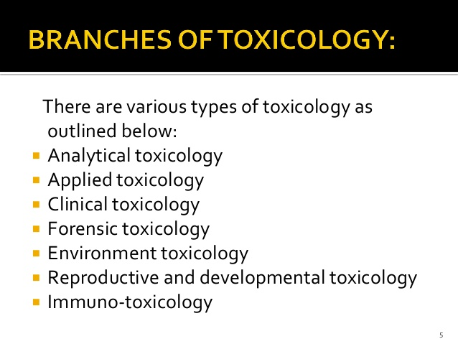

Slide 7
Contribution to the other Branches of Science
Is a developing Science
Contribute to every branch of science.
Chemistry, Biochemistry, Biology, Physics, Pathology, Epidemology, Immunology, Ecology, Public Health, Biostatistics, Pharmacology etc.
Protection of environment.
Agriculture.
Veterinary Science.

Slide 8
Diagramatic representation of Toxicology
Pharmacology
Pathology
Physiology
Toxicology
Chemistry
Public Health
Biology
Immunology
Environmental Pollution
Economic Development
Forensic Toxicology

Slide 9
Toxins and Toxicants
Toxin- Poison of plant or animal in origin
Toxicants- Toxic substance introduced in to the environment
Phytotoxins – Toxins of plant in origin
(Sulfur Compounds, lipids, phenols, alkaloids glycosides) e.g. Caffeine, Nicotine
Zootoxins : Toxins of Animal in Origin.
(different tissues, glands, organs,skin)e.g. Cnidarian toxins, Arthropods.
Mycotoxins :Toxins Produced by fungi
(Alkaloids, Aflatoxins, Trichothesenes e.g. Claviceps, Aspergillus sp.

Slide 10
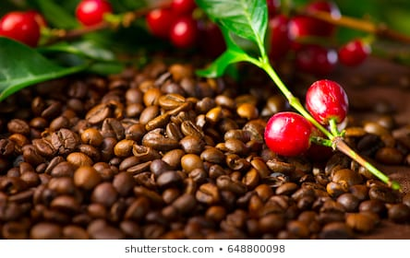
Phyto toxins - Caffeine
Caffeine : extracted from bean of coffee plant. Coffea canephora
(used in foods and drinks,coffee, chocolate,gum, medicines pesticides)
Mode of entry- GI passed all barrier
Organ | Effect
CNS | Increased hunger, anxiety, Confusion, irritability
Eyes | Blurred eyes
Ears | Dizziness
Mouth | Dryness
Skin | Cold sweats
Heart | Fast Heartbeat
Respiratory | Troubled breathing
Gastric | Ache
Intestinal | Diarrhoea
Urinary tract | Increase Urination, Ketones in urine

Slide 11
Caffeine
Metabolism takes place in liver in presence enzyme cytochrome p450 separates in three compounds
  Paraxanthine- increase lipolysis resulting higher glycerol & Fatty acids.
  Theobromine- dilate blood vessel increase urine production
  Theophylline – causes nausea and irregular heart beat.
  Pregnancy significantly increase rate of miscarriage
  In children reduces growth rate, dehydration
  Increases toxicity of certain drugs like paracetamol
  Benefits of Caffeine
  Acts as mild analgesic
  Neurostumulant
  Help to prevent cardiovascular problems.

Slide 12
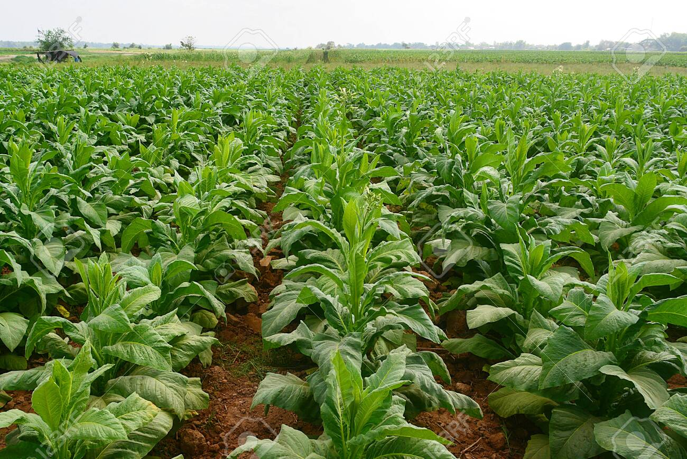
Nicotine ( Tobacco- Nicotina tabacum)
Family – Solanaceae have Poisonous alkaloids.
Highly addiction
Shows psychological and physiological addiction.
Active and passive smoking gives rise so many complications.
Easily cross blood-brain barrier.
Chewing shows adverse effect on GI.
It changes the level of chemicals in the brain.

Slide 13
Nicotine ( Tobacco- Nicotina tabacum)
Effects
Effect on PNS, heart
GI –Nausea, diarrhea, dizziness, increase in bowel activity.
Pain in jaw.
Lung, stomach, intestinal cancer

Slide 14
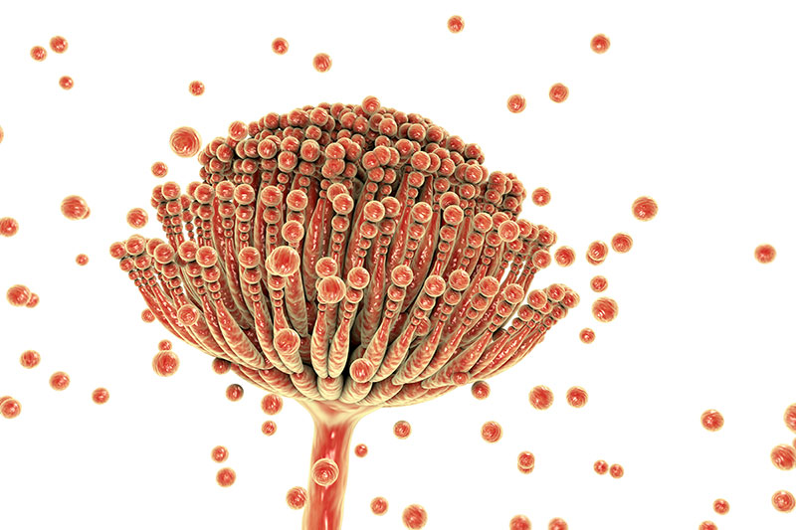
Mycotoxins – Produced by toxic fungi
They found in humans and domestic animals.
They contaminate mainly crops during growth and storage.
Also show adverse effect on poultry birds.
Some of these are acutely toxic.
Show various clinical symptoms.
They are neurotoxicant also causes vasoconstrinction
Alkaloid , Aflatoxins, trichothecenes.
Cytochrome p450 alters aflatoxins and results acute and chronic aflatoxins.

Slide 15
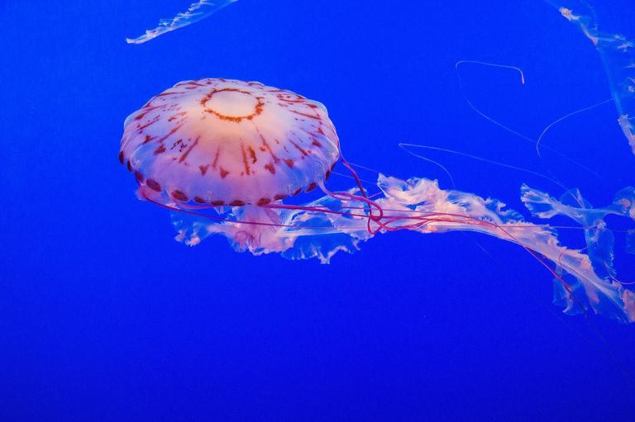
Zootoxins – animal in origin
400 species of poisonous snake and 1500 marine species.
Protozoans, cnidarians, arthropods, fishes, amphibians, reptiles vertebrates,
Defense mechanism.
Toxins of animals referred as venoms.
Cnidarian Toxins – (Coelenterates)
Possesses variety of biologically compounds. ( Polypeptide toxin, diterpenes and proteins.
Nematocysts to inject the venom. Stinging cells activated mechanically or chemically.
Neurotoxins paralyze prey

Slide 16
Arthropods Toxins – Mechanisms and Effects of Stinging
Produced by exocrine glands.
Larger group of in Animal Kingdom
Insect - Ants , Dragonflies, bees.
Arachnids – spiders, Scorpion.
Crustaceans – crabs, lobsters, shrimps
Myriapods - Centipedes, millipedes

Slide 17
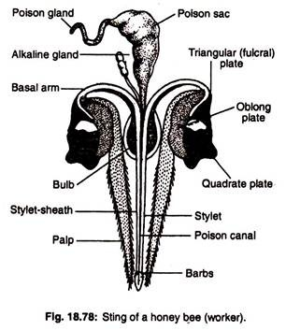
Honey Bees –Stinging
Order- Hymenoptera
Honey Bee sting
Modified ovipositor causes lethality.
Composition-Apamine, Phospholipase,
  Histamine, dopamine etc.
  50 sting can become leathal
  Respiratory dysfunction, intravascular hemolysis
  Hypertension, hepatic changes, renal changes.
  Symptoms – Stinging are painful, increase body
  Temperature, localized swelling, vomiting, irritation,
  cardiac arrest, local edema, haemolysis.

Slide 18
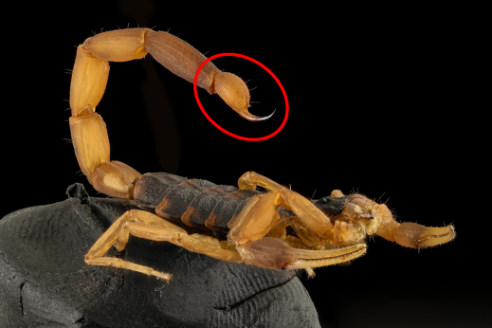
Venoms of Scorpion
Pandinus, Vejovis, Nebo
Oldest nocturnal terrestrial arthropods.
Contains low molecular wt. proteins
Peptides, amino acids, nucleosides, salts.
Symptoms – Localized pain, Swelling, mild
weakness, fever, impair in respiratory function.
Respiratory paralysis

Slide 19
Venoms of Snakes
400 variety of snakes venomous.
Venom is mixture of complex mixture of protein contain 95 %.
Also contain inorganic salts Ca, K,S, Mg, trace elements Ni, Fe, Zn,Mn, Cobalt.
Enzymes hydrolase, peptidase, protease, endopeptidase and ptorenase.
Thrombin like enzyme release fibrinopeptide.
Phosphodiesterase found in venoms families of snakes.
Acetylcholinesterase present in cobra
Some compound present as anticoagulants and prevents normal clotting

Slide 20
Mechanism and effects of biting
Transfer venom by fangs produces proteolytic and haemorrhagic action.
Neurotoxins block neuromuscular movements.
They are lethal because they have ability to cause respiratory failure.
Hemolytic agents hydrolyze and disturb RBCs.
Blood coagulation cause rapid and complete coagulation of preys blood.

Slide 21
Characteristics of Exposure
Duration of Exposure.
  Acute – 96 hrs Subacute – 30 days
  Chronic- sub chronic – 30-90 days
  Chronic- more that 90 days
  Based on source of exposure to chemicals the exposure can be
  Environmental
  Occupational
  Therapeutic
  Dietary
  Accidental
  Intentional
  Categories of toxic effects
  Local & Systemic effects
  Immediate and delayed effect
  Reversible and irreversible effects
Frequency of Exposure.
  No. of times dose on concentration taken in the body
Site of Exposure
Exposure-Absorption-Translocation – Storage depots- Bioaccumulation-Excretion
Routes of Exposure
  GI
  Integument
  RT

Slide 22
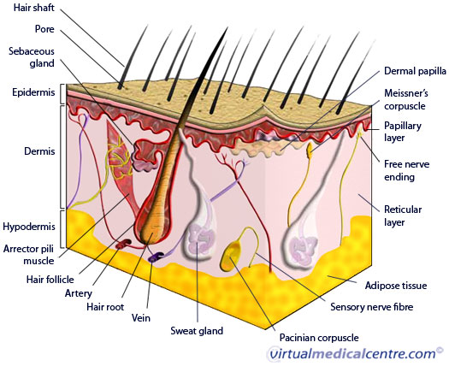
T.S. of Human Skin

Slide 23
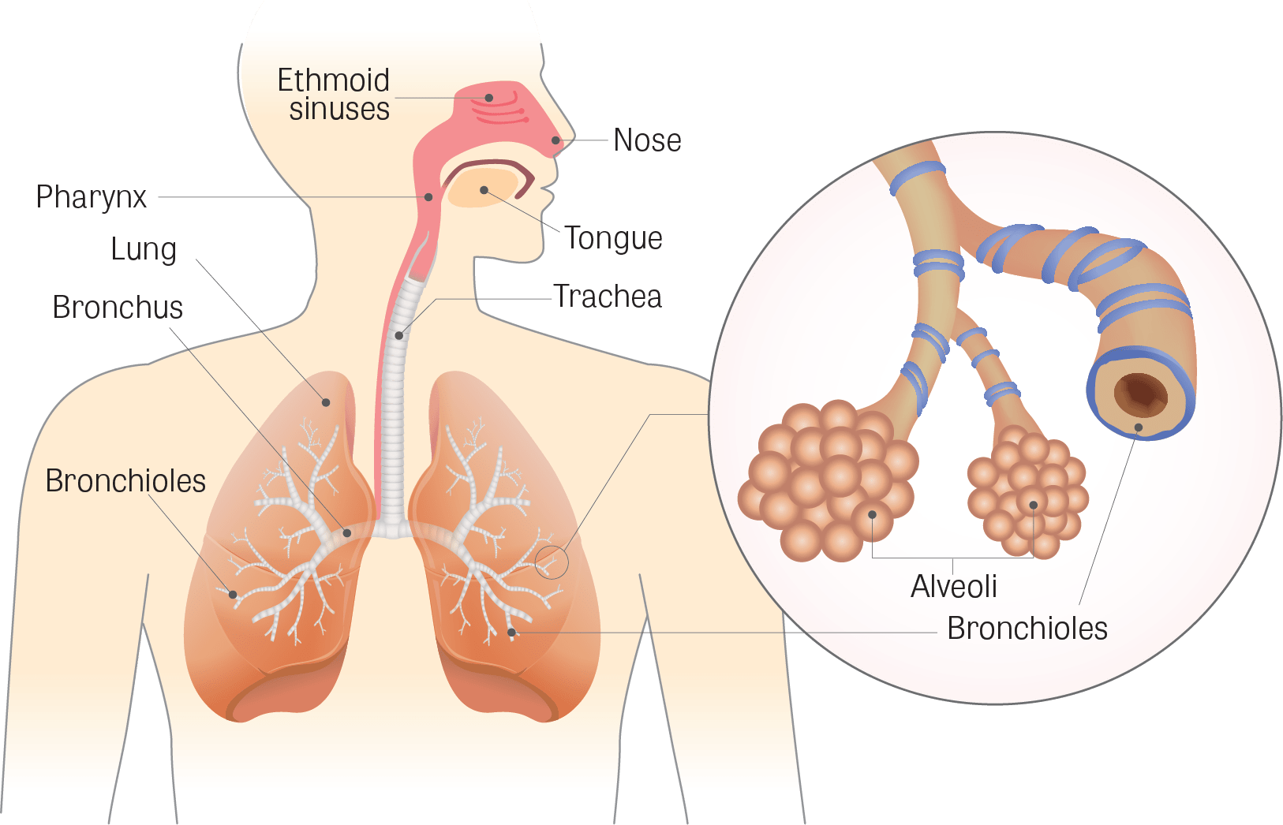
Respiratory Tract as a Route of Exposure of Toxicant.

Slide 24
Types of Toxicity
Acute toxicity
Chronic Toxicity
Concept of LD_{50,} LC_{50 ,} TD ₅₀ and ED₅₀
NOEL – No observed Effect Level
^{TLV- Threshhold limit Value}
LOAEL –Low observed adverse effect level
NOAEL- No observed adverse effects level

Slide 25
LD₅₀ (Median Lethal Dose)
( Dose in mg/kg body weight causing death of 50 % of Animals Exposed)
Help to take information about chemical exposure and minimizing impact on human health and environment.
Mostly done in rats and mice.
Doses either oral or dermal.
LD₅₀ is used as an aid in developing emergency procedures.
It only marks lethal toxicity .
Tests performed for pure chemicals.

Slide 26
LC₅₀ (Median Lethal Concentration)
( Concentration in mg/kg body weight causing death of 50 % of Animals Exposed)
Concentration of Chemical in water or some time in air.
Used for toxicity study of Aquatic animals.
In daphnia, Paramecium toxicity testing is carried for 4 hours.
For invertebrates and fishes studied for 96 hrs.
Aquatic animals are extensively used as experimental animals for toxicity studies.
Drugs discovery for the oceans in being increased.

Slide 27
EC₅₀ (Therapeutic Dose)
( amount of dose of drug that produces a therapeutic response or desired effects.)
Important to predetermine therapeutic dose.
Lowest level of drug that should show clinically significant response.
It should be between minimum effective dose (MED)and maximum tolerated dose (MTD).
If large difference between MED and MTD then drug has large therapeutic window.
LD₅₀ gives safety margin of drugs. Usually it is calculated with ED value .
The ratio of LD₅₀/ED₅₀ provides greater margin of safety called
“Therapeutic Index”.
Threshold Dose : Lowest amount or exposure level of a toxic substance at which a specified and measurable effect manifests.

Slide 28
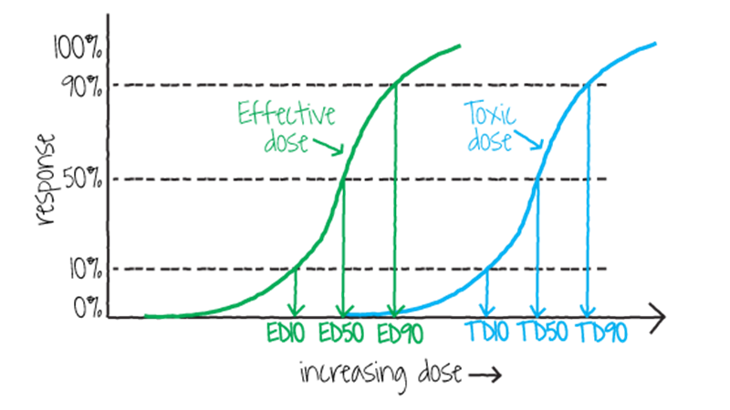
Comparison of effective dose, Toxic dose

Slide 29
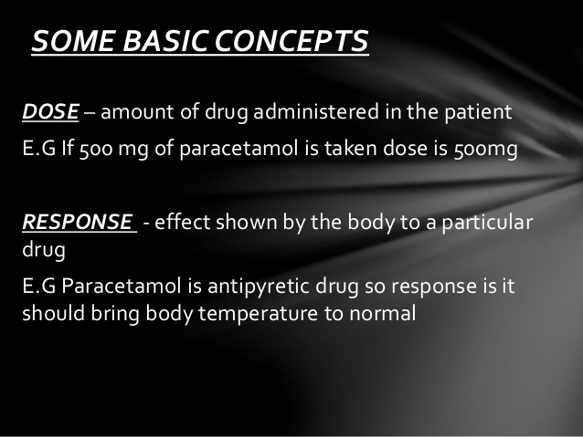
Dose- Response relationship

Slide 30
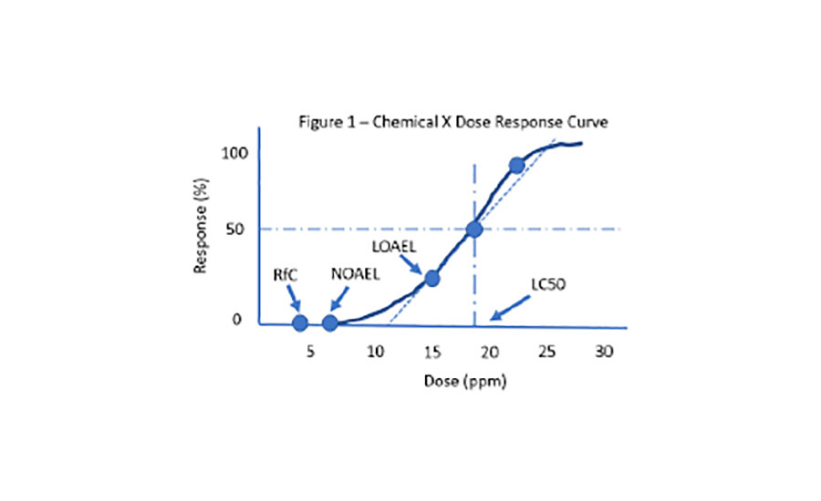
Dose- Response Curve

Slide 31
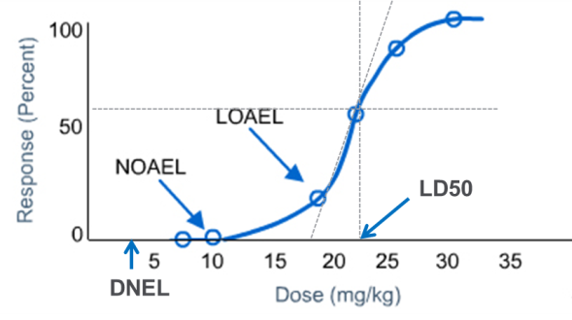
Dose- Response relationship

Slide 32
Therapeutic Index
Amount of therapeutic drug necessary to cause therapeutic effect.
It is range of dose between efficacy & Toxicity.
Helps to generate optimum therapeutic value without side effects.
In therapeutic index TD₅₀ drug responsible to cause toxic effects.
ED₅₀ drugs that give maximum pharmacological effects.
Therapeutic index for animals= LD₅₀/ED₅₀
Therapeutic index for humans = TD₅₀/ED₅₀

Slide 33
Margin of Safety
The Margin of Safety ( MOS ) is usually calculated as the ratio of the toxic dose to 1% of the population (TD01) to the dose that is 99% effective to the population ( ED99 ). ... Although more patients may benefit from higher doses , that is offset by the probability that toxicity will occur.
Margin of exposure
MOE = NOAEL/Estimated Exposure Dose.
Unit of NOAEL: mg/kg bw/day or ppm.
Margin of safety in pharmacology -The margin of safety of a drug is a concept that tells us how safely we can use a drug for therapeutic purposes without risking too many adverse effects at the same time.

Slide 34
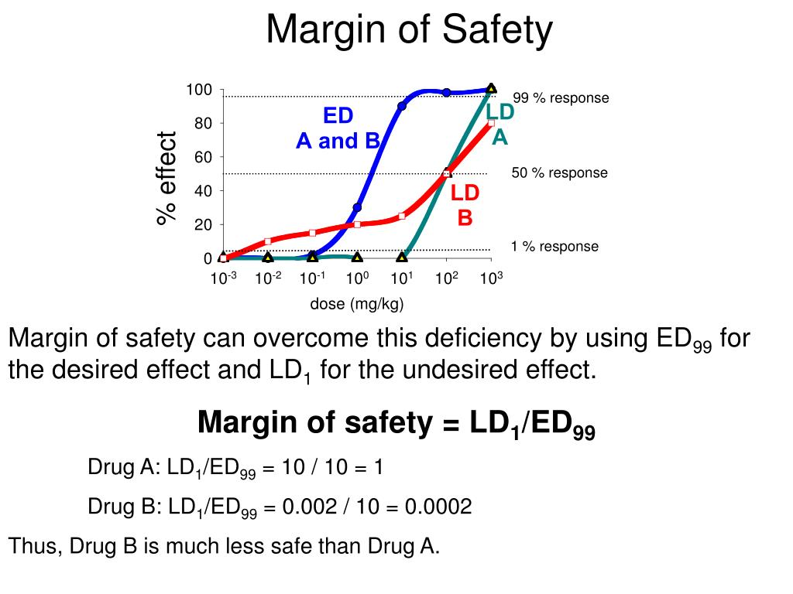

Slide 35
Dose translation from Animals to Humans
In new drugs appropriate translation of drug doses from one animal to another become necessary.
The animal doses should not be extrapolated to a human equivalent dose(HED)by simple conversion based on body weight.
BSA (Body Surface Area) is been as normal method.
K_{m} = body weight /BSA
While new drug assessment of human risk is been considered.
HED(mg/kg)=Animal dose (mg/kg)X(Animal K_{m}/Human K_{m)}
Safety factor is important : Risk = Hazard x Exposure.

Slide 36
Important terms in Toxicology
Acceptable Daily intake (ADI)
Safety Factor

Slide 37
Target Organ Toxicity
Target organ toxins are chemicals that can cause adverse effects or disease states manifested in specific organs of the body.
Toxins do not affect all organs in the body to the same extent due to their different cell structures.
is the result of alterations in cellular structure or function.
The liver is an important site for the breakdown of most metabolites in the body
Liver is “metabolic clearing house” of the body.

Slide 38
Hepato-toxicity
Function of liver is storage, metabolism and biosynthesis
Main site of xenobiotic metabolism
Susceptibility of Liver :- Largest organ in body.
Target organ chemically induced injuries.
First target organ, biotransformation, detoxication, oxidative reactions.
Role of cytochrome p450

Slide 39
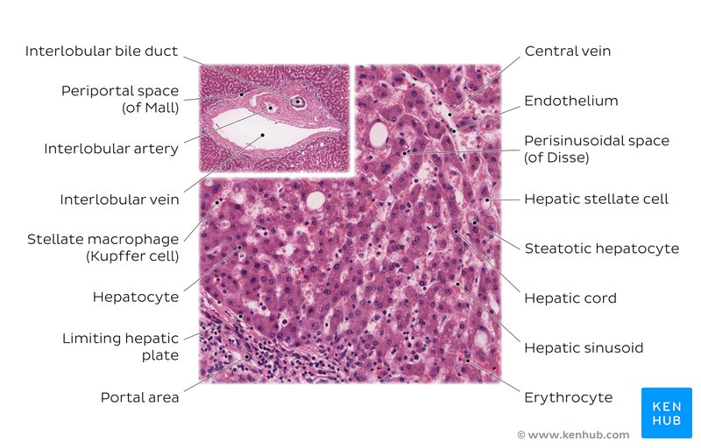
Histology of Liver

Slide 40
Types of Liver Injury
Fatty Liver- Accumulation of fat in hepatocyte.
Necrosis- denigrative process leading death of cells.
Apoptosis- is controlled form of cell death due to oxidative stress, anoxia, radiation.
Cholestasis- It is the result of interference of bile flow due to blockage of bile duct.
Cirrhosis- due to deposition of collagen in the liver.
Hepatitis- Inflammation due to viral infection.
Oxidative stress- Due to imbalance in the state of cell.

Slide 41
Examples of Hepatotoxicants
Many substances cause cellular injury by activating metabolic reactions.
Reactive metabolites can covalently bind to cellular macromolecules cofactors, coenzymes, proteins lipids, carbohydrates.
CCL₄ - Cytochrome p450 highly reactive free radicle.
Acetaminophen: commonly used as pain killer safe with therapeutic dose.
Over dose cause acute centrilobular necrosis can become fetal.

Slide 42
Neurotoxicity
The nervous system is a highly complex part of an animal that coordinates its actions.
Sensory information by transmitting signals to and from different parts of its body.
The nervous system detects environmental changes that impact the body, then works in tandem with the endocrine system
Blood brain barrier- N.S. is protected from adverse effect due to barriers.
a semipermeable membrane separating the blood from the cerebrospinal fluid.
constituting a barrier to the passage of cells, particles, and large molecules.

Slide 43
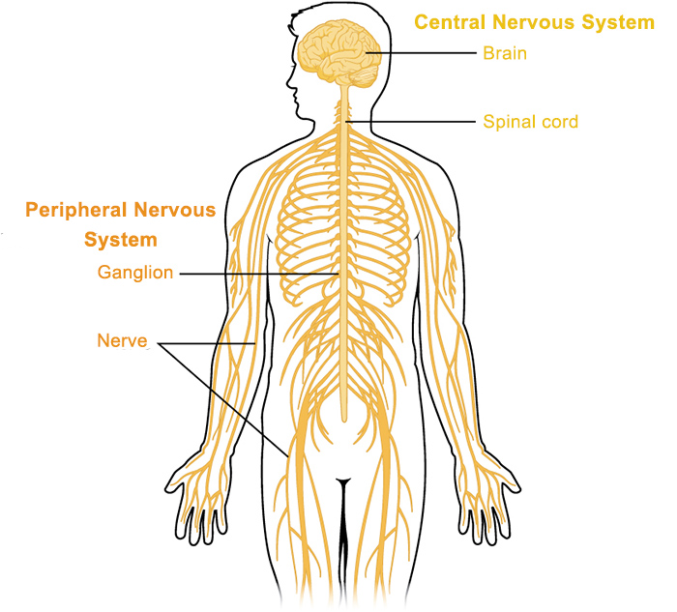
Nervous System

Slide 44
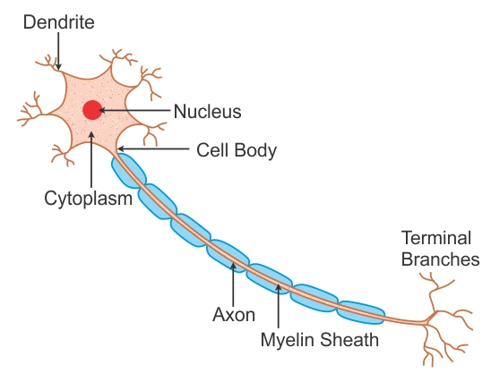
Structure of Human Nerve Cell

Slide 45
Neurotoxic agents
Chemotherapy drugs that are used to kill fast growing cells
Radiation
Drug therapies or drugs of abuse
Heavy metals such as mercury and lead
Certain foods and food additives
Insecticides/pesticides, Environmental pollutants.
Cosmetics
Industrial and cleaning solvents
Some examples of neurotoxic substances our environment has become polluted with and that it is difficult for people to avoid exposure to include:
Mercury
Cadmium
Lead
Insecticides
Solvents
Car exhaust
Chlorine
Formaldehyde
Phenol

Slide 46
Effects of Neuro toxicity
Paralysis or weakness in the limbs
Altered sensation, tingling and numbness in the limbs
Headache
Vision loss
Loss of memory and cognitive function
Uncontrollable obsessive and/or compulsive behavior
Behavioral problems
Sexual dysfunction
Depression
Loss of circulation
Imbalance
Flu-like symptoms

Slide 47
Examples of Neurotoxicant
Occupational Exposure for variety of compounds.
Neurotoxicants are substances capable of causing adverse effects in the central and peripheral nervous system, and in sense organs.
These effects include narcosis, nausea, dizziness, vertigo, irritability, euphoria, movement coordination problems, impaired memory and behaviour.
Neurodegenerative diseases like Alzheimer"s disease. Some neurotoxic effects may be reversible (e.g. narcosis, nausea, dizziness, vertigo) and others may be irreversible (e.g. neurodegenerative diseases).

Slide 48
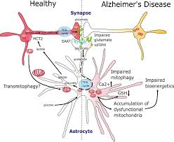
Alzheimer’s Disease

Slide 49
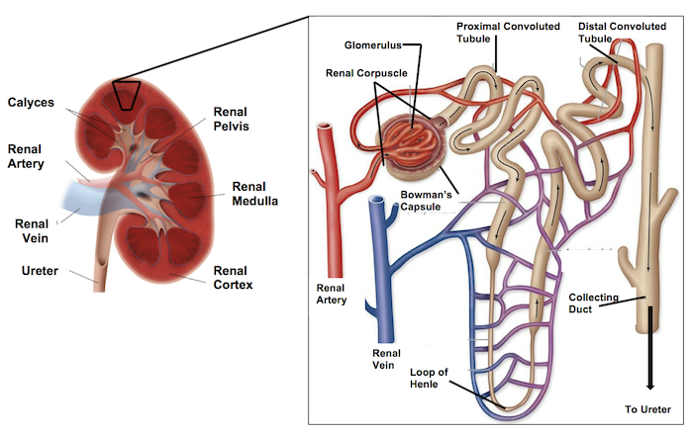
Nephrotoxicity

Slide 50
Susceptibility of Kidney
Site selective injury.
Glomerular Injury.
Proximal tubular Injury
Loop of Henely Injury
Distal tubule and collecting duct injury
Papillary Injury

Slide 51
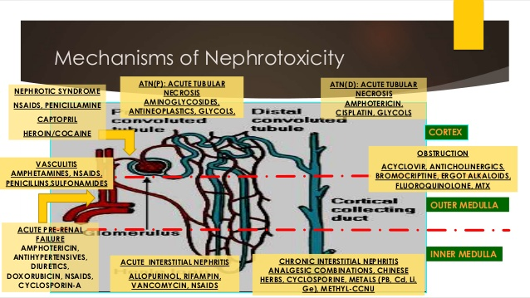

Slide 52
Types of Nephrotoxicant
Heavy metals
Chloraform
Fungi

Slide 53
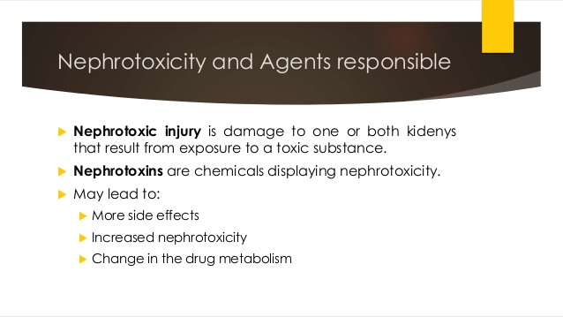

Slide 54
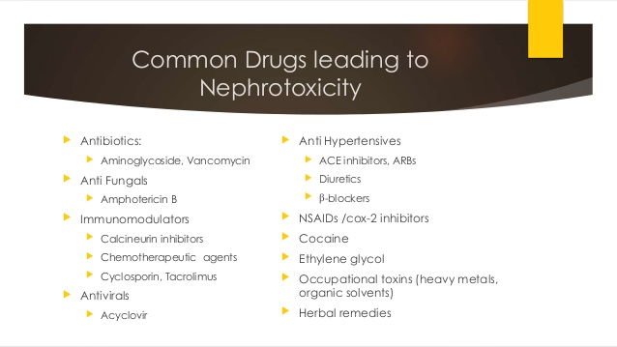

Slide 55
Regulatory Toxicology
OCED guidelines for testing of chemicals :
1.Physical & Chemical properties
2. Effect on biotic system.
3. Degradation & Accumulation.
4. Health effects.
5. Other test Guideline's.

Slide 56
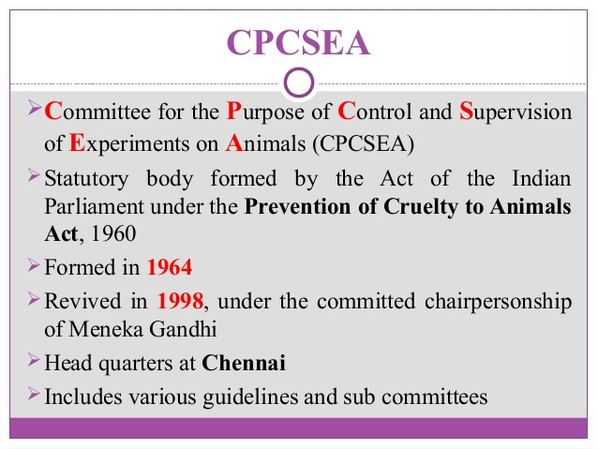

Slide 57
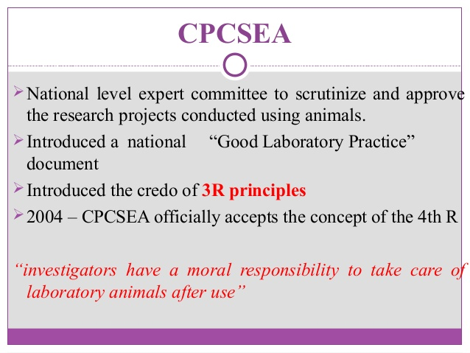

Slide 58
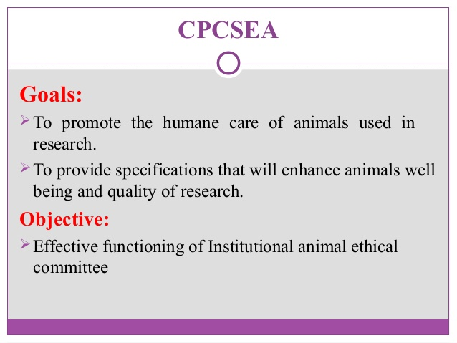
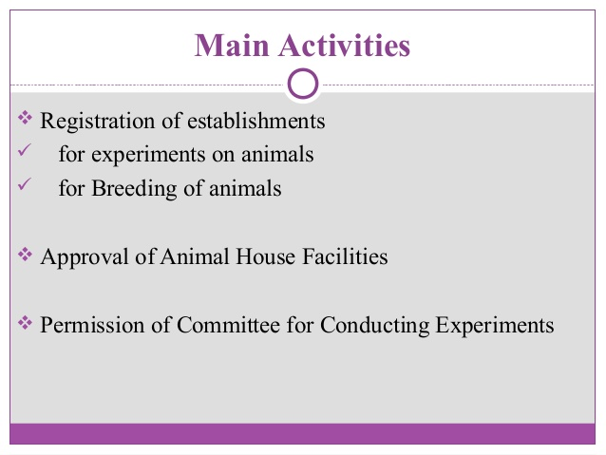

Slide 59
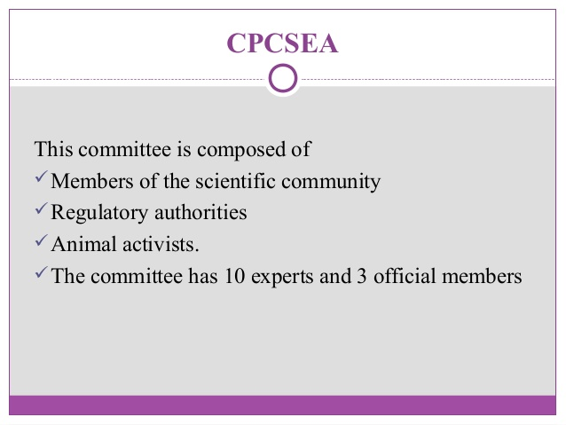

Slide 60
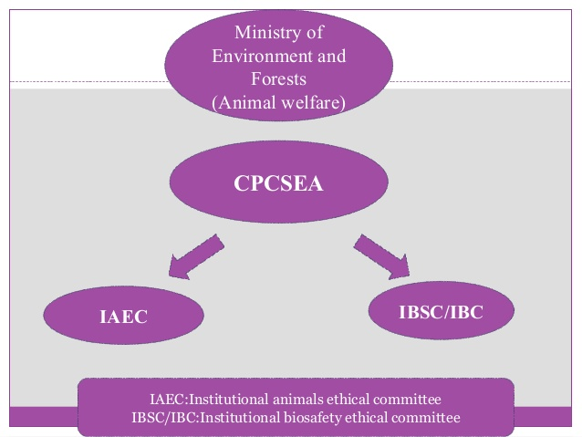

Slide 61
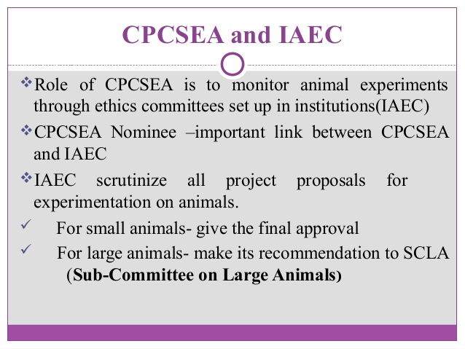

Slide 62
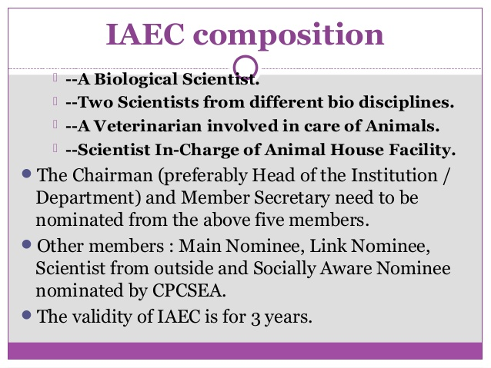

Slide 63
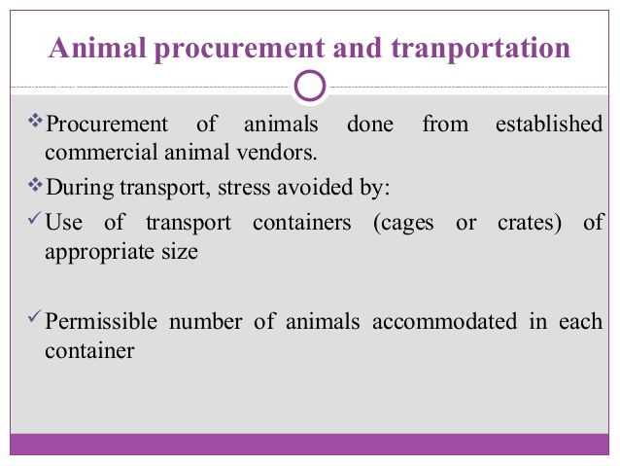

Slide 64
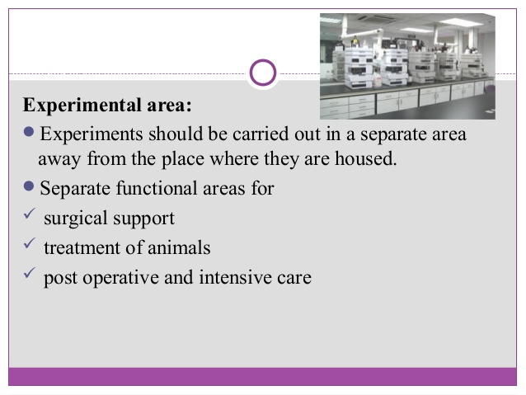

Slide 65
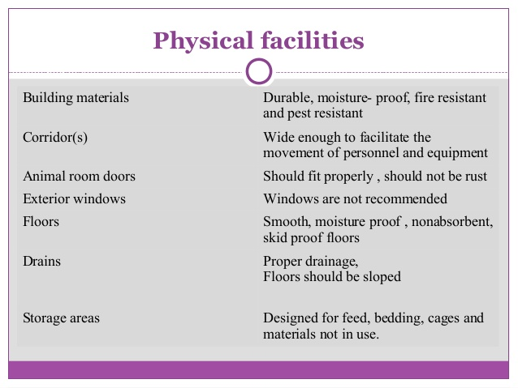

Slide 66
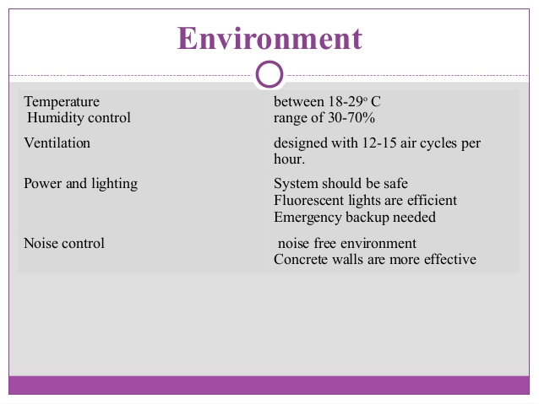

Slide 67
Animal Models used in Regulatory Toxicology
Animal model : Animal studies that the ranges of values of key parameters of the diseases.
It help to measure quality assurance and Quality Control.
Help it to create educational activity, to gain knowledge for basic understanding.
Animal Models are classified
1. Experimental – Used in an experiment to introduce condition that mimic a human disease.
2. Negative – particular condition cannot be produced therefore studies to better understand the reason of protective effects.
3. Spontaneous – to understand how animal suffers certain conditions.
4. Alternative models – used of animal extensively reduced or stopped.

Slide 68
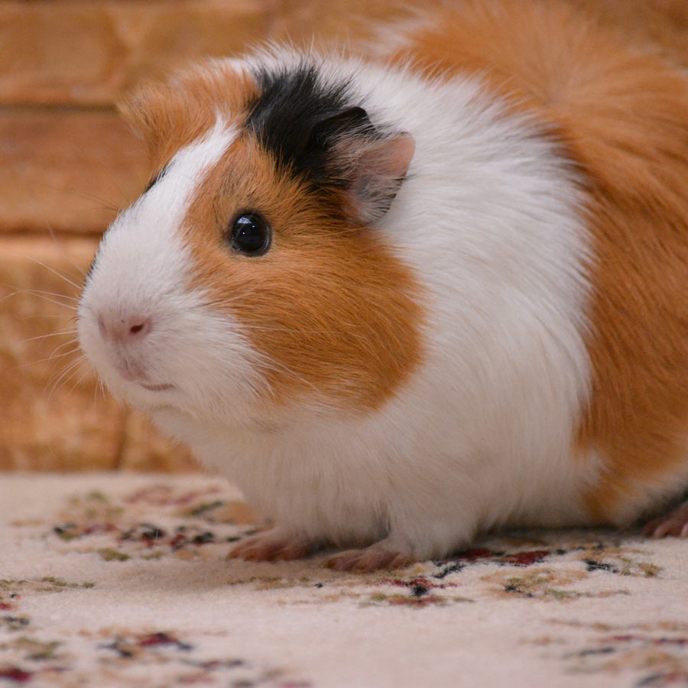
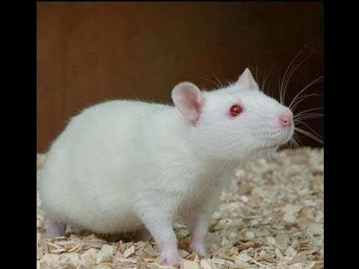
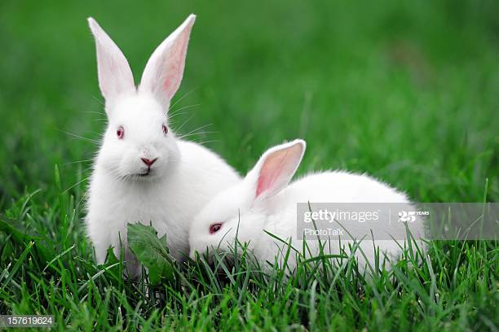
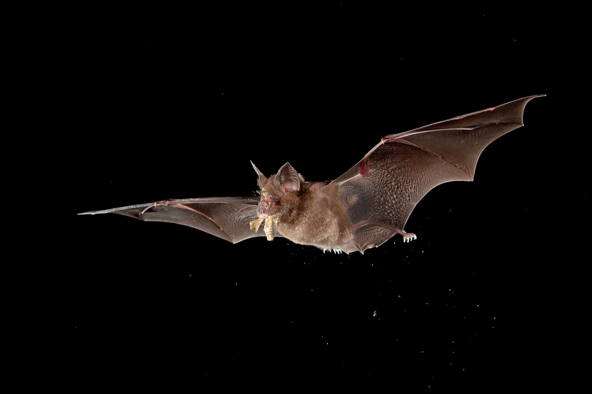
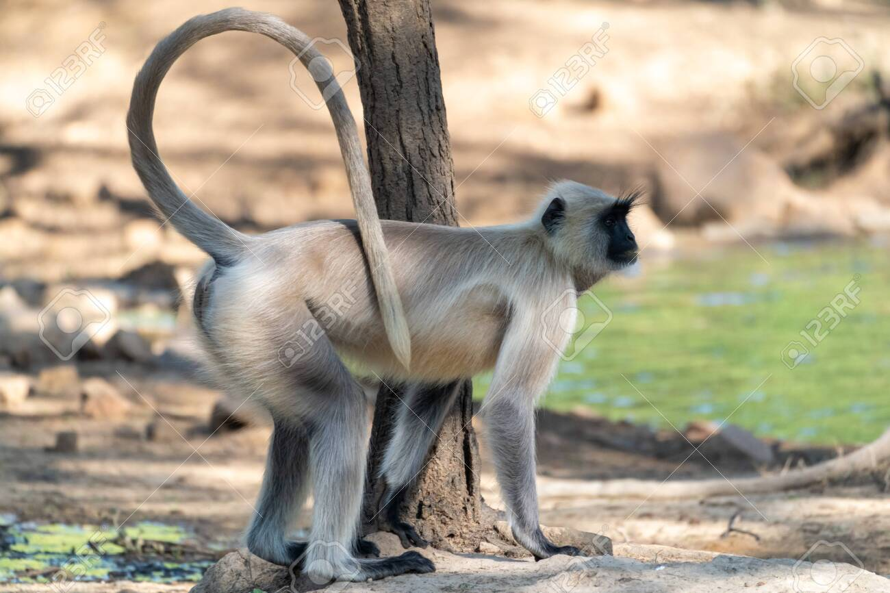
Animal models used in experiments
Guinea Pig
Daphnia, Bivalves, Prawns, Lobster, Crabs, Fishes
Guinea pigs
Rats
Monkeys
Rabbits
Bats

Slide 69
Alternative Methods in Toxicology
In vitro tests- outside the body of animals
Cells and tissue cultures
Mathematical Models.
Bioinformatics
Twenty first century Toxicology

Slide 70
Thank You

