Slide 1

Welcome Back to Class

Slide 2
Financial Markets and Stock Markets
Akash Deshmukh

Slide 3
Financial Markets
Financial markets, from the name itself, are a type of marketplace that provides an avenue for the sale and purchase of assets such as bonds, stocks, foreign exchange, and derivatives. Often, they are called by different names, including “Wall Street” and “capital market,” but all of them still mean one and the same thing. Simply put, businesses and investors can go to financial markets to raise money to grow their business and to make more money, respectively.
To state it more clearly, let us imagine a bank where an individual maintains a savings account. The bank can use their money and the money of other depositors to loan to other individuals and organizations and charge an interest fee.
The depositors themselves also earn and see their money grow through the interest that is paid to it. Therefore, the bank serves as a financial market that benefits both the depositors and the debtors.

Slide 4
Role of Financial Markets
Investors
(Firms, Financial Institutions,Individual Investors, etc.)
(Surplus Units)
Income > Consumption
Financial Intermediaries
Units Needing Capital
(Firms, Government Individuals etc.)
(Deficit Units)
Income > Savings
SAVINGS
Return On Capital Investment

Slide 5
Functions of the Markets
The role of financial markets in the success and strength of an economy cannot be underestimated. Here are four important functions of financial markets:
1. Puts savings into more productive use
2. Determines the price of securities
3. Makes financial assets liquid
4. Lowers the cost of transactions

Slide 6
Types of Financial Markets
There are so many financial markets, and every country is home to at least one, although they vary in size. Some are small while some others are internationally known, such as the New York Stock Exchange (NYSE) that trades trillions of dollars on a daily basis. Here are some types of financial markets.
1. Stock market
2. Bond market
3. Commodities market
4. Derivatives market

Slide 7
Importance of Financial Markets
There are many things that financial markets make possible, including the following:
Financial markets provide a place where participants like investors and debtors, regardless of their size, will receive fair and proper treatment.
They provide individuals, companies, and government organizations with access to capital.
Financial markets help lower the unemployment rate because of the many job opportunities it offers

Slide 8
Financial Markets: Segments and Financing Options
Financial Markets
Capital Market
International
Domestic
ADRs
GDRs
Euro Issue
Primary Markets
Secondary Markets
IPO
Term Loans
Venture Capital
Project Finance
Leasing
Investment Banking
Equity Shares
Debentures
Preferred Stock
Hybrids
Money Market
Lines of Credit
Commercial Papers
Factoring
Working Capital Loans

Slide 9
Stock Market
The stock market is a place where the shares of companies that are publicly owned can be bought and sold either OTC (Over-The-Counter) or through centralized exchanges. The equity market, as it is also known by, has established itself as a free-market economy, in that it offers companies the ability to access capital in exchange for offering interested outside parties a portion in the ownership of the company.

Slide 10
Stock Market
The stock market or equity market offers opportunity to investors to increase their income without the high risk of entering into their own businesses with high overheads and startup costs. On the other hand, selling of stocks did help the companies themselves expand exponentially. When you purchase a company’s shares it is generally associated with the increased in the company’s worth. Therefore, trading on the stock or equity markets can be a win-win for both investor and owner.

Slide 11
Stock Market
There is a negative risk however small or large depending on the amount of stock bought, that one can lose money in a trading environment. If the stocks traders hold from the company lose value, then so does the trader. If he decides to sell his stocks when the value is lower, he will sell at a loss.

Slide 12
Main Stock Exchanges
Local Stock Exchange | Region | Public Listing
New York Stock Exchange | New York, United States of America | Dow Jones Industrial Average, S&P 500
NASDAQ | New York, United States of America | Nasdaq
London Stock Exchange | London, England | FTSE 100 Index, FTSE 250 Index, FTSE 350 Index, FTSE SmallCap Index, FTSE All-Share Index
Borsa Italiana | Milan, Italy | FTSE MIB, FTSE Italia All-Share, FTSE Italia Mid Cap, FTSE Italia Small Cap, FTSE AIM Italia
Japan Exchange Group | Tokyo, Japan | Nikkei 225
Hong Kong | Central, Hong Kong | Hang Seng Index
Frankfurt Exchange | Frankfurt, Hesse, Germany | DAX, DAXplus, CDAX, DivDAX, LDAX EuroStoxx 50, MDAX
Shanghai stock exchange | Shanghai, China | SSE 50 Index, SSE 180 Index, SSE 380 Index, SSE Composite Index
Euronext | Amsterdam, Netherlands | CAC 40, PSI 20

Slide 13
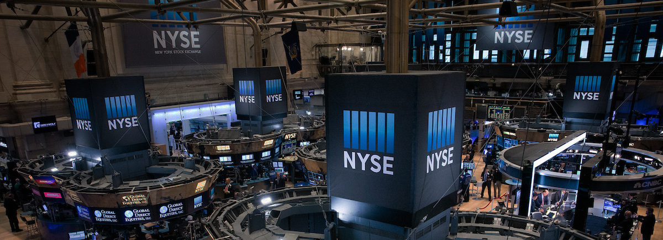
New York Stock Exchange (NYSE)
It was established on May 17, 1792 in New York. USA.
It consists of 2,400 listed companies.
It is the world’s largest stock exchange and has a market capitalization of US$ 30.1 trillion.
Back to the back of mergers has aided the New York Stock Exchange to gain its colossal size and global footprint.
The blue-chip companies which are listed under NYSE are :
Berkshire Hathaway Inc,
Coca-Cola,
Walt Disney Company,
McDonald’s Corporation, etc.

Slide 14
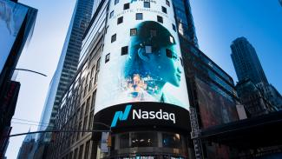
National Association of Securities Dealers Automated Quotations (NASDAQ)
It was established on February 8, 1771 in New York. USA.
It is sighted as the world’s first electronically traded stock market.
It has a combined market capitalization of $10.8 trillion.
It consists of more than 3,000 stocks listed under it and comprises of the world’s humongous tech giants such as Apple, Microsoft, Google, Facebook, Amazon, Tesla, and Intel.

Slide 15
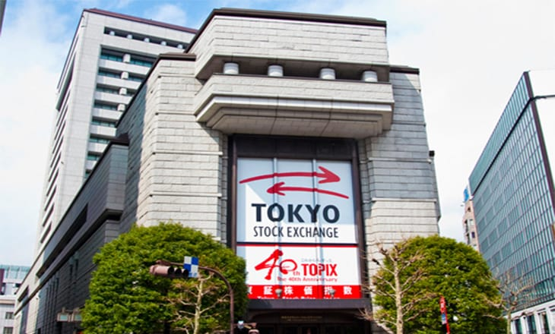
Tokyo Stock Exchange (TSE)
The Tokyo Stock Exchange (TSE) which is also known as Tōshō is located in Tokyo, Japan.
It was validated on May 15, 1878.
TSE has close to 3,500 listed companies with a syndicated market capitalization surpassing the US$ 5.67 trillion.
The TSE’s metric indicator is Nikkei 225 and it is home to some of the voluminous Japanese giants with international exposure, including Toyota, Suzuki, Honda, and Mitsubishi and Sony.

Slide 16
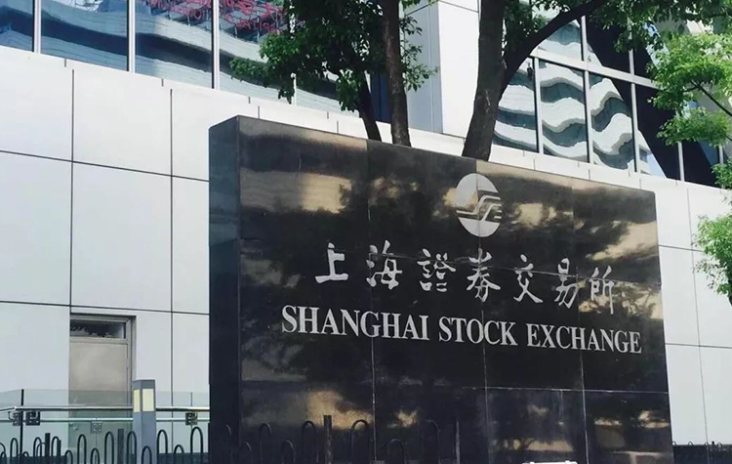
Shanghai Stock Exchange (SSE)
The Shanghai Stock Exchange (SSE) is located in the city of Shanghai, China.
Although its foundation traces back to 1866, it was adjourned after the Chinese Revolution in 1949. However, The Shanghai Exchange in its contemporary outlook was laid down in 1990.
Currently, Shanghai SSE is the world’s fourth-largest stock exchange with a combined market capitalization f US$ 5.01 trillion.
The most interesting fact is that the absolute market cap of the SSE is constructed out of formerly state-run insurance companies & commercial banks.

Slide 17
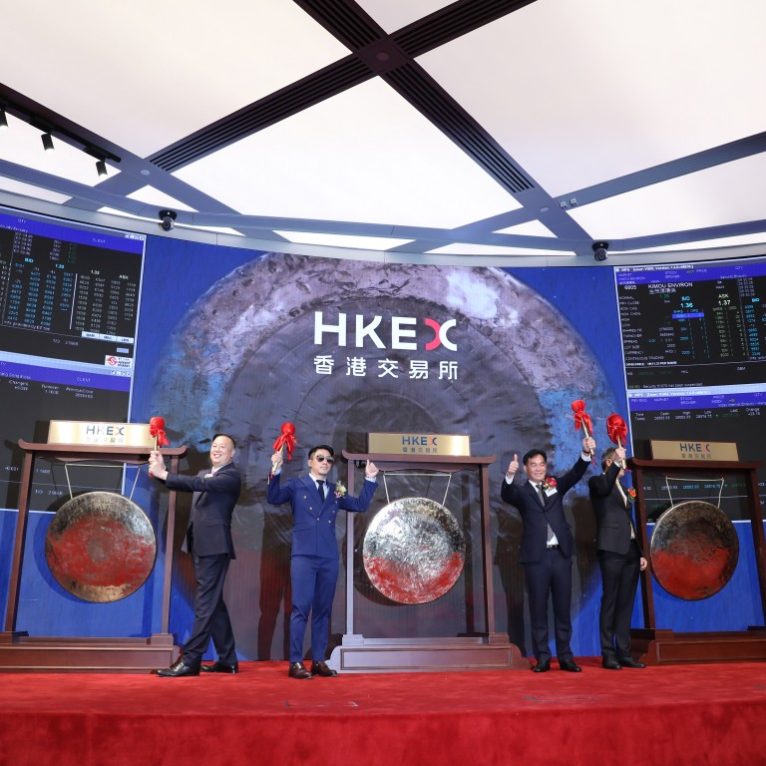
Hong Kong Stock Exchange (SEHK)
The Hong Kong Stock Exchange (SEHK) is located in Hong Kong.
It consists of 2,315 listed companies with a wholesome market capitalization of HK$29.9 trillion.
Its origin can be traced back to the mid-1800s and since then it has gone through a series of mergers and agglomeration with other exchanges.
Some of the gigantic and eminent companies listed under the Hong Kong Stock Exchange are China Mobile, and HSBC Holdings & Petro China.

Slide 18
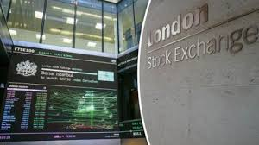
London Stock Exchange (LSE)
The London Stock Exchange (LSE) is based in London.
It was established in 1571 and is the oldest stock exchange in the world.
It has more than 3,000 listed companies with a combined market capitalization of $4.59 trillion.
LSE is also the maiden source of benchmark prices, equity-market liquidity and market data in Europe.
Some of the massive companies listed under the LSE are Barclays, British Petroleum and GlaxoSmithKline.

Slide 19
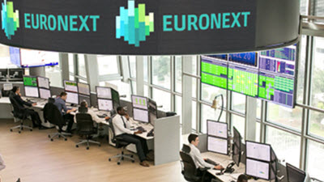
EURONEXT
The Word EURONEXT is an acronym for European New Exchange Technology and has its corporate address at La Défense in Greater Paris.
EURONEXT was established in 2000 by the consolidation of the exchanges in Amsterdam, Paris, and Brussels.
Over the years, it amalgamated with multiple exchanges, most particularly the New York Stock Exchange. It steers financial markets in Amsterdam, London, Brussels, Lisbon, Oslo, Dublin, and Paris.
It has around 1,500 listed companies leading to a market capitalization worth €4.1 trillion.
EURONEXT provided the segments which are equities, warrants, exchange-traded, bonds, commodities, funds and certificates, derivatives, indices, and foreign exchange trading platforms.

Slide 20
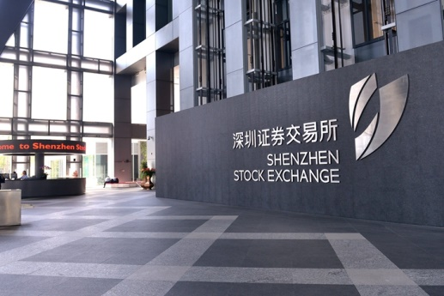
Shenzhen Stock Exchange (SZSE)
The Shenzhen Stock Exchange (SZSE) is oriented in the city of Shenzhen, China and was founded on December 1, 1990.
It has approximately 1,300 listed companies with a combined market capitalization of $3.92 trillion.
Most of the companies under this SZSE are corporate firms of companies in which the Government Of China has a controlling interest. The Shenzhen Stock Exchange had introduced the “ChiNext Board” in 2009 comprising of high-tech & high-growth startups, quite similar to NASDAQ.

Slide 21
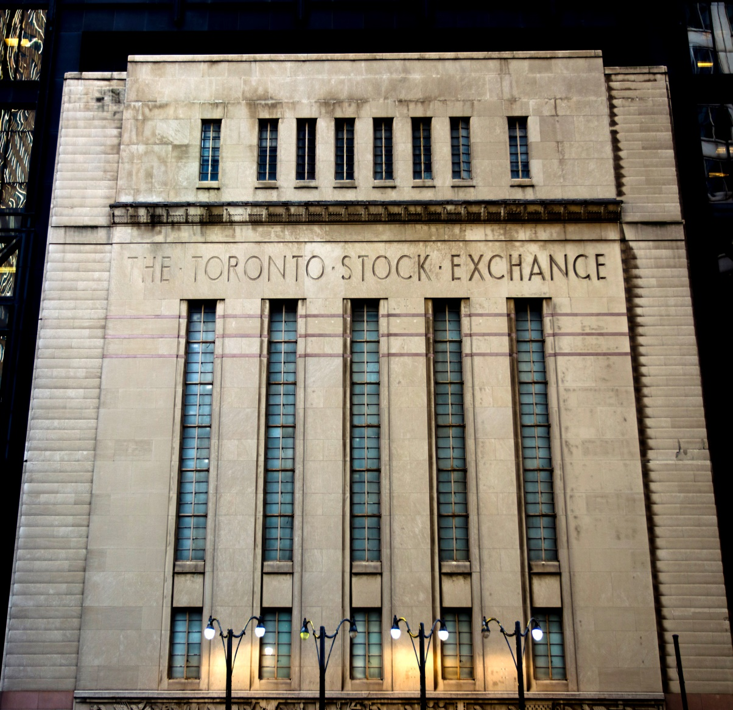
Toronto Stock Exchange (TSX)
The Toronto Stock Exchange (TSX) is situated in Toronto, Canada.
It was introduced in 1852 and is held and wielded as a subsidiary of the TMX Group. It has 2,207 listed companies with a combined market capitalization of $2.3 trillion.
The financial instruments include equities, investment trusts, exchange-traded funds, bonds, commodities, futures, options, and other products.
It is also to be noted that mining and oil and gas companies are listed in more numbers under the Toronto Stock Exchange compared to other stock exchanges around the world.

Slide 22
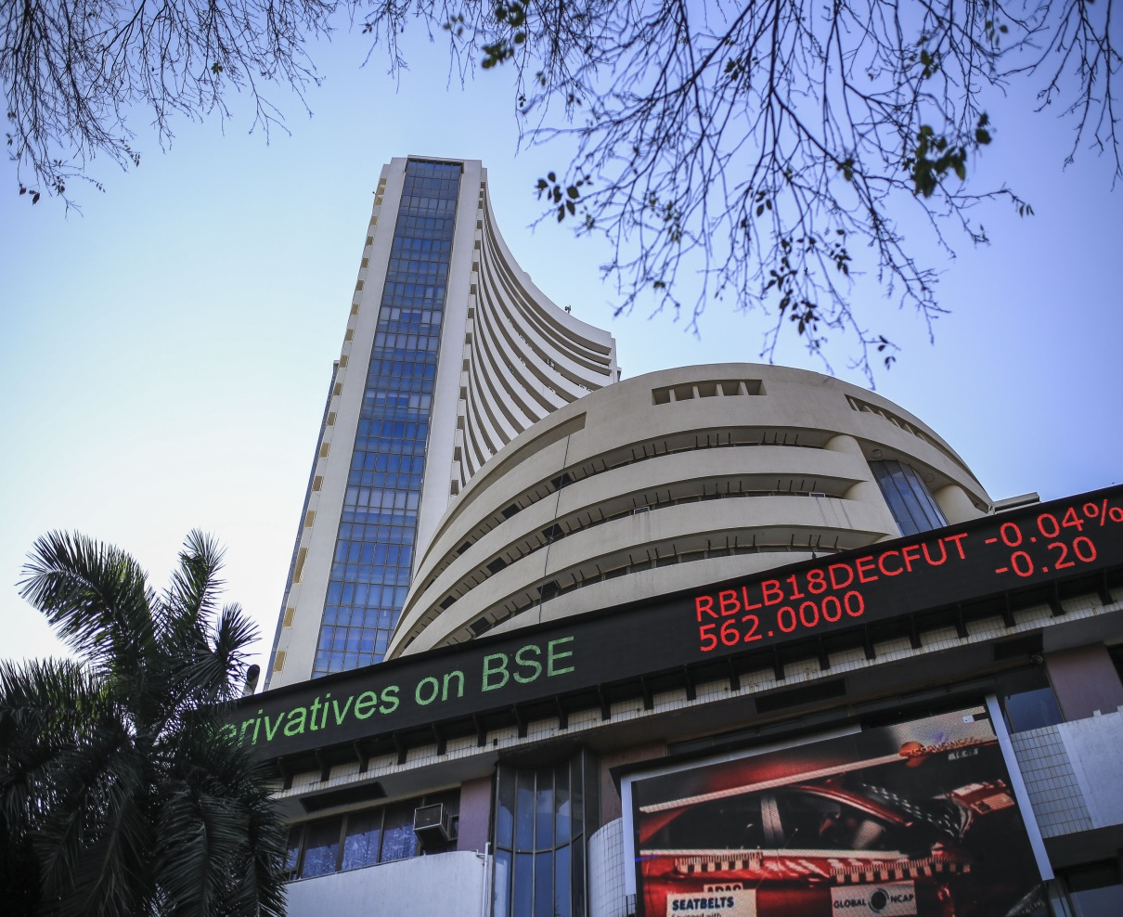
Bombay Stock Exchange (BSE)
The Bombay Stock Exchange (BSE) is an Indian stock exchange located at the high-wheeled Dalal Street in Mumbai.
It was established in 1875 and is Asia’s first-ever stock exchange.
A total market capitalization of more than $2.2 trillion.
The BSE has approximately 5,000 listed companies and has assisted in the growth of the country’s corporate sector and financial markets.
Securities listed under BSE comprises of stocks, futures, options, index futures, index options, and weekly options. However, the BSE’s benchmark is measured by the Sensex which nearly covers all the sectors of the Indian economy.

Slide 23

New Waves in Stock Market
Artificial Intelligence

Slide 24
Scams
A Scam is referred to as the process of obtaining money from someone by deceiving him/her. The majority of the securities market scams that took place in India eventually led to a lot of financial distress to the retail investors. They adversely affected the normal functioning of the markets and degraded the trusts of lakhs of investors on the Indian share market.

Slide 25
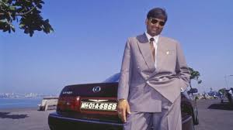
Harshad Mehta Scam
24,000 Crore valuation today
New India Assurance Company
Grow More Research
Minimum Balance of Government Bonds
ACC- Rs. 200 to Rs. 9000
Sucheta Dalal from TOI

Slide 26
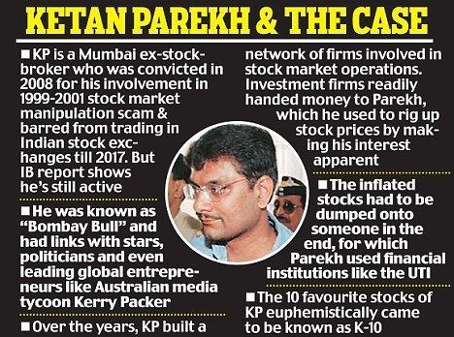
Ketan Parekh
Circular Trading – BADLA System
Pump and Dump
Pay Order of 1.3 Million from Madhavapura Mercantile Commercial Bank

Slide 27
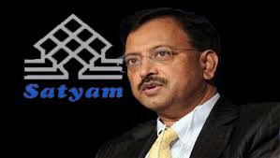
Satyam Case
India’s Biggest Accounting Fraud
Indian Version of Enron Shock
Fraud of Rs. 7,000 Crores
1987 Formation
1991 Listing in BSE, oversubscribed 17 times
Merger of Matyas
7,561 fake bills were created as identified by PWC

Slide 28
Other Honorary Mentions
Saradha Scam – Sudipta Sen-Chairman – Ponzi Scheme
National Spot Exchange Limited – Jignesh Shah and Shreekant Javalgekar– Rs. 5,600
Nirav Modi Scam – Punjab National Bank – Rs. 11,300 Crores (Latest and Largest Banking Fraud ) – Letters of Undertakings
Connection of Nirav Modi to Mehul Choksi

Slide 29

Get Ready… with Your Doubts or else ha ha ha ha…

Slide 30

Have a Great Time Ahead.

