Slide 1
Thakur College of Science & Commerce
Department of Zoology
Welcomes
Academic Year – 2020-21
(Paper – III Unit- III)
Vermiculture
Dr. Vitthal T. Mohite
Head, Department of Zoology

Slide 2
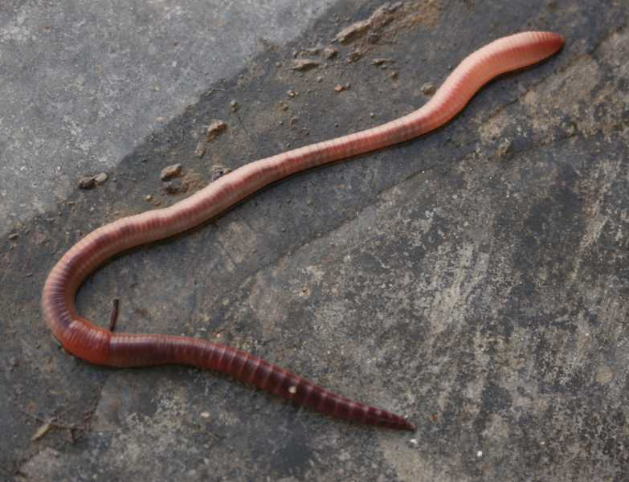
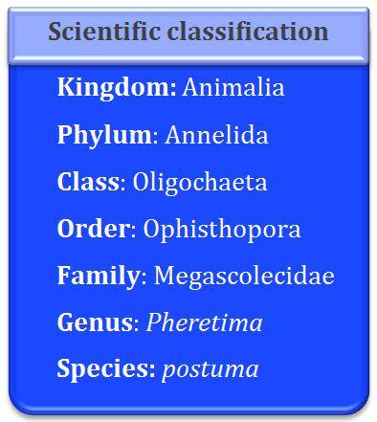
Vermiculture

Slide 3
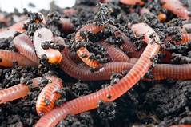
Vermiculture
Definition : process of rearing of earthworms to convert dead & decaying organic matter into natural fertilizers.
Organic food waste converts into nutrient rich material to support plant growth
Charles Darwin called them as “Farmer’s Friend”.
Biological indicators of soil fertility.
Responsible for physical & chemical changes of soil.
3000 species worldwide with five large families.
Mostly terrestrials but few are found in estuaries.

Slide 4
Types of Verms
Anecic : Burrowing worms come to surface at night drag food down to their permanent burrows deep in the soil. e.g. Lumbricus terrestris.
Endogeic : shallow soil burrowing worms, feed on organic matter present in soil. Rarely comes at surface. e. g. Allolobophora chlorotica.
Epigeic : live in surface litter & feed on decaying organic matter, do not have permanent borrow. e.g. Lumbricus rubellus.
Saprophagous: feed on dead decaying organic matter.
Detritivores: feed on plant litter, organic matter and mammalian dung near soil.
Geophagus : feed on organically rich soil beneath the soil surface.

Slide 5
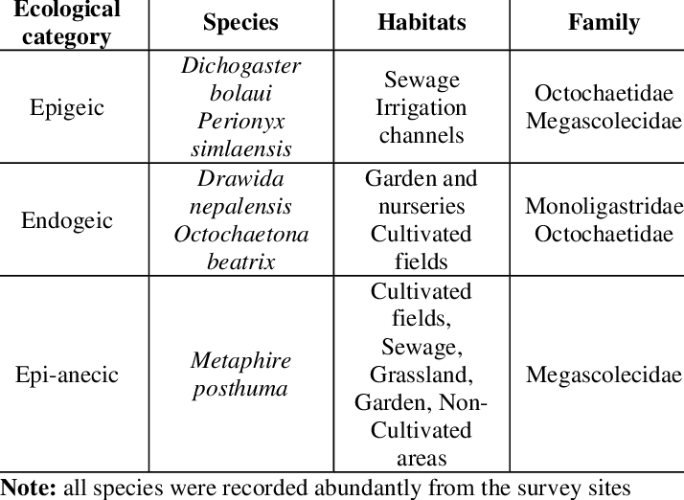
Species of Earthworm

Slide 6
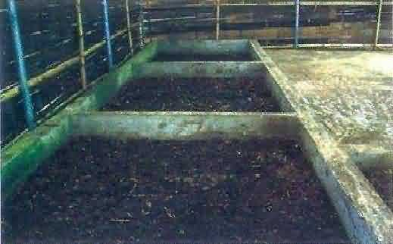
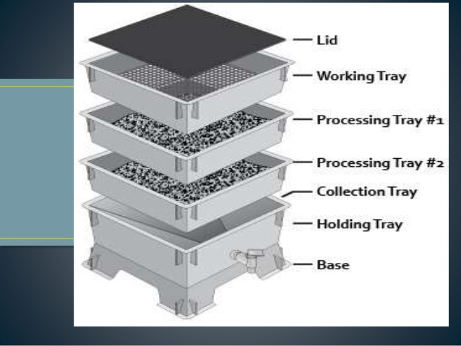
Vermiculture Requirements
Suitable species of earthworm.
Appropriate worm density.
Temperature
Moisture content.
Bedding material.
Feeding material.

Slide 7
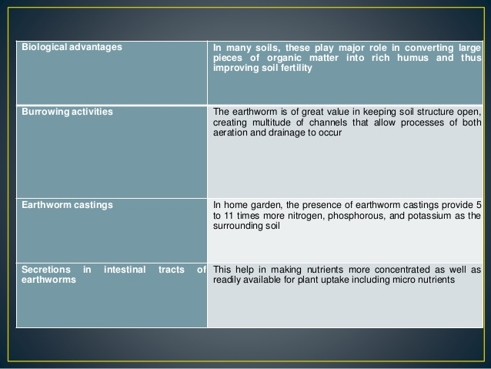

Slide 8
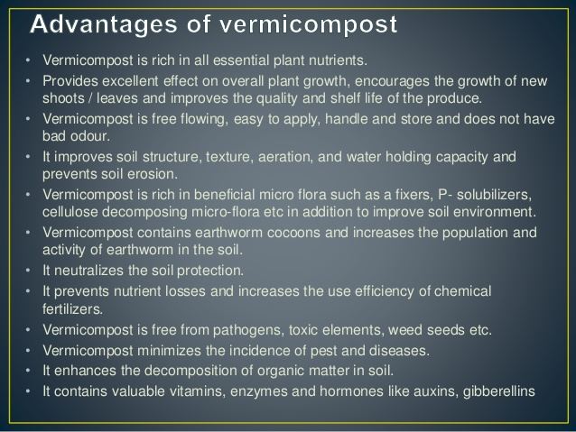

Slide 9
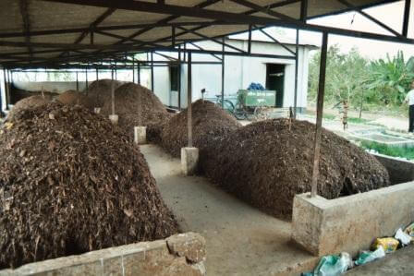
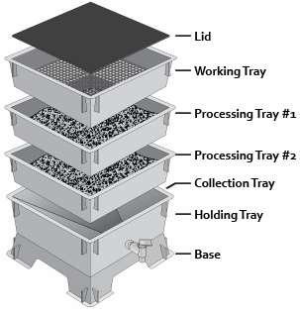
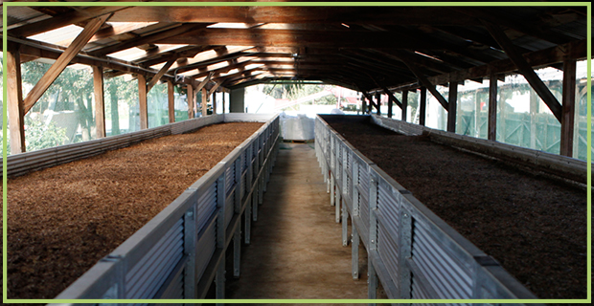
Methods used Vermiculture
1. Windrows Method
  A) Static pill windrow
  B) Top fed windrow
  C) Wedges
2. Beds or Bin Method
  A) Top fed beds
  B) Stacked bins
3. Flow through Reactor Method.
Windrow Methods
Bin Method
Flow through reactor

Slide 10
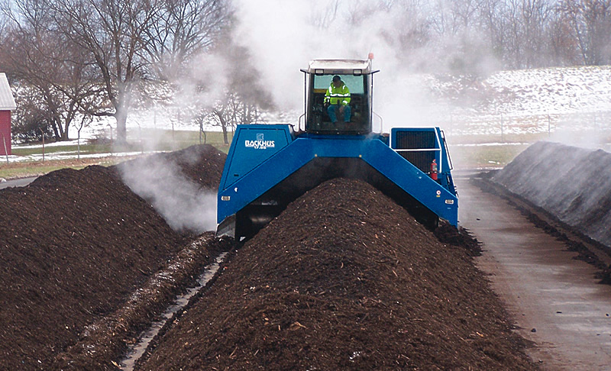
Windrows Method
Long rows of bedding .
Used to produce large volume of Vermicompost.
Three Types
a) Static pile Windrows ( Batch Method)
Bedding and food are mixed.
Only worms are added and not much care is taken.
Bed is with large quantity of hay & Silage increase porosity & increase rate of earthworm reproduction.
Poultry manure is used as feed stock with shredded fiber with ratio 1:9.
Hight of bed is up to 1 meter, 3 meter wide and 15 meters long.
Biomass is prepared within 45 – 50 weeks.

Slide 11
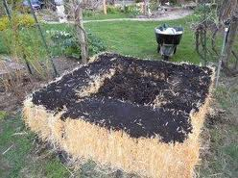
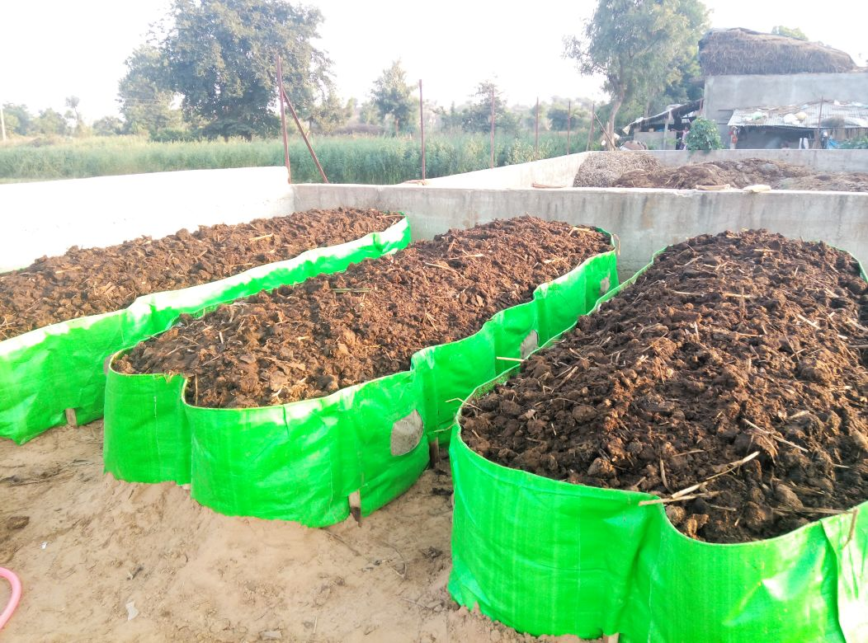
I. Windrows Method
b) Top fed Windrows ( Continuous Flow) :
Similar to static windrows, but set up as continuous flow.
Only once worms are added only once but bedding is added continuously.
Bedding is placed first then worms inoculated.
New bedding added periodically consumed by worms & manure is produced.
This method decrease the costing of the manure production.
c) Wedges ( Continuous Flow) :
Initial stock of worms in bedding is placed 3 sided not more than 3 m height.
Side of corral can be concrete, wood or even of hay or straw.
Fresh material is added on regular basis through open side by
Bucket loader.
Worms used fresh material & Vermicompost left behind.

Slide 12
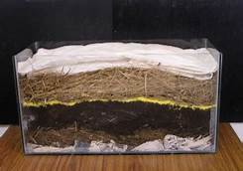
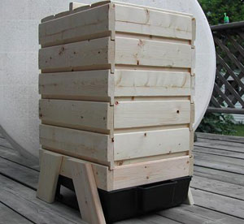
II. Beds or Bins Methods
a) Top-Fed beds ( Continuous Methods)
It works similar to top-fed windrows but difference is contained four wall and floor.
The bins are built with insulated sites.
They are large, sheltered from the wind & precipitation.
Different size of bins are made.
b) Stacked bins(Batch or continuous Flow) :
Bins are small & Lifted easily
Material is premixed, placed in bins & worms are added.
Size is predetermined & usual sine is1.2 m² with depth 30 to 45 cm.
Each bins 2.27kg of worms are added & population increase 4-5 times.
6 months required for processing.

Slide 13
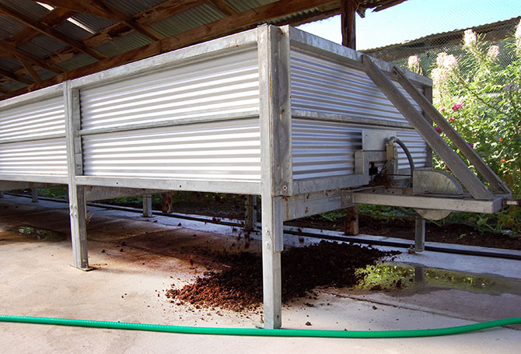
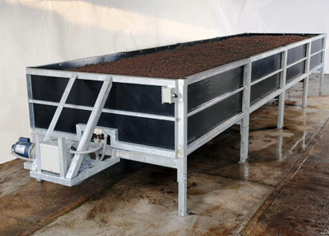
III. Flow –Through Reactor Method
Concept is developed by Dr. Clive Edward & his colleagues in England in 1980.
Worms live in raised box, usually rectangular & not more than 3 meters.
Material is added from top and product is removed from bottom.
Worms are not disturbed in the bed.
Eisenia fetida species is suitable for this.

Slide 14
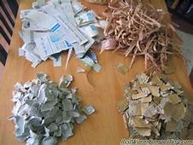
Maintenance
Bedding :
Contains biodegradable materials provides worms stable habitat.
It should be highly absorbent & retain water.
Material with good bulking potential low protein& nitrogen content.
Cardboard paper, news paper, coconut husk fibers & sawdust.
Excessive heating may become toxic.
Food scraps can be placed on the bedding.
Food buried in the bedding is easy for the worms to find.
Red worms also eat the bedding.
They convert these materials into “humus” – a dark,
organic fertilizer that is prized by gardeners.

Slide 15
Food Source
Under ideal condition earthworm consume food equivalent to its body weight each day.
Plant – dead parts of plants.
Animal origin- Cattle, poultry, sheep, goat manure
Fresh food scraps
Poultry , fish, cardboard, grains, hay, legumes.
Slaughter wastes.

Slide 16
Moisture : Earthworm breath through skin
Moisture content should be more than 50 %.
Aeration : Worms require oxygen breathing & Can’t survive anaerobically.
Poor aeration cut oxygen supply resulting death of worms.
Presence of microbes & their activities release toxic substances may kill the worms.
Temperature : 15 to 20⁰c temperature is sufficient for vermiculture.
pH : Worms survive at pH range 5-9. But pH between 7.5 to 8.0 considered optimum.
Salt content : Very sensitive for salt, prefers less than 0.5 %.
Urine content : Less urine is suggested. Excess urine produces gases like ammonia is toxic.
Toxic components: free from horse manure, detergent, chemicals, pesticides etc.
Protection from pests & Diseases : Free from microorganisms.
Ants & mites

Slide 17
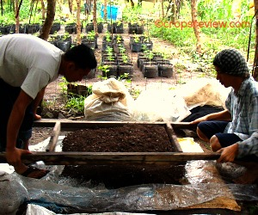
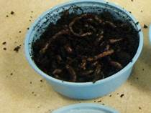
Methods of Harvesting worms
Worm harvesting carried out for selling the worms and to start new worm beds.
Replacing material with new bedding & feeding is very essential.
Worm separated, weighed and transferred in sterile pots.
1. Manual Method
2. Migration Method
3. Mechanical Method

Slide 18
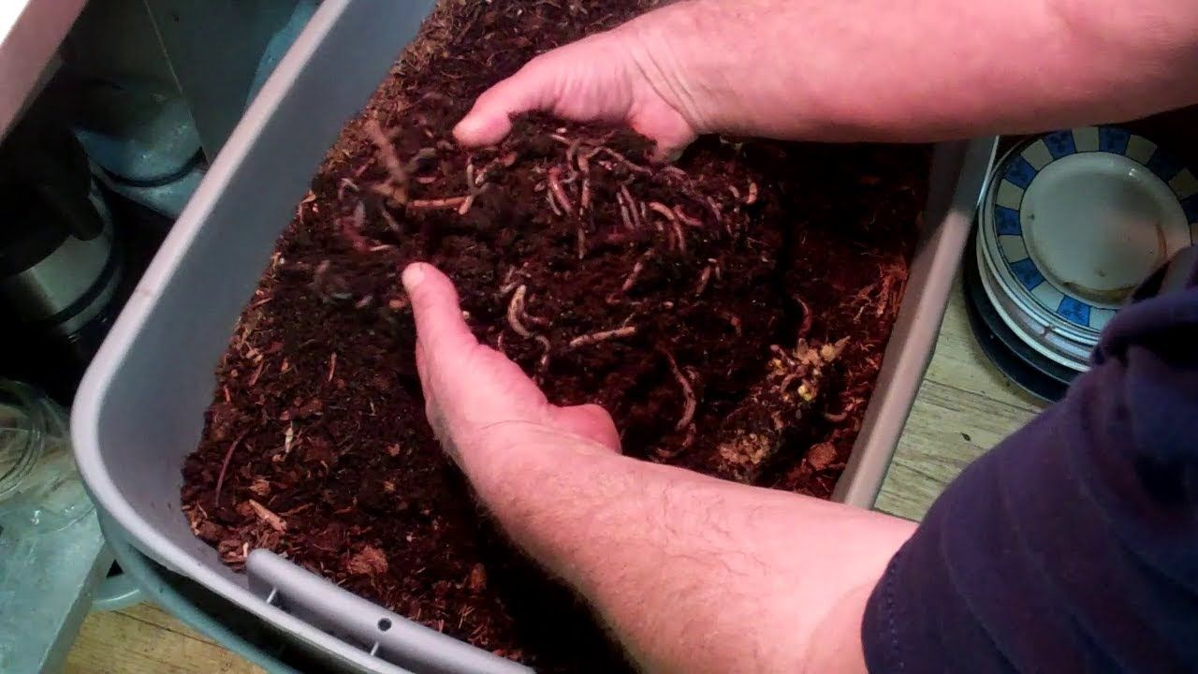
Manual Method
Small scale growers uses this method those sell worms to home.
Involves hand sorting , picking the worms & keeping in container.
Followed by weighing & preparation for delivery.

Slide 19
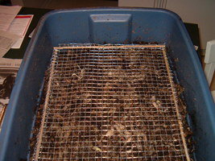
Migration Method
Worm has tendency to migrate new region for food and avoid dryness , light.
1) The Screen Method:
Very convenient & easy to use.
Box is constructed with screen bottom, mesh is with ¼ inch n size is used.
Earthworms are forced downwards by strong light.
Due to this worms go down through screen prepared , preweighed container.
Once worms gone down compost is removed.
Worm harvester can move from one box to another.
2) Upward migration :
Is similar to Screen method but mesh is kept on the bed.
Food attractant to worms like chicken mass, fresh cattle manure, ground coffee are put on it.
Worms move in upward direction & beds are not disturbed.

Slide 20
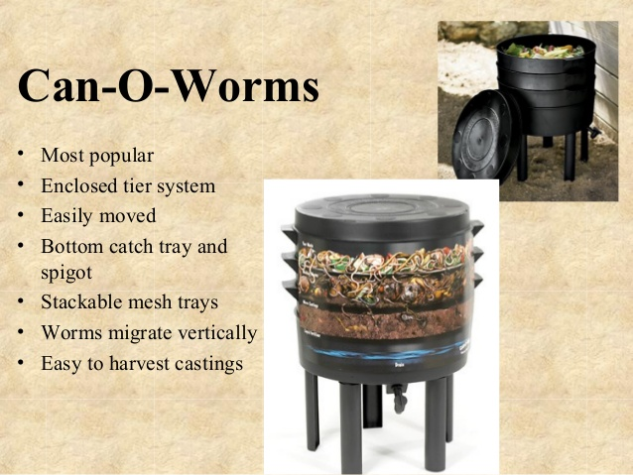

Slide 21
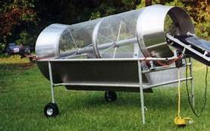
Mechanical Method
Most rapid & Easiest method, described by Boganov in 1996.
Mechanical harvester is used is rotating cylinder of 8-10 feet in length 2-3 foot in diameter.
Cylinder wall is made up of screen material of different mesh sizes.
Cylinder rotates by electric motor.
As cylinder rotates worms passes through lower end in to wheel barrow.
This method is useful for harvesting earthworms in large number.

Slide 22
Economic Importance
Play role of decomposer & help recycling of nutrients by improving soil fertility.
Enrich nutrient in soil, retain moisture, improves soil structure.
Increase suitable microbial activity for agriculture.
Forms manure with N,P,K & Mg as compare to conventional compost.
Advantages :
Does not require expensive equipment.
Ecofriendly socially come economically viable technology.
Eliminate use of chemical fertilizers.
Microbes in vermicompost transferring nutrients in forms readily taken up by plants.
It improves crop plant production by enhancing growth rate of plants.
Used to convert Municipal & Industrial solid organic wastes in to organic fertilizers.

Slide 23
Demand of earthworms
Worms have potential to generate NPK equal about 10-12 million tons in India.
1200 tons of organic wastes convert into 350 tone of vermicompost.
Large number Municipal corporation set up vermicompost plants.
Earthworms also used as fish bait.
Worms can be used as fish feed.
Due to high protein content in body can be used in pig & poultry feed.
Used in medicine ( Unani Medicine) on Small pox, jaundice, wounds healing, boils, piles, sore throat.

Slide 24
Marketing of Vermicompost
Flourishing industry due to increase in awareness of organic farming.
Cost Rs. 3000 to Rs. 6000 per ton of compost.
Retail market Rs. 20 to Rs. 50 per kg.
Metro cities can be sold for kitchen gardens.
Entrepreneurship.

Slide 25
Thank You

