Slide 1
The Public Sphere and Internet

Slide 2
The “public sphere” is generally conceived as the social space in which different opinions are expressed, problems of general concern are discussed, and collective solutions are developed communicatively.

Slide 3
Jurgen Habermas defined the public sphere as a virtual or imaginary community which does not necessarily exist in any identifiable space.
In its ideal form, the public sphere is "made up of private people gathered together as a public and articulating the needs of society with the state"

Slide 4
Public Space
access to public debate is free and open to everybody,
• all participants in public debate are considered as equal,
• no subjects and topics are excluded from the debate,
• the result of public deliberation is judged only on the basis of best arguments,
• the aim of the debate is consensus and unanimity

Slide 5
Access and Interaction given by internet
More and more people are turning to internet- reasons
Cost effective-free
Anywhere – Anytime
Voice to voiceless

Slide 6
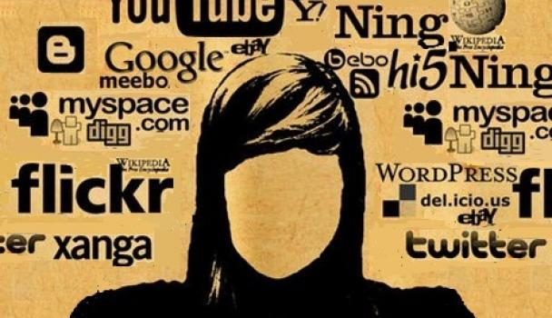
Pervasive media in our lives – the media saturated environment

Slide 7
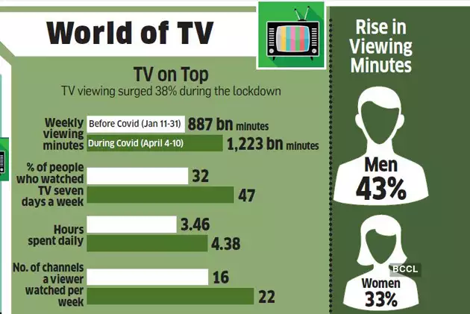
Effects of mass media?
Two views:
1) Non literate peoples have benefited as television and radio make for a more democratic flow of information- John Fiske
2) Those who control television and radio gained more control over society by duping consumers who consume their produced images.

Slide 8
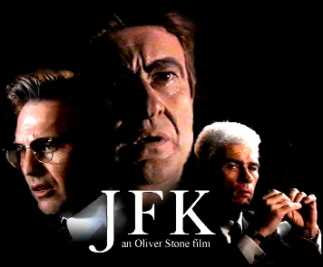
Media operate in the context of other media and we are aware that they are not neutral in conveying messages.
In terms of information… a documentary on the JFK assassination is very different from Oliver Stone’s JFK, which we may know is staged, but still may influence our perception of the historical event.
The way we rank media is based on where that media stands in relation to older and new media - and whether they are primarily oriented toward entertainment, news or information.
For example, news on the internet has come to be associated with speed of transmission and a global scope.

Slide 9

Media, both news and fiction, facilitate the social sphere for public debate and action.
We are also aware that the broadcast media pitch their shows to viewers with buying power. Middle class youth 13-26 are sought after…
Thus we are influenced -and we influence - broadcast media in the ways we use it.

Slide 10
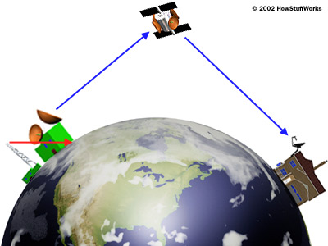
The computer and Web allow anyone to become and author/producer, thus giving rise to international subcultures.
Satellite technology gave rise to global communications and the end of narrowcasting for some 20 years, until community television rose again in the form of “minority” networks appealing to narrow demographics/cultures, especially through cable television.
There is no longer a single mass audience, but perhaps multiple audiences who are the products of narrowcasting.

Slide 11
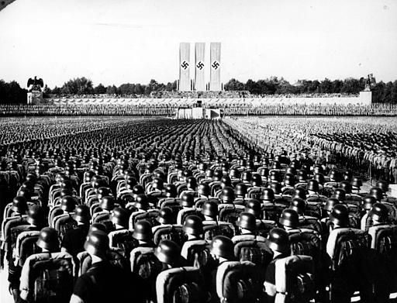
Critics argue that the new electronic technologies are powerful new tools for mass persuasion (or propaganda) allowing for political oppression and control.
Viewers, they fear, are gullible recipients of media messages.
This chapter discussed one of the primary examples of modern propaganda, Leni Reifenstahl’s Triumph of the Will, a documentary account of a Hitler rally in Sept 1934.
The point is that this film encourages overt nationalism and idolatry of a political leader.
This film, along with the Nazi’s introduction of television as something to be viewed collectively in public spaces, helped forge a collective ideology.
The collective practice of looking was a major tool in Josef Goebbels’ propaganda ministry in Hitler’s Germany.

Slide 12

Guy Debord understood the effects of collective practices of looking.
His group Situationist International, noted how the social order of the late 20th c global economy exerts influence through representations.
Thus, the spectacle, ie, the image and the practice of gazing as central, becomes the instrument of unification.
The Situationists, or Situs, were the first revolutionary group to analyse capitalism in its current consumerist form.

Slide 13
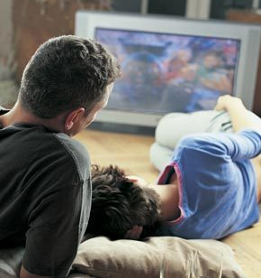
A spin-off of this was the realization that TV was a narcotic that was, by unifying and consolidating masses under a single political belief, was replacing actual participation in organized politics, hence leading to more and more disaffection.

Slide 14

The Frankfurt School (Max Horkheimer, Theodor Adorno, Walter Benjamin, Herbert Marcuse) criticized post WW2 capitalist and consumerist orientation of popular media forms.
The culture industry creates and caters to a mass public that cannot distinguish between reality and illusion.
They found the culture industry generates a false consciousness, encouraging consumers to buy into the belief system that allows capitalism to thrive. (They were strongly influenced as victims of the rise of Nazi Germany in the 30s)

Slide 15
Media and the Public Sphere
Viewers often experience interpellation, ie they see themselves as members of a national audience.
This is a reflection of what Jurgen Habermas called ‘the public sphere’ which in the 19th century was a physical place where middle class men assembled to discuss matters of public interest, but in the late 20th c this sphere is truly public, involving women, minorities, the poor, etc. and involves many media.
Is this a single public or a multiplicity of publics?
TV helps create the idea of a national culture even though it moves images around the planet. The tv talk show has gained inordinate power in influencing public debate.
Authors fail to mention that the level of debate and discussion tend toward the lowest common denominator, not to the educated mind. This is often referred to as “the dumbing down of the American mind”

