Slide 1
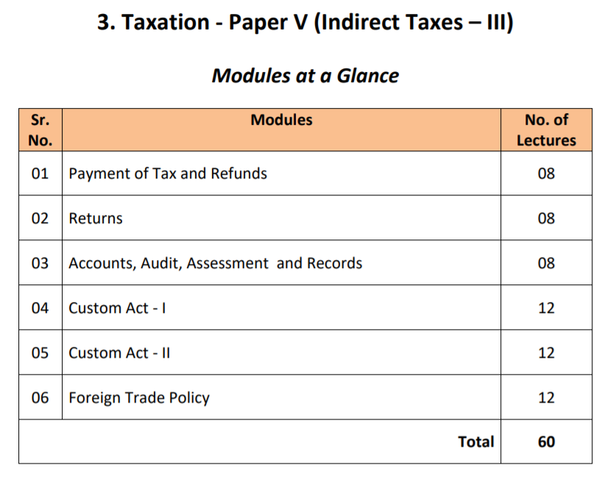

Slide 2

UNIT 1
Payment of Tax & Refunds

Slide 3
INTRODUCTION
We have studied the basic fundamentals of GST in the previous semester.
This semester we will be taking a look at the practical compliance of GST.
In this chapter we will be discussing the Payments of GST and its Refund.

Slide 4
CONCEPTS TO BE COVERED
The relevant concepts relating to payment and refunds
Ledgers to be maintained by the Taxable person
Utilization of the Input Tax Credit
Discharge of the liability of the taxable person
Situations where penalty / interest is to be charged
Transfer of ITC between Centre and State

Slide 5
PAYMENTS TO BE MADE UNDER GST
The following payments are to be made under GST –
CGST and SGST/UTGST (Intra State Supply)
IGST (Inter State Supply)
Tax Deducted at Source (TDS)
Tax Collected at Source (TCS)
Interest, Penalty, Fees or any other payments

Slide 6
DEFINITIONS

Slide 7
PERSON
“Person” includes –
Individual
Hindu Undivided Family (HUF)
Company
Firm or Limited Liability Partnership (LLP)
Association of Persons (AOP) & Body of Individuals (BOI)
Co-operative society
Local Authority
Central or State Government

Slide 8
AUTHORISED BANK
“Authorised Bank” shall mean a bank or a branch of a bank authorised by the Government to collect the tax or any other amount payable under this Act [Section 2(14)]

Slide 9
AGENT
“Agent” means a person, including a factor, broker, commission agent, arhatia, del credere agent, an auctioneer or any other mercantile agent by whatever name called, who carries on the business of supply or receipt of Goods or Services or Both on behalf of another. [Section 2(5)]

Slide 10
COMMON PORTAL
“Common Portal” means a Common GST electronic portal referred to in section 146. [Section 2(26)]
“www.gst.gov.in” is the Government’s official GST website / portal

Slide 11
TAXABLE PERSON
“Taxable Person” means a person, means a person who is registered or liable to be registered under Section 22 or Section 24. [Section 2(107)]
VALID RETURN
“Valid Return” means a return furnished under sub-section (1) of section 39 on which self assessed tax has been paid in full [Section 2(117)]

Slide 12
OUTPUT TAX
“Output Tax” in relation to a taxable person, means the tax chargeable under this Act on taxable supply of goods or services or both made by him or by his agent but excludes tax payable by him on reverse charge basis [Section 2(82)]

Slide 13
INPUT TAX
“Input Tax” in relation to a registered person, means the Central Tax, State Tax, Integrated Tax or Union Territory Tax charged on any supply of goods or services or both made to him.
“Input Tax Credit” means the credit of Input Tax which can be claimed by the Taxable Person.

Slide 14
ELECTRONIC LIABILITY LEDGER
Electronic Liability Ledger shall be maintained in Form GST PMT-01.
This ledger will reflect the Total tax liability of a taxpayer.
Amounts payable for tax, interests, penalty, fees, etc. are debited in this ledger.
Dues relating to the previous year are paid before the current year.

Slide 15
ELECTRONIC CREDIT LEDGER
Electronic Credit Ledger shall be maintained in Form GST PMT-02.
The Credit available under this ledger is used only for payment of Tax.
ITC cannot be used for nullifying any tax under Reverse Charge Mechanism (RCM)
The rules relating to ITC need to be followed.

Slide 16
ELECTRONIC CASH LEDGER
Electronic Cash Ledger contains a summary of all deposits/payments by a taxpayer.
A person liable has to maintain the electronic cash ledger on the GST portal.
Payments in the Cash Ledger can be done through Internet Banking, Credit / Debit Cards, NEFT / RTGS or Over the Counter (OTC)
OTC payment however has a limit of Rs. 10,000/- per transaction or challan.

Slide 17
FORMS FOR ELECTRONIC CASH LEDGER
GST PMT-05 – Basic form for maintaining the Electronic Cash Ledger
GST PMT-06 – Form for generation of Challan
GST PMT-07 – Form to communicate when the CIN is not generated.
GST PMT-04 – Communicate any discrepancy in the Electronic Cash Ledger

Slide 18
CHALLANS
CPIN – Common Portal Identification number. Created for every Challan successfully generated. 14 digit unique number which remains valid for 15 days.
CIN – Challan Identification number. Generated by banks once payment is successful. It is a 17 digit number (14 digit CPIN + 3 digit Bank Code)
BRN – Bank Reference Number. Transaction number given by the bank for a payment against challan.
E-FPB – Electronic Focal Point Branch. These are branches of authorised banks which are authorised to collect payment of GST.

Slide 19
ORDER OF SET-OFF (Sec. 49A)
Sec. 49A is inserted from 1st February, 2019 which talks about Order of Set-off
This section states that the ITC for IGST has to be utilized fully before other
The preferences (order) of the ITC remains unchanged which was under Sec. 49(5)

Slide 20
INTEREST (Sec. 50)
Interest needs to be paid for 2 reasons –
Failing to pay tax in the prescribed time limits
Undue or excess claim of ITC or any reduction to the output tax liability
As far as (1) mentioned above, maximum rate of interest is 18%
As far as (2) mentioned above, maximum rate of interest is 24%
The interest will be payable for the number of days it is unpaid

Slide 21
T.D.S (Section 51)
TDS is Tax deducted at source
TDS is where the recipient deducts a percentage of tax at the point of payment
TDS needs to be collected by –
A department or establishment of Central, State Govt. or Local Authority
Governmental Agencies
Any person notified by the Central Government or the GST council

Slide 22
T.D.S Requirements
The amount of supply should exceed Rs. 2,50,000/- in a single contract.
TDS should be @ 2% (CGST + SGST or IGST)of the supply price excluding tax.
Such TDS should be paid within 10 days from the end of month.
A certificate is given by the deductor to the deductee within 5 days.
The deductee can claim the credit of this TDS in his Electronic Cash Ledger.

Slide 23
NO T.D.S
No TDS will be charged in the following cases –
PSU is contracting with a PSU
Where the location of the supplier and the place of supply is in the same state or UT (Intra-state) but the location of the recipient is in some different state or union territory

Slide 24
REFUND (Sec. 54)
GST refund can be claimed when the GST paid is more than the GST liability
Refund of any balance in the Electronic Cash Ledger can be claimed as refund
Such refund has to be claimed within 2 years of filing.

Slide 25
CIRCUMSTANCES TO CLAIM REFUND
Refund of any balance in Electronic Cash Ledger can be claimed
Refund of tax paid by agencies like UNO, consulates etc. on inward supplies
Unutilized balance of ITC can be claimed as refund at the end of tax period
Excess payment of taxes
Documents like Copy of proof of deposit, invoices, etc. need to be attached while filing for refund if the amount exceeds Rs. 2,00,000/-

