Slide 1
Tools of Economic Analysis

Slide 2
Economic theories are formulated to explain different phenomenon. While formulating theories a number of tools are used by experts in this field. The tools of economic analysis are found in the realm of Mathematics.

Slide 3
VARIABLES
A variable is something whose magnitude can change.
It assumes different values at different times or places.
Variables that are used in economics are income, expenditure, saving, interest, profit, investment, consumption, imports, exports, cost and so on.
It is represented by a symbol.

Slide 4
Variables can be endogenous and exogenous.
An endogenous variable is a variable that is explained within a theory. An exogenous variable influences endogenous variables, but the exogenous variable itself is determined by factors outside the theory.

Slide 5
CETERIS PARIBUS
Ceteris paribus is a Latin phrase meanings, “all other things remaining the same” or all relevant factors being equal.
In Economics the term “Ceteris Paribus” is used quite often to assume all other factors to remain the same, while analyzing the relationship between any two variables.
The assumption of Ceteris Paribus thus eliminates the influence of other factors which may get in the way of establishing a scientific statement regarding the behavior of economic variables.
Without the assumption we cannot reach on economic relations, sequences and conclusions.

Slide 6
FUNCTION
A 'function' explains the relationship between two or more economic variables.
A simple technical term is used to analyze and symbolizes a relationship between variables.
It indicates how the value of dependent variable depends on the value of independent or other variables.
It also explains how the value of one variable can be found by specifying the value of other variable.

Slide 7
For instance, demand for a good depends upon its price. It is expressed as -
D = f (P)
Where D = Demand, P = Price and f = Functional relationship.
Functions are classifieds into two types namely explicit function and implicit function.
Explicit function is one in which the independent variables are expressed explicitly, whereas in implicit function they are not expressesd explicitly.
Ex. Y = x2 + 1 (Explicit)
x2 + y2 – 1 = 0 (Implicit)

Slide 8
EQUATIONS
Economic theory is a verbal expression of the functional relationships between economic variables.
When the verbal expressions are transformed into algebraic form we get Equations.
The term equation is a statement of equality of two expressions or variables. The two expressions of an equation are called the sides of the equation.
Equations are used to calculate the value of an unknown variable. An equation specifies the relationship between the dependent and independent variables. Each equation is a concise statement of a particular relation.

Slide 9
GRAPHS AND DIAGRAMS
A graph or a diagram presents the relationship between two or more sets of data or variables that are related to one another.
Graph is most commonly used tool in modern economics.
Graph depicts the functional relationship between two or more economic variables.
The use of graph provides a better understanding of the economic generalizations.
Graph presents a visual picture of an abstract idea. Also it is useful for accuracy and precision.

Slide 10
Graph can only be drawn as a two-dimensional figure.
It represents the values of only two variables at a time. The common method of constructing a graph or a diagram is described below:
A graph has a horizontal line termed as X axis and a vertical line termed as Y axis. The point of intersection between X and Y axis is termed as 'origin' point.
The surface is divided into four parts, each part is called a quadrant. The four quadrants are numbered in anticlockwise direction as depicts in following diagram.

Slide 11
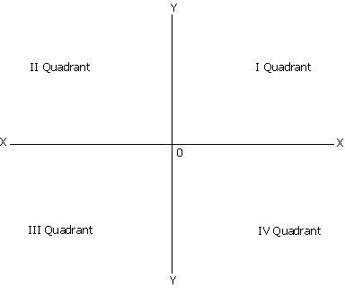

Slide 12
LINES AND CURVES
The functional relationship between the variables may be linear or non-linear.
A line or a curve is nothing but the locus of various points. A line depicts the relationship between the variables.
For example, the relationship between consumption and income as shown in the following diagram:

Slide 13
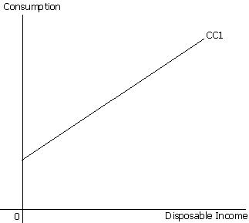
Line CC₁ is a straight line and has a positive slope. It depicts that aggregate consumption is positively related to aggregate disposable income. It explains that, an increase in disposable income will promote to an increase in consumption.

Slide 14
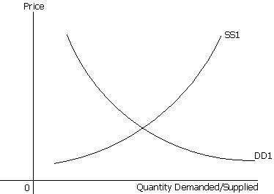
In the following diagram,DD₁ is a smooth downward sloping non-linear demand curve. It explains the relationship between quantity demanded of good X at various prices. Moreover, SS₁ is an upward sloping supply curve. It is also a non-linear curve and shows relationship between quantity supplied of good X at various prices.

Slide 15
SLOPE
Slope is an important term in modern economic analysis. The slope indicates change in one variable due to a change in other variable.
Slope is defined as the amount of change in the variable measured on the vertical or Y axis per unit change in the variable measured on the horizontal or X axis.
It is expressed as ∆Y/∆X, where delta (∆) stands for a change in the variable.
The slope of a curve is an exact numerical measure of the relationship between the change in the variable Y to change the variable X.

Slide 16
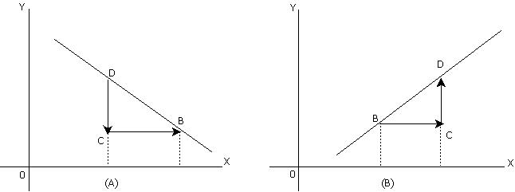
In both the diagrams (A) and (B) slope = vertical distance/horizontal distance. i. e. CD / BC. However, in diagram (A), slope is negative as the relationship between X and Y is inverse. Here units of Y decrease with increase in the units of X. In Diagram (B) the curve is slopping upwards, indicating a positive relationship between X and Y. Here units of Y increase with increase in the units of X.

Slide 17
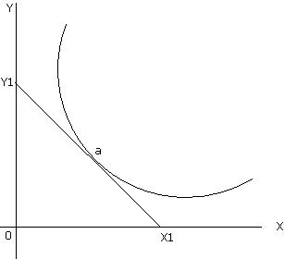
If the curve is non-linear, then its slope changes at various points. Slope on a non-linear curve is measured at a given point by drawing a tangent at the given point and is then measured as the vertical distance/horizontal distance. This is shown in the adjacent diagram with a non-linear curve.
We measure slope at point 'a' by drawing a tangent at point 'a'. Y₁X₁ is the tangent drawn at point 'a'. Slope of the curve at point 'a' is given as OY₁/OX₁

Slide 18
Forecasting
Forecasting refers to the practice of predicting what will happen in the future by taking into consideration events in the past and present.
Basically, it is a decision-making tool that helps businesses cope with the impact of the future’s uncertainty by examining historical data and trends.
It is a planning tool that enables businesses to chart their next moves and create budgets that will hopefully cover whatever uncertainties may occur.

Slide 19
Trend Analysis
Trend Analysis is a statistical tool that helps to determine future movements of a variable on the basis of its historical trends.
In simple words, it predicts future behavior on the basis of past data.
Under this method, a researcher collects information from multiple time periods and plots the information on a horizontal line to get some meaningful information.
There is no specific amount of time for a movement to become a trend. However, the longer the movement, the better it is.
In finance, trend analysis is a technique to determine the future movement of a stock. It is a part of technical analysis and predicts the stock movement on the basis of past performance.

Slide 20
Time Series Analysis
Time series analysis is a statistical technique that deals with time series data, or trend analysis. Time series data means that data is in a series of particular time periods or intervals. The data is considered in three types:
Time series data: A set of observations on the values that a variable takes at different times.
Cross-sectional data: Data of one or more variables, collected at the same point in time.
Pooled data: A combination of time series data and cross-sectional data.

