Slide 1
Module 4. Entrepreneurship-I
Introduction: Concept and importance of entrepreneurship, factors contributing to growth of Entrepreneurship, Entrepreneur
and Manager, Entrepreneur and Intrapreneur.
The Entrepreneurs: Types of Entrepreneurs, Competencies of an Entrepreneur, Biographical study of entrepreneurs i)
Narayan R. Murthy ii) Dr. Nilkanth Kalyani iii) Bhavarlal Jain iv) Any successful Entrepreneur from your area
Women Entrepreneurs: Problems and Promotion

Slide 2
Concept and importance of entrepreneurship
Entrepreneurship is the dynamic process of creating incremental wealth and innovating things of value that have
a bearing on the welfare of an entrepreneur. It provides civilization with an enormous amount of goods and
services and enhances the growth of social welfare.
It provides civilization with an enormous amount of goods and services and enhances the growth of social welfare.

Slide 3
The main importance of entrepreneurship is the creation of job opportunities, innovation and improve the economy
Entrepreneur is risk taker action oriented and highly motivated individual to achieve goals with responsibility of
social welfare. As per M. Kirzner Entrepreneur is “ is one who perceives what others have not seen and acts upon
that vision.Thus entrepreneurs take the economy and the society to the state of progress and prosperity.

Slide 4
Importance of entrepreneurship are as follows:
1. Growth of Entrepreneurship
2. Creation of job opportunities
3. Innovation
4. Impact on social development

Slide 5
Importance of entrepreneurship are as follows:
5. Reduced failure of business
6. Political and economic integration of outsiders
7. Breeds entrepreneurism
8. Improves standard of living
9. Promotes research and development.

Slide 6
Factors contributing to growth of Entrepreneurship-
1. Political factors
2. Legal factor
3.Taxation-
4.Availability of Capital-
5.Labour market-
6.Raw material availability
7.Infrastructure

Slide 7
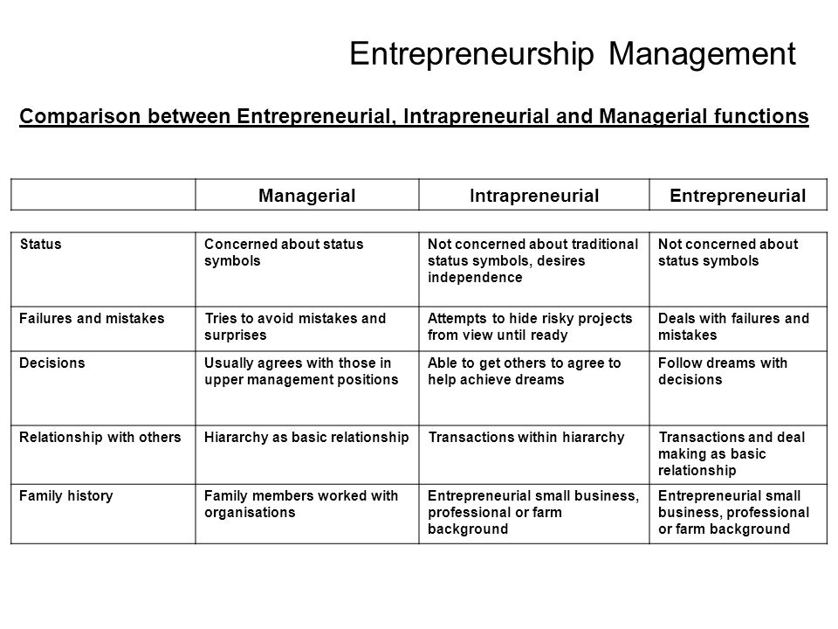

Slide 8
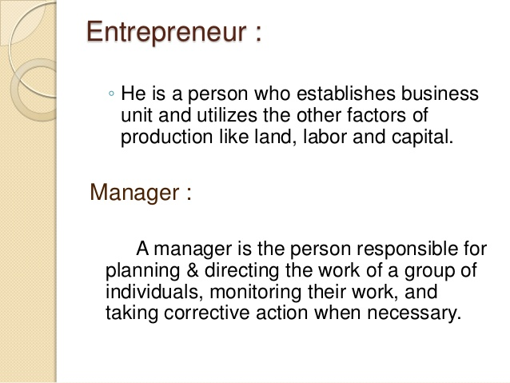

Slide 9
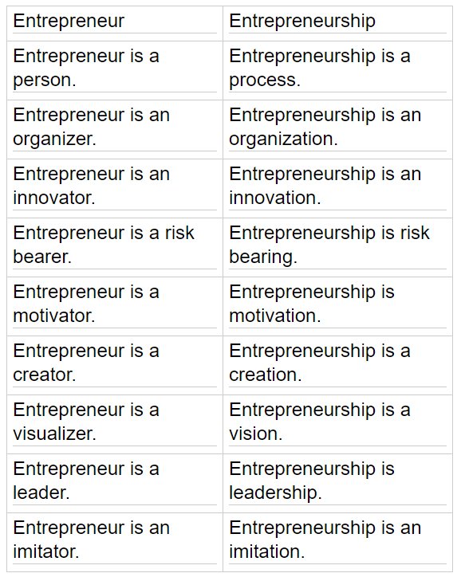

Slide 10
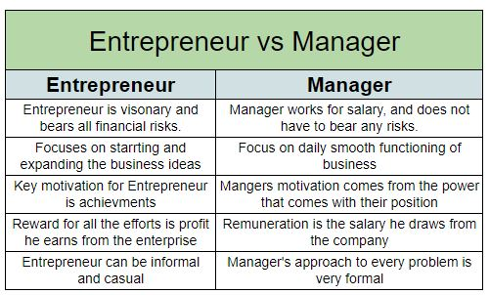

Slide 11
Competencies/Qualities/ Traits of an Entrepreneur
Opportunity -seeking and initiative. Entrepreneurs seek opportunities and take the initiative to transform them into business situations.
Persistence-When most people tend to abandon an activity, successful entrepreneurs stick with it.
Commitment- Entrepreneurs keep their promises, no matter how great the personal sacrifice.
Demand for efficiency and quality- Entrepreneurs try to do something better, faster or cheaper.
Taking calculated risks- Taking calculated risks is one of the primary concepts in entrepreneurship.

Slide 12
Goal setting- This is the most important competency because none of the rest will function without it. Entrepreneurs set goals and objectives which are meaningful and challenging.
Information seeking- Entrepreneurs gather information about their clients, suppliers,technology and opportunities.
Systematic planning and monitoring- Systematic behaviour means acting in a logical way.Planning is deciding what to do. Monitoring means checking.
Persuasion and networking- Entrepreneurs influence other people to follow them or do something for them.
Independence and self-confidence- Entrepreneurs have a quiet self-assurance in their capability or potential to do something.

Slide 13
Top 10 Indian Entrepreneurs
Dhirubhai Ambani. Dhirubhai Ambani (1932-2002) is an Indian businessman who started out humbly by selling traditional snacks to religious pilgrims. ...
Jehangir Ratanji Dadabhoy Tata. ...
Nagavara Ramarao Narayana Murthy. ...
Shiv Nadar. ...
Lakshmi Niwas Mittal. ...
Ghanshyam Das Birla. ...
Dilip Shanghvi. ...
Azim Premji.

Slide 14
Top 10 Famous Women Entrepreneurs in India
#1 Vandana Luthra – The founder of VLCC. ...
#2 Kiran Mazumdar Shaw – The founder of Biocon Limited. ...
#3 Priya Paul– The chairperson of Park Hotel. ...
#4 Ritu Kumar – The Fashion designer. ...
#5 Suchi Mukherjee – Founder & CEO of Limeroad. ...
#6 Indra Nooyi – The board member of Amazon. ...
#7 Aditi Gupta – The Co-founder of Menstrupedia.
#8 Falguni Nayar – The Founder of Nykaa
#9 Vani Kola – Founder, Kalaari Capital
#10 Radhika Ghai Aggarwal – Co-Founder & CMO, Shopclues.com

Slide 15
Problems faced by women entrepreneurs in India
8 Problems Faced by Women Entrepreneurs in India – Explained!
Problem of Finance: Finance is regarded as “life-blood” for any enterprise, be it big or small. ...
Scarcity of Raw Material: ...
Stiff Competition: ...
Limited Mobility: ...
Family Ties: ...
Lack of Education: ...
Male-Dominated Society: ...
Low Risk-Bearing Ability:

Slide 16
Characteristics of women entrepreneurs
Enterprising women have further ability to work hard. The imaginative ideas have to come to fair play. Hard work is needed to build up an enterprise.
Women entrepreneurs must have an intention to fulfil their dreams. They have to make a dream translated into an enterprise.
Most of the successful women entrepreneurs measure the pros and cons of a decision and tend to change if the situation demands. They never feel reluctant to revise their decisions.
Successful entrepreneurs always tend to think ahead. They have got telescopic abilities which make them think for the future.
Enterprising women take risk but the risk is well calculated. It offers challenges where chances of survival and failure are on equal footing.
Successful women entrepreneurs like to have immediate feedback of their performance. They learn from their experience and never get discouraged having received unfavorable information.
Entrepreneur has got the quality of sticking to job she decides to undertake. They work sincerely until the whole project is successfully implemented

Slide 17
Problems of women entrepreneurs
Due to various constraints imposed by traditional society, women entrepreneurs show an initial of confidence in their abilities.
The legal, statutory and procedural formalities to be completed before and after launching an enterprise frighten women entrepreneurs as they possess little knowledge about it.
Quick decision making and problem solving approach is not commonly found among the women entrepreneur. They get emotionally involved in tackling problems.
Problems of product marketing is a common experience of most of the women entrepreneurs that they face a tremendous problem while marketing their products.
Many women entrepreneurs face operational problems particularly when dealing with workers. Due to sociological norms, it is observed that male workers do not like to take orders and obey women executives.

Slide 18
Occupational mobility, such as shifting from one product line to another is an area where women entrepreneurs are generally found to be more at a disadvantageous position role
Women, especially in our country, face certain problems, which are different from their male counterparts, in the course of starting and managing their own businesses.
Many women entrepreneurs lack of management inputs like business planning, administration, marketing, finance, labour laws, taxation etc.
Inadequate vocational and technical training among women reflects upon their project selection. The basket of opportunities, government schemes and incentives do not promptly reach the aspiring women entrepreneurs
The women entrepreneurs were exasperated by the indifferent attitude of government officials of the small industry-related departments like taxation, labour, power etc., i.e., when the authorities come to know that the unit is being run by a woman, they discourage allotting sales tax number and giving electricity connection.
Typically women entrepreneurs of small-scale enterprises start well but somewhere down the line in their day to day operations they miss the route to success.
The women entrepreneurs also expressed their inability to change the negative attitude of labour force while some of them complained of unionism amongst them. Moreover the women entrepreneurs admitted the lack of experience and self-confidence on their part to deal with personal working in their organizations.

Slide 19
Promotional Efforts Supporting Women Entrepreneurs in India
Self-Help Groups (SHGs): This is an association of small group of self-employed rural or urban women entrepreneurs who join together to take care of group welfare. This is a voluntary association each member contributes small amount to cover seed money.
Federation of Indian Women Entrepreneurs (FIWE): It is an outcome of the resolution passed in 4th International Conference Women Enterprises held at Hyderabad. It is mainly interacts with various women associations of the country through a network to facilitate the members in diversified activities.
Women’s India Trust: This trust was established in 1968. Aims were to give educational programs and training to women in various fields. Also aimed at giving computer training to women.
Small Industries Development Bank of India (SIDBI): It is an institution established at national level to provide facilities to small-scale industries. It has two programs in the name Mahila Udyam Nidhi and Mahila Vikas Nidhi to support and promote women entrepreneurs
Central and State Government Schemes: It includes DWACRA- Development of women and children in Rural Areas.

Slide 20
National Bank for Agriculture and Rural Development (NABARD): It is an autonomous financial institution at the national level established on the lines of Reserve Bank of India. It provides various types of agricultural credits to agriculturalists of the country. It is also provides liberal credits to rural women.
Indira Mahila Yojana (IMY): IMY was develop to help women to achieve economic strength through micro-level income generating activities and to establish convergence of various services such as literacy, health, non-formal education, rural development, water supply, entrepreneurship etc.
Swayamsidha: Swayamsidha was evaluated by an external agency in 2005. The evaluation report indicated that women in Swayamsidha Blocks have strengthened their social standing in society. Awareness of social evils alcoholism, dowry and female feticide is visible.

Slide 21
Swa-Shakti: Another similar project implemented by this Ministry from 1999 with funding from World Bank, International fund for Agricultural Development (IFAD) and Government of India on experimental basis was Swa-Shakti. This project was implemented through State women’s development corporation (WDCs) at State level and NGOs (Non-Governmental Organizations) at field level. Swa-Shakti showed good progress as it achieved most of its physical targets and has been graded most of the World Bank as satisfactory.
Support to Training and Employment Programme (STEP) for Women: The scheme aims at providing an integrated package of the services to women like up gradation of skills through training, better and sustainable employment opportunities, facilitation of organization of women and support services with the coverage of health check-ups, referral services, mobile crèches and education facilities.

