Slide 1
Propaganda
Information, especially of a biased or misleading nature, used to promote a political cause or point of view..
Information, ideas, opinions, or images, often only giving one part of an argument, that are broadcast, published, or in some other way spread with the intention of influencing people's opinions

Slide 2
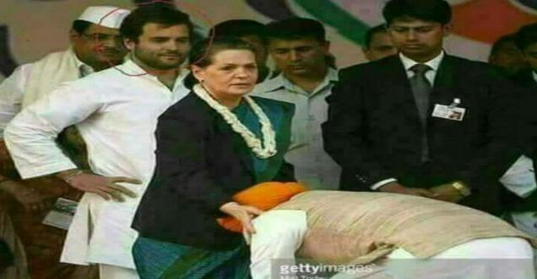
PM Manmohan Singh touching feet of Sonia Gandhi
Fact Check: The man in Turban is not our PM….Source: altnews

Slide 3
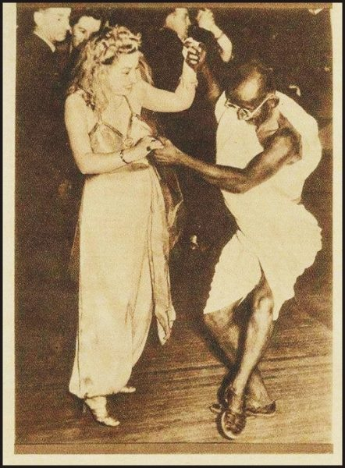
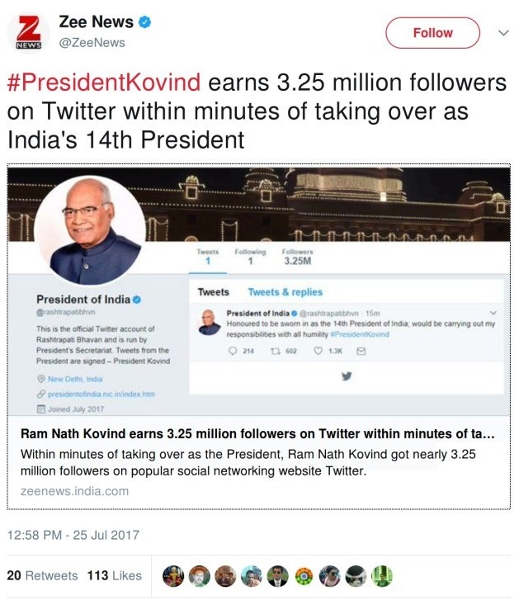
Fact check: The person dancing is not Gandhiji…Source…many websites
Fact check: our president just inherited the followers from the account already existent.

Slide 4
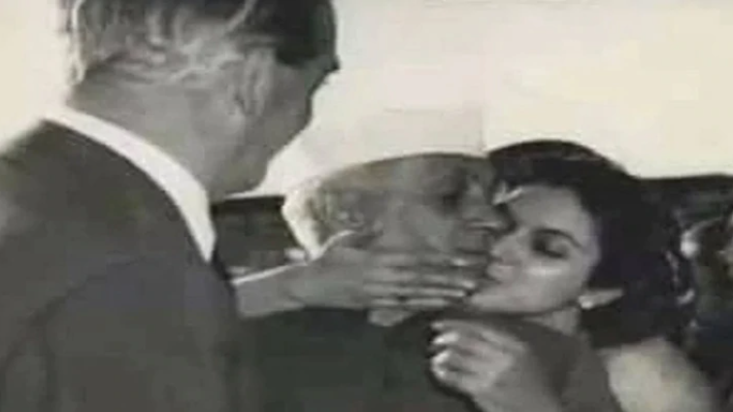
Claim: Nehruji romanticizing a foreigner
Fact Check: The woman being called a foreigner was actually Nayantara Sahgal, daughter of Vijaya Lakshmi Pandit and niece of Jawaharlal Nehru. Source: India Today

Slide 5
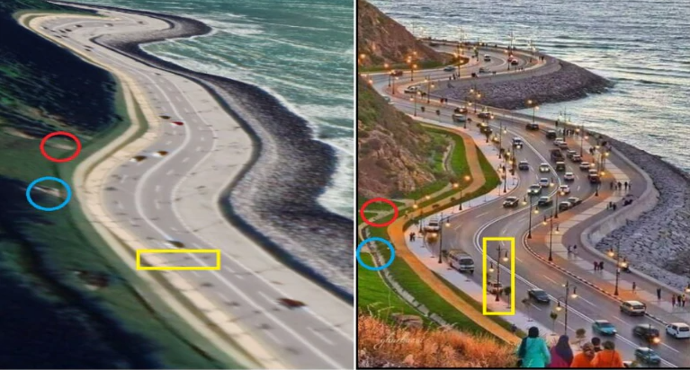
A new road to Char Dham
Fact Check: A bridge that looks like an engineering marvel; a road from Morocco passed off as the road to Char Dham. Some people could easily make out that roads in India are not left-hand drive and that there is no sea en route to Char Dham in the Himalayas. Source- India Today

Slide 6
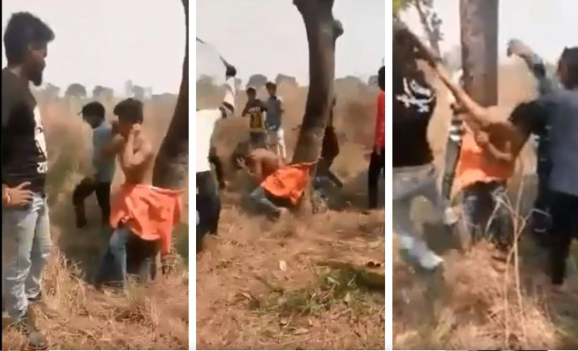
Man being beaten brutally by other community
FactCheck: The incident was actually related to money dispute between some people from same religion in Uttar Pradesh's Deoria. But it was circulated as an incident from West Bengal, with the claim that the youth was thrashed for "hoisting a particular colour flag atop his house".

Slide 7
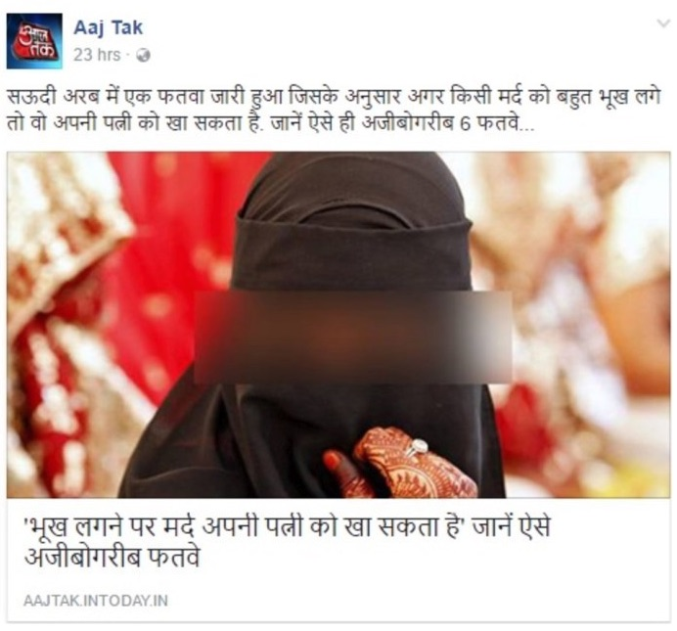
Fact Check: The “story” carried by India Today’s Hindi channel had its origins in a satirical column by a Moroccan blogger and was quashed in 2015 by Daily O, a website. Source” The Wire

Slide 8
Roots?
‘Propagation’ – derived from the organization set up by the Roman Catholic Church in 1622 to propagate that faith in the aftermath of the Reformation and the rise of Protestantism.

Slide 9
News and Propaganda
News | Propaganda
News draws attention into the text, seeking to resolve conflicts. | Propaganda directs attention beyond the text, seeking to provoke conflict in the reader
News are images of the past, in which the action is completed | Propaganda aligns the reader with the future, towards actions yet to occur.
News positions the reader as uncommitted, even passive recipients or consumers. | Propaganda calls the reader towards participation.
News seeks to convey the impression that it is true, unauthored and real. | Propaganda seeks to produce faithfulness in a relationship between addresser and addressee.

Slide 10
Propaganda examples world over
After the events of September 11, 2001, the US Defense Department set up an ‘office of strategic influence’, which planned to feed information, some of it false, to foreign news agencies, in an attempt to influence public opinion across the world (especially the Islamic world) in favour of the US-led ‘war on terrorism’.
Invasion of Iraq by America
Israel V/s Palestine
Propaganda by China
https://www.canva.com/learn/examples-of-propaganda/

Slide 11
Defining Propaganda
Propaganda is a form of persuasion involving a mass message campaign designed to discourage rational thought and to suppress evidence- Encyclopedia of Communication theory.
The systematic propagation of a doctrine or cause, communication’s role in social struggle, or mass suggestion of influence through the manipulation of symbols and psychology.
No-holds-barred use of communication to propagate specific beliefs and expectations

Slide 12

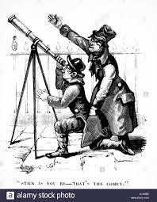
Common propaganda tactics are those of persuasion.
They often include misdirection or distraction of the audience’s attention away from issues important to the opposition and toward irrelevant issues associated with fear and hatred by the target audience.

Slide 13
Types of Propaganda
White propaganda- the actual source is attributed to the message.
e.g.- Two countries having their own interests may be throgh govt owned media platforms
Grey propaganda- actual source is difficult to identify
E.g.- Unattributed publications, such as articles in newspapers written by a disguised source. dissemination of ideas put forth by others—by foreign governments, by national and international media outlets, or by private groups, individuals, and institutions
Black propaganda,- the attributed source is not the actual source. e.g.- prepared by secret agents or an intelligence service

Slide 14
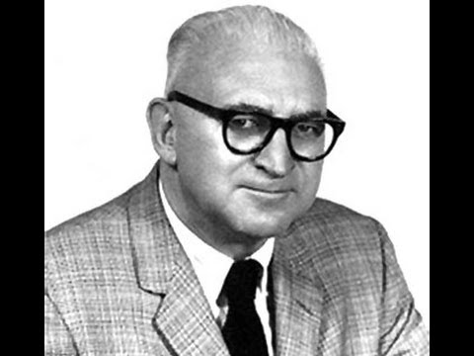
HAROLD LASSWELL’S PROPAGANDA THEORY
The American political scientist Harold D. Lasswell (1902-1978) is known chiefly for his studies of political terminology and his application of psychology to politics
HAROLD LASSWELL
In 1927, Harold D. Lasswell, published a now-famous book, Propaganda Technique in the World War, an analysis of the massive propaganda campaigns conducted by all the major countries in World War I.

Slide 15
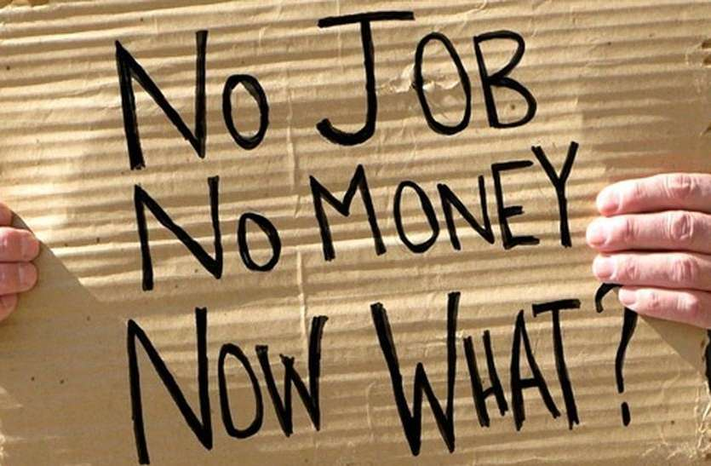
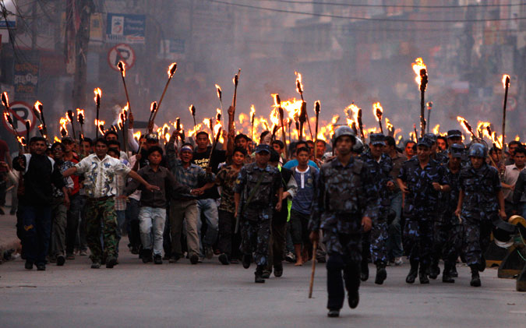
Propaganda Theory by Lasswell
The power of propaganda was not so much the result of the appeal of specific messages but, rather, the result of the vulnerable state of mind of average people.
Lasswell argued that economic depression and escalating political conflicts had induced widespread psychosis, and this made most people vulnerable to even crude forms of propaganda.

Slide 16
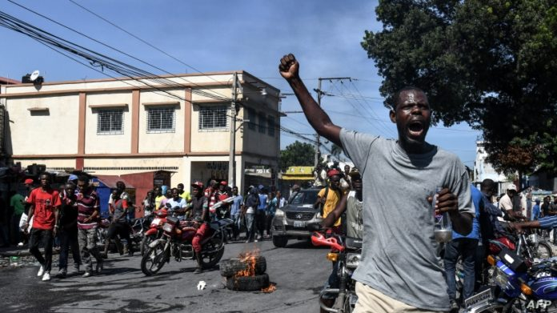
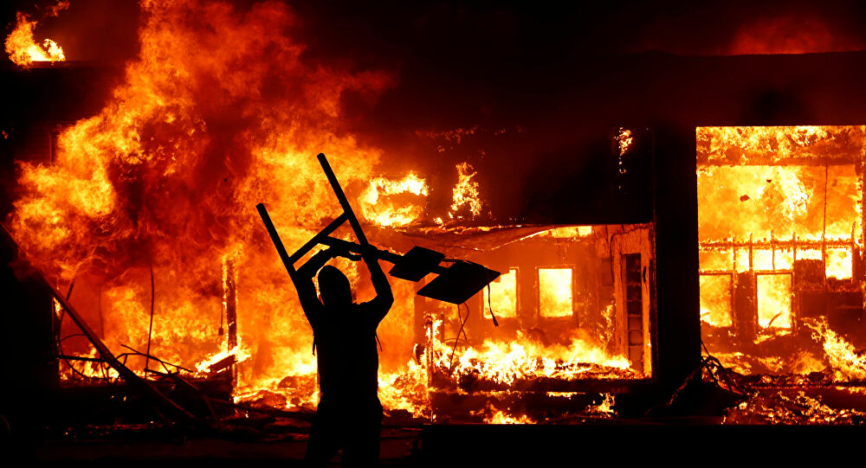
When average people are confronted daily by powerful threats to their personal lives, they turn to propaganda for reassurance and a way to overcome the threat.
When people are jobless and their homes are in foreclosure, propaganda
appeals find a ready audience.

Slide 17
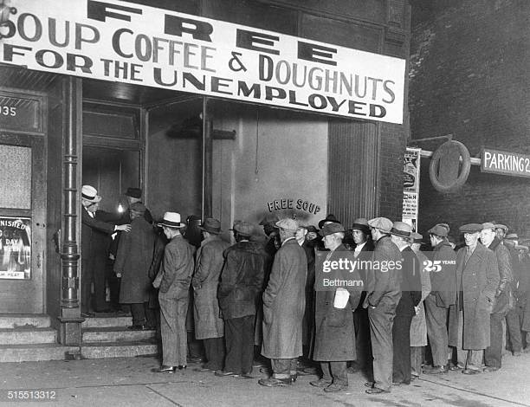
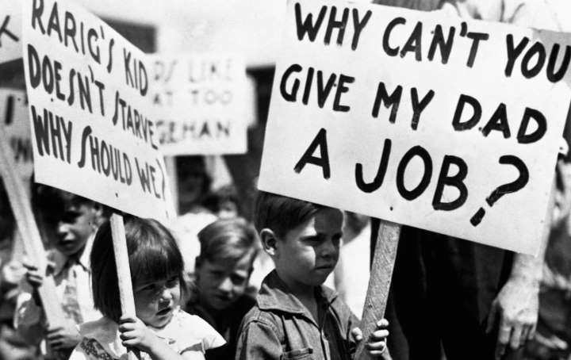
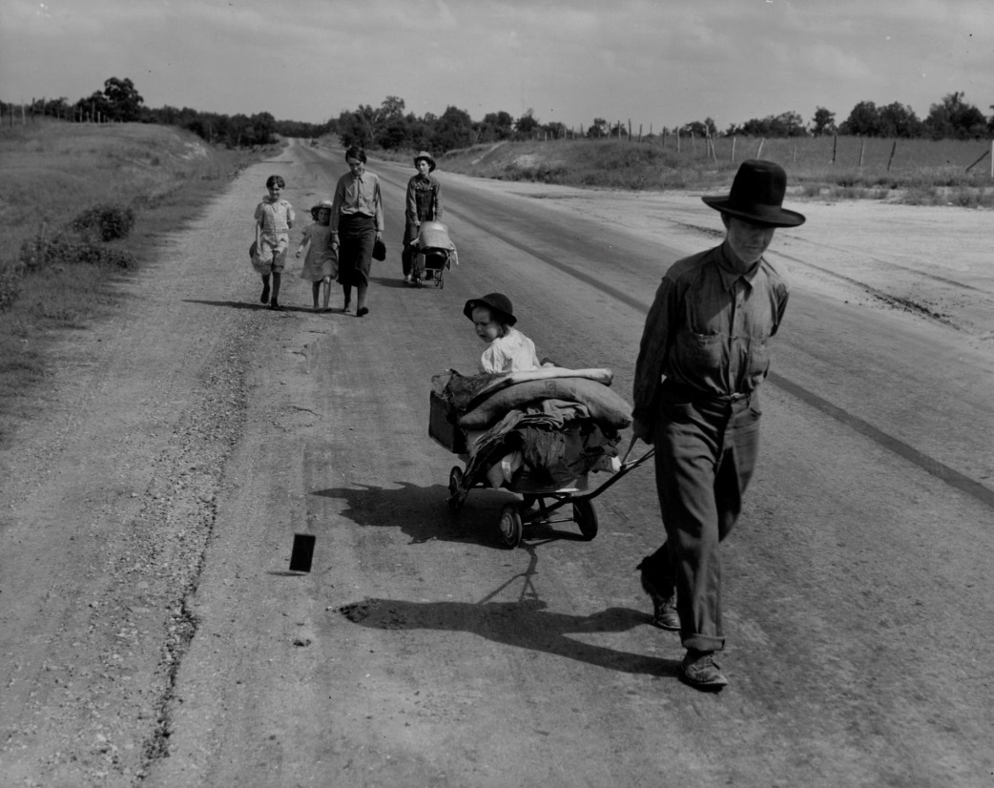
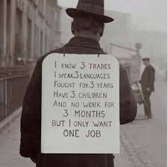
The great depression-1929 witnessed this ….and result was Rise of Hitler, Mussolini

Slide 18
How Propaganda works according to Lasswell
Lasswell’s theory envisioned a long and quite sophisticated conditioning process.
Exposure to one or two extremist messages would not likely have significant effects.
Master symbols should be used as they evoke strong emotions and possess the power to stimulate large-scale mass action

Slide 19

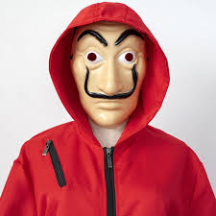
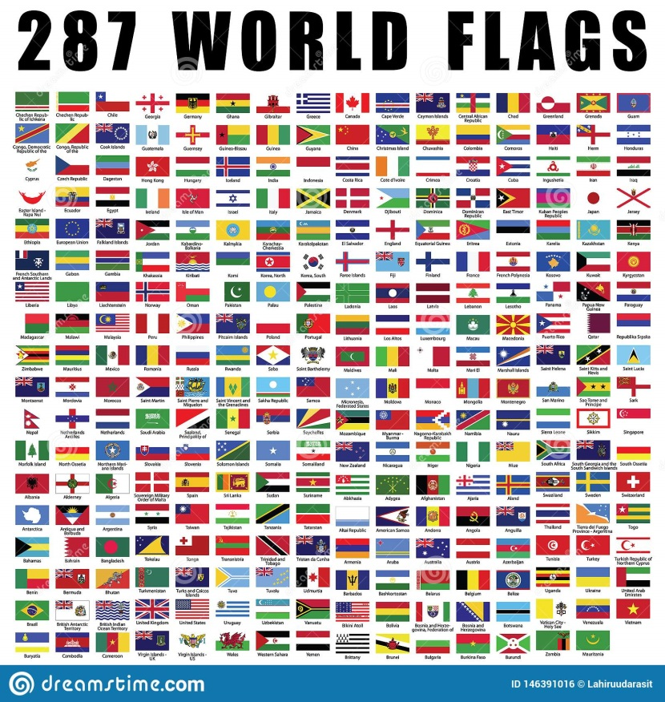


Lasswell argued that successful social movements gain power by propagating master symbols over a period of months and years using a variety of media.
Master Symbol Examples-Flag, Anthem, Logo, Face etc.

Slide 20
Familistic symbolisms- child lives on in every adult
“the fatherland,”
“the mother country,”
“the Mother Church,”
“the Holy Father,”
“Mother Russia,”
Mother India
the large number of statesmen who are known as the “fathers of their countries.”
(Uncle Sam, Uncle Ho Chi Minh, Chacha Nehru, Bapu, Saaheb, Sarkar)

Slide 21
Lasswell wrote
“The form in which the significant symbols are embodied to reach the public may be spoken, written, pictorial, or musical, and the number of stimulus carriers is infinite….
Consider, for a moment, the people who ride the street cars. They may be reached by placards posted inside the car, by posters on the billboards along the track, by newspapers which they read, by conversations which they overhear, by leaflets which are openly or surreptitiously slipped into their hands, by street demonstrations at halting places, and no doubt by other means. Of these possible occasions there are no end”

Slide 22
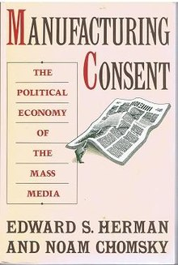
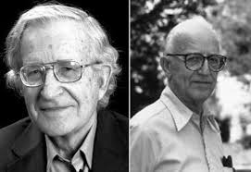
Modern Propaganda Theory- The Propaganda Model
The Propaganda model of media control was introduced by Edward. S. Herman and Noam Chomsky in their book ‘Manufacturing Consent – The Political Economy of the Mass Media’ in the year 1988.
Noam Chomsky
Edwards. S Herman

Slide 23
According to the theory media operates as a business which sells its products (readers and subscribers) to other business entities that do their advertisements in media, rather than performing the function of disseminating news for the public.
Here the news is being misshaped and reformed from its original form.
Herman and Chomsky call the factors which misshape news as filters. The news is being filtered by each of these factors before they reach its audience or general public.

Slide 24
Case Examples
The failure of the media to question the legality of the Vietnam War while greatly emphasizing the Soviet–Afghan War as an act of aggression.
Gulf War (1990), the media's failure to report on Saddam's peace offers.
Global warming, the media gives near equal balance to people who deny climate change despite only "about one percent" of climate scientists taking this view

Slide 25
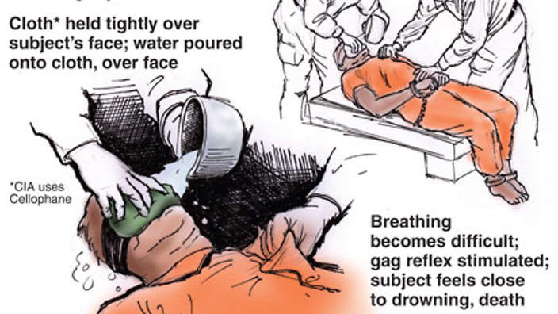
Case examples
In April 2010, a study conducted by the Harvard Kennedy School showed that media outlets such as The New York Times and Los Angeles Times stopped using the term "torture" for waterboarding when the US government committed it, from 2002 to 2008.

Slide 26
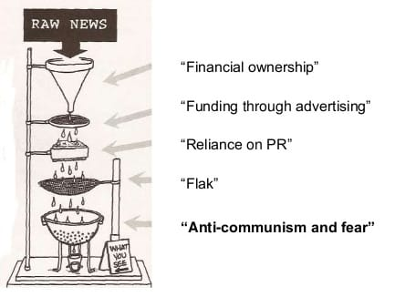
The five Filters
Size, Ownership and Profit orientation of mass media
Funding
Source
Flaks
Anti-communism

Slide 27
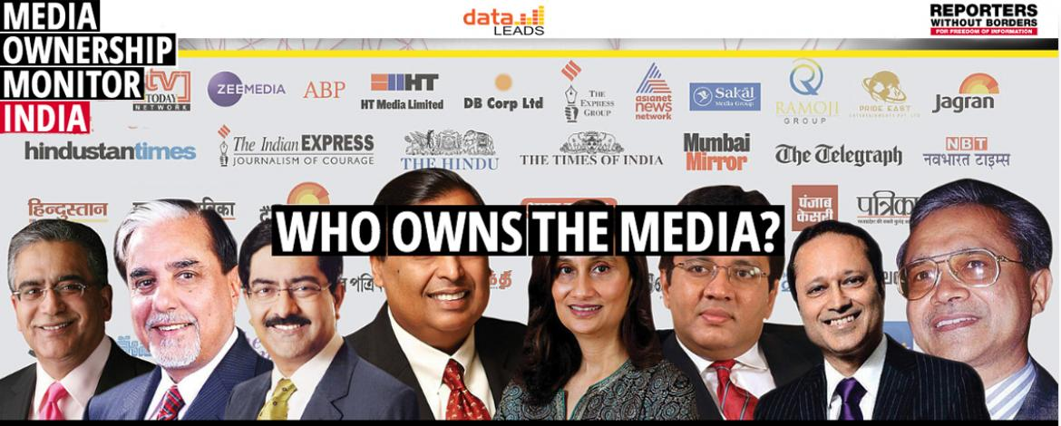
Size, Ownership and Profit orientation of mass media
The major media organizations are in the hands of a few elites.

Slide 28
As a part of maximizing profit they sacrifice some news objectives.
The extensive financial interests of these organizations may endanger the quality of news.
It is common around the world that the medias in the hands of government being puppets.

Slide 29
Funding
The advertisements play the major role of funding in mass media.
it is common that the media filters the news, in favor of their advertisement providers.
Example: A corporate organization may threaten the media saying that they will withdraw advertising contract if the media publishes any news which damage the reputation of the organization.

Slide 30
Source
Even the biggest media organizations cannot afford to have reporters and camera persons where ever the news breaks.
For availing a continuous flow of news, the media take suitable actions in favor of source.
The spokesperson of a prime minister or president is considered as a powerful source of news. For making sure of a proper flow of news the organizations keeps the sources delighted by fine-tuning the news.

Slide 31
Flaks
Flaks refer to the negative responses to the statement or programme published or broadcasted.
Media avoids the news items which may bring sorts of negative responses.
Most of the media never publishes news projecting negative image of religious leaders without strong evidence.

Slide 32
The negative responses can be—complaints, lawsuits, or punitive legislative actions—from governments, advertisers, mighty corporations, and private influence groups.

Slide 33
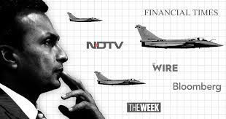
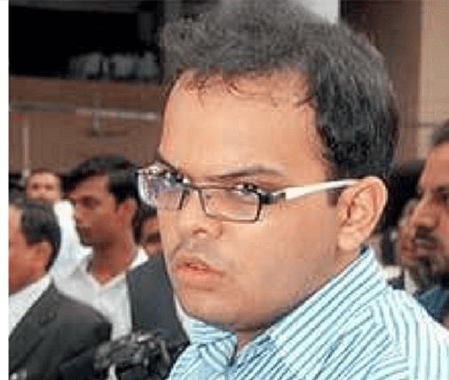
Examples of Flaks
Anil Ambani-led Reliance Infrastructure has filed defamation against news channels on Rafael
BJP president Amit Shah’s son Jay Amit Shah filed a lawsuit against a news website for publishing a report about suspiciously high revenue generation by his company

Slide 34

Resignations of two journalists at ABP News cause disquiet in newsrooms and far beyond

Slide 35
Anti-communism- Now Anti….
As far as the American corporations and elite groups are concerned the communism was an ultimate evil because it took their wealth and power from them, it threatened their superior positions and high class.
Example: The news which says about the communal living of workers was never allowed to publish in America. Because they were afraid of a revolt by the workers if such articles and news are disseminated.

Slide 36
Examples from India
Urban Naxals
Common Enemy
Migrants

Slide 37
References
MASS COMMUNICATION THEORY- Foundations, Ferment, and Future- SEVENTH EDITION- by Stanley J. Baran and Dennis K. Published by Ceneage Learning
Encyclopedia of Communication Theory- by Stephen W. Littlejohn Karen A. Foss- Sage Publication
https://medium.com/@vikrammalla/the-politics-of-indian-media-houses-by-ownership-82ecbe2dafab
Media Ownership Monitor- http://india.mom-rsf.org/en/owners/
https://www.indiatoday.in/india/story/2019-battle-how-fake-news-was-used-as-a-weapon-of-mass-deception-1537908-2019-05-29
https://economictimes.indiatimes.com/news/politics-and-nation/fake-news-still-a-menace-despite-government-crackdown-fact-checkers/articleshow/72895472.cms?from=mdr
Noam Chomsky - The 5 Filters of the Mass Media Machine- by Al Jazeera English https://www.youtube.com/watch?v=34LGPIXvU5M

