Slide 1
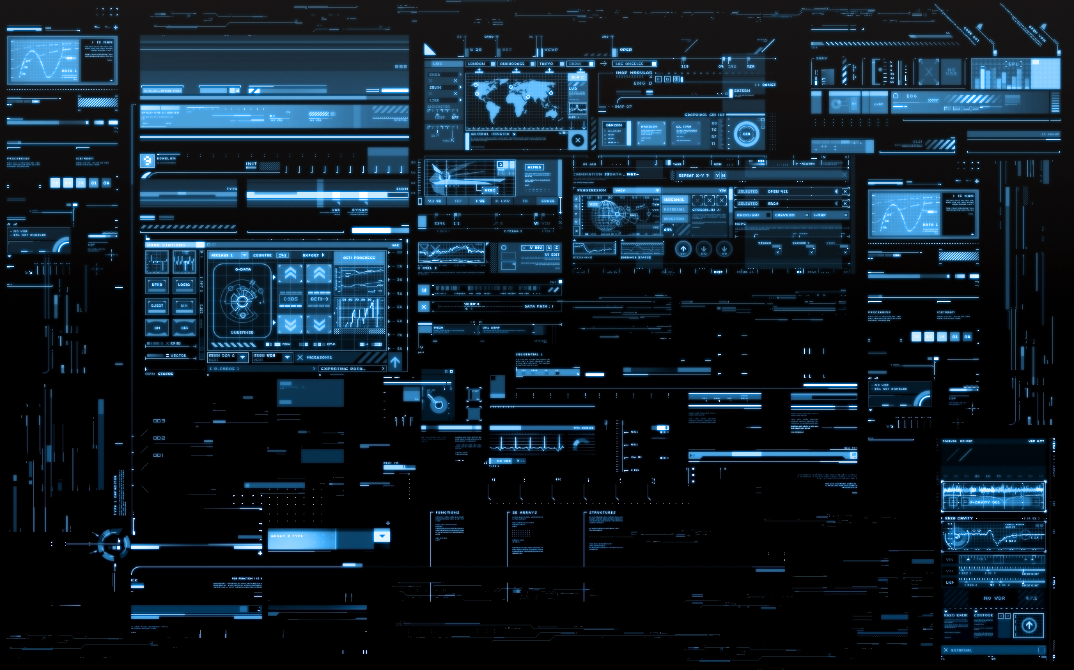
Science and Technology

Slide 2
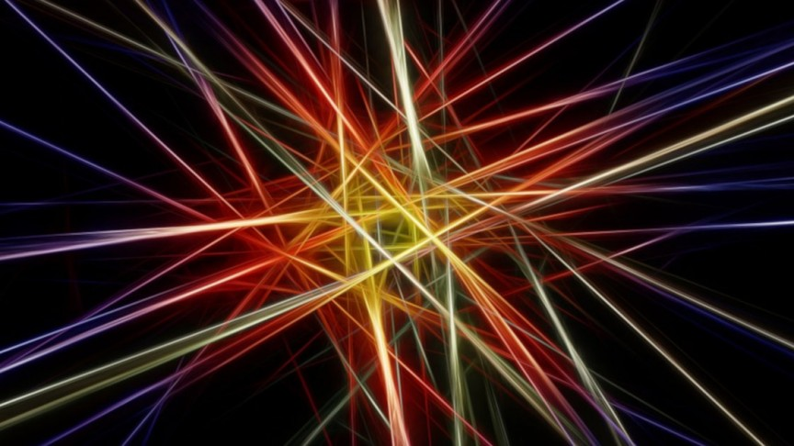
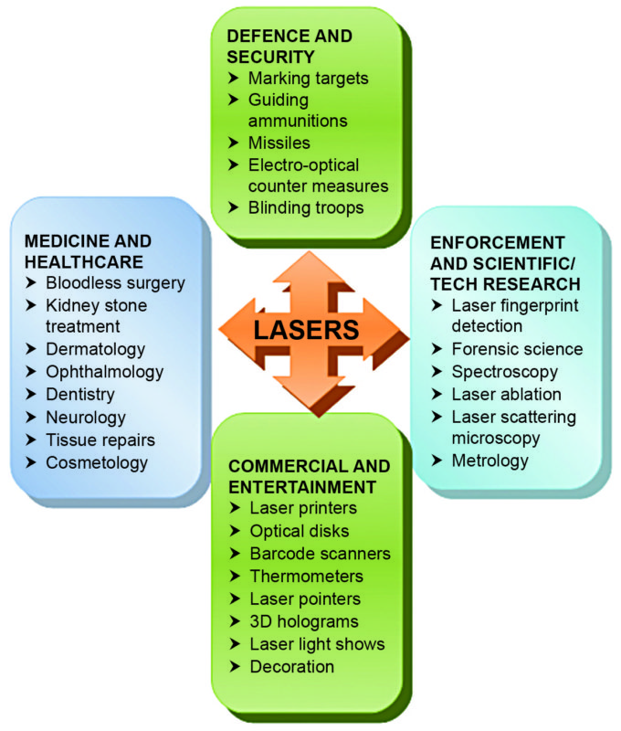
LASER TECHNOLOGY
Laser devices use light to store, transfer, or print images and text; they are also used in a wide range of other applications, including surgery and weaponry. The coherent radiation of the laser gives it special strength.
The first working laser was demonstrated on May 16, 1960 by Theodore Maiman at Hughes Research Laboratories. Since then, lasers have become a multi-billion dollar industry.
In industry, lasers are used for cutting steel and other metals and for inscribing patterns (such as the letters on computer keyboards).
Lasers are also commonly used in various fields in science, especially spectroscopy, typically because of their well-defined wavelength or short pulse duration in the case of pulsed lasers.

Slide 3
Design:
A laser consists of a gain medium, a mechanism to energize it, and something to provide optical feedback.
The gain medium is a material with properties that allow it to amplify light by way of stimulated emission.
Light of a specific wavelength that passes through the gain medium is amplified (increases in power).
Feedback enables stimulated emission to amplify predominantly the optical frequency at the peak of the gain-frequency curve.
As stimulated emission grows, eventually one frequency dominates over all others, meaning that a coherent beam has been formed.
The process of stimulated emission is analogous to that of an audio oscillator with positive feedback which can occur, for example, when the speaker in a public-address system is placed in proximity to the microphone. The screech one hears is audio oscillation at the peak of the gain-frequency curve for the amplifier.
For the gain medium to amplify light, it needs to be supplied with energy in a process called pumping. The energy is typically supplied as an electric current or as light at a different wavelength. Pump light may be provided by a flash lamp or by another laser.

Slide 4
The most common type of laser uses feedback from an optical cavity—a pair of mirrors on either end of the gain medium. Light bounces back and forth between the mirrors, passing through the gain medium and being amplified each time.
Typically one of the two mirrors, the output coupler, is partially transparent.
Some of the light escapes through this mirror. Depending on the design of the cavity (whether the mirrors are flat or curved), the light coming out of the laser may spread out or form a narrow beam.
In analogy to electronic oscillators, this device is sometimes called a laser oscillator.
Most practical lasers contain additional elements that affect properties of the emitted light, such as the polarization, wavelength, and shape of the beam.
ADD VIDEO : https://www.youtube.com/watch?v=_zMGqVuhxrE

Slide 5
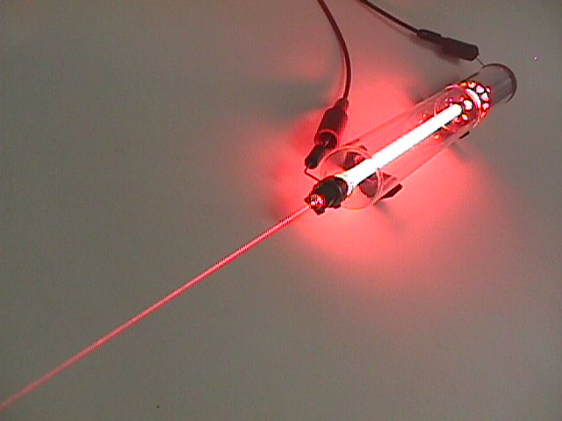
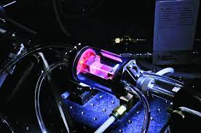
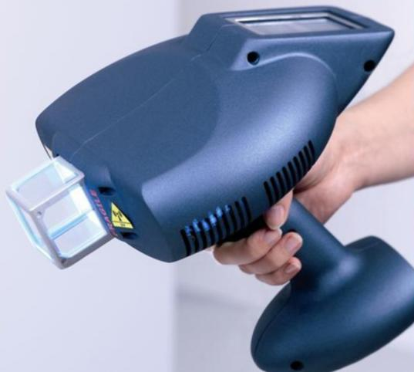
Types and Operating Principles
Gas Lasers : When an electric current is discharged through a gas to produce coherent light it forms a gas laser.
Chemical Lasers : A large amount of energy quickly released by chemical reactions constructs chemical lasers.
Excimer Lasers :Excimers are the molecules which can exist with one atom in an excited electronic state. This laser technology uses special gas laser propelled by electric discharge, where, lasing medium is an excimer or exciplex in modern-day designs. photolithography and LASIK (laser in-situ keratomileusis) eye surgery.

Slide 6
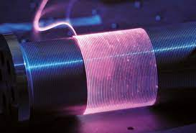
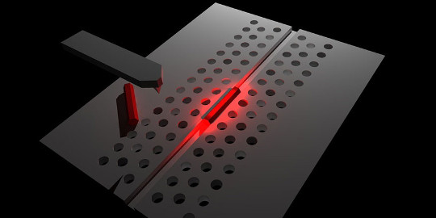
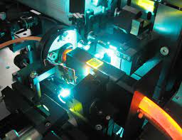
Fiber Lasers : The total internal reflection in solid-state lasers or laser amplifiers is guided in a single mode optical fiber is called Fiber Laser.
Photonic crystal Lasers :The lasers based on nanostructures that provide the mode confinement and the density of optical state (DOS) structure required for the feedback to take place.
Dye Lasers : Another type of lasers is dye lasers which have organic dye as the gain medium. These lasers are highly tuneable (wavelength can be altered).

Slide 7
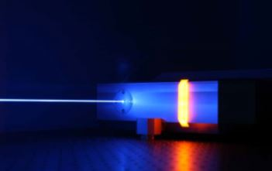
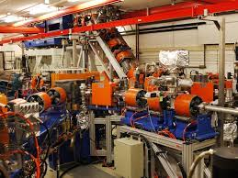
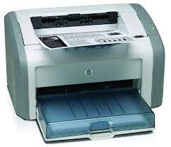
Solid State Lasers : In a solid state, laser gain medium is solid unlike liquid in dye lasers energy states. Solid state lasers are mainly used for defense weapons developments.
Free Electron Lasers : Free Electrons, as the name suggests are not bound to atomic or molecular states, they use rather a relativistic electron beam as the lasing medium.
Semiconductor Lasers Commercial laser diodes emit at wavelengths from 375 nm to 1800 nm, and wavelengths of over 3 nm have been demonstrated. Low power laser diodes are used in laser printers and CD/DVD players.

Slide 8
Uses/Application
When lasers were invented in 1960, they were called “a solution looking for a problem”.
Since then, they have become ubiquitous, finding utility in thousands of highly varied applications in every section of modern society, including consumer electronics, information technology, science, medicine, industry, law enforcement, entertainment, and the military.
Commercial Use: The first application of lasers visible in the daily lives of the general population was the supermarket barcode scanner, introduced in 1974.
Industrial Use: In industry, lasers are used for cutting steel and other metals and for inscribing patterns (such as the letters on computer keyboards). Laser welding has found wide applications in industry. In electronic and microelectronics lasers are used for precision welding.

Slide 9
Military Use: Laser range finding technique has many military applications. It can exactly determine the range of the target. It can also be used for target identification.
Medicines: Lasers used in medicine are used for internal surgery and cosmetic applications. Lasers are being used to study cellular metabolism and photochemical reactions of macro molecular level in biochemistry.
Distance and Velocity Measurements : Distances can be measured accurately using laser light. The usual method to measure the distance of an object is to measure the time taken to reach the object.
Laser Induced Fusion : Intense research is being carried out by using laser for thermonuclear fusion processes. Many countries have taken up research programme in laser fusion.

Slide 10
Optical Communication ; Visible light has been used for communication purposes. Simple systems such as signal fires, fire works, reflecting mirrors and signaling lamps in railways are examples of such communications.
Environmental Studies : Lasers are increasingly used in pollution control and monitoring the environment. Lasers can be used for remote sensing of the pollutants without collecting the samples.
Holography : Holography is a powerful technique that produces three dimensional pictures. Dennis Gabor, in 1940 proposed a method of recording three dimensional pictures which is now called Holography.

Slide 11
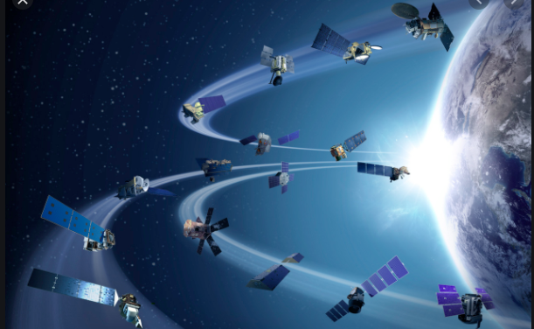
SATELLITE TECHNOLOGY
A satellite is a moon, planet or machine that orbits a planet or star. For example, Earth is a satellite because it orbits the sun. Likewise, the moon is a satellite because it orbits Earth. Usually, the word "satellite" refers to a machine that is launched into space and moves around Earth or another body in space.
Earth and the moon are examples of natural satellites. Thousands of artificial, or man-made, satellites orbit Earth.
Still other satellites are used mainly for communications, such as beaming TV signals and phone calls around the world.
Centripetal force due to the Earth’s gravitational pull : Centripetal forces cause centripetal accelerations. In the special case of the Earth's circular motion around the Sun – or any satellite's circular motion around any celestial body – the centripetal force causing the motion is the result of the gravitational attraction between them.

Slide 12
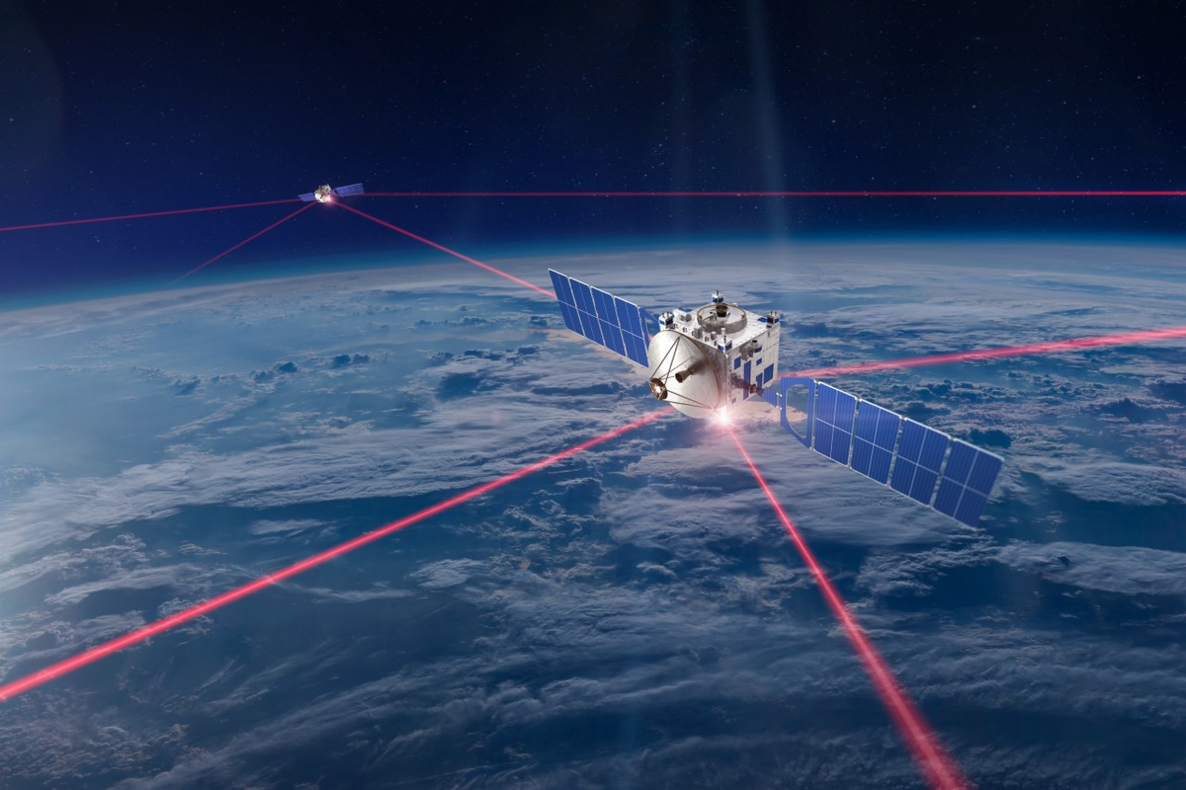
Types of satellites
Types of satellites include Communication Satellite, Scientific Satellites / Research Satellites, Observation Satellites, Weather Satellites, Navigation Satellites, Radio Satellites.
Communication Satellite: It includes television, phones (cellular as well as others), the Internet, beepers, etc. Communications Satellites have been around since 1958.
Scientific / research Satellites: Certain satellites are important for scientific research. These satellites gather data for scientific analysis. This includes observations of the atmosphere of our planet, the stars, the sun and other parts of space.

Slide 13
Observation Satellites: Observation satellites help to observe many features of the earth’s surface. Scientists use earth observation satellites to locate mineral deposits, to determine the location and size of freshwater supplies and to detect the spread of disease in crops and forests.
Weather satellites : They photograph the earth regularly in visible and infrared light, and they provide data to weather stations on earth, thus enabling the forecasting of weather conditions around the world
Navigation Satellites: Navigation satellites allow the operators of land Vehicles, ships, and aircraft to determine their locations within 100 feet any where on earth.
Radio Satellites: Radio transmissions are also conducted through Satellite facilities. Amateur radio operators or “hams” have built several Orbital Satellites Caring Amateur Radios (OSCARS) that take advantage df leftover payload space on other missions to get a free ride into orbit.

Slide 14
USES of SATELLITE TECHNOLOGY
Navigation / Location: Navigation satellites allow the operators of land vehicles, ships, and aircraft to determine their locations within 100 feet any where on earth.
These vehicles have on board a computerized receiver which can pick up radio signals from satellites miles in space.
The signal receiver can be used in cars, cell phones, and other devices.
Navigation satellite can indicate the nearest restaurants, business centers, railway stations, airports, etc.
Also, one may be in a position to locate roads with traffic jams, the nearest free parking space, and so on.

Slide 15
To pinpoint your location accurately, your receiver needs to receive signals from at least two navigational satellites.
The receiver determines your distance from each of the satellites. This is possible by measuring the time taken by the signal to travel from the satellite to your receiver antenna.
GPS : The United States’ Global Positioning System (GPS) consists of up to 32 medium Earth orbit satellites in six different orbital planes, with the exact number of satellites varying as older satellites are retired and replaced. Operational since 1978 and globally available since 1994, GPS is currently the world’s most utilized satellite navigation system.
GAGAN: The GPS Aided Geo-Augmented Navigation (GAGAN) is a planned implementation of a regional satellite based augmentation system (SBAS) by the Indian Govt.

Slide 16
Prediction of Weather: Weather satellites are one of the most important instrumentation used to predict the weather. Weather satellites photograph the earth regularly in visible and infrared light, and they provide data to weather stations on earth.
This 24-hour global coverage provides us with a never-ending stream of information critical for making decisions affecting everything from what you are going to wear today to governments making decisions about how to deal with climate change.
The National Oceanic and Atmospheric Administration (NOAA) in collaboration with the National Aeronautics and Space Administration (NASA) and the U.S. Air Force, manages and operates fleets of weather and environmental monitoring satellites.

Slide 17
Meteorologists (meteorologist is a specialist who studies processes in the earth’s atmosphere that cause weather conditions) generally use two types of satellites: -
Geostationary Operational Environmental Satellites (GOES) and
the Pacific and Atlantic Ocean (for tropical storms),
NOAA operates two GOES satellites simultaneously - GOES-East and GOES-West.
By having imagery of the whole globe, meteorologists are able to develop models to predict the weather out to five to ten days.
When polar-orbiting satellites fly over severe weather, they can also give us very detailed pictures of the storms given how much closer they are to storms than GOES.

Slide 18
Communications: The satellites are also used for the purpose of communications in respect of television, phones (cellular as well as others), the Internet, beepers, etc. Communications Satellites have been around since 1958.
One of the best known uses of communications satellites is for the radio/ television transmission.
Satellites facilitate high bandwidth, which in turn allow easy sending of television broadcasts. In addition, developments in broadcast technology allow different types of transmissions to be sent, taking advantage of sharing the same satellite signal.
Communications satellites not only help out a person in distress but also allow a person walking on the street in Mumbai to use the cellular phone to speak with someone in Mexico or some other place.
More and more satellites are being launched each year to support new and ‘growing uses for business, military and communication needs.

Slide 19
Scientific Research: Certain satellites are important for scientific research. These satellites gather data for scientific analysis.
These satellites are able to record data without the interference of gases, lights, and magnetic fields produced on earth.
Observation of Earth’s Surface: Observation satellites help to observe many features of the earth’s surface. Scientists use earth observation satellites to locate mineral deposits, to determine the location and size of freshwater supplies and to detect the spread of disease in crops and forests.
For instance, The U.S. satellites of the LANDSAT and SEASAT series find such data.

Slide 20
Business Logistics : A growing number of companies like AirTrak that dispatch fleets of delivery or repair trucks are tracking their vehicles via GPS in order to monitor their employees’ whereabouts and determine who to send to what job site.
Farming: In USA, GPS sensors are attached to tractors. These sensors help in navigation at night and during periods of poor visibility.
Rescue and Relief Measures: GPs assists in search and rescue efforts, and speeding the delivery of emergency services and disaster relief.
Lost Pets : Several companies sell implants for the family pet: like cats and dogs. A tracking device can be easily embedded under a pet’s skin.

Slide 21
Personal Emergencies : Applied Digital Solutions has a GPS device called the “Digital Angel,” which is worn on a watch or taped to a person’s body.
Prevention of Car Theft: By installing a tracking device on a vehicle, the location of it can always be known. The vehicle can be easily recovered, but the device will also act as a deterrent for thieves.
Police & Private Detectives: Police can benefit by attaching tracking devices to vehicles during investigations, allowing them to easily track movement and come up with solid evidence.

Slide 22
Hiking and Camping: Hikers often venture into uncharted areas. With a GPS device, hikers who get lost can be recovered quickly should they ever come up missing. Similar to hikers, camping enthusiasts who bring a tracking device with them are less likely to get lost without being rescued.
Mobiles and Automobiles: The GPS device in mobiles and automobiles help the owners to locate the streets, places, restaurants, and so on.

Slide 23
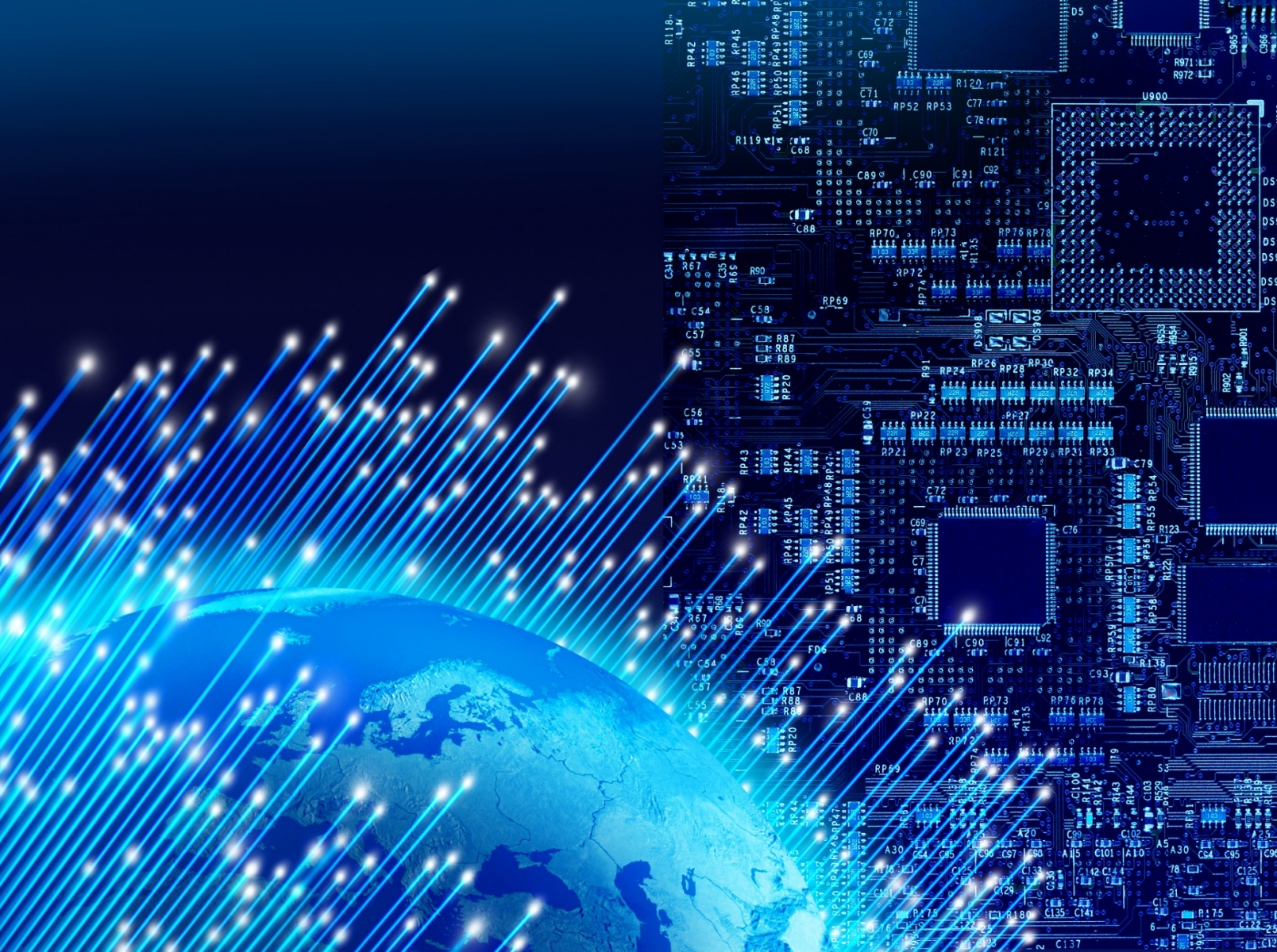
INFORMATION AND COMMUNICATION TECHNOLOGY
Information and Communication Technology can simply be defined in its simplest form as an electronic medium for creating, storing, manipulating receiving and sending information from one place to another.
Although ICT is just one among many different types of technologies, it has achieved a special prominence in technology and engineering literacy because familiarity and facility with ICT is essential in virtually every profession in modern society, and its importance is expected to grow over the coming decades.
Moving far beyond traditional text-based communication methods, the common language of global information sources and communication has broadened to include vast collections of images, music, video, and other media.
Computers, networks, telecommunications, and media support collaboration, expression, and dissemination ranging from data organization and analysis, research, scholarship, and the arts to peer interactions.

Slide 24
ADVANTAGES OF INFORMATION AND COMMUNICATION TECHNOLOGY
Communication – with help of information technologies the instant messaging, emails, voice and video calls becomes quicker, cheaper and much efficient.
Globalization and cultural gap – by implementing information systems we can bring down the linguistic, geographical and some cultural boundaries.
Availability – information systems has made it possible for businesses to be open 24×7 all over the globe. This means that a business can be open anytime anywhere, making purchases from different countries easier and more convenient.
Creation of new types of jobs – one of the best advantages of information systems is the creation of new and interesting jobs.
Cost effectiveness and productivity – the IT application promotes more efficient operation of the company and also improves the supply of information to decision-makers; applying such systems can also play an important role in helping companies to put greater emphasis on information technology in order to gain a competitive advantage.

Slide 25
DISADVANTAGES of INFORMATION AND COMMUNICATION TECHNOLOGY
1. Expense of Implementation and Maintenance : Setup costs for implementing an information technology system within a home or business can be very costly. Software can training can also take another big bite out of the budget.
2. Elimination of Jobs : By implementing IT systems into a company, tasks take less time and therefore, employees have more time throughout the day.
3. Breaches in Security : When information is stored electronically, there are more chances of having security breaches. Hackers are evolving along with technology and they are never up to any good.

Slide 26
APPLICATION OF INFORMATION AND COMMUNICATION TECHNOLOGY
Business : Information technology plays an important role in business environment in order to perform tasks effectively. The developments in IT, in communications, electronic service networks and multimedia have opened up new opportunities for corporate world.
Manufacturing : Corporates are developing a manufacturing society to provide manufacturers, distributors, and researchers with structured methods and practices for implementing technologies in manufacturing environments.
Mobile Computing : Mobile computing is a technology of wireless networking that uses common frequencies for transmission to permit networked devices move freely within the broadcast coverage area.
Defense Services : Military operators are restricted in their access to information. Military operators use voice radio or formatted text messages to communicate during crisis. New IT capabilities allow military person to literally converse with computers to create, access and manage information and solve problems. The presence of IT helps to gain relevant information in an organized manner.

Slide 27
Media : Computers have been used to for processing and analyzing information. Information technology used in media includes TV, radio, VCR, video cameras, and computers. The print as well as electronic media are benefited from information technology.
Education : Technology in general has affected the way our learning and the way processes are carried out. Technology is becoming powerful tool for communication, problem solving, and a means of research for learning in education areas.
Publication : Publishing houses, universities and e-book stores have started to use information written in printed version of books, on their computer screen through the use of technology. E-texts plays an important role in education and research. The files can be downloaded from various websites and can be read on the screen, printed and photocopied.
Impact on Medicine and Health: ICT can be used in the field of medicine and health. For instance, videoconferencing is a highly useful technology for real-time telemedicine and telenursing applications, such as diagnosis, consulting, transmission of medical images, etc

