Slide 1
ECONOMICS-I
MODULE-2
DEMAND AND SUPPLY ANALYSIS AND THEORY OF CONSUMER’S CHOICE

Slide 2
DEMAND AND ITS DETERMINANTS AND LAW OF DEMAND
What is demand?
Demand simply means a consumer’s desire to buy goods and services without any hesitation and pay the price for it. In simple words, demand is the number of goods that the customers are ready and willing to buy at several prices during a given time frame. Preferences and choices are the basics of demand, and can be described in terms of the cost, benefits, profit, and other variables.
The amount of goods that the customers pick, modestly relies on the cost of the commodity, the cost of other commodities, the customer’s earnings, and his or her tastes and proclivity. The amount of a commodity that a customer is ready to purchase, is able to manage and afford at provided prices of goods, and customer’s tastes and preferences are known as demand for the commodity.
The demand curve is a graphical depiction of the association between the price of a commodity or the service and the number demanded for a given time frame. In a typical depiction, the cost will appear on the left vertical axis. The number (quantity) demanded on the horizontal axis is known as a DEMAND CURVE.

Slide 3
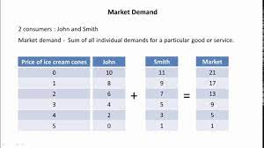
INDIVIDUAL AND MARKET DEMAND

Slide 4
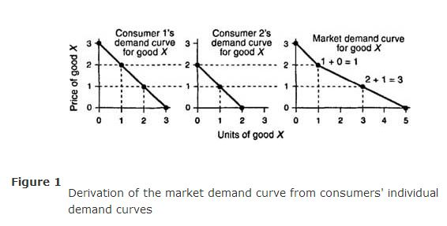

Slide 5
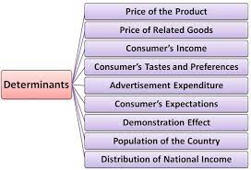

Slide 6
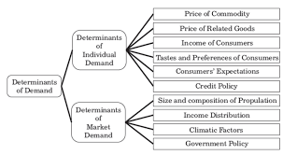

Slide 7
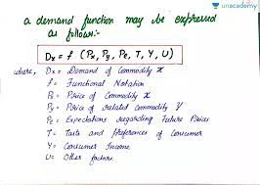

Slide 8
Types of Demand
Few important different types of demand are as follows:
Price demand: It refers to various types of quantities of goods or services that a customer will buy at a quoted price and given time, considering the other things remain constant.
Income demand: It refers to various types of quantities of goods or services that a customer will buy at different stages of income, considering the other things remain constant.
Cross demand: This means that the product’s demand does not depend on its own cost but depends on the cost of the other related commodities.
Direct demand: When goods or services satisfy an individual’s wants directly, it is known as direct demand.
Derived demand or Indirect demand: The goods or services demanded or needed for manufacturing the goods and satisfying the consumer indirectly is known as derived demand.
Joint demand: To produce a product there are many things that are related to each other, for example, to produce bread, we need services like an oven, fuel, flour mill, and more. So, the demand for other additional things to produce a product is known as joint demand.
Composite demand: A composite demand can be described when goods and services are utilised for more than one cause. Example: Coal

Slide 9
quantity demanded
the amount of a good that
buyers are willing and
able to purchase
demand schedule
a table that shows the
relationship between the
price of a good and the
quantity demanded
law of demand
the claim that, other
things being equal, the
quantity demanded of a
good falls when the price
of the good rises

Slide 10
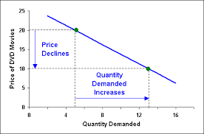
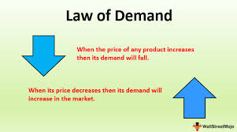
Law of demand :-
Law of demand state the inverse relationship between price and quantity demanded.
Other things being equal, when the price of a good rises, the quantity demanded
of the good falls, and when the price falls, the quantity demanded rises.

Slide 11
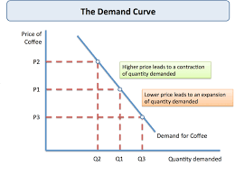
DEMAND CURVE.
The demand curve is a graphical depiction of the association between the price of a commodity or the service and the number demanded for a given time frame. In a typical depiction, the cost will appear on the left vertical axis. The number (quantity) demanded on the horizontal axis is known as a DEMAND CURVE.

Slide 12
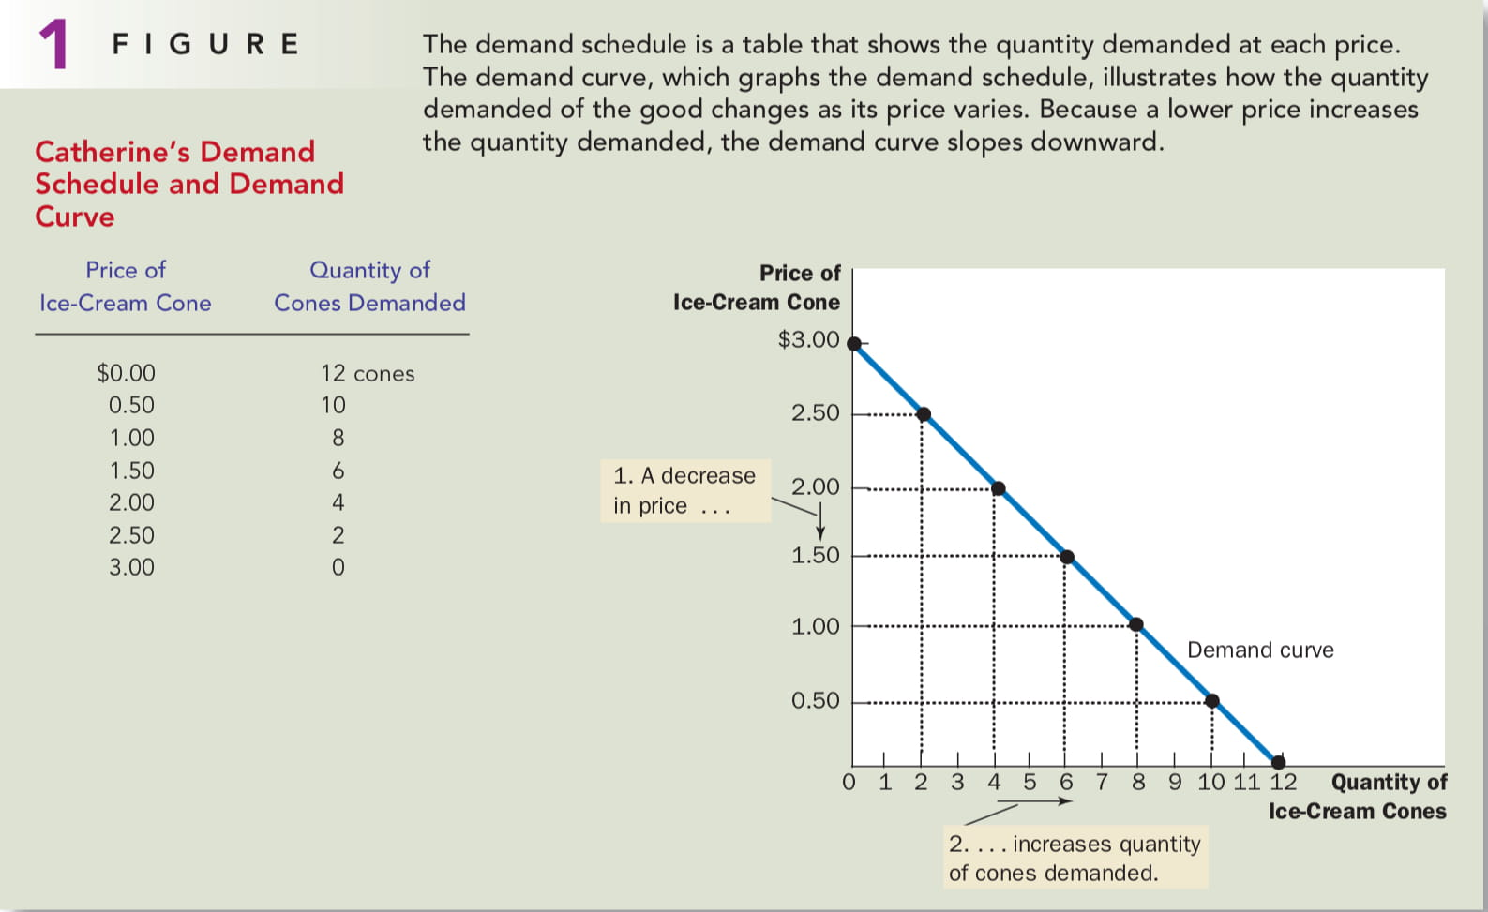

Slide 13
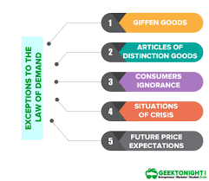

Slide 14
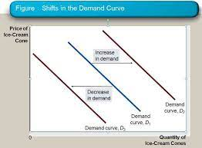
Shifts in the Demand Curve
Any change that raises the quantity that
buyers wish to purchase at any given
price shifts the demand curve to the
right. Any change that lowers the quantity
that buyers wish to purchase at any given
price shifts the demand curve to the left

Slide 15
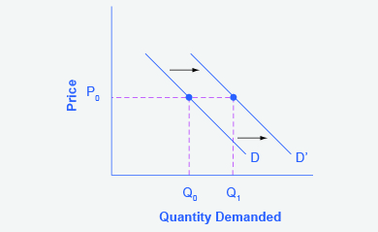
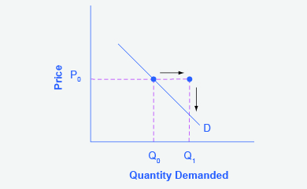
Step 2. Suppose income increases. As a result of the change, are consumers going to buy more or less pizza? The answer is more. Draw a dotted horizontal line from the chosen price, through the original quantity demanded, to the new point with the new Q₁. Draw a dotted vertical line down to the horizontal axis and label the new Q₁. An example is provided in Figure 3.

Slide 16
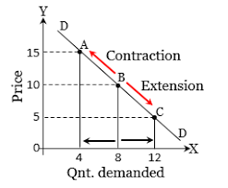

Slide 17
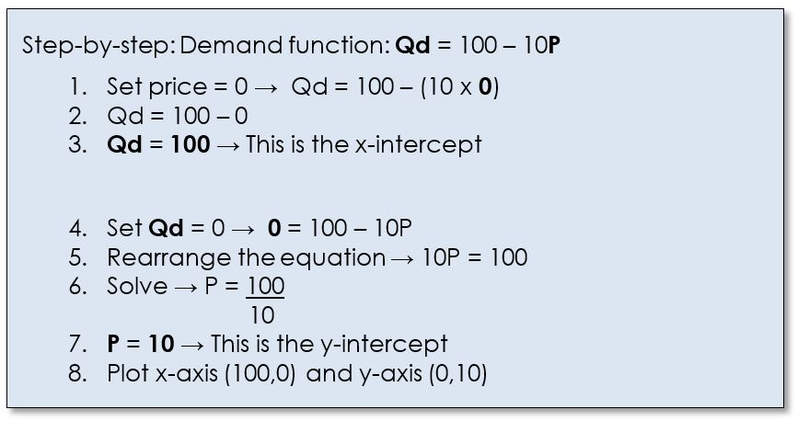

Slide 18
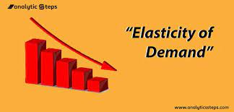
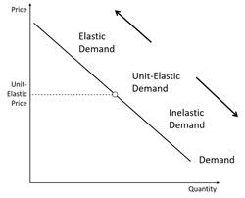
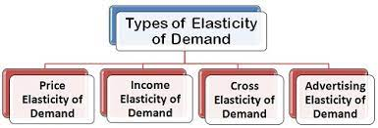
responsiveness in change in demand due to change in its determinants.
Notes:
Elasticity :- responsiveness in change in demand due to change in its deterinants.

Slide 19
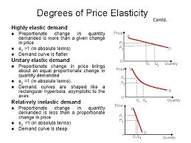
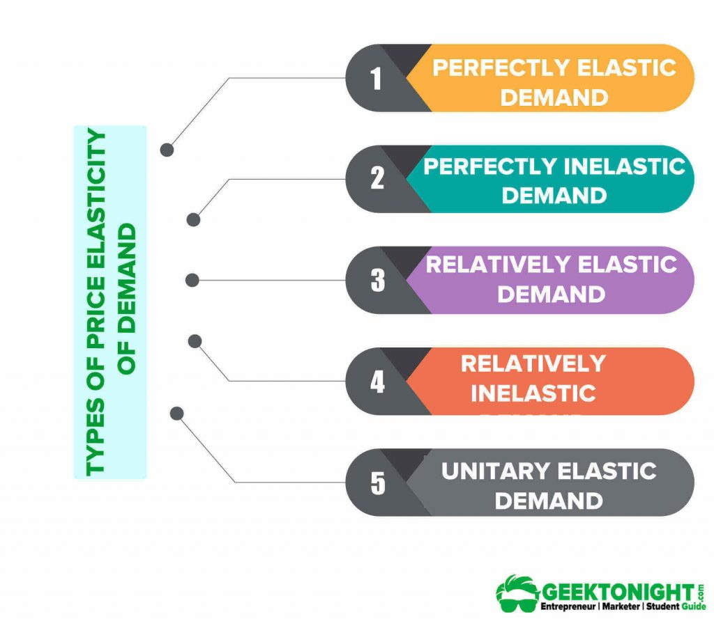

Slide 20
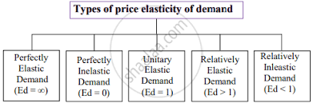

Slide 21
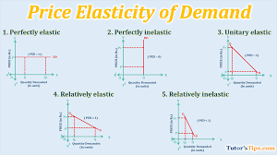
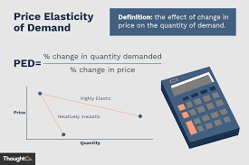

Slide 22
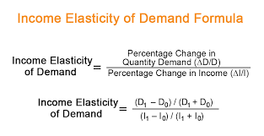
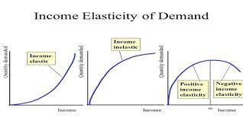

Slide 23
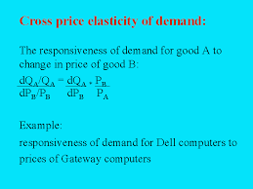

Slide 24
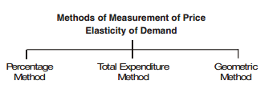
Methods of Calculating Price Elasticity of Demand
• Percentage or Proportionate Method: Elasticity is measured as the ratio of % change in quantity demanded to % change in price
• Geometric or Point Method: It measures elasticities at different points on a demand curve
• Total Expenditure Method: It examines how the total expenditure incurred on a good changes with a change in the price of the good.

Slide 25
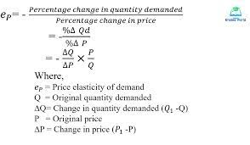

Slide 26
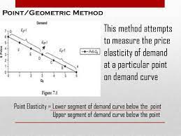
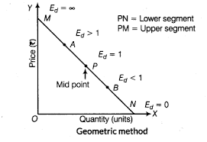

Slide 27
