Slide 1
Technological changes in Indian banking
Unit 2 SYBBI

Slide 2
Lead role of Reserve Bank of India
Monetary Authority
Regulator and supervisor of the financial system
Regulator and supervisor of the payment systems
Manager of Foreign Exchange
Issuer of currency
Developmental role
Banker to the Government
Banker to banks

Slide 3
ACH Operations
The Automated Clearing House (ACH) Network is an electronic funds-transfer system run by NACHA, since 1974.
This payment system provides ACH transactions for use with payroll, direct deposit, tax refunds, consumer bills, tax payments, and many more payment services in the U.S.
NACHA is a self-regulating institution, and it gives the ACH network its management, development, administration, and rules. The organization's operating rules are designed to facilitate growth in the size and scope of electronic payments within the network.
The ACH Network essentially acts as a financial hub and helps people and organizations move money from one bank account to another. ACH transactions consist of direct deposits and direct payments, including business-to-businesss (B2B) transactions, government transactions, and consumer transactions.

Slide 4
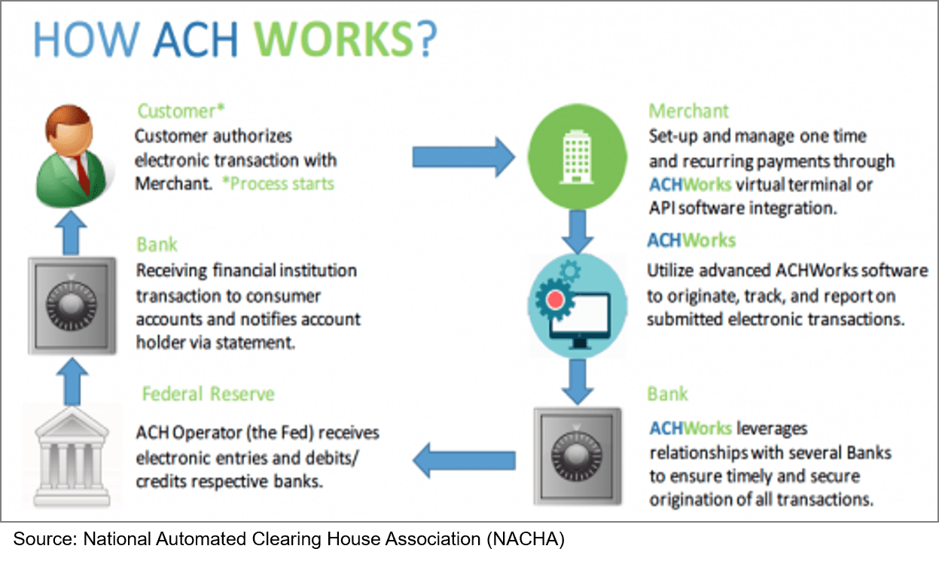

Slide 5
Automation in Indian Banks
Indian banking industry is now in the midst of IT revolution paving the way for the introduction of new technology into banking operations. Increasing importance of total banking automation in Indian banking industry has been realised because of a combination of regulatory and competitive scenario.
Information Technology has been largely used basically under two different avenues in Banking. One area is communication and connectivity and the other in Business Process Reengineering.
As a result of this, modern technology has largely changed the contours of three major functions usually performed by banks, i.e., access to liquidity, transformation of assets and monitoring of risks. Moreover, Information Technology and the communication networking systems have an important bearing on the efficiency of money, capital and foreign exchange markets.
In India, the Software packages for Banking Applications had its beginning in the middle of eighties, when Indian Banks made an attempt to computerize their branches in a limited scale.

Slide 6
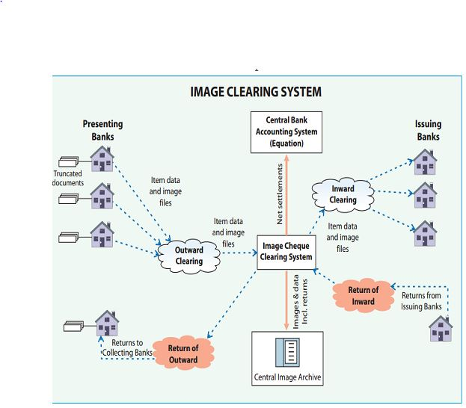
Cheque clearing using MICR

Slide 7
CORE Banking solutions (CBS)
The features of CBS:
Customer-On boarding
Managing deposits and withdrawals
Transactions management
Interest calculation and management
Payments processing.
Customer relationship management
Designing new banking products
Loans disbursal and management
Account management

Slide 8
Human resource Development(HRD)
Challenge in talent acquisition:
Staying relevant:
Digital will be key:
Redefining diversity:
Performance management:
Changes in work “space”:
Focus on data analytics:

Slide 9
Technology in Banking Industry
Teleconferencing: Audio, video, computer, audiographics.
Internet Banking
Digital signature in banking MICR
Cheque truncation.

Slide 10
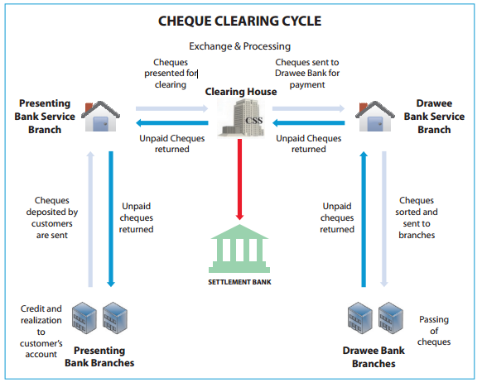
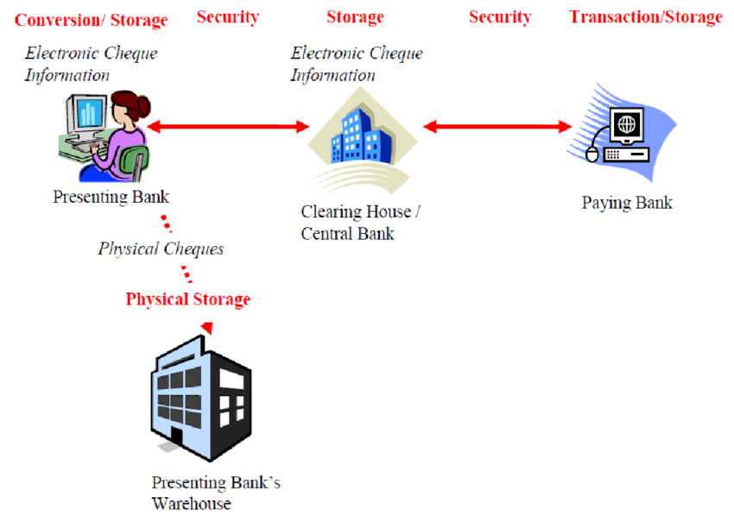
MICR
CHEQUE TRUNCATION

Slide 11
Dealing with fraud transactions under CTS
One can take following preventive measure while paying/collecting high value cheque at non home branch:
If doubt, then contact home branch.
Bank can ask for physical instrument and check it properly before paying.
Person doing CTS clearing must have knowledge of CTS cheque security parameter because then only he can catch forged cheque.

Slide 12
CONT.
HOW A PERSON COMMIT FRAUD IN CTS?
The person first tries to get information of customer such as their account number, their cheque book series number, account transaction etc.
He notes which cheque number is used for last transaction
Then he uses some image editting software like photoshop and create forged cheque of his own.
A fraud person uses such cheque either ou of city or out of state to get payment.

Slide 13
IDRBT
The Institute for Development & Research in Banking Technology (IDRBT) is an institution exclusively focused on banking technology.
Established by the Reserve Bank of India (RBI) in 1996, the institution works at the intersection of banking and technology.
The main focus of the institute is on conducting applied research and experimental development in the area of banking technology. The research at the institute is directed primarily towards a specific practical objective that will serve the banking and financial sector.
Accordingly, the research and development activities of the institute aim at improving banking technology in India.
While addressing the immediate concerns of the banking sector, the research at the institute also focuses on anticipating the future needs and requirements of the banking sector and developing technologies to address them.

Slide 14
E-Checks-Protocols and Standards
The drawbacks of e-Checks are:
Customer education
Chances of misuse, fraud
Need a different infrastructure
Unauthorized transaction becomes challenge for banks.

Slide 15
E-Banking RBI Regulations.
The bank should formulate a policy for Internet Banking with the approval of the Board.
The policy should fit into the bank’s overall Information technology and Information Security Policy and ensures confidentiality of records and security systems.
The policy should clearly lay down the procedure to be followed in respect of 'Know Your Customer' requirements.
The policy should cover technology and security standards and also address the legal, regulatory and supervisory issues as enumerated in this Annex.
The banks should put in place sound internal control systems and take into account the operational risks involved in providing the service.
Adequate disclosure should be made regarding the risk, responsibilities and liabilities to the customers before offering the facility.

Slide 16
Technology and Security Standards
Use of IS and other forms of securities.
The banks should designate a Network and Database Administrator with clearly defined roles as per the IS Audit policy duly approved by their Board.
Logical access controls to data, Systems, Application software, utilities, telecommunication lines, libraries, System software, etc. should be in place.
The banks should ensure that there is no direct connection between the Internet and the bank's system.
The banks should have effective safeguards to prevent intrusions into the systems/network.

Slide 17
THANK YOU

