Slide 1
History of Newspapers
Divya Narang Tinna
Assistant Professor, TCSC

Slide 2
History of Newspapers
Newspapers started during Julius Caesar’s reign
News about the proceedings of the courts
Name of the newspaper “Acta Diurna’
Which means action of the day
Until the beginning of 17th century, there was no concept of newspapers
In Europe, newspapers started appearing in 1609
These were handwritten newsletters
Circulated among merchants
Information from war to economy

Slide 3
History of Newspapers
The first printed forerunners of the newspapers appeared in Germany in 1400s
They were in the form of pamphlets or broadsheets
Most of them were sensationalized
First Printing Press in England came in 1476
But no efforts to print newspapers
In England, the earliest predecessors of the newspapers were ‘Corantos’ (1620)
Coranto-Single Sheet in the form of pamphlets
It was produced whenever there was some important news

Slide 4
History of Newspapers
“The Weekly News” was a regular coranto in London (1622 Onwards)
Earlier these corantoes had no titles
“The London Gazette” is considered the legitimate precursor of today’s newspapers (1665)
It was a bi-weekly periodical
The “Daily Courant” was the first daily to be published in England
First Edition came in 1702

Slide 5
History of Newspapers
In America, First newspaper appeared in Boston in 1690
‘Public Occurrences’, was banned after first edition
It had not obtained the necessary permission from the government
The first successful newspaper was “The Boston Newsletter”
1846- Associated News Press Agency was established in the US
1851- Reuters, another news agency by Paul J Reuter in London

Slide 6
History of Newspapers
29 Jan, 1780-India got its first newspaper
Name- Bengal Gazette/Calcutta’s General Advertiser/Hickey’s Gazette
Started by James Augustus Hickey
Closed down in 1781
News about the arrival and departure of the ship, engagements, extra-marital affairs etc.
Hickey published a news about Sir Warren Hasting’s wife’s extra-marital affair
He was sent behind the bars

Slide 7
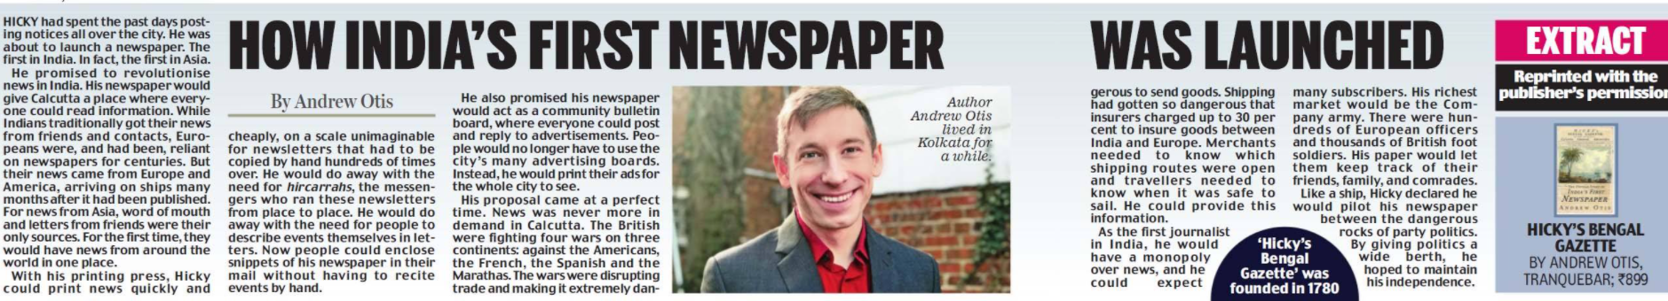
History of Newspapers

Slide 8
History of Newspapers
Next five years, many newspapers started
Indian Gazette, Calcutta Gazette, The Bengal Journal
Madras Courier, Madras Gazette, Indian Herald
These newspapers were subservient to the government
1799-Press Regulations Act
Publication of the name of the printer, editor and proprietor was obligatory

Slide 9
History of Newspapers
Serampore Missionaries were the pioneers in Indian Language Press
‘Samachar Darpan’ was the first (Bengali) newspaper (1818)
Raja Ram Mohan Roy brought Persian newspaper ‘Miratool Akbar’
But he ceased publishing his paper in protest against the Press Regulations
1822- Bombay Samachar, a Gujarati paper appeared
1857-Year of Sepoy Mutiny and ‘Gagging Act’
The main topics of discussion- Sati, Caste, Widow remarriage, crime, opposition to the teaching of English in schools and colleges

Slide 10
History of Newspapers
Many English newspapers were also launched during this time
“The Times of India” (1861) was started as a paper supporting the British
The author of “The Jungle Book” , Rudyard Kipling, started “The Pioneer” in 1865 from Allahabad
The Amrita Bazar Patrika-1868
The Statesman-1875
The Hindu-1878, started as a weekly, became a daily in 1889
The Tribune 1881
The Hindustan Times was started later, in 1924

Slide 11
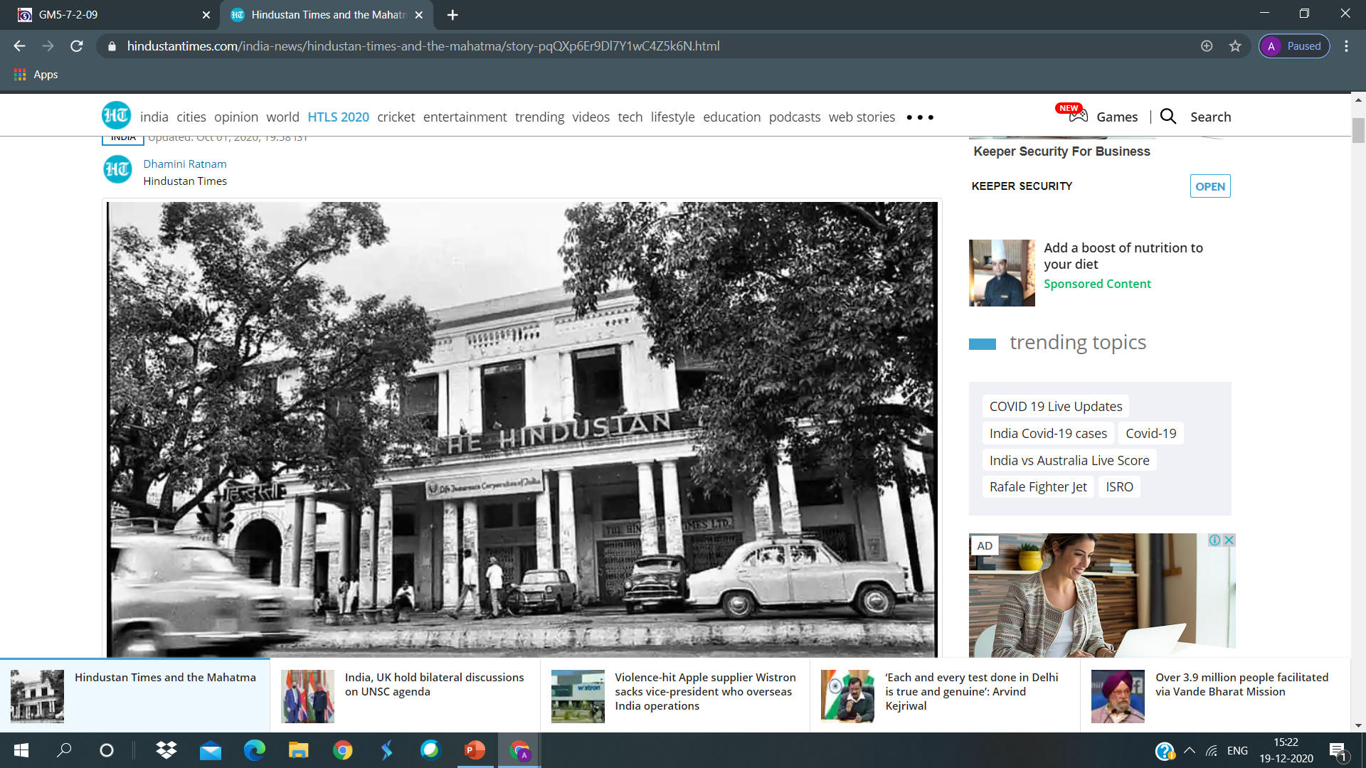
History of Newspapers
The Hindustan Press (Delhi) was inaugurated by Mahatma Gandhi

Slide 12
History of Newspapers
1876- Vernacular Press Act was promulgated
1881- Kesari and Maratha were started by Bal Gangadhar Tilak
Young India, Indian Opinion, Navjivan, Harijan by Mahatma Gandhi
National Herald by Jawaharlal Nehru
1910-Indian Press Act was clamped
Rs.500-2000 as a security deposit

Slide 13
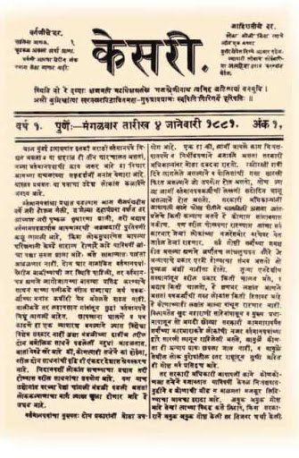
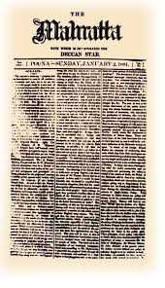
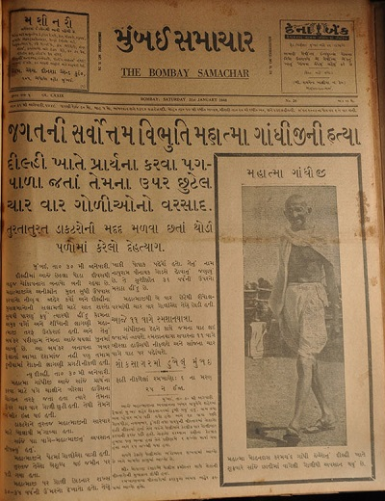
History of Newspapers

