Slide 1
Media Studies
Media Studies encompasses the academic investigation of the mass media from perspectives such as sociology, psychology, history, semiotics- Oxford Reference
In Simple words- Seeing Media and its content from different angles and understanding its effect on various aspects

Slide 2
Objectives
1. | To provide an understanding of media theories
2. | To understand the relationship of media with culture and society
3. | To understand Media Studies in the context of trends in Global Media

Slide 3
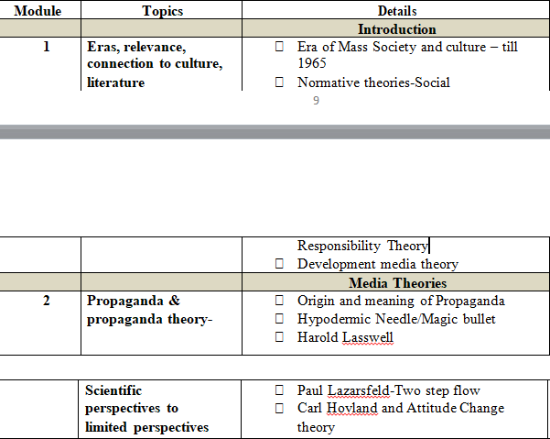
What to Study?
Syllabus

Slide 4
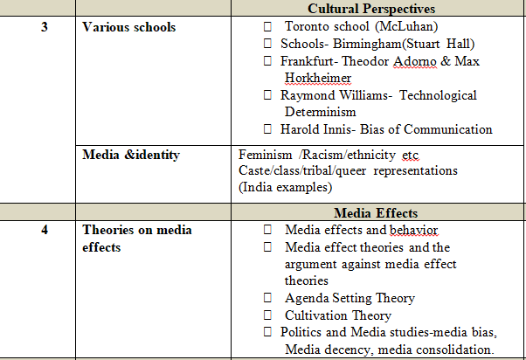

Slide 5
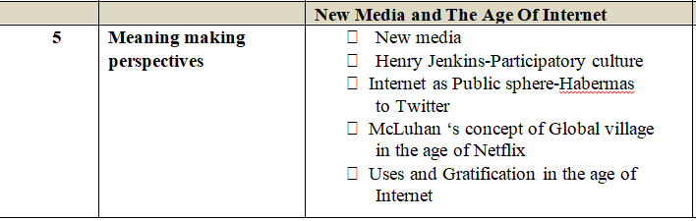
Some Reference Books
Mass communication theory- Dennis Mcquail
Mass communication theory: foundations, ferment and future-Stanley j Baran & Dennis k Davis
Introduction to mass communication: media literacy and culture updated edition 8th edition
Introduction to mass communication – Stanley j baran
Media and cultural studies-meenakshi gigi durham & douglas m kellner
Social media: a critical introduction- christian fuchs

Slide 6
Download the following App for notes
EDUSANCHAR

Slide 7
We will be studying a lot of theories. So, what is it?
Theories are constructed in order to explain, predict and master phenomena (e.g. relationships, events, or the behavior). In many instances we are constructing models of reality.
A theory makes generalizations about observations and consists of an interrelated, coherent set of ideas and models.
e.g.- The Big Bang Theory, Evolution Theory

Slide 8
Ask these questions to yourself
What happens after death?
Why Sun rises from the east and sets in the west?
What can be done to stop COVID-19?
The Janata Curfew will break the chain of corona.
Aren’t we trying to explain or predict the phenomenon in all these examples?

Slide 9
Defining Theory
Theories …are set of statements asserting relationships among classes of variables (Bowers & Courtright).
“ Explanations and predictions of social phenomena… relating the subject of interest…to some other phenomena” (Bailey).
“Any conceptual representation or explanation of a phenomenon” (Steve Littlejohn).
“Sets of ideas of varying status and origin which may explain or interpret some phenomenon” (Denis McQuail).

Slide 10
Mass Communication and Theory
  So little agreement about what constitutes a generally accepted theory of mass communication?
  Communication’ itself carries many problems. Either ‘mass media’ or ‘communication’ would cover a dozen disciplines and raise a thousand problems. –several hundred theories.
  Personalized and ever-evolving and dynamic.

Slide 11
The Four Eras in Mass Communication Theories
Era of Mass Society Theory (1850-1940)
Era of Scientific perspective on Mass Media (1940-1950)
Era of Limited effects(1950-1960s)
Era of cultural criticism (1960s-1980s)

Slide 12
Module 1- Topic 1
Era of Mass Society and Culture

Slide 13
Mass Society…It was an effect of Industrialization
An early twentieth-century model of the social organization of industrial/capitalist societies comprising a vast workforce of atomized, isolated individuals without traditional bonds of locality or kinship, who were alienated from their labor by its repetitive, unskilled tendencies.
Such individuals were entirely at the mercy of
. totalitarian ideologies and propaganda;
. influence by the mass media (comprising, in this period, the press, cinema and radio).

Slide 14
Mass society theory was an understandable response to the economics and politics of the 1930s, and was neatly summed up in Charlie Chaplin’s film Modern Times (1936).
It has view that media is influential but problematic.
It is rooted in a nostalgia for golden age of rural life and anticipates a nightmare future where we all lose our individuality and become servants to machine.
The modern image of mass society begins with the French aristocrat Alexis de Tocqueville who toured the United States of America in the 1830s in search of the ‘secret of democracy’.
In a democracy, the greatest concern is that the majority will tyrannize and exploit diverse smaller interests

Slide 15
Tocqueville’s classic description of mass society
An innumerable multitude of men, all equal and alike, incessantly endeavoring to procure the petty and paltry pleasures with which they glut their lives. Each of them, living apart, is a stranger to the fate of all the rest. His children and his private friends constitute to him the whole of mankind. As for the rest of his fellow-citizens, he is close to them but he sees them not; he touches them be he feels them not.

Slide 16
Mass society theory argues that with industrialization and subsequent social changes, people have become isolated and alienated.
Non-elites in particular are also highly available for mobilization because they lack attachment to independent groups, the local community and voluntary associations.
E.g. Rise of Nazi Germany

Slide 17
Read this very carefully to understand
Some thinkers of this era blamed industrialization for disrupting peaceful, rural communities and forcing people to live in urban areas merely to serve in their factories, mines or homes.
e.g.- Frankfurt School: mass society was linked to a society of alienated individuals held together by a culture industry that served the interests of capitalism

Slide 18
In a nutshell
Refers to a society with a mass culture and large-scale, impersonal, social institutions.
Mass society theory has been active in a wide range of media studies, where it tends to produce apocalyptic visions of what television and cinema are doing to the masses

Slide 19
Mass Culture
A set of cultural values and ideas, that arises from common exposure of a population to the same cultural activities, communications media, music and art etc.
E.g. Cinema, Popular bands

Slide 20
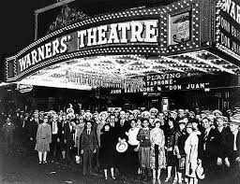
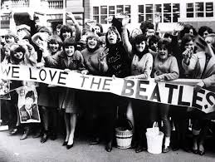
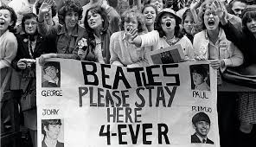
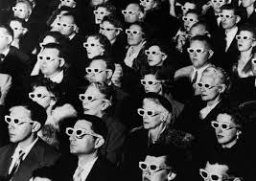

Slide 21
The Era of Scientific Perspective
This has the view that media is not as powerful as previously imagined in mass society era.
The era emphasized the use of scientific research and experiments that were carefully conducted.
This perspective says that media reinforces social trends and strengthens rather than threatening the status quo.

Slide 22
The Era of Limited Effects
There are factors like Family, church, society which limit the effects of Media

Slide 23
The Era of cultural criticism
Media enables dominant social elites to maintain power.
Characterized by domination of one culture over another

Slide 24
References
MASS COMMUNICATION THEORY- Foundations, Ferment, and Future- SEVENTH EDITION- by Stanley J. Baran and Dennis K. Published by Ceneage Learning
COMMUNICATION, CULTURAL AND MEDIA STUDIES- The Key Concepts by John Hartley With additional material by Martin Montgomery, Elinor Ronnie and Marc Brennan- Rutledge Publication
https://www.masscommunicationtalk.com/different-theories-used-mass-communication.html

Slide 25
The End

