Slide 1
Unit IV
Key Marketing
Dimensions

Slide 2

Role of
Consumer
Organisation
https://www.youtube.com/watch?v=rd58fzZSxo8

Slide 3

Consumer Organisation
To protect consumers
Eg. Consumer guidance society of
India, Voice
https://youtu.be/_3odZWPQ_A4

Slide 4
Role of Consumer Organisation
1. Creating Consumer Awareness
2. Assistance in legal cases
3. Recommendation to government
4. Education of consumers

Slide 5
Role of Consumer Organisation
5. Makes business sensitive to consumer needs
6. Resolving consumer complaints
7. Protection of environment
8. Publishing information

Slide 6
Role of Consumer Organisation
9. Organising protests
10 Product testing

Slide 7
MARKETING
ETHICS

Slide 8
Concept of Marketing Ethics
Derived from Greek word “Ethos”
Which means Character or fundamental Values
Guiding beliefs or ideals that characterize a group
Branch of philosophy concern with human conduct

Slide 9
Unethical Practices in Marketing
Targeting to Children
Dramatisation of Children
Unhealthy Products
https://youtu.be/fsfXddAVMxM
https://youtu.be/nZXWUd-sGDk
https://youtu.be/cx0458MJwT0
https://youtu.be/ekR5Lx63ZUk

Slide 10
Unethical Practices in Marketing
https://www.youtube.com/watch?v=6ttdOfJT2jk
4. Exorbitant Prices – High price of medicines
5. Privacy Concerns
6. Trade mark Violations

Slide 11

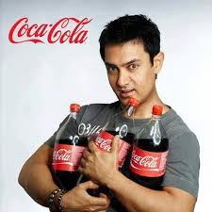
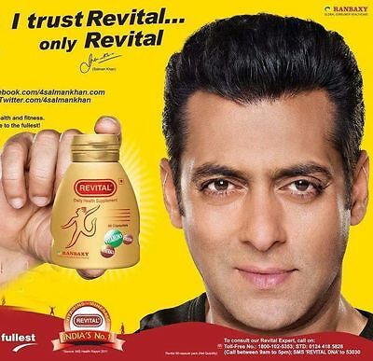
Unethical Practices in Marketing
7. Unethical sales Promotion
8. Celebrity Endorsement
9. Artificial Shortage

Slide 12
Unethical Practices in Marketing
10. After sale service Concerns

Slide 13
Niche Marketer
Small Market Segment
Eg. Rolls Royce, Rolex,
https://youtu.be/OkND3_7GYGw

Slide 14
Advantages of Niche Marketing
1. Less Investment
2. Less Risk
3. Higher Profit
4. Brand Loyalty

Slide 15
Advantages of Niche Marketing
5. Customer Satisfaction
6.Competitive Advantages

Slide 16
Advantages of Niche Marketing
5. Customer Satisfaction
6.Competitive Advantages

Slide 17
Market Challengers
https://youtu.be/1GCr2WzqcCE
Market Leader
https://youtu.be/6Xx1ZDWrPUs
Market Followers
https://youtu.be/O86sDJ8RxLE

Slide 18
Rural Marketing
Marketing of goods and services in rural areas.
70% population lives in villages
Offer huge opportunities to marketers

Slide 19
RURAL
MARKETING

Slide 20
Features of Rural Marketing
Scattered in Nature
Total 6,40,000 villages
55% villages have population less than 500
2. Size of Rural Demand

Slide 21
Features of Rural Marketing
3. Consumer Behaviour
Price sensitive
Value for money
Buy in small packs
4. Mode of Payment

Slide 22
Features of Rural Marketing
5. Awareness
6. Rural Income
7. Opinion Leaders
8. Lifestyle

Slide 23
Strategies for Effective Rural Marketing
Distribution Strategy
Delivery Van
Syndicated Distribution
https://youtu.be/qlGcd_5fyzI

Slide 24
Strategies for Effective Rural Marketing
2. Communication Strategy
Advertisement
Fairs and exhibitions
Sponsorship of local events

Slide 25
Strategies for Effective Rural Marketing
3. Sales force Management
4. Warehousing Strategy
5. Village cooperative strategy
Purchase directly

Slide 26
Strategies for Effective Rural Marketing
6. Sales Promotion strategy
Sell on instalment
Offers on local festivals
Free samples or free gifts
7. Pricing Strategy
Penetration strategy

Slide 27
Strategies for Effective Rural Marketing
8. Media Mix strategy
Hoardings
Van publicity
Drama
Lottery / Bus tickets
Puppet shows
9. Product Strategy
Small packets
More durable

Slide 28
Green
MARKETING

Slide 29
Meaning of Green Marketing
Environment friendly business activities
Definition
According to AMA
“Green Marketing is the marketing of products that are presumed to be environmentally safe”

Slide 30
Contribution to the Growth of Green Marketing
Undertake R & D to develop eco friendly products
Adopt anti pollution measures
Recycling waste products
Educating people about benefits of eco friendly products

Slide 31
Contribution to the Growth of Green Marketing
5. Inviting suggestions from employees, customers, for developing eco friendly products
6. Encourage people to demand eco friendly products

Slide 32
Challenges in selling Green Products
False safety claim
High price
Not available everywhere

Slide 33
Importance of Green Marketing
Protection of environment
Public Health
Corporate Image
Competitive advantages

Slide 34
Importance of Green Marketing
5. Education of customers
6. Responsible Corporate citizen
7. Influence consumer behaviour

Slide 35
Case study on Orchid hotel

Slide 36
Digital
MARKETING

Slide 37
Meaning of Digital Marketing
Use of electronic device for marketing of goods and services
Use of computers, tablets, Smartphone etc.

Slide 38
Form of Digital Marketing
Internet Marketing
B2B
B2C
C2C
2. Social media Marketing
Twitter, Facebook, Whatsapp

Slide 39
Form of Digital Marketing
3. Telemarketing – call centres
4. Mobile Marketing

Slide 40
Trends in Digital Marketing
Artificial Intelligence
Growing importance of videos
Personal branding by celebrities on social media
Story telling

Slide 41
Challenges faced by Marketing Manager in 21st century
New and faster technology, redefined values, and shifting customer demands are changing the way businesses operate in the twenty-first century.
The delivery of goods, services, and spare parts will be done by e-commerce organizations.
In the majority of developed countries, the population is aging.
Human resources is being transformed from a specialized, stand-alone function to a broad, corporate competency.
HR policies and program initiatives will have to be responsive to market conditions and global business structures.
Importance of Global Leadership in the 21st century

Slide 42
Impact of Globalization - leads to strategic challenges of mixed cultures and languages in the business environment.
Managing Across Borders – the ability of an organisation to survive and succeed in the 21 st century transnational workforce and borderless business environment. Challenges in managing enterprise-wide production environments.
Revolution of Information Technology – supported by a new world infrastructure of data communications and telecommunications i.e. use of internet, wireless, e-commerce as part of management tools and easing of technology transfer.
Security Issues with wide usage of internet platform in business transactions.
Increasing demand for knowledge-worker in the knowledge driven organizations.

Slide 43
The Knowledge-Worker “ These new industries differ from the traditional 'modern' industry in that they will employ predominantly knowledge workers rather than manual workers.”
Peter Drucker in The Age of Discontinuity (1969)
Peter Drucker predicted that the major changes in society would be brought about by information. He argues that knowledge has become the central, key resource that knows no geography. According to him, the largest working group will become what he calls knowledge workers. The defining characteristic of these knowledge workers is the level of their formal education. Thus education and development, and to some degree training, will be the central concern of a knowledge society.

Slide 44
The Key to Organisation Survival & Prospering in the 21 st Century
Corporate Strategy - Organizations must have a structure that help to unleash the power of their professionals and to capture the opportunities of today's economy.
Ethical Issues – Understanding the new ethical issues emerged from changes in the social and political landscape and from the development of new technologies.
Social Responsibility – The issues of privacy and confidentially, accessibility to technology issues, property right and ownership issues, freedom of speech…etc
Global Challenges – impact of globalisation and cross-border work culture.
Ecological Issues – Oil exploitation and land rights, food security, mining in Africa, climate vulnerability and ecotourism.
Workforce Diversity - Cultural Awareness/Acceptance (i.e. Ethnic Minorities, Multilingualism, Individual Differences)

Slide 45
Changes in Workplace Environment
Change from fixed contracts to more negotiated relationships
Large rise in part-time and temporary workers
Employees demand greater flexibility and work/life balance
Office structures are moving towards ‘club’ environments
Space for meeting, brainstorming, etc.
Leisure facilities, shops, eateries, dry-cleaning, crèche facilities (day care).
Change in Employment Status, Male Female Total Full time Part time Self-employed

Slide 46
ORGANISATION CHALLENGES IN MANAGING BUSINESS IN THE NEW MILLENNIA (21ST CENTURY)
Enterprise Mobility: is commonly defined as the process of extending business applications / solutions through the use of wireless technology, which can be wireless LAN (WLAN), cellular / mobile, or other technologies, such as wireless broadband.
Maintain and contribute to a sustainable socioeconomic environment: recycle waste and control pollution in the physical environment.
Importance of human capital : to create an organisations which support the workers in their cooperative endeavors.
Improve organisation management (leadership) : Eliminating internal competition, alignment of measurement and reward systems, training and empowering employees to act on the scene and communicate critical problems without delay and to get rapid organisational response.

Slide 47
Consumers’ Trend in the 21st Century
More affluent -Disposable incomes have doubled since 1971
More educated -35% of 24 year olds are graduates
Quality of life -38% would take a pay cut for less stress
More feminised - 40% of workforce are women
Older -40% of the population over 50 by 2010
More fragmented households-Only 1 in 3 households contain a ‘nuclear’ family
Less happy -Over half of adults are ‘unhappy with their standard of living’
Fewer children - 1 in 4 women born in 1972 will not have children
Adapted from: www.henleycentre.com

Slide 48
STRESSFUL ENVIRONMENT
Working on parallel projects, tight schedules and deadlines, high workload, demanding customers and clients, increasing global competition, high degree of flexibility and availability - those are important key factors that characterize and coin the dynamic work environment of the 21 st century.
International competition, globalization and modern technology have prompted organizations to consider downsizing, restructuring, and outsourcing as business strategies and hence, making the work environment more competitive than ever before.
Working under these “conditions” will lead to higher pressure that is burden on professionals within an organisation; no matter if the individual is employed or self-employed.

Slide 49
INDIVIDUAL & LEADERSHIP CHALLENGES
To bear the pressure and face the challenges, workers/professionals need to be flexible and able to adjust to the changing conditions.
Generational leadership - managing an older workforce, as well as the digital generation
Sustainability - protecting today's environment and addressing consumers' needs
Virtual leadership - leading an internet-based environment
The developing world - responding to a changing economy
Diversity - leading a workforce comprising ethnic minorities, mature workers, etc
Globalisation - managing an extended workforce, and social responsibility.

Slide 50
Marketing as a career
Marketing provides a great diversity of opportunities.
Marketing activities account for about one in every three jobs in the United States.
Growth in the field of Marketing
Job opportunities in marketing are growing, while those in production are decreasing.
This is because production lends itself to automation while marketing requires personal contact
Benefits of a Marketing Career
The opportunity to make an above-average income.
Most jobs in marketing, especially those beyond entry-level positions, are interesting and varied.
You will usually have more opportunities to advance in a marketing career than in almost any other area of business!

Slide 51
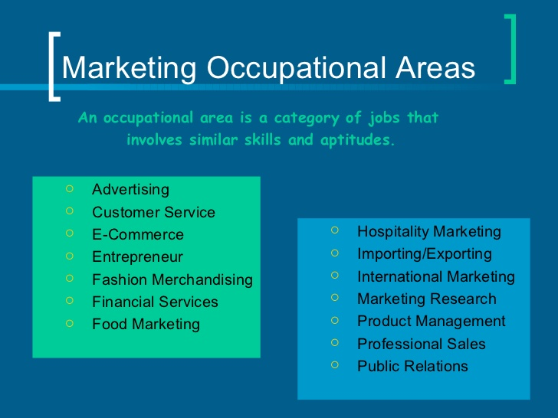

Slide 52
Job Levels in Marketing
Entry-level jobs usually require no prior experience and involve limited decision-making skills.
Career sustaining jobs require a higher level of skill and more decision making.
Marketing specialist employees must show leadership ability and make many decisions on a daily basis.
Marketing supervisors must have good management skills, the ability to make many decisions on a daily basis, and excellent marketing skills.
Manager/owners are competent to run a small business or a significant part of a large business.

Slide 53
SKILLS REQUIRED FOR MARKETING CAREER
COMMUNICATION SKILL
PUBLIC SPEAKING
ANALYTICAL SKILL
CREATIVITY
TECHNICAL SKILL
STRESS MANAGEMENT
NEGOTIATING SKILL
LEARNING ATTITUDE
DATA USE /RESEARCH SKILL
CRISIS MANAGEMENT

Slide 54
FACTORS CONTRIBUTING TO SUCCESS OF BRAND S IN INDIA
DEGREE OF COMPETITION
Size of Market
Element of Novelty
Availability of resources
Innovation and technology
Building Quality
Brand Positioning
Brand Preference
Nature of Product
Using founders name

Slide 55
FACTORS CONTRIBUTING TO FAILURE OF BRAND S IN INDIA
WRONG TIE-UP
FALLING CELEBRITY POPULARITY
LOW BRAND RECALL
BLIND COPYING
Deception
Brand Supremacy
False Marketing
Cut throat competition
Nature of Product
Poor service

