Slide 1
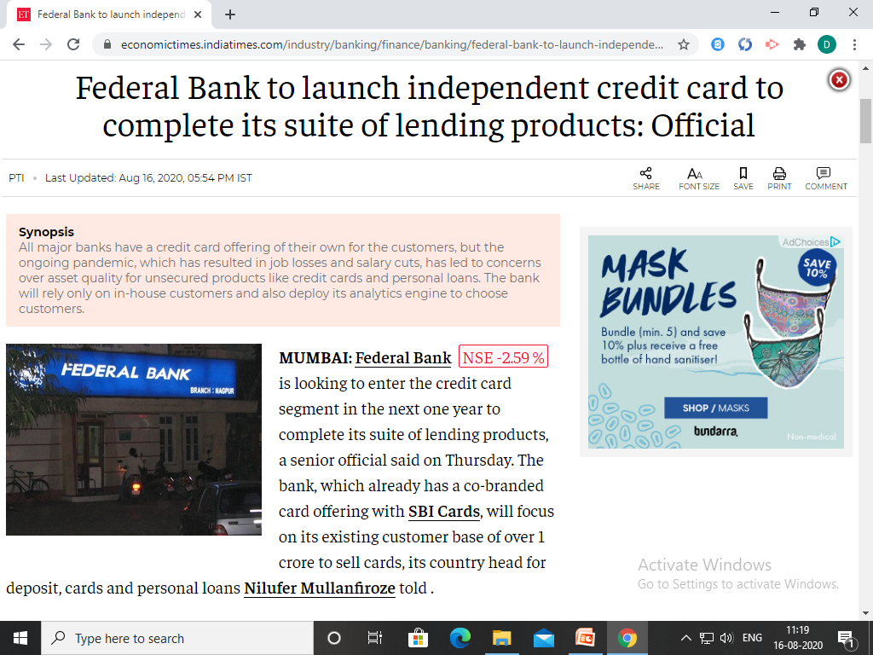

Slide 2
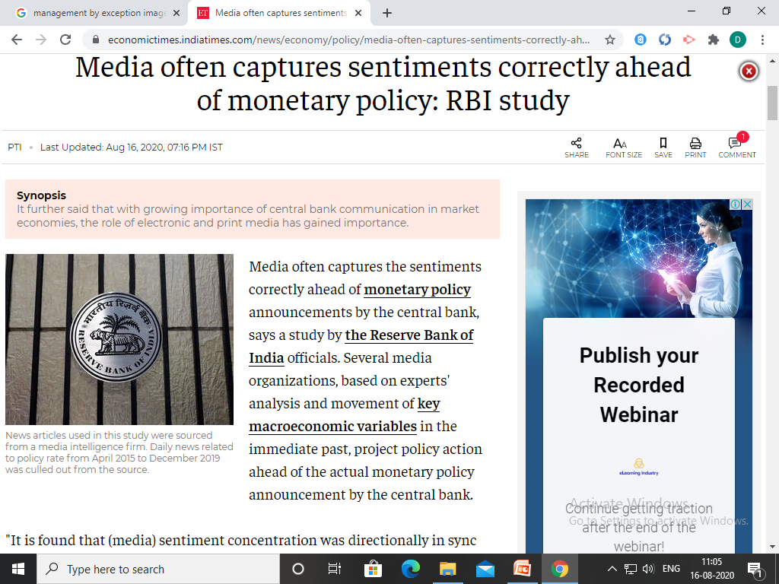

Slide 3
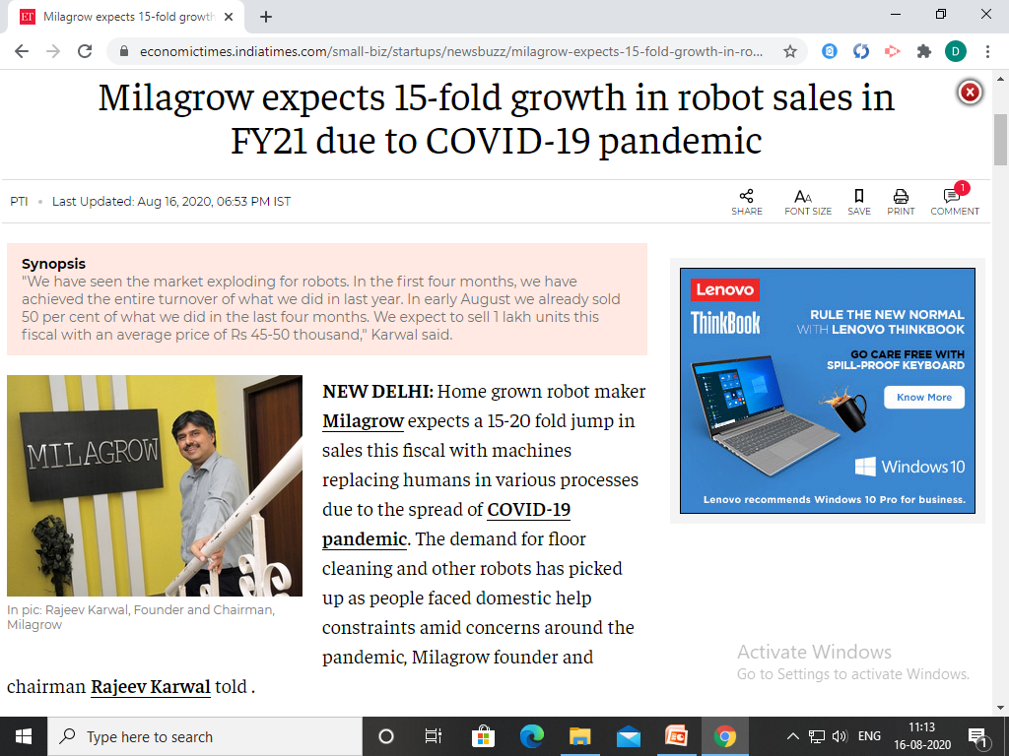

Slide 4
Let’s Revise Previous lecture ....
Integration of activities or actions of the subordinates by the superior
Importance of Coordination
Ddivision of Work
Interdependence of Units
Integration of Individual and Group Goals
Essence of Management
Smooth Functioning
Enhance Morale of employees
Achievement of Goals
Higher Efficiency

Slide 5

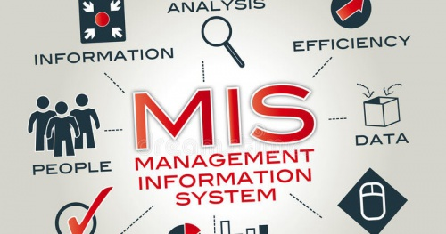
Management Information System

Slide 6
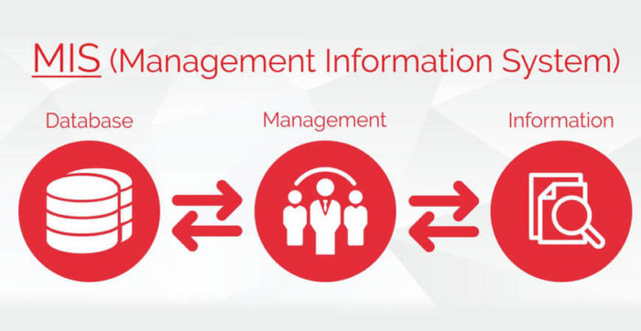
Meaning
Management required complete reliable information to take decision
Proper collection, handling and providing data
Right information at right time, to right person
Information is different than data

Slide 7
Meaning
MIS is planned, organised and systematic collection of relevant, accurate, precise and timely information.
Objectives of MIS
Facilitates decision making
Avoid duplication
Saving time
Improve service

Slide 8
Definition
“A formal method of collecting timely information in a presentable form in order to facilitate effective decision making” - Walter

Slide 9
Features of MIS
Systematic Process
Gathering data
Classification of data
Comparing data
Analysis of data
Transmitting data

Slide 10
Features of MIS
2. Components
Hardware
Software
Data
Procedures
People
Network resources

Slide 11
Features of MIS
3. Unified and Centralised
4. Professional Approach
5. Continuous in Nature
6. Accessibility and Integration

Slide 12
SUMMARY ....
MIS - MIS is planned, organised and systematic collection of relevant, accurate, precise and timely information.
Systematic Process
Components
Unified and Centralised
4. Professional Approach
5. Continuous in Nature
6. Accessibility and Integration

Slide 13
Components of MIS
People
Computer device operator – who operates computer device and feeds data
Support staff
Network administrator -keeping computer network up to date
System specialist – Technical knowledge of the system
End users – who used information

Slide 14
Components of MIS
2. Hardware
Input and out put device
Input device – keyboard, scanners, mouse, sensors etc.
Output device – monitors, printers, network device etc.
Storage device – hard drives , cloud storage

Slide 15
Components of MIS
3. Software
Various programmes and application
Like Microsoft word, Excel . Google Chrome, You tube, Skype, Whatsapp, Linux, etc.

Slide 16
Components of MIS
4. Data
Raw data and processed data
Data can be Text data, numeric data, graphic , image, audio etc.

Slide 17
Components of MIS
5. Network Resources
Server computer – internet
6. Process or procedure
Set of guidelines for use of data

Slide 18


