Slide 1

Hurry Up…
The Infinity War is about to begin

Slide 2
Tybbi: international banking & finance
Akash Deshmukh

Slide 3
Topic: exchange rate

Slide 4
Exchange Rate
It the ratio of two currencies
Exchange Rate is a price of a nation’s currency in terms of another currency.
Foreign Exchange Rate is an equality which provides an relationship between two currencies.
Exchange Rate is the value of base currency expressed in terms of variable currency.
Exchange Rate has two components- Domestic currency & Foreign Currency.
Exchange Rates are quoted by banks on a two-way basis. In India, Inter-Bank market rate is up-to four Decimal places

Slide 5
Representation of Exchange Rate
1 USD = INR 74.8930 – 75.9450
USD/INR 74.8930 – 75.9450
INR 74.8930 – 75.9450 per USD
INR 74.8930 – 75.9450/USD
INR 74.8930 – 75.9450 = 1 USD

Slide 6
Pips (Percentage in Points) or Points
Rupees
Paise
USD/INR 74.8930 – 75.9450
Variable Currency/
Right Hand Side (R.H.S.) Currency
Bid Rate/
Left Hand Side (L.H.S.) Rate
Ask Rate/
Right Hand Side (R.H.S.) Rate
Base Currency/
Left Hand Side (L.H.S.) Currency

Slide 7
Salient Features of Exchange Rate
Base Currency / Transaction currency is the fixed unit of currency unit in a given currency pair/ exchange rate.
Variable Currency / Quoted Currency / Counter Currency is the changing / variable units of currency unit in a given currency pair / exchange rate.
Bid rate is the rate at which bank would buy one unit of base currency.
Ask rate/ Offer rate is the rate at which bank would sell one unit of base currency.
Exchange rates are expressed to base of 1, 10, 100 or 1000 units of base currency.

Slide 8
Salient Features of Exchange Rate
Abbreviations used for currencies are prescribed by International Organisation for Standardisation (ISO). ISO 4217 provides three letter code to represent a particular currency.
Representation of rates as base currency to variable currency are in the format called Association Cambiste Internationale (ACI) convention.

Slide 9
Country | Currency | Abbreviation
USA | US Dollar | USD
UK | Pound Sterling | GBP
Japan | Japanese Yen | JPY
Euro zone | European Euro | EUR
India | Indian Rupee | INR
Switzerland | Swiss Franc | CHF
Canada | Canadian Dollar | CAD
Australia | Australian Dollar | AUD
Singapore | Singaporean Dollar | SGD
Sweden | Swedish kroner | SEK
Germany | Deutsche Mark* | DEM
France | French Franc* | FRF
South Africa | South African Rand | ZAR
Hong Kong | Hong Kong Dollar | HKD
Norway | Norwegian Krone | NOK
Country | Currency | Abbreviation
New Zealand | New Zealand Dollar | NZD
China | Chinese Renminbi (Yuan) | CNY
Mexico | Mexican Peso | MXN
South Korea | South Korean Won | KRW
Turkey | Turkish Lira | TRY
Russia | Russian Rouble | RUB
Brazil | Brazilian Real | BRL
Denmark | Danish Krone | DKK
Poland | Polish Zotty | PLN
Taiwan | New Taiwan Dollar | TWD
Malaysia | Malaysian Ringgit | MYR
Kuwait | Kuwaiti Dinar | KWD
Thailand | Thai Baht | THB
United Arab Emirates | United Arab Emirates Dirham | AED

Slide 10
Features of Exchange Rate
Foreign exchange rates are quoted by banks on a two-way basis
LHS rate in the quotation is called as BID rate and represents the rate at which the bank would buy one unit of the base currency
RHS rate in the quotation is called as ASK rate and represents the rate at which the bank would sell one unit of the base currency
The difference between ASK and BID rates is called as Spread (SPREAD = ASK-BID)
Spread is always positive as ASK>BID
An exchange rate is quoted to two or four decimal places
An exchange rate is expressed to the base of 1, 10, 100 or 1000 base currencies.

Slide 11
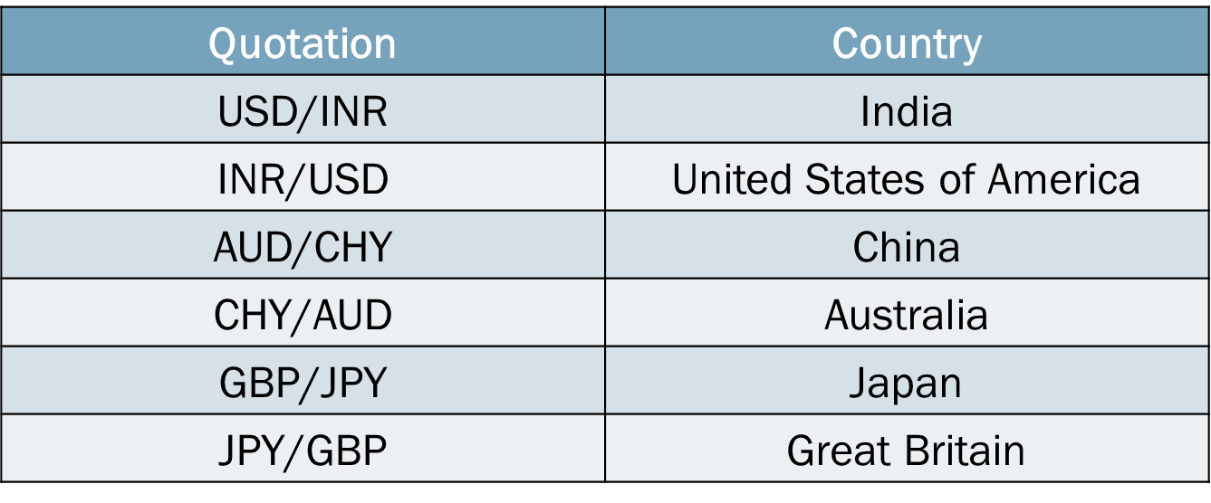
Classifications of Exchange Rate
Direct quotes are the exchange rates which represent a relationship between fixed units of foreign currency against variable number of units of domestic currency.

Slide 12
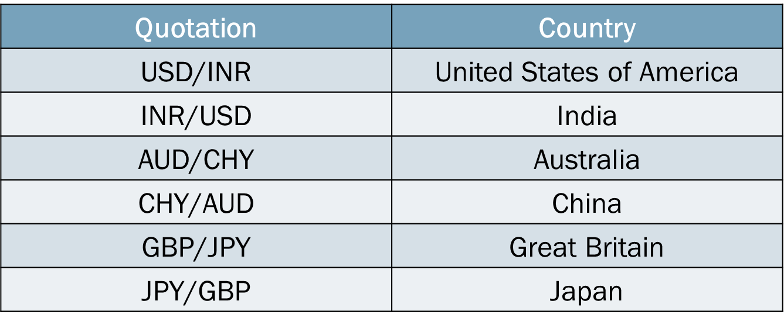
Classifications of Exchange Rate
Indirect quotes / Reciprocal quote / Inverse quote are the exchange rates which represent a relationship between fixed number of units of domestic currency against variable number of units of foreign currency.

Slide 13
Classifications of Exchange Rate
Quotation | Direct Rate | Indirect Rate
USD/INR | India | United States of America
INR/USD | United States of America | India
AUD/CHY | China | Australia
CHY/AUD | Australia | China
GBP/JPY | Japan | Great Britain
JPY/GBP | Great Britain | Japan

Slide 14
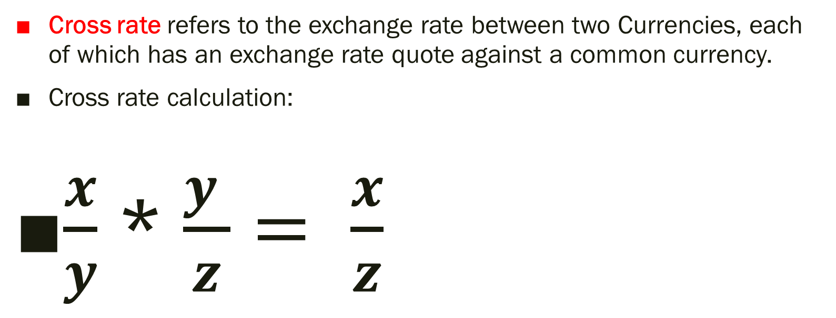
Classifications of Exchange Rate
Cross rate refers to the exchange rate between two Currencies, each of which has an exchange rate quote against a common currency.
Cross rate calculation:
$\frac{x}{y}$ * $\frac{y }{z}= \frac{x}{z}$

Slide 15
Classifications of Exchange Rate
Crossing is the process of calculating cross rates.
Cross Currency rates are combination with vehicle currency rate against the domestic currency to establish the value of the domestic currency against all international currencies.
While calculating the cross rate, the common currency is eliminated to derive the new rate.

Slide 16
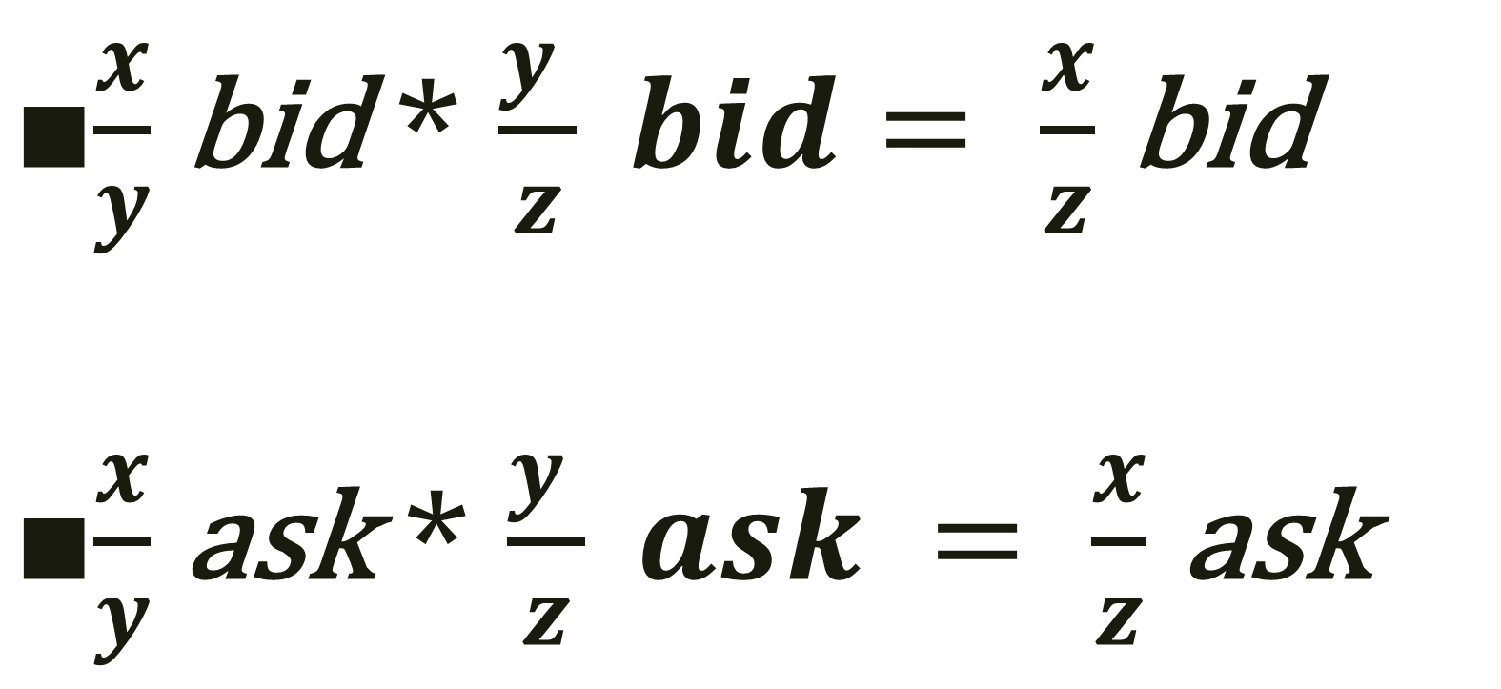
Classifications of Exchange Rate
$\frac{x}{y}$ bid * $\frac{y }{z} bid= \frac{x}{z}$ bid
$\frac{x}{y}$ ask * $\frac{y }{z} ask = \frac{x}{z}$ ask

Slide 17
Classifications of Exchange Rate
There are two methods of crossing
Chain Rule :-
(X/Y) * (Y/Z) = (X/Z)
(X/Z)_{Bid} = (X/Y) _{Bid} * (Y/Z) _{Bid}
(X/Z) _{Ask} = (X/Y) _{Ask} * (Y/Z) _{Ask}

Slide 18
Classifications of Exchange Rate
Inverse Rule or Direct/Indirect Rule:-
(X/Y) * (Z/Y) = (X/Z)
(X/Y) * 1/(Z/Y) = (X/Z)
(X/Z)_{Bid} = (X/Y) _{Bid} * 1/(Z/Y) _{Ask}
(X/Z) _{Ask} = (X/Y) _{Ask} * 1/(Z/Y) _{Bid}

Slide 19


Slide 20


