Slide 1

Universal Banking

Slide 2
Introduction
“A universal bank is a financial service conglomerate combining retail, wholesale and investment banking services under one roof and reaping synergies between them.”
Universal banking is a system in which banks provide a wide variety of comprehensive financial services, including those tailored to retail, commercial, and investment services.

Slide 3
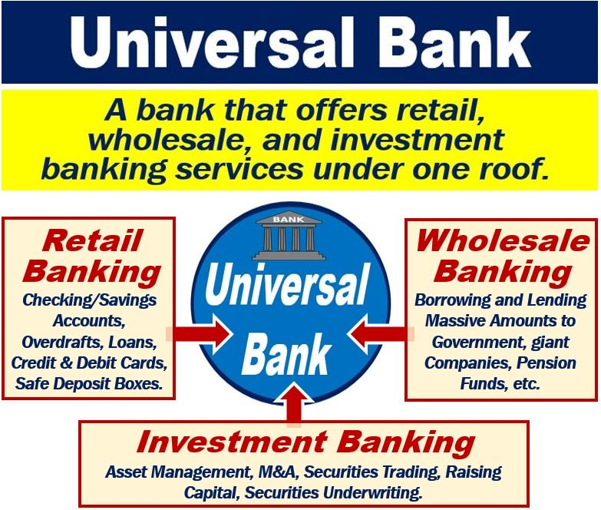

Slide 4
Universal banking is a term for banks that offer a wider variety of services than their competitors, or when compared with traditional banks.
Universal banking is not yet common in the United States, but it's growing; right now, banks in the United States focus more exclusively on investments than their European counterparts.
Banks in a universal system may still choose to specialize in a subset of banking service, even though they technically offer much more to their client base.
Some of the more notable universal banks include Deutsche Bank, HSBC and ING Bank; within the United States, Bank of America, Wells Fargo and JPMorgan Chase qualify as universal banks. *SBI

Slide 5
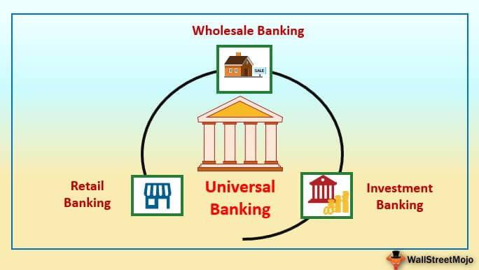

Slide 6
It is a multi purpose & multi functional financial supermarket providing both banking and financial services through single window.
This bank is engaged in diverse kind of banking activities.
Under this bank undertakes broad based & comprehensive activities.
Activities: Loans & Advances, Working Capital Finance, Corporate Advisory Services, Venture Capital , Brokerage, Insurance, Depository Services, Underwriting, etc..

Slide 7
Indian Scenario
New era started in 1990’s , post Liberalisation.
Structural Changes introduced in Banking.
Restriction, Regulation & Changes introduced.
Permission granted for In-house activities.
Reforms in Financial Sectors gave boost to universal banking in India. ( NIP, LPG Reforms)
1997, RBI formed Committee: Chairmanship of Mr. Khan(IDBI) to work on “Harmonizing the role & operation of Development Financial Institution & Banks.”

Slide 8
Recommendation’s of Khan Committee
1. A Progressive move towards universal banking.
2. Development of regulatory framework.
3. A full bank license is eventually granted to DFI’s.
4. RBI +GOI to provide financial support.
5. Corporate Structure : Management, Share Holders, Regulations. (Integration)
6. Mgmt & DFI should be permitted to entre into merger.

Slide 9
Narasimhan Committee II Report 1998, Conversation of DFI into Universal Bank.
Acceptance came in 2002.
Initiated by :ICICI gave presentation to RBI.
(Time Frame)
Merging ICICI with ICICI Bank Ltd.
Initiative taken by : IDBI, EXIM Bank, IFCI & IIBI.

Slide 10
Need for Universal Banking
Liberalisation
Different Product & Service under one roof
Demand of Customers
Usage of Expertise
Interlinked Products & Services

Slide 11
Advantages
Economies of Scale
Profitable Diversification
Resources Utilisation
Investors Trust
Easy Marketing
One roof Services

Slide 12
Limitations
Different Rules & Regulations
Risk of Failure
Monopoly
No expertise in long term lending
Conflict of Interest

Slide 13
Products offering
Retail Banking
Trade Finance
Treasury Management
Banking Products

Slide 14
Services Offering
Accepting Deposits
Cheque Clearance
Advances
Add on services

Slide 15
Other Services
Services to Government
Merchant Banking
Payment & Settlement
Mutual Funds
Depository Services
Wealth Management
Portfolio Management
Bancassurance
NRI Remittance

Slide 16
SWOT Analysis
Strength
Economies of Scale
One point services
Weaknesses
Regulatory Obstacles
NPA
Increased proficiency & productivity
Opportunity
Advantage in marketing
Optimum utilisation of resources
Diversification
Complex term lending
Threat
Victim of own size
Global presence & Market
Elimination of financial inequality
http://www.ijrbs.com/wp-content/uploads/2018/12/Mr.%20Ankur%20Tayal%20&%20Mrs.%20Ridhima%20Tayal.pdf

Slide 17
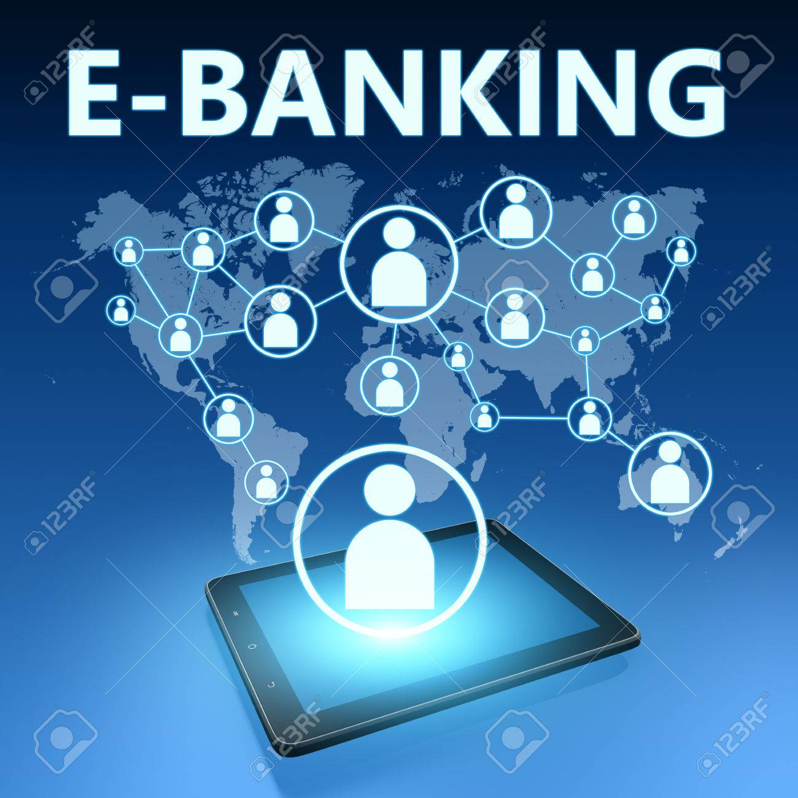

Slide 18
Introduction
Information Technology Revolution
Internet Network
Emergence of E-commerce
E-banking Facilities
1983 & 1988 Committee.
Chairmenship : Dr. C. Rangrajan
(Dy. Governer of RBI)
Obj : Customer Services, Home Keeping, Decision Making , Productivity & Profitability.

Slide 19
Electronic banking has many names like e banking, virtual banking, online banking, or internet banking.
It is simply the use of electronic and telecommunications network for delivering various banking products and services.
Through e-banking, a customer can access his account and conduct many transactions using his computer or mobile phone.
E-banking is a safe, fast, easy and efficient electronic service that enables you access to bank account and to carry out online banking services, 24 hours a day, and 7 days a week.

Slide 20
E-banking enables the following:
1. Accurate statement of all means available in your bank account
2. Statement of current account, credits, overdrafts and your deposits
3. Execution of national and international transfers in various currencies
4. Execution of all types of utility bill payments (electricity, water supply, telephone bills, etc..)
5. Carrying out customs payments
6. Electronic confirmation for all transactions executed by E-banking

Slide 21
Basis | Traditional Banking | E- Banking Practices
Global Coverage | Traditional Practice provides limited coverage. | E-Banking Practices involve global coverage while sitting at home/office.
Marketing Tool | Traditional Practice does not provide proper marketing tools. | E-Banking provides the facility of marketing of products/ schemes online easily.
Prompt Services | Traditional Practices involves process which requires more time. | E-Banking same lot of line as there is no need to stand in long queues.

Slide 22
Basis | Traditional Banking | E- Banking Practices
Reduction of errors/ Frauds | Traditional banking practices do not provide a complete check on banking transactions. | With the system of reconciliation of inter-branch transactions, frauds and errors could be reduced.
Paperwork | Bank executives have to perform a lot of paperwork which increases both time and cost. | Cost and time could be reduced or everything is to be through some interval and no need for huge paperwork.
Risk of carrying cash | In the case of traditional business, a person has to carry cash at each point of time. | E-banking provides banking without carrying cash as plastic money (ATMs, Credit cards are available)

Slide 23
Features of E-banking
24 X 7
Anywhere
Easy transfer of fund
Services at home
Cost reduction
Multiple Delivery Channel
Scientific Way
Easy Accessibility

Slide 24
Advantages
24 X 7
Convenience
Low cost
Customer Satisfaction
Profitable Banking
Time Saved
Service banking

Slide 25
Constraints
Start up cost
Training
Maintenance
Lack of skilled personnel
Security
Restricted Business

Slide 26
Electronic Delivery Channels
ATM
Smart Cards
Tele Banking
Internet Banking
Mobile Banking

Slide 27
SWOT ANALYSIS
Strength
Weaknesses
Opportunity
Challenges

Slide 28
Payment & Settlement System
Large Value System
RTGS
High Value Clearing
Retail Payment System
Paper Based System
CCIL
Electronic Payment Instrument
EFT
NEFT
ECS

Slide 29
Banking Technology
POS Terminal
IMPS
NUUP
AEPS
APBS
CBS
CTS
Digital Signature
M-Wallet

Slide 30
Online Account Process
Form filling & generation of Temporary Customer Reference Number.
Detail of Applicant ( Type of Account, Nomination, Product & Services)
Submission of Document along with Form.
Documents : Passport Size Photograph, KYC Form, Form 60 or PAN Card, Aadhar Card, Residential Proof, etc.)

Slide 31
Card Application
Select the type of Card
Providing details
Loan Application
Select the type of Loan
Eligibility Checking
Verification & issue of card
Document verification

Slide 32
KYC : Know Your Customer
Process by which Bank obtains information about identity & address of the customers.
Ensures that banks services are not misused.
Process : At the time of opening account & Periodic updates.
Proof : Identity & Address
GOI Approved : Passport, Driving Licence, Voter’s Identity Card, PAN Card, Aadhar Card, Card issued by UIDAI & NREGA Job Card.
“Small Account”
e-KYC

