Slide 1
E-banking in New Technology

Slide 2
Mapping E-Banking with new Technologies
The e-banking model based on five key domains:-
1. Banks requirements: Determining banks requirements requires an
insight analysis to business, environment, and regulations.
a) Business analysis
This phase includes analyzing banks scope, vision, mission,
strategy, policies, procedures, programs, daily operations, synergies,
core competences, and all aspects of banks daily work.
b) Environmental analysis
Analyzing the stakeholders, who have direct or indirect impact on
banking, in order to determine alliances, economical situations, and so
forth.

Slide 3
Cont…
c) Governmental analysis
This phase includes analyzing governmental and international laws
and standards related to financial operations.

Slide 4
Cont…
2. Customer requirements: Identifying the target customers
(individual, business corporations, and governmental) who will use
e-banking, and their characteristics. Then determining customer’s goals
in the form of functional and non-functional requirements.
a) Functional requirements
This type of requirements, incorporate all required operations and
transactions that the customer needs from banks.
b) Non-functional requirements
Non-functional requirements, affect customer satisfaction. Therefore, an analysis to these requirements must be conducted. In general, common non-functional requirements can be considered that have a direct or indirect impact on customers acceptance to e-banking.

Slide 5
Cont…
3. Banks technological resources and capabilities
Information technology (IT) can be defined as all sources of technology, which is used to create, store, disseminate, exchange, and use information, which includes hardware, software, and telecommunications.
4. Customers technological resource and capabilities
The information technology resources available to customers; which
includes hardware, software, and telecommunications. The customer
capabilities include the skills and abilities of customer to use e banking.

Slide 6
5. Information technology supplies:
An Information technology supply is the market, where, banks can collect IT requirements and services. This phase includes analyzing the available hardware, software, and telecommunications in the market.

Slide 7
Cont…
Requirements Bidirectional Fit to Technological Capabilities: To develop an e-banking system that matches between banks and customer’s capabilities that matches the latest technologies, two type of bidirectional fit take place. First, the requirements bidirectional fit to supplier’s technological capabilities. Second; the requirements bidirectional fit to banks and customers Capabilities.

Slide 8
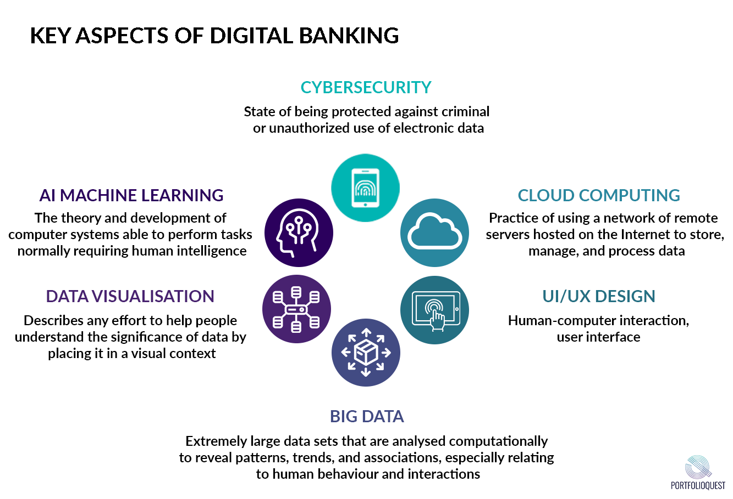

Slide 9
Requirements bidirectional fit to suppliers technological capabilities: Achieving this type of bidirectional fit requires developers to analyze the latest technologies in the market, and then analyze banks and customers requirements as if they use this latest technology. This is an essential step that enables banks to keep up to date with technology. In case the current requirements are less than latest technology capabilities, developers can take into consideration the current requirements, and leave the remaining requirements for future work as a plan.

Slide 10
Requirements bidirectional fit to banks and customers capabilities: Prior researches find out that the successful system is the one that accepted by customers. Therefore, developers have to match between bank and customers functional and non-functional requirements from one side, and match between banks and customers capabilities from the other side. After that, a match must be conducted between the requirements and actual capabilities.

Slide 11
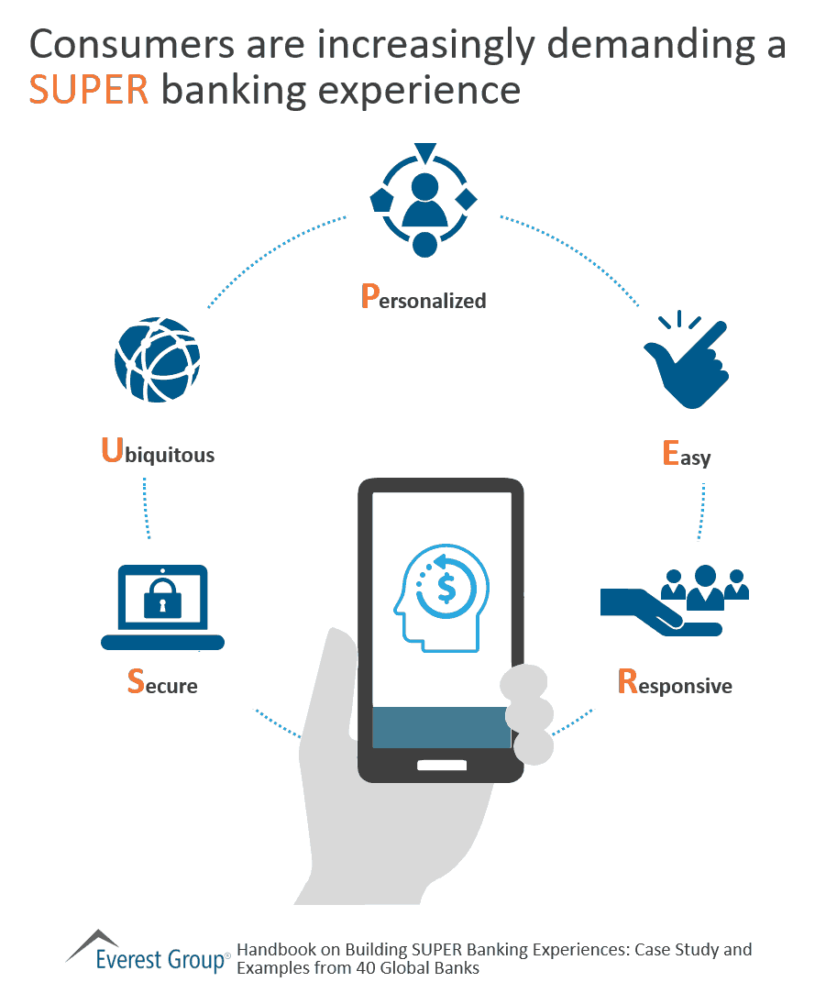

Slide 12
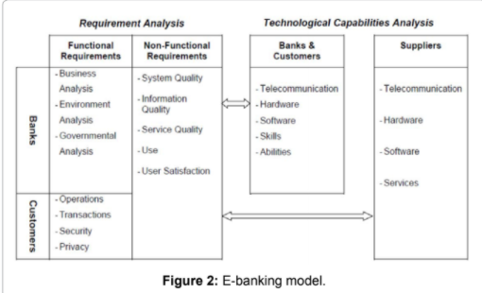

Slide 13
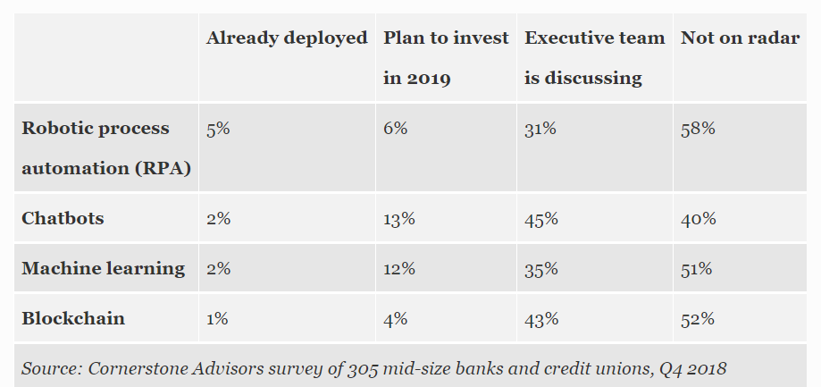
Latest Technologies used in e-Banking

