Slide 1
Module 2. Marketing Decisions
Part. II
TOPICS
BRANDING – CONCEPT, COMPONENTS
BRAND EQUITY – CONCEPT, FACTORS INFLUENCING BRAND EQUITY, ADVANTAGES OF BRAND EUITY
Prepared By HARSHADA MHATRE

Slide 2
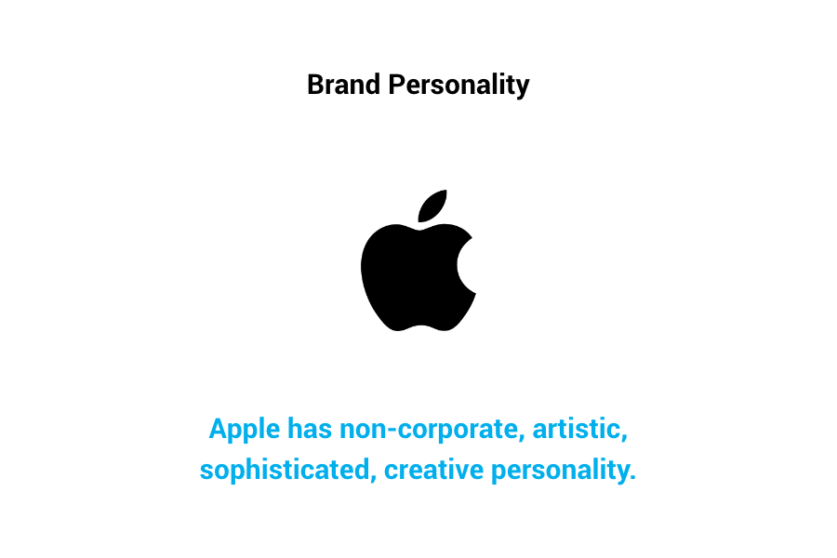
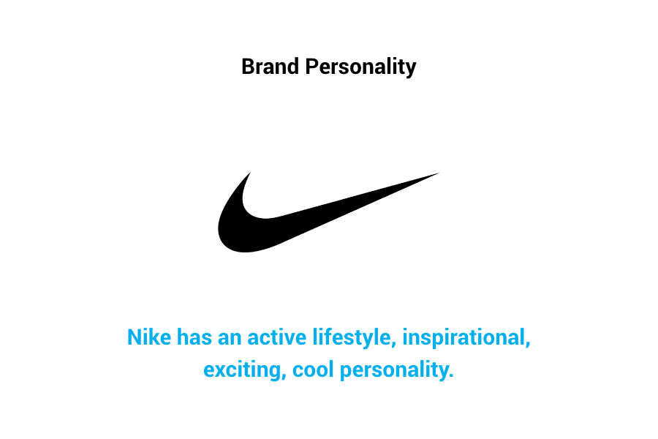
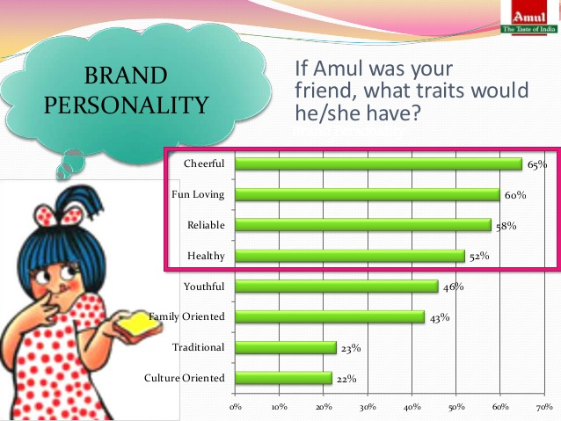

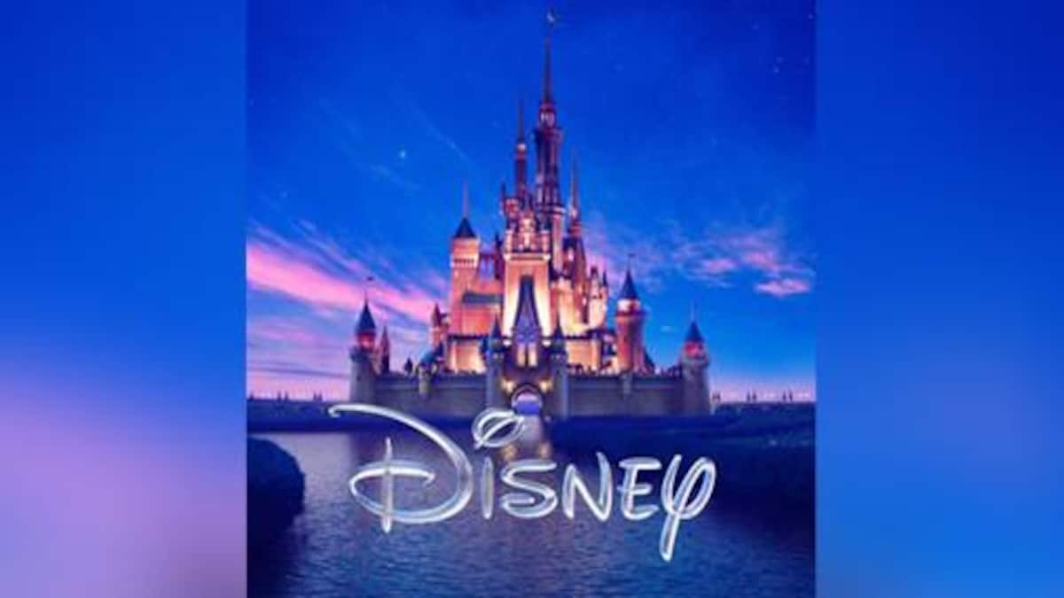
BRANDING - COMPONENTS
1. BRAND PERSONALITY- Marketers must try to personify their brand with personality traits.
2. BRAND FUNCTIONS- Every Brand perform certain functions.
Example : A Tourist hotels perform functions of rest, stay, etc.
McDonald’s: Food Disney : Entertainment

Slide 3
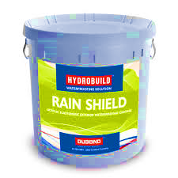
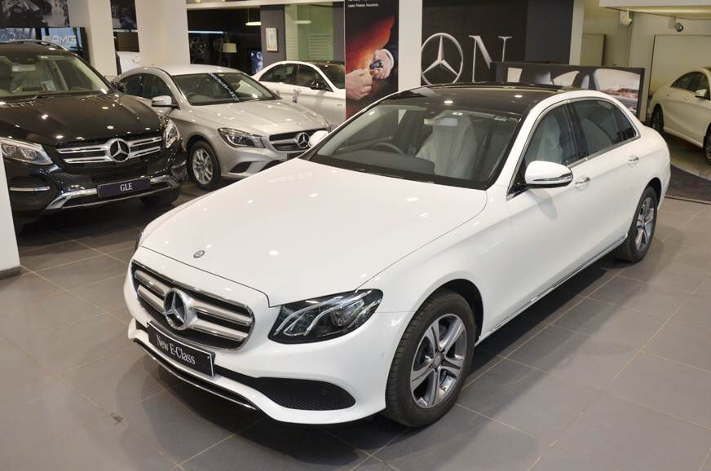

3. BRAND BENEFITS- Brand should offer tangible and psychological benefits.g
Example: a. Waterproof paints for walls.
b. luxury car provides tangible benefits such as interiors and Elegant seating arrangement.
4.BRAND ASSOCIATION- The Brand must Link or Connect to certain associations.
Example : Lux soap- beauty soap of Film stars.
Darjeeling Tea is associated with Darjeeling district.
Goa is associated with clean and Beautiful beaches.

Slide 4
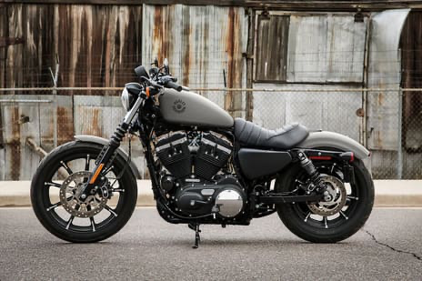
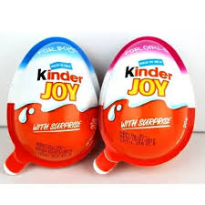
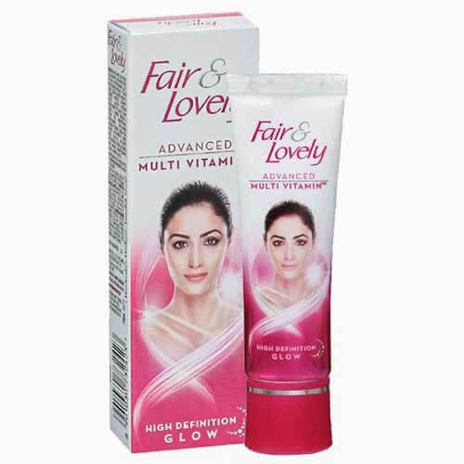
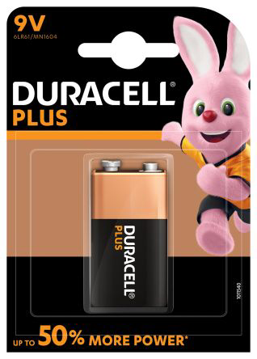
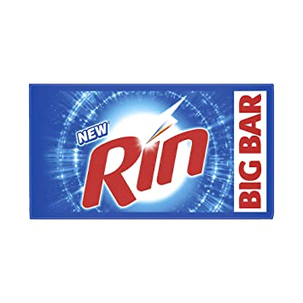
5. BRAND IMAGE- Brand Image is the Perception or general impression of a brand in the minds of Potential Customers. The Brand perception differs from customer to customer.
Example : Harley Davidson is dream bike for Urban youngsters but rural youngsters not heard about it.
6. BRAND NAME- The Brand Name is name given by maker to a product to identify among other products. The brand name must be relevant to the Product, easy to pronounce ,describe benefits.
Example:

Slide 5
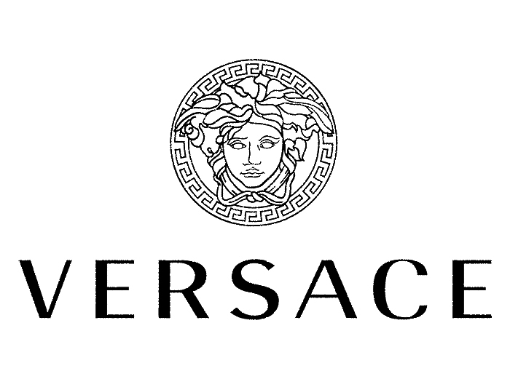
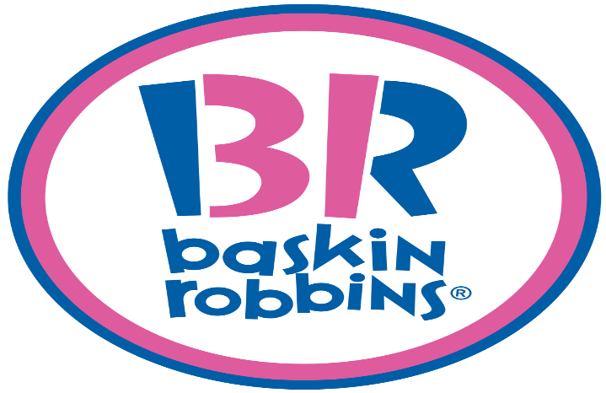

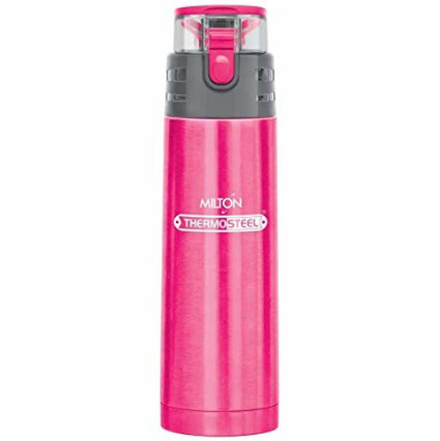
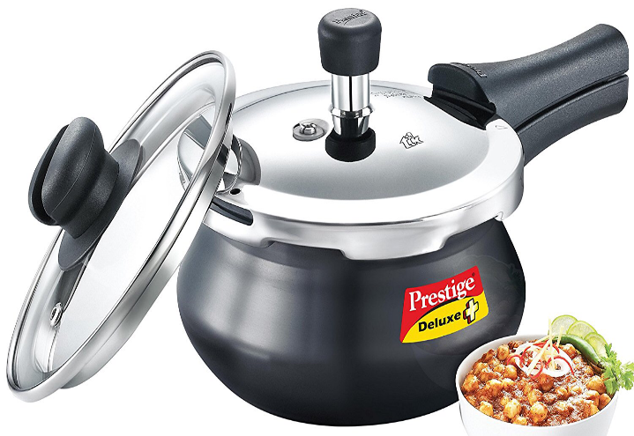

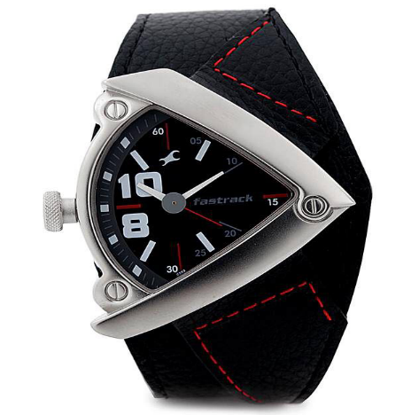
7. BRAND LOGO- A Brand logo is a graphic mark, emblem, symbol or stylized name used to identify a company, organization, product, or brand. It may take the form of an abstract or figurative design, or it may present as a stylized version of the company's name if it has sufficient brand recognition
Example:
8. Brand Features and Design : A Brand may have unique features and design which can give competitive advantage in the market.
Example:

Slide 6
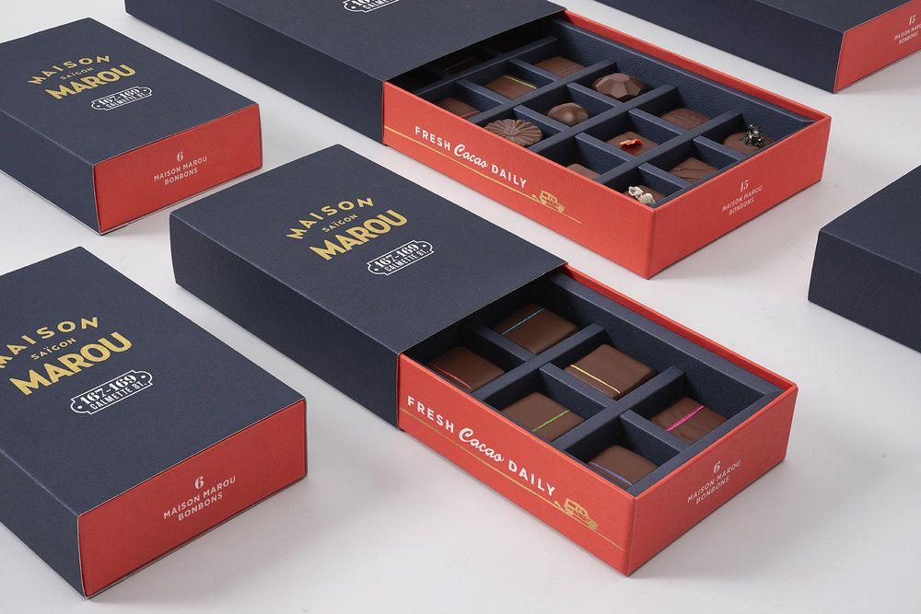

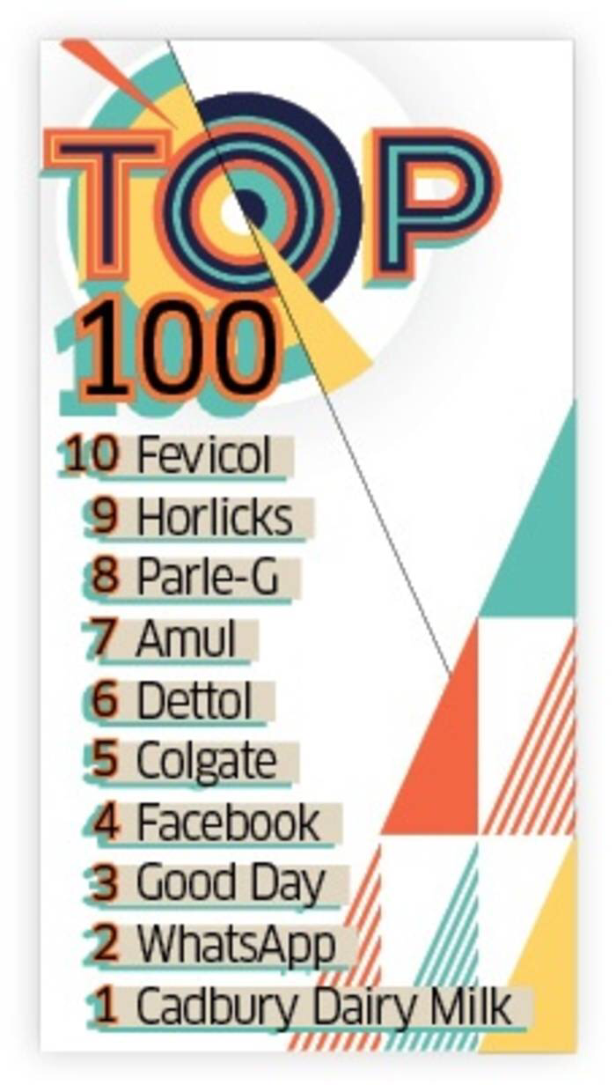
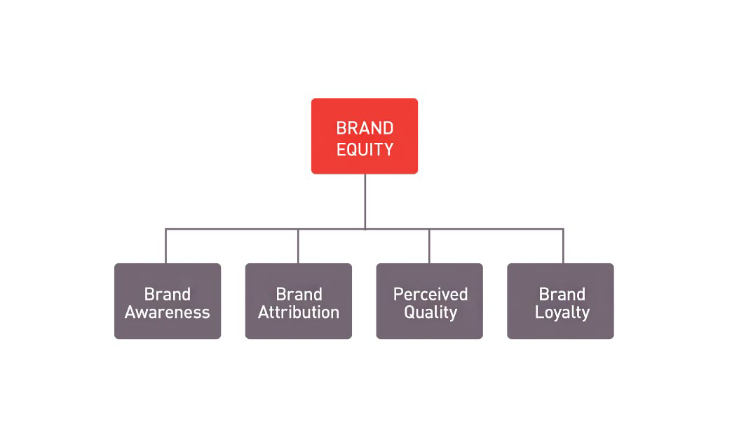
9. Brand Packaging: Brand Packaging offers insight on how to successfully create strategic branding through package design. When design and packaging work together brands are elevated from a commodity to an expression of a consumers lifestyle.
10. Brand Equity : Brand equity is a marketing term that describes a brand’s value. That value is determined by consumer perception of and experiences with the brand. If people think highly of a brand, it has positive brand equity.
Example:

Slide 7
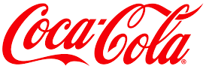

BRAND EQUITY- CONCEPT AND FACTORS
MEANING :- In simple words, BRAND VALUE of a brand in the market.
Brand equity is a marketing term that describes a brand’s value. That value is determined by consumer perception of and experiences with the brand. If people think highly of a brand, it has positive brand equity.
Definition:-
EDWARD TAUBER- “The incremental value of a business above the value of its physical assets due to the market position achieved by its brand and the extension potential of the brand”.
FACTORS INFLUENCING BRAND EQUITY
1. BRAND LOYALTY- Brand loyalty is the positive feelings towards a brand and dedication to purchase the same product or service repeatedly, regardless of a competitor's actions or changes in the environment.

Slide 8
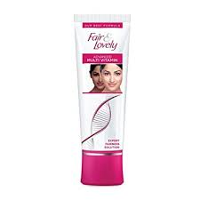



2. BRAND NAME AWARENESS- Brand awareness is one of two dimensions from brand knowledge, an associative network memory model.The extent to which customers are able to recall and remember the name of the brand and product.
Examples: Fair and lovely cream always for girls.
Mc Donald’s known to all
3. BRAND ASSOCIATION- Anything which is deeply remembered by the customers about the particular brand.
Example : Bata –”branded shoes", Woodland- Strong Shoes”

Slide 9




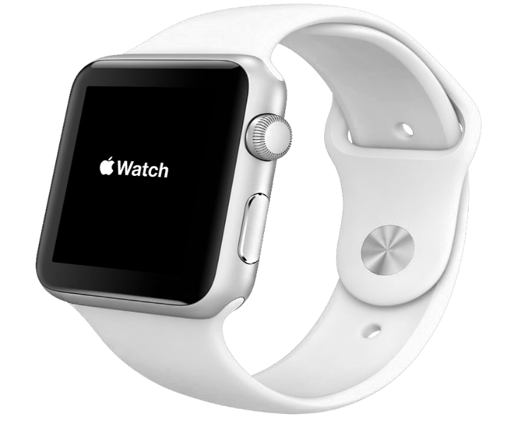
4. BRAND AMBASSADOR- A celebrity hired by the company to promote and create a positive image of the brand and product.
5. BRAND PATENTS- Company can obtain Patents for new and innovative products.
Example: Apple smart watch.

Slide 10

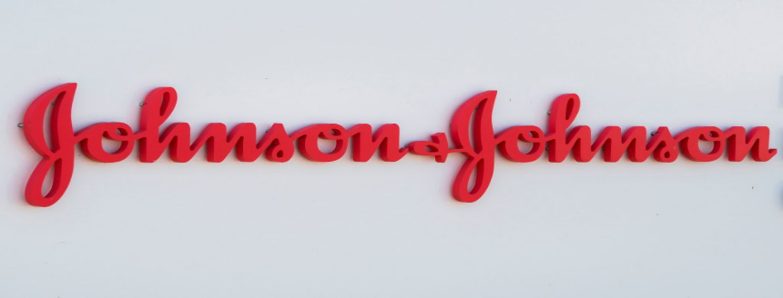



6. BRAND LOGO – A Brand logo is a graphic mark, emblem, symbol or stylized name used to identify a company, organization, product, or brand. It may take the form of an abstract or figurative design, or it may present as a stylized version of the company's name if it has sufficient brand recognition
7. AFTER SALE SERVICE- It is the Services provided to customer after sale of product.
Example : after sale service provided by water filter company

Slide 11
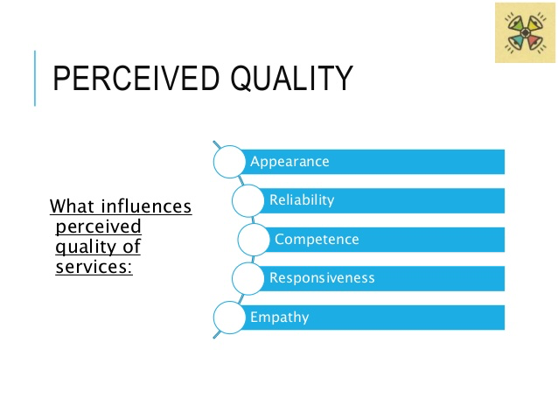
8. Perceived quality of the Brand - Perceived quality can be defined as the customer's perception of the overall quality or superiority of a product or service with respect to its intended purpose, as compare to other competing brands.

Slide 12
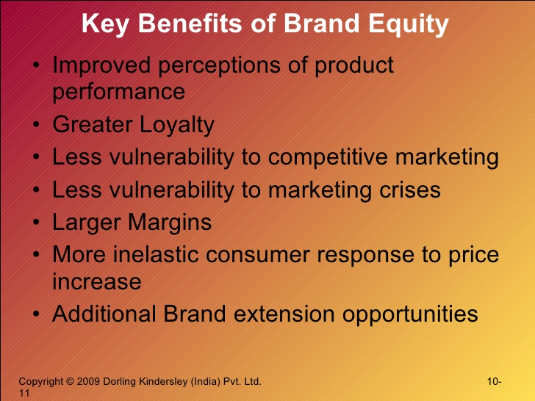
ADVANTAGES OF BRAND EQUITY
1. Customer satisfaction
2. Brand loyalty
3. Premium price and profit margins
4. Trade leverage
5. Customer loyalty
6. Expansion opportunity

