Slide 1
FLORAL ENTREPRENEUR

Slide 2
ENTERPRENEUR
Entrepreneur is defined as a person who constantly seek market opportunities to create something of “recognise value” (Bolton and Thompson, 2000).
Generally, the innovators, inventors, leaders and pioneers are the entrepreneurs.
We can say that entrepreneurship is a process of an entrepreneur’s action in the search of something new such as thinking about gaining profitable opportunities by accepting the risk and take their enterprise to the higher level.

Slide 3
IMPORTANCE OF FLOWER
Flowers are the most versatile and charming gift.
It can be gifted to your loved ones and also look pleasant when gifted to the formal business associates.
Flowers are inexpensive, look pretty and are considered as a perfect gift for any occasion.
There is constant need to buy flowers especially at the time of your birthday, Valentine’s Day, mother’s day, teacher’s day, anniversary, weddings or funerals.

Slide 4
Floriculture is important from the following point of view:
1. Economic point of view
2. Aesthetic point of view
3. Social point of view

Slide 5
THING TO KNOW BEFORE SETUP FLORIST SHOP
KNOWLEDGE OF INDUSTRY
Market Research And Feasibility Studies
Demographic And Psychographic
Home Delivery Of Flowers
Economic Analysis
Catchy Business Name That Is Suitable For A Flower Shop Business
Legal Entity And Insurance Policies
Coordinating With Allied Service Providers
Technical And Manpower Details

Slide 6
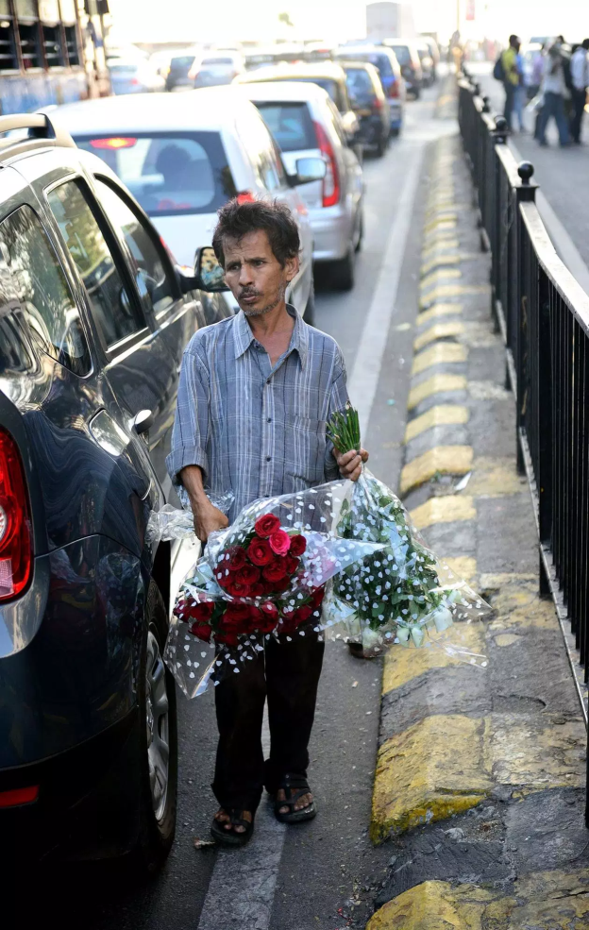


Slide 7
Scope to enter floriculture industry in India
India is blessed with varied and dynamic agro-climatic condition, good quality soil and water made suitable for floriculture
Winter is being very mild and hence there is lot of scope to export Indian flowers to temperate countries during the winter season, when the demand is in peak because of important winter festivals like Christmas, New Year Day and Valentine’s Day.

Slide 8
Labour cost is very low in India, nearly 10-15 times cheaper than that of similar employees in the Netherlands, Israel and Japan.
The Govt. of India has setup the infrastructure for floriculture industry in major cities like New Delhi, Mumbai, Kolkata, Chennai, Bengaluru, Pune etc.
Floriculture is capable of attracting and retaining large number of progressive farmers entrepreneurs.

Slide 9
Due to ample sunlight and optimum temperature during winter, it does not require artificial lighting or heating for green house production of cut flowers.
The Government of India has identified product specific zones for selective research and development of floriculture.
APEDA and GOK have established four flower auction centers including one in Bengaluru, Noida (UP), Mumbai and New Delhi.
APEDA also has setup a marketing center at Aalsmeer (The Netherlands) to promote Indian produce.

Slide 10
