Slide 1
Valuation of Bonds

Slide 2
Bond valuation
Bonds provide holders a regular interest payment till maturity and principle repaid on maturity. The fundamental principle of bond valuation is that its value is equal to the sum of present value of its expected cash flows.
The method for valuation of bonds involves three steps as follows:
Step 1: Estimate the expected cash flows : The usual cash flow cycle of the bond is coupon payments are received at regular intervals as per the bond agreement, and final coupon plus principle payment is received at the maturity. There are some instances when bonds don’t follow these regular patterns. Unusual patterns maybe a result of the different type of bond such as zero-coupon bonds, in which there are no coupon payments. Considering such factors, it is important for an analyst to estimate accurate cash flow for the purpose of bond valuation.
Step 2: Determine the appropriate interest rate that should be used to discount the cash flows. : the next step is to determine the appropriate interest rate to discount cash flows. The minimum interest rate that an investor should require is the interest available in the marketplace for default-free cash flow. Default-free cash flows are cash flows from debt security which are completely safe and has zero chances default. Such securities are usually issued by the central bank of a country, Govt dated securities and T bills.
Consider a situation where an investor wants to invest in bonds. If he is considering to invest corporate bonds, he is expecting to earn higher return from these corporate bond compared to rate of returns of G-Secs. As he is taking a higher risk by investing in corporate bonds, he expects a higher return.

Slide 3
Step 3: Calculate the present value of the expected cash flows (step-1) using appropriate interest rate (step- 2) i.e. discounting the expected cash flows. Now that we already have values of expected future cash flows and interest rate used to discount the cash flow, it is time to find the present value of cash flows. Present Value of a cash flow is the amount of money that must be invested today to generate a specific future value. The present value of a cash flow is more commonly known as discounted value.
The present value of a cash flow depends on two determinants: When a cash flow will be received i.e. timing of a cash flow & the required interest rate, more widely known as Discount Rate (rate as per Step-2) .First, we calculate the present value of each expected cash flow. Then we add all the individual present values and the resultant sum is the value of the bond.
Present Value _{n} = Expected cash flow in the period n/ (1+i) ^{n} Here, i = rate of return/discount rate on bond, n = expected time to receive the cash flow
Bond Value = Present Value ₁ + Present Value ₂ + ……. + Present Value _{n}
Example : A bond that matures in 4 years, has a coupon rate of 10% and has a maturity value of Rs 100. The bond pays interest annually and has a discount rate of 8%.
The cash flow of the bond is (yearwise) : Rs 10, Rs 10, Rs 10,Rs 110

Slide 4
The present value of each cash flow is:
Year 1 – Present Value (PV₁) = Rs10/ (1.08)¹ = Rs 9.26
Year 2 – Present Value (PV₂) = Rs 10/ (1.08)² = Rs 8.57
Year 3 – Present Value (PV₃) = Rs10/ (1.08)³ = Rs 7.94
Year 4 – Present Value (PV₄) = Rs110/ (1.08)⁴ = Rs 80.85
Thus, total Present Value of Bond = 9.25+8.57+7.94+80.85 = Rs 106.62
There are other approaches to bond valuation such as relative price approach, arbitrage-free pricing approach, and traditional approach. But this present value approach is the most widely used approach to bond valuation.
There are many factors such as inflation, credit rating of the bonds, etc. that affect the value of bonds. Furthermore, there are many features of the bond itself determines its intrinsic value. As an investor it is important to be fully aware of what we are investing in, what are the risks involved and how much returns can we expect. Bond valuation tries to take into consideration all the features to determine an accurate present value. This present value can be very helpful for investors & analysts to make an informed investment decision.

Slide 5
Duration
Duration is one of the fundamental characteristics of a fixed-income security (e.g., a bond) alongside maturity, yield, coupon, and call features. It is a tool used in the assessment of the price volatility of a fixed-income security.
Since the interest rate is one of the most significant drivers of a bond’s value, duration measures the sensitivity of the value fluctuations to changes in interest rates. The general rule states that a longer duration indicates a greater likelihood that the value of a bond will fall as interest rates increase.
Duration is commonly used in the portfolio and risk management of fixed-income instruments. Using interest rate forecasts, a portfolio manager can change a portfolio’s composition to align its duration with the expected level of interest rates. The 3 different types of duration are :
1 Macaulay duration (named after Canadian Fredrick Macaulay) is a weighted average of the times until the cash flows of a fixed-income instrument are received.
2.Modified duration metric is a more precise measure of price sensitivity. It is primarily applied to bonds, but it can also be used with other types of securities that can be considered as a function of yield.
3. Effective duration is a measure of the duration for bonds with embedded options (e.g., callable bonds). Unlike the modified duration and Macaulay duration, effective duration considers fluctuations in the bond’s price movements relative to the changes in the bond’s yield to maturity (YTM). In other words, the measure takes into account possible fluctuations in the expected cash flows of a bond.

Slide 6
Macaulay Duration of a bond is a measure of the time taken to recover the initial investment in present value terms. In simplest form, duration refers to the payback period of a bond to break even, i.e., the time taken for a bond to repay its own purchase price. Duration is expressed in number of years.
Calculation :
First, each of the future cash flows is discounted to its respective present value for each period. Since the coupons are paid out every six months, a single period is equal to six months and a bond with two years maturity will have four time periods.
Second, the present values of future cash flows are multiplied with their respective time periods (these are the weights). That is the PV of the first coupon is multiplied by 1, PV of second coupon by 2 and so on.
Third, the above weighted PVs of all cash flows is added and the sum is divided by the current price (total of the PVs in step 1) of the bond. The resultant value is the duration in no. of periods. Since one period equals to six months, to get the duration in no. of year, divide it by two. This is the time period within which the bond is expected to pay back its own value if held till maturity.

Slide 7
Illustration:
Taking a bond with par value of Rs 100 having 2 years maturity, and 10% coupon, and current price of ₹101.79, the cash flows will be (prevailing 2 year yield being 9%):
Duration in number of periods = (Total PV*Time)/Current market price = 379.28/101.79 = 3.73
Duration in years = Duration in periods / nos of periods in 1 year = 3.73/2 = 1.86 years
Modified Duration = Duration in years / ( 1 +disc rate of period/100) = MD = 1.86/(1+0.09/2) = 1.78
Aid to calculation : Discount rate is 9 % annually. Since coupon is given half yearly applied rate is 9/2 = 4.5%. 5/(1.045)^1=4.78, 5/(1.045)^2=4.58, 5/(1.045)^3=4.38, (100+5)/(1.045)^4=88.05, here at the end of 4th year we receive both principal (100) and interest (5), i.e, 100+5=105. 4.78*1=4.78, 4.58*2=9.16, 4.38*3=13.14, 88.05*4=352.20
Time period (half year) | 1 | 2 | 3 | 4 | Total
Inflows (₹) | 5 | 5 | 5 | 105
PV at a yield of 9% | 4.78 | 4.58 | 4.38 | 88.05 | 101.79
PV* time | 4.78 | 9.16 | 13.14 | 352.20 | 379.28

Slide 8
More formally, duration refers to:
The weighted average term (time from now to payment) of a bond's cash flows or of any series of linked cash flows.
The higher the coupon rate of a bond, the shorter the duration (if the term of the bond is kept constant).
Duration is always less than or equal to the overall life (to maturity) of the bond.
Only a zero coupon bond (a bond with no coupons) will have duration equal to its maturity.
Modified duration (MD) is a modified version of Macaulay Duration. It refers to the change in value of the security to one per cent change in interest rates (Yield). Example Taking a bond having 2 years maturity, and 10% coupon, and current price of ₹101.79, the cash flows will be (prevailing 2 year yield being 9%),
MD = 1.86/(1+0.09/2) = 1.78
Duration is useful primarily as a measure of the sensitivity of a bond's market price to interest rate (i.e., yield) movements. It is approximately equal to the percentage change in price for one percent change in yield. For example the duration is the approximate percentage by which the value of the bond will fall for a 1% per annum increase in market interest rate. So, a 15-year bond with a duration of 7 years would fall approximately 7% in value if the interest rate increased by 1% per annum. In other words, duration is the elasticity of the bond's price with respect to interest rates.

Slide 9
PV01
PV01 describes the actual change in price of a bond if the yield changes by one basis point (equal to one hundredth of a percentage point). It is the present value impact of 1 basis point (0.01%) (1%=100 bps) movement in interest rate. It is often used as a price alternative to duration (a time measure). Higher the PV01, the higher would be the volatility (sensitivity of price to change in yield).
Illustration
From the modified duration (given in the illustration 1), we know that the security value will change by 1.78% for a change of 100 basis point (1%) change in the yield. In value terms that is equal to 1.78*(101.79/100) = ₹ 1.81.
Hence the PV01 = 1.81/100 = ₹0.018, which is 1.8 paise. Thus, if the yield of a bond with a Modified Duration of 1.78 years moves from say 9% to 9.05% (5 basis points), the price of the bond moves from ₹101.79 to ₹101.70 (reduction of 9 paise, i.e., 5x1.8 paise).

Slide 10
Illustration 2: Taking a bond with par value of Rs 100 having 4 years residual maturity, and 10% coupon, and current price of ₹ 95, discount rate being 9%:
Duration in number of periods = (Total PV*Time)/Current market price = 360.95/95 = 3.79
Duration in years = Duration in periods / nos of periods in 1 year = 3.79/1 = 3.79 years
Modified Duration = Duration in years / ( 1 + discount int. rate/100) = 3.79/1.09 = 3.47 years
Aid to calculation : Discount rate is 9 % annually. 10/(1.09)^1=9.17, 10/(1.09)^2=8.41, 10/(1.09)^3=7.72, (100+10)/(1.09)^4=77.95, here at the end of 4th year we receive both principal (100) and interest (10), i.e, 100+10=110.
Time period (half year) | 1 | 2 | 3 | 4 | Total
Inflows (₹) | 10 | 10 | 10 | 110
PV at a yield of 9% | 9.17 | 8.41 | 7.72 | 77.95 | 102.98
PV* time | 9.17 | 16.82 | 23.16 | 311.80 | 360.95

Slide 11
Duration is inversely related to YTM and bond’s coupon rate.
Convexity
Calculation of change in price for change in yields based on duration works only for small changes in yields. This is because the relationship between bond price and yield is not strictly linear. Over large variations in yields, the relationship is curvilinear i.e., the reduction in option free bond price is less than the change calculated based only on duration for yield increase, and increase in option free bond price will be more than the change calculated based only on duration for yield decrease. This is measured by a concept called convexity, which is the change in duration of a bond due to change in the yield of the bond.
As the yield on a bond changes so too does its duration. A bond’s convexity measures the sensitivity of a bond’s duration to changes in yield. Duration is an imperfect way of measuring a bond’s price change, as it indicates that this change is linear in nature when in fact it exhibits a sloped or “convex” shape.
A bond is said to have positive convexity if duration rises as the yield declines. A bond with positive convexity will have larger price increases due to a decline in yields than price declines due to an increase in yields.
Positive convexity can be thought of as working in the investor’s favor, since the price becomes less sensitive when yields rise (prices down) than when yields decline (prices up). Bonds can also have negative convexity, which would indicate that duration rises as yields increase and can work against an investor’s interest.
https://www.youtube.com/watch?v=OQ3JDGy4hw0

Slide 12
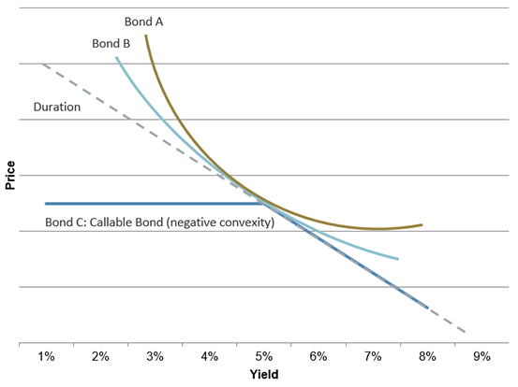
A useful way to visualize a bond’s convexity is to plot the potential price change against various yields. If two bonds have the same duration and yield but differing convexities, a change in interest rates will affect each bond differently. For example, the chart below shows three bonds: a bond with higher positive convexity (Bond A) will be less affected by interest rates than a bond with lower positive convexity (Bond B). On the other hand, a bond with negative convexity (Bond C) will exhibit larger price fluctuations should rates rise than if they were to fall.

Slide 13
Duration and convexity are two metrics used to help investors understand how the price of a bond will be affected by changes in interest rates. How a bond’s price responds to changes in interest rates is measured by its duration, and can help investors understand the implications for a bond’s price should interest rates change. The change in a bond’s duration for a given change in yields can be measured by its convexity.
If rates are expected to increase, consider bonds with shorter durations. These bonds will be less sensitive to a rise in yields and will fall in price less than bonds with higher durations.
If rates are expected to decline, consider bonds with higher durations. As yields decline and bond prices move up, higher duration bonds stand to gain more than their lower duration counterparts.
Calculations using Microsoft Excel
https://www.youtube.com/watch?v=Fb6znTRQhUY

Slide 14
DETERMINANTS TO THE VALUE OF BOND
Market conditions
Ratings
The residual maturity a bond
Prevailing Interest Rate
Liquidity in the market
Demand and supply
Monetary policy
Fiscal policy
Other markets and alternative investment destinations
Risk aversion
Access to money markets by institutions
Economic conditions

Slide 15
Yield curve
A yield curve is a way to measure bond investors' feelings about risk, and can have a tremendous impact on the returns you receive on your investments. It's a graphical representation of the yields available for bonds of equal credit quality and different maturity dates.
In general, short-term bonds carry lower yields to reflect the fact that an investor's money is at less risk. The thinking behind this is that the longer one commit funds, the more he should be rewarded for that commitment owing to the credit risk.
When bond investors expect the economy to grow at a normal pace, without significant changes in the rate of inflation or major interruptions in available credit, the yield curve slopes upward from left to right on the graph as maturities lengthen and yields rise.
An upward slope yield curve indicates that the economy may normally be functioning. The steeper the curve is, the impression is that the economy is normal and not in a recession like a scenario anytime soon.

Slide 16
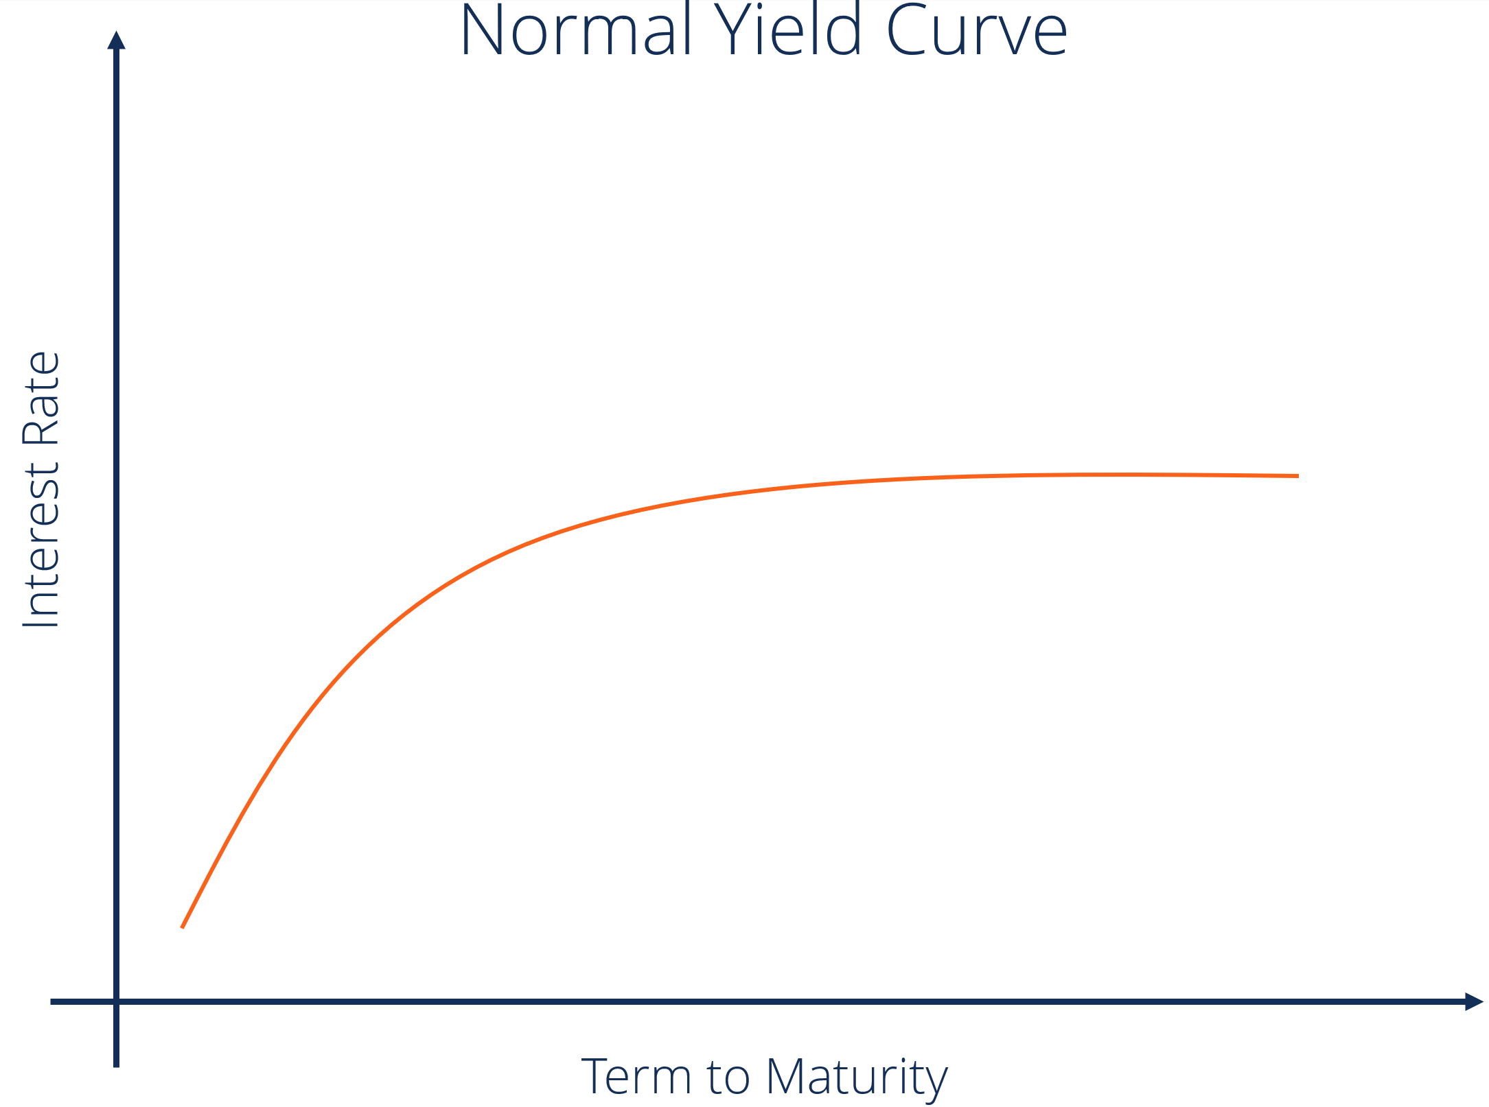

Slide 17
Steep curve : A steep yield curve is generally found at the beginning of a period of economic expansion. After a bout of depression, there is a sudden increase in demand of capital leading to rise in interest rates and inflation. The bond buyers hence demand higher interest in the fear of getting locked down to a low interest rates when an inflation is imminent.
Both the normal and steep curves are based on the same general market conditions. The only difference is that a steeper curve reflects a larger difference between short-term and long-term return expectations.

Slide 18
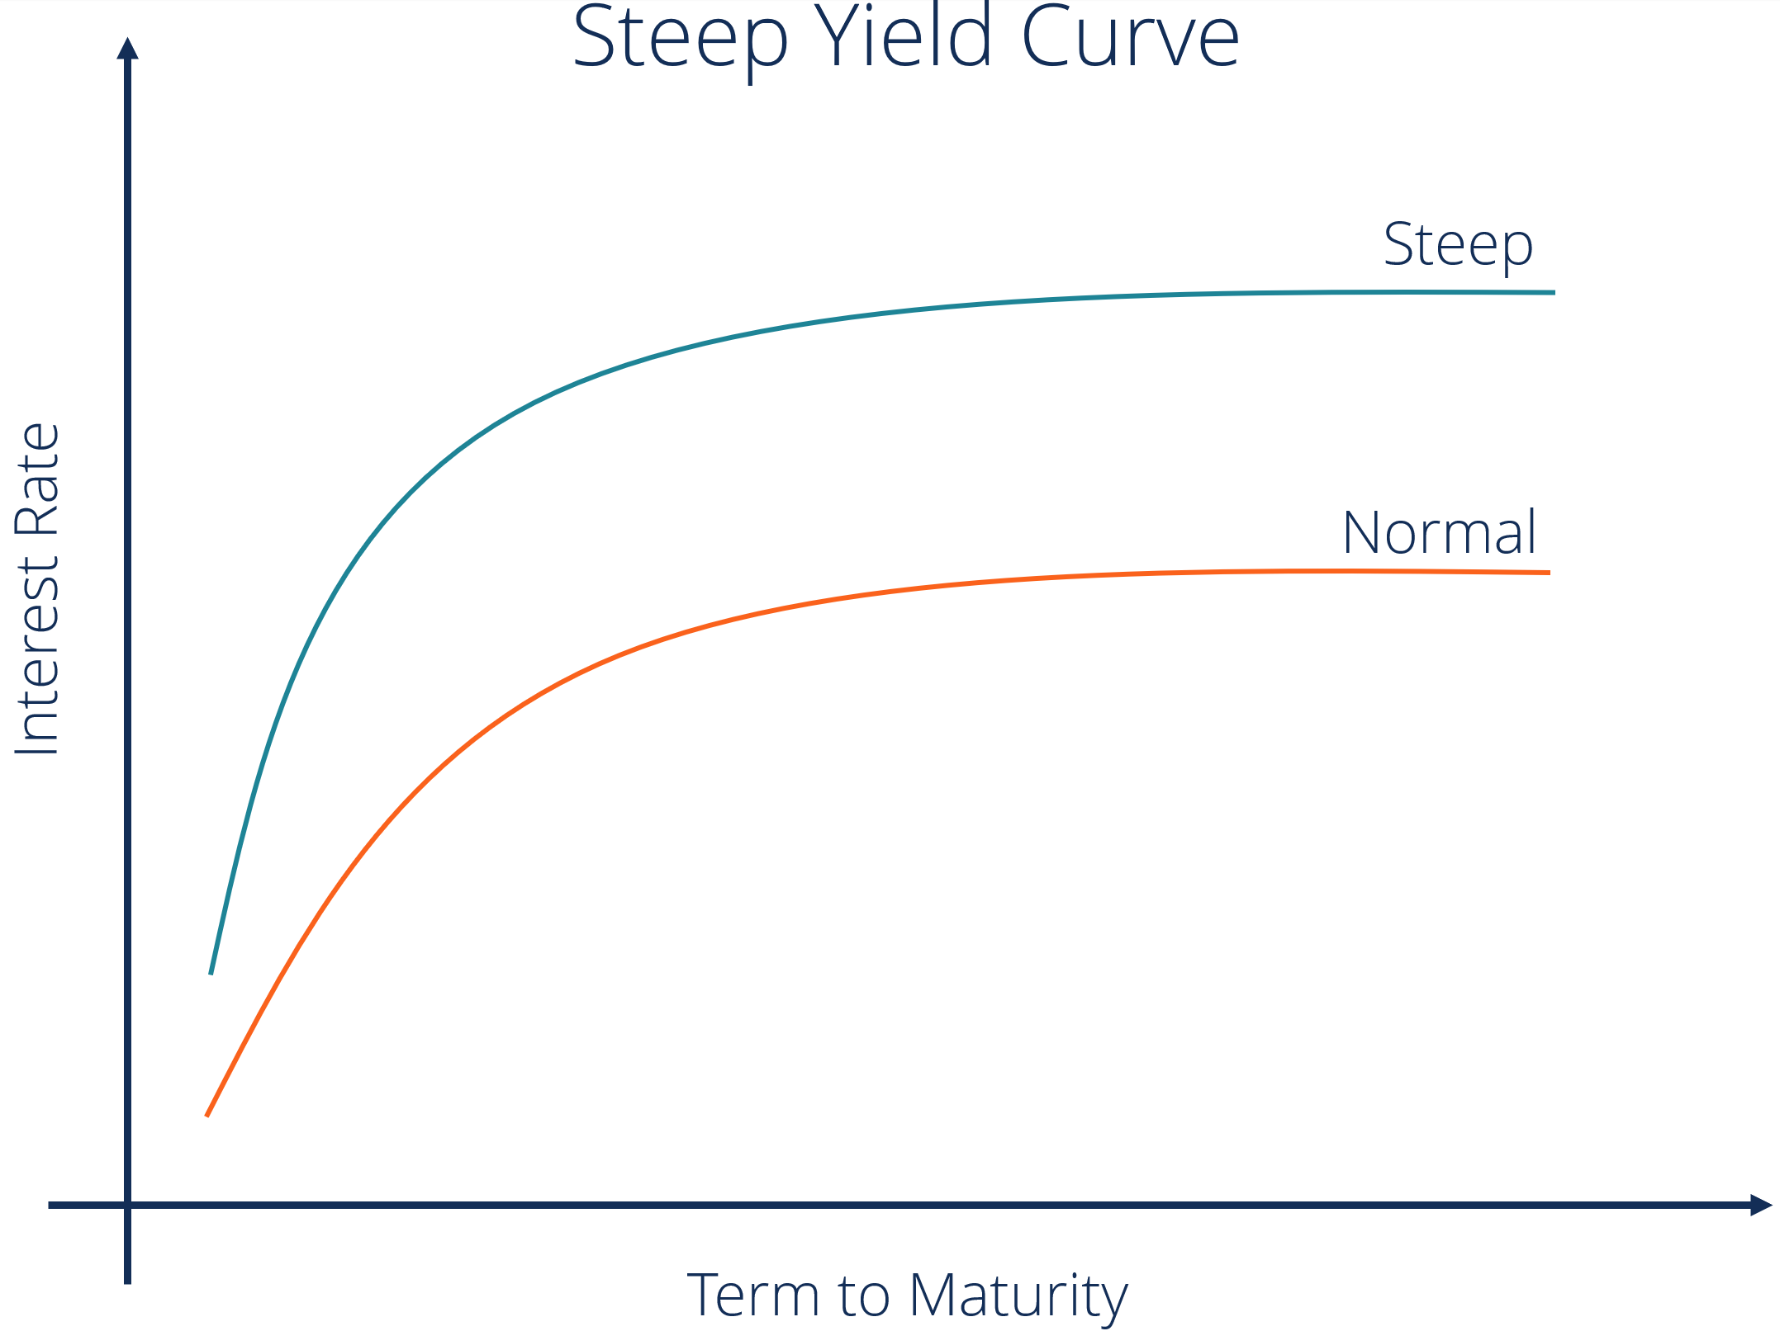

Slide 19
Inverted curve :
When long-term investors believe that this is their last chance to lock in current rates before they fall even lower, they become slightly less demanding of lenders. since lower interest rates generally mean slower economic growth, an inverted yield curve is often taken as a sign that the economy may soon stagnate. So when the yield curve starts to shift toward an inverted shape, it is perceived as a leading indicator of an economic downturn.
An inverted yield curve occurs when short-term debt instruments carry higher yields than long-term instruments of the same credit risk profile.
Inverted yield curves are unusual since longer-term debt should carry greater risk and higher interest rates, so when they occur there are implications for consumers and investors alike.
When short-term interest rates exceed long-term rates, market sentiment suggests that the long-term outlook is poor and that the yields offered by long-term fixed income will continue to fall.
In a growing economy, investors also demand higher yields at the long end of the curve to compensate for the opportunity cost of investing in bonds versus other asset classes, and to maintain an acceptable spread over inflation rates.

Slide 20
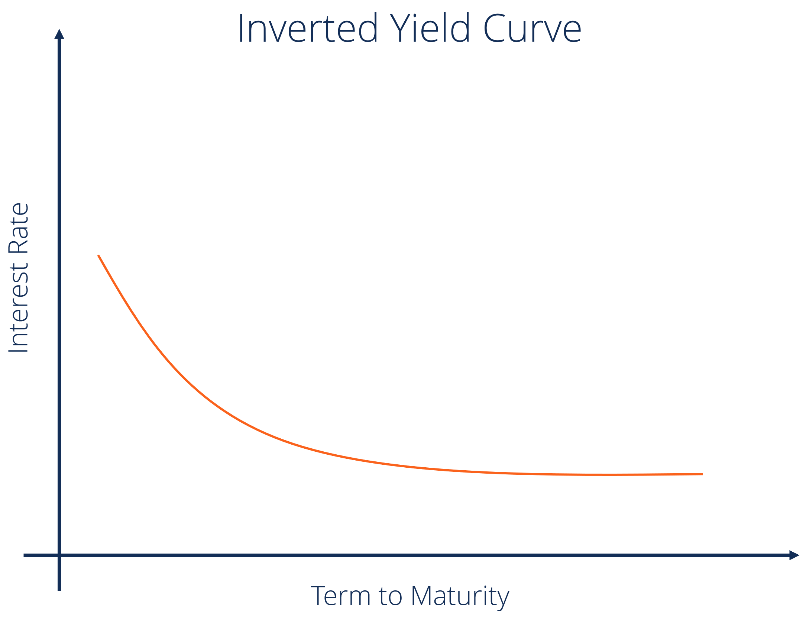

Slide 21
Flat yield curve :
A flat curve happens when all maturities have similar yields. This means that the yield of a 10-year bond is essentially the same as that of a 30-year bond. A flattening of the yield curve usually occurs when there is a transition between the normal yield curve and the inverted yield curve.
Humped
A humped yield curve occurs when medium-term yields are greater than both short-term yields and long-term yields. A humped curve is rare and typically indicates a slowing of economic growth.

Slide 22
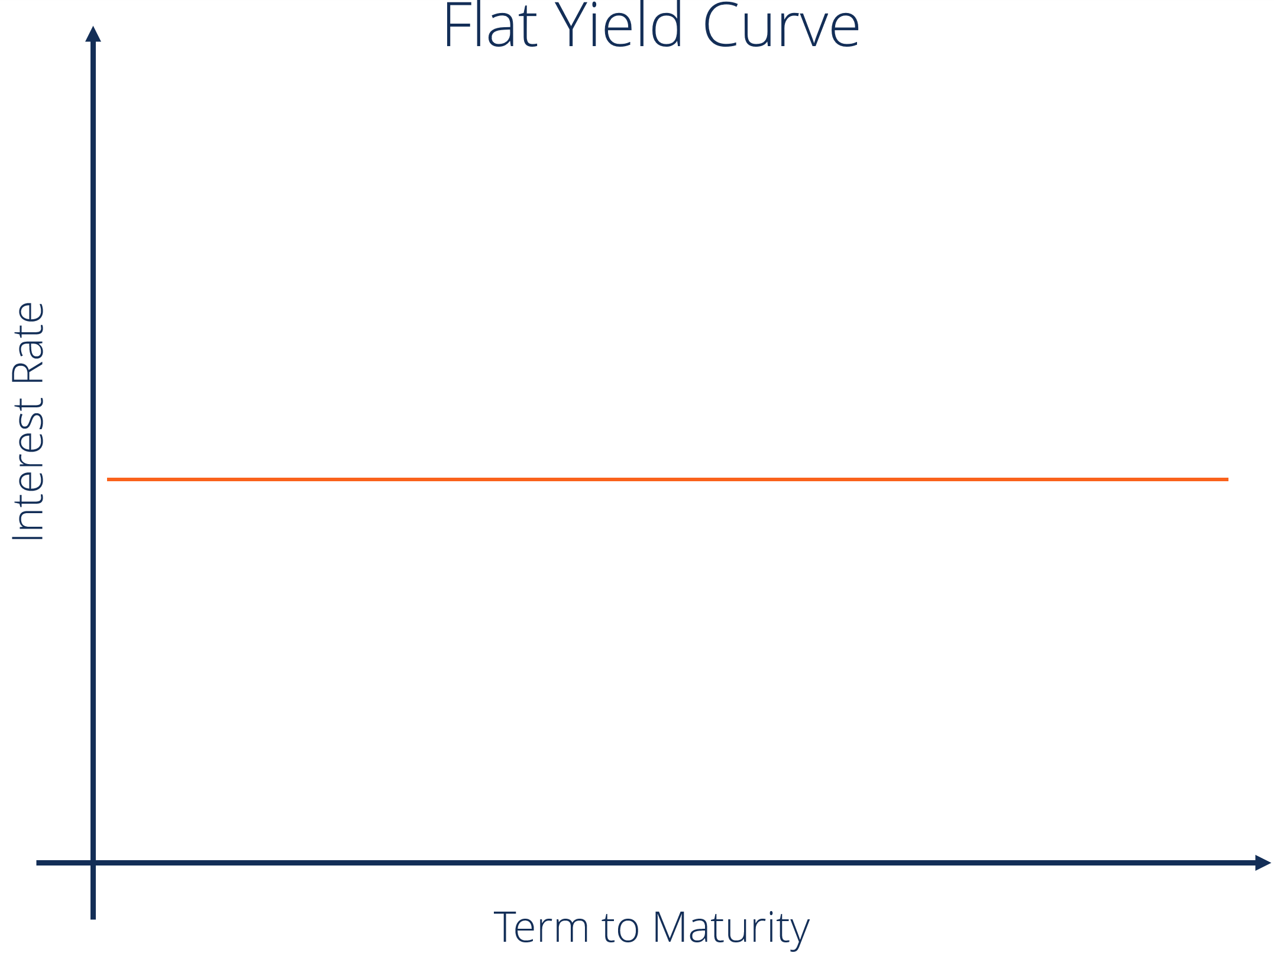

Slide 23
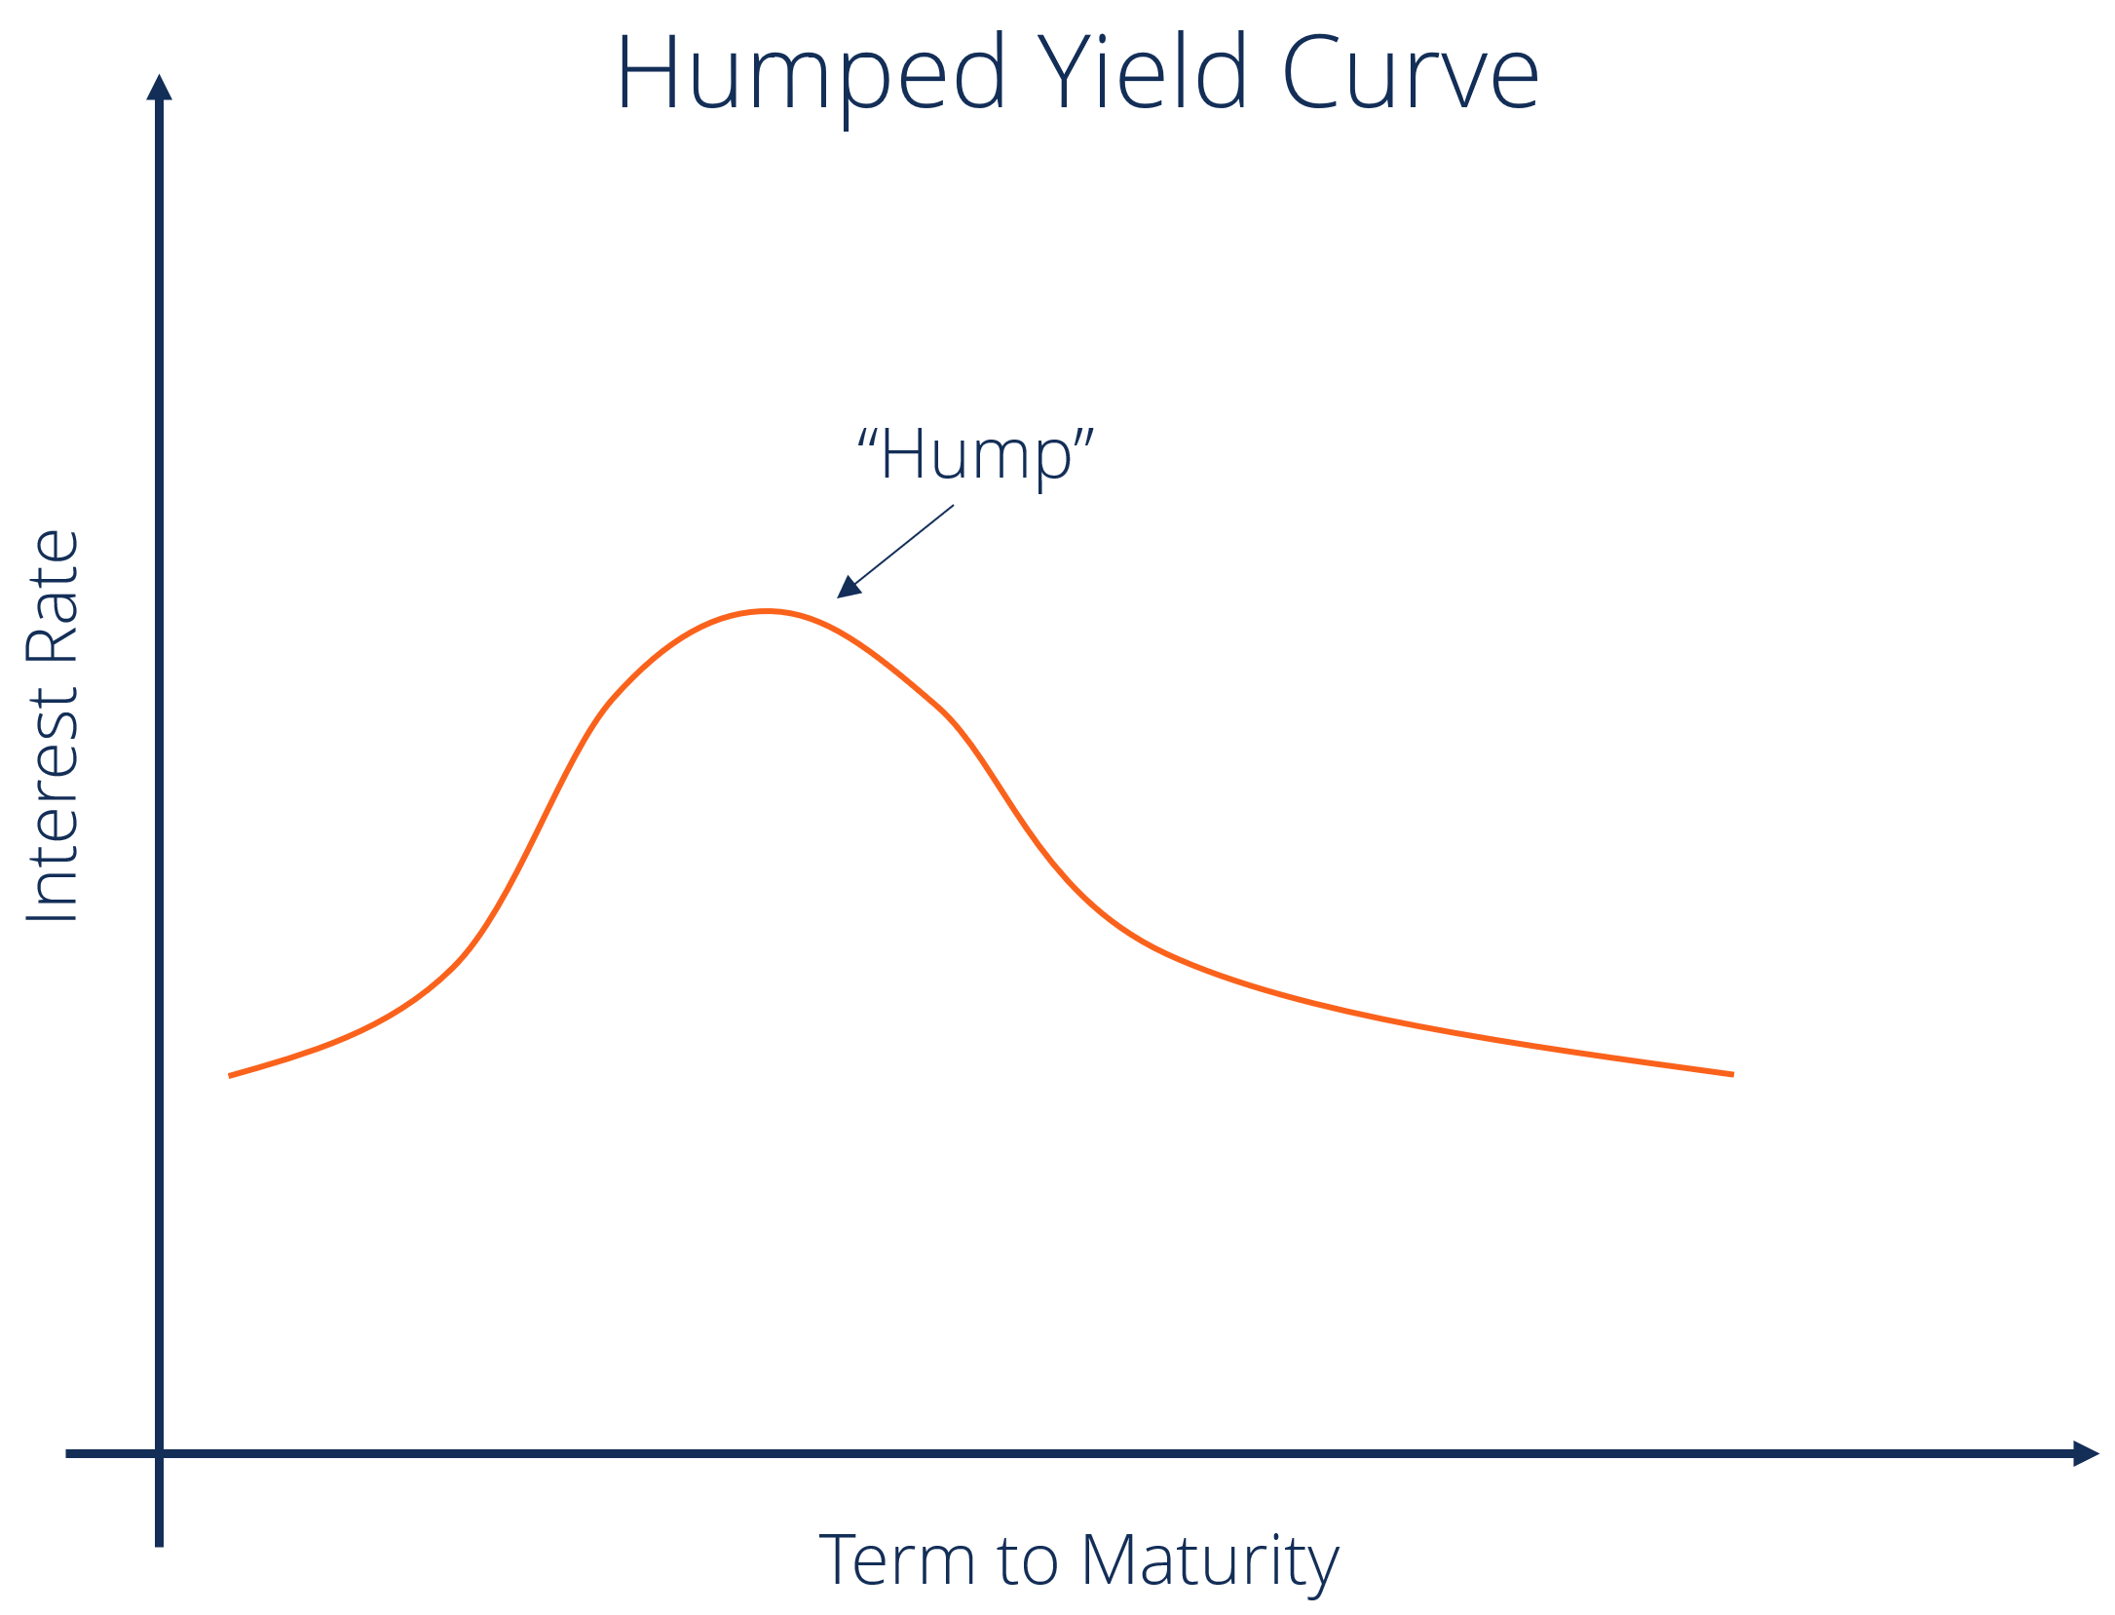

Slide 24
Bonds with embedded options ( Callable bonds and putable bonds)
An embedded option represents a right that can be exercised by the bond issuer or bondholder or automatically as interest rate changes. Embedded bonds may be simple ( callable or putable ) or complex ( estate put, sinking fund bonds , etc)
A callable bond is a debt instrument in which the issuer reserves the right to return the investor's principal and stop interest payments before the bond's maturity date. Corporations may issue bonds to fund expansion or to pay off other loans. If they expect market interest rates to fall, they may issue the bond as callable.
Paying down debt early by exercising callable bonds saves a company interest expense and prevents the company from being put in financial difficulties in the long term if economic or financial conditions worsen.
For example, a bond maturing in 2030 can be called in 2020. It may show a callable price of 102. This price means the investor receives Rs 1,020 for each Rs 1,000 in face value of their investment. The bond may also stipulate that the early call price goes down to 101 after a year.

Slide 25
A call option decreases the value of the bond to the investor. So,
Value of callable bond = Value of straight bond – Value of issuer call option
Value of issuer call option = Value of straight bond - Value of callable bond
A put option increases the value of the bond to the investor. So,
Value of putable bond = Value of straight bond + Value of issuer put option
Value of issuer put option = Value of putable bond - Value of straight bond
The value of embedded option increases with interest rate volatility. With increase in interest rate volatility the probability of people exercising the options goes up. The demand for these bonds goes up and hence the price or value.
The call option is more likely to be exercised when interest rates fall. The value of callable bonds increases when the yield curve is downward sloping.
Similarly, the converse is true for putable bonds. The put option is more likely to be exercised when interest rates rise. The value of putable bonds increases when the yield curve is upward sloping.

