Slide 1
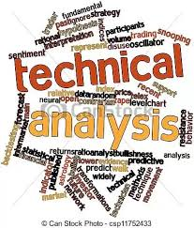
Technical Analysis

Slide 2
Market Analysis
Financial Market
Profits
Data Analysis
Methods Fundamental Analysis
                Technical Analysis

Slide 3
Fundamental Analysis
Publicly available data
Financial Statements
Analysis Methods
Roadmap
Valuation Methods
Calculation of Intrinsic Value

Slide 4
Technical Analysis
Clubbing of all Information
(Price , Volume , Interest , Time , Trends)
Patterns
Principles (Art + Science)
Astrology
DD – SS Analysis
Quick & Easy Method
No calculation of Intrinsic Value

Slide 5
FA V/s. TA
Particulars | Fundamental Analysis | Technical Analysis
Methods | Examination of Financial Statement | Examination of Price , Movements , Volume & Market.
Time Horizon | Long term view | Short term view
Function | For investment Purpose. | For Trading Purpose
Source of Information | Data Collection from Various Sources | Data Collection from charts & market trends.
Goal | Find Intrinsic Value | Find right time to enter & exit market.
Decision ( Buy /Sell) | Buy : IV < MV Sell : IV > MV | Buy : Upward Trend Sell : Downward Trend
Vision | Backward + Forward | Backward

Slide 6
What is Technical Analysis ?
Technical Analysis is the study of market action, primarily through the use of charts, for the purpose of forecasting future price trends. John Murphy
Technical Analysis is the science of recording, usually in graphic form, the actual history of trading (price changes, volume of transactions, etc.) in a certain stock or in “the Averages” and then deducing from that pictured history the probable future trend. Edward & McGee.
Basically Technical Analysis is study of Price and Volume

Slide 7
Investment Cycle
Income
Returns
Expenses
Investment
Savings

Slide 8

Investors ?
Risk Averse Investors
Risk Seeker Investors
Risk Neutral Investors
Investors : Speculator : Gambling

Slide 9
Is Technical Analysis a Holy Grail (Magic formula) to make money?
TA is one of the methods used to study price action.
It is Not a Holy Grail, there is no magic formula for making money in markets using TA.
Without appropriate risk management, TA is like driving a luxury car without brakes.

Slide 10
Premises /Rationale /Philosophy of Technical Analysis (TA).
The three premises on which the technical approach is based:
1. Market action discounts everything.
2. Price moves in trends.
3. History repeats itself.

Slide 11
Advantages of TA
Universal Applicability
Not Just for Stocks
Focus on Price
Demand Supply Analysis
Support & Resistance
Historical Price Clarity
Helps to Enter & Exit Security

Slide 12
Limitation of TA
Biasness
Different Interpretation
Too Late
Always new level due to different time frames
Trader’s Remorse
Historical Prices

Slide 13
Charts
Charts are basic working tools.
Graphical representation of past Price Moves.
Pictorial Representation.
It plots the complete price movements of the security over selected period of time.
X – axis : Represents Time.
Y – axis : Represents Price of Security.

Slide 14
Line Charts
Formed by Connecting the Dots, which represents Closing Price.
Very important in analysing the trend & breakouts in case of pattern system.
Provides Clear Visual Illustrations.
Very useful when studying long term trend & Corrections.

Slide 15
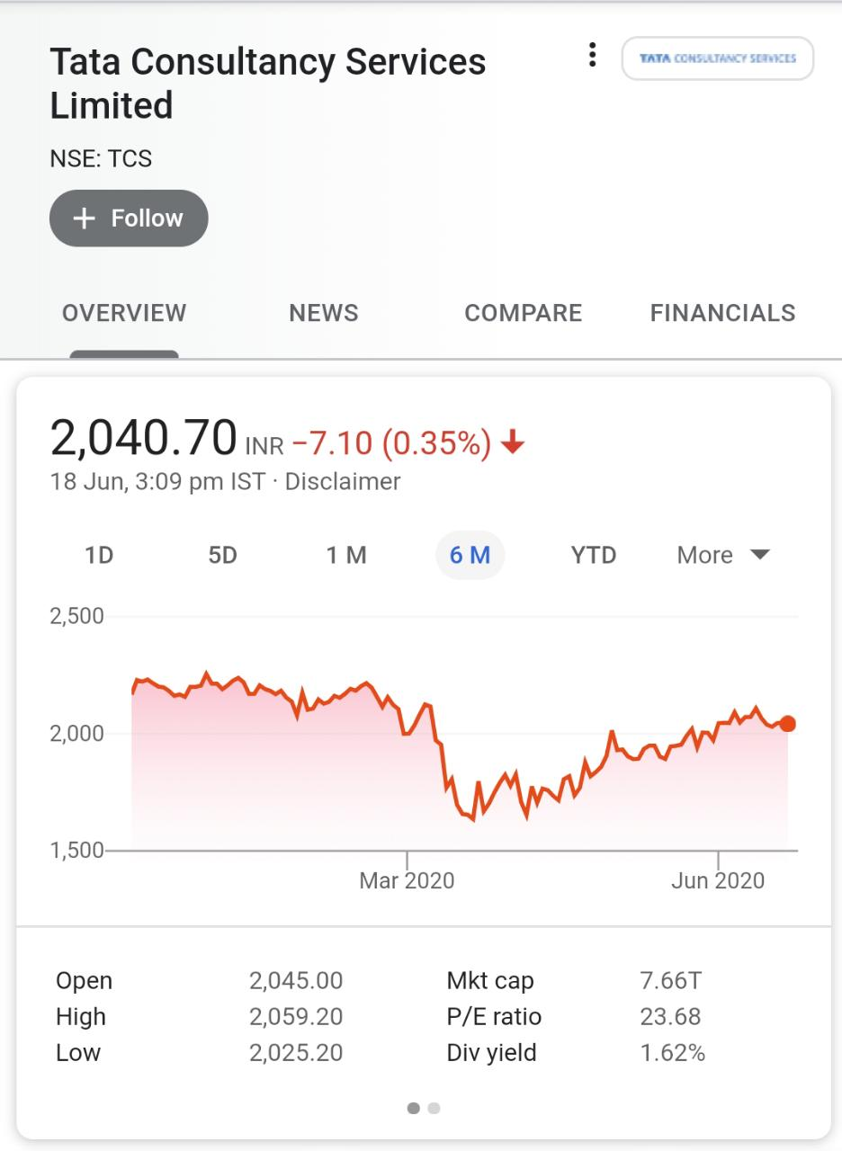
Line Charts

Slide 16
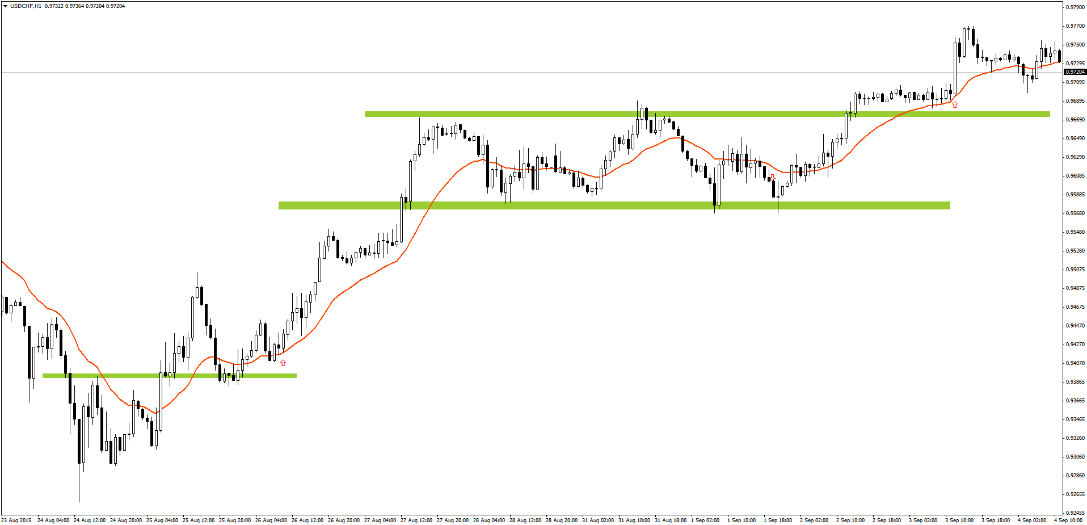
Bar Chart
Bar Chart shows 4 Pieces of Information :
1. Opening Price 2. Closing Price
3. High Price 4. Low Price
High
Close
Open
Low

Slide 17
Candle Stick Chart
Originated in Japan.
Mid 1600s (Rice Future)
Similar to Bar Charts.
In place of vertical line, it has Rectangular Box.
This box is called as Body.
Gives information for:
Opening Price, Closing Price,
High Price & Low Price.

Slide 18
Candle Stick Chart (TYPES)
Doji
One Candle Pattern
Two Candle Pattern
Three Candle Pattern

Slide 19
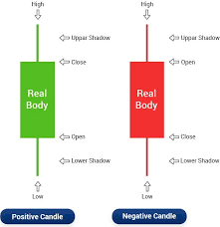
Candle Stick Chart

Slide 20
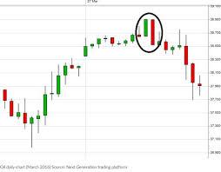
Candle Stick Chart

Slide 21
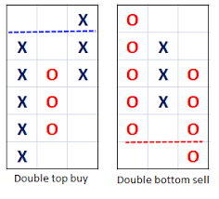
Point & Figure Charts
An interesting & accurate method of price analysis.
X : represents Price Rise.
O : represents Price Fall.
All information are provided in Box Sheet.
Little tedious to Construct.
Time is not a factor in P & F Charts.

Slide 22
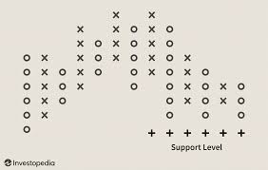
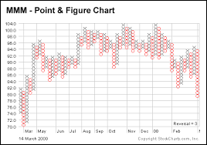
Point & Figure Charts

Slide 23
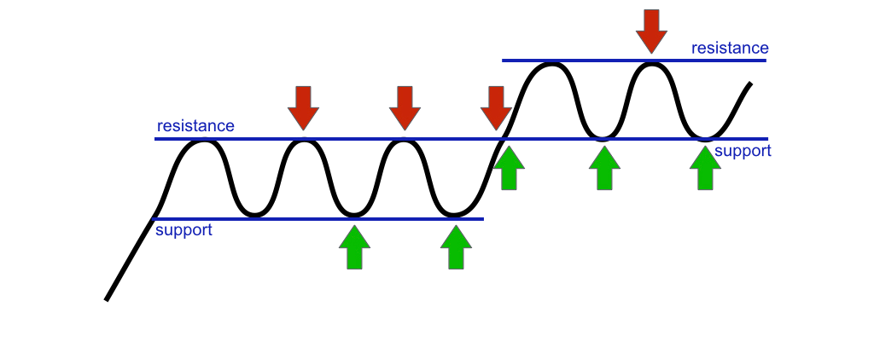
Support & Resistance Lines
Trend line may Halt, either Temporary or Permanent.
Represents key Junctures
Market forces of Supply & Demand Meet.
Appears as Thresholds of the Price Pattern.
Price Levels / Lines which stops the prices from Decreasing (Support) & / or Increasing (Resistance)

Slide 24
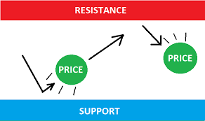

Slide 25
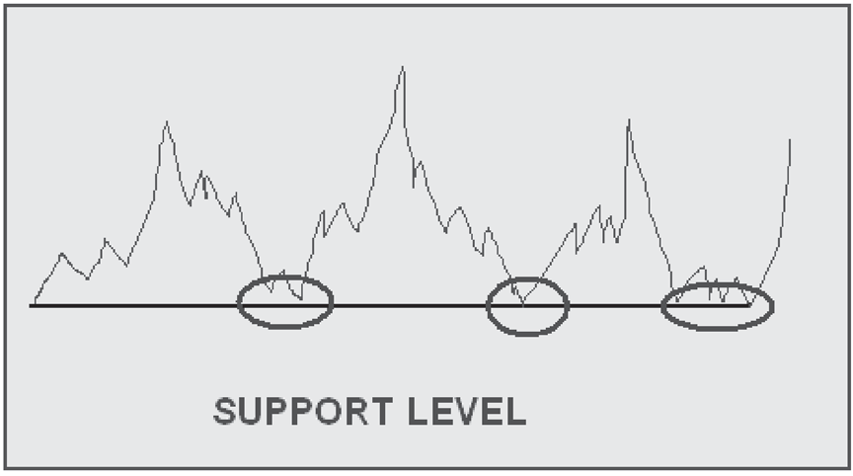
Support Line
Refers to that level below which a stock’s price will not fall.
Level at which there is a sufficient amount of demand to stop & possibly, for time being, turn a downtrend higher.
A pullback or even
a trend reversal.

Slide 26
Support
Price level where the price halt from falling down.
A pause or make base formation for the next up rally.
Buyer find great buying opportunity.
Create Demand, which may overcome supply.
Buyer are more inclined to Buy.
Seller are less inclined to sell.

Slide 27
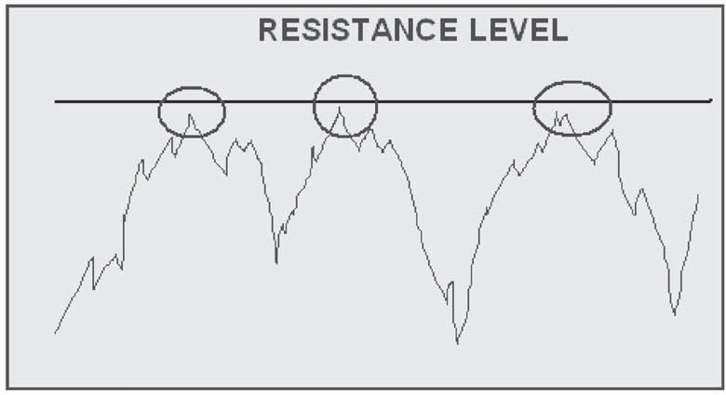
Resistance Line
Refers to a line beyond which stock’s price will not increase.
Price level at which a sufficient supply of stock is available to stop & possibly, for time being, blow off an uptrend in price.

Slide 28
Resistance
Price level where price halt from rising up.
Take a pause or distribution pattern for the next down rally.
Buyer may think of taking out profit from long position.
Seller may push price lower.
Bears may take a toll by bringing price down.
Supply is more than the demand.

Slide 29
Key takeaways
S&R are price points on the chart.
Support is a price point below the current market price that indicate buying interest.
Resistance is a price point above the current market price that indicate selling interest.
To identify S&R, place a horizontal line in such a way that it connects at least 3 price action zones, well spaced in time. The more number of price action zones (well spaced in time) the horizontal line connects, the stronger is S&R.

Slide 30
Key takeaways
S&R can be used to identify targets for the trade.
For a long trade : look for the immediate resistance level.
For a short trade : look for the immediate support level.
Lastly, comply with the checklist for optimal trading results.

Slide 31
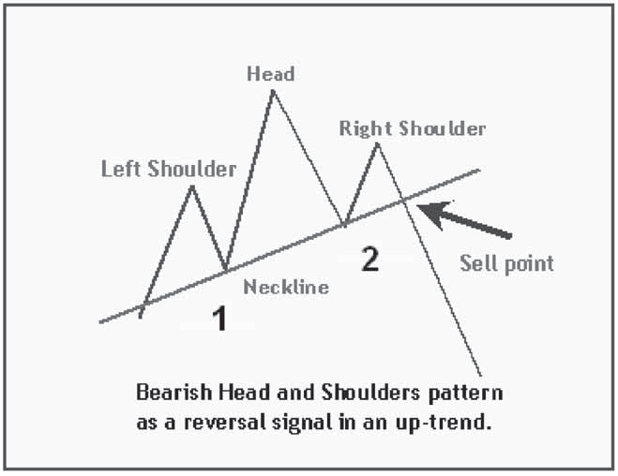
Head & Shoulder Top
Pattern has 3 different Peaks.
2 Smaller & 1 Larger (Centre)
Appears at the Top of the trend.
Highly Reliable Reversal Pattern.

Slide 32
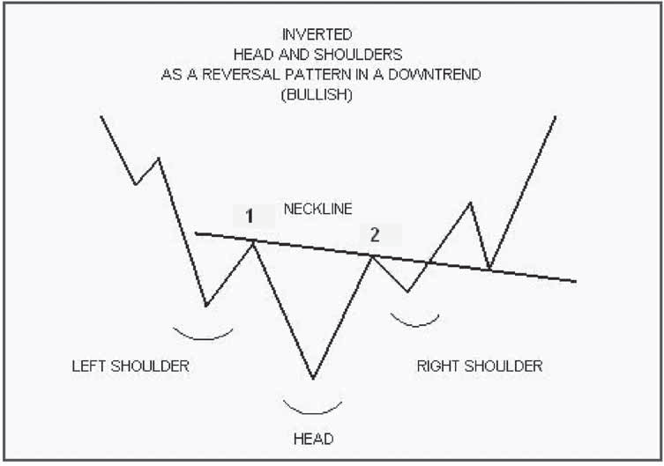
Inverted Head & Shoulder
Inverse Head & Shoulders
Pattern appears at the bottom of Trend.
Clear indication of Downtrend, Price Fall.
Price fails to surpass previous bottoms & Bounce back.
Price breakthrough neckline & continues.

Slide 33
Triangles
Triangle is a consolidation of Price.
The pattern can be continuation of existing trend or reversal.
Ascending Triangle
Symmetrical Triangle
Descending Triangle
Types of Triangle

Slide 34
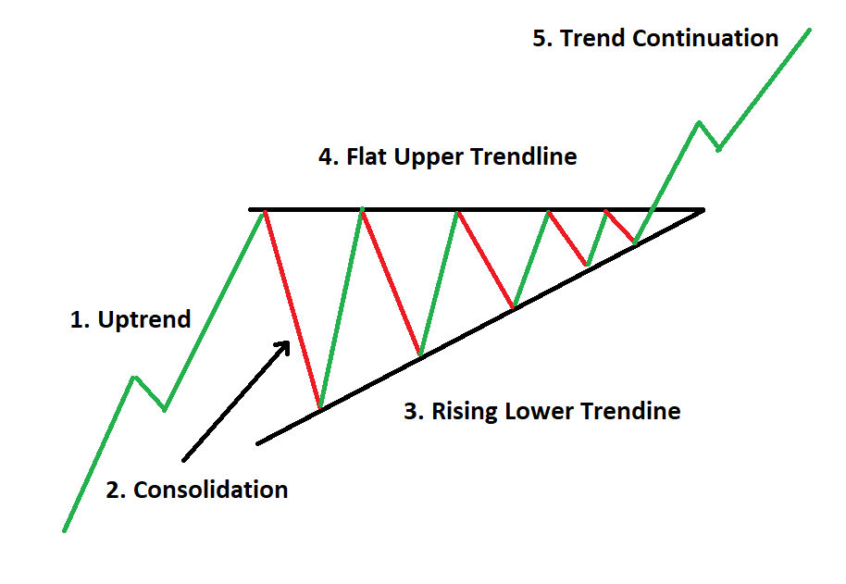

Slide 35
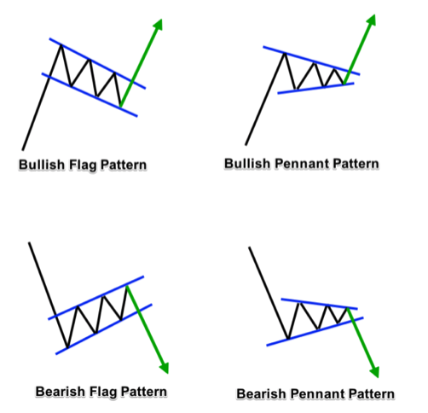
Flag & Pennant
Appears with pause in present rally, small consolidation & really continuation on breakout.
Good time to catch rally.
Flag : Rectangle Channel
Pennant : Symmetrical Channel

Slide 36

Elliott Wave Theory

Slide 37
Introduction
Developed by Ralph Nelson Elliott (1871-1948)
1930’s Theory
To analyse stock market to forecast market trends.
It is based on the hypothesis that stock prices move between optimism & pessimism of all market participants psychology & wide swings in the participants psychology makes stock prices move in certain patterns/ trends.

Slide 38
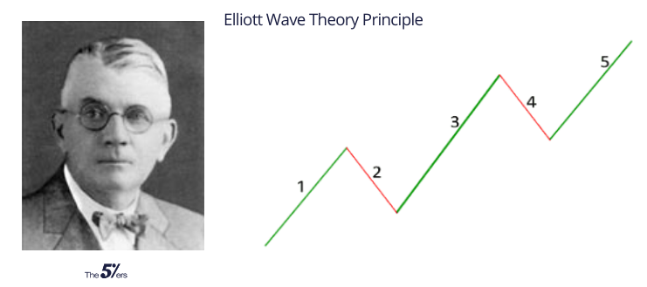
Fundamental Concept
Prices moves in trends.
1. Dominant Wave ( 5 Waves)
2. Corrective Wave (3 Waves)

Slide 39
Dominant Wave
Dominant Wave consist of 5 Waves.
It can be either up or down.
In Up direction: Advancing wave-> Impulsive Waves & Declining Wave -> Corrective Waves.
In Down direction : Declining Wave -> Impulsive Waves & Advancing Waves -> Corrective Waves.

Slide 40
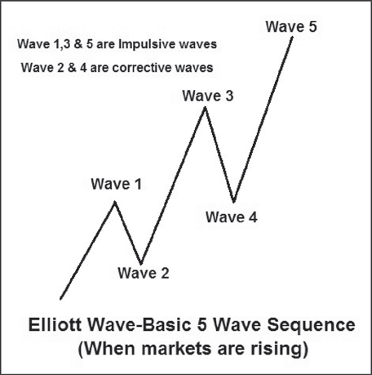

Slide 41

Theories of Technical Analysis

Slide 42
Dow Theory
Charles H. Dow, (1851-1902) , Father of Technical Analysis.
It’s a basic theory & more than 100 year old , but still remains the foundation of TA.
He never wrote any theory &/or book on TA.
His followers & associates have published work based on his theory from 255 wall street editorial written by him.

Slide 43
Samuel A. Nelson , He is the first person to use the term Dow Theory and he selected fifteen articles by Charles Dow for his book The ABC of Stock Speculation.
William P. Hamilton's "The Stock Market Barometer" (1922)
Robert Rhea's "The Dow Theory" (1932)
E. George Schaefer's "How I Helped More Than 10,000 Investors To Profit In Stocks" (1960)
Richard Russell's "The Dow Theory Today" (1961)
https://www.investopedia.com/terms/d/dowtheory.asp
https://www.youtube.com/watch?v=OwIwD_ql3N4

Slide 44
The Dow Theory is a technical framework that predicts the market is in an upward trend if one of its averages advances above a previous important high, accompanied or followed by a similar advance in the other average.
The theory is predicated on the notion that the market discounts everything in a way consistent with the efficient markets hypothesis.
In such a paradigm, different market indices must confirm each other in terms of price action and volume patterns until trends reverse.

Slide 45
Principles of Dow Theory
1. The Stock Market discounts all information.
2. The Stock Market has Three Trends.
3. Primary Trend has Three Phases.
4. Stock Market Indexes must confirm each other.
5. Volume must confirm the Trend.
6. Trend remains intact until & unless clear Reversal Signals occurs.

