Slide 1
INVENTORY MANAGEMENT

Slide 2
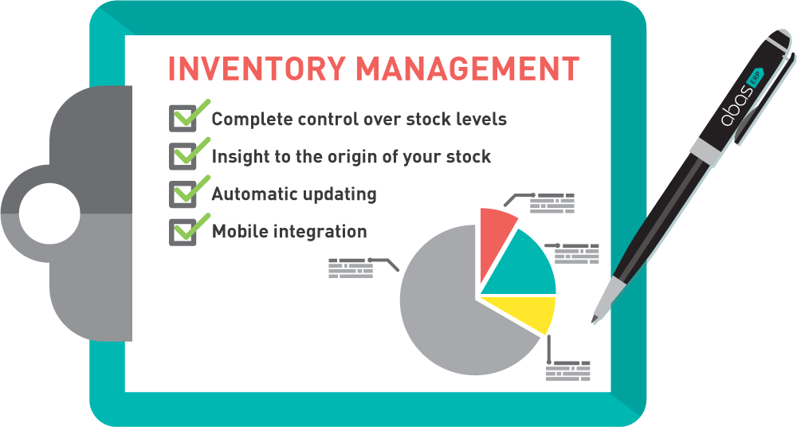

Slide 3
INTRODUCTION
Inventory is material that the firm obtains in advance of need, holds until it is needed, and then used, consumes, incorporates into a product, sells, or otherwise disposes it of. A business inventory is temporary in nature.
Inventories are stock of any kind like fuel and lubricants, spare parts and semi-processed materials to be stored for future use mainly in the process of production or it can be known as the ideal resource of any kind having some economic values.

Slide 4
What is Inventory Management?
Inventory management is a collection of tools, techniques, and strategies for storing, tracking, delivering, and ordering inventory or stock.
A majority of a company’s capital is wrapped up in their inventory.
For that reason, it’s incredibly important to control the coming and going of inventory as best you can to minimize losses and maximize profits – which is where inventory management techniques come into play.

Slide 5
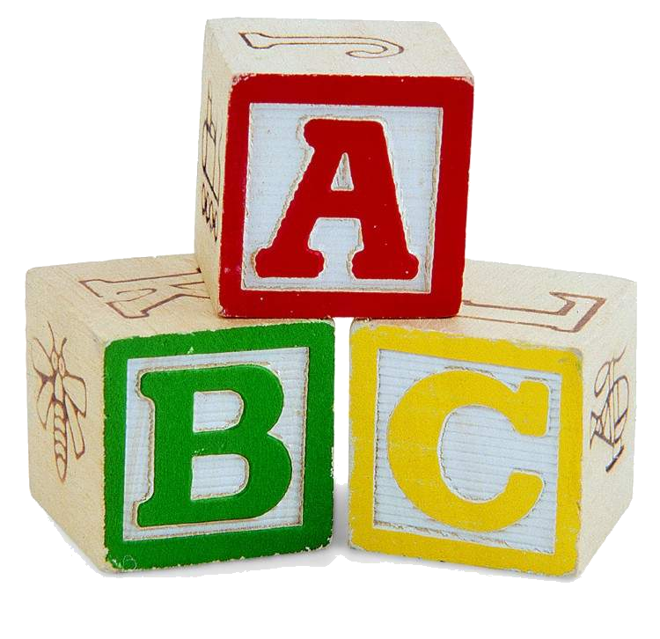
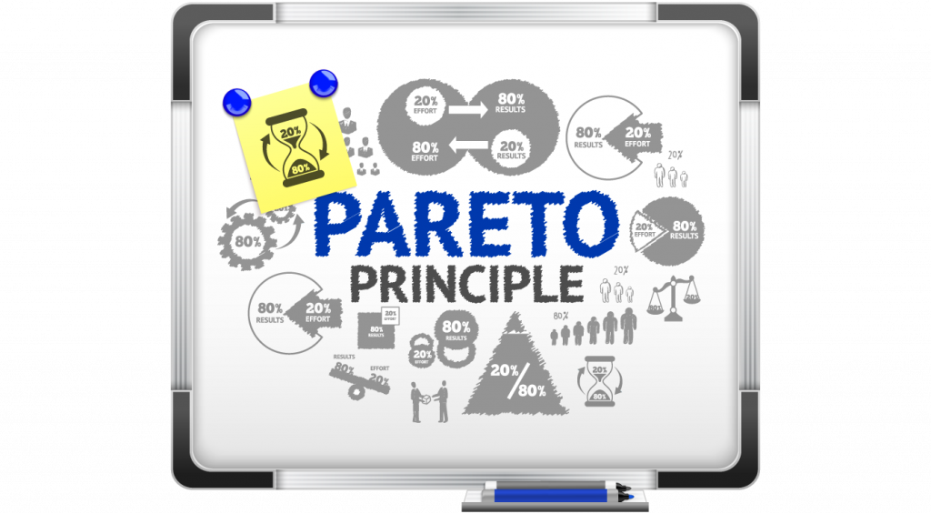
ABC ANALYSIS
ABC (always better control) is a basic technique of inventory control.
Classification based on value of inventory.
A- Group of items having High value although their number may be low.
B – Group of items fit in between with average value and number.
C - Group of items having low value although their number may be high.
GROUP | NO. OF ITEMS (%) | INVENTORY VALUED (%)
A | 15 | 70
B | 30 | 20
C | 55 | 10
TOTAL | 100 | 100

Slide 6
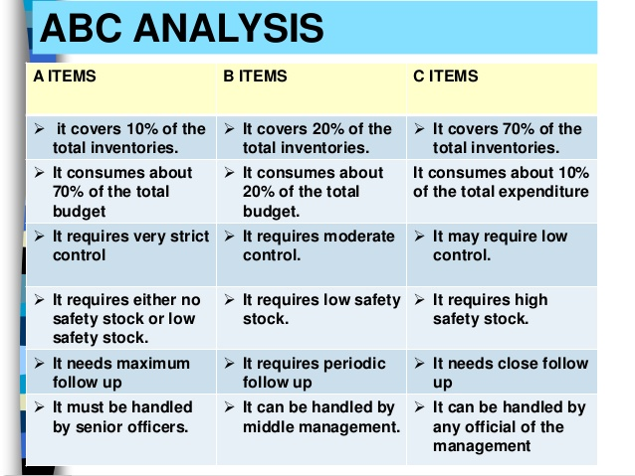

Slide 7

VED ANALYSIS
VITAL,ESSENTIAL, DESIRABLE
It is based on the importance of the item and its effects.
VITAL DRUGS – Such drugs are categorized as vital whose absence (no stock) cannot be tolerated even for an single day. That means in their absence the work of hospital or wards or patient care to come standstill.
ESSENTIAL Drugs – These are the drugs without which a hospital can function but may affect the quality of service to some extent but not to a very serious extent.
DESIRABLE Drugs - These are the drugs whose absence will not affect the functioning of hospital or ward or department or patient care

Slide 8
VED ANALYSIS
The motive of this system is to reduce investment in inventories. The drugs which are fast moving , ie which are in great demand should be stocked more than drugs occasionally demanded and lastly the drugs which are rarely demanded should be stocked in minimum quantity.

Slide 9
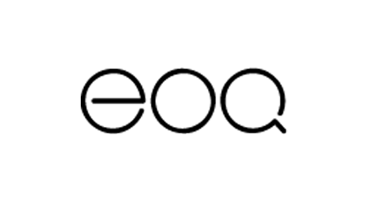
ECONOMIC ORDER QUANTITY
Economic order quantity is the lowest amount of inventory you must order to meet peak customer demand without going out of stock and without producing obsolete inventory
Its purpose is to reduce inventory as much as possible to keep the cost of inventory as low as possible.

Slide 10

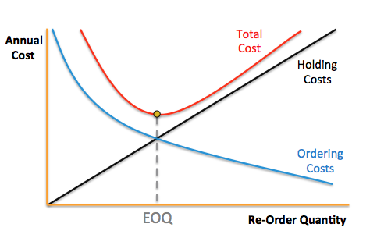
ECONOMIC ORDER QUANTITY
To help you calculate EOQ, here is the formula from Kenneth Boyd , author of Cost Accounting for Dummies
The widely used formula is EOQ =√2D×S/H
Economic order quantity = square root of [(2 x demand x ordering costs) ÷ carrying costs]
Where , D= The demand, in units, for the product for a specific time period
S=Ordering cost
H=Carrying cost

Slide 11
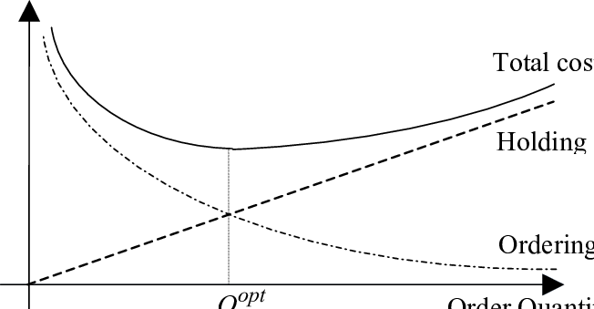
example
Total quantity required per annum = 5000 units
Ordering cost per order = Rs.100
Carrying cost per order = Rs.1.00
Answer?
1000 units

Slide 12
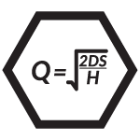
EXAMPLE
A firm’s annual inventory is 1,600 units. The cost of placing an order is Rs 50, purchase price of raw material/unit is Rs.10 and the carrying costs is expected to be 1 per unit p.a. Calculate EOQ?
D=1600, S= Rs. 50, H= Rs.1
EOQ = 2 x 1600 x 50
1
= 400 units

Slide 13

JUST-IN-TIME (JIT) INVENTORY
CONTROL
The JIT control system implies that the firm should
maintain a minimal level of inventory and rely on
suppliers to provide parts and components ‘just-in-time’
to meet its assembly requirements.
JIT also known as Zero Inventory Production Systems(ZIPS), Zero Inventories(ZIN), Materials as Needed(MAN), or Neck of Time(N0T)

Slide 14
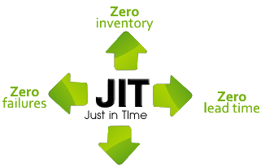
Just-in-Time Inventory Management is simply making what is needed, when it’s needed, in the amount needed
Many companies operate on a “just-in-case” basis – holding a small amount of stock in case of an unexpected peak in demand.
JIT attempts to establish a “zero inventory” system by manufacturing goods to order; it operates on a “pull” system whereby an order comes through and initiates a cascade response throughout the entire supply chain – signaling to the staff they need to order inventory or begin producing the required item.

Slide 15
benefits of just-in-time inventory:
Minimize costs such as rent and insurance by reducing your inventory
Less obsolete, outdated, and spoiled inventory
Reduce waste and increase efficiency by minimizing or eliminating warehousing and stockpiling, while maximizing inventory turnover
Maintain healthy cashflow by ordering stock only when necessary
Production errors can be identified and fixed faster since production happens on a smaller, more focused level, allowing easier adjustments or maintenance on capital equipment

Slide 16
MINIMUM SAFETY STOCKS
Minimum level or safety stock level is the level of inventory, below which the stock of materials should not be fall. If the stock goes below minimum level, there is a possibility that the production may be interrupted due to shortage of materials. In other words, the minimum level represents the minimum quantity of the stock that should be held at all times.
It is the stock that keep you in the safe side if you have any delay in the delivery

Slide 17
FSN Analysis
Inventory is classified based on the MOVEMENT OF INVENTORIES from stores
Inventory technique used to AVOID OBSOLESCENCE
F- Fast moving
S- Slow moving
N- Non moving
Here in this analysis, the date of receipt or the last date of issue, which ever is later, to determine the no. of months which have lapsed from last transaction.
FSN is helpful in identifying active items which need to be reviewed regularly and surplus items and non- moving items are examined.

Slide 18
SDE Classification:
The SDE is based upon the availability of items.
Here ‘S’ refers to ‘Scarce’ items
‘D’ refers to ‘Difficult’ items
‘E’ refers to ‘Easy to acquire’
This is based on problems faced in procurement, were some strategies are made on purchasing.

Slide 19
SOS Analysis
‘S’ stands for Seasonal items and ‘OS’- Off Seasonal items.
In general it is merit to seller to buy seasonal items at lower price and keep inventory and sell them at high price during Off seasons.
If not the seller has to buy the goods at higher prices during Off seasons.
Decisions are taken based on the fluctuations and availability.

Slide 20
MATERIAL REQUIREMENTS PLANNING (MRP) METHOD
Material Requirements Planning is an inventory control method in which the manufacturers order the inventory after considering the sales forecast. MRP system integrates data from various areas of the business where inventory exists. Based on the data and demand in the market, the manager would carefully place the order for new inventory with the material suppliers.

