Slide 1
Revenue Concepts

Slide 2
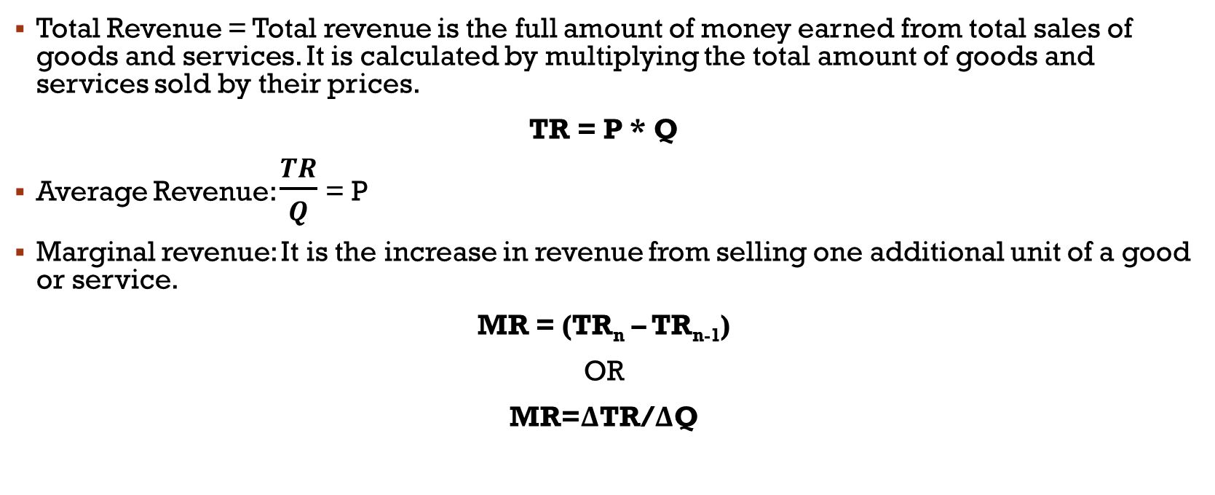
TR, AR, MR
Total Revenue = Total revenue is the full amount of money earned from total sales of goods and services. It is calculated by multiplying the total amount of goods and services sold by their prices.
TR = P * Q
Average Revenue: $\frac{TR}{Q}$ = P
Marginal revenue: It is the increase in revenue from selling one additional unit of a good or service.
MR = (TR_{n} – TR_{n-1})
OR
MR=ΔTR/ΔQ

Slide 3
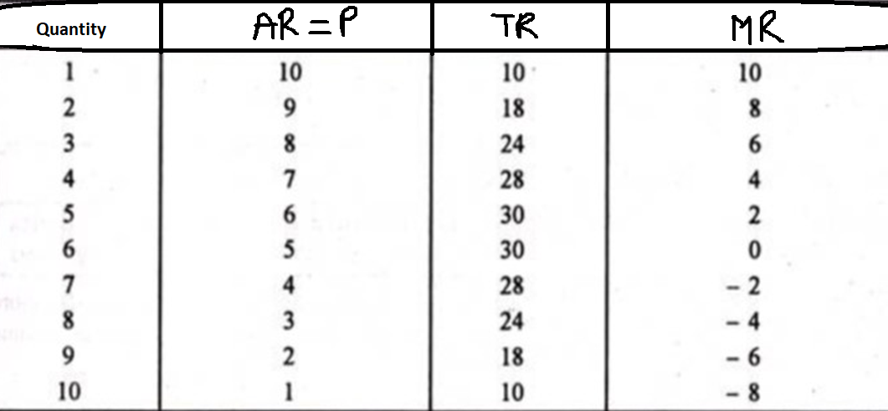

Slide 4
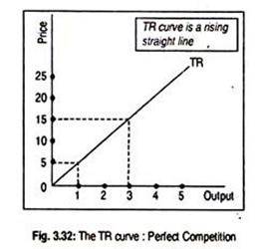
Revenue curves under perfect and imperfect competition
A firm, under perfect competition, behaves as a ‘price-taker’ in the sense that no single firm can influence the price of the product. Under this situation, the TR curve is a rising straight line from the origin. TR rises in direct proportion to output. The TR curve has been drawn in the diagram whose slope is the given price in the market.

Slide 5
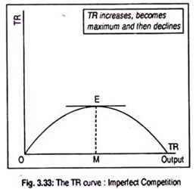
In any branch of imperfect competition (say, monopoly or monopolistic competition or oligopoly), a firm behaves as the ‘price- maker’ in the sense that it can influence the price of the product. A firm has to reduce the price of the product if it wants to sell more. So TR must rise.
However, TR does not increase in proportion to the increase in the volume of sales. Under imperfect competition, TR initially rises, reaches maximum when OM units of output are sold, and then starts declining as output sold increases over time.

Slide 6
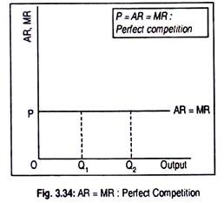
Shapes of AR Curve under Perfect and Imperfect Competition:
As a competi­tive firm behaves as a price-taker, its AR remains the same even if volume of sales increases. That is why the AR curve in the following diagram has been drawn parallel to the horizontal axis. AR curve shows that, at price OP, any amount of the goods (OQ₁ or OQ₂) may be demanded. In other words, the AR curve or the demand curve faced by a competitive firm becomes perfectly elastic.

Slide 7
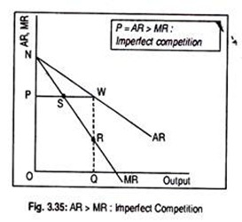
Under imperfect competition, AR curve becomes negative sloping. It declines continuously as price declines. However, demand curve of a monopolistically compe­titive firm is more elastic than that of the demand curve faced by a competitive firm.
In the diagram, linear AR and MR curves have been drawn. They can be non-linear also.

Slide 8
Numericals
If demand function for commodity X is Qd = 500 – 5P, what will be the price if quantity demanded is 50 units?
If the demand function is Qdx = 150 – 20 Px and supply function is Qsx = -30 + 50Px, find –
  The equilibrium price.
  Whether there will be excess demand or excess supply if price = 3.

Slide 9
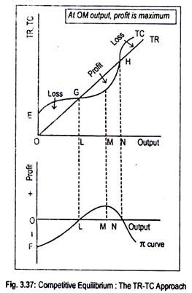
Behaviour of PROFIT MAXIMIZING FIRMS UNDER PERFECT COMPETITIONN
Profit becomes maximum irrespective of the market situation, when the difference between total revenue (TR) and total cost (TC) becomes the greatest.
In the diagram, a TR curve for a perfectly competitive firm has been drawn. The TR curve starts from the origin and it rises in proportion to the rise in the volume of sales.
The TC curve starts from point E which lies above the origin. This means that costs are positive even if no output is produced. Such costs are called fixed costs of a firm.
All these curves have been drawn in the upper panel of the figure. The bottom part of the figure shows various amounts of profit enjoyed by a firm at various volumes of output. Profit Curve is denoted by π (pi). (Must be included in the diagram for both perfect competition and imperfect competition.)

Slide 10
Below the level of output OL, the firm incurs a loss since TC exceeds TR. Only at the OL output level, TR equals TC and the firm earns only normal profit. Thus, point G is called break-even point. Now, if more than OL but less than ON output is produced, TR will exceed total cost and the firm will earn supernormal profit.
However, at the output level OM, as the difference between TR and TC is the greatest, profit is maximum. This is clear from the bottom panel of the figure where π curve is the profit curve. Below OL output level, profit curve lies below the origin indicating negative profit. Profit becomes zero at OL output level.
It becomes maximum at OM output level and, again, it reduces to zero (i.e., break-even point) when ON amount of output is produced. Beyond ON (or at ON), as TC exceeds TR, the firm incurs a loss. Now the profit curve has again entered the negative quadrant. Anyway, maximum profit is obtained at the output level OM, where the vertical distance between TR and TC curves is the maximum.

Slide 11
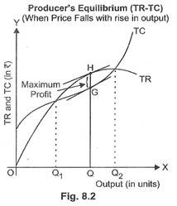
Profit Maximization under Imperfect Competition

