Slide 1
Mutual Funds – An Investment Avenue
By Sriram Rangarajan , Contact – 8454949588
Email – rsriram0910@yahoo.co.in

Slide 2
Mutual Funds in India
The mutual fund industry in India started in 1963 with the formation of Unit Trust of India, at the initiative of the Government of India and Reserve Bank. The history of mutual funds in India can be broadly divided into four distinct phases.
 First Phase – 1964-87 Established Unit Trust of India (UTI) .
 Second Phase – 1987-1993 Entry of Public Sector Funds.
 Third Phase – 1993-2003 Entry of Private Sector Funds.
 Fourth Phase – Feb 2003-Apr 2014 Phase of consolidation
 Since May 2014 - Phase Of Steady Development And Growth

Slide 3
First Phase – 1964 to 1987
Unit Trust of India (UTI) was established in 1963 by an Act of Parliament.
It was set up by the Reserve Bank of India and functioned under the Regulatory and administrative control of the Reserve Bank of India.
In 1978 UTI was de-linked from the RBI and the Industrial Development Bank of India (IDBI) took over the regulatory and administrative control in place of RBI.
The first scheme launched by UTI was Unit Scheme 1964. At the end of 1988 UTI had Rs. 6,700 crores of assets under management.

Slide 4
Second Phase -1987 to 1993 (Entry of Public Sector Funds)
1987 marked the entry of non-UTI, public sector mutual funds set up by public sector banks and Life Insurance Corporation of India (LIC) and General Insurance Corporation of India (GIC).
SBI Mutual Fund was the first non-UTI Mutual Fund established in June 1987 followed by Canbank Mutual Fund (Dec 87), Punjab National Bank Mutual Fund (Aug 89), Indian Bank Mutual Fund (Nov 89), Bank of India (Jun 90), Bank of Baroda Mutual Fund (Oct 92).
LIC established its mutual fund in June 1989 while GIC had set up its mutual fund in December 1990.
At the end of 1993, the mutual fund industry had assets under management of Rs. 47,004 crores.

Slide 5
Third Phase – 1993 to 2003 (Entry of Private Sector Funds)
Private sector funds entered the scene in 1993 and a new era began in the Indian mutual fund industry, giving the Indian investors a wider choice of fund families.
The first Mutual Fund Regulations came into being in 1993, under which all mutual funds, except UTI were to be registered and governed.
The erstwhile Kothari Pioneer (now merged with Franklin Templeton) was the first private sector mutual fund registered in July 1993.
The 1993 SEBI (Mutual Fund) Regulations were substituted by a more comprehensive and revised Mutual Fund Regulations in 1996. The industry now functions under the SEBI (Mutual Fund) Regulations 1996.
The number of mutual fund houses went on increasing, with many foreign mutual funds setting up funds in India and also the industry has witnessed several mergers and acquisitions. As at the end of January 2003, there were 33 mutual funds with total assets of Rs. 1,21,805 crores. The Unit Trust of India with Rs. 44,541 crores of assets under management was way ahead of other mutual funds.

Slide 6
Fourth Phase – phase of consolidation – (Feb 2003 to Apr 2014)
In February 2003, following the repeal of the Unit Trust of India Act 1963 UTI was bifurcated into two separate entities. One is the Specified Undertaking of the Unit Trust of India (SUUTI) with assets under management of Rs. 29,835 crores as at the end of January 2003, representing broadly, the assets of US 64 scheme, assured return and certain other schemes. SUUTI, functioning under an administrator and under the rules framed by Government of India and does not come under the purview of the Mutual Fund Regulations.
The second is the UTI Mutual Fund, sponsored by SBI, PNB, BOB and LIC. It is registered with SEBI and functions under the Mutual Fund Regulations. With the bifurcation of the erstwhile UTI which had in March 2000 more than Rs. 76,000 crores of assets under management and with the setting up of a UTI Mutual Fund, conforming to the SEBI Mutual Fund Regulations, and with recent mergers taking place among different private sector funds, the mutual fund industry has entered its current phase of consolidation and growth.

Slide 7
Fourth Phase – phase of consolidation – (Feb 2003 to Apr 2014) contd..
After the global economic recession of 2009, the financial markets across the globe were at an all-time low and Indian market was no exception to it.
Majority of investors who had put in their money during the peak time of the market had suffered great losses. This severely shook the faith of investors in the MF products. The Indian Mutual Fund industry struggled to recover from these hardships and remodel itself over the next two years.
The situation toughened up more with SEBI abolishing the entry load and the lasting repercussions of the global economic crisis. This scenario is evident from the sluggish rise in the overall AUM of the Indian MF industry.

Slide 8
Phase Of Steady Development And Growth (Since May 2014):
Since May ’14, the Indian MF industry has experienced a consistent inflow and rise in the overall AUM as well as the total number of investor accounts (portfolio).
Currently (March 2019), all the Asset Management Companies in India manage a combined worth of around ₹ 24,58,016 crore of assets at the end of March 2019. The total number of accounts (or folios as per mutual fund parlance) as on March 31, 2019 stood at 8.25 crore (82.5 million), while the number of folios under Equity, ELSS and Balanced schemes, wherein the maximum investment is from retail segment stood at 6.93 crore (69.3 million). This is 58th consecutive month witnessing rise in the no. of folios.
It is estimated that Indians save approximately Rs. 20-30 lakh crore annually. The Indian mutual fund industry can grow immensely if Indians started parking a higher percentage of their savings in MFs. Observers say that Indians have begun shifting a part of their savings from physical assets like gold and land to financial instruments like bonds and silver. However, the AMFI and the government need to encourage Indians even more for investments in mutual funds.

Slide 9
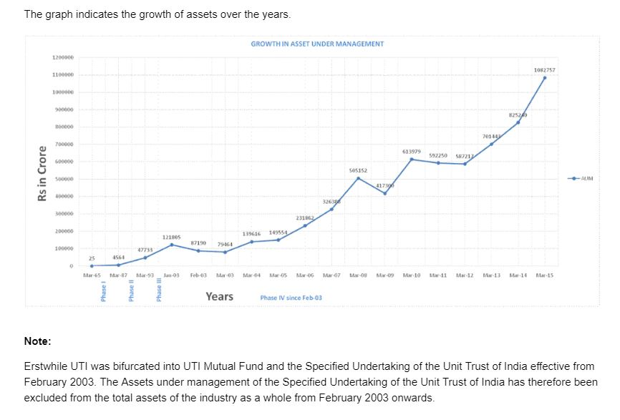
Data - AMFI India

Slide 10
How does a Mutual Fund work?
Mutual funds are an investment avenue, which invest in securities such as stocks, bonds, money market instruments, etc. A properly structured portfolio of securities for investment is designed by expert fund managers in order to match with the predefined investment objectives and goals.
Mutual funds tend to have broader portfolios in order to disperse
the potential risk quotient and thus make it less risky for the
investors.
For example - A stock in which you have invested is going through a rough patch, and if you have a broad portfolio of mutual fund, you tend to lose only a fraction of your investment. Hypothetically if one had a narrow portfolio consisting of a particular stock or sector and if that stock or sector is not doing well then the potential loss would be higher. Thus, the risk is diversified over a wide range of securities, which are chosen wisely for investment by experts to build a broader portfolio.

Slide 11
How to Invest in Mutual Funds
You can easily invest in mutual fund schemes by following the below mentioned steps
Complete KYC and registration procedure: Duly fill the registration form and complete the KYC (Know your customer) procedure by submitting all the required copies of address and identity proofs along with other required documents. It is important that you have your PAN (Permanent Account Number) card and bank account with proper MICR (Magnetic Ink Character Recognition) code and IFSC (Indian Financial System Code).
Explore assets for allocation in portfolio: Analyze different securities and stock options available for asset allocation in your portfolio.
Shortlist fund types: Shortlist the types of funds you would want to invest in to fulfill your financial goals.

Slide 12
How to Invest in Mutual Funds
Research, Analyze and Compare different funds: Analyze and research about different fund schemes and compare them to make fruitful decisions. Some mutual fund schemes would look attractive, but the question here is whether it matches your financial goals and to what extent will it be helpful in achieving your financial goals in time within your risk quotient.
Look for diversification in your portfolio: Make sure you structure your portfolio with assets that match your financial goals and diversify the risk. The broader your portfolio, the more the risk gets dispersed. This will be beneficial if the stock or sector you have invested in goes through a rough patch, then you would lose only on a fraction of your investment.
Track the performance of portfolio: In order to understand how your portfolio is keeping up with your goals and when you need to change the gear, you should track the performance of your portfolio on a regular basis.

Slide 13
ADVANTAGES OF MUTUAL FUNDS
1. Portfolio Diversification
Each investor in the fund is a part owner of all the fund's assets, thus enabling him to hold a diversified investment portfolio even with a small amount of investment instead of a large capital.
2. Professional Management
Investment in Mutual Fund by an investor small or big is benefited by professional management skills brought by the Mutual Fund.
Most of the individual Investor do not have the requisite Investment Management skills and Research skills to generate superior returns from his investment while a Mutual Fund has both Investment Management and Research skills.

Slide 14
ADVANTAGES OF MUTUAL FUNDS
3. Reduction/Diversification Of Risk:
When an investor invests directly whether he places a deposit with a company or a bank, or he buys share or debenture on his own or in any other form all the risk of potential loss is his own. While investing in the pool of funds with investors, the potential losses are also shared with other investors. The risk reduction is one of the most important benefits of a collective investment vehicle like the mutual fund.
4. Reduction Of Transaction Costs:
The investor bears all the costs or investing such as brokerage or custody of securities. When going through a fund, he has the benefit of economics of scale; the funds pay lesser costs because of larger volumes, a benefit passed on to its investors.

Slide 15
ADVANTAGES OF MUTUAL FUNDS
5. Liquidity:
Often, investors hold shares or bonds they cannot directly, easily and quickly sell. When they invest in the units or a fund, they can generally cash their investments any time, by selling their units to the fund if open-ended, or selling them in the market if the fund is close-end. Liquidity is clearly a big benefit.
6. Convenience And Flexibility:
Mutual funds offer many investor services that a direct market investor cannot get. Investors can easily transfer their holding from One scheme to the other; get updated market information and so on.

Slide 16
DISADVANTAGES OF INVESTING IN MUTUAL FUND
1. No Control Over Costs:
An investor in a mutual fund has no control of the overall costs of investing. The investor pays investment management fees as long as he remains with the fund, albeit in return for the professional management and research. Fees are payable even if the value of his investments is declining.
2. No Tailor-Made Portfolio:
Investors who invest on their own can build their own portfolios of shares and bonds and other securities, Investing through fund means the decision of investing is taken by fund managers, High net worth individuals or large corporate investors may find this to be a constraint in achieving their objectives.

Slide 17
DISADVANTAGES OF INVESTING IN MUTUAL FUND
3. Managing A Portfolio Of Funds:
Availability of a large number of funds can actually mean too much choice for the investor. He may again need advice on how to select a fund to achieve his objectives, quite similar to the situation when he has individual shares or bonds to select.
4. The Wisdom Of Professional Management:
The average mutual fund manager is no better at picking stocks than the average non professional, but charges fees.
5. No Control:
The Fund Manager of the Mutual Fund picks individual stocks unlike an individual investor picking his own stock, mutual fund puts you in the passenger seat of somebody else's car.
6. Dilution:
Mutual funds generally have very high number of stocks in their portfolio resulting in very small holdings of many stocks. Even a great performance by a fund's top holdings doesn't make much of a difference in a mutual fund's total performance.

Slide 18
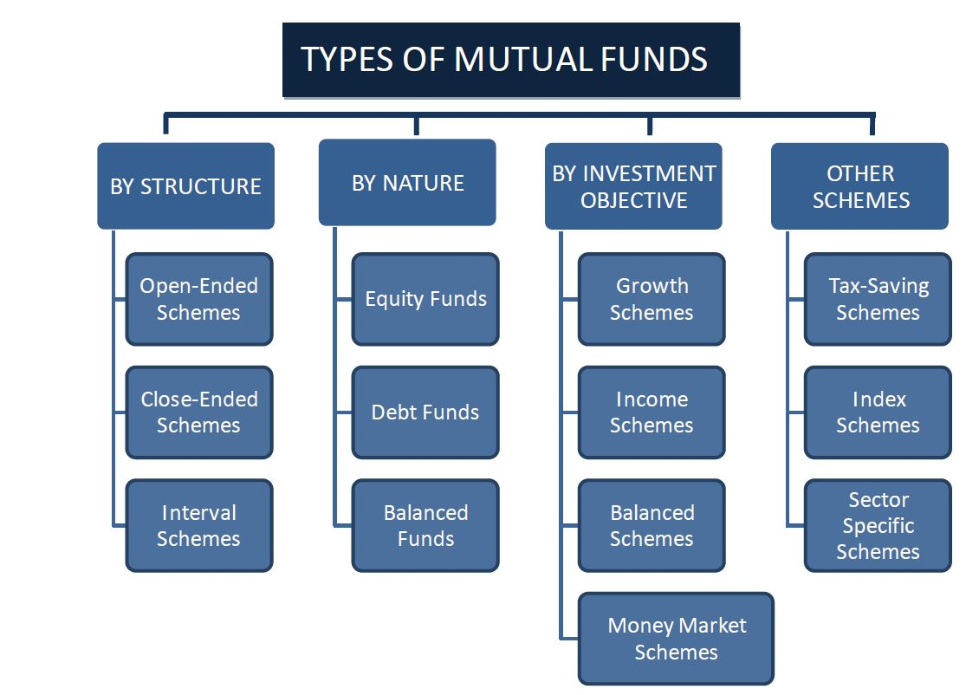
TYPES OF MUTUAL FUNDS SCHEMES

Slide 19
TYPES OF MUTUAL FUND
A) BY STRUCTURE
1. Open - Ended Schemes:
An open-end fund is one that is available for subscription all through the year. These do not have a fixed maturity. Investors can conveniently buy and sell units at Net Asset Value (“NAV”) related prices. It is highly liquid.
2. Close - Ended Schemes:
A closed-end fund has a stipulated maturity period which ranges from 3 to 15 years. The fund is open for subscription only during a specified period. Investors can invest in the scheme at the time of the initial public issue and thereafter they can buy or sell the units of the schemes on the stock exchanges, where they are listed. In order to provide an exit route to the investors, some close-ended funds give an option of selling back the units to the Mutual Fund through periodic repurchase at NAV related prices. SEBI Regulations stipulate that at least one of the two exit routes is provided to the investor.
3. Interval Schemes:
Interval Schemes are that scheme, which combines the features of open-ended and close ended schemes. The units may be traded on the stock exchange or may be open for sale or redemption during pre-determined intervals at NAV related prices.

Slide 20
TYPES OF MUTUAL FUND
B) BY NATURE
1. Equity Fund
These funds invest the maximum part of their corpus into equities holdings. The structure of the fund may vary for different schemes and the fund manager’s outlook on different stocks. The Equity Funds are sub-classified depending upon their investment objective, as follows:
• Diversified Equity Funds
• Mid-Cap Funds
• Sector Specific Funds
• Tax Savings Funds (ELSS)
Equity funds rank high on the risk-return matrix , hence equity investments are meant for a longer time horizon.
2. Debt Funds
The objective of these Funds is to invest in debt instruments, Government authorities, private companies, banks and financial institutions are some of the major issuers of debt papers. By investing in debt instruments, these funds ensure low risk and provide stable income to the investors. Debt funds are further classified as:
• Gilt Funds: Invest their corpus in securities issued by Government of India. These Funds carry zero default risk but are associated with Interest Rate risk. These schemes are safer as they invest in papers backed by Government.
• Income Funds: Invest a major portion into various debt instruments such as bonds, corporate debentures and Government securities.
• Liquid Funds: Also known as Money Market Schemes, These funds provides easy liquidity and preservation of capital, These schemes invest in short-term instruments like Treasury Bills, inter-bank call money market, CPs and CDs. These funds are meant for short-term cash management of corporate houses and are meant for an investment horizon of 1 day to 3 months. These schemes rank low on risk-return matrix and are considered to be the safest amongst all categories of mutual funds.

Slide 21
TYPES OF MUTUAL FUND
3. Balanced Funds
As the name suggest they are a mix of both equity and debt funds. They invest in both equities and fixed income securities, which are in line with pre-defined investment objective of the scheme. These schemes aim to provide investors with the best of both the worlds. Equity part provides growth and the debt part provides stability in returns. Further the mutual funds can be broadly classified on the basis of investment parameter viz; each category of funds is backed by an investment philosophy, which is pre-defined in the objectives of the fund. The investor can align his own investment needs with the funds objective and invest accordingly.

Slide 22
TYPES OF MUTUAL FUND
C) BY INVESTMENT OBJECTIVE
Growth Schemes:
Growth Schemes are also known as equity schemes. The aim of these schemes is to provide capital appreciation over medium to long term. These schemes normally invest a major part of their fund in equities and are willing to bear short-term decline in value for possible future appreciation.
Income Schemes:
Income Schemes are also known as debt schemes. The aim of these schemes is to provide regular and steady income to investors. These schemes generally invest in fixed income securities such as bonds and corporate debentures. Capital appreciation in such schemes may be limited.
Balanced Schemes:
Balanced Schemes aim to provide both growth and income by periodically distributing a part of the income and capital gains they can. These schemes invest in both shares and fixed income securities, in the proportion indicated in their offer documents (normally 50:50).
Money Market Schemes:
Money Market Schemes aim to provide easy liquidity, preservation of capital and moderate income. These schemes generally invest in safer, short-term instruments, such as treasury bills, certificates of deposit, commercial paper and inter-bank call money.

Slide 23
TYPES OF MUTUAL FUND
OTHER SCHEMES
1. Tax Saving Schemes:
Tax-saving schemes offer tax rebates to the investors under tax laws prescribed from time to time. Under Sec.80C of the Income Tax Act, contributions made to any Equity Linked Savings Scheme (ELSS) are eligible for rebate.
2. Index Schemes:
Index schemes attempt to replicate the performance of a particular index such as the BSE Sensex or the NSE 50. The portfolio of these schemes will consist of only those stocks that constitute the index. The percentage of each stock to the total holding will be identical to the stocks index weightage. And hence, the returns from such schemes would be more or less equivalent to those of the Index.
3. Sector Specific Schemes:
These are the funds/schemes which invest in the securities of only those sectors or industries as specified in the offer documents, e.g., Pharmaceuticals, Software, Fast Moving Consumer Goods (FMCG), Petroleum stocks, etc. The returns in these funds are dependent on the performance of the respective sectors/industries. While these funds may give higher returns, they are more risky compared to diversified funds. Investors need to keep a watch on the performance of those sectors/industries and must exit at an appropriate time.

Slide 24
SEBI REGULATIONS
1. As far as mutual funds are concerned, SEBI formulates policies and regulates the mutual funds to protect the interest of the investors.
2. SEBI notified regulations for the mutual funds in 1993. Thereafter, mutual funds sponsored by private sector entities were allowed to enter the capital market.
3. The regulations were fully revised in 1996 and have been amended thereafter from time to time.
4. SEBI has also issued guidelines to the mutual funds from time to time to protect the interests of investors.
5. All mutual funds whether promoted by public sector or private sector entities including those promoted by foreign entities are governed by the same set of Regulations. The risks associated with the schemes launched by the mutual funds sponsored by these entities are of similar type. There is no distinction in regulatory requirements for these mutual funds and all are subject to monitoring and inspections by SEBI.
6. SEBI Regulations require that at least two thirds of the directors of trustee company or board of trustees must be independent i.e. they should not be associated with the sponsors.
7. Also, 50% of the directors of AMC must be independent. All mutual funds are required to be registered with SEBI before they launch any scheme.
8. Further SEBI Regulations, inter-alia, stipulate that MF’s cannot guarantee returns in any scheme and that each scheme is subject to 20:25 condition [i.e. minimum 20 investors per scheme and one investor cannot hold more than 25% stake in the corpus in that one scheme].
9. Also, SEBI has permitted MF’s to launch schemes overseas subject various restrictions and also to launch schemes linked to Real Estate, Options and Futures, Commodities, etc.

Slide 25
Definitions of key terms
Net Asset Value (NAV)
A Fund’s net asset value or NAV equals the current market value of a fund’s holdings minus the fund’s liabilities (sometimes referred as “net assets”). It is usually expressed as a per-share amount, computed by diving net assets by the number of fund shares outstanding. Funds must compute their net asset value according to their prospectus which is typically at the end of each day the New York Stock Exchange is open, though some funds compute their NAV more than a once daily.
Sale Price
Sale price is the price you pay when you invest in a scheme. Also called Offer Price. It may include a sales load. Repurchase Price It is the price at which a close-ended scheme repurchases its units and it may include a back-end load. This is also called Bid Price.
Redemption Price
It is the price at which open-ended schemes repurchase their units and close-ended schemes redeem their units on maturity. Such prices are NAV related.

Slide 26
Definitions of key terms
Sales Load
It is a charge collected by a scheme when it sells the units. Also, called as 'Front-end' load. Schemes that do not charge a load are called 'No Load' schemes.
Repurchase or 'Back-end' Load
It is a charge collected by a scheme when it buys back the units from the unit holders.
Expenses Ratio
The expenses ratio allows investors to compare expenses across funds. Expense Ratio is a measure of what it costs an investment company to operate a mutual fund. The largest component of the expense ratio is the fees paid fr managing your money. The expenses ratio sometimes referred to as the “total expense ratio” or TER.
Turnover
Turnover is the measure of the volume of a fund’s securities trading. It is expressed as a percentage of average market value of the portfolio’s long-term securities. Turnover is the lesser of a fund’s purchases or sales during a given year divided by average long-term securities market value for the same period. If the period is less than a year, turnover is generally annualized.
New Fund Offer
New Fund Offer is the first subscription offer for a new scheme launched by the asset management company (AMCs). A NFO is launched in the market to raise capital from the public in order to buy securities like shares, Govt Bonds etc from the market. It is similar to IPO. NFOs are offered for a stipulated period only.

Slide 27
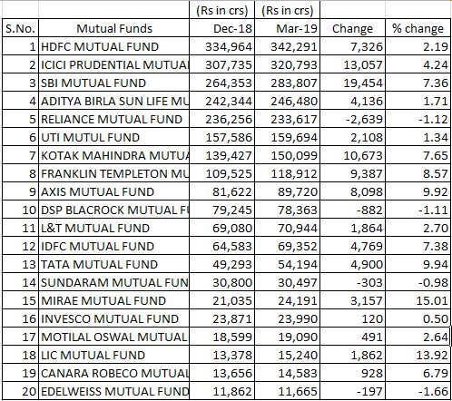
Top 20 Mutual Funds as on Mar 19

Slide 28
THANK YOU

