Slide 1
Module 2. Marketing Decisions
Part. III
TOPICS
PACKAGING – CONCEPT, ESSENTIALS OF A GOOD PACKAGE
PRODUCT POSITIONING – CONCEPT,STRATEGIES OF PRODUCT POSITIONING
SERVICE POSITIONING – IMPORTANCE AND CHALLENGES
Prepared By HARSHADA MHATRE

Slide 2
PACKAGING
Meaning - Packaging is the science, art and technology of enclosing or protecting products for distribution, storage, sale, and use. Packaging also refers to the process of designing, evaluating, and producing packages. Packaging contains, protects, preserves, transports, informs, and sells.
DEFINITION -
“The science, art and technology of enclosing or protecting products for distribution , storage, sale and use”
“The wrapping material around a consumer item that serves to contain, identify, describe, protect, display, promote and otherwise make the product marketable and keep it clean.”

Slide 3
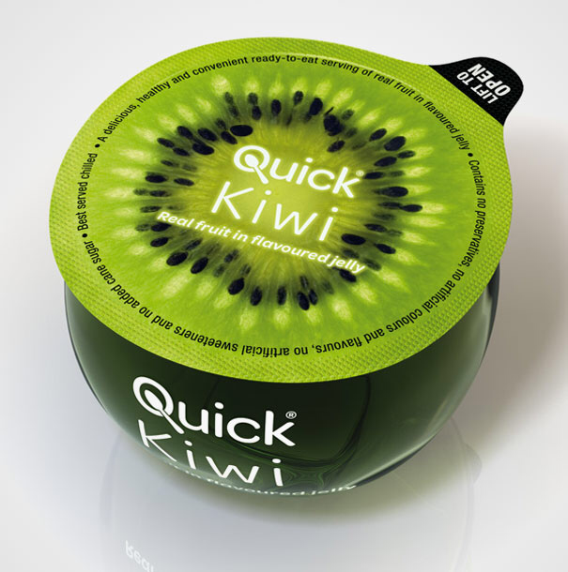
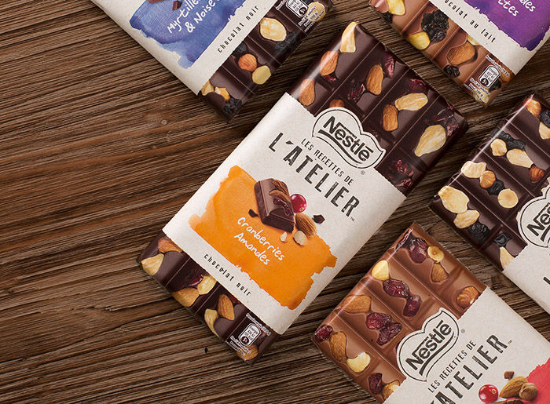
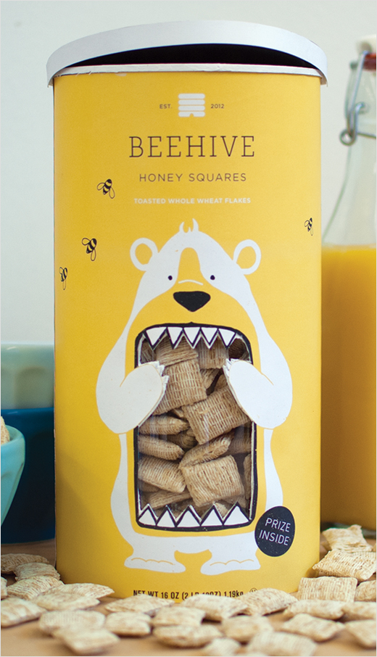
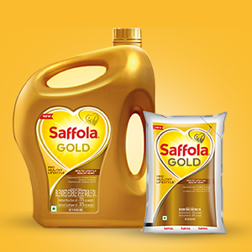
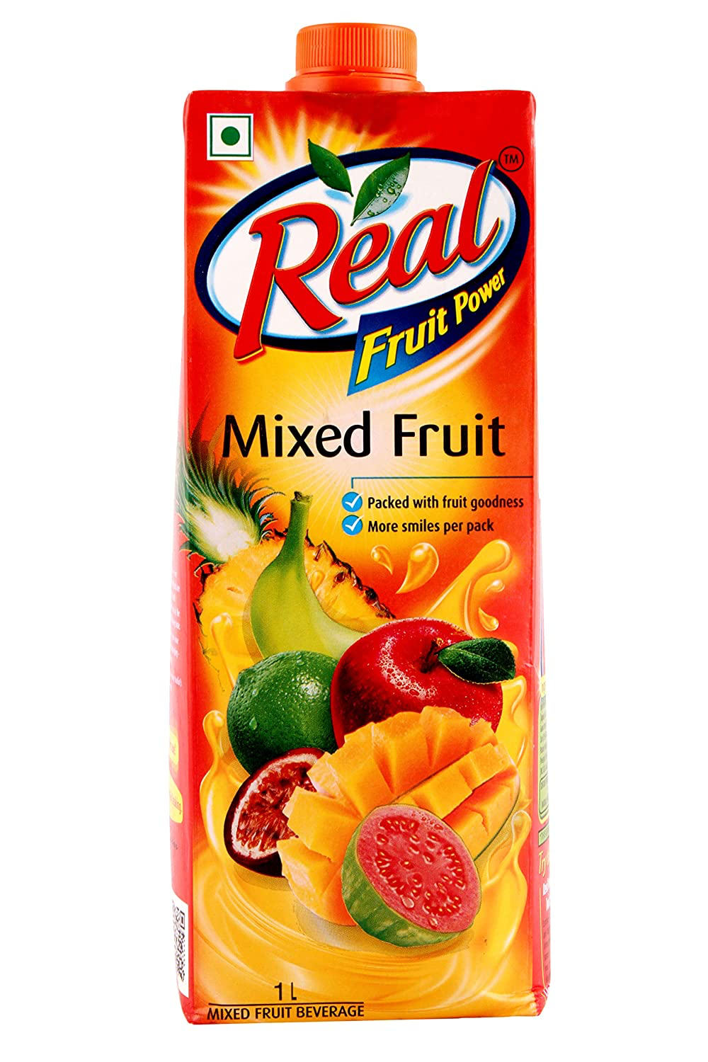
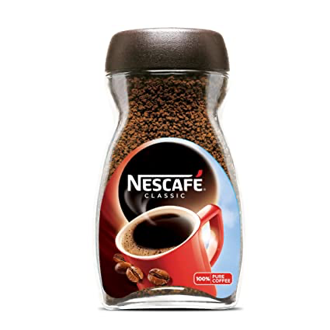
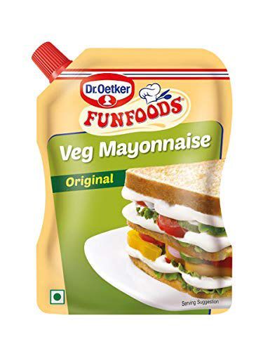
ESSENTIALS OF A GOOD PACKAGE
1.Attractive: The design, color, shape and size of the package should be attractive to arouse customer interest in the product.Innovative packages attract customers.
2. Convenient: The package should be convenient for the customer to carry, open, use and store. The size and shape should be appropriate to the needs of customers.

Slide 4
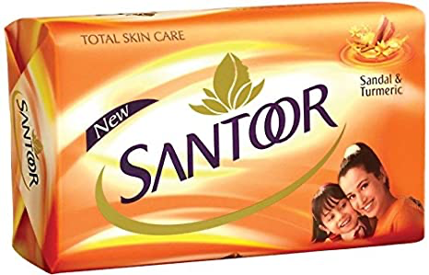
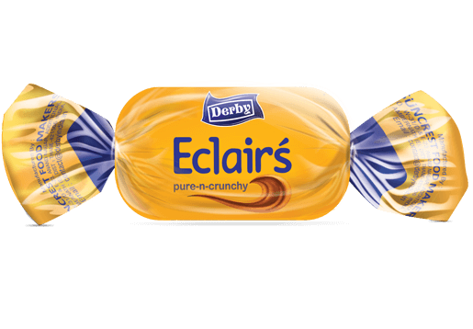
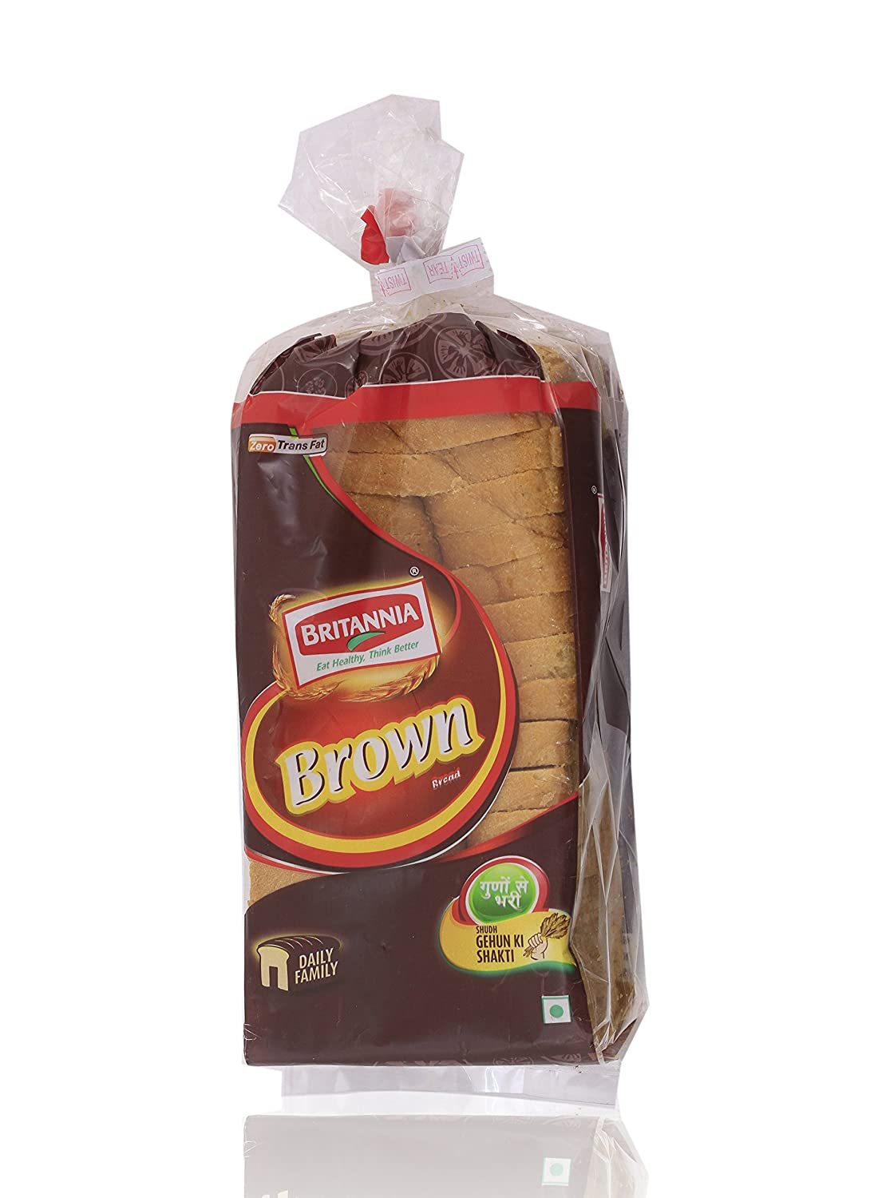
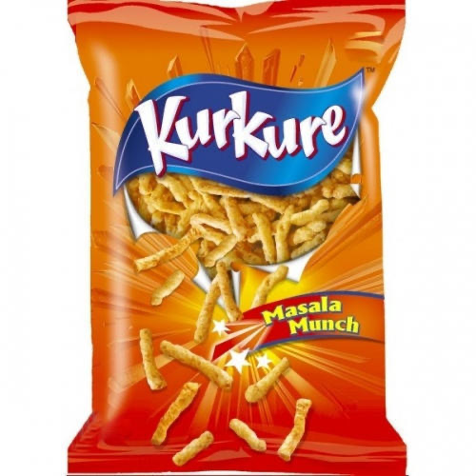
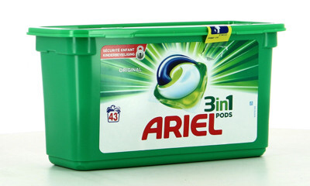
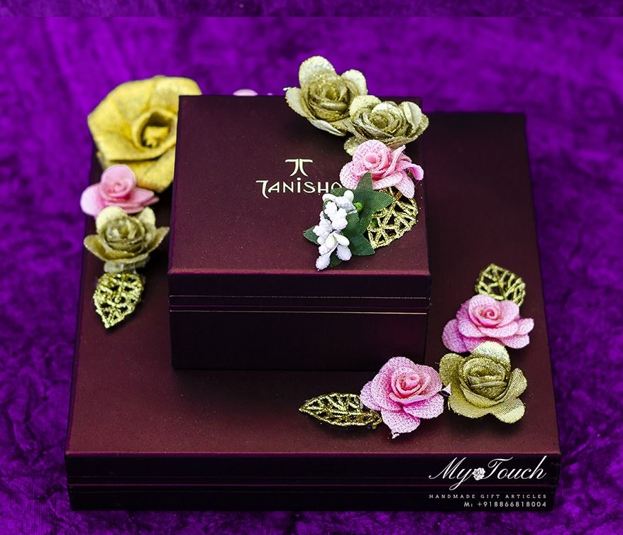
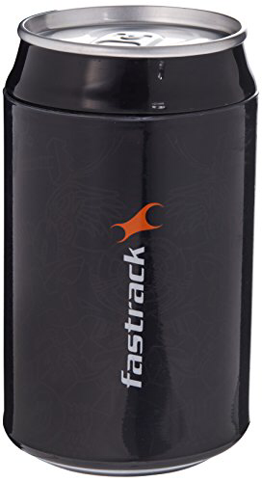

4. Reusable: The package should be reusable or it should have multiple uses. Customers value increases by such package.
3. Economic: The cost of packaging should not be high. Over packaging should be avoided. The nature of product should be properly considered for packaging.

Slide 5
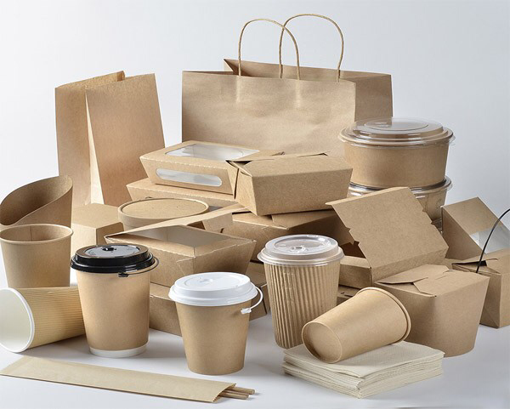

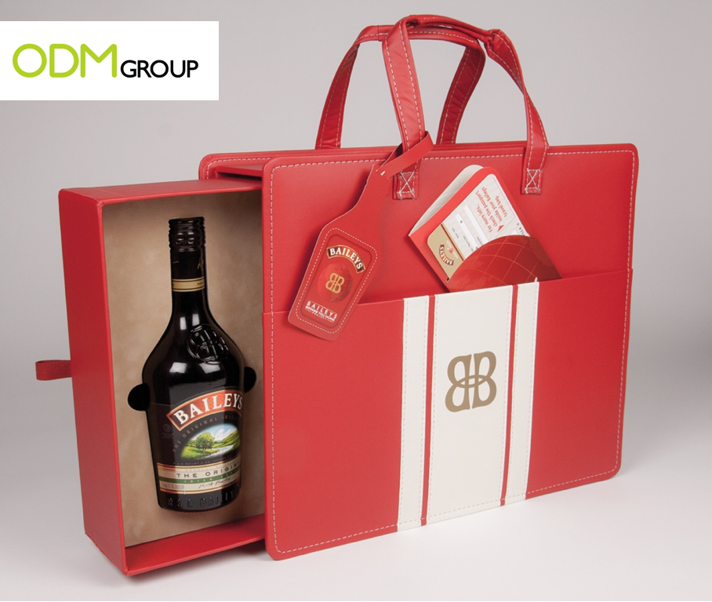
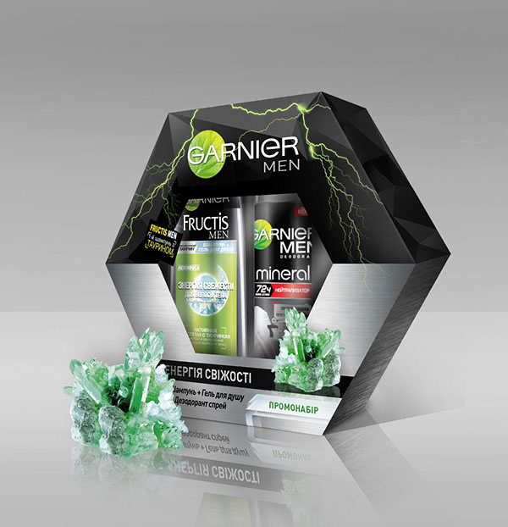
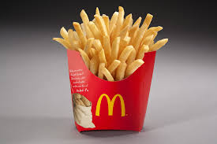
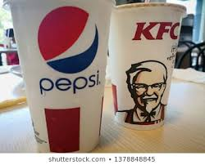
5. Communicative: Packaging should provide information required by law and desired by customers
6. Environment friendly: Packaging material should not pollute the environment. Recyclable material should be preferred.
7. PROMOTION- The Packing should effectively provide information to target market.
8.BUYER’S SPECIFICATION- Packing should conform to buyers tastes and preferences.

Slide 6
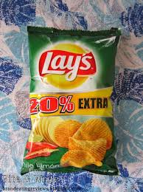
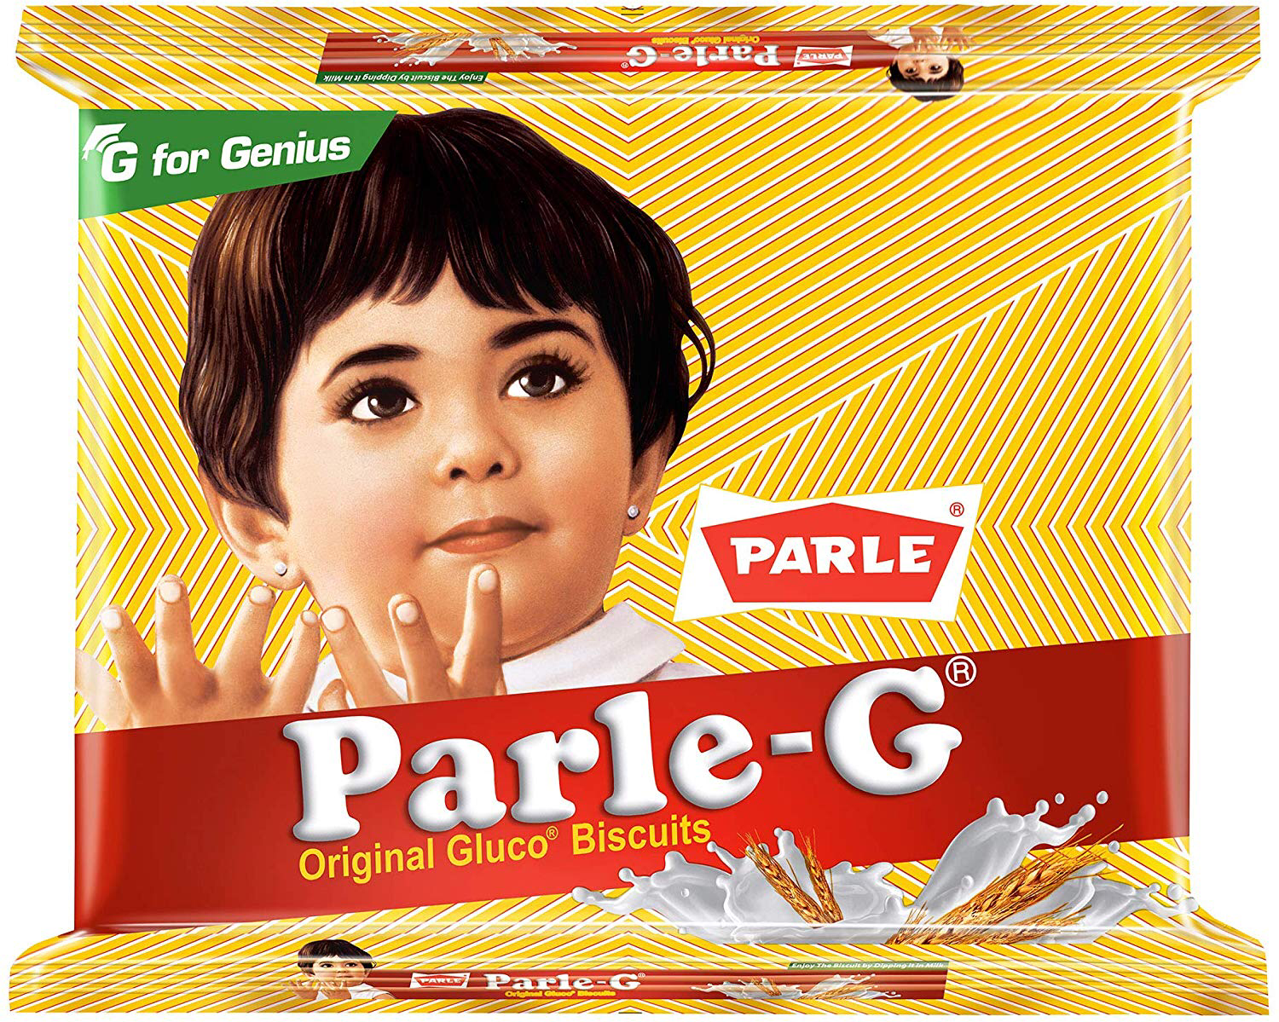
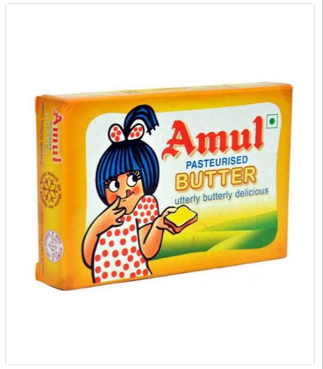
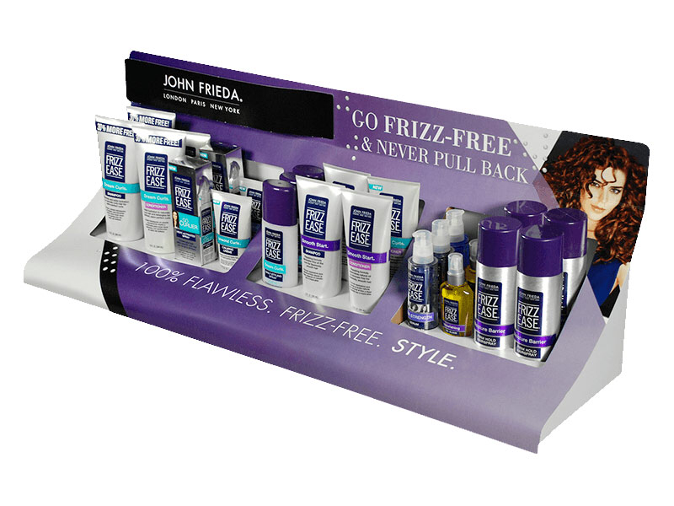
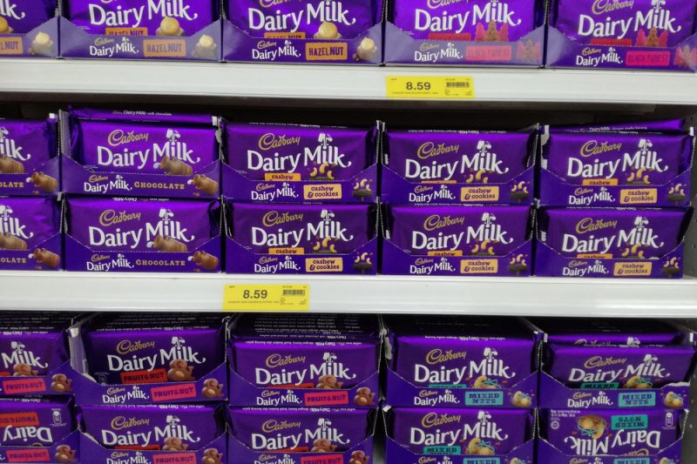
9. DEPENDABLE- Consumers rely on the packaging and assume what is shown outside the product should be inside the product.
Example: Often lays shows 20%extra which is merely air filled.
10. EASE IN IDENTIFICATION- The printed matter, mark or symbol should be familiar to customer.
11.EASE IN DISPLAY - Packages must be convenient to display in showcase or on the racks at stores.

Slide 7
PRODUCT POSITIONING
Meaning :
“A process of creating image of the product in the minds of the customers.”
Product positioning is the process marketers use to determine how to best communicate their products' attributes to their target customers based on customer needs, competitive pressures, available communication channels and carefully crafted key messages.
Definition:
PHILIP KOTLER - “Positioning as the act of designing the company’s offering and image to occupy a distinct place in the mind of the target market.”
David Ogilvy his definition is "what a product does, and who it is for". For instance, Dove has been successfully positioned as bars of soap for women with dry hands, vs. a product for men with dirty hands

Slide 8
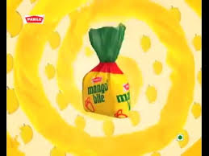
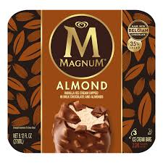
PRODUCT POSITIONING STRATEGIES
1.PRODUCT FEATURES- Highlight the benefits which highlight the product in the minds of the customers .
Example: a.Mango bite toffee “every bite with mango flavor” is humor to highlight the product.
2.PRICE QUALITY- Positioning with Price and Quality.
(good quality, higher price) Example: Magnum

Slide 9

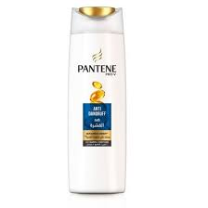
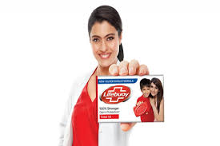
3. Positioning By Use- Positioning by use or application of the product.
Exapmle: BMW (The sheer driving experience)
4. Positioning by Product Class -
Positioning on the basis of type / class of produc.
Example: Pantene as anti-dandruff shampoo
5.Positioning by User Category-
Positioning by user or class of users, use of celebrities
E.g. lifebuoy soap, lux soap, etc.

Slide 10
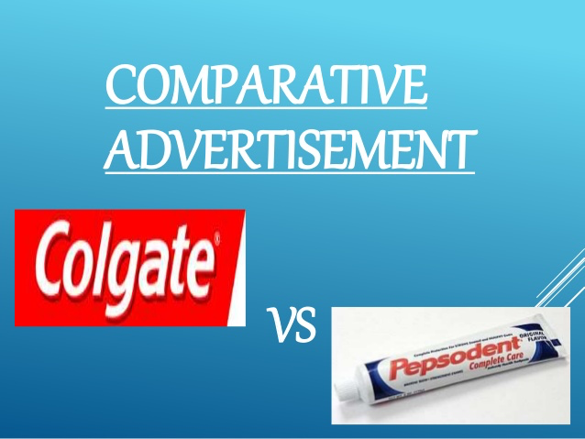





6. Positioning by Competitors- in some cases, a reference may be made directly or indirectly to one or more competitors.
7. Positioning by Cultural Symbols/ Names - Marketers may use cultural symbols to differentiate their brands from competitors.

Slide 11
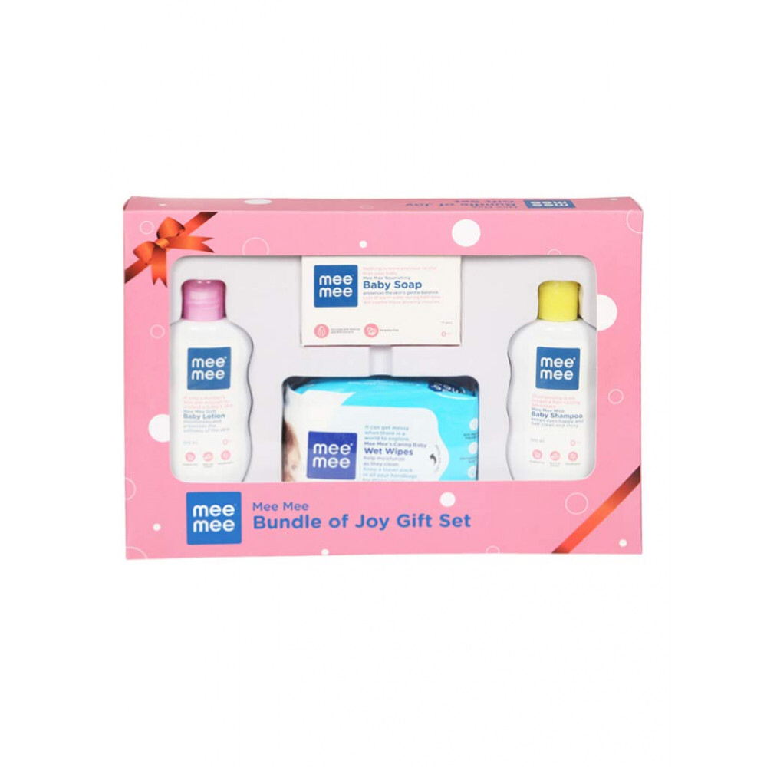
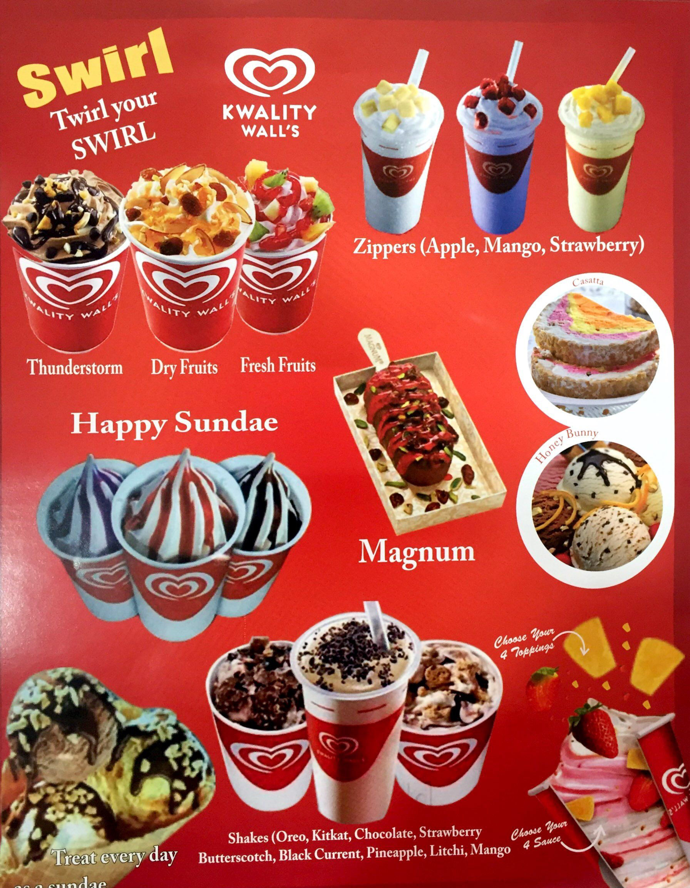
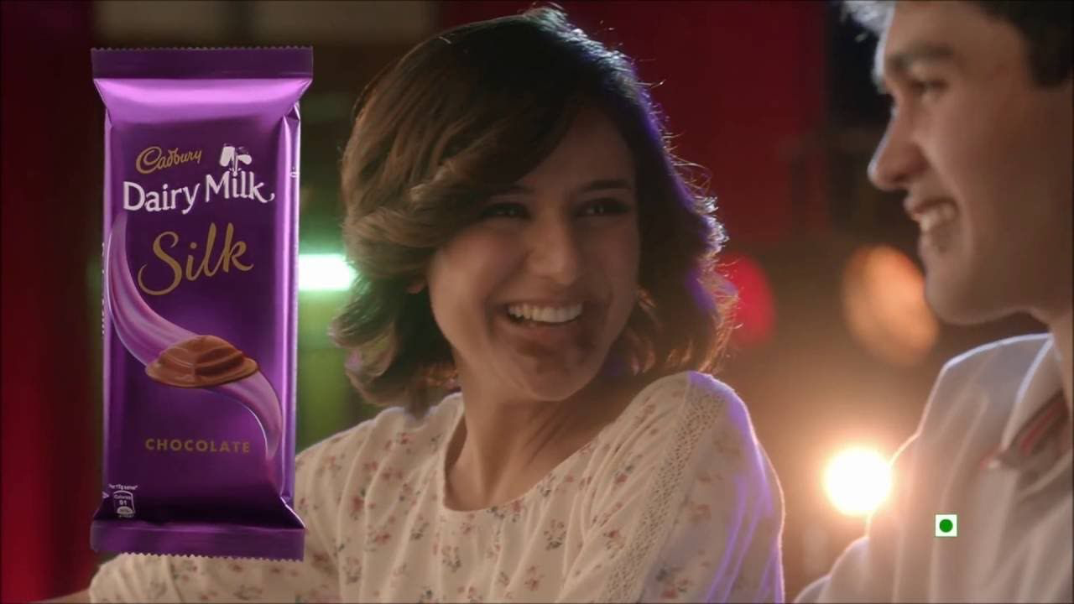
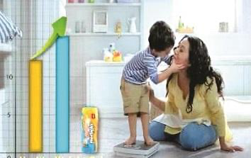

8. Positioning by Corporate Image – Marketers use their corporate image to position themselves.
9. Positioning by Emotions – A Firm position its product by dramatising emotions.
10. Positioning by Highlighting Social Issues- Firm positioning product by highlighting Social Values.

Slide 12


SERVICE POSITIONING
Meaning:
Service positioning is the unique identity of a service in a competitive market. A valuable position serves customer needs and stands out from the competition in a way that has meaning to customers.
Definition:
“A process of creating a distinct image of the service in the competitive world.”
Example: a.HDFC Bank has positioned itself as a preferred provider of financial services by incorporating technological advancement in its core businesses.
b.LIC positions itself as the most sort after insurance company providing financial solutions to the people.

Slide 13
IMPORTANCE OF SERVICE POSITIONING
1. CORPORATE IMAGE- It helps firm to develop favourable positive image in the minds of customers.
Example: Maruti Suzuki has developed a positive image of reliable company through positioning “ Count on us”.
2. CREATED DEMAND – It helps to increase demand for the service in the market.
Example: The Positioning of Dominos – Delivery in 30 Minutes.
3. COMPETITIVE ADVANTAGE-
Example: Apple has positioned the IPhone series of products by offering an affordable smart phone.
4. STATUS- Proper Service positioning creates status to the customers.
Example: Jet Airways provides great experience and value services to its customers which helps to maintain and positioning the best image for the best experience.

Slide 14
5. COMMANDS A PREMIUM PRICE – A Firm can demand premium price through effective positioning.
Example: Titan watches kept themselves positioning as a premium brand, providing high quality products
6. CUSTOMER LOYALTY – Customers may go for repeat purchase and may also recommend to others.
Example: Samsung as a company believes in pulling the customer to themselves through advertising but at the same time uses strong tactics to push the product to the customer through sales promotions
7. TARGETING CUSTOMERS - Firm can target its customers through effective Positioning
Example: Gillette has become one of the most recognized brands built on the pillars of professional and masculine razors
8. CREATES BRAND IMAGE – Proper Positioning helps to improve brand image of organisation.
Example: McDonald's has made itself positioned as to be the family friendly low cost restaurant in the fast food business.

Slide 15
CHALLENGES IN SERVICE POSITIONING
1. Intangibility: Services are intangible in nature. They cannot be seen or touched but can be felt. Demonstration of service is difficult .
Example: A student paying fees for tuition is actually paying for getting knowledge, which is not seen or touched, but it is felt.
2. Inseparability: Services cannot be separated from the service providers.The production and consumption of service happens at the same time.
Example: a maid has to be physically present to cook the food; a teacher has to be present to explain things to the students.
3. Perishability: The service cannot be stored. It is perishable in nature. Therefore Mass Provision of Services is not possible.
Example : Railway or bus ticket will last only for that particular journey and not for the next one. Similarly, a movie ticket will be used for that particular show and not for the next show.

Slide 16
4. Non-transferable Ownership: Services are of non-transferable ownership. A person pays to get the service, but not to own the service.
Example: a person makes the payment to book a room in a hotel or books a table for dinner, but he does not own the hotel or restaurant.
5. Inconsistency: Services are inconsistent or heterogeneous in nature. A repeated service will never be same.
Example: A teacher in a school or college may explain differently the same topic every year.

Slide 17
the above characteristics of service creates difficulties for positioning of services.
A. Services cannot be positioned on the basis of physical features.
B. It is difficult to position the services on the basis of regularity.
C. It is difficult to position the services on the basis of use of service.
D. It is difficult to position the services on the basis of Quality, as the services are
Intangible.
E. It is difficult to position the services on the basis of status as the services lacks physic

