Slide 1

FYBCOM/FY PROFESSIONAL-SEM 2-FOUNDATION COURSE
UNIT 3-Ecology

Slide 2

The Road Map
Foundation: Concept of Environment
Components of Environment
The Study Of Ecology : The Concept
Scope of Ecology
Disciplines of Ecology
Environment. Ecology. Ecosystem
Structure and Functions of an Ecosystem
The importance of Environmental Studies
The Concept of Natural Capital
Environmental Degradation: Forms, Causes, Impact
Sustainable Development: Concept and Components

Slide 3

Concept of Environment
Environment means anything that surround us. It can be living (biotic) or non-living (abiotic) things. It includes physical, chemical and other natural forces. Living things live in their environment. They constantly interact with it and adapt themselves to conditions in their environment.
Land, air, water, plants and animals all comprise the natural environment. Let us learn about the different domains of the natural environment. These are the lithosphere, hydrosphere, atmosphere and biosphere.

Slide 4

Components of Environment
The basic components of the environment are atmosphere or the air, lithosphere or the rocks and soil, The lithosphere is the solid crust or the hard top layer of the earth, hydrosphere or the water, and the living component of the environment or the biosphere which is also the Flora, Fauna and microbes.
The anthroposphere is that part of the environment that is made or modified by humans for use in human activities and human habitats.

Slide 5

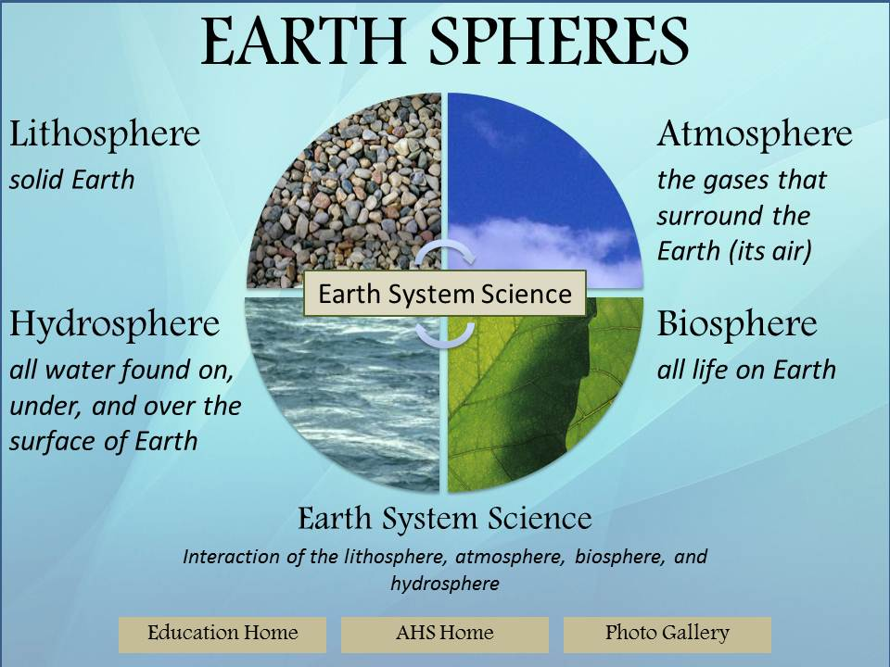
Geo – Spheres
Geographers break down the Earth's systems into four spheres that make up the world's air (atmosphere), water (hydrosphere), land (geosphere), and living organisms (biosphere)
Today, it defines our planet as 7 interconnected spheres-Cryosphere, Hydrosphere, Atmosphere, Biosphere, Lithosphere, Magnetosphere and Technosphere.

Slide 6

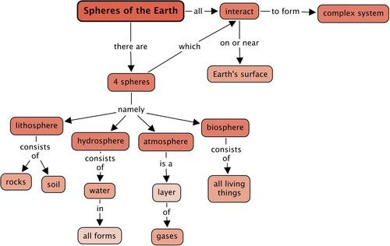
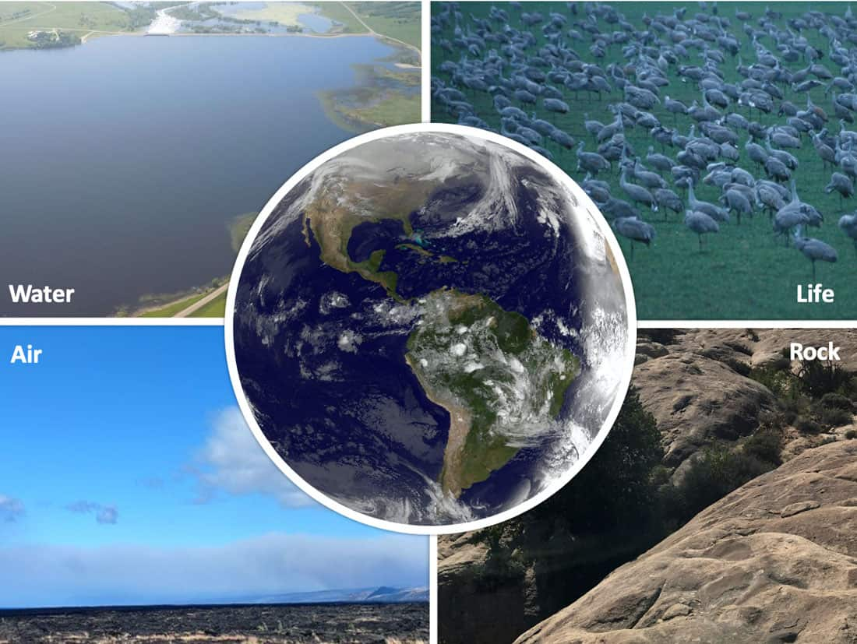
Inter relation between these Spheres
Four spheres are all independent parts of a system. The spheres interact with each other, and a change in one area can cause a change in another. Humans (biosphere) use farm machinery manufactured from geosphere materials to plow the fields, and the atmosphere brings precipitation (hydrosphere) to water the plants.
Earth's spheres interact as energy moves between them. ... Energy is TRANSFERRED between spheres BUT the energy is NOT created or destroyed. The energy simply moves between spheres or changes into other forms of energy.

Slide 7

The Study Of Ecology : The Concept
Ecology is the branch of biology that studies how organisms interact with their environment and other organisms. Ecology is the study of these forces, what produces them, and the complex relationships between organisms and each other, and organisms and their non-living environment
Ecology is the branch of science that deals with the study of interactions between living organisms and their physical environment. Both are closely interrelated and they have continuous interaction so that any change in the environment has an effect on the living organisms and vice-versa. Introduction. The term “ecology” was coined by the German zoologist, Ernst Haeckel, in 1866 to describe the “economies” of living forms.

Slide 8

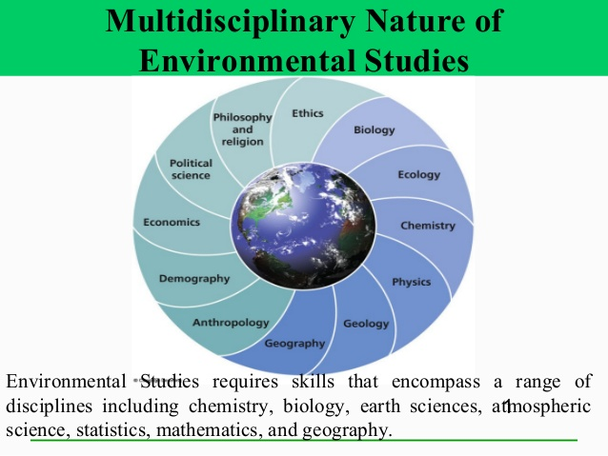
Scope of Ecology
Ecology is a multidisciplinary science related with Biology, Climatology, Chemistry, Biochemistry, Physics, Biophysics, Geology and Geography. ... For Ecology, Geography is a very important discipline because of the specific distribution of living beings on Earth.
Ecology is an interdisciplinary science which studies the interactions between all living beings and their environment, but also the interactions of living beings among them

Slide 9


Disciplines of Ecology
Behavioral Ecology:
It is concerned with explaining the patterns of behavior in animals.
Behavioral ecology is the study of behavioral interactions between individuals within populations and communities, usually in an evolutionary context. It looks at how competition and cooperation between and within species affects evolutionary fitness.

Slide 10
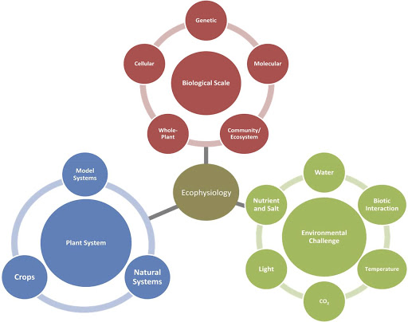
Physiological Ecology or Eco-Physiology:
It deals with how organisms are adapt­ed to respond to temperature, maintain prop­er water and salt balance, balance levels of oxygen and carbon dioxide, or deals with other factors of their physical environment.
Ecophysiology is the study of how a community of plants, animals, and microorganisms function together. Environmental ecophysiology is the study of how factors such as light, temperature, atmospheric carbon dioxide concentration, wind, relative humidity, soil water, and nutrients affect community function.

Slide 11

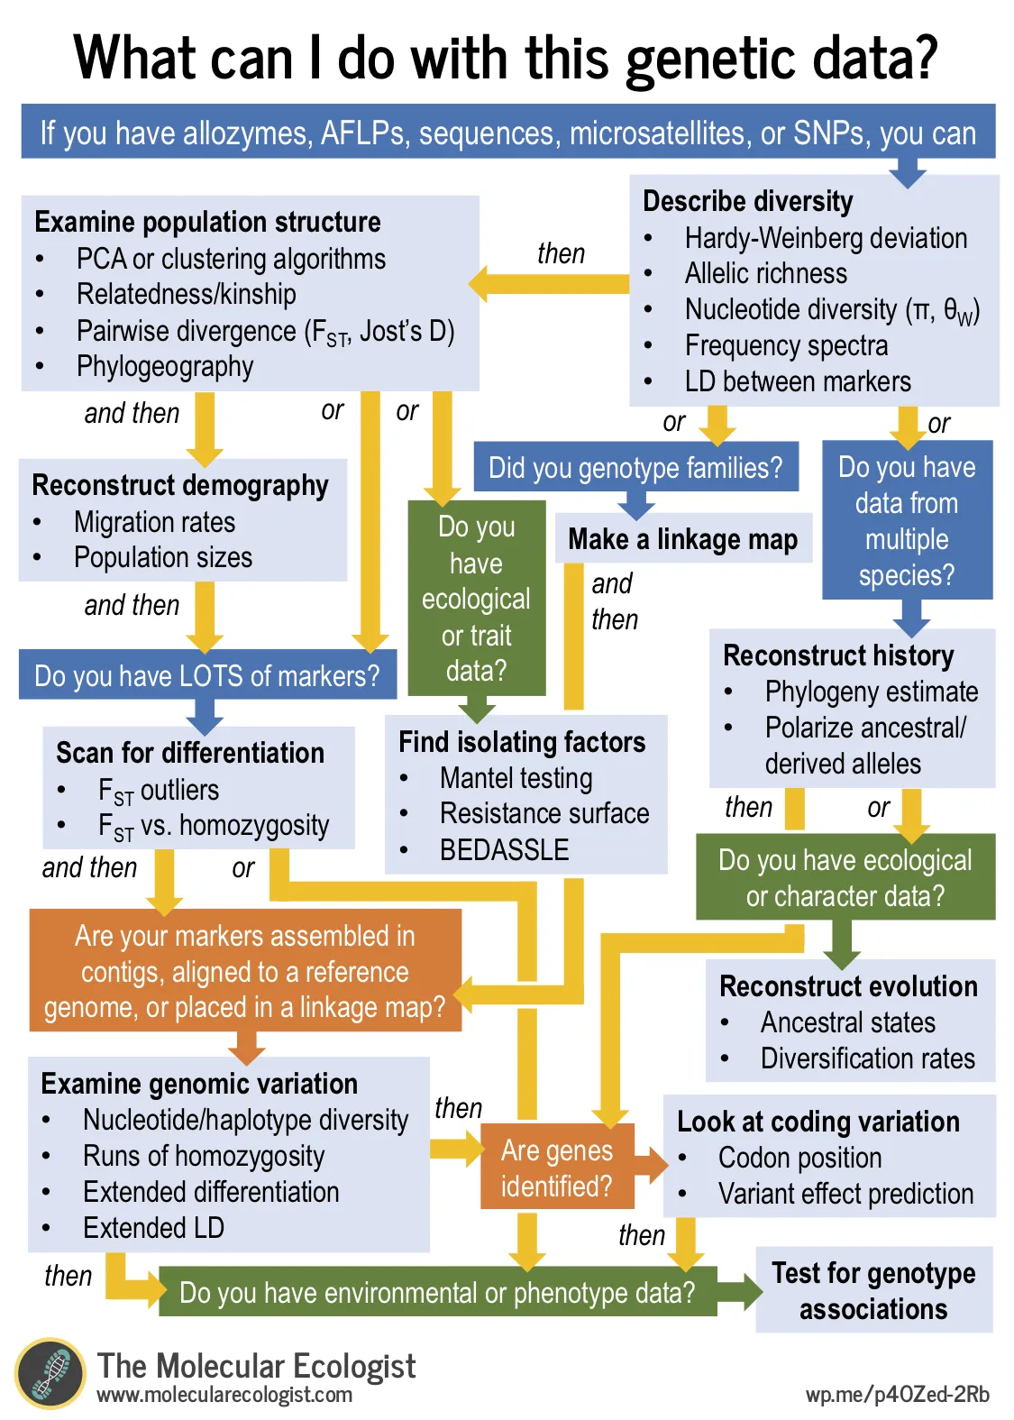
Molecular Ecology:
The use of mole­cular biology to directly tackle ecological problems is the focus of molecular biology.
Molecular ecology is a field of evolutionary biology that is concerned with applying molecular population genetics, molecular phylogenetics, and more recently genomics to traditional ecological questions (e.g., species diagnosis, conservation and assessment of biodiversity, species-area relationships, and many questions in behavioral ecology). It is virtually synonymous with the field of "Ecological Genetics"

Slide 12

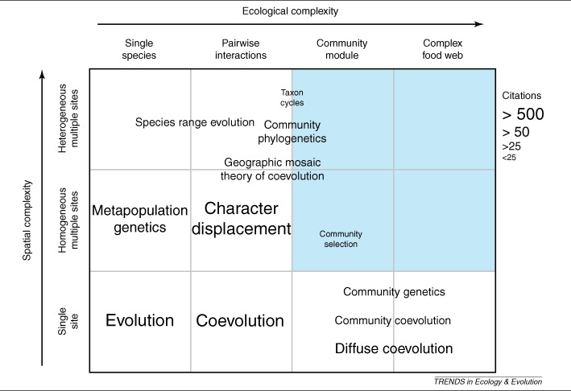
Evolutionary Ecology:Evolutio­nary ecology emphasizes the impact of evo­lution on current patterns and human induced changes.
Evolutionary ecology is a field within both ecology and evolution that examines how interactions between and within species evolve. It explicitly considers the evolutionary effects of competitors, mutualists, predators, prey and pathogens.
It plays a significant role in forming new species and in modifying living ones. The environment defines a template and the process of evolution by natural selection shapes organisms to fit that template.

Slide 13

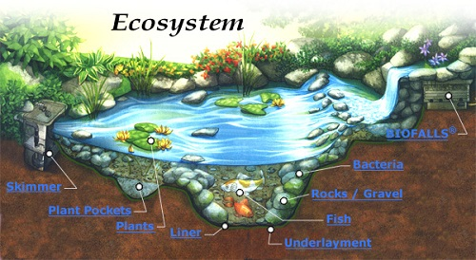
Ecosystem Ecology:The interaction between the biotic and abiotic components called an ecosystem is the sub-field of ecology called ecosystem ecology.
Ecosystem ecology is the study of these and other questions about the living and nonliving components within the environment, how these factors interact with each other, and how both natural and human-induced changes affect how they function. Ecosystem ecology is the integrated study of living and non-living components of ecosystems and their interactions within an ecosystem framework. This science examines how ecosystems work and relates this to their components such as chemicals, bedrock, soil, plants, and animals.

Slide 14

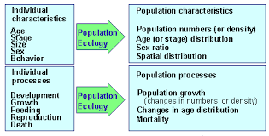
Population Ecology:
Population ecology constitutes organisms of the same species living in the same place and same time.
Population ecology is the study of these and other questions about what factors affect population and how and why a population changes over time. Population ecology has its deepest historic roots, and its richest development, in the study of population growth, regulation, and dynamics, or demography.
A population is a group of one particular species in a particular place. That group of birds that lives near your house, you know which one, is a good example

Slide 15
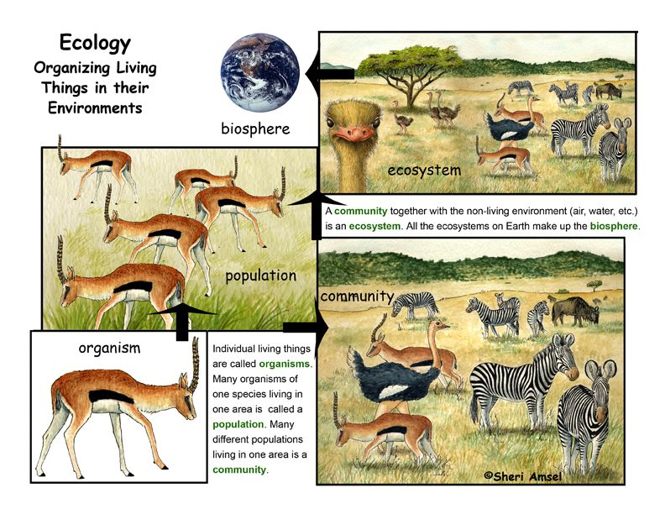
Community Ecology:
Populations of many different organisms in a particular place are tied to one another by feeding rela­tionships and other interactions. These rela­tionships of interacting populations are called ecological communities and their study is under the purview of community ecology.
Community ecology, study of the organization and functioning of communities, which are assemblages of interacting populations of the species living within a particular area or habitat. As populations of species interact with one another, they form biological communities.

Slide 16

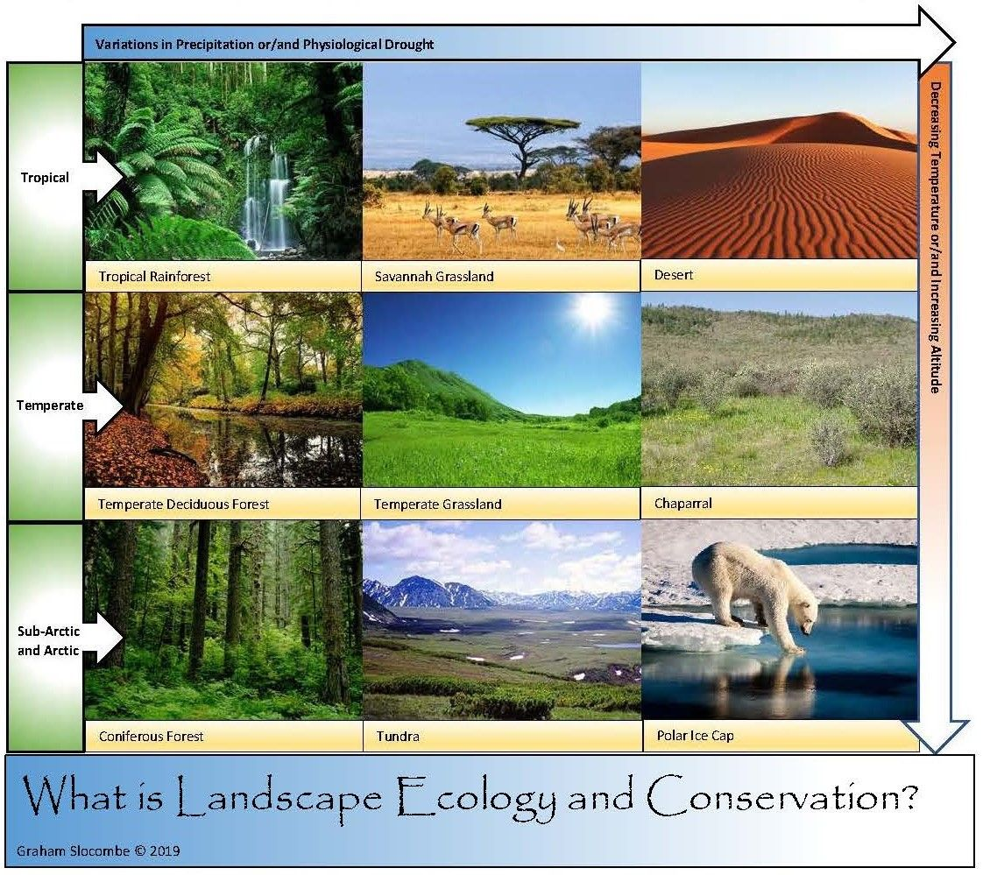
Landscape Ecology:
Landscape ecology is one that emphasizes the inter-connections among ecosystems of a region. Landscape ecology is the study of the pattern and interaction between ecosystems within a region of interest, and the way the interactions affect ecological processes, especially the unique effects of spatial heterogeneity on these interactions.

Slide 17

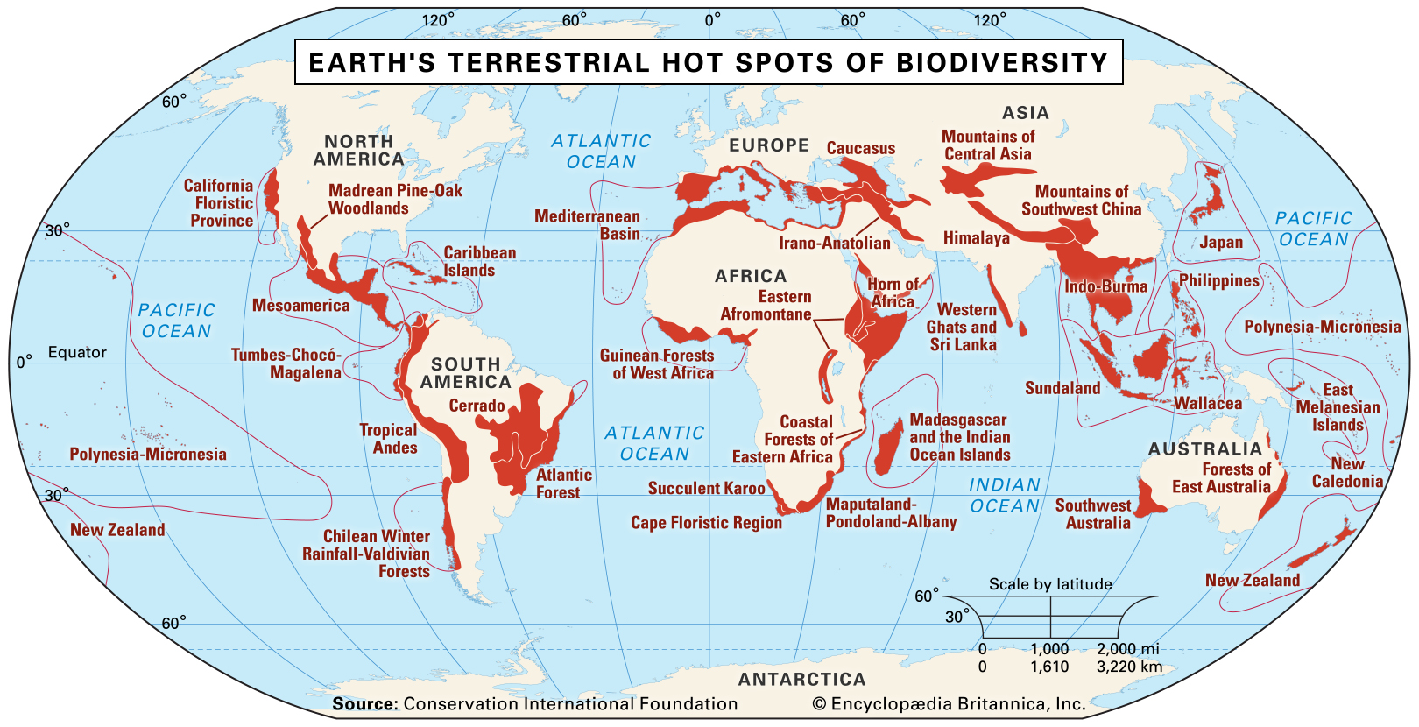
Conservation Biology:
It takes a landscape approach and is related to the maintenance of biodiversity and the preservation of endangered species. Conservation ecology is the branch of ecology and evolutionary biology that deals with the preservation and management of biodiversity and natural resources. It is a discipline that is emerging rapidly as a result of the accelerating deterioration of natural systems and the worldwide epidemic of species extinctions.

Slide 18

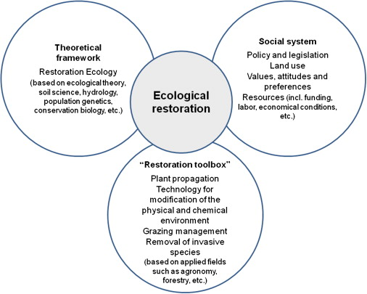
Restoration Ecology:
It relates to the re-establishing of the integrity of natural sys­tems that have been damaged by human activity. Ecological restoration is the process of assisting the recovery of an ecosystem that has been degraded, damaged or destroyed. It is an intentional activity that initiates or accelerates an ecological pathway—or trajectory through time—towards a reference state

Slide 19

Environment. Ecology. Ecosystem
Environment refers to the interaction between the physical, chemical and biological components.
Ecology is the study of relationship between organisms and their environment/ The environmental issues include pollution, deforestation, global warming, and other broader issues.
Ecosystem is the community where the biotic and abiotic elements interact with each other.

Slide 20
Natural Ecosystem
The ecosystem is the community of living organisms in conjunction with non-living components of their environment, interacting as a system.
Terrestrial Ecosystem:
Grassland Ecosystem.
Temperate Forest Ecosystems.
Tropical Rainforest System.
Desert Ecosystem.
Aquatic Ecosystems:
Coral Reefs.
Ponds, Lakes, Oceans, Rivers

Slide 21
Artificial Ecosystem
An artificial ecosystem is a human made system of plants, animals, and people living in an area together with their surroundings. Zoo parks often create artificial ecosystems by placing animals in human-made areas similar to their natural habitat
Different artificial ecosystems are crop land and aquarium (artificial aquatic ecosystems). Agriculture (crop raising, animal husbandry) has created and agroecosystem which differs from place to place depending upon climate, latitude, altitude, topographic, and edaphic factors.

Slide 22

Structure and Functions of an Ecosystem
The ecosystem is the functional unit of the environment system. The abiotic components provide the matrix for the synthesis of organic components.
It is comprised of non living components, living components and includes the primary producers, consumers and decomposers.
Fundamentally, ecosystem functions are exchange of energy and nutrients in the food chain. These exchanges sustain plant and animal life on the planet as well as the decomposition of organic matter and the production of biomass.

Slide 23

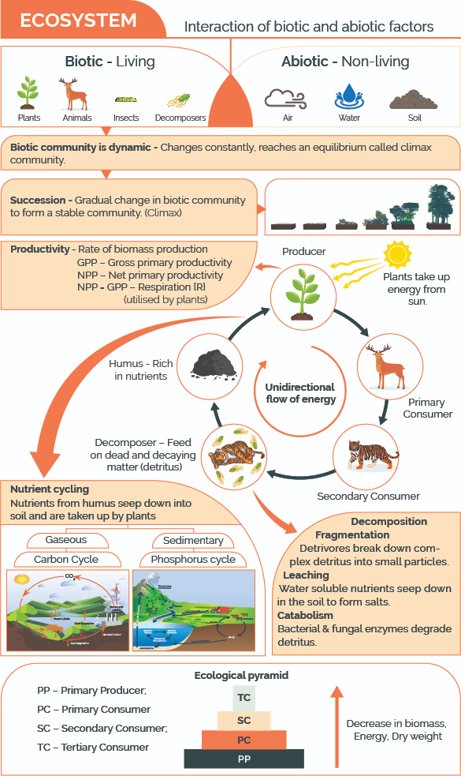

Slide 24

The importance of Environmental Studies
Environment studies is all about learning the way we should live and how we can develop sustainable strategies to protect the environment. It helps individuals to develop an understanding of living and physical environment and how to resolve challenging environmental issues affecting nature.

Slide 25

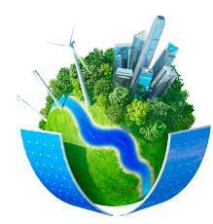
Reason for environmental studies
urbanization
Industrial growth
Agriculture and use of pesticides
Pollution
Developmental projects
Climate changes
Reduction of energy resources

Slide 26

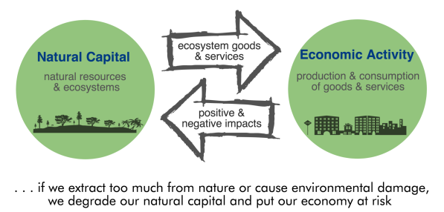
The Concept of Natural Capital
Natural capital refers to the elements of the natural environment which provide valuable goods and services to people. For example, a woodland can be regarded as a natural capital asset, from which flows valuable benefits, or ecosystem services, such as flood risk reduction and carbon capture.

Slide 27
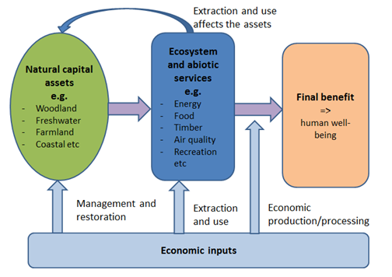
Natural capital
Energy source
Resource and food supply
Source for recreation
Forest resources
We degrade natural capital by cutting down trees faster than they can grow back, replacing diverse and sustainable forests with croplands, and adding harmful chemicals and wastes to streams and oceans faster than they can cleanse themselves.

Slide 28

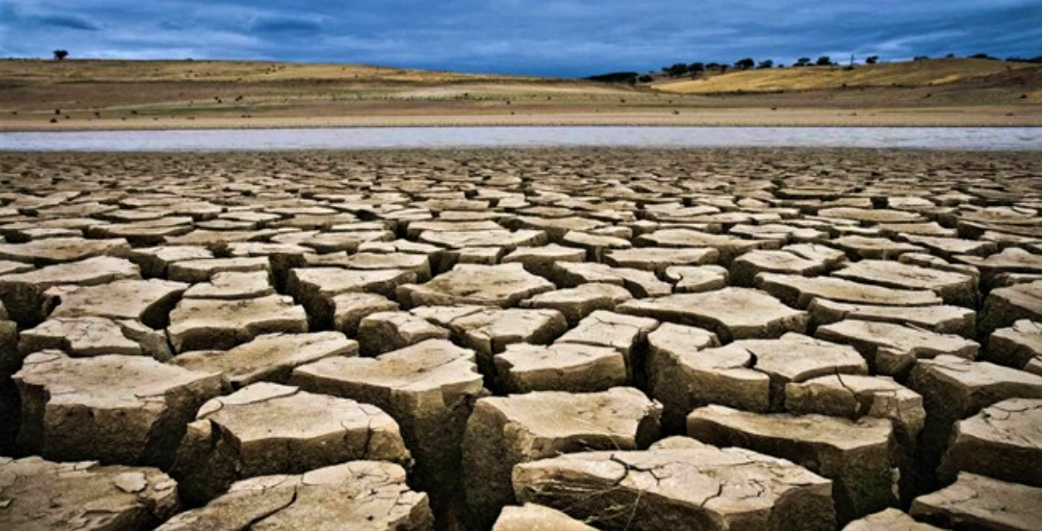
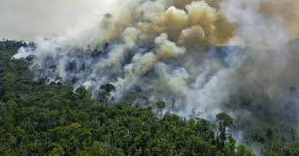
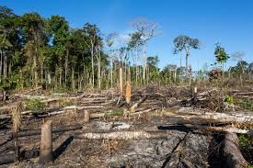
Environmental degradation
Environmental degradation is the deterioration of the environment through depletion of resources such as air, water and soil; the destruction of ecosystems; habitat destruction; the extinction of wildlife; and pollution. ... When natural habitats are destroyed or natural resources are depleted, the environment is degraded.

Slide 29
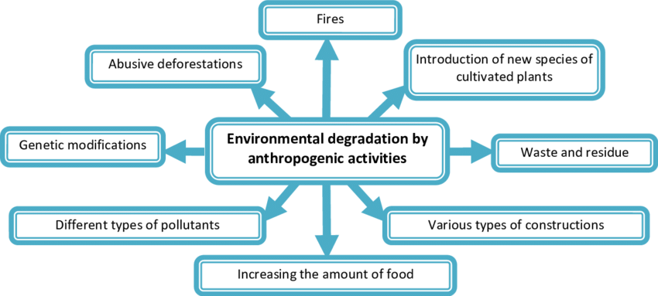
Forms of environmental degradation
Deforestation
Emissions
Desertification
Erosion
Extinction
Marine degradation

Slide 30
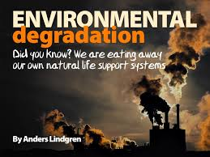
Causes of environmental degradation
Industrial activities
Population explosion
Farm mechanization
Pesticides and insecticides
Felling of trees
Lifestyle changes
Automobile industry
Falling levels of ground water.
Burning of coal and mineral oil.

Slide 31
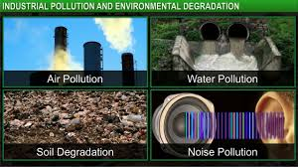
Causes of environmental degradation
Depletion of the ozone layer
Throwing waste in river.
Urbanization
Poverty
Government policies
Construction projects
Natural causes

Slide 32
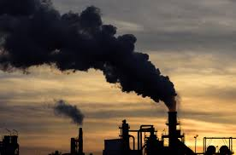
Impact of environment degradation
Disruption od biodiversity
Scarcity of resources
Climate change
Global warming
Deforestation
Desertification
Soil contamination
Air and noise pollution, water pollution and scarcity
Acid rain
Depletion of marine life
Ozone depletion

Slide 33

Sustainable Development: Concept
Sustainable development is the idea that human societies must live and meet their needs without compromising the ability of future generations to meet their own needs. The “official” definition of sustainable development was developed for the first time in the Brundtland Report in 1987
This sustainable development goal focuses on developing and expanding renewable energy resources such as sun, wind, hydropower, liquid and solid biofuels, biogas and geothermal. These renewable sources of energy don't emit greenhouse gasses to the atmosphere and therefore are ideal for the environment and human health.

Slide 34

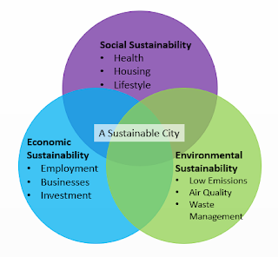
Need for sustainable development
The goal of sustainable development is to meet the needs of today, without compromising the needs of tomorrow. This means we cannot continue using current levels of resources as this will not leave enough for future generations. Stabilizing and reducing carbon emissions is key to living within environmental limits.

Slide 35

Components of sustainable development
Sustainable development is dependent on three factors: environment, social and economic
There is a need to understand the complexity of the situation
We must remember the sections of society and note that poverty and environment are linked
Lack of livelihood
Economic development
Health risks
Resilience to environmental risks

Slide 36
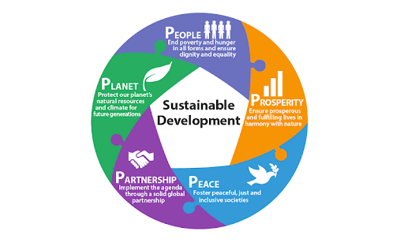
Methods to achieve sustainable development
Integration of environment and economic decision
Shared responsibility
Waste minimization
Rehabilitation and reclamation
Conversation and prevention
Global approach
Scientific and technological innovation

