Slide 1
SM and CRM – UNIT 3

Slide 2
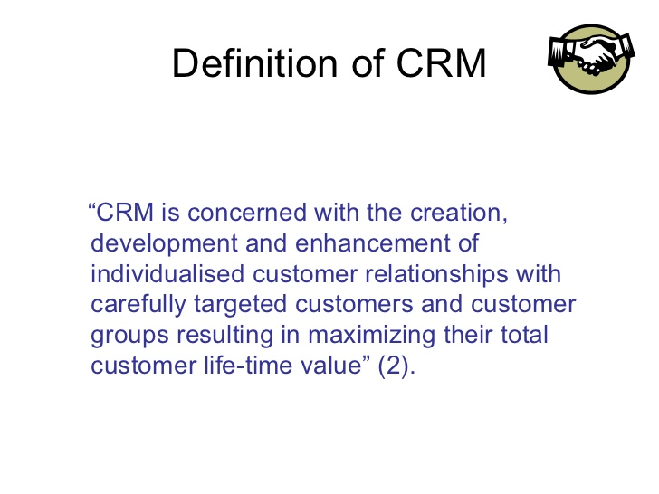
CUSTOMER RELATIONSHIP MANAGEMENT

Slide 3
CRM
Customer relationship management (CRM) is a process in which compile data from a range of different communication channels, including a company's website, telephone, email, live chat, marketing materials and more recently, social media. They allow businesses to learn more about their target audiences and how to best cater for their needs, thus retaining customers and driving sales growth.^{[3]} CRM may be used with past, present or potential customers.
CRM is a business strategies that integrate people, processes and technologies to optimise the relation of an organisation with all types of customers.
It is a comprehensive strategy and process of acquiring, retaining and partnering with selective customers to create superior values for the company and customer

Slide 4
Purpose of CRM
Improve marketing
Enhance mutual value for the parties involved in relationship
It helps to evaluate, CRM performance by comparing results achieved against objectives of financial goals, marketing goals, strategic, goals, operational and general goals.
Consumers are motivated to indulge in CRM because it reduces psychological and sociological benefits associated with reduction in choice.
CRM offers rewards and associated benefit.

Slide 5
SCOPE OF CRM
Reduction in customer recruitment cost
Generation of more and more loyal customer
Expansion of customer base
Reduction in advertisement and other sales promotion expenses
Benefiting customer selectivity approach
Increase in the number of profitable customers
Easy introduction of new products.
Easy business expansion possibilities
Increase in customer partnering.

Slide 6
Feature of CRM
A central database that is available to all employees to view and update customer data.
Customer self service where the customer can self order and help themselves using web based password access
Identifying and tracking potential customers.
report generated with up to date information including revenue forecasting and trend analysis.

Slide 7
Benefits of CRM
To customers
To organisation
Benefit of better service
Improved relationship
Social relationship
Involvement in process
Identification of potential customers.
Increase profitability
Decrease operating cost
Increased customer loyalty
Improved customer satisfaction

Slide 8
OBJECTIVE OF CRM
Providing service and product as per customer need.
Offering better customer service.
Retaining existing customer and discovering new ones.
Lower level of operating cost.
Aiding marketing department.

Slide 9
CUSTOMER LIFE CYCLE MANAGEMENT
COMPONENTS OF CRM
CUSTOMER LIFETIME VALUE

Slide 10
CLM (Customer Lifecycle Management)
It is also called CRP (Customer Relationship Planning) is mapping of customer data to define customer behaviour so that the process of a company are fully occupied in acquiring, selling and maintaining a long term relationship to a customer.
CLM defines full spectrum of customer interaction as engage, transact, fulfil and service. The purpose of CLM is to envelop the customer deeply into corporate mesh so that they arecaptured and retained for eternity.

Slide 11
CUSTOMER LIFETIME VALUE(CLTV)
It is a measurement of what a customer is projected to be worth over a lifetime. Its importance has increased due to contemporary customer’s freedom of choice

Slide 12
Following are important component of CRM
SalesForce Automation
Human Resource Management
Lead Management
Customer Service
Marketing
Workflow Automation
Business Reporting
Analytics

Slide 13
SalesForce Automation
It helps to know the revenue generation opportunities better and that makes it very significant. The component also includes analyzing the salesforecasts and the performances by the workforce. To achieve an overall improvement in the development and growth of the industry, numerous components work hand in hand to form salesforce automation as a consequent unit. Some of the major elements of the same are Lead Management, Account Management, Opportunity Management, Forecasting, Pipeline Analysis, Contact Management, Activity Management, Email Management and Reporting.

Slide 14
Human Resource Management
Human Resource Management involves the effective and correct use of human resource and skills at the specific moment and situation. This requires to be make sure that the skills and intellectual levels of the professionals match the tasks undertaken by them according to their job profiles. It is an essential component not only for the large scale corporations but the medium industries as well. It involves adopting an effective people strategy and studying the skills or the workforce and the growth being generated thereby designing and implementing the strategies needed accordingly with the aim of achieving development.

Slide 15
Lead Management
Lead Management as the name suggests, refers to keeping the track of the sales leads as well as their distribution. The business that are benefitted by this component of CRM the most are the sales industries, marketing firms and customer executive centres. It involves an efficient management of the campaigns, designing customized forms, finalizing the mailing lists and several other elements. An extensive study of the purchase patterns of the customers as well as potential sales leads helps to capture the maximum number of sales leads to improve the sales.

Slide 16
Customer Service
Customer Relationship Management emphasizes on collecting customer information and data, their purchase informations and patterns as well as involves providing the collected information to the necessary and concerned departments. This makes customer service an essential component of CRM.
Almost all the major departments including the sales department, marketing team and the management personnel are required to take steps to develop their awareness and understanding of the customer needs as well as complaints. This undoubtedly makes the business or the company to deliver quick and perfect solutions and assistance to the customers as well as cater to their needs which increases the dependability and trust of the customers and people on the organization.

Slide 17
Marketing
Marketing is one of the most significant component of Customer Relationship Management and it refers to the promotional activities that are adopted by a company in order to promote their products. The marketing could be targeted to a particular group of people as well as to the general crowd. Marketing involves crafting and implementing strategies in order to sell the product. Customer Relationship Management assists in the marketing process by enhancing and improving the effectiveness of the strategies used for marketing and promotion.

Slide 18
Workflow Automation
number of processes run simultaneously when it comes to the management and this requires an efficient cost cutting as well as the streamlining of all the processes.The phenomenon of doing so is known as Workflow Automation. It not only reduces the excess expenditure but also prevents the repetition of a particular task by different people by reducing the work and work force that is getting wasted for avoidable jobs. Routing out the paperwork and form filling are some of the elements of the process and it aims at preventing the loss of time and excess effort.

Slide 19
Business Reporting
CRM comes with a management of sales, customer care reports and marketing. The customer care reports assist the executives of a company to gain an insight into their daily work management and operations.This enables one to know the the precise position of the company at any particular instance. CRM provides the reports on the business and that makes it play a major role here. It is ensured that the reports are accurate as well as precise. Another significant feature is the forecasting and the ability to export the business reports on other systems. In order to make comparisons, one can save historical data as well.

Slide 20
Analytics
nalytics is the process of studying and representing the data in order to observe the trends in the market. Creating graphical representations of the data in the form of histograms, charts, figures and diagrams utilizing the current data as well as the one generated in the past is essential to achieve a detailed understanding and study of the trends. Analytics is an extremely significant element of Customer Relationship Management as it allows to make in-depth study of information that is required to calculate the progress in the business.

Slide 21
CRM Cycle
Interact and Deliver
Deliver increased value to customer
Acquire and Retain
Acquire customer and prospective customer
Understand and differentiate
Understand customer’s need
Develop and Customise
Retain valuable customer
Differentiate based on customer need, characteristics and behaviour
Customise by customer segment
Develop product services
Interact with customer and prospective customer

Slide 22
RELATIONSHIP CHALLENGES (issues in relationship mktg)
The customers are not always right
The wrong segment
Not profitable in the long run
Difficult customer

Slide 23
RELATIONSHIP MARKETING
It is a philosophy of doing business where focus is on keeping and improving relationship with current customers rather than acquiring new customers.
The bucket theory illustrates the importance of relationship strategy

Slide 24
EVOLUTION OF RELATIONSHIP WITH CUSTOMERS
CUSTOMER AS STRANGERS
CUSTOMER AS ACQUAINTANCES
CUSTOMER AS FRIEND
CUSTOMER AS A PARTNER

Slide 25
Customer as strangers
Not yet entered into transaction
Service provider initiates communication with them in order to attract and acquire their business.

Slide 26
Customer as acquaintances
Customer has tried the product.
Primary goal of the provider is to satisfy the customer
Firm focus on creating value.

Slide 27
Customer as a friend
Customers make repeat purchase and receive value in exchange relationship
Firm acquire knowledge of the customer need.
Tries to customise product as per the requirement of the customers.
The relationship transform to friendship from acquaintance because of the development of trust.
The primary goal at friendship stage is customer retention.

Slide 28
Customers as partners
Level of trust grows
Commitment of customer increases
Highly personalised and customised service offering help the company to move to partnership
Company-customer relationship become more dependant

Slide 29
SCOPE OF CRM
Marketing and fulfillment
Customer service and support
Retention and loyalty
Storefront and field service
Sales; cross sales; upscale

Slide 30
CRM Partners
Customer service and support
supplier
Owners
Employees
Other partners

Slide 31
CUSTOMER SERVICE AND SUPPORT
Special prices, preferential treatment an bring about drastic increase in value due to frequent sales from satisfied customers.
Positive word of mouth; reduced need for product; sampling and ad; increased possibility of cross selling or upselling.

Slide 32
Supplier
Suppliers provide input like RM, technologies, HR and expertise
Trend is shifting to smaller number of supplier and creating and maintaining long term relationship with them.
With fewer vendors, increased co op between the remaining parties in the form of MIS alignment and customer info sharing become possible

Slide 33
Owners
Management need to establish productive relationship wih its owners and create values for them in the form of enduring company and value of stock.
EMPLOYEES
In service employee satisfaction drive customer satisfaction.
A positive environment for service is less rule driven, more customer oriented and more supportive of personal initiatives.
OTHER PARTNERS
Partnering with another firm can support the creationand delivery of value throughin creasing efficiency,sharing product development
Marketing and distribution cost and sharing key resources.

Slide 34
FACTORS RESPONSIBLE FOR GROWTH OF CRM
Customer becoming more powerful because of globalisation
Mass customisation
Cost of customer
Limitation of ERP fund
Firms opting for direct selling
Technology act as catalyst for CRM.

Slide 35
CHALLENGES OF CRM TODAY
Marketing is in transition. Channels are multiplying, traditional markets are breaking up and reforming. The brand concept is less powerful , competition is intense. The consumer is changing too. Customer satisfaction is declining and product and service innovation only realise short term gains.
Poor project planning, weak and incomplete business cases, cost and complexity of technology, lack of skill, lack of involvement of senior mgmt. in the CRM processes are among many factors for failure in CRM in organisation.

Slide 36
Continued…
Slow adoption process in developing CRM capability.
Though businesses are eager to adopt new technologies but success comes through careful use of technology.
Technology need to be utilised optimally to redesign business processes, improve supply chain management and increase values provided to customer.
Employees are critical to the success of any CRM project and it is critical to train them effectively to handle any process change.
CRM demand careful planning and implementation, greater understanding by cross functional teams through organisational learning and closer interaction with end user to ensure that the technological environment is optimised to achieve desired objective.

Slide 37
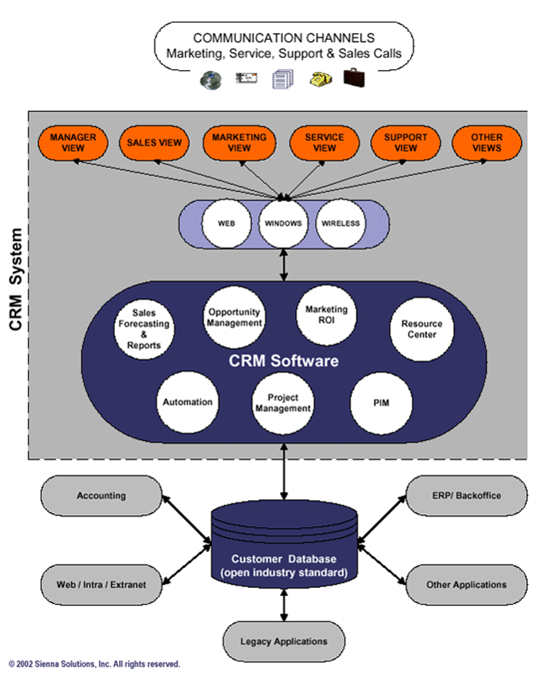
CRM MODEL

Slide 38
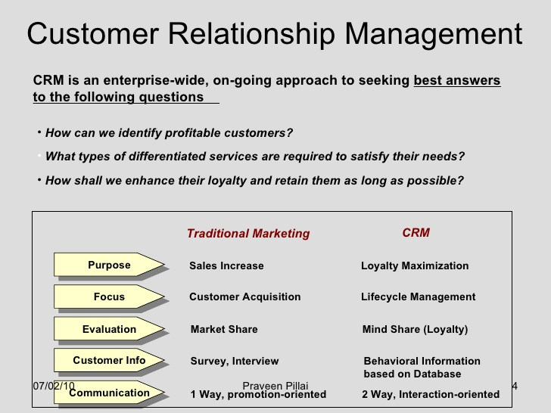
EVOLUTION OF CRM

Slide 39
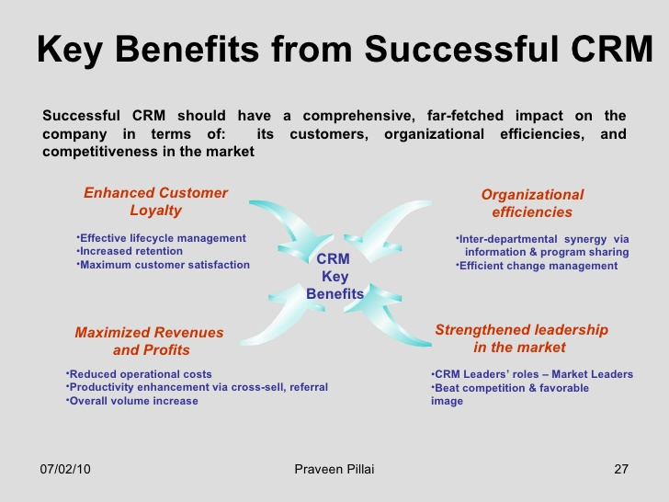

Slide 40
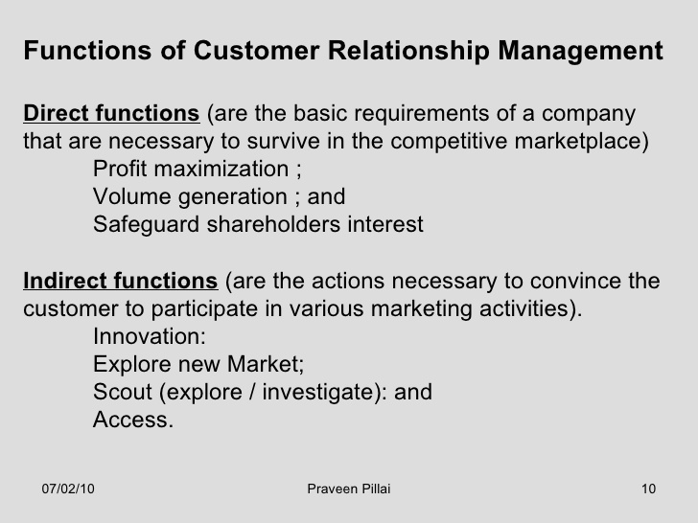

Slide 41
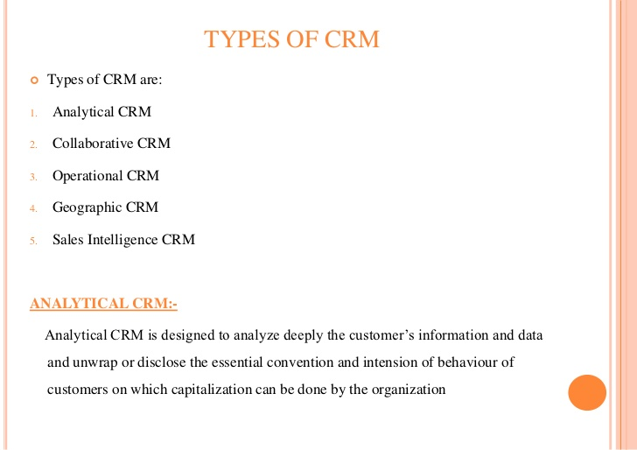

Slide 42
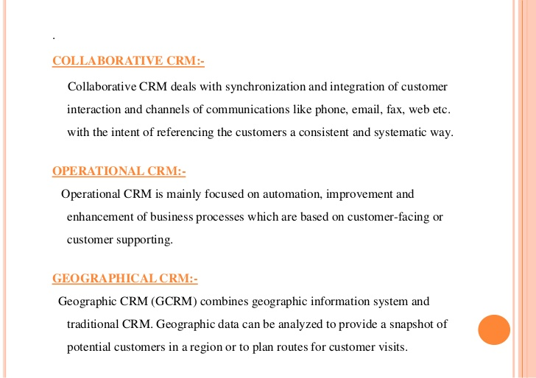

Slide 43
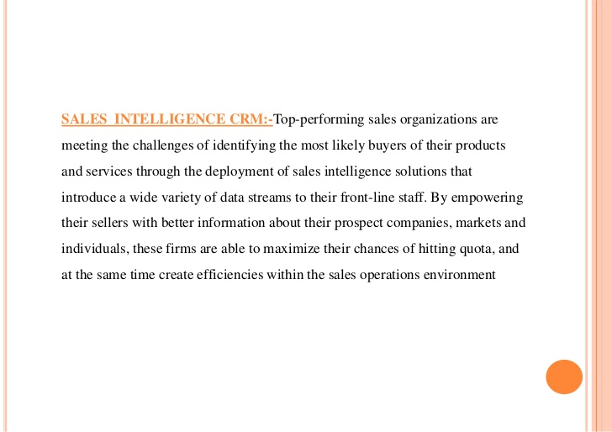

Slide 44
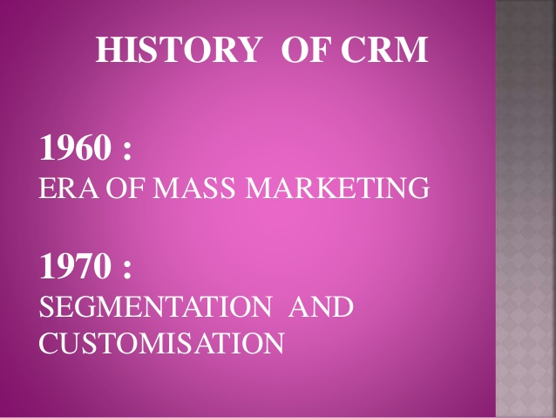

Slide 45


Slide 46
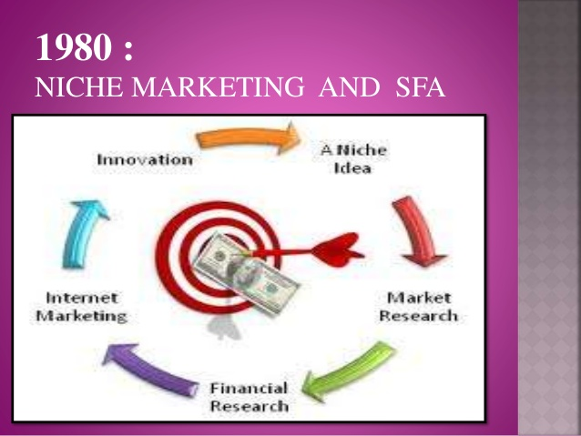

Slide 47
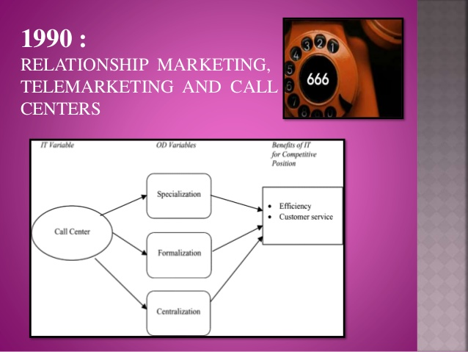

Slide 48
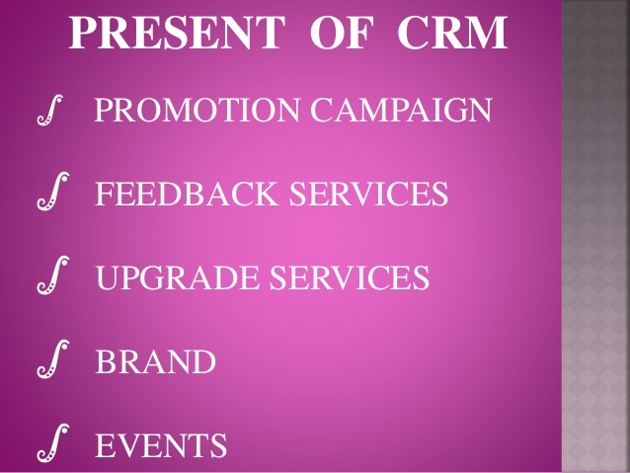
CRM AT PRESENT

Slide 49
Emergence of CRM
EARLY 1980s= Database marketing involved manually collecting and analysing customer information. Statistical modelling helped in the process.
1986= the first contact management software or CMS Act was introduced. It helped individual and businesses to efficiently store and organise info gathered from thousands of customers.
Early 1990s= Sales Force Automation(SFA) helped sales organisation to streamline their sales processes and increase productivity. The computing and software revolution led to the adoption of data and networking strategy called crm.

Slide 50
1990s
Richard Brock initially developed this application as sales and marketing solution for mid sized companies. Bust since at that time Sales and Marketing Automation was happening on phone. Brock persisted and proceeded to expand CMS into SFA. This type of automation combined aspect of database marketing and contact management. However mid 1990s the product lost its relevance.
1993= Tom Siebel employed in oracle came with foremost SFA provider available to business.
1995= SFA and CMS took aspect of modern CRM.

Slide 51
LATE 1990s = lot of changes in CRM industry. ERP vendors emerged into the CRM market place along with German company SAP.
An innovative breed , e- CRM started to infiltrate the marketplace. They focussed on intra organisational collaboration.
2000s=growth in the use of internet but dot com bubble busted in 2002.
Mid 2000s considerable focus on heritage software,
2007=emergence of cloud based crm.
Late 2000 to present= dominated by cloud based and Saas CRM system. social CRM became part of business world when businesses decided they needed better software to manage their contacts and customers.
With the advent of social CRM tool and the emphasis on social media, the focus has significantly expanded to be that of interaction with customer. Through social CRM, businesses have enhanced their capability of gathering dat, engaging with customers and build strong customer relationship.

Slide 52
https://www.salesforce.com/in/crm/what-is-crm/

Slide 53
suyati.com/blog/how-salesforce-crm-works-and-uses/

Slide 54
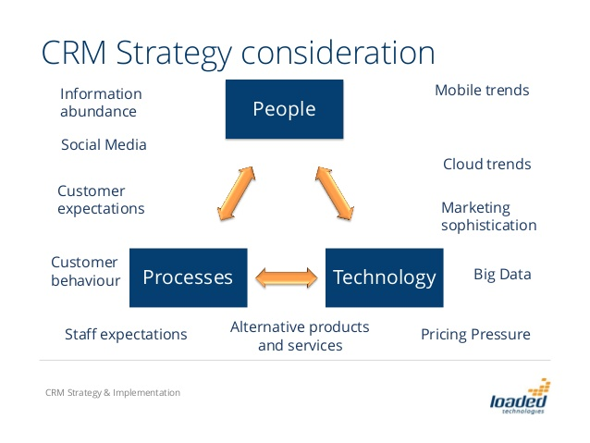

Slide 55
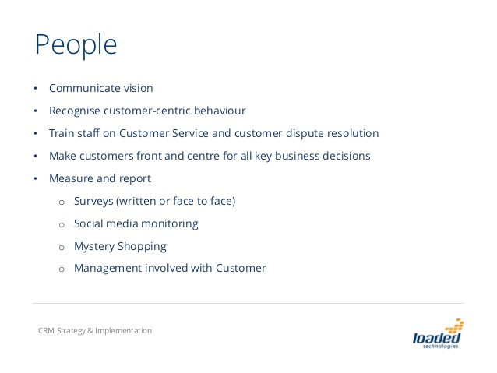

Slide 56
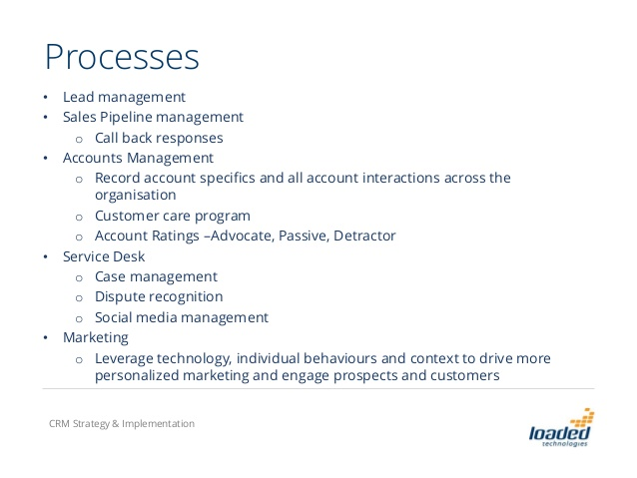

Slide 57
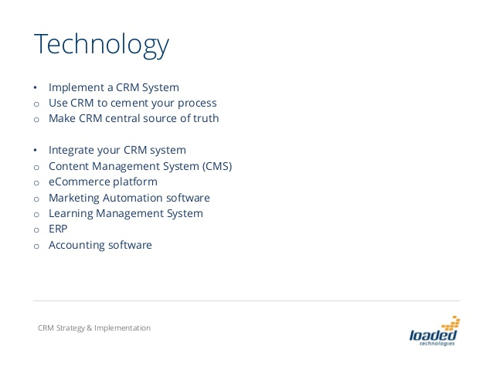

Slide 58
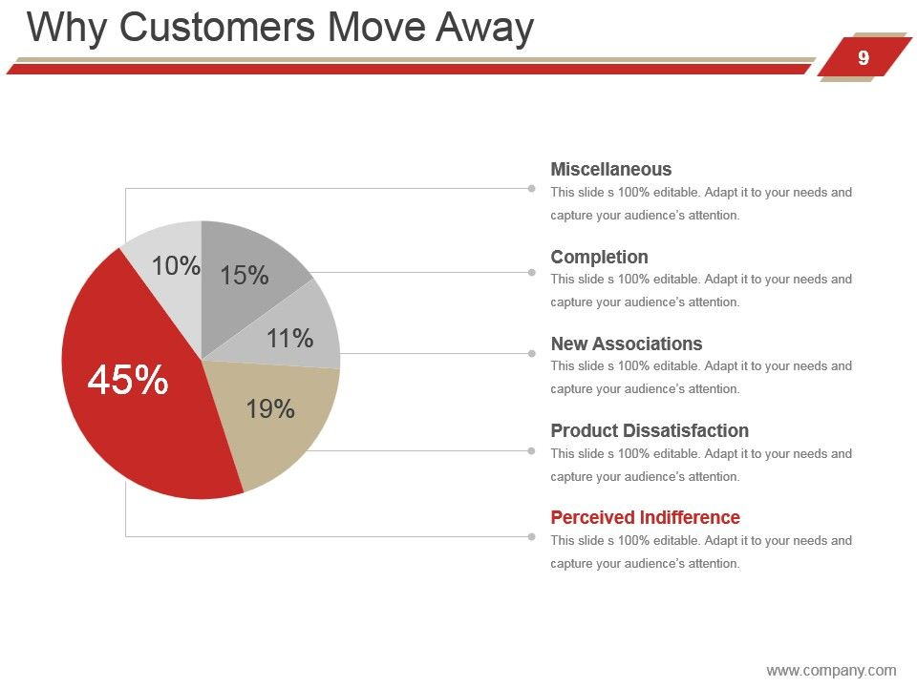

Slide 59
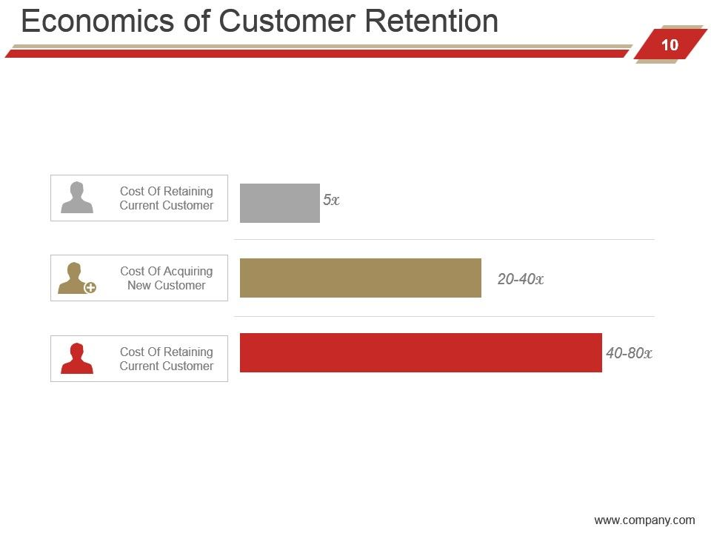

Slide 60
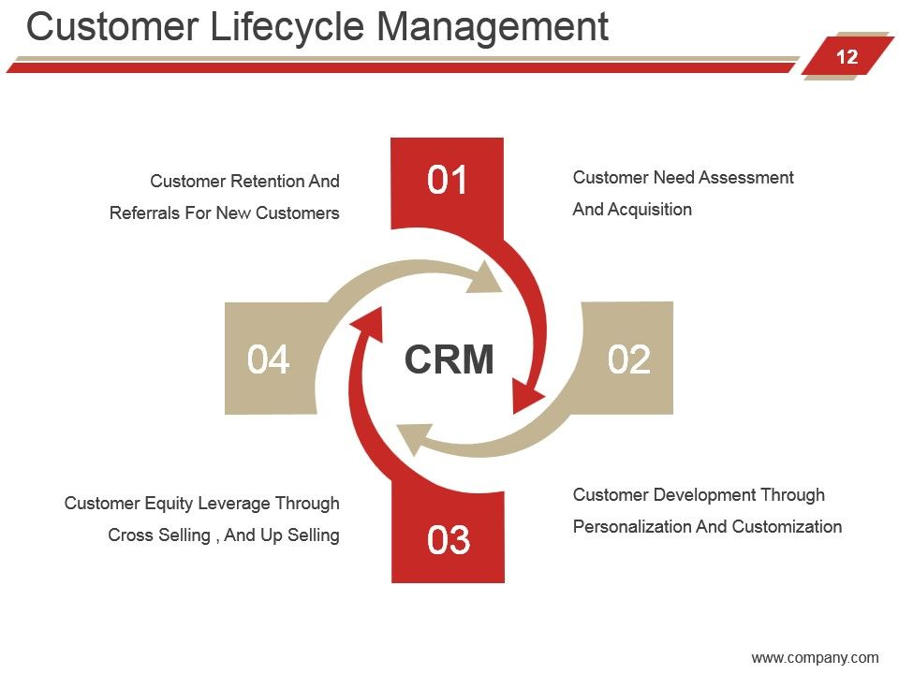

Slide 61
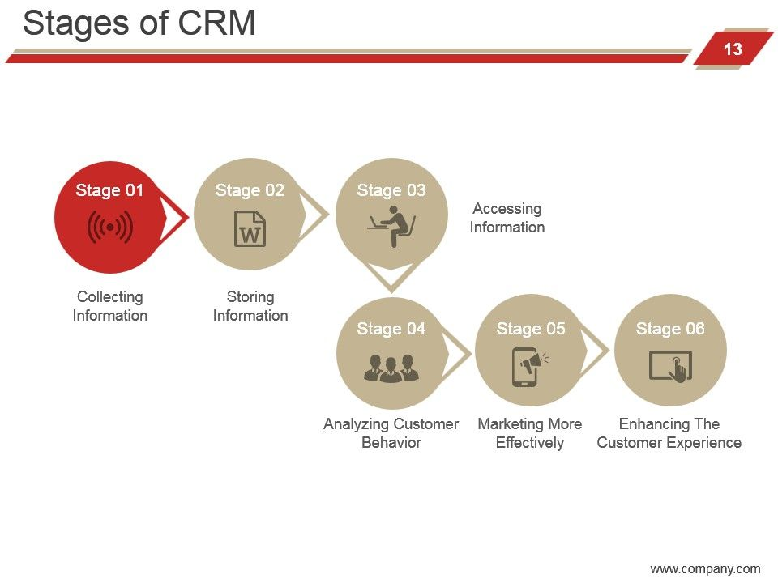

Slide 62
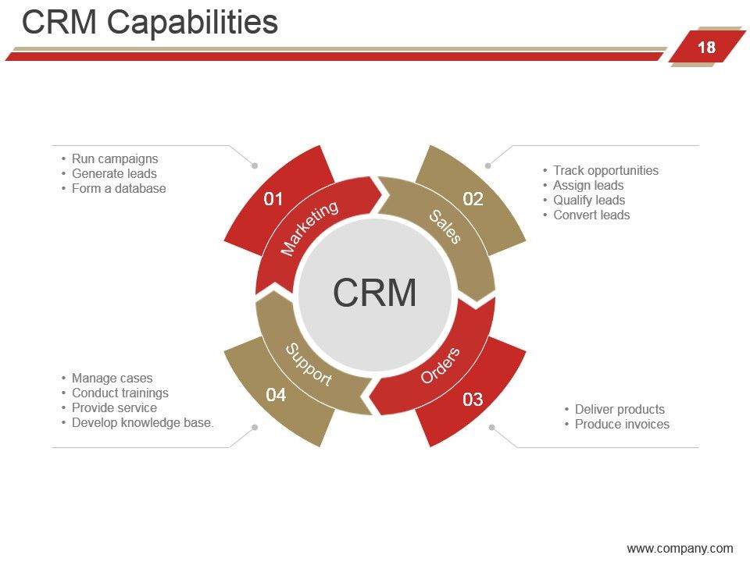

Slide 63
CRM STRATEGY
A CRM strategy shows the intent of a firm concerning its customer base, pointing out how it shall acquire, maintain and retain customers through improvement in customer value deliverables as the way to enhance customer performance

Slide 64
CRM Strategy and implementation model
CRM readiness assessment
Process 1: Strategy Development
ENABLING PROCESS
Process 2 Process 3 Process 4
Value creation Multi Channel Info Mgmt
Integration
Employee Engagement
Process 5: Performance Assessment

Slide 65
STRATEGY DEVELOPMENT PROCESS
CRM vision stands as established customer value proposition effected through customer audit
Target customer segments based on values
Establish CRM objective for every targeted segment
Conduct Capability Analysis
Develop CRM strategic option and evaluate them
Choose the most appropriate CRM STRATEGY AND ESTABLISH RIGHT MEASURE OF PERFORMANCE

Slide 66
CRM Marketing Initiatives
Cross selling
Up selling
Customer Retention
One of the key objective of the Marketing function of the CRM software is to generate sales related leads, which finally get converted into Sales revenues for the company

Slide 67
Cross Selling
It is a old technique used by sales people to increase order size and to transform single product buyer to multi product ones. Recently, cross selling has evolved into a strategy for CRM.
In cross selling organisation is taking over share of mind of the customer.
As the customer buys more and more product and services from a firm the scope of relationship broadens and firms learn more about the customer need and preference.

Slide 68
Benefit
It cost 5 times less to cater to existing customer.
Response rate from cross selling efforts are 2 to 5 times greater than normal sales.
Cross selling increases the actual and psychological cost of switching improving retention.
Information advantage.
Cost are lower as the contact is initiated by the customer and there is no waste in reaching the customer.

Slide 69
CONS OF CROSS SELLING
Excessive cross selling may irritate customers and cause switching.
The annoyance of the customer may lead to attrition
Several times cross selling is done at the cost of profitability, mostly in case of financial services where many services are offered under one roof to the customer but it may not add up to the profit margin of the firm.

Slide 70
UPSELLING
It involves the increase of order volume either by the sales of more units of the same purchased item, or the upgrading into a more expensive version of the purchased item.
It is not need based and depend on the selling skill of customers

Slide 71
Benefit of upselling
It helps to increase sale.
It help increasing customer loyalty.
Customer feel appreciated and get wow factor

Slide 72
Customer Retention
Customer retention strategies are:
Customer complaint management strategies
Service Recovery Strategy
Managing customer waiting strategy

Slide 73
PRINCIPLES OF CUSTOMER COMPLAINTS HANDLING
Fairness
Impartiality
Confidentiality
Transparency
Accessibility
awareness
Access
Responsiveness
Efficiency
Integration

Slide 74
Strategies in service recovery
Track complaints
Act quickly
Detailed explanation
Develop relationship
Learn from experiences

Slide 75
STRATEGIES FOR MANAGING WAITING TIME
Reduce unoccupied time as it feel longer than occupied time
Pre and post process wait feel longer than In Process wait. So it is wise to make an appointment and call accordingly
Uncertain and unexplained waits feel longer
People will wait longer for valuable service.
Uncomfortable wait feel longer so customers should be made comfortable.

Slide 76
CRM STRATEGY CYCLE
CUSTOMER ACQUISITION
RETENTION
WINNING BACK

Slide 77
CUSTOMER ACQUISITION
There are variety of marketing techniques to generate customer prospect and inquiries. customer acquisition involves methods and strategies to deal with these inquiries. It can also be said that customer acquisition mgmt. act as a bridge between advertising and CRM
Though it appear similar to lead management but its reporting system is different.
It also include response to a prospective customer immediately without delay.

Slide 78
CUSTOMER RETENTION
Benefit of word to mouth promotion by loyal customer
Cost of acquiring new customer is very expensive compared to cost of retaining customers
The first step in contacting prospective customer forms the stepping stone for forming CLV and this is reinforced by customer retention strategy

Slide 79
Winning back strategy
It is a key element of CRM strategy
Regaining lost customers is related to enhanced rates of repeat selling which is profitable for the organisation.
Benefits of winning back:
Ability to identify service improvement opportunity by tracking customers reasons for leaving
Increased capability to detect at risk customers
Ability to limit negative word of mouth and increase positive word of mouth.

Slide 80
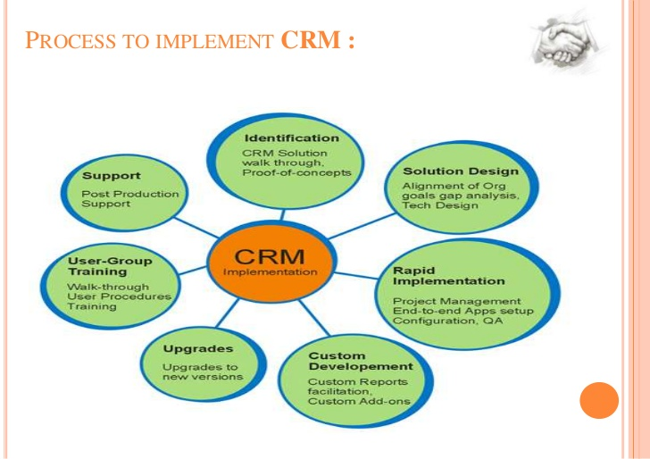

Slide 81
CRM IMPLEMENTATION
Develop the CRM Strategy
Build CRM Project foundations
Need specifications and partner selection
Project implementation
Performance evaluation

Slide 82
Develop the CRM Strategy
Situational analysis
Customer or segments
Market offering
Channels of distribution
Commencing the CRM education
Developing CRM vision
Setting priorities
Goals and objectives
Identifying the people, process, and technology requirement
Develop a business case

Slide 83
Build CRM Project foundations
Identify stakeholders
Establishing the governance structure
Identify the change management need
Identify the project management needs
Identifying the criteria success factors
Developing a risk management plan

Slide 84
Need specifications and partner selection
Data reviewing and gap analysis
Hosted or On-premise CRM
Calling for proposals
Invite potential partners
Revised technology need identification
Asset the proposals and select one or more partners
Process mapping and refinement

Slide 85
.Project Implementation
Refining project plan
Identifying the technology customization needs
Prototype design,test,modify,and roll out.

Slide 86
Performance Evaluation
Project outcomes
Business outcomes
Implementation issues
Poor planning
Poor Integration
Towards a solution

Slide 87
SERVICES OF CRM
Analytical CRM
OPERATIONAL CRM

Slide 88
ANALYTICAL CRM
Analytical CRM may be defined as a decision support system that is targeted to helping senior executives ,marketing, sales and customer support personnel to better understand and capitalize upon their customer needs.
Analytical CRM consist of applications that enable business to analyze relevant data in order to achieve a more meaningful and profitable interaction with the customer.
It uses customer data for analysis, modeling and evaluation to create a mutual relationship between company and its customers.
It helps to better understand customer behavior.
The analytical CRM solution enable the effective management of a customer relationship.

Slide 89
PURPOSE OF ANALYTICAL CRM
Design and execution of targeted marketing campaigns to optimize marketing effectiveness.
Design and execution of specific customer campaigns, including customer acquisition, cross selling, up- selling, retention.
Analysis of customer behavior to aid product and service decision making.
Management decisions • Prediction of the probability of customer defection
Analytical CRM generally makes heavy use of data mining.

Slide 90
Importance of analytical CRM
Make more profitable customer by providing high value services.
Retaining profitable customer through sophisticated analysis.
Addressing individual customer needs and efficiently improving the relationship with new and existing customer.
Improves customer satisfaction and loyalty.
Find and explore useful knowledge in large customer database.
It helps in classifying customers, predicting customer behavior

Slide 91
STEPS IN ANALYTICAL CRM
Step:1 Problem formulation
Step 2 Segmentation of clients
Step 3 Acquisition analysis
Relational Analysis; Channel or Approach Analysis

Slide 92
OPERATIONAL CRM
OPERATIONAL CRM involves the areas where direct customer contact occurs. These interactions are referred to as customer touch points.
Company maximize the process of gathering and understanding customer information from all touch points.( eg: call centers, point of sales, web etc.)

Slide 93
Operational CRM
MARKETING AUTOMATION:
SALES FORCE AUTOMATION:
CUSTOMER SERVICE AND SUPPORT AUTOMATION
CALL CENTER MANAGEMENT
ENTERPRISE MARKETING AUTOMATION

Slide 94
OPERATIONAL CRM
CUSTOMERS
Customer touchpoints
Call centre
Web access
E-mail
usage
Direct sales

Slide 95
Collaborative CRM
Collaborate CRM includes suite of customer interaction soft ware such as email management and conferencing tools. It provides a point of interaction between customers, staff and business partners through new and traditional web based technology.
Eg Computer Telephony integration
Web conferencing response.

Slide 96
Process for effective CRM in different areas
The CRM process is a strategy for keeping every customer interaction personalized and meaningful that consists of five main steps. A customer relationship management system (CRM system) provides the data and functionalities needed to execute this strategy—and ultimately turn leads into customers.
There are five key stages in the CRM cycle:
Reaching a potential customer
Customer acquisition
Conversion
Customer retention
Customer loyalty

Slide 97
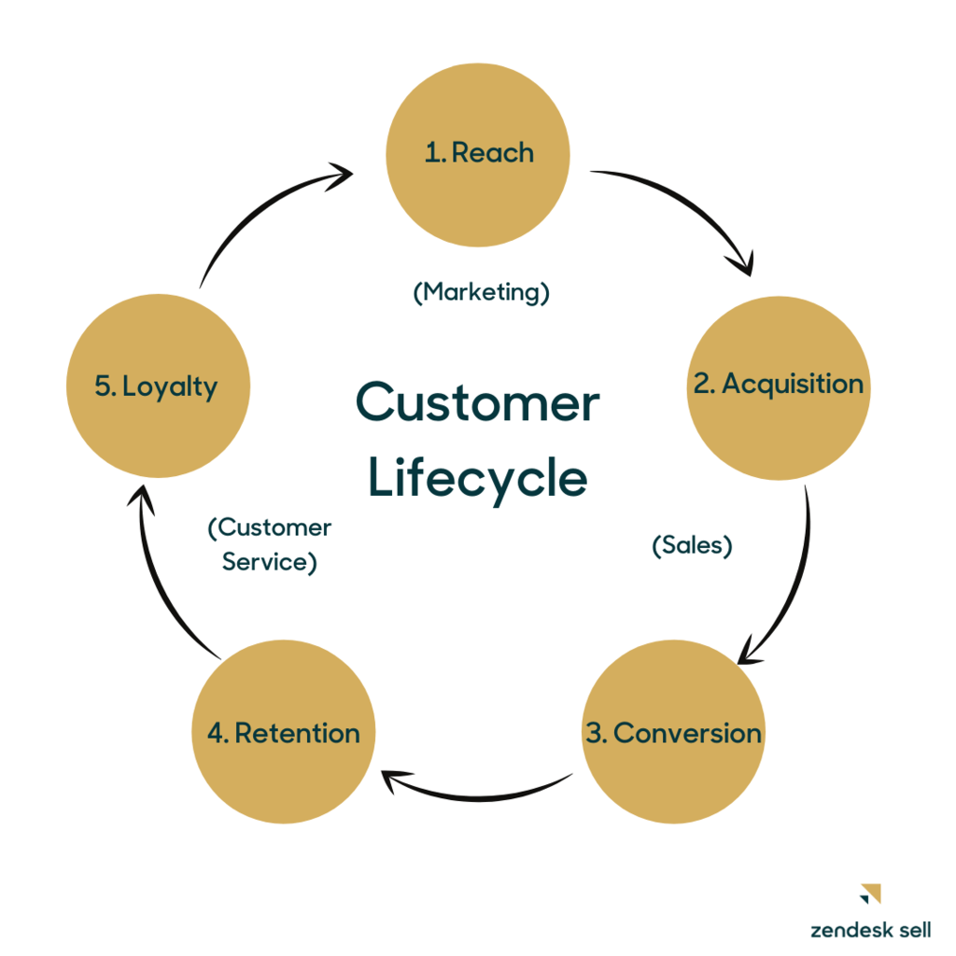
CRM process
The CRM process is that concept in action. It’s the tangible steps an organization must take to help drive consumers through the cycle of learning about your brand and ultimately becoming repeat customers.

Slide 98
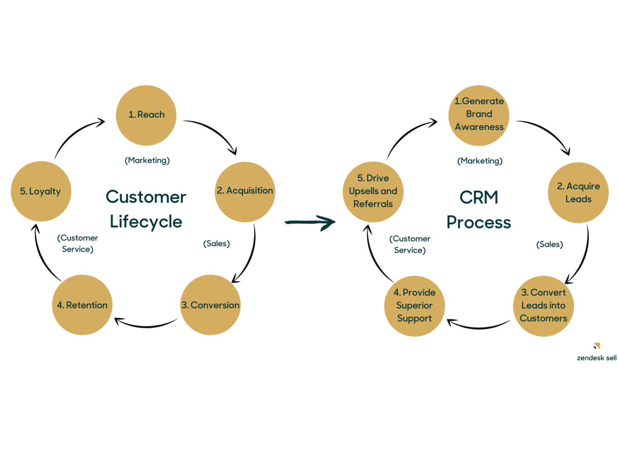

Slide 99
1. Generate brand awareness
The first step to acquiring new customers is to introduce them to the business
1. Learning about your target audience. Marketers will conduct research to identify their audience’s target demographics, interests, preferred channels of communication, what messaging they respond most to, and what they care about.
2. Segmenting your target audience. Audience personas are created to segment a brand’s target audience into similar groups based on similar interests or demographics. This helps marketers identify which types of people are most likely to become customers and who their campaigns should target.
3. Creating marketing campaigns that speak to those target demographics. A/B tests and marketing automation can be used to identify what works and what doesn’t, to create unique campaigns for unique customer segments such as on social media or email, and to create strategies for lead acquisition.

Slide 100
2. Acquire leads
Introducing your brand to a potential customer is just the beginning of the CRM process. From there, you have to encourage them to learn more about your business and engage with it.
Depending on how your company is structured, this lead acquisition step could be a marketing or sales team responsibility — or both. Your marketing team, for example, might encourage website visitors to share their email with a newsletter signup CTA or a social media giveaway. Sales, on the other hand, could use their CRM system to set up live chat on your site. With this feature, your team can proactively reach out to potential customers who land on your website.
If your CRM technology comes equipped with a lead enrichment tool, like Reach, lead acquisition is unbelievably simple. All the tool needs is a lead’s email address to instantly reveal detailed information about the person. With customer data, you can personalize your outreach with the lead to start the relationship off on the right note. Not to mention, you can save tons of time by not needing to research leads yourself.

Slide 101
3.Convert leads into customers
You’ve successfully engaged with your leads, and they’re interested. Now it’s time to turn those leads into customers.
To do so, sales reps must first be skilled at identifying how interested leads are and, specifically, whether they’re interested enough to make a purchase. A CRM system is very helpful here. The historical data from past successful sales can be used to identify lead-qualification criteria. These criteria can be added as “attributes” to your CRM’s lead-scoring tool to help reps identify opportunities with the highest probability of a sale.
If leads do seem likely to make a purchase, reps must then be able to nurture them further and build their trust enough to convert. One way to do this is for reps to send leads case studies, white papers, and other resources that may sway their decision.* *
Reps should also use their CRM platform to set reminders and tasks to follow up with interested leads. Use your CRM’s dashboard to help you remember to follow up to ensure that no opportunities are missed.

Slide 102
4.Provide superior customer service
You’ve successfully converted your lead into a customer. Great! But the CRM process doesn’t end when a customer converts. In order to grow as a company, you need to retain customers. How do you keep that customer coming back? Excellent service from support.
According to Zendesk’s 2020 Customer Experience Trends Report, customer service is the biggest factor that determines a consumer’s loyalty to a brand. Conversely, poor customer service can cost you customers and negatively impact your reputation. Support teams must be able to deliver superior support whenever, wherever, and however their customers expect it.
Forty-nine percent of customers say being able to resolve their issue quickly is the most important aspect of a good customer service experience. With CRM software, support agents can easily access the historical customer information they need to resolve a ticket quickly.
Fifty-seven percent of customers expect to have a choice of channels when reaching out to customer support. CRM features allow support agents to not only provide omnichannel support but also manage those conversations in a single, unified view.
With the right CRM, your agents have the customer information and resources they need to resolve a customer’s issues quickly and effortlessly. This allows for a stress-free and efficient experience for both the customer and the support agent.

Slide 103
5. Drive upsells
When we think of a returning customer, we imagine a shopper continually coming back to the same business to buy the products they know and love. But there is another key way existing customers provide value — by upgrading to more expensive products.
How do you convince customers to switch products? Personalized recommendations via email are a great place to start. You can use your CRM to organize customers into smart lists based on similar purchase histories. You can then create custom email templates that send relevant product releases to entire lists of customers at once. This way, you can be sure the promotional deals or releases you send are reaching the people most likely to buy them.
If your business is service-based, you may find upsell opportunities through check-in calls. Set reminders in your CRM to regularly reach out to repeat customers to ask how they’re doing and whether there is any way you could improve your service. Their needs may very well have changed since the last time you spoke, and they may be ready for an upsell.
With a CRM process, the customer lifecycle no longer feels abstract. The right CRM enables you to create a deliberate, personalized experience that naturally drives leads through your sales pipeline.

Slide 104
Determinants of relational exchange
Trust
Bonding
Empathy
Reciprocity

