Slide 1

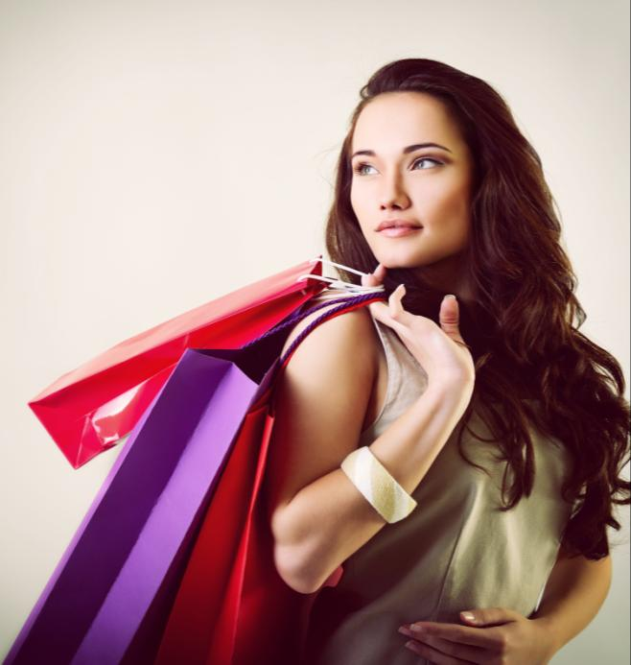
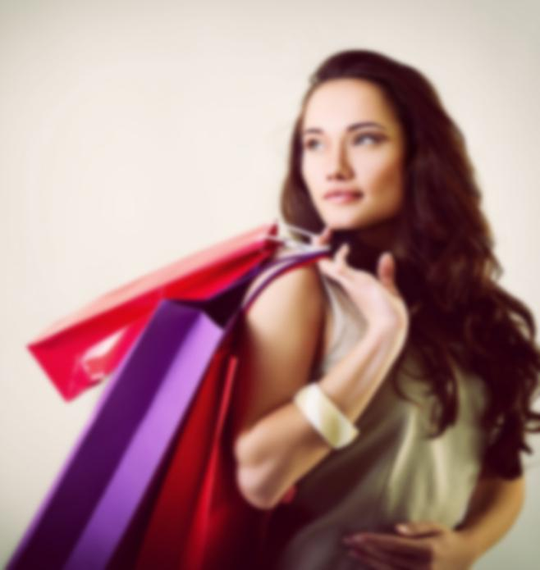




Consumer
Behavior

Slide 2

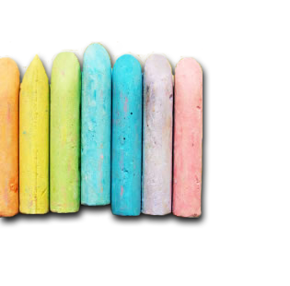
Syllabus
Unit I
Introduction to Consumer Behaviour
Unit II
Individual Determinants of Consumer Behaviour
Unit III
Environmental Determinants of Consumer Behaviour
Unit IV
Consumer Decision Making Models & New Trends

Slide 3

Unit I
Meaning, Features, Need and Importance of Consumer Behaviour
Types/ Classification of Consumer and their Behaviour
Profiling Consumers and understanding their Needs
Consumer Involvement
Application of Consumer Behaviour Knowledge in Marketing
Consumer Decision Making Process
Determinants of Buyer Behaviour

Slide 4




Who is a CONSUMER

Slide 5
CUSTOMER
CONSUMER
◆ Any individual who purchases goods and services from the market for his/her end-use.
◆ In simpler words, a consumer is one who consumes goods and services available in the market.

Slide 6
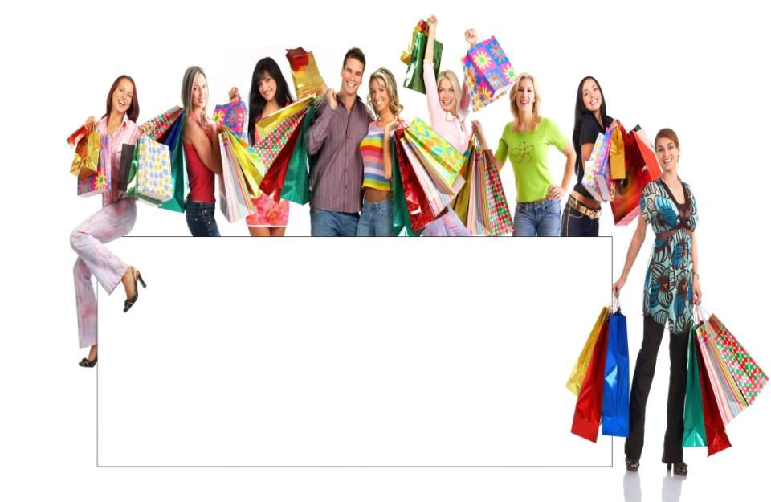
"Consumer behaviour may be defined as the behaviour that consumers display in searching for, purchasing suing, evaluating and disposing of produces, services and ideas which they expect will satisfy their needs."
SCHIFFMAN & KANUK

Slide 7
What is Consumer Behaviour ??
Consumer behaviour can be defined as the process whereby individuals decide
What
When
Where
Why
How and
from Whom
to purchase goods or services

Slide 8
Consumer Behaviour …..
A study of 6 Q’s
Who – Who is the Consumer ??
Why – Why does the Customer want to buy ??
What – What does the Customer want to buy ??
When – When does the Customer want to buy ??
Where – Where the Customer want to buy from ??
How – What is the procedure and circumstances under which the cusromer wants to buy ??

Slide 9

.
♦
It encompasses all of the consumer displays in
behaviour searching
that for,
purchasing, using, evaluating and disposing of product and services.
3

Slide 10
Example
◆ Vani and Rani went to buy dresses for themselves.
◆ The store manager showed them the best dresses available with him.
◆ Vani immediately purchased two dresses but Rani returned home empty handed.
◆ The dresses were little too expensive for Rani
◆ In this case, Vani and Rani had similar requirements but there was a huge difference in their taste, mind set and ability to spend.

Slide 11
Features / Characteristics of Buyer Behaviour
Comprises both mental and physical activity of consumer.
Buyer behaviour is a integral part of human behaviour
Buyer behaviour is very dynamic and complex
It is the sum total of the behaviour of a number of persons
It is influenced by internal factors such as needs, habit, attitudes etc.. And external factors like family, social group, culture etc…
Consumer behaviour starts before buying and goes even after buying
Answers various questions to marketers

Slide 12
Features & Characteristics of Consumer Behaviour ???
Mental & Physical Activity
Internal Factors
Influenced by External Factors
Dynamic & Complex
Helps marketers frame plans
Varied Behaviour patterns
Systematic Process that goes on post purchase too

Slide 13
Need & Importance of study of Consumer Behaviour
It helps in formulating effective marketing strategy.
It gives information regarding colour, design, and other features that a consumer want in his product. Thus it helps in formulating production policy.
It is important for framing suitable pricing policies.
Consumers demand more for quality products at reasonable prices. Marketers should first study the needs of consumers and then try to satisfy them.
Rapid technological advancement compels the marketers to study consumer behaviour.
Understanding of consumer behaviour helps avoid or minimise market failures.
For effective market segmentation and target marketing, it is essential to have an understanding of consumer and their behaviour.

Slide 14
Why do I study Consumer Behaviour ???
Design 4 P’s of Marketing
Understand their Needs & expectations
Assist Production strategy
Effective Market Segmentation
Plan Customer Acquisition & Retention Strategies

Slide 15
Video on Consumer Behaviour
https://www.youtube.com/watch?v=5oyjXg4qWyA

Slide 16
Types of Consumers & their Behaviour

Slide 17
Classification on basis of Size
Consumers
Institutional
Purchase in bulk, periodically as per production need
Retail
Purchase in small quantities fro personal use

Slide 18
Organizational Consumer
◆ Organizational consumers purchase products for organizations, governments or businesses, They often buy in bulk and may place long-term recurring orders.
◆ Products and services sold to organizational consumers are often required to meet very strict standards. They may need to be adapted to meet the specific requirements of the buyer, and specific prices are negotiated.
◆ Quality is often pre-set and important to be met with
◆ Goods may be offered for resale at a profit to the organizational purchaser. Or an organization may buy raw materials that are aimed at producing other goods which will later be offered for sale to other consumers.

Slide 19
Classification on basis of Buyer’s style
Loyal Consumers – Brand Loyal consumers, eg. Colgate
Opportunistic Consumers – choose between sellers to protect personal interest, eg.laptops
Best Deal Consumers – search for seller offering best deal eg.washing machines, TV (Vijay Sales)
Creative Consumers – clear with their requirements eg. Executives for shirts
Advertising Consumers – carry newspaper cut-outs for product information
Chisellers – Discount hunters- constantly demand extra discounts
Nuts & Bolts Consumers – small scale purchasers from local stores. Eg Bread, salt

Slide 20
Classification on basis of other factors
On basis of Age group – Children, Teens, Young, Senior Citizens
On basis of Gender – Men, Women
On basis of Family Structure – Nuclear family, Joint family, Single
On basis of Social Class & Income – Affluent Class, Upper Middle Class, Lower Middle Class, Lower Class, Poor
On basis of Geography – North, South, East, West
On basis of Lifestyle – Rich, Middle and Poor

Slide 21
Special Types of Consumers
Women Consumers
Search & choose
Rural Consumers
Search for Value of money spent
Senior Citizens as Consumers
Pensioners
Cost and Quality conscious
Household products, clothes, jewellery, house, car
Influenced by advertisements & sales promotions
Educated & well informed with purchasing capacity
Every FMCG wants to capture this audience
Transport, communication & utilities
Interest in only routine necessary purchases
Not frequent shoppers
Have learnt e-shopping techniques
Medicines, diapers, books

Slide 22
Consumer Profiling

Slide 23
Consumer profiling
◆ A consumer profile is a way of describing a consumer categorically so that they can be grouped for marketing and advertising purposes.
◆ By target advertising to a specific market segment, companies and marketers can find more success in selling a particular product and increase profits.
◆ As a short-hand way of talking about consumers, market segments are often represented by consumer profiles.

Slide 24
Consumer Profiling is done to understand Consumer Needs
Geographic
Demographic
Psychographic
Behavioural

Slide 25
Geographic Profile
Nations
States
Regions
Cities
Eg. Demand for woollens in Kashmir
Demand for coffee in South India
Demographic Profile
Age
Gender
Family Size
Literacy
Family Income
Occupation
Toys
Clothes with cartoon prints
Women products
Large packs for joint familt
Small car/ big car
Veg/ Non Veg

Slide 26
Behavioural Profile
Attitudes
Learning
Beliefs
Ocassions
User Status
Brand Loyalty Status
Innovatoive products – new producst
Heavy/light/medium users - detergents
Regular Users – perfumes
Hard core loyalist- Coconut hair oil
Switchers – buy anything
Psychographic Profile
Lifestyle
Social Class
Personality
Branded Shirts
Mobile phones
Jewellwey

Slide 27
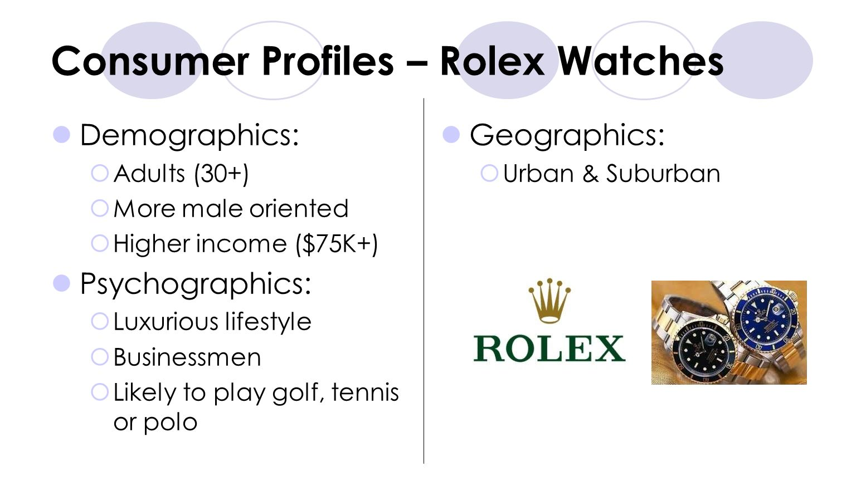

Slide 28
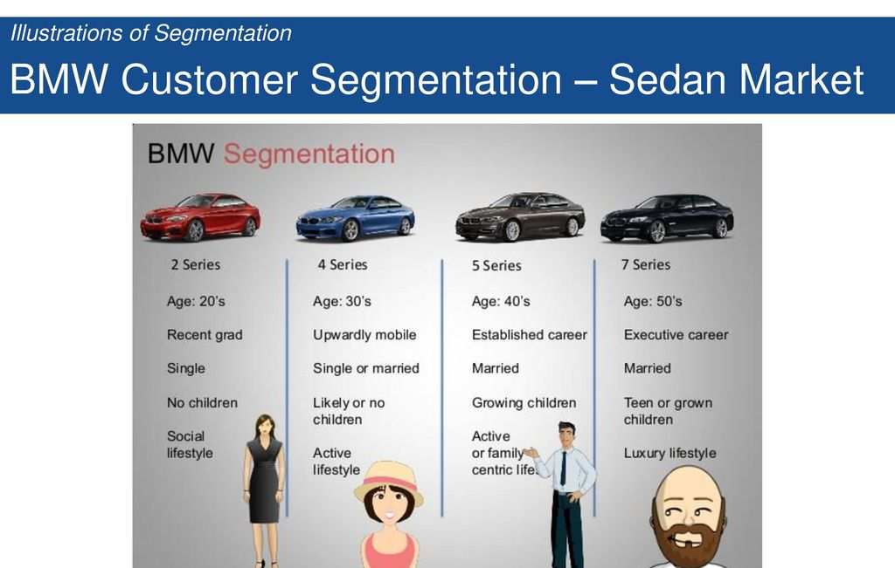

Slide 29
Why Consumer Profiling ??
Too diverse population – need to understand consumer needs
Identify Consumer Segmentation
Plan Production strategies to suit needs
Plan a Marketing Mix to attract attention
Create a Portrait of the Consumer in minds of Marketer

Slide 30
Review Questions
◆ Is it important to consider the behavior of consumers while deciding on the marketing mix of the company ? Why? Explain with suitable examples
◆ It is said that each consumer is unique, and any study that concentrates on the “average consumer” is meaningless. Discuss its implication.
◆ Why is it so important to conduct a consumer research before the launch of any campaign?
◆ “It has become important for marketers to understand the psyche of the consumer. ”. Comment.

Slide 31
Understanding Consumer Needs

Slide 32
Consumer Needs
A. Biogenic [Air, Water, Sunlight]
B. Physical [Food, Shelter clothing, civilized world]
C. Psychogenic [Society / culture]
D. Utilitarian / hedonic Objective oriented need

Slide 33
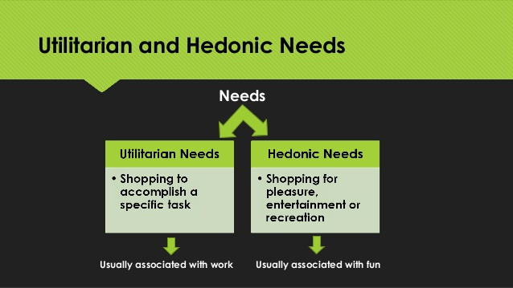
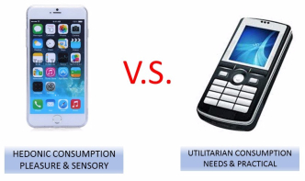

Slide 34
Consumer Involvement

Slide 35
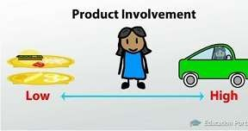
Consumer Involvement
◆ Consumer involvement refers to degree of information processing or extent of importance that a consumer attaches to a product.
◆ The degree of involvement has a very significant effect on consumer behavior.
◆ When more expensive products are to be purchased, the consumer gets more involved in purchase process but he may not be equally involved in a product which is just a rupee or two priced.

Slide 36
Examples
CAR- As it is a expensive product so consumer will get highly involved resulting in higher involvement.
BOOK- The book purchased by a student for preparing competitive exam may not be as expensive as car, yet the customer gets highly involved because it is a important product.
MEDICINE- When a medicine is being purchased, which may not be very
expensive, yet the customer may be highly involved in checking that it shouldn’t react him.

Slide 37
High and Low involvement Hierarchy
Low- involvement | High- involvement
Brand beliefs are formed first by passive learning | Brand beliefs are formed by active learning
Consumer makes purchase decision | Consumer evaluates various brands
There may or may not be post-purchase evaluation | Consumer makes purchase decision

Slide 38
LEVELS OF INVOLVEMENT
LOW
INVOLVEMENT
SOME
INVOLVEMENT
HIGH
INVOLVEMENT
Habitual decisions
Simple decisions
Lengthy decisions
eg. Tea, toothbrush, | eg. Skin cream, | eg. Cars, diamond,
Washing powder. | Torch, snacks. | Property.

Slide 39
Consumer Involvement
Consumer Involvement is a motivational state that drives and directs the behaviour of consumers under decision making.
Low Involvement
High Involvement
Enduring Involvement
Situational Involvement

Slide 40
Types of Involvement
Situational Involvement
Situational involvement is temporary and refers to emotional feelings of a consumer, experiences in a particular situation when one thinks of a specific product
Enduring Involvement
Enduring involvement is persistent over time and refers to feelings experienced toward a product category across different situations. For example, holiday- makers renting a resort for their trip are highly involved in their choice, but their involvement is temporary.

Slide 41
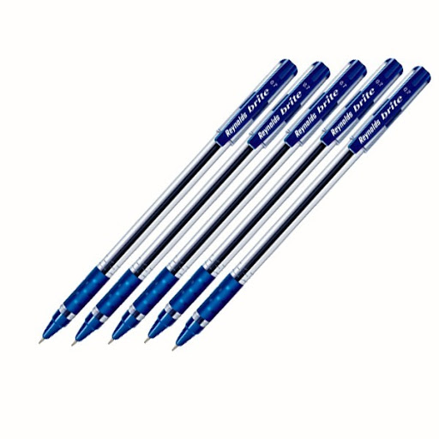
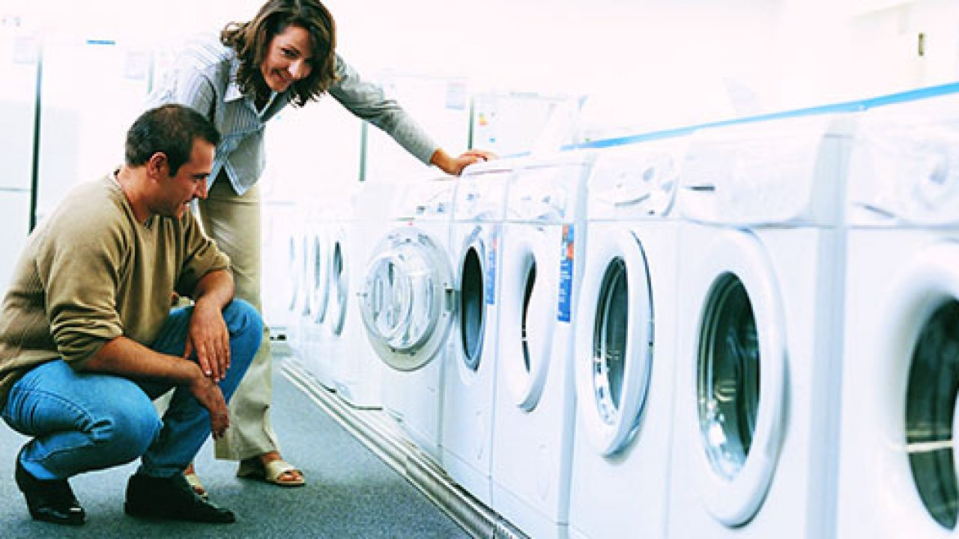

Slide 42

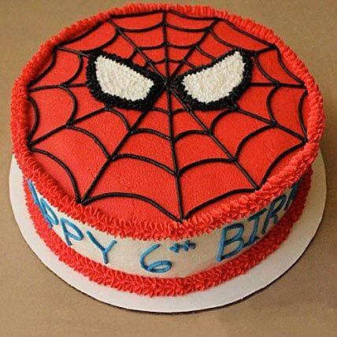

Slide 43
Application of Consumer Behaviour knowledge in Marketing

Slide 44
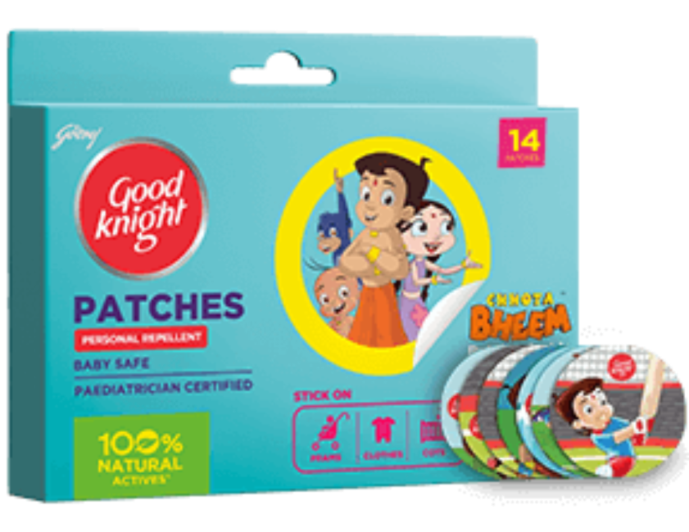

1) Analyzing Market Environment
◆ Consumer behavior study helps in identifying the unfulfilled needs and wants of consumers.
◆ This requires examining the trends and conditions operating in the marketplace, consumers' lifestyles, income levels and emerging influences.
◆ Identifies opportunities for market development, identifies threats to overcome challenges

Slide 45
2) Sementation, targeting & Positioning
◆ A review of market opportunities often helps in identifying distinct consumer segments with very distinct and unique wants and need.
◆ Identifying these groups, learning how they behave and how they make purchase decisions enables the marketer to design and market products or services particularly suited to their wants and needs.
◆ For example, consumer studies revealed that many existing and potential shampoo users did not want to buy shampoo packs priced at Rs. 60 or more and would rather prefer a low priced sachet containing enough quantity for one or two washes. The finding led companies to introduce the shampoo sachet which became a good seller.

Slide 46
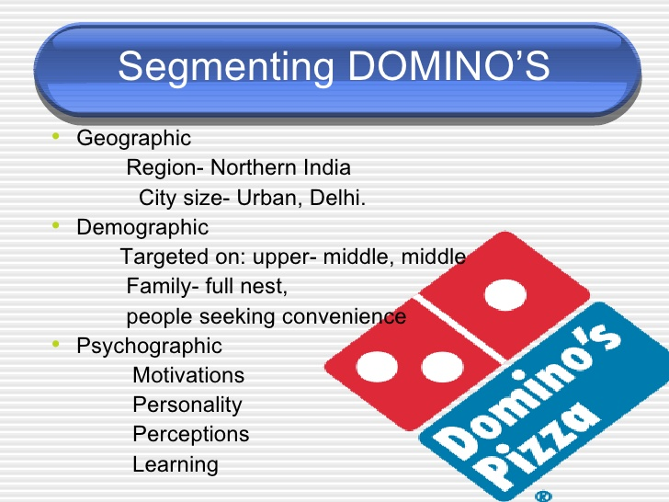
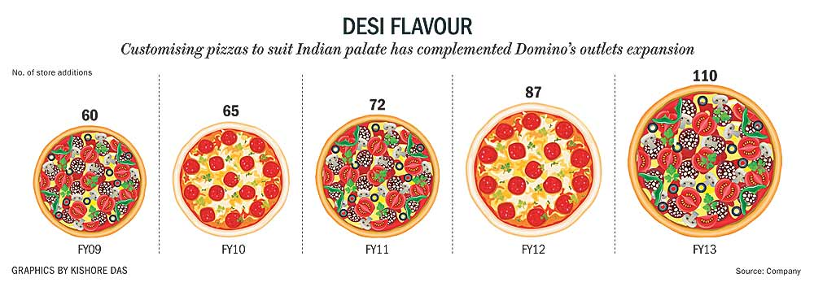

Slide 47
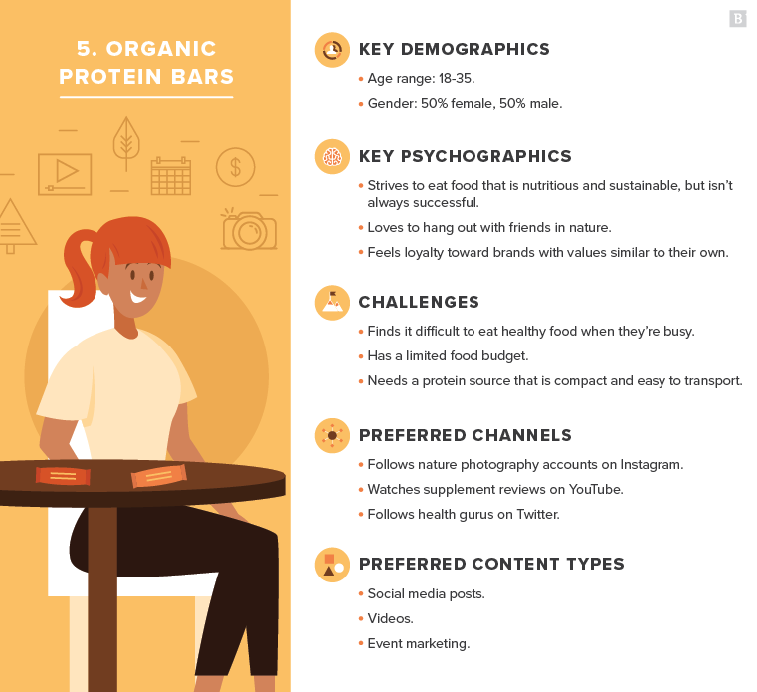

Slide 48
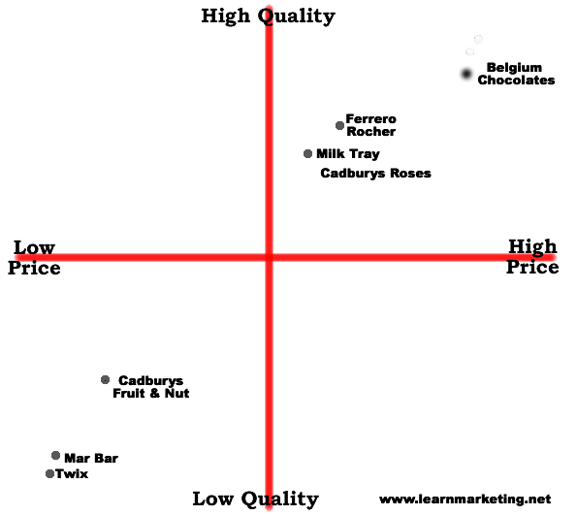

Slide 49
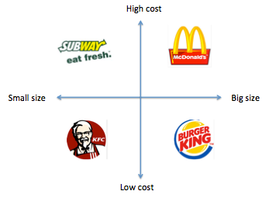

Slide 50
3) Marketing-mix decisions
◆ Once unsatisfied needs and wants are identified, the marketer has to determine the right mix of product, price, distribution and promotion.
◆ Here too, consumer behavior study is very helpful in finding answers to many perplexing questions.

Slide 51
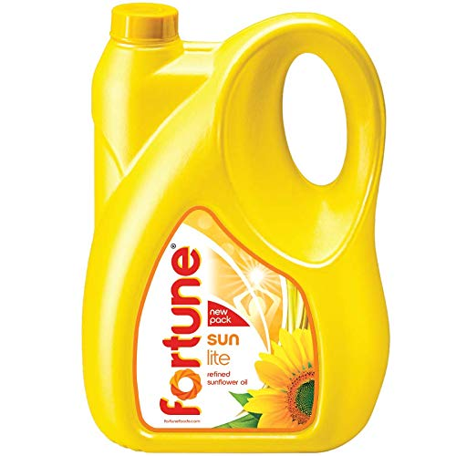
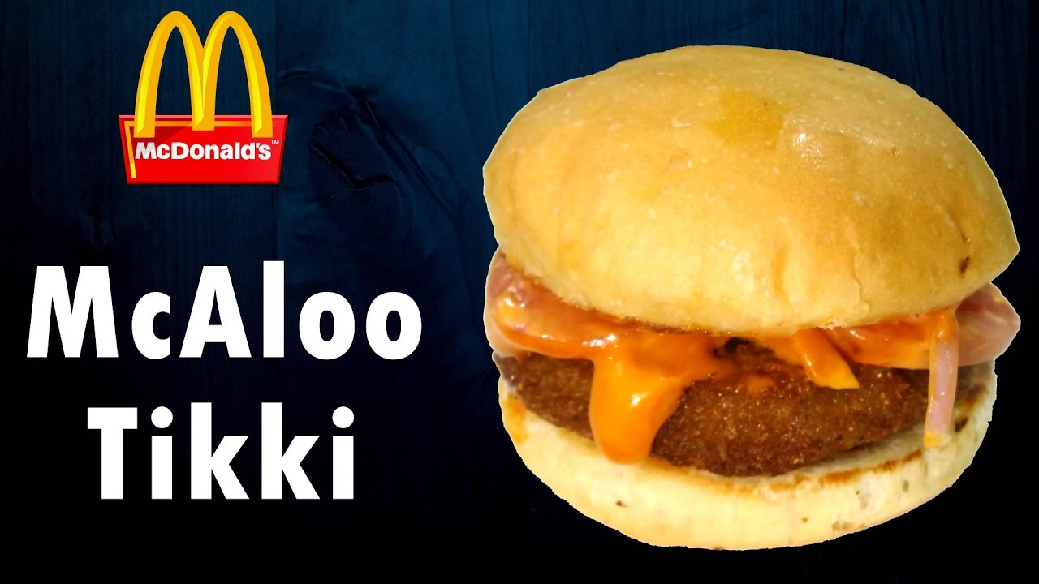
3a) Product
◆ The marketer designs the product or service that would satisfy unfulfilled needs or wants. Further decisions regarding the product concern to size, shape and features.
◆ The marketer has also to decide about packaging important aspects of service, warranties and accessories etc.

Slide 52
3b) Price
Only revenue earning component.
Price levels affect sales, thus customer perception is important.
It is only through consumer behaviour study in actual buying situations that the marketer can hope to find answers to these important issues.
Will customers pay this price ??????

Slide 53
3c)Distribution
The next decision relates to the distribution channel, that is, where and how to offer products and services for sale.
Should the products be sold through all the retail outlets or only through selected ones?
Should the marketer use only the existing outlets, which also sell competing brands, or should new exclusive outlets selling only the marketer's brands be created?
Is the location of retail outlets important from consumers' point of view?
Should the company think of direct maketing?
The answer to these question are furnished by consumer behaviour research.

Slide 54
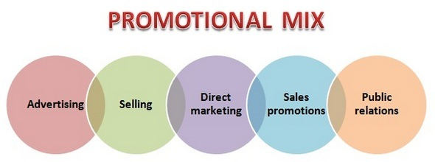
3.d) Promotion

Slide 55
4)Use in Social and Non-profits Marketing
Consumer behavior studies are useful to design marketing strategies by social, governmental an not-for-profit organizations to make their programmes such as family planning, awareness about AIDS, crime against women, safe driving, environmental concerns and other more effective.
Eg. UNICEF (greeting cards), Red Cross and CRY etc.

Slide 56
Consumer Decision Making Process
https://www.youtube.com/watch?v=cKGmETvpKEo

Slide 57
CONSUMER DECISION MAKING PROCESS
Problem Recognition
Information Search
Evaluation of alternatives
Purchase Decision
Post Purchase Behaviour

Slide 58
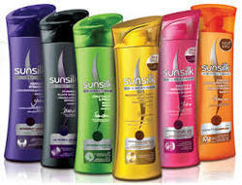
Recognising the Need

Slide 59

Recognising Need

Slide 60
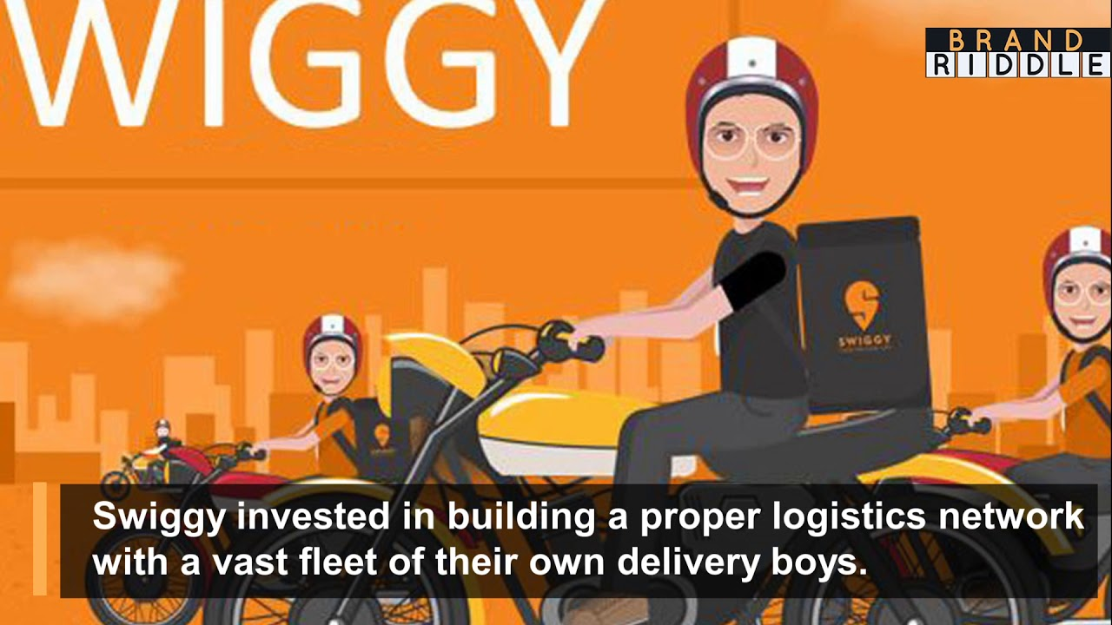

Slide 61
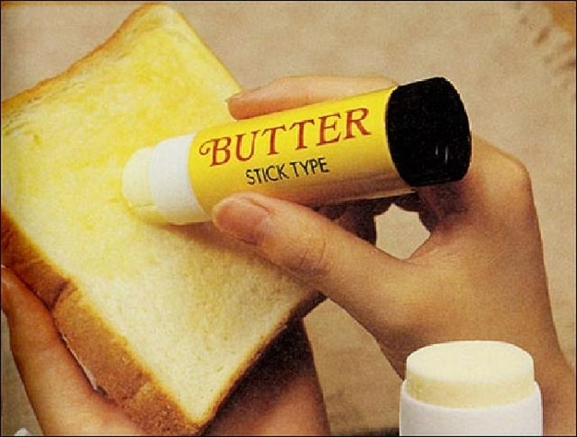

Slide 62
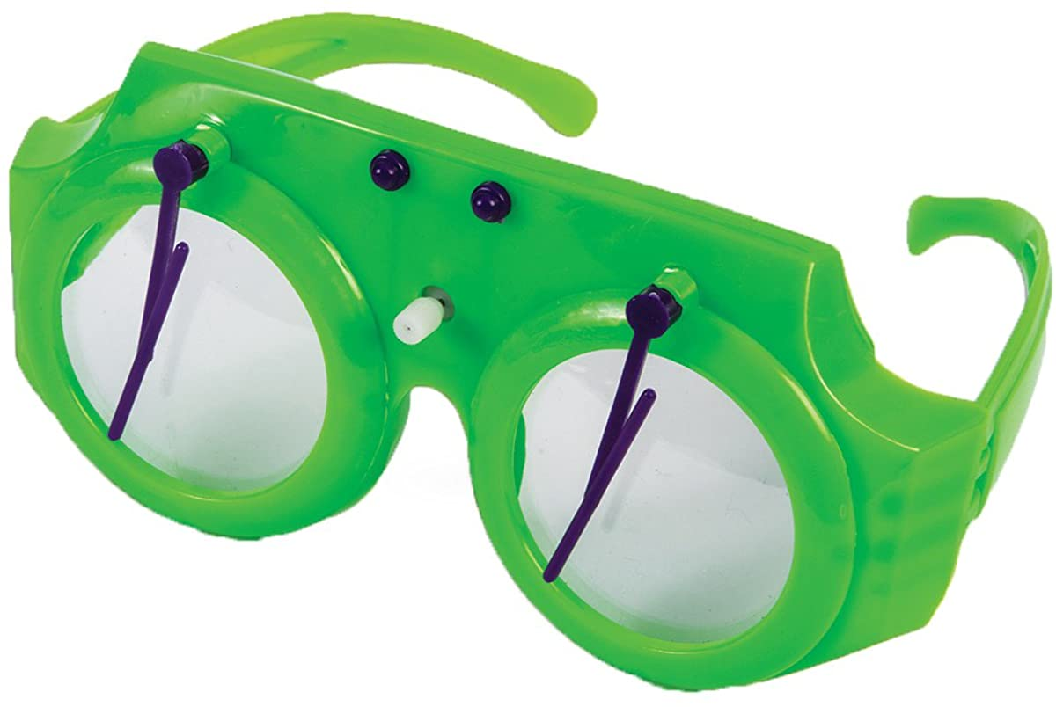

Slide 63
Information Search-
Personal Sources
Commercial Sources
Public Sources
Experiential Sources

Slide 64
Information Search
Consumers can get information about goods from different sources :
Personal sources: This includes family, friends, neighbors, acquaintance, etc.
Commercial source: This includes advertising, salespeople, dealers, packaging, display, etc.
Public sources: This includes mass media, consumer rating organizations, etc. they also become confidential to provide information.
Experimental sources: This includes handling, examining, using, etc. Such information becomes decisive and confidential.

Slide 65
Evaluation of Alternatives
The next step is to evaluate these alternatives and make a choice : assuming a choice is possible that meets the consumer’s financial and psychological requirements.
Evaluation criteria vary from consumer to consumer and from purchase to purchase, just as the needs and information sources vary.
One consumer may consider price most important while another puts more weight on quality or convenience.

Slide 66

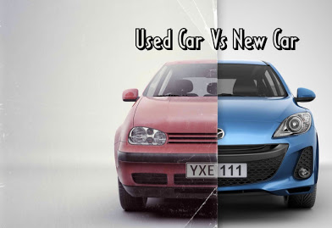
Evaluation of alternatives

Slide 67
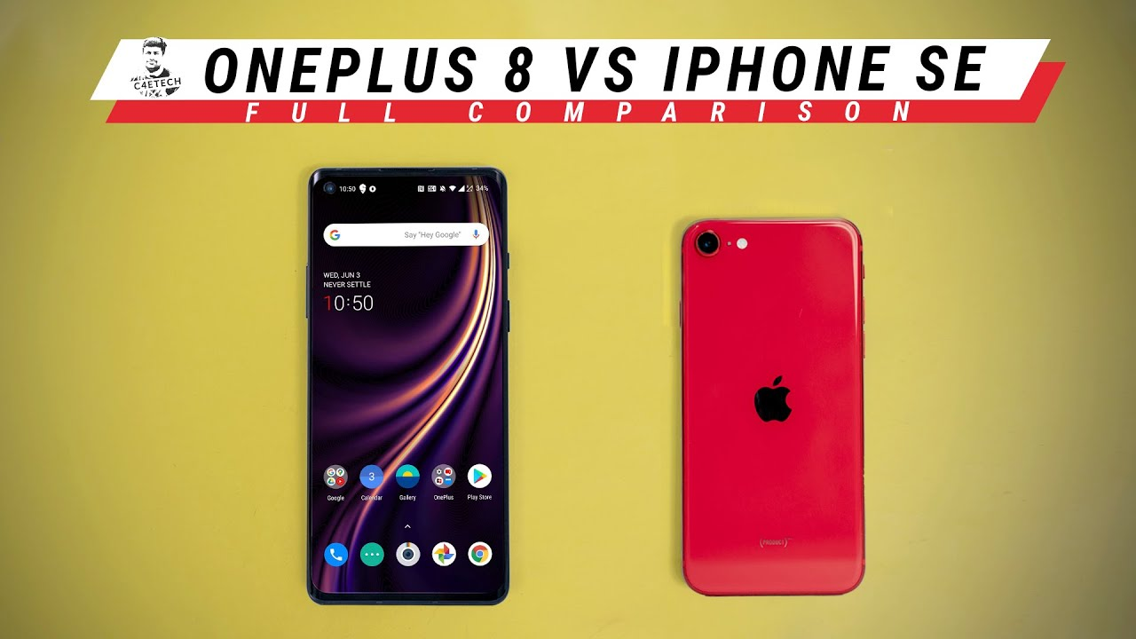


Slide 68
Purchase Decision
After the alternatives have been evaluated, consumers take the decision to purchase products and services. They decide to buy the best brand.
But their decision is influenced by others’ attitudes and situational factors.

Slide 69
Purchase Decision –
Seller and location of the store
Time of purchase
Colour, package and size of the product
Price of the product
Warranty, guarantee and delivery
Mode of payment – cash, debit card, credit card, instalment, etc.

Slide 70
Post – purchase behaviour-
Is satisfied
Surpasses his expectations
Neither satisfied nor dissatisfied
Dissatisfaction / dissonance after purchasing the product

Slide 71
Consumer Buying Behaviour Types
Video - https://www.youtube.com/watch?v=JFqee_LfqvU
https://www.youtube.com/watch?v=1e0yO3t0k2o
https://www.youtube.com/watch?v=JFqee_LfqvU&t=255s

Slide 72
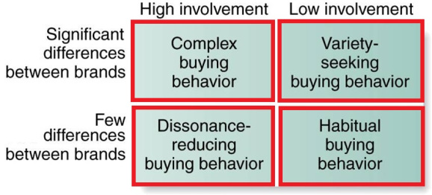
TYPES OF BUYING Behaviour

Slide 73
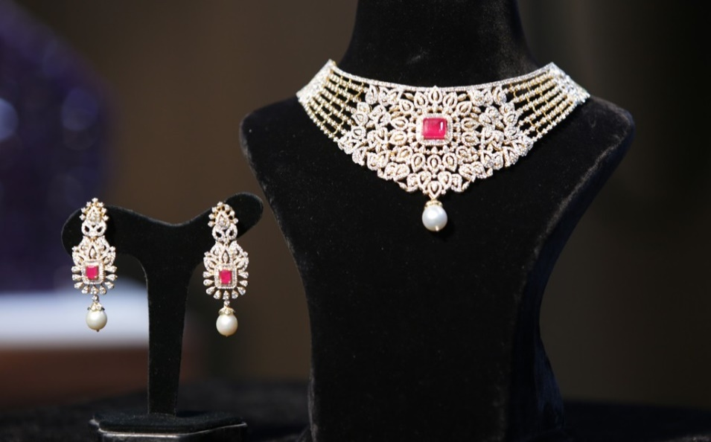

COMPLEX BUYING BEHAVIOUR
 High consumer involvement
 Significant perceived difference between brands
 Usually happens when product is expensive, risky, purchased infrequently like a PC, jewellery, house

Slide 74
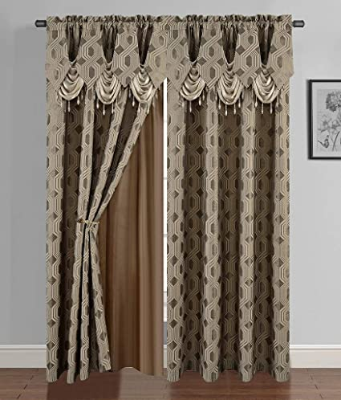
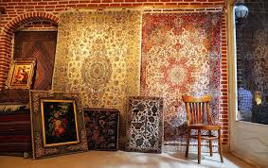
DISSONANCE REDUCING BUYING BEHAVIOUR
 High involvement, Less perceived difference between brands
 Expensive, risky and infrequently purchased products like carpets, Furniture, curtains

Slide 75
HABITUAL BUYING BEHAVIOUR
 Low consumer involvement, Little significant brand difference
 Purchase is out of habit not customer loyalty
 Low cost, frequently purchased products like salt
 Brand familiarity is important
Ad campaigns with repetition and short duration
Salt, sugar

Slide 76
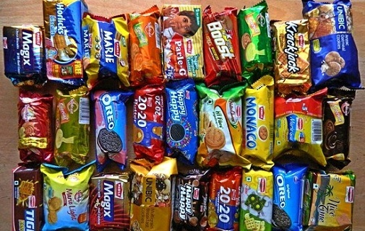
VARIETY-SEEKING BUYING BEHAVIOUR
 Low consumer involvement
 Significant perceived difference
 Lot of brand switching happens
 Ex: Cookies, biscuits, entertainment, retail

Slide 77
Factors determining the Buying Behaviour
https://study.com/academy/lesson/influences-on-consumer-buying-decisions-cultures-values-more.html

Slide 78
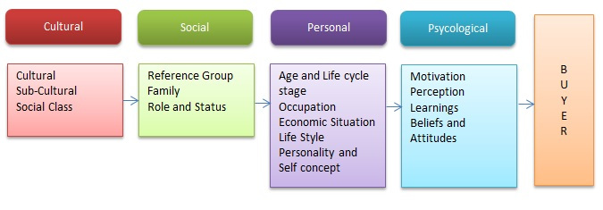
Factors affecting Consumer Buyer Behaviour

Slide 79
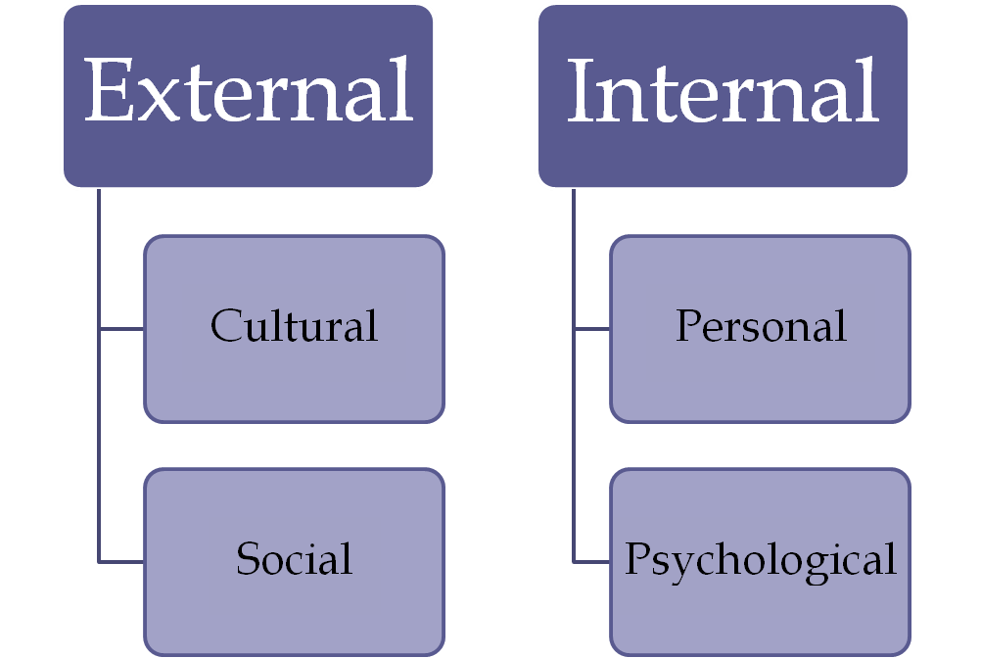
Consumer purchases are highly influence by two factors.

Slide 80
Cultural Factors

Slide 81
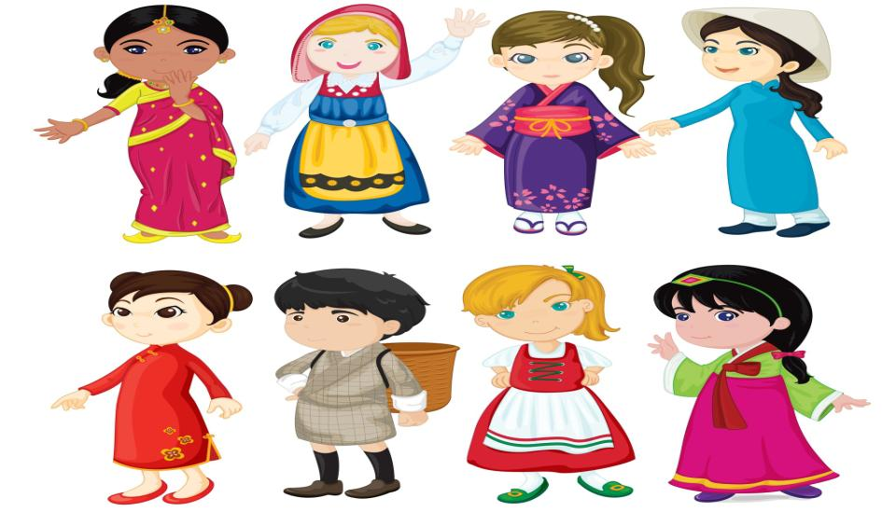
The word ‘Culture’ means a set of values, norms, attitudes, and other meaningful symbols that shape human behavior and the artefacts, or products, of that behavior as they are transmitted from one generation to the next.
It has been found ever since the prehistoric times that culture is: pervasive, functional, learned and dynamic.

Slide 82

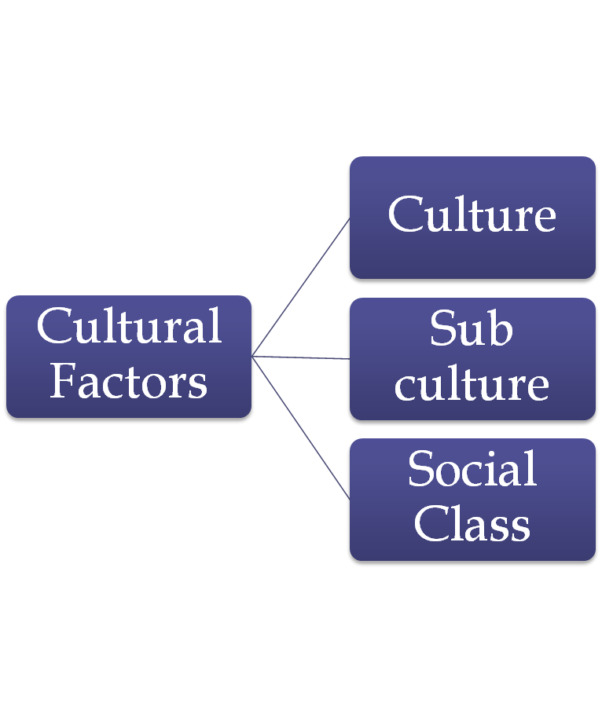

Slide 83
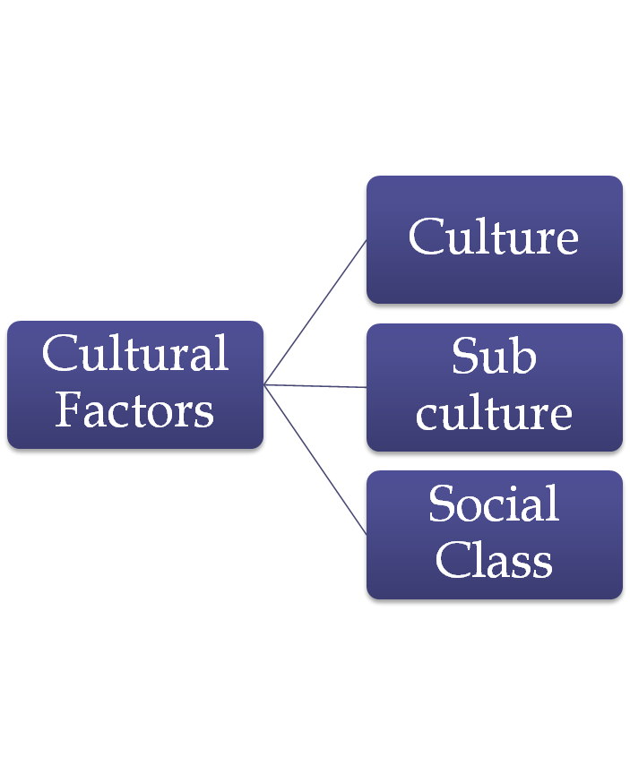

Culture
Relates to social values, attitudes towards work, beliefs, morals, language etc.
Includes religon, language, food habits, food choices, dressing sense, events etc.

Slide 84

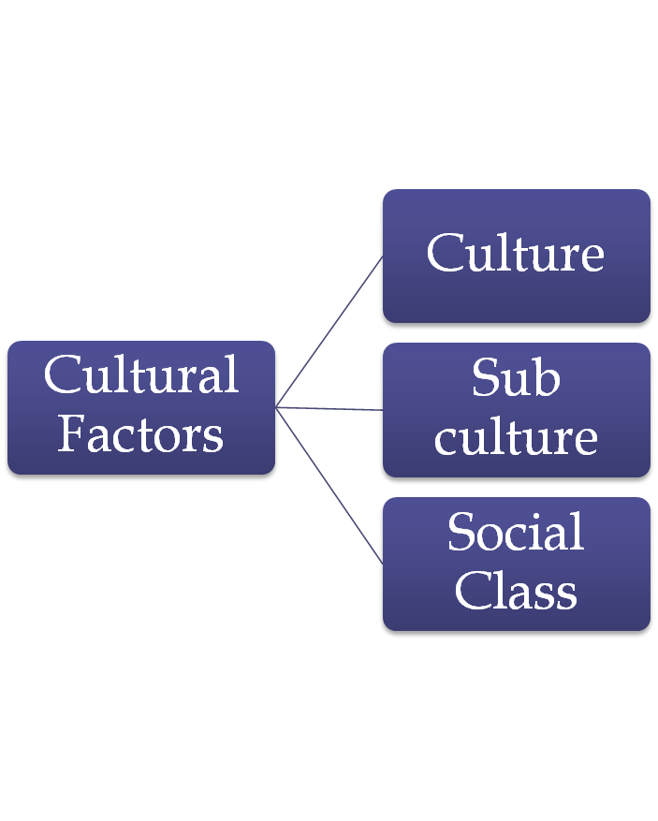

Sub-Culture
Consists of more specific identification and socialisation of members
Nationality Groups – Indian, Chinese
Religious groups – Hindus, Sikh
Racial groups – Aryans, Arabs

Slide 85
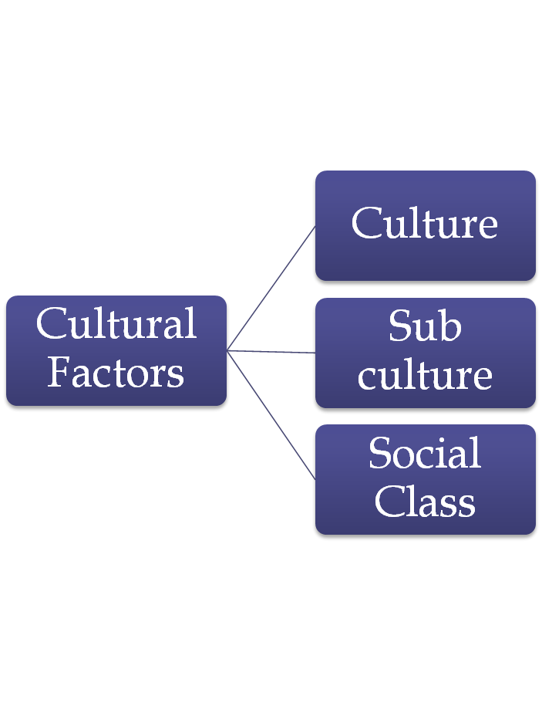
Social Class
Relatively permanent and ordered divisions in a society whose members share similar values, interests and behavior.
It is determined by occupation, wealth, income, education etc.
Rich/ Poor/ Middle Class

Slide 86
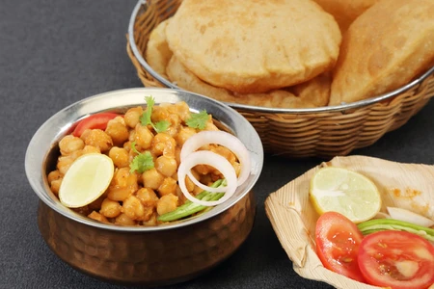
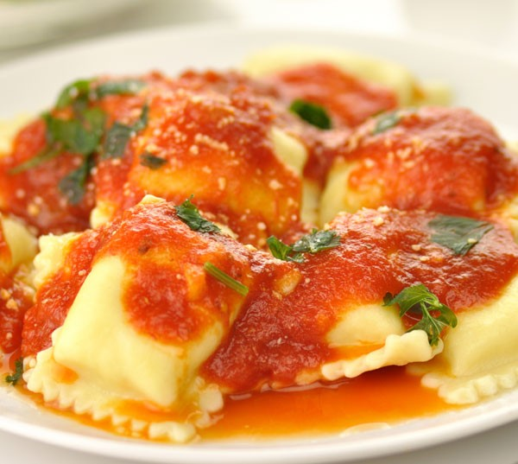
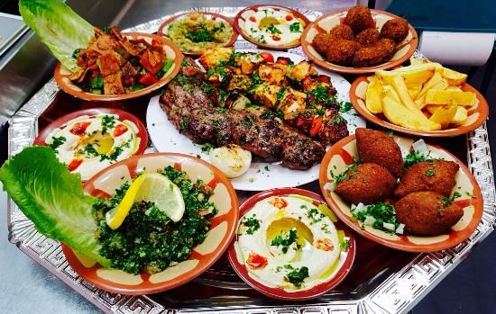
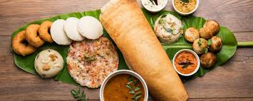

Slide 87
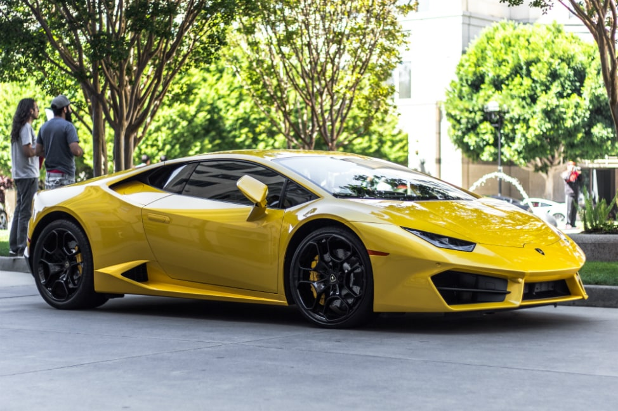
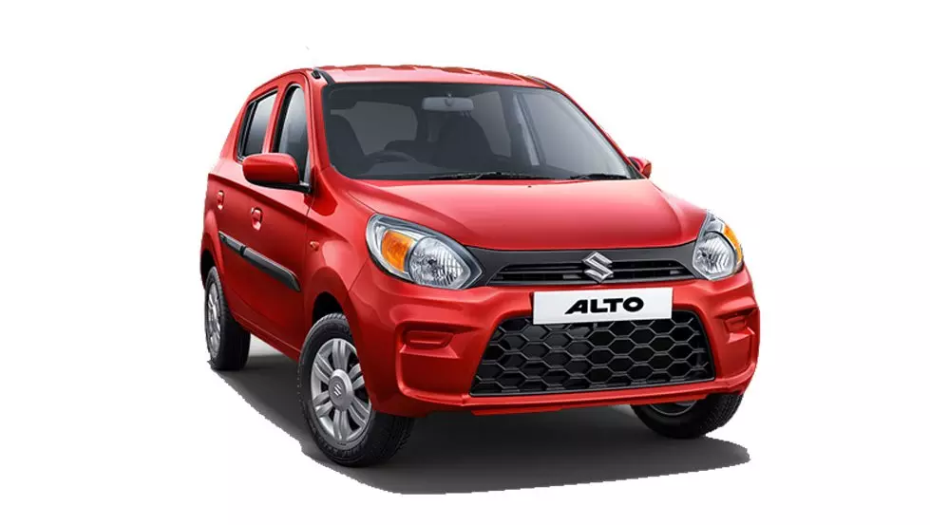

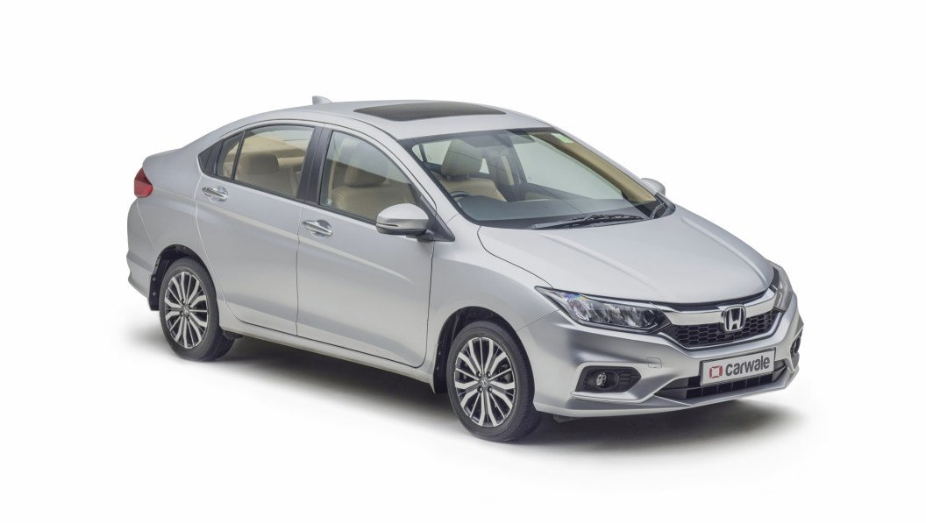

Slide 88
How will culture affect consumer behaviour of buying a sofa?
Culture is an umbrella term which encompasses the social behavior and norms found in human societies, as well as the knowledge, beliefs, arts, laws, customs, capabilities, and habits of the individuals in these groups. While purchasing furniture like sofa, the choice of consumer is strongly influenced with the way he looks at the colour, style and fabric of the sofa.
For example, in Indian cultures red, brown, coffee colours (dark tones) are preferred keeping in view the atmosphere, temperature and legacy of the families. We find that different parts of the world have different bed designs and the designs of these beds are usually heavily influenced by the history and culture of that particular geographical location. But, in contrast to this, in European countries, light and cool colours are preferred for sofa and other furniture.

Slide 89
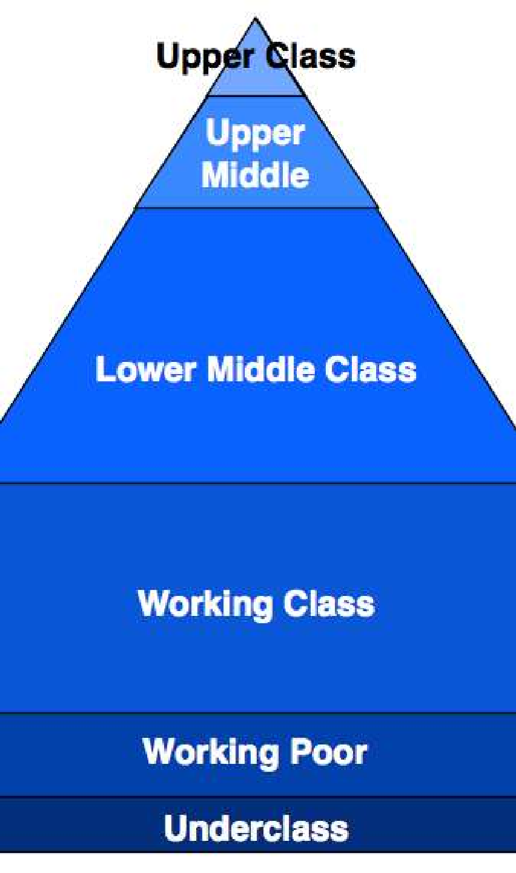
How will social class affect consumer behaviour of purchase of sofa?
A social class is a set of concepts in the social sciences and political theory centered on models of social stratification in which people are grouped into a set of hierarchical social categories, the most common being the upper, middle and lower classes. Social classes are directly and indirectly linked with the income of a consumer. These also affect the consumer behaviour.
For example, upper class people would be comfortable spending on luxury items and certainly their preference of a sofa would be classy, stylish, and costly. Upper middle class would focus on quality and durability of the product whereas lower middle class looks at the comfort and affordability. Working class would merely focus on even buying a sofa and underclass would be more than satisfied if they get proper housing facilities only.
SOCIAL CLASS

Slide 90
Social Factors

Slide 91
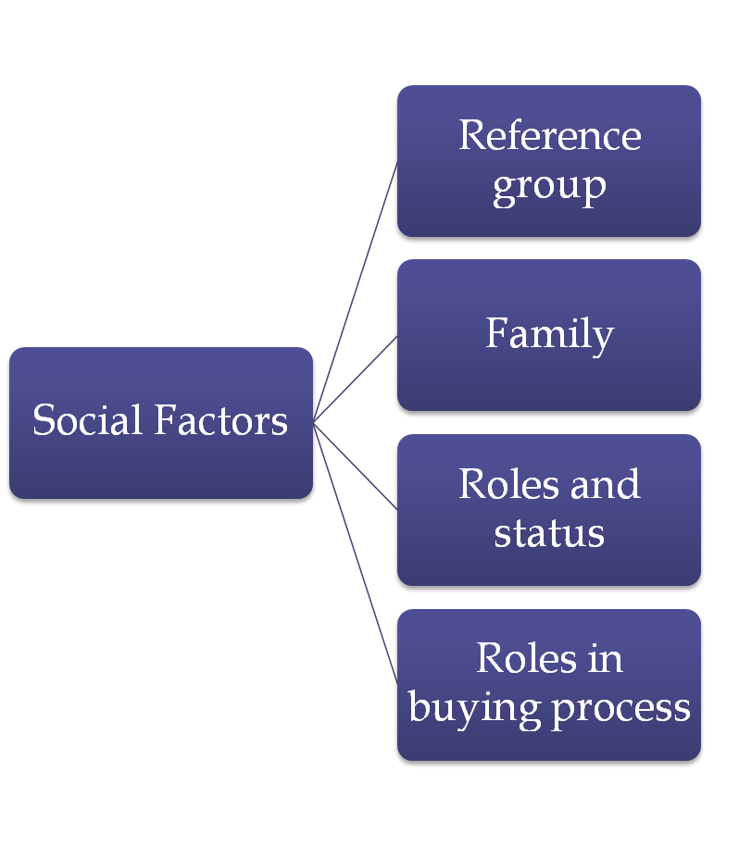

Slide 92

Reference groups
A person’s reference groups consists of all the groups that have a direct (face- to-face) or indirect influence on his/her attitudes or behavior.

Slide 93
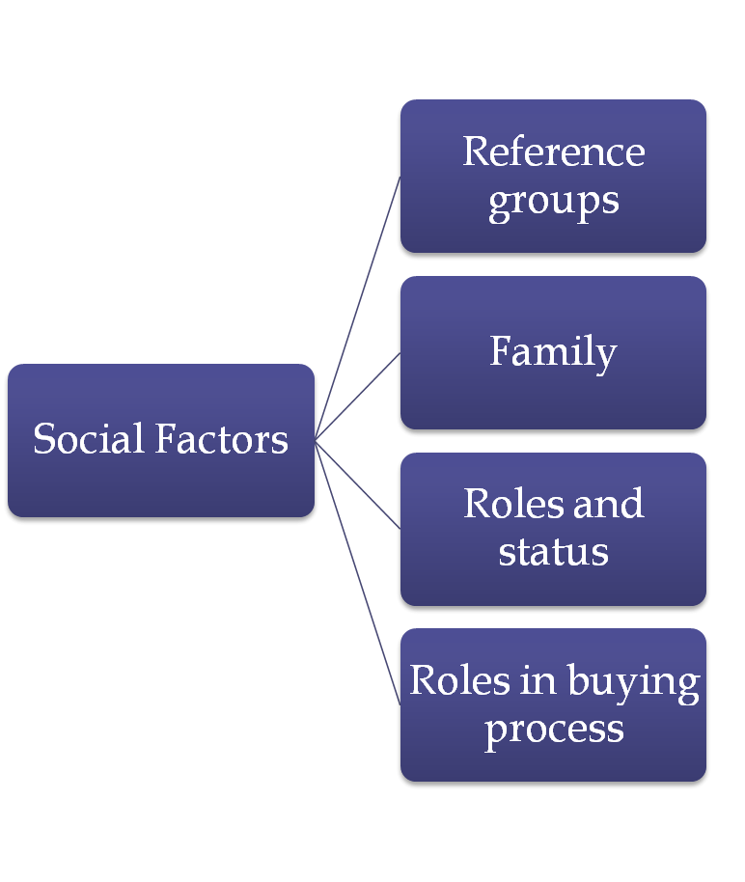

Family
Family members can
strongly buyer
influence behaviour.
Marketers are interested in the roles, and influence of the husband, wife and children on the purchase of different products and services.

Slide 94

Roles and Status
A role consists of the activities people are expected to perform according to persons around them
A man plays role of son at home and of an executive at office

Slide 95
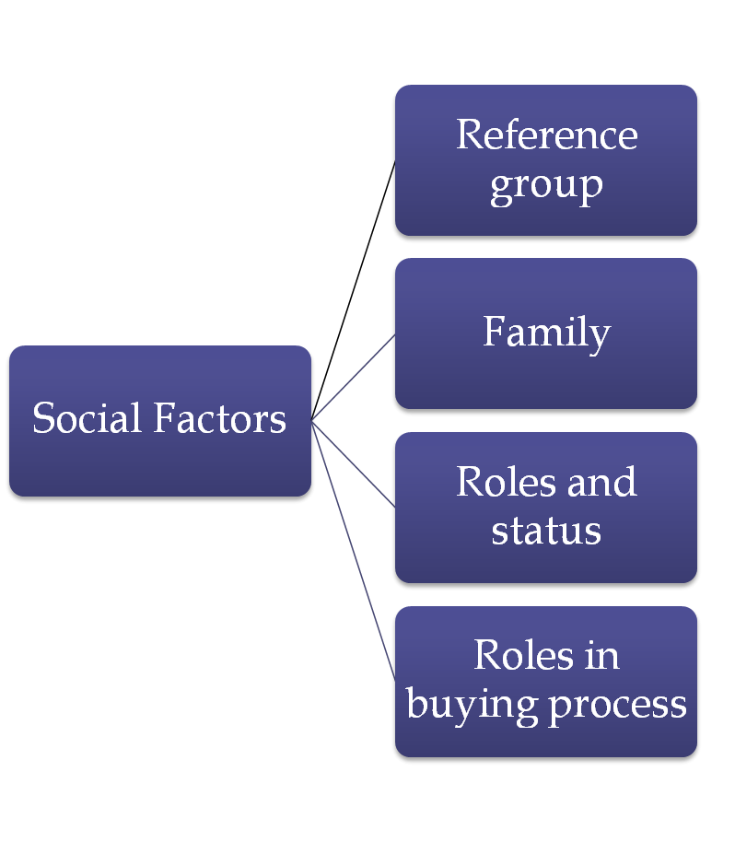
Roles in buying process
Initiator
Influencer
Decider
Buyer
User
Gatekeeper

Slide 96


Slide 97

Reference group influence

Slide 98
Personal Factors

Slide 99


Slide 100

Age and life cycle
Needs and
consumption pattern of people vary with advancement in age

Slide 101
Occupation
influence the behavior of individuals.

Slide 102
Economic Situation
A person’s economic situation will affect product and service choice.

Slide 103

Life Style
Lifestyle is an individual’s way or pattern of living which is reflected in his activities, interest and opinions.

Slide 104
Economic Factors
Disposable Personal Income
Size of Family
Credit Facilities
Extra discretionary Income
Prospensity to Consume & Save

Slide 105


Slide 106





AGE

Slide 107



Family Size

Slide 108
Psychological Factors

Slide 109

There are various psychological factors that influence consumer behavior or consumer buying decisions such as follows:

Slide 110


Slide 111

Motivation
Motive or inner drive to fulfill the need.
Motivation to look good, Motivation to show power,
Motivation for security

Slide 112
Perception
The initial impression that a consumer forms about a product or situation
The process by which people select, organize and interpret information to form a meaningful picture of world.
Eg.A thirsty person may purchase juice while another may purchase plain water

Slide 113
Learning
Changes
in an
individual’s behavior arising from experience.

Slide 114
Beliefs
A descriptive thought or conviction that a person holds about something.
Based on knowledge, opinion, faith & confidence
Eg. Brand Image is based on belief

Slide 115

Attitude
A person’s relatively consistent evaluation, feelings and tendencies towards an object or an idea.
A person’s favourable or unfavourable evaluation of a product/ service
Eg. A person may have positive attitude towards luxury spending while someone has similar attitude for investments

Slide 116


Motivation

Slide 117


Slide 118


Slide 119

Perception

Slide 120

Perception

Slide 121


Slide 122



Slide 123



Slide 124


Slide 125


Slide 126


Slide 127



Slide 128


Slide 129


Slide 130
https://www.youtube.com/watch?v=ECKu7eOHaqM – Fair & Handsome
https://www.youtube.com/watch?v=lmI-jd0X04Y
https://brandequity.economictimes.indiatimes.com/news/digital/loreal-paris-endorses-the-concept-of-break-up/49048564
https://www.youtube.com/watch?v=0JPmNLMDTTU – axe chocolate

Slide 131
Review Questions
◆ Is it important to consider the behavior of consumers while deciding on the marketing mix of the company ? Why? Explain with suitable examples
◆ It is said that each consumer is unique, and any study that concentrates on the “average consumer” is meaningless. Discuss its implication.
◆ Why is it so important to conduct a consumer research before the launch of any campaign?
◆ “It has become important for marketers to understand the psyche of the consumer
”. Comment.

