Slide 1
Let’s Revise Previous lecture ....
Peter Ferdinand Drucker Management Dimensions
An Austrian-born American management consultant, educator, and author
Best book – The Practice of Management -1956
Introduced Management BY Objectives (MBO) – 1954
Five Management Dimensions
Purpose and Mission
Productive work and Worker Achievement
Social Impacts and Social Responsibilities
Time Dimension
Administration and Entrepreneurship

Slide 2


Slide 3
Reference Books
SYBCOM : COMMERCE III REFERENCE BOOKS LIST
Management Principles And Practices by M.Sakthivel Murugan
Principles of Management by T.Ramasamy
http://14.139.242.244/extra/library/library/_14022020061808
PrinciplesofManagement.pdf4.
https://www.pdfdrive.com/principles-of-management-books.html
(free ebooks)

Slide 4

Indian Management Thoughts
Indian Ethos in Management

Slide 5
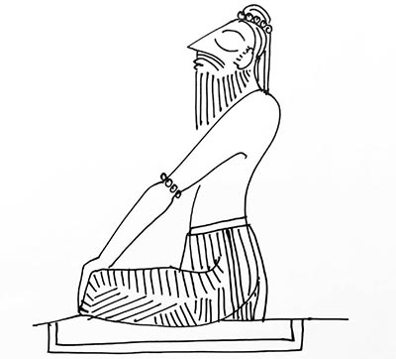
Meaning of Indian Ethos
Ethos is Greek word which means “Character”
Derived from ancient Indian Scriptures like vedas, Upanishads,Manusmriti etc,

Slide 6
DEFINITIONS
“the characteristic spirit and beliefs of community or people which distinguishes one culture from the other”- Oxford Dictionary

Slide 7
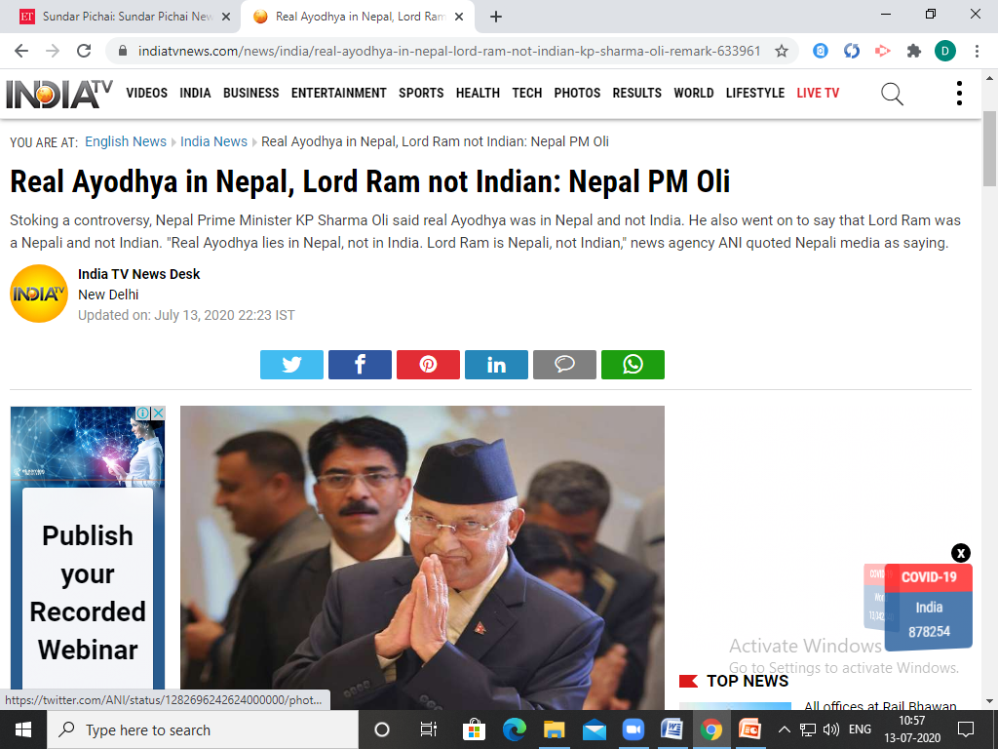

Slide 8
Significance of Indian Ethos
1. Ethics in Functional Areas
Production – Focus on quality
Marketing – Right product, price place and promotion
Finance _ obtaining funds from right sources
Human Resources – Fair Hr Policies
2. Respect
Self respect and respect to others
Respect views and opinion of other managers and subordinates

Slide 9
Significance of Indian Ethos
3. Equity
Give fair and justice treatment
No partialities and undue favours
4. Authority and Responsibility
Do not misuse authority
Take responsibility of work
5. Discipline
Work with application and dedication
For benefits of the organisation
6. Attitude
Emphasis on positive attitude
Importance to good thoughts and actions

Slide 10
Significance of Indian Ethos
7.Passion
Leaders preach passion towards work
Come with innovative ideas
8.Low of Giving and Receiving
Encourage to do good for society
Receive back from society
9. Law of Dharma
Dharma means mission or purpose of life
Encourage workers to achieve organisation mission
10. Law of Karma
What you sow is what you reap
Cause and effect relationship

Slide 11
Significance of Indian Ethos
11.Humility
Must practice art of humility
Accept mistakes
Give credit who deserve
12.Loyalty
Must loyal to organisation
Protect interest of organisation

Slide 12
SUMMARY ....
Indian Ethos
Ethos – Greek word means Character
Significance of Indian Ethos
Ethics in functional areas
Respect
Equity
Authority and responsibility
Discipline
6. Passion
7. Law of Giving and Receiving
8. Law of Dharma
9. Law of Karma
10. Attitude
11. Humility
12. Loyalty

Slide 13


Slide 14


Slide 15


Slide 16
