Slide 1
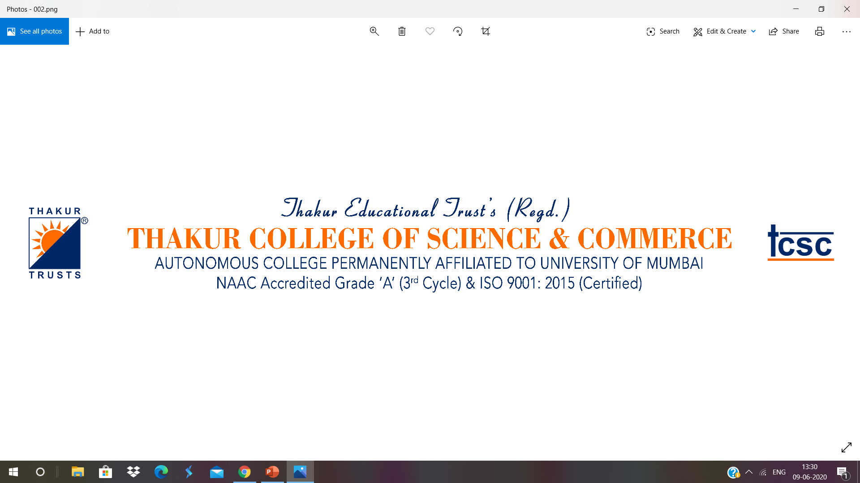
PR VS. Advertising
Divya Narang Tinna
Assistant Professor, BAMMC

Slide 2
PR VS. AD
PR can not replace advertising
But, it can help to increase sales
It can change consumer’s perception
But, sometimes advertisements are not necessary
Ads have a greater role in selling tangible products
PR creates good image
Advertising can take advantage of that image

Slide 3
PR VS. AD
Difference | PR | AD
1. Paid Space/Free Coverage | Focus on getting free coverage through Press Conferences, Press Releases etc. | Company pays for it
2. Control | Media is not obliged to cover the event or publish the press release | Control over the content as company pays for it

Slide 4
PR VS. AD
Difference | PR | AD
3. Shelf Life | Same Press Release can not be used again | Longer shelf life. Till the time company pays for it.
4. Wise consumers | Company gets unpaid publicity when media endorses your product or service | Consumers are aware about the selling message/purpose behind the ad.

Slide 5
PR VS. AD
Difference | PR | AD
5. Contacts | PR officials develop contact with media and other stakeholders. Their contacts are not limited to in-house communication. | Main contacts are co-workers, agency, clients and media.
6. Target Audience/Scope | Internal and External (Media, Employees, Govt., Community, Customers etc. ) | Narrow (Customers, Clients, Media)

Slide 6
PR VS. AD
Difference | PR | AD
7. Special Events | CSR, Sponsorship, Collaboration, Campaign etc. Press Release is sent to the Media. | Ad might not work
8. Writing Style | No nonsense news style. Inverted pyramid style. | Buy now! Call Now! Offer valid till the stock lasts!

Slide 7
PR VS. AD
Difference | PR | Ad
9. Creativity/Nose for News | PRO should have a nose for news. He should know when to send the press release. | One has to be creative to design new advertisements.

Slide 8
PR VS Marketing
Difference | PR | Marketing
Purpose | Maintains good image. Builds relationship with various stakeholders. | Promotes the transfer of goods and services from producer to the consumer.
2. Explicit goals | Mutual Understanding or positioning of the organization with its public. | Marketing’s immediate goal is sales.

Slide 9
PR VS. Marketing
Difference | PR | Marketing
3. Implicit Goals | Positive Perception and Favourable attitude. | To earn profit and maximise wealth.
4. Measurement | PR’s measure of success is expressed by way of public opinion or other evidence of public support. | Sales Data or Growth Rate

Slide 10
PR VS. Marketing
Difference | PR | Marketing
5. Target Audience | Internal and External | Customers
6. Longevity | Believes in building long term relationship. | Relatively short term activity. Marketing seeks to drive instant, tangible sales success.
7. Legitimacy of messages | Messages delivered through articles, conference speakers or reputable bloggers are subconsciously regarded by consumers as more legitimate | Generally, people can clearly recognize that advertising and marketing are driven by a company’s desire to increase sales

Slide 11
PR VS. Journalism
PR | Journalism
Targeted Audience (Stakeholders) | Mass Audience
About good image and reputation of the company | It is about facts and truth
Works in the interest of a client or company | Works in the interest of general public
PR is formative and influential | Journalism is factual, objective and truthful

Slide 12
PR VS. Journalism
PR | Journalism
PR’s responsibility is to inform the public and to change the attitude and behaviour to benefit a certain organization/cause | Gathering, Selecting, Writing and Editing News etc. To educate, To inform and to entertain etc.
PR is concerned with commercial aspect | Journalism is concerned with civic aspect

