Slide 1
MS-Office: Packages for Institutional Automation
Module-4
SYBBI-SEM-IV

Slide 2
MS-PowerPoint presentation
PowerPoint is a presentation software that allows you to create dynamic slide presentations.
Slideshows can include animation, narrations, images, videos and much more.

Slide 3
Hyperlinks
In PowerPoint, you can create a hyperlink using any text within your presentation. When clicked on, a hyperlink can directly link to a specific slide within your presentation, a saved file, a web page, another PowerPoint presentation, or a custom email.
To insert a hyperlink into your presentation:
Open the PowerPoint presentation.
Highlight the text or object you would like to hyperlink.
Right-click the highlighted text and select "Hyperlink..."
From the "Link to:" side panel, choose the destination for your hyperlink.
  For Existing File or Web Page, browse your computer to locate the file you wish to link to.
  For Place in This Document, choose the slide you wish to link to.
  For Create a New Document, type the name of your new PowerPoint presentation and choose when to edit the document.
  For E-mail Addresses, enter the recipient(s) email address and the subject line of the email.
Click [OK].
To test the action button, start your PowerPoint slideshow (Click F5 on your keyboard) and click the text with the action button.

Slide 4
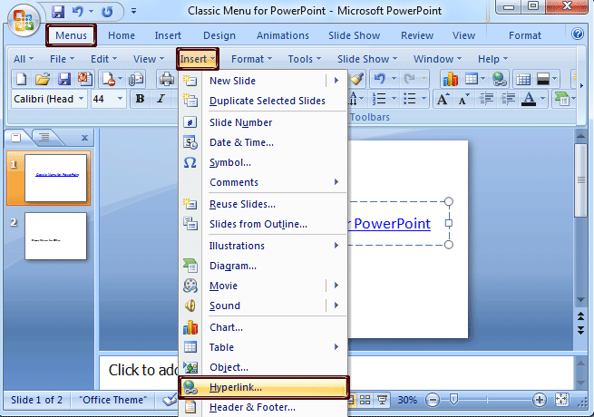

Slide 5
Embedding multimedia contents
In short, it's combining multiple types of media in your presentation. You can use combinations of images, audio, and video to make your point.
Every PowerPoint slide is a blank canvas, waiting for your content to reinforce your speaking points or guide the presentation. Multimedia brings variety to your slides and helps visual learners understand your content better.

Slide 6
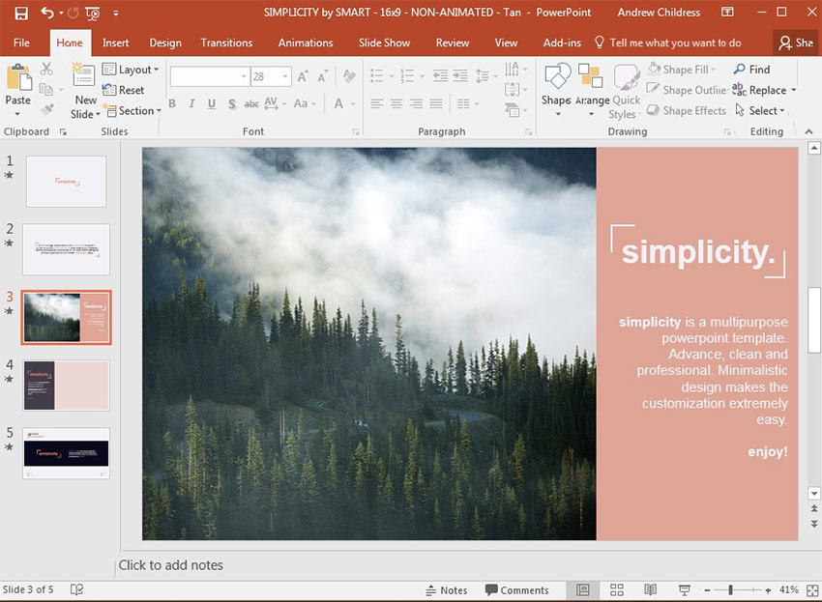

Slide 7
Cont.
Why Use Multimedia in Your Presentation?
If we were bound to using only text and shapes, it would be much harder to hold an audience's attention during a presentation.
Multimedia exists to help reinforce our key speaking points. Here are a few ideas for working with images, audio, and video to make your presentation more interesting:
Images - These could be used for everything from simple stock photos that add slide variety, to logos and icons that showcase your brand.
Audio - Audio is a great way to add narrations to your slides if you can't present directly to your audience or to add music and sound effects.
Video - You can add video clips from your computer or sites like YouTube. Videos could be used for showing instructional walkthroughs from YouTube, TED talks or a recorded screen cast of your own.

Slide 8
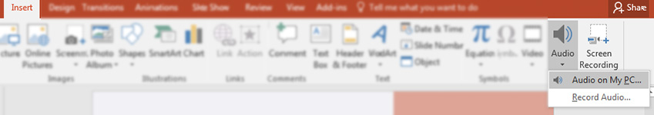
Audio in PPT
Add an Audio File to PowerPoint
Audio is another multimedia type you can work with in PowerPoint.
If you have an audio track on your computer like an MP3 or WAV file, you can easily add them to your presentation. Choose the Insert > Audio > Audio on My PC option to browse for and choose an audio file.

Slide 9
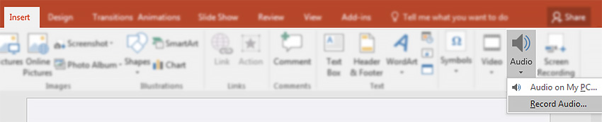
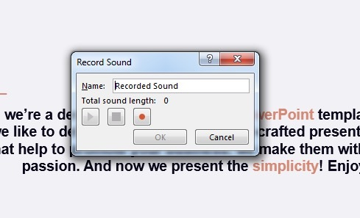
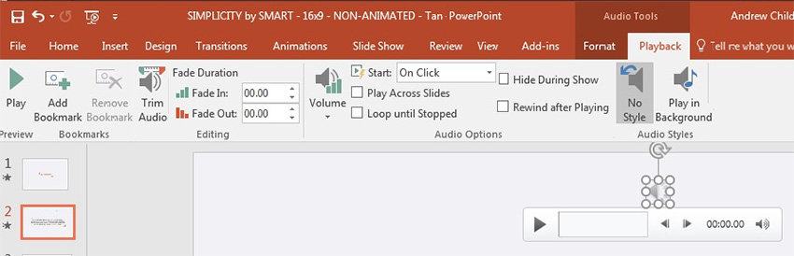

Slide 10
Video in PPT
Video is a powerful multimedia type you can use. PowerPoint supports adding video from your computer or online. Let's look at how to insert and modify them:
Add a Clip From Your Computer
If you have a video clip on your computer, you can quickly drop it into your presentation by using the Insert menu. Go to Insert > Video > Video on My PC to browse to your video file.

Slide 11
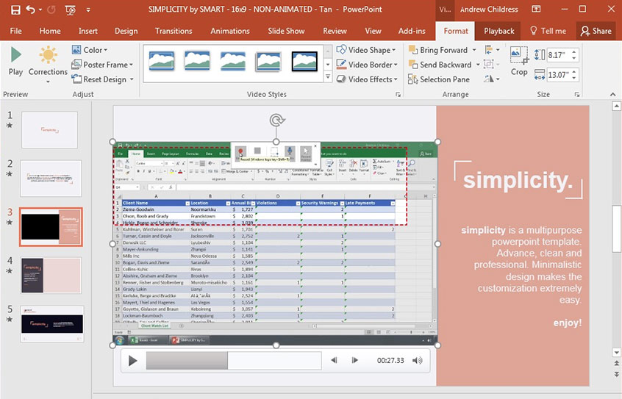

Slide 12
Cont.
Add a Video Clip from Online
Finding an inspiring or insightful YouTube video can help make drive your point to reach an audience. Instead of finding a workaround to download and convert a YouTube video, PowerPoint can link to and insert them directly.
To add a YouTube (or other online) video, go to Insert > Video > Online Video to launch the menu.

Slide 13
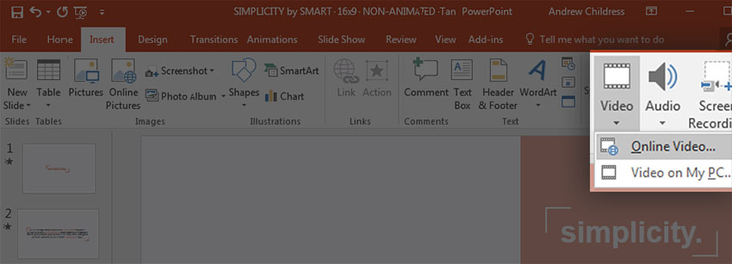
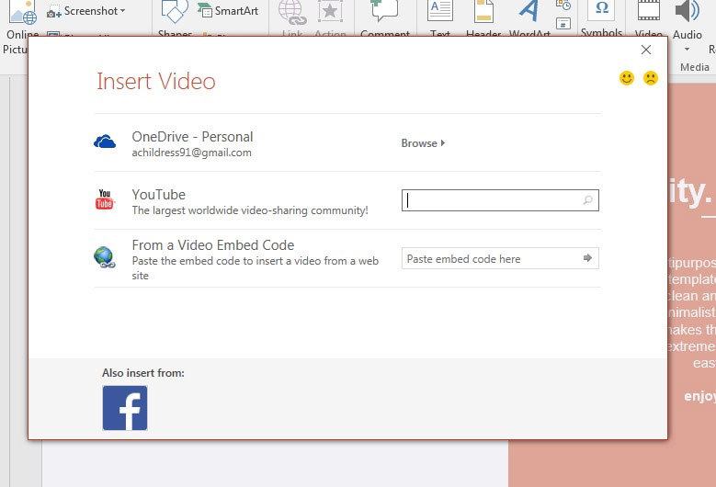

Slide 14
Slide animation
A slide transition is the visual effect that occurs when you move from one slide to the next during a presentation. You can control the speed, add sound, and customize the look of transition effects.
Add slide transitions to bring your presentation to life:-
Select the slide you want to add a transition to.
Select the Transitions tab and choose a transition. Select a transition to see a preview.
Select Effect Options to choose the direction and nature of the transition.
Select Preview to see what the transition looks like.
To remove a transition, select Transitions > None.

Slide 15
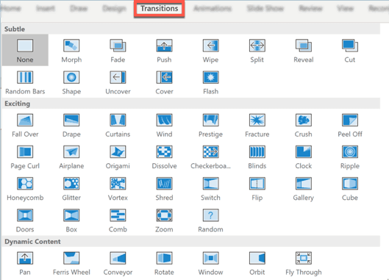

Slide 16
Creating a new presentation by existing theme
A PowerPoint template is a pattern or blueprint of a slide or group of slides that you save as a .pptx file. Templates can contain layouts, colors, fonts, effects, background styles, and even content.
You can create your own custom templates and store them, reuse them, and share them with others. You can also find hundreds of different types of free templates on Office.com and on other partner websites that you can apply to your presentation.

Slide 17
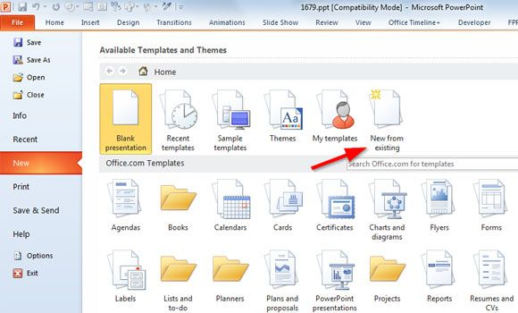

Slide 18
Themes in PPT
A PowerPoint theme is a set of backgrounds, font pairings, color schemes, and slide designs. It's also commonly referred to as a PowerPoint template.
How to import online themes?
Open your presentation in PowerPoint.
On the Design tab, in the Themes group, click the drop-down arrow. Now click Browse for Themes. A new window will open, where you need to select the presentation that contains the theme you want to import.

Slide 19
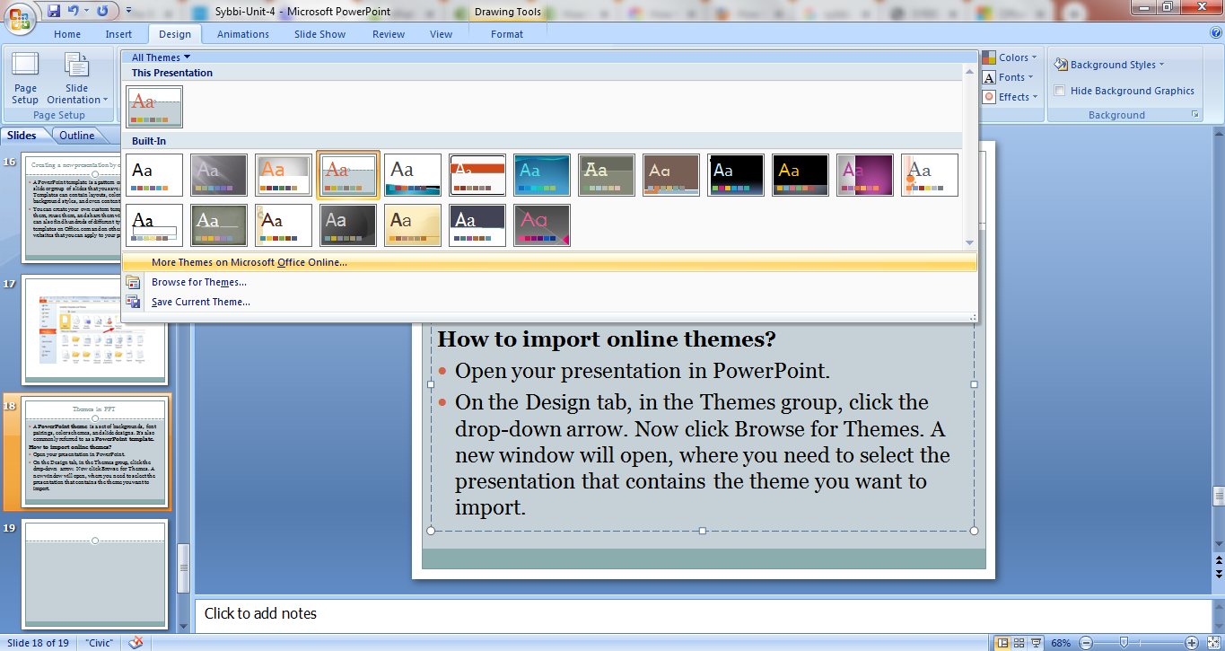
Cont.

Slide 20
Creating a template
Open a blank presentation: File > New > Blank Presentation
On the Design tab, select Slide Size > Custom Slide Size and choose the page orientation and dimensions you want.
On the View tab, in the Master Views group, choose Slide Master.

Slide 21
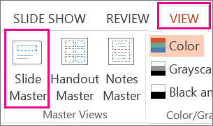
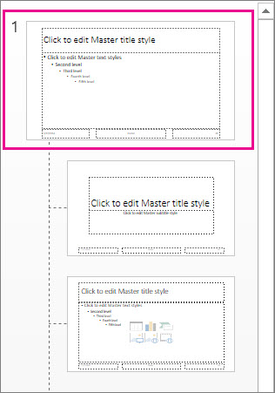

Slide 22
Saving a PPT
Make a slide show that starts automatically when opened
Select File > Save as (or Save a Copy).
Click More options.
Browse to the folder where you want to save your presentation.
In the File name box, type a name for your presentation.
Under Save as type, select PowerPoint Show.
How to Edit a .ppsx file:-
In PowerPoint, click File > Open.
Browse to the .ppsx file, and open it.

Slide 23
Applications of Internet
Introduction to e-Mail:
E-mail or web-mail or e-post refers to the transmission of message over communication networks.
Electronic mail (email or e-mail) is a method of exchanging messages ("mail") between people using electronic devices.
Email entered limited use in the 1960s, but users could only send to users of the same computer, and some early email systems required the author and the recipient to both be online simultaneously, similar to instant messaging.
One of the best features is that a message can be sent to several users simultaneously.
The contents of email message can be some lines of keyboard typed text, files stored in your PC.

Slide 24
Cont.
There's a large variety of an email service providers to chose from like Gmail or Yahoo!
Gmail: Gmail is Google’s free e-mail service. It offers online storage that’s practically unlimited. Gmail had an initial storage capacity offer of one gigabyte per user, a significantly higher amount than competitors offered at the time. Today, the service comes with 15 gigabytes of storage. Users can receive emails up to 50 megabytes in size, including attachments, while they can send emails up to 25 megabytes. In order to send larger files, users can insert files from Google Drive into the message.

Slide 25
Yahoo mail
Yahoo mail is an email service launched on October 8, 1997, by the American company Yahoo!, now a subsidiary of Verizon. It offers four different email plans: three for personal use (Basic, Plus, and Ad Free) and another for businesses. As of January 2020, Yahoo! Mail had 225 million users.
Users are able to access and manage their mailboxes using webmail interface, accessible using a standard web browser. Some accounts also supported the use of standard mail protocols (POP3 and SMTP). Since 2015, users can also connect non-Yahoo e-mail accounts to the webmail client.

Slide 26
MSN Windows Hotmail
Another well used free service, hotmail is supported by Microsoft technology and features 5 GB of online storage space.
A versatile desktop design allows users to customize the color and layout of their mail manager.
It also offers users the choice of working a classic, familiar format and switching to an updated look with added features.

Slide 27
Cont.
An email address has two components separated by “@” symbol.
Username: on the left side of “@” separator is the username. A username cannot be blank.
Domain name: the portion to the right of “@” is the domain name.
For e.g. syed@companyname.com
Composing an E-mail:- to compose an email, the compose page is the page on which you write and address your outgoing E-mail messages. To compose, click on compose in the left-side navigation panel or click on email icon next to a name in your address look.

Slide 28
Cont.
Addressing your message:-type your full e-mail address in order to send your message to multiple recipients, separate each recipient by a comma. For example: nickname1, nickname2, recipient3@host.domain.
Include main recipients in the To: field and secondary recipients you would like to carbon copy in the Cc: field. If you wish to hide the names of your secondary recipients use the Bcc: field to blind carbon copy.

Slide 29
Writing professional e-mails
Email is one of the most widely used forms of communication both in and out of the workplace. Because of its speed and efficiency, you will likely use email in some capacity no matter your role or industry. You can write professional emails for a variety of reasons. For example, you might need to recap an important meeting, exchange information, relay an important update, or send a letter of introduction.
A well-composed email provides the recipient with a friendly, clear, concise and actionable message. Learning how to write an email that meets all of these criteria can take practice.
Six steps for writing professional emails:-
Identify your goal
Consider your audience
Keep it concise
Proofread your email
Use proper etiquette
Remember to follow up

Slide 30
Format and structure for formal Email
There are five elements to consider when formatting your email:-
1. Subject line: This is a short phrase that summarizes the reason for your message or the goal of your communication. It is important to include a subject line when sending a professional email so your audience knows exactly what to expect and is able to locate the message easily if needed. For example: “Follow up: Product presentation”
2. Salutation: This is the first line of your email and generally acts as the greeting. For example: “Hi Mr. Samson,"
3. Body: Just like the body of a letter, this is where you’ll share your full message. For example: “Thank you for attending the new product presentation this afternoon. I’ve attached a video file of the full recording so you can share it with your team. Please let me know if you have any questions.”
4. Closing:- This is the last line of your email before your signature and should wrap up your message. This is also where you may reiterate any requests you’ve made in the body of your message. For example: “I look forward to speaking with you on Wednesday. Thanks again!”
5. Signature:- The signature is where you identify yourself by name, title and any other information relevant to your communications. Most email programs allow you to set a fixed signature that’s automatically added to the end of every email you send.
“Sincerely,
Jillian Jones
Senior Software Engineer
ABC Company, Inc.”

Slide 31
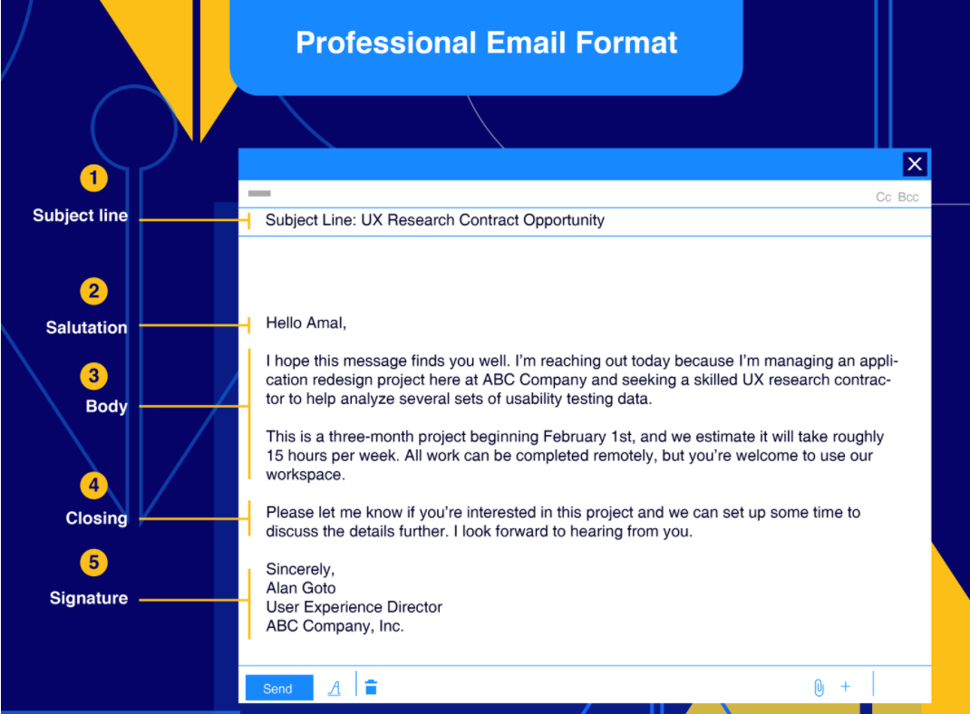
Format

Slide 32
Outlook Express
Microsoft Outlook Express is an free formerly known as Microsoft Internet Mail and News, is a discontinued email and news client included with Internet Explorer versions 3.0 through to 6.0. As such, it was bundled with several versions of Microsoft Windows, from Windows 98 to Windows Server 2003, and was available for Windows 3.x, Windows NT 3.51, Windows 95, Mac System 7, Mac OS 8, and Mac OS 9. In Windows Vista, Outlook Express was superseded by Windows Mail.
Outlook Express is a different application from Microsoft Outlook. The two apps do not share a common codebase, but they do share a common architectural philosophy. The similar names lead many people to conclude incorrectly that Outlook Express is a stripped-down version of Microsoft Outlook. Outlook Express uses the Windows Address Book to store contact information and integrates tightly with it. On Windows XP, it also integrates with Windows Messenger.

Slide 33
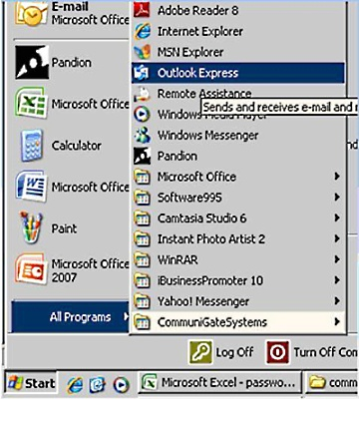
How to setup Microsoft Outlook Express Email
Step 1: Open Microsoft Outlook Express. The below screen shot illustrates how to launch Outlook Express using the Start menu on your computer.

Slide 34
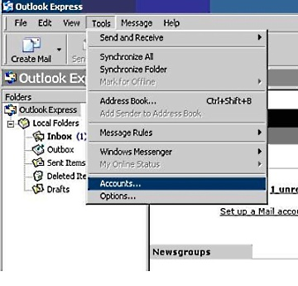
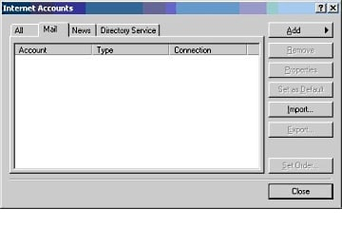
Cont.
Step 2: Select Accounts from the Tools menu, (the 4th drop down menu from the top left).
Step 3: Click on the Mail tab.

Slide 35
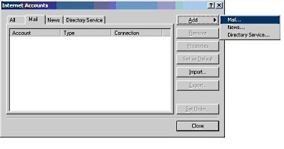
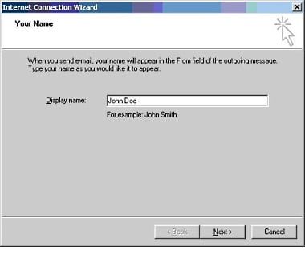
Cont.
Step 4: Click the Add button. Then select Mail from the menu that appears.
Step 5: For your Display name, enter the name you want to associate with this email account. Normally, this will be your first and last name. Then click Next.

Slide 36
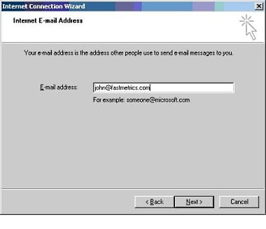
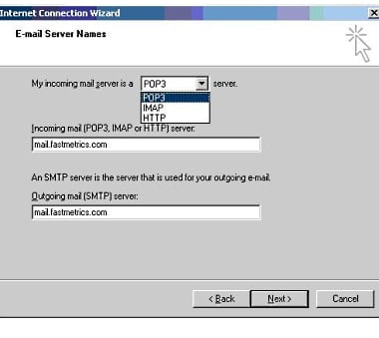
Step 6: For E-mail address, enter the full email address for this account. Example: accountname@yourdomain.com.
Step 7: Select the server type you will be using. Enter both the incoming and outgoing mail servers. We have used the Fastmetrics email service settings for our clients, as an example below. This will be mail.yourdomain.com. Then click Next.

Slide 37
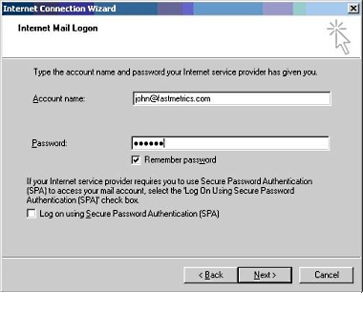
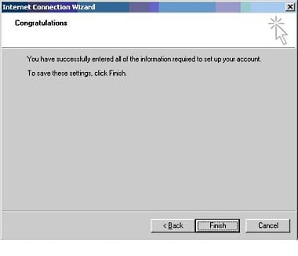
Step 8: For Account name, enter your full email address. For Password enter the password you set up for your email account. Optionally select Remember password by placing a check in that box. Then click Next.
Outlook Express setup is now complete and ready to send and receive emails. Click Finish.

Slide 38
Boomerang App for e-Mail
Boomerang is an app or extension to manage your email box.
It is available for outlook, Gmail and mobile.
You can schedule your email to be sent. You can even schedule your emails in your inbox.
Millions of Gmail and G Suit users count on Boomerang for easy, integrated scheduled email sending and reminders.
Boomerang also helps you to postpone (“snooze”) incoming emails, by making them disappear from your Inbox into a folder or label, then bringing them back to the top of the message list at the specified time.
It helps you keep your Inbox clean, without losing track of important messages. Boomerang is also the only reminder service that can alert you if you do not get a reply to a message.

Slide 39
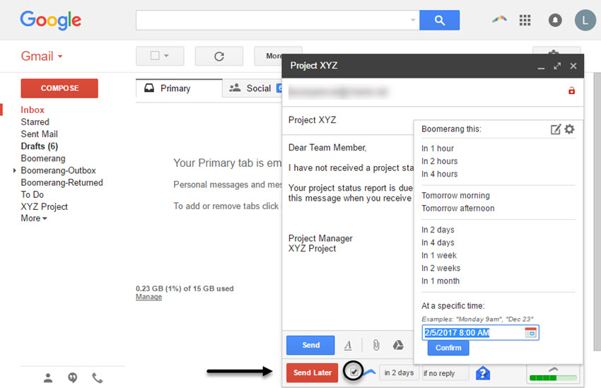

Slide 40
Google Drive
With Google Drive, you can open your files from your computer’s Drive folder on the desktop or from your browser.
Files you create with Google Docs open in your browser or mobile app. Other files in your Drive folder will open in their regular applications (like Adobe Reader for PDF files) on your computer.
Google Drive offers users 15 GB of free storage through Google One. Google One also offers 100 GB, 200 GB, 2 TB, 10 TB, 20 TB, and 30 TB, offered through optional paid plans. Files uploaded can be up to 5 terabytes in size.
Users can change privacy settings for individual files and folders, including enabling sharing with other users or making content public. On the website, users can search for an image by describing its visuals, and use natural language to find specific files, such as "find my budget spreadsheet from last December".
Google Drive is a key component of Google Workspace, Google's monthly subscription offering for businesses and organizations that operated as G Suite until October 2020. As part of select Google Workspace plans, Drive offers unlimited storage, advanced file audit reporting, enhanced administration controls, and greater collaboration tools for teams.

Slide 41
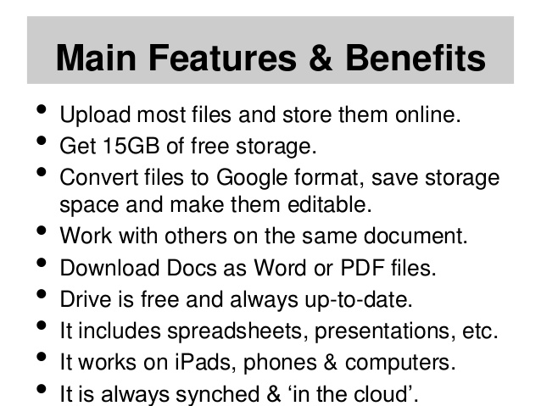
Features

Slide 42

Usage of Drive with Google files

Slide 43
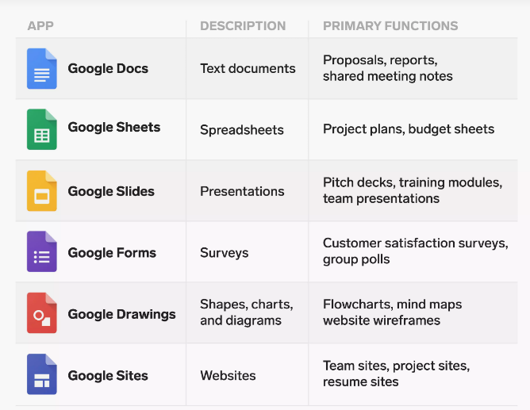

Slide 44
THANK YOU!

