Slide 1
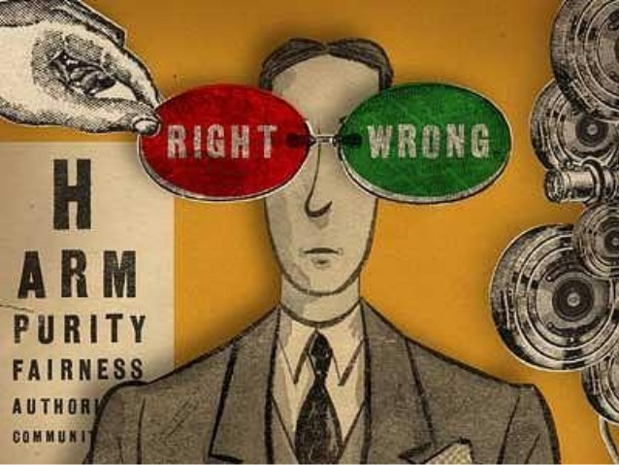
FINANCIAL REPORTING AND ANALYSIS
ETHICAL BEHAVIOUR AND IMPLICATIONS FOR ACCOUNTANTS

Slide 2

INTRODUCTION
The fraud of Rs. 11,400 crores committed by Nirav Modi in Punjab National Bank comes out as one of the most ill-famous scam in the country. It took manipulative bank officials and a deeply compromised banking system. Up till now it is considered as one of the biggest banking frauds in our nation.
The Times Of India based on the Reserve Bank of India Report revealed that one bank official is held for fraud every four hours in a public sector bank (PSB). Over 5200 officials were held for fraud in PSB between 1st Jan 2015 to 31st March 2017.
Hence , ethical behaviour by employees is important to the practicality of all the organisations “ Doing what is Right” matters to the company, their employees, stakeholders, and society as a whole. The unethical behaviour of by employees can effect individual organization, standard of ethics, social behaviour and public accounting.

Slide 3
CONCEPT OF ETHICS
ETHICS
Meta Ethics
Normative
Ethics
Applied
Ethics
Descriptive
Ethics

Slide 4

DEFINITION OF ETHICAL BEHAVIOUR
The term “ethical behaviour” refers to how an organisation makes sure that all its decision, actions and stakeholders interactions conform to the organisation’s moral and professional principles.
These principles should support all applicable laws and regulations and are the foundation for the organisation’s culture and values.
They distinguish “right” from “wrong”, “proper” from “improper”, “correct” from incorrect”.

Slide 5

WORKPLACE ETHICAL BEHAVIOUR
Ethics in the workplace is defined as the moral code that guides the behaviour of employees with respect to what is right and wrong in regard to conduct and decision making.
Furthermore, ethical behaviour doesn't only apply to individual employees, the organization itself should exemplify standards of ethical conduct.
Examples of ethical behaviours in the workplace includes; obeying the company's rules, effective communication, taking, responsibility, accountability, professionalism, trust and mutual respect for your colleagues at work. These examples of ethical behaviours ensures maximum productivity output at work.

Slide 6
COMPONENTS OF WORKPLACE ETHICAL BEHAVIOUR
HONESTY
1
ETHICAL
BEHAVIOUR
LEGALITY
4
INCLUSIVITY
2
DISCLOSURE
3

Slide 7
ADVANTAGES OF ETHICAL BEHAVIOUR
CUSTOMER
LOYALTY
POSITIVE
WORK
ENIVIRONMENT
RETAIN
GOOD
EMPLOYEES
AVOID
LEGAL
PROBLEMS
ADVANTAGES OF ETHICAL BEHAVIOUR

Slide 8
ACCOUNTING PROFESSION WITH ETHICAL BEHAVIOUR
Finance and accounting are important functions for the management of any firm, accounting system are an essential tool for providing information for decision-making as well as for the evaluation of decisions previously made, and the finance function must seek resources at a reasonable cost and used them efficiently.
Finance and accounting are not merely technical tools with no connection with ethics. They cannot work without trust and trust is not possible without ethics. Ethics includes action, foreseeable consequences and people, with their virtues or lack of virtues, involved in any human activity.

Slide 9
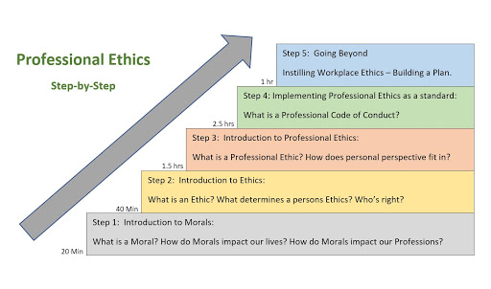
PRESSURE ON THE PROFESSIONAL
A finance and accounting professional may face pressure to:
Act contrary to law or regulation
Act contrary to technical or professional standards

Slide 10
PRESSURE ON THE PROFESSIONAL
Facilitate unethical or illegal earnings management strategies.
Lie to, or otherwise intentionally mislead.
The auditors of the employing organisation.
Regulators
Issue, or otherwise be associated with, a financial or non-financial report that materially misrepresents the facts

Slide 11

SOUND ETHICAL ENVIRONMENT
Ensuring that employees are aware of their legal and ethical responsibilities.
Ethical organisations would have policies to train and motivate employees.
Providing a communication system between the management and the employees.
Protect whistle-blowers

Slide 12

REASONS OF UNETHICAL BEHAVIOUR
Emphasis on short term results.
Ignoring small unethical issues
Economic cycles
Accounting rules

Slide 13
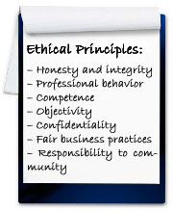
PRINCIPLES OF ETHICAL BEHAVIOUR

Slide 14
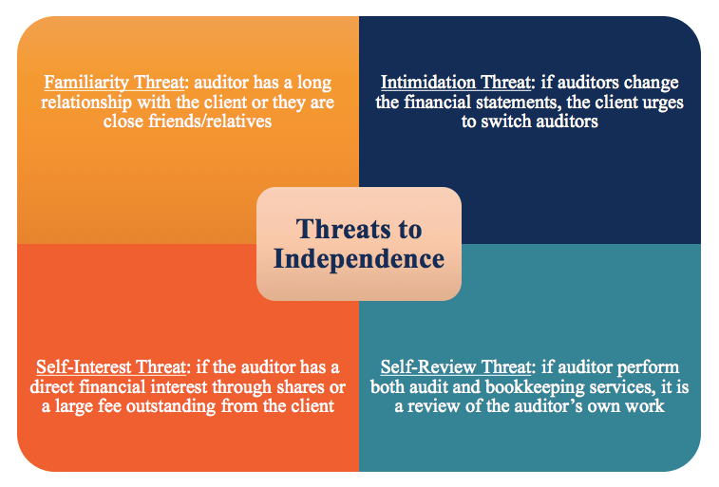
THREAT TO INDEPENDENCE

Slide 15
IMPLICATIONS
Fraudulent Financial Reporting
Misappropriation
Of Assets
Disclosure
Violations
Penalties

Slide 16

PRINCIPLES OF ACCOUNTING AND FINANCE ETHICS
Independence and Objectivity
Integrity
Confidentiality
Professional Competence
Professional Behaviour
Professional Investment
Corporate Disclosure

Slide 17

ACCOUNTING STANDARDS SETTING PROCESS AND ETHICS
Area Identification
Proposed Standard
Study Group
Deliberations
Circulation
Meeting
Exposure Draft
Draft Approval
Verification
Issue of the Standard

Slide 18
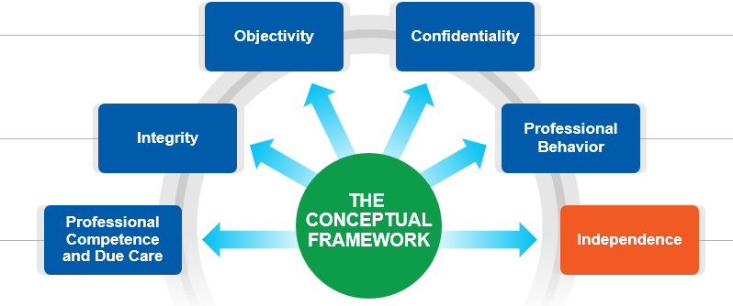
FUNDAMENTAL PRINCIPLES

Slide 19
APPLICATIONS OF ETHICS
Professional Appointment
Conflict of Interest
Second Opinion
Fees
Marketing Professional Services
Gifts And Hospitals
Custody Of Assets
Objectivity
Independence

Slide 20
ETHICS REPORT IN THE ACCOUNTING WORK ENVIRONMENT
Maintaining Confidentiality
Workplace Accuracy
Managing Accountability
Ethics, Values and Morals
Misstated Revenues
Working with Family
Conflict of Interest
Confidentiality

Slide 21
CASES OF ETHICS IN ACCOUNTING
First Case
Second Case
Third Case
Fourth Case

Slide 22

REASONS FOR UNETHICAL REPORTING
Lack of ethical sensitivity
Self interest
Vague standards
Lapse on the part of auditors
Lack of efficient law
Inadequate punishment for defact
Delay in judgement
Failure to maintain objectivity
Non-vigilant audit committee

Slide 23
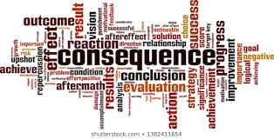
THE CONSEQUENCES
Law suits
Tarnished business reputation
Companies getting de-listed
Loss of trust
Promotes culture of corruption
Loss of human capital
No second chance
Loss of market capitalisation
Loss of tax revenue to the government

Slide 24
REMEDIES
Remedies
Mentoring
Peer Support
Ethics Education
Personal Ethical Orientation

Slide 25

CODE OF ETHICS
Employees should let values guide their actions in all cases
Address if anything goes wrong
Market responsibility
Treat people fairly
Respect the free market
Compete fairly
Deal honestly with the government
Keep honest books and records
Respect the environment

Slide 26
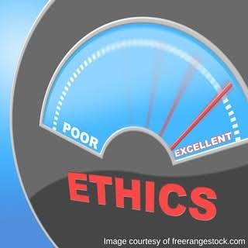
NEED OF CODE OF ETHICS
Act as an internal guidelines and external statement of corporate values
Clarifies an organisation’s mission, values and principles
It is a benchmarks against which individual and organizational performance can be measured
An employee can make day-to-day decision making if there is code as it act as a central guide
A code encourages discussion of ethics and compliance.

Slide 27

PURPOSE OF CODE OF ETHICS
Following are the three purpose of code of ethics:
Compliance
Marketing
Risk Mitigation

Slide 28

BENEFITS OF CODE OF ETHICS
Guide employees in situation where the ethical course of action is not immediately obvious.
Help the company reinforce
Help the company communicate its expectations to the staff, suppliers, vendors, and customers.
Minimise subjective and inconsistent management standards.
It helps to build public trust and enhance business reputations
Offer protection in preempting or defending against lawsuits.

Slide 29

COMPANY CODE OF ETHICS
Company code of ethics is based on the following:
Shareholders and Owners
Directors and Management functions
In relation to Competitors of the Company
In relation to the Communal Society

Slide 30

THE INCREASING ROLE OF WHISTLE BLOWING
Whistle blowing is basically a process and not an individual occasion.
“Whistle-blowers are like eyes and ears of the public” said Dorji Thinlay, a Corruption hunter with the Anti-Corruption commission of Bhutan
A whistle-blower is a person who comes forward and share his/her knowledge on any wrong doing which he/she thinks is happening in the whole organisation or in specific department.

Slide 31
HOW DOES WHISTLE BLOWING RELATE TO ETHICS
Whistleblowing relates to ethics because whistle-blowing often involves a number of moral dilemmas, and at least for the whistle-blower, it is not always clear as to whether they should blow the whistle on their peers.
For example: a whistle-blowers has to weigh up their own moral conscience against the will of their peers/friends.

Slide 32
BENEFITS OF WHISTLE BLOWING
The benefits are as under:
The company can easily deal with the misconduct and thus prevent embarrassing public disclosure
Helps in exposing unethical behaviour
Complete protection to the whistle-blower

Slide 33

BENEFITS OF ETHICS TO STUDENTS
A high level of competence and knowledge is maintained
Reject bribery in all forms
Disclosing any conflicts of interest
Develops honesty in dealings
Fairness is inculcated
Loyalty is developed and they demonstrate fidelity
Ethical students purse excellence and they are committed to it
The students accept personal accountability for their decisions

Slide 34
BENEFITS OF PROFESSIONAL ETHICS
Good Quality
Competitive
Edges
Sustainability
ROI
Goodwill
Benefits of Professional Ethics

Slide 35


