Slide 1




Slide 2

Introduction
▶ The efficient markets hypothesis (EMH), popularly known as the Random Walk Theory,
▶ states that share price fluctuation are random and do not follow any regular pattern
▶ It is the proposition that current stock prices fully reflect available information about the value of the firm, and there is no way to earn excess profits, (more than the market overall), by using this information.
▶ It suggests that profiting from predicting price movements is very difficult and unlikely.
“no one can predictably outperform the market”

Slide 3

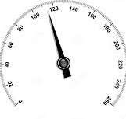
Basic concepts
▶ Market efficiency :The accuracy and speed with which in which market translates the expectation into prices are termed are market efficiency
▶ market is said to be “efficient” if prices adjust quickly and,on average, without bias, to new information.
Measured by factors such a time taken to execute the order, no.of bad delivery
EMH Does not deal with this efficiency
Operational efficiency
Informational efficiency
Measure of swiftness or the market reaction to new information

Slide 4
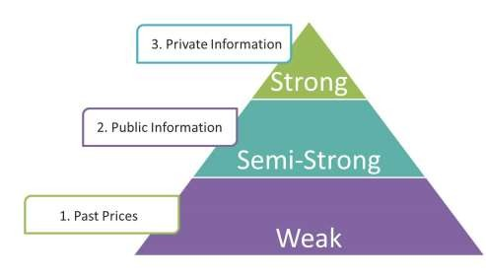
Weak form
THREE VERSIONS OF THE EFFICIENT MARKETS HYPOTHESIS
the current price fully incorporates information contained in the past history of prices only.
Semi strong
the current price fully incorporates all publicly available information.
data reported in a company’s financial statements, earnings and dividend announcements,, expectations regarding macroeconomic factors
the current price fully incorporates all existing information, both public and private (inside information).
Strong

Slide 5


Weak form
▶ The weak form of the efficient markets hypothesis asserts that the current price fully incorporates information contained in the past history of prices only.
▶ Technical analysis will not able to produce excess return
▶ nobody can detect mis-priced securities and “beat” the market by analysing past prices.
▶ Thus, one should not be able to profit from using something that “everybody else knows”.
▶ The empirical evidence for this form of market efficiency, and therefore against the value of technical analysis, is pretty strong and quite consistent.
▶ Under weak form of market ,on a average short term trader will not be able to outperform blindfolded investor .
“Chartist cannot beat average buy and hold strategy “

Slide 6

Empirical evidence
Filter rule : technical trading strategy based on historical prices. If price of a security increases at least by “x”% investor should by and hold until its price decline by at least “x”% from subsequent high
▶ Several studies have found that average gains by filter rule were much below
than simple buy and hold strategy
Run test : Used to find out whether ,the series of price movement have occurred by chance
▶ Published results of study using run test suggest that the runs in price series are
not significantly different form that of random numbers
Serial correlations: to test independence between successive price changes
▶ Many studies have failed to show any significant correlation between successive price changes.

Slide 7
Semi strong
▶ The semi strong form of EMH states that security prices adjust rapidly to all publicly available information
▶ The assertion behind semi-strong market efficiency is still that one should not be able to profit using something that “everybody else knows” (the information is public).
▶ the “public” information may be relatively difficult to gather and costly to process. It may not be sufficient to gain the information from, say, major newspapers and company-produced publications. etc. in order to gather all information necessary to effectively analyse securities.
▶ ”Nither fundamental analysis nor technical analysis techniques will be able to reliably produce excess returns.”

Slide 8

Evidence for semi strong
▶ Various studies were carried out by Fama,fisher ,jenson and roll in examining the semi strong form of EMH.
▶ Analysed the effect of stock split on share prices
▶ Developed a method to calculate abnormal return using simple regression technique ,security return were regressed against the return of market index
R_{it} = a_{i} + b_{i} R_{It} + e_{it}
▶ Here eit is assumed to indicate the abnormal return
▶ Authors of studies reviewed hundreds of cases to study the effect of stock splits ,examined 940 stock splits from 1927-1959,and found out that level of abnormal returns were insignificant.

Slide 9

Strong from
▶ The strong form of market efficiency hypothesis states that the current price fully incorporates all existing information, both public and private
▶ states that a company’s management (insiders) are not be able to systematically gain from inside information by buying company’s shares ten minutes after they decided (but did not publicly announce) to pursue what they perceive to be a very profitable acquisition.
▶ This implies that that security analysis and portfolio managers who have access to information more quickly than ordinary investors would not be able to use it to earn more profit

Slide 10

Evidence for strong form of EMH
▶ Many tests of strong form of emh deal with mutual fund performances.
▶ Financial analysis have studied the risk adjusted discount rates of return from hundreds of mutual funds and found out that professionally funds are not able to out perform the naïve buy and hold strategy.
▶ Not able to forecast return accurately enough to recovery the research and transaction cost

Slide 11

Market inefficiencies
▶ Low P/E effect :Stocks with lower p/e ratio yield higher return
▶ Small firm effect
▶ The weekend effect : Stock prices tend to rise all weak long to a peak on Friday

Slide 12


