Slide 1

UNIT I
An Introduction to Life Insurance
Life Insurance Business
Products of LIC
Non Traditional Life Insurance Products

Slide 2
Introduction
Insurance : Eliminates risk & which substitutes certainty for uncertainty.
Protection of the economic value of assets.
Life Insurance is a contract for payment of a sum of money to the person assured or failing him/her , to the person entitled to receive the same on the happening of the event insured by the contract.

Slide 3
Definition
Section 2(11) of the Insurance Act,1938 defines life insurance business as the business of effecting contract upon life.
A. Any contract whereby the payment of money is assured upon death or the happening of any contingency dependent on human life.
B. Any contract which include the granting of disability & double or triple indemnity, accident benefits, the granting of annuities upon human life & the granting of superannuation allowances.
https://www.investopedia.com/terms/i/insurance.asp

Slide 4
Insurance is a contract (policy) in which an insurer indemnifies another against losses from specific contingencies or perils.
There many types of insurance policies. Life, health, homeowners, and auto are the most common forms of insurance.
The core components that make up most insurance policies are the deductible, policy limit, and premium.
In order to select the best policy for you or your family, it is important to pay attention to the three critical components of most insurance policies—the deductible, premium, and policy limit

Slide 5
Concept
Life insurance is basically associated with the risk of human lives.
Indian Society : Joint Family System V/s. Nucleus Family System.
Socio – Economic Condition
Contract
Premium
Risk
Purpose : Financial Support

Slide 6
Nature of Life Insurance
The contracted event is bound to happen & the insurer has to perform the contract.
Life Insurance covers death due to natural causes as well as due to accidents.
Life insurance contract is a long term contact having all essential features of a valid contract.
Life Insurance is contact of assurance & indemnity.
A warranty in a life insurance policy is not collateral but basis to the contract.
Life insurance is a kind of investment to the assured where he gets the compounded value of premiums upon survival.

Slide 7
Essential Features
Elements of a valid contract
Insurable Interest
Utmost good faith
Warranties
Assignment & nomination
Premium
Certainty of event

Slide 8
Advantages
Encourages & aids thrift
Protection
Accidental death benefits
Tax benefits
Provides liquidity
Collateral Security
Transfer
Easy settlement of claim
Group life insurance
Investment
Knowledge of Expertise

Slide 9
Components
Superior to any other savings plan
Death benefit component
Encourages & forces thrift
Cash value components
Easy settlement & protection against creditors
The owners insured
Beneficiary
Ready marketability & suitability for quick borrowings
Accidental death benefits
Tax benefits

Slide 10
Insurance ?
Principle of Ownership of Property
An asset loses value
Certain event
Economic loss

Slide 11
Human Life Value (HLV)
The Asset
Net Earning = Annual Income – Personal Expenses
HLV = Net Earning / Rate of Interest
The Risk
Dying too early
Living too long
Level Premium
Term or Protection Component
Cash Value Element
Living with Disability
* Liability Insurance

Slide 12
Principle of Risk Pooling & Mutuality
Contractual Financial Institutions
Contractual Guarantees
Role
Providing protection against the economic loss arising as a result of one’s untimely death.
Risk pooling (Financial Risk)

Slide 13
Life Insurance Contract
Utmost Good Faith
Material Facts
Insurable Interest
Proximate Cause
Indemnity
Subrogation

Slide 14
Determinants of Risk Premium
Age
Lifestyle
Profession
Smoking
Drinking
Lifestyle Choices
Obesity

Slide 15
Premium Payment
Premium
Rebates : on Sum Assured & on Mode of Payment
Extra Charges : DAB , PDB , Health , Occupation
Determining Premium : Mortality Changes, Expenses, Saving Component
Net Premium
Gross Premium
Loading : Adequacy , Equity, Competitiveness

Slide 16
Procedure
Proposal Form
Submission of Proof of Age & Medical Examination
Scrutiny & Acceptance of Proposal
Payment of First premium
Issue of Policy

Slide 17


Slide 18


Slide 19

Product
Product is same as commodity.
“Reproduce” -> “ to bring forth or create.”
Product may be Tangible & Intangible.
Life insurance is an Intangible Product.

Slide 20
Traditional Life Insurance Products
Term Insurance Plans
Whole Life Insurance Plans
Endowment Insurance Plans

Slide 21


Slide 22
Term Insurance Plan
Valid only during a certain period that has been specified in the contract.
One day trip to long period.
Protection is similar to property & casualty insurance contracts.
Term life insurance guarantees payment of a stated death benefit to the insured's beneficiaries if the insured person dies during a specified term.
These policies have no value other than the guaranteed death benefit and feature no savings component as found in a whole life insurance product.
Term life premiums are based on a person’s age, health, and life expectancy.

Slide 23
Purpose
Disability
Term Insurance as a Rider
Renewability
Convertibility
USP
A. Decreasing Term Assurance
B. Increasing Term Assurance
C. Term Insurance with return of premiums
Relevant Scenarios
Considerations
Limitations

Slide 24


Slide 25
Whole Life Insurance
Permanent Life Insurance Policy.
No fixed term to cover.
Policy lapses due to non payment of premium or is cancelled.
Premium : One’s life or for a specified period of time.
Cash Value & Death benefits
Loans benefits
Plan for income earner of the family.
Financial Security
Retirement needs
Role of savings & wealth creation

Slide 26
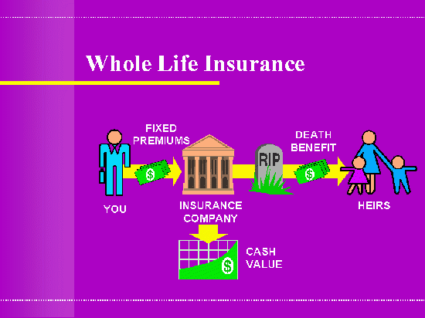

Slide 27
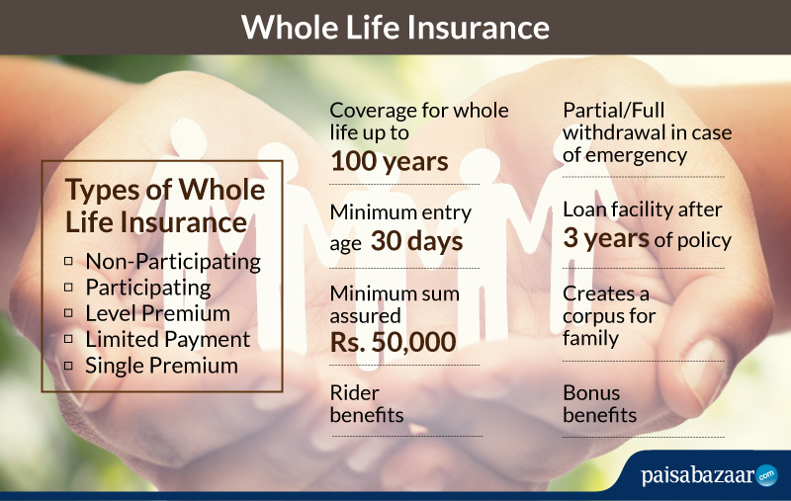

Slide 28
Whole life insurance lasts for a policyholder’s lifetime, as opposed to term life insurance, which is for a specific amount of years.
Whole life insurance is paid out to a beneficiary or beneficiaries upon the policyholder’s death, provided that the premium payments were maintained.
Whole life insurance pays a death benefit, but also has a savings component in which cash can build up.
The savings component can be invested; additionally, the policyholder can access the cash while alive, by either withdrawing or borrowing against it, when needed.
Whole life insurance is different from term life insurance, which is typically only available for a certain number of years, rather than a lifetime, and only pays out a death benefit.
Most whole life insurance policies have a withdrawal clause, which allows the policyholder to cancel coverage and receive a cash surrender value.

Slide 29
Benefits
The cost of the premium paid to the policy never increases.
The premium paid is towards increasing the cash value.
Willing to pay more, proportionate increase in death benefits.
Cash Value & Death benefit never decreases in value.( Withdrawal)
Cash value grow without taxation. ( Tax Free)

Slide 30
Dividend are tax free.
Dividends can be reinvested in cash value of policy or to purchase additional , paid up insurance or to buy more life insurance provides bigger death benefits & earn interest.
Policy holder can take loan at competitive rates then regular banks.
Loan repayment at the time of death. ( Death benefits – Loan liability)
Potential for tax free income.
Long term investment .

Slide 31
Endowment Assurance
A combination of two plans.
A. A term assurance which pays the full assured in case of death of the insured during the term.
B. A pure endowment plan which pays this amount if the insured survives at the end of the term.
A death & a survival benefit component.

Slide 32
Decreasing term insurance & increasing investment element.
A savings programme ( Protection by provision of insurance)
Offers safe & compulsory method of savings.
Method for old age provisions or for meeting specific purpose.
One of the ideal way for a mortgage loans.
MWPA 1874 (Married Women’s Property Act)
Protection against all creditor’s claim.
Retirement benefits / Supplements.

Slide 33
Variants
Money back plan
Par & non par schemes
Participating or with profit plans
Dividend methods of profit participation
Portfolio Method
Current Money Method

Slide 34
Riders
A rider is a provision typically added through our endorsement, which then becomes part of the contract.
Add ons or additional benefits which you can opt for along with your current life insurance policy at affordable rates.
Used to provide some sort of supplementary benefits or to increases the amount of death benefits provided by a policy.
Benefits : Disability cover, Accident cover, Critical illness cover, additional benefits.

Slide 35
Types
Wavier of Premium
Critical Illness
Accidental Death Rider
Permanent & Partial Disability
Income benefits rides

Slide 36
Benefits
Extra Coverage
Affordability
Flexibility
Tax Benefits

Slide 37
Life insurance Forms & Procedures
Prospectus
Proposal Form
Agent’s Report
Medical Examiner’s Report
Moral Hazard Report
Age Proof ( Standard & Non Standard)
Anti Money Laundering
KYC
Free Look Period

Slide 38
Documents
https://www.youtube.com/watch?v=OVA5au86mg8&feature=emb_logo
First Premium Receipt (FPR)
Renewal Period Receipt (RPR)
Policy Document
Policy Schedule
Standard Provision
Specific Policy Provision
https://www.youtube.com/watch?v=0jo7SPpmhG0

Slide 39
Non Traditional Life Insurance Products
Non traditional Insurance plans are result of a new idea to reap better returns along with the provision of Insurance.
Plans = Insurance + Investments
Universal Life Insurance is a form of permanent life insurance featured by its flexible premiums.
Flexible face amount , death benefits amounts & the unbundling of its pricing factors.

Slide 40
Universal life policies allow the policy holder within limit to decide the amount of premiums he or she wants to pay for the coverage.
Larger the size of the premium, greater the coverage provided & greater the policy’s cash value.
Completely flexible premiums after the first policy year.
One had to ensure that premium as a whole were enough to cover the costs of maintaining policy.
Flexibility of structures also enables the policy holder to make partial withdrawals from cash value that was available without the obligation to repay this amount or pay any interest on it.

Slide 41
Non Traditional Life Products
Variable Life Insurance Plans
Unit Linked Insurance Plans

Slide 42
Variable Life Insurance Plans
Introduced in USA in 1977.
A kind of Whole Life policy : Death benefits + Cash Value fluctuates according to investment performance.
Provides no guarantees with respect to either the interest rate or minimum cash value.
A traditional cash value policy has a face amount that remains level throughout the policy term.
Cash value grown with premium & interest earning at a specified rate.
Asset backing the policy reserves form part of a general investment account in which the insurer maintains the fund of its guaranteed products.

Slide 43
Then this assets are placed in a portfolio of secured investments.
So insurer can expect to earn a fixed rate of return on the assets in this account.
USA : Separate Accounts, Canada : Segregated Accounts.
Its a preferred option for those who wanted to keep their assets invested in an assortment of fund of their choice & also wanted to directly benefit from favourable investment performance of their portfolio.
Insure with knowledge & quite comfortable with Equities , Debt investments & market volatility.

Slide 44
Unit Linked Insurance Plans (ULIP’s)
One of the most popular & significant products displacing plans in many markets.
Introduced in UK.
Substantial investments that life insurance companies made in ordinary equity shares & the larger capital gains & profits they made as a result.
Profit policies offer some linkages with life office’s investment performance.
Bonus depends on periodic valuations of assets & liabilities & resultant surplus declared.

Slide 45
It provides means for directly & immediately cashing on the benefits of a life insurance's investment performance.
Units are usually those of a specified authorised unit trust or a segregated fund managed by the company.
Units may be purchased by payment of a single premium or via regular premium payments.
ULIP Premium = Expenses + Mortality + Investments.
The value of units is fixed with reference to some predetermined index performance. (NAV , Market value of asset)

Slide 46
It provides option of choosing between different kind of fund.
Each fund has a different portfolio mix of assets.
Options
Equity fund : This fund invests major portion of the money in Equity & Equity related instruments.
Debt fund : This fund invests major portion of the money in Govt. Bonds, FD’s, etc.
Balanced fund : This fund invests in a mix of equity & debts instruments.
Money Market fund : This fund invests money mainly in instruments such as T Bills, COD’s,CPs.

Slide 47
ULIP work on a minimum premium basis and not on sum assured.
Insured can decide the amount of premium contribute at regular interval.
Insurance cover is a multiple of the premium paid.
Choice between high or low cover.
The term component may be placed in a guaranteed fund that would yield a minimum amount of cover for death.
The balance or premium is used to purchase units that are invested in capital markets.
In case of death, the death benefit would be higher of the sum assured r the fund value standing in account.
Fund Value = unit Price X No. of Units

Slide 48


Slide 49
SBI Life Insurance is a joint venture life insurance company between State Bank of India (SBI), the largest state owned banking and financial services company in India, and BNP Paribas Cardif.
BNP Paribas is a French multinational bank and financial services company with global headquarters in Paris.
SBI has a 62.1% stake in the company and BNP Paribas Cardif owns a 22% stake. Other investors are Value Line Pte. Ltd. and MacRitchie Investments Pte. Ltd., holding a 1.95% stake each while the remaining 12% is free float stake with public investors.
SBI Life Insurance has an authorized capital of ₹20 billion (US$280 million) and a paid up capital of ₹10 billion (US$140 million).
In 2007, CRISIL Limited, a subsidiary of global rating agency S&P, gave the company a AAA/Stable/P1+ rating.

Slide 50
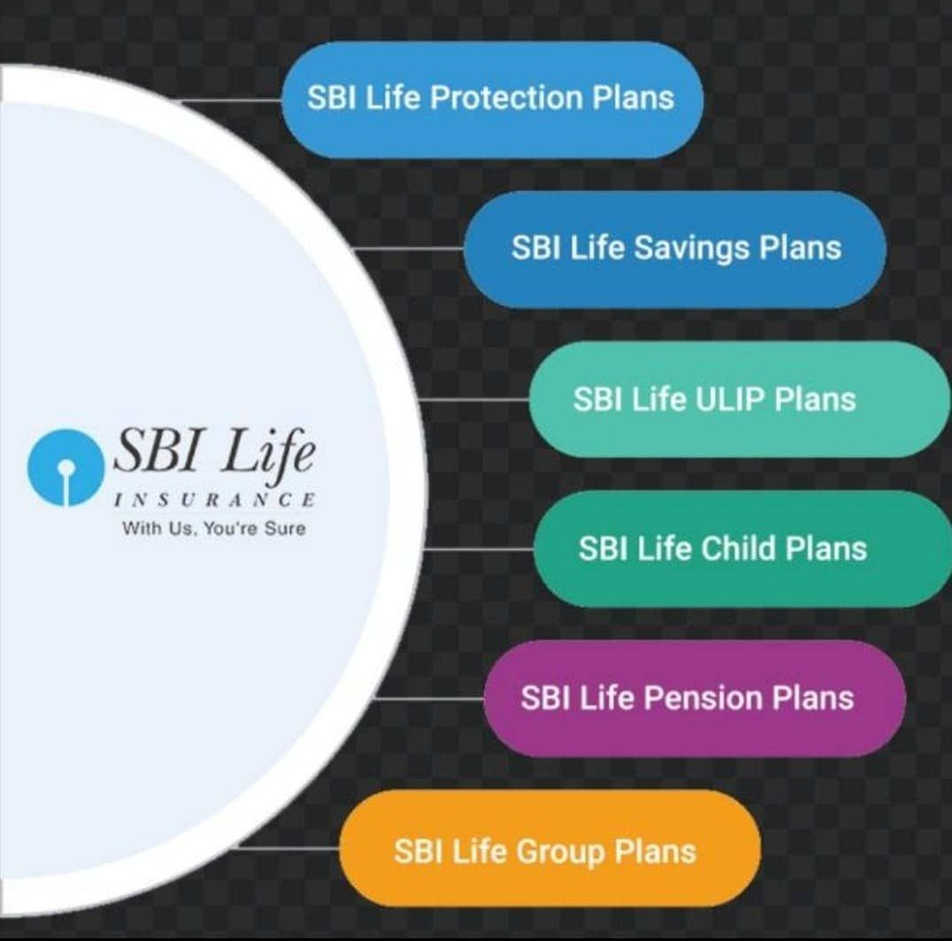
Product & Timeline of SBI Life Insurance
https://www.sbilife.co.in/en/about-us/key-milestones#2000

Slide 51
SBI PLANS
Non traditional life insurance plans
SBI Life Smart Guaranteed Saving Plan
SBI Life Flexi Smart Plan
ULIP SBI Life Insurance Plans
SBI Life Wealth Insurance
SBI Life SMART Money Back Gold
SBI Life Maha Anand II
SBI Life Unit Plus Super
SBI Life Saral Maha Anand Plan
SBI Life Smart Scholar Plan

Slide 52
SBI Life Smart Guaranteed Saving Plan
Offers Safety & protection cover to family in case of uncertainty.
Gives additional benefits & savings
Security : In case of eventuality to your family.
Reliability : In case of assured condition
Affordability : Through reasonable premium
Tax Benefits

Slide 53
SBI Life Flexi Smart Plan
Plan offers financial protection, guaranteed minimum bonus interest, policy holder can adjust the policy term & sum assured.
Does not offers liquidity during the first five years of the contract.
Withdrawal is allowed from the 6th policy year.
Tax benefits as per Income Tax Regulation.

Slide 54
Features
Guaranteed minimum bonus interest rate of 1% p.a. For the whole term.
An interim bonus interest rate will be declared at the beginning of each financial year.
Regular bonus interest rate will be declared at the end of every financial year.
Terminal bonus interest rate may be credited t the time of exit. (On maturity, death or surrender)
Two protection option : Gold & Platinum (105% of total premium as death benefit)
Flexibility to increase your chosen policy term.

Slide 55
SBI Life SMART Money Back Gold
A participating traditional money back insurance plan.
Benefit : Life cover as well as periodic income.
Protect your life’s future , money back at regular intervals, flexibility to choose our options, riders benefits at an affordable rate.
Maturity benefit : Get a part of Sum assured as per schedule along with Bonus.
Tax benefits under sec 80C for premium payment & under sec 10(10)D at the time of maturity.

Slide 56
Features & Advantages
Get life cover benefit irrespective of survival benefits already paid.
Participating money back plan
Payment intervals are 4 variants. (M/Q/HY/Y)
Survival benefits : 110% - 125% of SA
Rider : Accident death benefit rides, Accidental total permanent disability rider, Term assurance rider , Criti care 13 non linked rider.

Slide 57
SBI Life wealth insurance
A non participating online ULIP.
Enhance wealth as important as earning it.
Plan : Growth & Balanced
Premium for plan will be based on Automatic Asset Allocation feature.
Higher exposure to equity in the initial policy year & gradually moves towards less risky debt or money market instruments.
Premium starting @ Rs. 1000/ Month
Liquidity : Partial withdrawal from 6th policy year

Slide 58
SBI Life Maha Anand II
Insurance cover without any Medicals.
Manage your investments according to your risk appetite & ensure market related returns.
Guaranteed additions upto 90% of annualized premium.
Benefit : Market related return + insurance cover.
Liquidity through partial withdrawal
Enhanced value at optimal cost
Tax benefits under sec 80C & 10(10)D
Premium : M/Q/HY/Y
Additional rider benefits

Slide 59
SBI Life Unit Plus Super
Premium is invested in equity or debt markets
Risk of investment borne by policy holder
Guarantee will start only from 10th policy year.
Option to increase / decrease Sum Assured. ( 6th policy year)
Rider : Criticare 13 riders, Accidental death benefit linked rider, Premium payer or waiver benefit rider, Income sustained rider.

Slide 60
Tax benefit under sec 80C
Single premium payment term.
Investment fund : Index fund, Equity fund, Top 300 fund, Equity optimised fund, Price earning manager fund, Growth fund, Balanced fund, Bond Fund, Money Market fund.
Minimum premium Rs. 65,000 & Maximum premium Rs.150,000
Withdrawal allowed after 5th policy year.
Minimum withdrawal Rs. 5,000 & maximum allowed upto 15% of fund value.

Slide 61
SBI Life Saral Maha Anand Plan
Premium amount s invested in capital market.
Value of plan depends upon the market.
Risk is borne by policy holder.
Guaranteed addition of upto 30% of annualised premium.
No premium allocation charge from 11th year onwards.
Option to avail rider benefits.
Investment Funds : Index, Equity , Balanced, Bond

Slide 62
Death benefit : Higher of the SA or Fund Value.
Maturity : Fund Value
Tax benefit under sec 80C
Single premium is not allowed. (M/Q/HY/Y)
Partial withdrawal from 5th year. ( Minimum Rs. 2,000 & maximum 15% of Fund Value)
Maximum 2 partial withdrawals can be made in one policy year & not more than 5 are allowed in entire policy term.

Slide 63
SBI Life Smart Scholar Plan
A non participating linked insurance plan.
Do not offer any liquidity during first 5 years of policy.
Not allowed to surrender or withdrawal.
Offers security for your child to achieve dreams
Premiums being waived in case of eventuality.
Premium is flexible according to need of child.

Slide 64
Policy holder will get lumpsum amount at maturity.
Regular loyalty additions for in force policies on completion of specific duration.
Accidental death benefit & permanent disability benefits.
Premium : M/Q/HY/Y
Death event : Lumpsum benefit equal to higher of SA or 105% of premium paid.
Fund options: Index, Equity, Top 300, P/E managed, Growth, Money Market funds
Withdrawal : 6th Year onwards, Minimum Rs. 5,000 & partial withdrawal upto 15% of fund value.
Tax benefit under sec 80C & 10(10)D

Slide 65


Slide 66
Company Overview
ICICI Prudential Life Insurance Company Limited (ICICI Prudential Life) is promoted by ICICI Bank Limited and Prudential Corporation Holdings Limited.
The first insurance company listed in stock exchange.
Prudential corporation is a leading international financial service group having headquarter in UK.
ICICI Prudential was established in 2001.

Slide 67
Year | Particulars
FY2001 | Our company started operations
FY2002 | Crossed the mark of 100,000 policies
FY2005 | Crossed the mark of 1 million policies
FY2008 | Crossed the mark of 5 million policies Crossed receipt of `100 billion of the total premium Crossed `250 billion of assets under management
FY2010 | Established subsidiary to undertake pension funds related business Our company turned profitable - a registered profit of `2.58 billion Crossed `500 billion of assets under management
FY2012 | Started paying dividends
FY2015 | Crossed `1 trillion of assets under management
FY2017 | First insurance company in India to list on NSE and BSE
FY2021 | Crossed `2 trillion of assets under management

Slide 68
Term Insurance Plan
Basic plan form
Provides financial security to family.
Relatively low premium payment.
Sum Amount : Pre decided amount payment at the time of eventuality of death during policy tenure.

Slide 69
Protect Smart ICICI Prudential
Provides a lump sum pay out to your nominee in case of unfortunate event.
Helps to meet regular expenses. ( Financial Security)
Protection : Death, Permanent disability, Terminal Illness & Accidental Death.
Critical Illness : Lump sum Payment
Death due to Accident : Pay out that is double the life cover opted by policy holder to a maximum of Rs. 2 Crore.
Permanent Disability : Future Premium waivers & policy continuation
Also gives protection to family for life events such as marriages, birth of child.
Tax benefits :
Tax free under sec 80 C
For critical illness benefits, accident tax benefit under sec 80D
Claim amount received by nominee is tax free under sec 10(10)D

Slide 70
Smart Health ICICI Prudential
Health insurance that covers medical expenses that arise due to an illness.
Expenses : Hospitalisation Cost, Cost of Medication, Doctors Consultation & Follow ups.
Provides extensive protection against critical illness, disabilities , death & terminal illness.
Eligibility:
Age : 18 / 50 year. ( Min/Max)
Policy Term : 10/ 30 Years ( Min/ Max)
Mode of Premium Payment : Yearly
Maximum sum assured : Rs. 25,00,000

Slide 71
USP
Extensive protection against 34 critical illness & death.
No extra premium as you grow old
Longer term coverage upto 30 years
Tax benefits under sec 80C & 80D.
It also covers medical cost for women such as Breast cancer & cervical cancer.
SA will be paid out on death of the life insured.
Diagnosis of terminal illness & all future premiums for all benefits under the policy are waived.
Critical Illness : Cancer, Heart attack, Heart Valve Surgery, Coma, Permanent Paralysis of limbs, Loss of limbs, Deafness, Loss of speech, etc.

Slide 72
ICICI Prudential Life Term Classic
A potential to grow your money & also provides life cover to protect your family & gives a tax benefits.
In case of unfortunate event, nominee will receive the SA as a lump sum payout which is completely tax free under sec 10(10)D.
Investment Option : Bluechip Fund, Maximeses Fund, Multicap Growth Fund, Opportunities Fund, Maximise India Fund, Multicap Balanced fund, Active Asset Allocation Balanced Fund, Income Fun & Money Market Fund

Slide 73
Benefits
SA including top up SA if any.
Fund Value including top up fund value , if any.
Minimum Death benefit. It will be 105% of total premium paid including top up premiums if any.
In case of one pay policy : Death Benefit = 1 or 2 or 3 whichever is highest.
In case of limited pay & regular pay policy for age at entry less than 50 years : Death Benefit = (1+2) or 3 whichever is higher.
For age entry greater then or equal to 50 years : Death Benefit = 1 or 2 or 3 whichever is higher.

Slide 74
ICICI Prudential Smart Kid Solution – Children Education Plan
A ULIP Plan.
Opportunity to set potentially better returns & grow your money by investing it in equity or debt funds for the long term.
Mange your money to create an ideal balance of equity & debt funds depending on your age.
In case of unfortunate event during policy term your child receive a lump sum amount.
Help cover the cost of regular expenses & helps fund child’s education.
Wealth Booster increases savings without making any additional investment.
Tax benefit under sec 80C.
Shifting of money from debt to equity is completely tax free.

Slide 75
Life insurance Forms & Procedures
Prospectus
Proposal Form
Agent’s Report
Medical Examiner’s Report
Moral Hazard Report
Age Proof ( Standard & Non Standard)
Anti Money Laundering
KYC
Free Look Period

