Slide 1
Business Research Methods UNIT II

Slide 2
WHAT IS DATA?
“Data is a collection of facts.”
Such as numbers, words, measurements, observations or even just descriptions of things.

Slide 3
What is Data Collection?
It is the process by which the researcher collects the information needed to answer the research problem
The task of data collection begins after a research problem has been defined and research design chalked out.

Slide 4
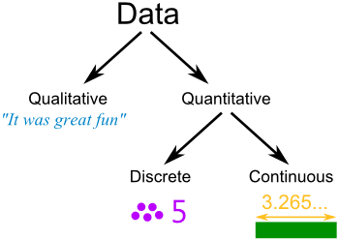
Qualitative data is descriptive information
(it describes something)
Quantitative data, is numerical information (numbers).
Discrete data can only take certain values (like whole numbers)
Continuous data can take any value (within a range)

Slide 5
In collecting the data,the researcher must decide:
Which data to collect?
How to collect the Data?
Who will collect the Data?
When to collect the Data?

Slide 6
The selection of a method for collecting information depends upon the :-
Resources available
Credibility
Analysis and reporting
Resources
And the skill of the evaluator

Slide 7
SOURCES OF DATA
Primary Data
  The data collected first hand by researcher for his research
Secondary Data
  The data which is already collected by someone
  It is readymade data

Slide 8
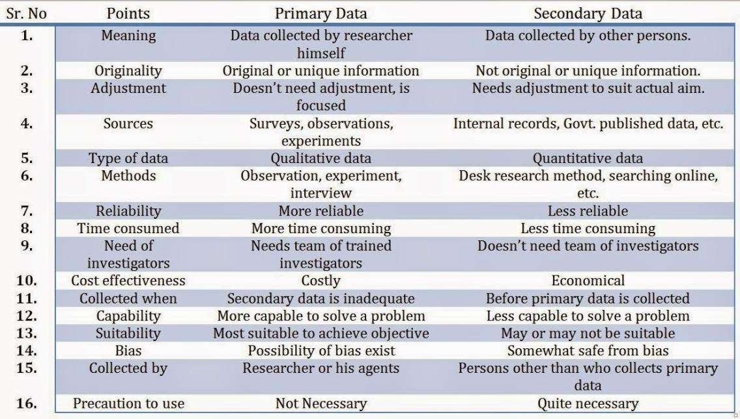

Slide 9
Sources of Data Collection
Primary Source
Secondary Source
Observation
Interview
Unpublished
Published
Questionnaire
Schedules
Books Websites Newspapers Magazines Journals
Government Reports Publications Research reports
Other Warranty Cards Distributor Audit
Pantry Audits Consumer Panels
Mechanical Devices Projective Techniques Depth Interviews Content analysis

Slide 10
Collection of Primary Data
Primary Data may be collected through:
Experiments
Surveys (sample surveys or census surveys)
Interviews
Observation
Questionnaires
Schedules

Slide 11
Methods of Primary Data Collection
Observation Method
Survey Method
Experimentation
Live & Mechanical
Disguised & Undisguised
Structured & Unstructured
Direct & Indirect
Interviews
Telephone Interviews
Mail Survey
E-mail Survey
Consumer Panel
Field Experimentation
Laboratory

Slide 12
Collection of Primary Data
Of the above, the important ones are:
Observation Method
Interview Method
Questionnaires
Schedules

Slide 13
1.Observation Method
Observation method is a method under which data from the field is collected with the help of observation by the observer or by personally going to the field.
In the words of P.V Young
“Observation may be defined as systematic viewing,coupled with consideration of seen phenomenon.”

Slide 14
OBSERVATION
Study relating to Behavioral Science
Information is sought by way of investigator’s own direct observations
Respondent is not asked/communicated.
Eg. Brand of wrist watch
Willingness of respondent to respond is not necessary
Less demanding of active cooperation

Slide 15






Steps For An Effective Observation
Determine what needs to be observed
Select participants
Random/Selected
Conduct the observation
(venue, duration, recording materials, take photographs )
Compile data collected Analyze and interpret data collected

Slide 16
Advantages of Observation
Produces Large quantities of data.
All data obtained from observations are usable.
The observation technique can be stopped or begun at any time.
Relative Inexpensive

Slide 17
OBSERVATION
Limitations:
  Expensive
  Limited Data
  Can’t observe what is going on in mind
  Some people are rarely accessible

Slide 18
OBSERVATION
Things to keep in mind:
  What should be observed?
  How observation should be made and recorded?
  How to ensure accuracy?

Slide 19
OBSERVATION
Structured Vs. Unstructured observations:
Careful definition of units to be observed
Style of recording observed information
Standardized conditions of observation
Structured >>> Descriptive
Unstructured >>> Exploratory

Slide 20
OBSERVATION
Participant and non-participant:
Researched is member of group that he observes > Participant
  Ex: Going in slum and living their life
Researched is detached from group and observes > Non - participant
  Ex: Study of slum people without being its part/member

Slide 21
OBSERVATION
Controlled and Uncontrolled:
Observation in natural setting > Uncontrolled
  Ex. Study of consumers in a mall
Observation in predefined environment > Controlled
  Ex. Marshmallow Test

Slide 22
OBSERVATION
Disguised & Non-Disguised:
Observation in a cover, act like one of the shoppers or customers > Disguised
  Ex. Study of consumers in a mall acting like one of them
Observation in Uniform or Identity > Non Disguised
  Ex. Observor in a Uniform checking customers responses to a new product

Slide 23
OBSERVATION
Mechanical & Human :
Observation done by mechanical equipments like CCTV, camera, Log Book etc > Mechanical
  Ex. CCTV Cameras in a classroom or office
Observation done in person > Human

Slide 24
INTERVIEW

Slide 25
INTERVIEW
Interview method involves face-to-face interaction of the interviewer/ researcher with the respndents.
The questions and responses during an interview may be oral or verbal as the case may be
Conducted in order to reflect emotions and experiences, and explore issues with a greater focus

Slide 26
Types of Interviews
Personal Interview
Telephonic Interview
Focussed Group Interview
In-depth Interview

Slide 27
Personal Interview:
Presentation of oral-verbal stimuli and reply in terms of oral-verbal responses.
Personal Interview:
  Two persons (Interviewer and interviewee)
  Face-to-face contact
  Direct or indirect interview
  Structured (Descriptive Study) or unstructured (Exploratory Study) interview
  Pre-determined questions
  Standardized technique of recording
  Example: Investigation, documentary, exit interview etc.

Slide 28
Types of Personal Interviews
Formal & Informal
Structured & Unstructured
Individual & Group
General or Specific
Directive & Non-directive

Slide 29
INTERVIEW
Advantages of personal interview:
More and in depth information
Interviewer can overcome the resistance by his skills
Greater flexibility
Observation method can also be applied
Personal information can be easily obtained
Greater response
Catch spontaneous reaction
Language can be adapted
Can also collect supplementary information

Slide 30
INTERVIEW
Disadvantages of personal interview:
Expensive
Possibility of bias
Certain respondents may not be approachable
More time consuming
Training and selecting the field staff
Requirement of proper rapport with respondents

Slide 31
INTERVIEW
2. Telephonic Interview:
Faster method
Suitable for long distances
Cheaper than personal interview
Simple and economical
Higher rate of response
Replies can be easily recorded
No field staff is required

Slide 32
INTERVIEW
2. Telephonic Interview – Demerits:
Interview duration can not be too long
Restricted to only those having telephonic facility
Questions have to be short and to the point
Non verbal responses not able to judge

Slide 33
INTERVIEW
3. Focused Group Interview:
Focus groups are also known as group interviews or group discussions. They are used to understand the attitude or behaviour of the audience.
Six to twelve individuals are selected and either one or two moderators (those who lead the discussions) are selected.
If there are two moderators, they will adopt opposite positions. It is the moderator who introduces the topic. Discussion is controlled through these moderators.
The group is watched from adjacent rooms. There are various devices which are used to record these discussions.
Number of individuals with common interest are interviewed
Free discussion is encouraged
Information may be obtained through questionnaire
Eg. People’s reaction on public amenities, health projects, welfare schemes, movie review etc.

Slide 34
Advantages of Focus Group
It is used to collect primary information and therefore it can conduct a pilot study also.
Relative cost is not much.
It can be conducted quickly.
It has flexibility.
Moderator can detect the opinion and certificates of those who cannot speak well by facial expression and other non verbal behaviour.
We can get the questionnaire filled up either before or after the discussion.
Disadvantages of Focus Group
It is inappropriate for gathering quantitative data.
Self appointed group leader may impose his /her opinion on other members. Moderators can restrict people.
t depends heavily on skills of moderator.
Respondents in the focus group may or may not represent the population from which they are drawn.
Recording equipments are likely to restrict respondents. Location of recording equipment is very important.

Slide 35
INTERVIEW
4. In-depth Interview
Semi-structured approach where respondents opinions, emotions, attitudes, convictions etc are sought
Purpose is to get a true picture of the respondent through deep probing into his mind
Requires a through training of the interviewer, a mature understanding of human behaviour
The possibility to collect the specific type of information required

Slide 36
PREREQUISITES OF INTERVIEW
Interviewers should be carefully selected, trained and briefed.
Honest, sincere, hardworking, impartial, unbiased
Must possess technical competence
Practical experience
Create friendly atmosphere of trust and confidence
Recording responses accurately and completely
Interviewer should not show surprise or disapproval
Should not argue
Keep things on track

Slide 37
Disadvantages 0f Interview - INADEQUATE RESPONSE
Partial response : Relevant but incomplete answer
Non-response : Respondent remains silent/refuses
Irrelevant response : Answer is irrelevant
Inaccurate response : Reply is biased/distorted
Verbalized response : Respondent’s failure to understand question

Slide 38
INTERVIEWER’S BIAS
Interviewer’s own attitude and expectations
Interviewer’s own interest
Interviewers must be selected and trained properly

Slide 39
NO RESPONSE
Failure to obtain responses from some respondents
Non-availability : Respondents are not available at home/office etc. (busy, tired, out of station)
Refusal : Refuse to furnish information
Inability : Illness or physical disability
Inaccessibility : Due to migration, transfer etc.

Slide 40
SURVEY thru a Questionnaire

Slide 41
Mail Survey
E-mail Survey
Social Media Survey

Slide 42
PREPARE A QUESTIONNAIRE ON FOLLOWING

Slide 43
PREPARE A QUESTIONNAIRE ON FOLLOWING
Objective of research:
  To assess the awareness of among people
  To analyze the reasons behind unawareness (if any)
Decide in advance:
  Sample Size
  Sample Unit(i.e. target audience)

Slide 44
QUESTIONNAIRE

Slide 45
WHAT IS QUESTIONNAIRE?
“A document containing set of questions logically related to the problem under study.”
If the questions are filled by respondents, then its called as ‘Questionnaire’
If filled by interviewer, it’s called as ‘Schedule’

Slide 46
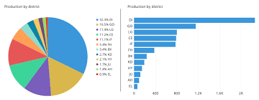
SURVEY INSTRUMENT-QUESTIONNAIRE

Slide 47
INTRODUCTION
Meaning :- Questionnaire is the most common research instrument/tool used for data collection under field investigation.
Defination:-According to David J. Luck and Ronald S. Rubin, “A questionnaire is simply a formalized schedule to obtain and record secified and relevant information with tolerable accuracy and completeness.”
Questionnaire acts as an instrument for collecting uniform and comprehensive information.
Questionnaire is normally treated as a tool rather than a method of data collection.
Questionnaire is a fairly reliable tool for gathering data from large, varied and scattered groups.

Slide 48
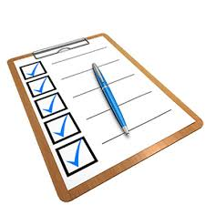
Questionnaire is an intergrated series of questions used for data collection.
When the questionnaire is handed over to respondents for recording their responses is called as schedule.
MERITS OF QUESTIONNAIRE
Collection of comprehensive
Convenience to researchers & respondents
Wide geographical coverage in data collection
Work is simple & easy
Suitable for collecting data based on personal,emotional matters etc.
Collection of varied data
Information in a uniform manner is available
Collection of quality data easily
Gives convenience to respondents
Done in Uniform manner and in structured data.

Slide 49
IMPORTANCE OF QUESTIONNAIRE
Questionnaire plays an important role in data collection
It is one basic tool used for data collection from the respondents.
Ample information will be available if the survey is well planned and comprehensive.
A good questionnaire serves as the backbone of whole data collection work.
There are two types of questionnaire:
(A)Consumer Questionnaire (B) Trade Questionnaire
Consumer questionnaire is used for collecting information from consumers.
Trade questionnaire is useful for collecting information from traders.

Slide 50
STEPS IN QUESTIONNAIRE
The following steps are used in designing a questionnaire :-
(1) PRELIMINARY DECISIONS
(2) INFORMAL INTERVIEWING
(3) DRAFTING QUESTIONNAIRE
(4) PILOTING QUESTIONNAIRE
(5) DECIDING FINAL FORM OF QUESTIONNAIRE
(6) FINAL QUESTIONNAIRE

Slide 51

FEATURES/REQUIREMENTS/ESSENTIALS OF GOOD QUESTIONNAIRE
Short and simple
Easily understandable by respondents
Specific and relevant questions
Types of questions
Logical arrangements of questions
Interesting to respondents
No pressure on respondents memory
Removing lengthy/personal/confusing questions
Avoiding questions involving motives

Slide 52
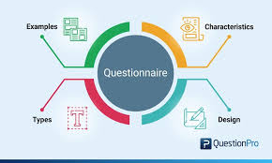
10. Providing adequate space for answers
11. Proper numbering of questions
12. Avoiding embarrasment to respondents
13. Avoiding introducing bias through questionnaire
14. Purpose of inquiry should be made clear to respondents
15. Making questionnaire attractive to respondents
16. Pre-testing of questionnaire

Slide 53
QUESTIONNAIRE
ADVANTAGES
Free from bias of interviewer
Respondents have adequate time
Large samples can be used to get more dependable and reliable data
DISADVANTAGES
Used only when respondent is educated and cooperating
Control over questionnaire is lost once it is sent
Inflexibility
Time and cost

Slide 54
QUESTION CONSTRUCTION
Question Relevance
Question Wording
Types of questions
Question order or sequence

Slide 55
QUESTION CONSTRUCTION
1. Question Relevance
Should be relevant to research objectives
Question should be able to answer research problem
Single question may not be able to answer problem or attain objective
Respondents should know the answer
Question should not test respondents recall ability
Should be easily understandable.
Should be specific

Slide 56
QUESTION CONSTRUCTION
2. Question Wording
Vocabulary : Use of common vocabulary
Exactness : Do you usually go to gym? Vs. How many days in a week do you go to gym?
Simplicity : Simple words and sentence construction, avoid jargons
Neutrality : Should not cause undue influence. E.g. You prefer Bru over Nescafe, right?
Presumption : Shouldn’t presume about respondent E.g. How many times a day do you drink coffee?
Hypothetical Questions : Avoid. E.g. What would you do if …. ?
Embarrassing Questions : Personal Questions

Slide 57
QUESTION CONSTRUCTION
3. Types of Questions
Open Ended
  Free Scope for respondents to answer
  Used to explore more and in depth information
  Difficult to analyze
  E.g. What are your career plans after post graduation

Slide 58
QUESTION CONSTRUCTION
3. Types of Questions
Closed Ended
  Dichotomous
    Can be answered with 2 responses
    E.g. Do you own or rent your house?
    Do you like Marathi movies?
  Multiple Choice Questions
    More than 2 alternatives for one question
    E.g. Which brand of jeans do you prefer?
    MCQ must contain all the possible choices
    Should not contain overlapping choices
    Alternatives should be reasonable

Slide 59
QUESTION CONSTRUCTION
Types of questions to be avoided
Leading Questions : Influences respondent to give a certain answer
E.g. Are you against giving too much power to the trade unions?
Loaded Questions : Contains words which are emotionally colored.
E.g. Have you ever tried to get benefit to the business by giving bribe?
Ambiguous Questions : Does not have clear meaning
E.g. Are you interested in a small house?

Slide 60
QUESTION CONSTRUCTION
Types of questions to be avoided
Double-barreled Questions : Contain two or more different ideas
E.g. Do you favor or oppose increased job security and productivity linked wage system?
Long Question : Lengthy question
Double negative : E.g. Don’t you oppose this bill?

Slide 61
QUESTION CONSTRUCTION
4. Question Order or Sequence
One question should follow another in logical sequence
Sequence should have relation
E.g. What is volume of your trading?
How many trades do you make in a week?

Slide 62
MECHANICS OF QUESTIONNAIRE
Introduction
Pre-coding
Spacing
Paper
Printing
Margins
Note of thanks

Slide 63
Secondary Data
Definition of secondary data in words of M. M. Blair,
“Secondary data are those which are already in existence and collected for some other purpose than the answering of the question in hand.”

Slide 64
Secondary Data
Secondary data are information already collected by others or somebody else and later used by a researcher (or investigator) to answer their questions in hand. Hence, it is also called second-hand data.
It is a ready-made, quantitative information obtained mostly from different published sources like companies' reports, statistics published by government, etc.
The required information is extracted from already known works of others (e.g. Published by a subject scholar or an organization, government agency, etc.).
It is readily available to a researcher at his desk or place of work.
Eg. You are preparing a brief report on your country's population for which you take reference of the census published by government, is an example of secondary data collection.

Slide 65
Secondary Data Collection
Internal Sources
Company's accounts,
External Sources
Data published by country's central, state and local governments,
Trade Journals / Business Journals
Sales figures,
Reports and records,
Promotional campaigns' data,
Customers' feedback,
Cost information,
Marketing activities
Data published by foreign governments,
Publications released by international organizations (like the IMF, WHO, ILO, UNO, WWF, etc.) and their subsidiary bodies,
Reports prepared by various commissions and other appointed committees,
Results of research work published by research institutions, universities, subject scholars, economists, etc.,
Books, newspapers, and magazines,
Reports and journals of trade unions, industries, and business associations,
Information released by a central bank, stock exchanges, etc.,
Public libraries,
Archives, Directories, Databases, and Indexes,
Old historical records,
Online websites, blogs, and forums.

Slide 66
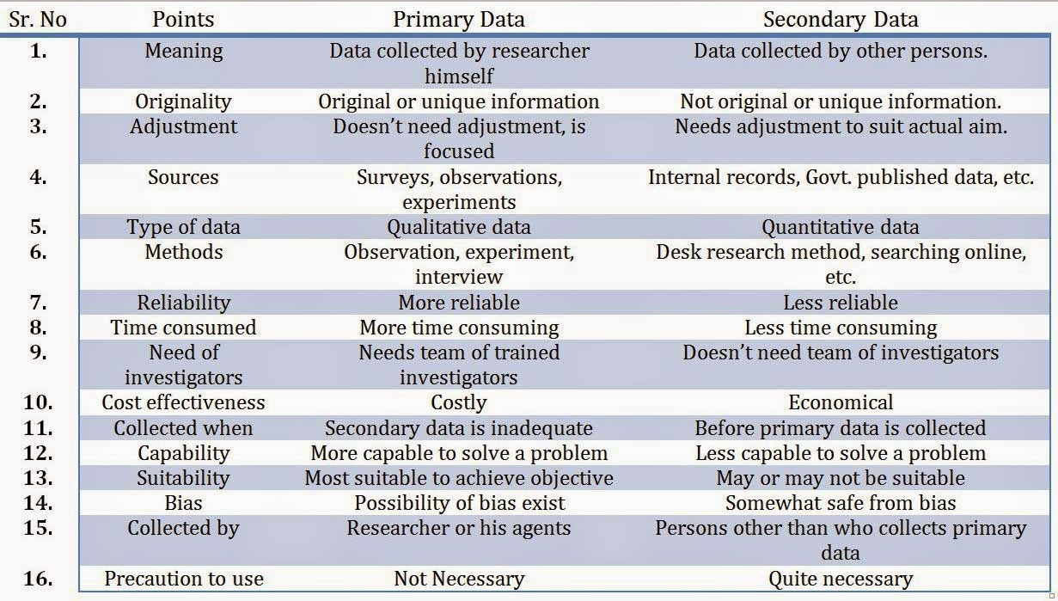

Slide 67
ATTITUDE MEASUREMENT TECHNIQUES

Slide 68
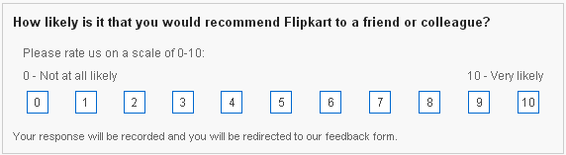
MEASUREMENT
SCALE
Assigning numbers or symbols to the characteristics of certain objects
E.g. Recommendation of Flipkart
Involves creating a continuum on which measurement of objects are located
E.g. Recommendation of Flipkart

Slide 69
TYPES OF MEASUREMENT SCALE
Nominal Ordinal
Interval Ratio

Slide 70
Nominal
Lowest level of measurement
Numbers are assigned for purpose of identification of objects
Numbers don’t represent superiority of inferiority
Each number is assigned to only one object
What is your religion?
Hinduism
Sikhism
Christianity
Islam
Buddhism
Any other
In which of the following department do you work?
Marketing
HR
Finance
Production
IT
Any other
Example:

Slide 71
Nominal
Uses
  To identify food habits, gender, caste, respondents, brand, attributes, players of hockey team etc.
How to analyze?
  Counting
  Making frequency distribution table

Slide 72
Ordinal
Next higher level than Nominal scale
In nominal, superiority/inferiority can not be measured
In ordinal scale, one can tell which object has more or less characteristic than other
It can not answer how much more or how much less
Example:
Ranking in class:
Shashi
Mohan
Krishna
Attribute | Rank
Food Quality
Prices
Menu Variety
Ambience
Service
Rank the attributes while choosing a restaurant for dinner.

Slide 73
Ordinal
Ranks can not be added, multiplied, subtracted or divided
Difference in score has no meaning
Uses
  Quality ranking, ranking of teams, ranking of preferences of color, soft drinks, socio-economic status, occupational status etc.
How to analyze?
  Median
  Percentile
  Quartiles
  Rank Correlation
– + all analysis of nominal scale

Slide 74
Interval
Next higher to ordinal scale
Difference in score has meaningful interpretation
Example:
How important is price to you while buying a car?
Least Important | Unimportant | Neutral | Important | Most Important
1 | 2 | 3 | 4 | 5
How do you rate the work environment of your organization?
Very Good | Good | Neutral | Bad | Very Bad
5 | 4 | 3 | 2 | 1

Slide 75
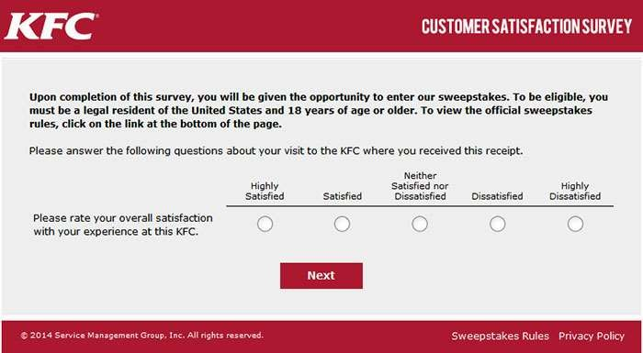

Slide 76
Interval
Difference has meaningful interpretation but ration does not have meaningful interpretation
 | Very Unlikely | Unlikely | Neutral | Likely | Very Likely
Scale A | 1 | 2 | 3 | 4 | 5
Scale B | 0 | 1 | 2 | 3 | 4
Scale C | -2 | -1 | 0 | 1 | 2

Slide 77
Interval
Numbers can be added, subtracted, multiplied or divided
How to analyze?
  Mean
  Standard Deviation
  Correlation
  T-test
  Z-test
  Regression Analysis
  Factor Analysis
– + all analysis of ordinal scale and nominal scale

Slide 78
Ratio
Highest level of measurement
Ratio of measurement is meaningful
Example:
  How many chemist shops are there in your locality?
  How much distance you need to travel from your home to college?
Uses:
  Weight, distance, income, sales etc.
How to analyze?
  Coefficient of variance + geometric mean + harmonic mean + all other analysis of nominal, ordinal and interval scale

Slide 79
SUMMARY
Scale | Characteristic | Examples | Permissible Statistics
Nominal | Numbers are used to label and classify objects | Players of team India, Caste, Religion, Gender etc. | %, Mode, Chi-Square
Ordinal | Numbers indicate relative position of object. Difference in magnitude cant be known. | Preference ranking, Social Class etc. | Percentile, Quartile, Median, Rank Correlation
Interval | Difference is meaningful, ratio is not. | Attitude, Opinion etc. | Correlation, t-test, z-test, ANOVA, regression, factor analysis
Ratio | Ratio is meaningful | Age, Income, Market Share, Sales etc. | G. Mean, H. Mean, Coeff. Of variance

Slide 80
Scaling

Slide 81
What is Likert scale?
It is a psychometric scale commonly involved in research that employs questionnaires.
It is the most widely used approach to scaling responses in survey research.
Likert scales are a non-comparative scaling technique and are one-dimensional in nature.
When responding to a Likert questionnaire item respondents specify their level of agreement or disagreement on a symmetric agree-disagree scale for a series of statements.
Thus, the range captures the intensity of their feelings for a given item, while the results of analysis of multiple items reveals a pattern that has scaled properties of the kind Likert identities

Slide 82
Likert item is considered symmetric or balanced because there are equal amounts of positive and negative positions.
Often five ordered response levels are used, although many psychometricians advocate using seven or nine level, a recent empirical study found that a 5 or 7 point scale.

Slide 83
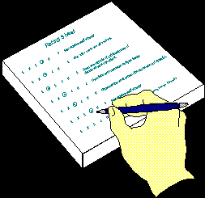
The format of a typical five-level Likert
        Strongly disagree
        Disagree
        Neither agree nor disagree
        Agree
        Strongly agree

Slide 84
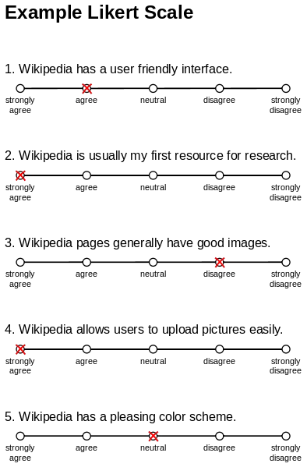

Slide 85
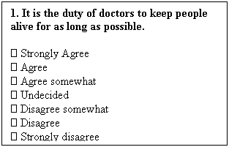
The format of a typical Seven-level Likert item

Slide 86
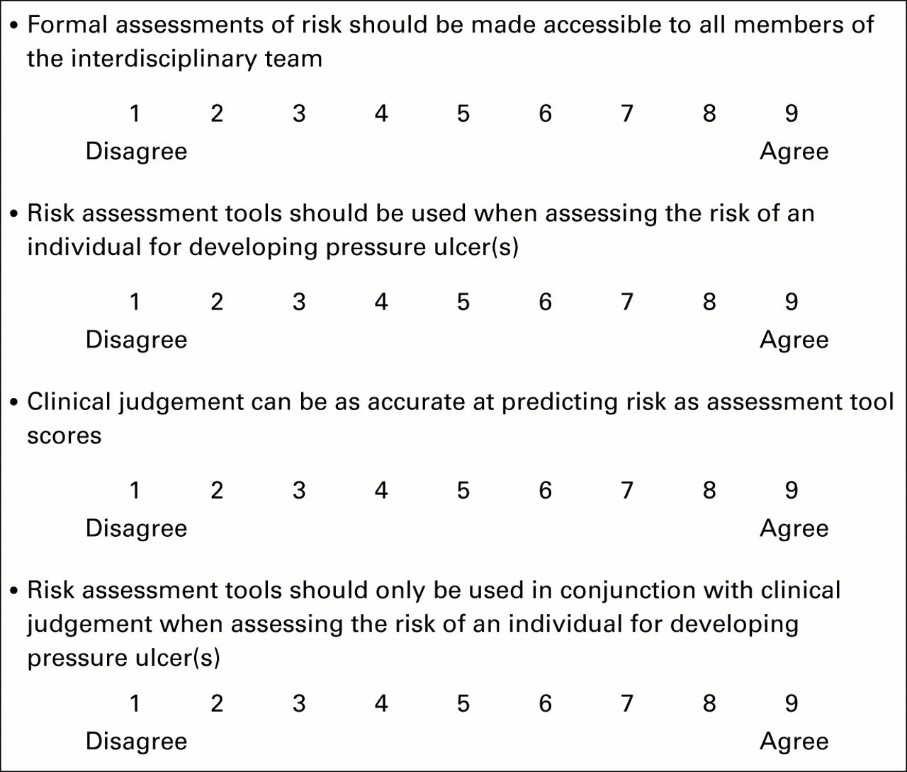

Slide 87
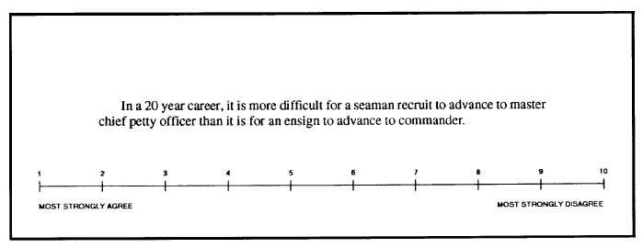

Slide 88
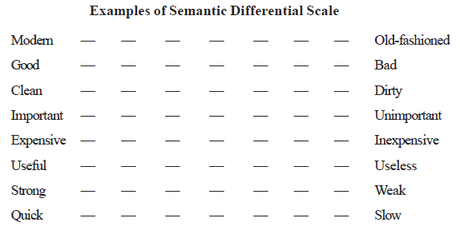
Semantic Differential Scale:
This is a seven point rating scale with end points associated with bipolar labels (such as good and bad, complex and simple) that have semantic meaning.
It can be used to find whether a respondent has a positive or negative attitude towards an object.
It has been widely used in comparing brands, products and company images.
It has also been used to develop advertising and promotion strategies and in a new product development study.

Slide 89
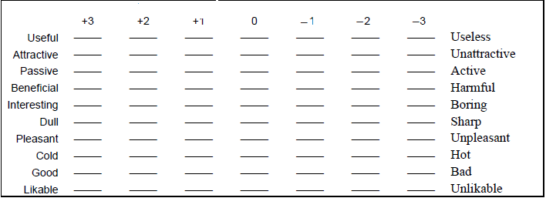
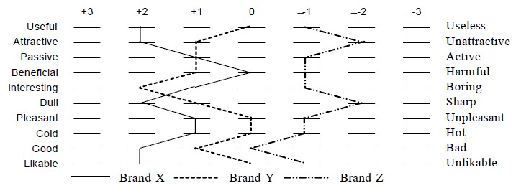

Slide 90
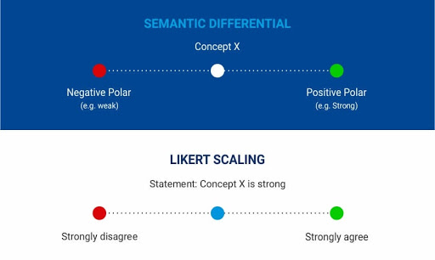
https://www.youtube.com/watch?v=TR_wtQMTBOU
https://www.youtube.com/watch?v=AKvgomEBF_I

