Slide 1

THAKUR COLLEGE OF SCIENCE & COMMERCE
DEPARTMENT OF COMMERCE
MODULE III
ECONOMIC ASPECTS
Presentation by :
Ms. Shakibaa.I.Merchant

Slide 2
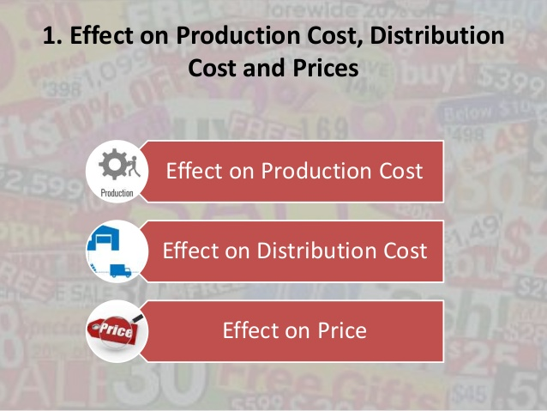
EFFECT OF ADVERTISING ON PRICE
Price is the exchange value of a product . Generally , price of a product is calculated by adding profit margin to the total cost of the production & distribution . In order to study the effect of Advertising of Price , it is necessary to find out the impact of advertising on the cost of production & distribution
EFFECT OF ADVERTISING ON VARIOUS COSTS
EFFECT OF ADVERTISING ON PRODUCTION COST
EFFECT OF ADVERTISING ON DISTRIBUTION COST
EFFECT OF ADVERTISING ON CONSUMER COST

Slide 3
EFFECT OF ADVERTISING ON PRODUCTION COST
The term production cost refers to the cost incurred in manufacture of a product . These include the following three basic cost :
Cost of raw materials
Cost of labour in the production process
Overhead expenses .
Advertising expenditure is not an element of production cost . Hence, it does not directly affect the production cost
Through advertising, a manufacturer with a considerable seasonal demand may be able to expand the demand over a broader time period. The producer can have economies of reduced storage capacity, because he needs lesser storage space for lesser period of time as the products are being sold over a larger time period during the year. The larger turnover would mean that during the season the storage space would be used extensively. This in turn would mean that larger number of units of production would be sharing the overhead costs and this would help reduce that cost of production.

Slide 4
PARTICULARS | BEFORE ADVERTISING Rs. | AFTER ADVERTISING Rs.
Material Cost | 5,000,000 | 8,000,000
Labour Cost | 3,000,000 | 5,000,000
Overhead Cost | 2,000,000 | 3,000,000
Total Cost of Production | 10,000,000 | 16,000,000
Units Produced | 100,000 | 200,000
Cost per Unit | 10 | 8
The optimum capacity of the firm is 2,00,000 units
Before advertising , the demand was of 1,00,000 units which means the firm was operated below the optimum level
After advertising , the demand increased to 2,00,000 units. As a result the production capacity was utilise fully
The reduction in cost of production per unit is due to factors such as economies of large scale production , optimum utilisation of production capacity , use of new technology introduction of labour saving devices etc.

Slide 5
EFFECT OF ADVERTISING ON DISTRIBUTION COST
The term Distribution Cost refers to the cost incurred for selling in product . Advertising is an element of distribution cost; other element include sales person’s salaries , storage, insurance , dealer’s margins, transport etc .
Since advertising is an element of distribution cost, it increases the distribution cost. In this competitive era, manufactures are spending more & more on advertising in order to survive in the market . However , advertising may reduce the cost of distribution per unit .
This can be due to several factors such as :
Advertising increases sales turnover which reduces the storage cost
Since products are not stored for long periods, the cost of maintenance & wear & tear is also reduced .
Effective advertising reduces the expenditure on personal selling
Middlemen perfer advertised products since consumers are attracted towards such products. Retailers do not need additional selling efforts.

Slide 6
PARTICULARS | BEFORE ADVERTISING Rs. | AFTER ADVERTISING Rs.
Advertising Expenses | NIL | 2,00,000
Salesman Salaries & Commission | 4,00,000 | 4,60,000
Other Distribution Expenses | 1,00,000 | 1,40,000
Total Cost of Distribution | 5,00,000 | 8,00,000
Units Distributed | 1,00,000 | 2,00,000
Cost per Unit | 5 | 4
Advertising has increased the distribution of the product from 1,00,000 units to 2,00,000 units
There is an increase in salesmen’s salaries & other distribution expenses but the increase is not in proportion to the number of units distributed due to advertising
The manufacturernmgets the benefits of largescale distribution which is more than the amount spent on advertising . Therefore , the cost of distribution has reduced from Rs. 5 to Rs. 4

Slide 7
EFFECT OF ADVERTISING ON CONSUMER PRICE
Consumer price consists of production costs, selling and distribution costs and profit margin of the seller. An expenditure on advertising will increase marketing costs.
Consumers and buyers of the advertised goods and services pay for advertising. If the consumer feels that he is not getting desired utility from a brand, he switches to some other brand. But in the long run, advertising may well work toward lowering down the prices. Effective advertising increases sales volumes and lowers down the prices. Many new products such as refrigerators, colour T.V., washing machines, computers, electronic typewriters have lowered down the price due to mass production distribution and consumption.

Slide 8
Particulars | Before Advertising | After Advertising
Production Cost per unit | 10 | 8
Distribution Cost per unit | 5 | 4
Profit margin per unit (assumed) | 3 | 4
Consumer Price | 18 | 16
Advertising affects consumer prices because:
Price is fixed by adding the desired profit on costs of production. Advertising is one of the elements of cost. Price of a product or service, therefore includes advertising cost.
(b) Advertising is an element of distribution cost. An increase in advertising cost increases, total cost which increases the price of advertised goods or service.
(c) Advertising cost increases due to competition. So, prices rise. However, under certain conditions, advertising checks prices. Severe competition makes a producer struggle to increase his market share by charging reasonable prices. So, even if a price-rise occurs, his freedom to raise the price is controlled by competition.

Slide 9
CREATES AWARENESS
INDUCES PEOPLE TO BUY THE PRODUCTS
INCREASE ASPIRATION LEVELS
STIMULATESIMPULSE BUYING
GENERATE OFF- SEASON DEMAND
CELEBRITY ENDORSEM-ENTS
ONLINE & SOCIAL MEDIA
THE EFFECT OF ADVERTISING ON CONSUMER DEMAND

Slide 10
EFFECT OF ADVERTISING ON MOOPOLY & COMPETITION
When a single firm is the only supplier of some goods or services for which no close substitute is generally available and when the firm is free from the treat of competition, it is called monopoly; the monopolist can set his own prices and levels of output.
Whether advertising leads to monopoly or not can be understood from two different viewpoints:
Advertising acts to control consumers in such a way that the advertiser has command over the consumer's mind and buying actions. In this line of reasoning, any monopoly that results would stem from a control of demand rather than of supply.
A more strongly supported position which related advertising to monopoly examines the ways in which advertising may act to limit the number of firms competing in a specific industry. The large companies can spend heavily on advertising to make their products appear different for all other products. This win helps them to take over sizable part of the market. In this way, advertising creates a barrier to new firms and a high level of concentration result. High monopolistic prices result in high monopoly profits.

Slide 11

Advertising is said to breed monopoly by restricting open competition. Advertising aim at enjoying monopoly powers to introducing a separate trade mark for their products. The reputation attached to a, trade mark does not increasingly involve advertising although advertising can play an important role. If people desire to have a rational trade mark, they must invariably buy from the marker. A manufacturer with brand of product differentiated form all other brands in the same business enjoys monopoly of that brand. He fully controls the supply and sells it at a profit. He tries to build large and stable following for his brand.

Slide 12

A manufacturer who has been able to build a substantial market may tend to hold his prices somewhat rigid. To the extent that he can, he will compete on the basis other than price but he cannot avoid price competition altogether. No manufacturer with or without advertising has been able to obtain monopoly position for himself. Because of this fact, no manufacturer can successfully manipulate supply price at will.

Slide 13

Product differentiation, a phenomenon of imperfect competition, would continue to exist even if there were no advertising. In the absence of advertising, consumers might still be induced to pay more because of product differentiation. However, advertising occupies its important status in bringing product differentiation to the attention of consumers. There should be no objection about this if the advertising is truthful and informative. If there were monopoly in advertising i.e., if advertising were available to only one manufacture, it would be different matter.

Slide 14
THAKUR COLLEGE OF SCIENCE & COMMERCE
DEPARTMENT OF COMMERCE
MODULE III
THANK YOU !
Presentation by :
Ms. Shakibaa.I.Merchant

