Slide 1
Module 2. Marketing Decisions
Part. IV
TOPICS
PRICING – CONCEPT,
OBJECTIVES OF PRICING
FACTORS INFLUENCING PRICING
PRICING STRATEGIES
Prepared By HARSHADA MHATRE

Slide 2
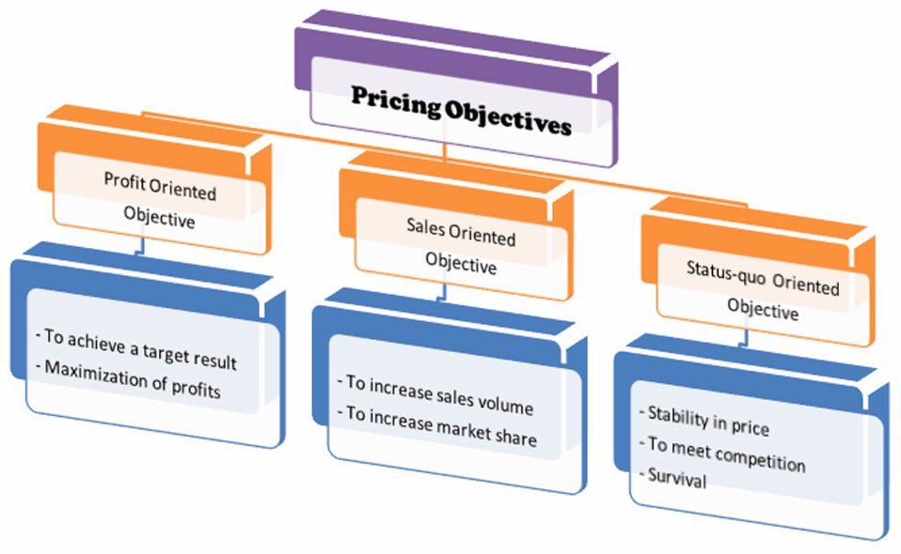
PRICING - OBJECTIVES
Meaning:
Pricing is the process whereby a business sets the price at which it will sell its products and services.
PRICE- Price is An exchange value of a product.
OBJECTIVES OF PRCING

Slide 3
The main objectives of pricing are as follows :
1. Survival : Its is the main objective of firm when companies are faced with problem of intense competition or changing consumer wants. Prices are reduced to survive in the market.
2. Profit Objectives: The main objective of pricing is to earn maximum profit.
A. return on Investment – To increase shareholders Wealth.
B. Profit Maximisation - To get as much profit as possible.
3. Sales Objectives: Firm fix prices In order to achieve sales objectives.
A. Market Share Growth - Firm fix the price to increase market share.
B. Sales Growth –Firm focus on sales revenue growth.

Slide 4
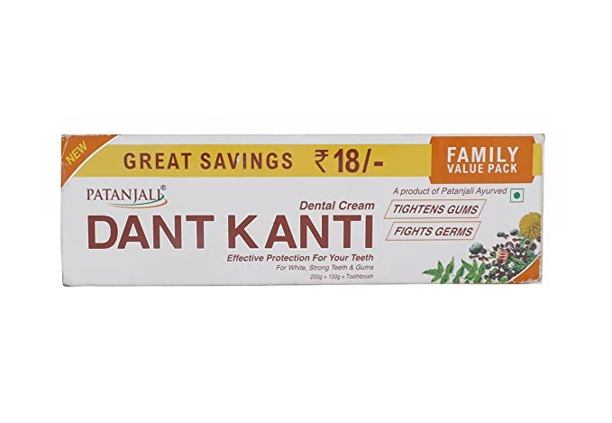
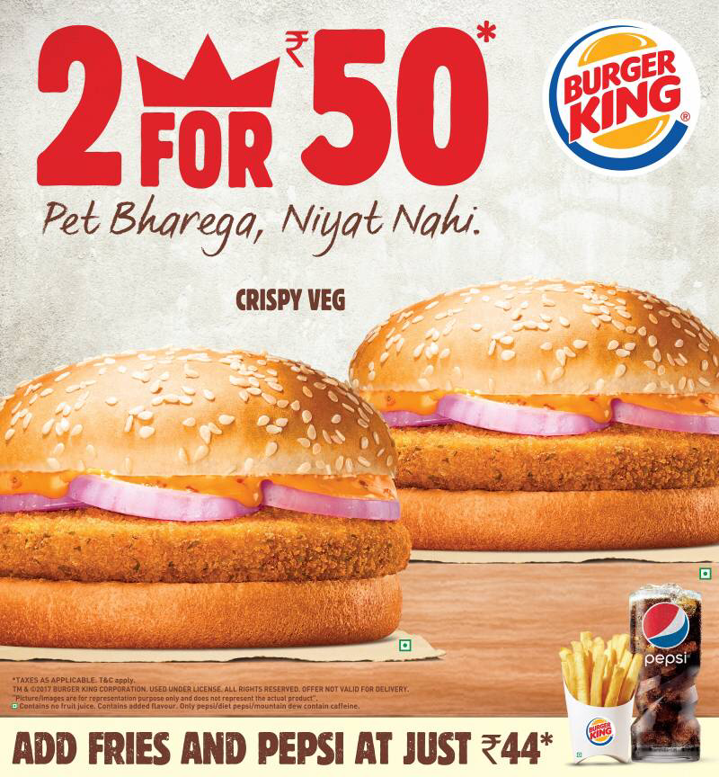
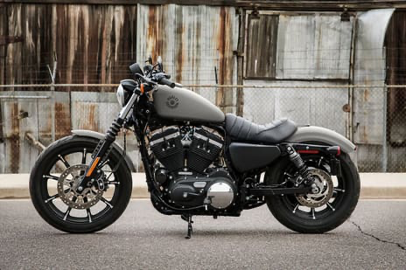

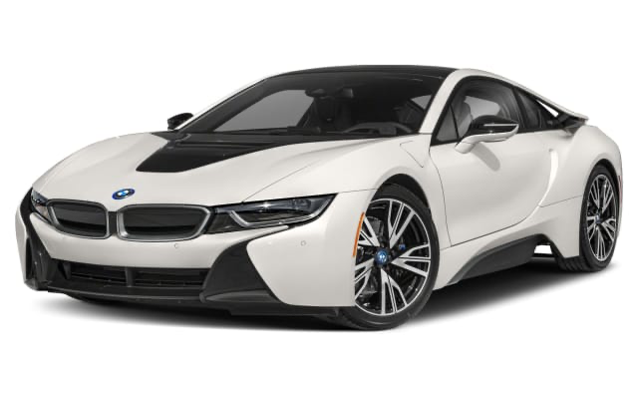
4. Competitive- Effect Objectives: Firm may fix prices to win over competitors customers or attract competitors customers.
Example :
5. Image Differentiation – Firm create different image through pricing. They may charge premium price to create a distinct image.
Example:

Slide 5
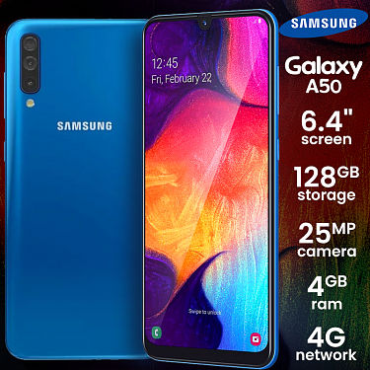
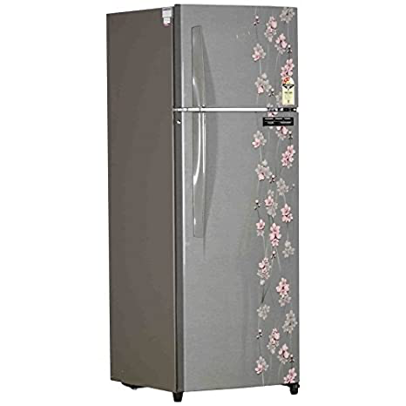
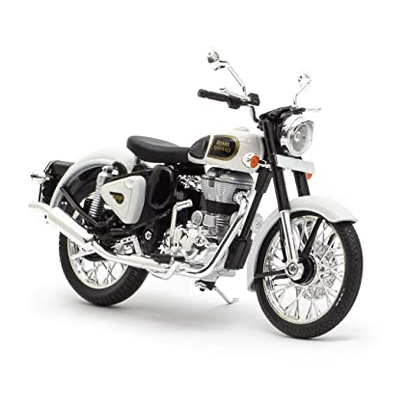
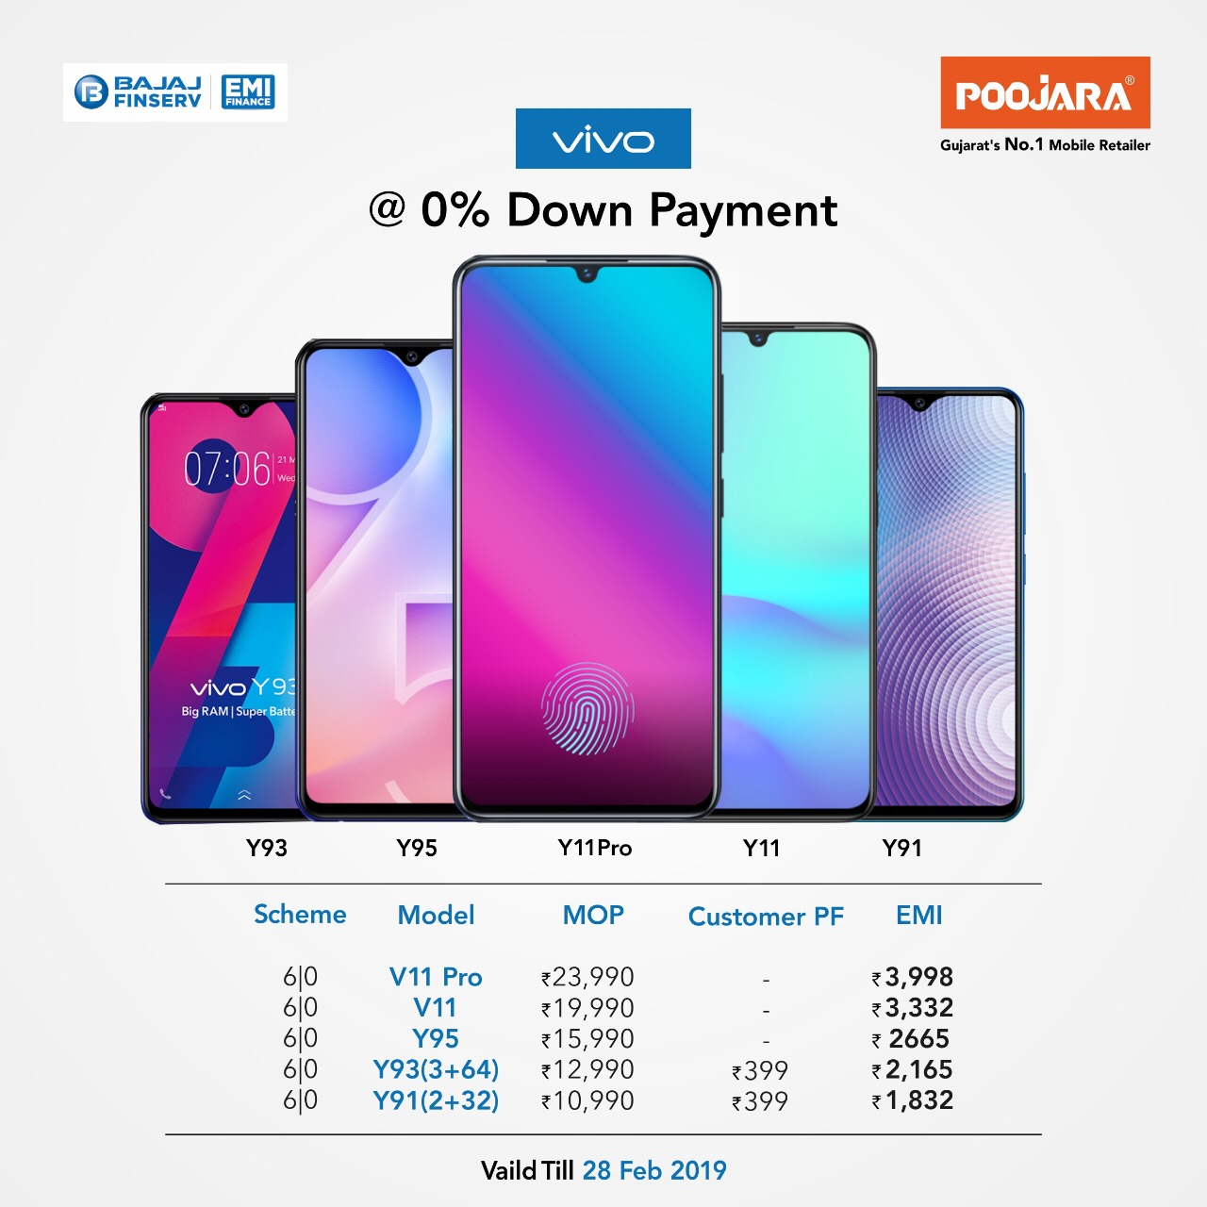
6.Market Skimming Objectives: The firm launched product at High Price then gradually reduce the price over period of time. Firm want to recover high development cost of New Product.
Example:
7. Early Cash Recovery: firms that face liquidity problems, and who think that Product life is short. Such firms may provide special offers and discounts to increase sales.
Example:

Slide 6
8. Market Entry Barrier Objectives: Firm may adopt low price strategy with objective of preventing others from entering the market.
9. Customer Satisfaction Objectives: firms may adopt a High Value Strategy, where product quality is high and the price is moderated ( Neither high nor Low) to win customers and retaining them.
Example : Parachute Advanced Therapy hairoil (Rs125) 100ml is costlier than Himalaya Anti Dandruff Shampoo(Rs100) as Himalaya promises more than just dandruff solution but also hair fall treatment and hair dryness repair too.
10. Social Responsibility Objectives: Professionals, Non – Profit organisations , Government may adopt social responsibility’s their pricing Objective.
Example: Some doctors may charge consulting fee in the basis of ability to pay, for poorer section they charge less and for richer section they charge more.

Slide 7
FACTORS INFLUENCING PRICING
A. Internal Factors:
1. Cost:While fixing the prices of a product, the firm should consider the cost involved in producing the product. This cost includes both the variable and fixed costs. Thus, while fixing the prices, the firm must be able to recover both the variable and fixed costs.
2. The predetermined objectives:While fixing the prices of the product, the marketer should con­sider the objectives of the firm.
For Example: if the objective of a firm is to increase return on investment, then it may charge a higher price, and if the objective is to capture a large market share, then it may charge a lower price.
3. Image of the firm:The price of the product may also be determined on the basis of the image of the firm in the market.
For Example : HUL and Procter & Gamble can demand a higher price for their brands, as they enjoy goodwill in the market.

Slide 8
.
4. Product life cycle:The stage at which the product is in its product life cycle also affects its price.
Example: During the Introduction stage the firm may charge lower price to attract the
custom­ers, and during the growth stage, a firm may increase the price.
5. Credit period offered:The pricing of the product is also affected by the credit period offered by the company. Longer the credit period, higher may be the price, and shorter the credit period, lower may be the price of the product.
6. Promotional activity:The promotional activity undertaken by the firm also determines the price. If the firm incurs heavy advertising and sales promotion costs, then the pricing of the product shall be kept high in order to recover the cost.
7. Product: If a Product is of superior quality, then a firm may either adopt Premium strategy or High value price strategy
In Premium Pricing, the firm charges high price for high quality.
In High value pricing, the firm charges Moderate/ Low Price for high quality.

Slide 9
(B) External Factors:
1. Demand:The market demand for a product or service obviously has a big impact on pricing. Since demand is affected by factors like, number and size of competitors, the prospective buyers, their capacity and willingness to pay, their preference etc. are taken into account while fixing the price.
2. Competition:Competitive conditions affect the pricing decisions. Competition is a crucial factor in price determination. A firm can fix the price equal to or lower than that of the competitors, provided the quality of product, in no case, be lower than that of the competitors.
3. Suppliers:Suppliers of raw materials and other goods can have a significant effect on the price of a product.
Example: If the price of cotton goes up, the increase is passed on by suppliers to manufacturers. Manufacturers, in turn, pass it on to consumers.

Slide 10
4. Economic Conditions:
The inflationary or deflationary tendency affects pricing. In recession period, the prices are reduced to a sizeable extent to maintain the level of turnover. On the other hand, the prices are increased in boom period to cover the increasing cost of production and distribution. To meet the changes in demand, price etc.
5. Buyers:The various consumers and businesses that buy a company’s products or services may have an influence in the pricing decision. Their nature and Behaviour or the purchase of a particular product, brand or service etc. affect pricing when their number is large.
6. Government:Price decision is also affected by the price-control by the government through enactment of legislation.The prices cannot be fixed higher, as government keeps a close watch on pricing in the private sector.
7. Financial Incentives: The Government may provide incentives to the firm, then firm may charge lower prices.
Example: Exporters get incentives from the Government, so that they charge low prices in overseas markets.

Slide 11
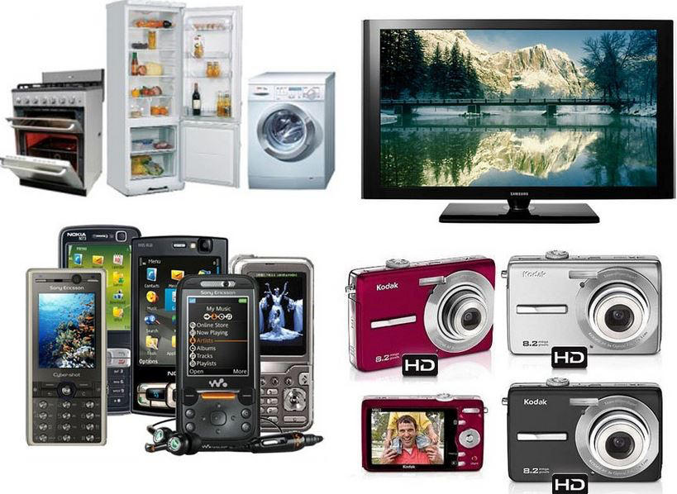
PRICING STRATEGY
Meaning : Pricing strategy is the tactic that company use to increase sales and maximize profits by selling their goods and services for appropriate prices.
Definition:
Pricing Strategy is defined as “A plan to achieve pricing objectives, market share, sales, etc.”
Pricing Strategies are as follows:
1. Skimming Pricing Strategy:
A high Premium price is charged when product launched in the market.
Objective: To get high profit margin at introduction stage of product.
Types: A. Rapid Skimming pricing : high prices are charged with heavy promotion expenditure.
B. Slow Skimming Pricing : high prices are charged with low promotional expenditure.
Example: the earliest prices for mobile phones, VCRs and other electronic items where a few players ruled attracted lower cost Asian players.

Slide 12
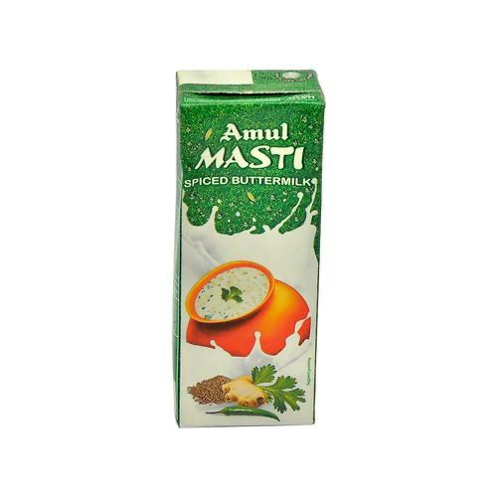
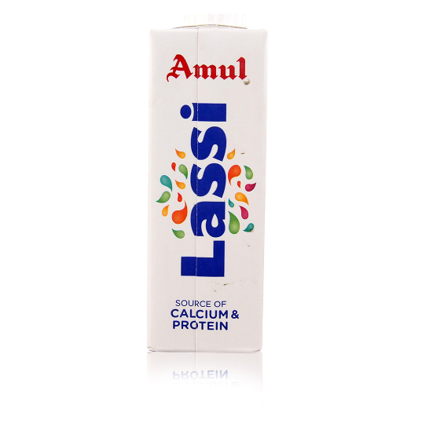
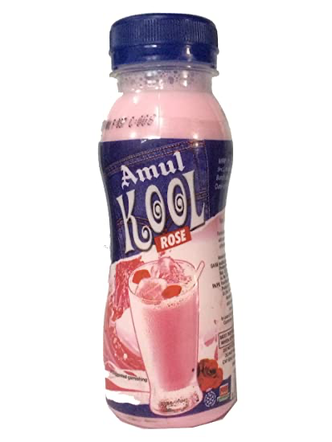
2. Penetration Pricing Strategy:
A Low price is charged when product launched in the market.
Objective: To capture a large share of market at introduction stage of product.
Types: A. Rapid Penetration pricing : Low prices are charged with heavy promotion expenditure.
B. Slow Penetration pricing : Low prices are charged with low promotional expenditure.
Example : Amul has a strategy of low cost pricing. Some may call it penetrative pricing.
3. STANDARD PRICING STRATEGY- Marketer charges SAME PRICE for all products in rural as well as urban areas.

Slide 13


4. PROBE PRICING STRATEGY- The marketer fix HIGHER PRICE at Introduction stage to know customer’s reactions and adjust price accordingly.
Example: The exporter may follow this technique, especially, when sufficient information is not available in respect of competitors’ pricing, purchasing power of the buyers,
5. DIFFERENTIAL TRADE MARGIN PRICING STRATEGY- The marketer may allow various discounts and trade margins, like season discounts, bulk quantity purchase discounts.
Example: A. Spotify premium membership is $9.90 in the US, while it's ₹150 ($2.30) in India.
B. A Teacher or student get discount on admission to a museum or entertainment facility.

Slide 14


6. Differential Pricing for Different Market Strategy - Different prices are charged to different markets.
Example: a. In any government examination, the form fee varies for the general category people and the other backward class people.
b. In movie theaters the customer pays different amounts for the different locations from where they can watch movies..
7.TRAIL PRICING- A firm may charge a lower price to induce customers to buy the products at introduction of product, after demand starts increasing they may charge higher price.
Example : Metro Train tickets, initially Metro charged 20 ₹. Per person so they can experience Journey then they started increasing price of tickets.
8. PREMIUM PRICING : The firm charges high price, Such pricing strategies work in segments and industries where a strong competitive advantage exists for the company.
Example: Porche in cars and Gillette in blades.

Slide 15


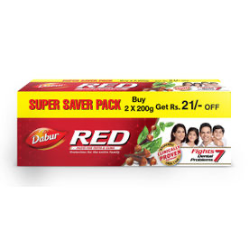

9. Follow The Leader Pricing Strategy: The marketer may fix price depending upon the prices of the leading competitor. The prices may be very close to that of price charged by the leader.
Example: Colgate is leading brand, it’s pricing followed by Meswak, Dabur and Patanjali.
10. Flexible – Price Strategy : A firms may offer the same product to different customers at different prices.
Example: a. when new Product is introduced, a firm may sell it at special price to its loyal customers.
b. The carpenter also charge price by taking into account how much the customer can afford or Pay.

Slide 16



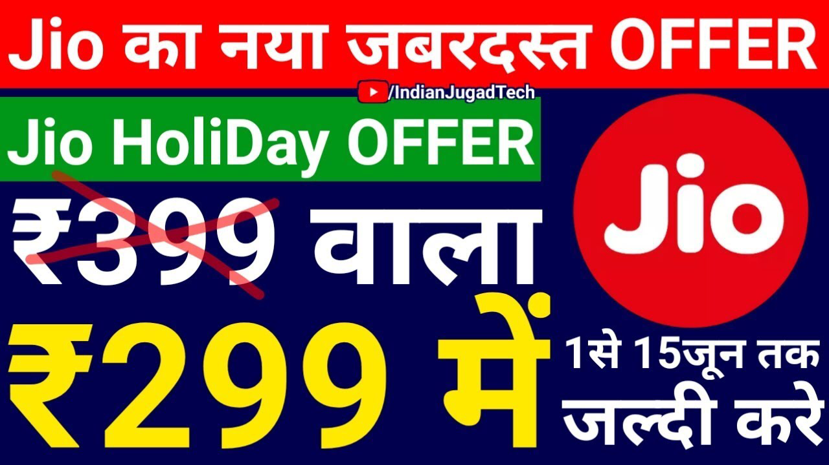
11. Psychological Pricing Strategy: Pricing Strategy plays on the psychology of the buyers.
Example: Odd pricing is done such as ₹ 999 instead of ₹ 1000.

