Slide 1
SM and CRM unit 2
Dr Rakhi BHATTACHARYA

Slide 2
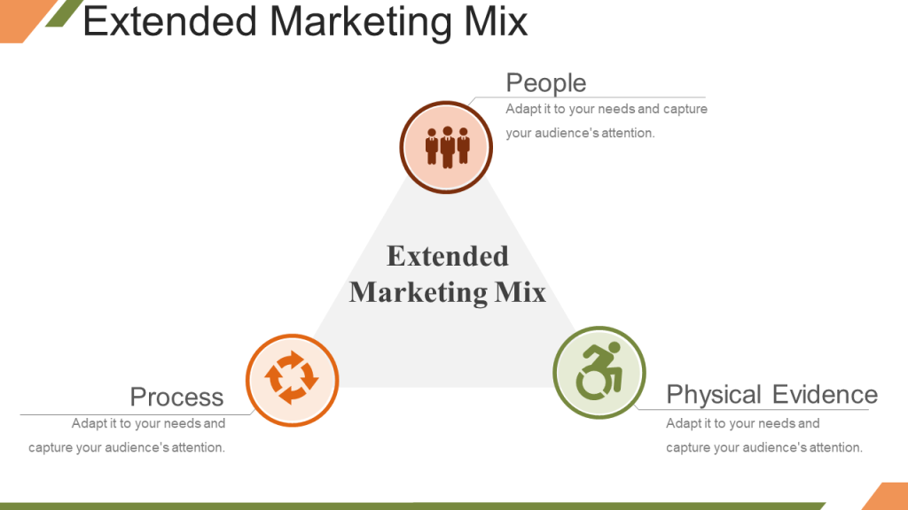

Slide 3
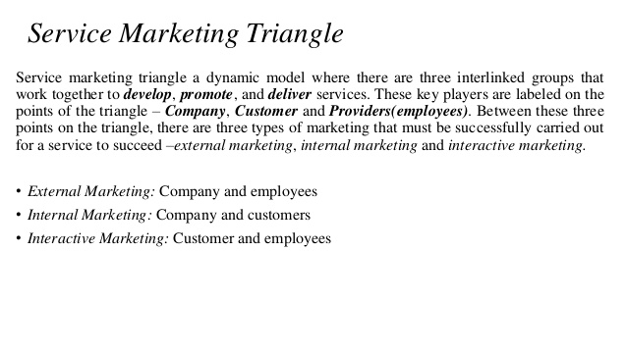

Slide 4
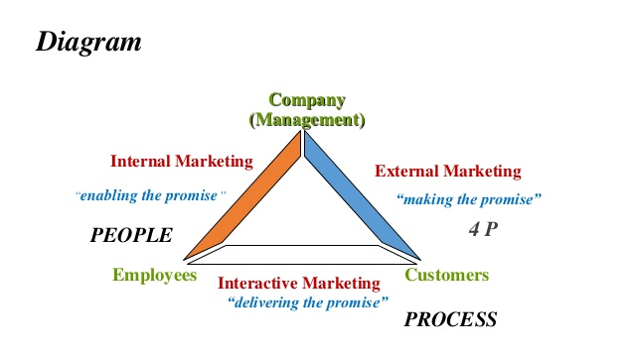

Slide 5
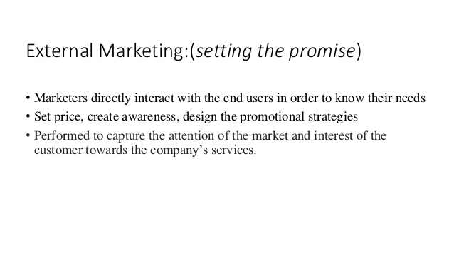

Slide 6
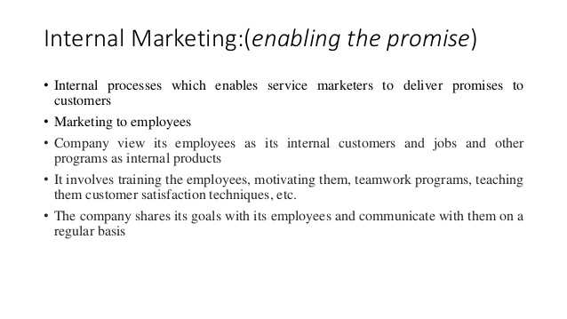

Slide 7
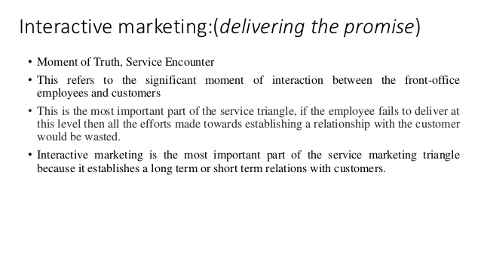

Slide 8
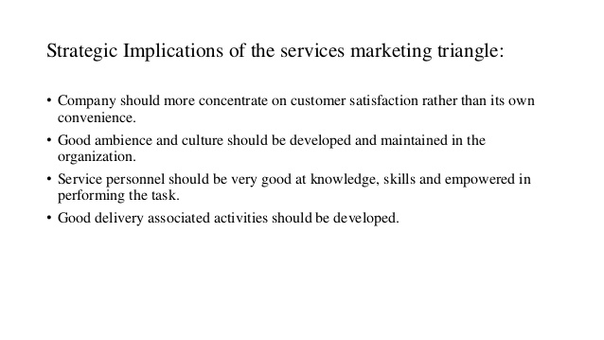

Slide 9
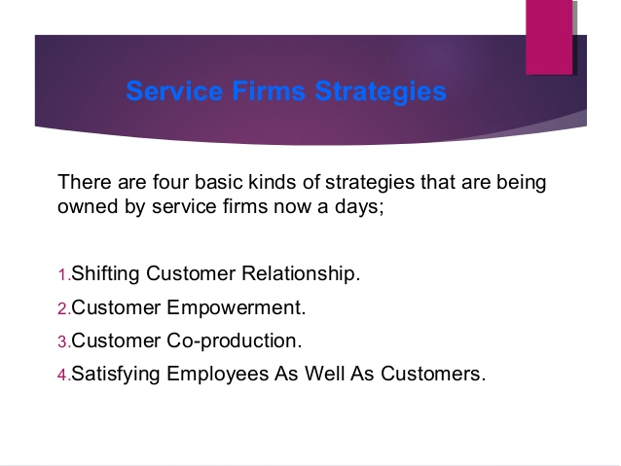

Slide 10
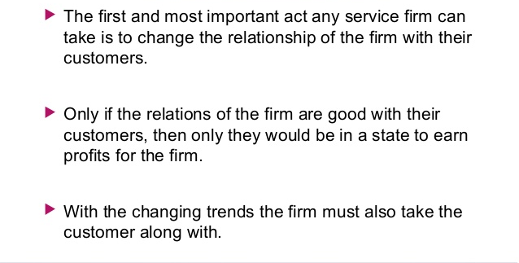
SHIFTING CUSTOMER RELATIONSHIP

Slide 11
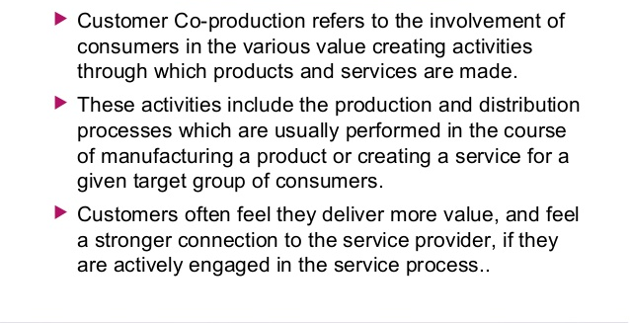
CUSTOMER COPRODUCTION

Slide 12
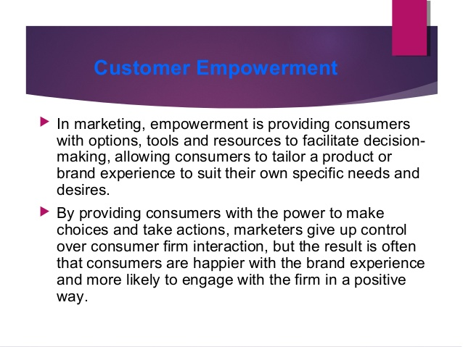
CUSTOMER EMPOWERMENT

Slide 13
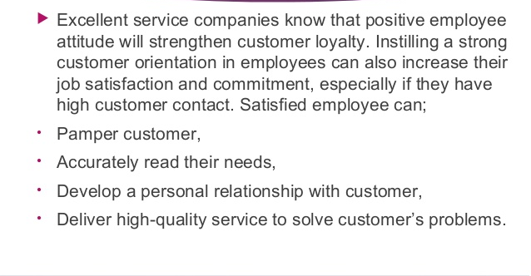
SATISFYING EMPLOYEES AS WELL AS CUSTOMERS

Slide 14
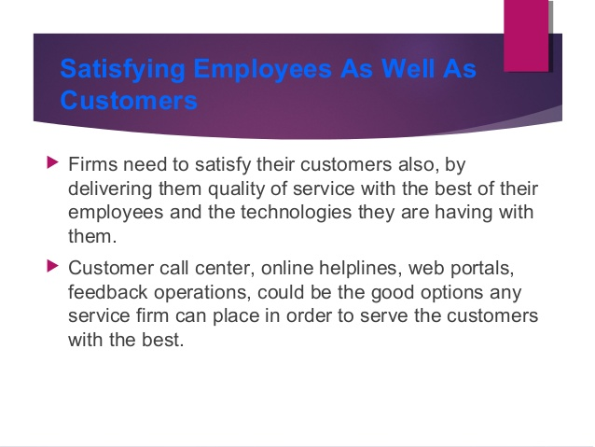
SATISFYING EMPLOYEES AS WELL AS CUSTOMERS

Slide 15
CONSUMER BEHAVIOUR

Slide 16
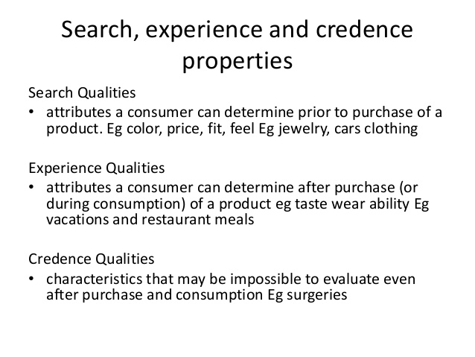

Slide 17
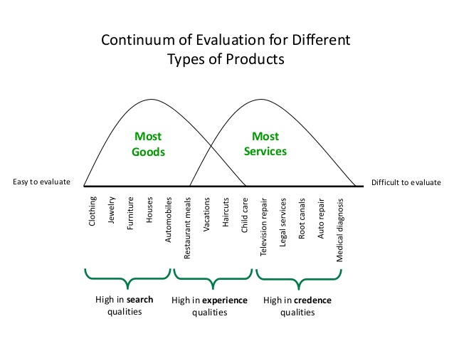

Slide 18
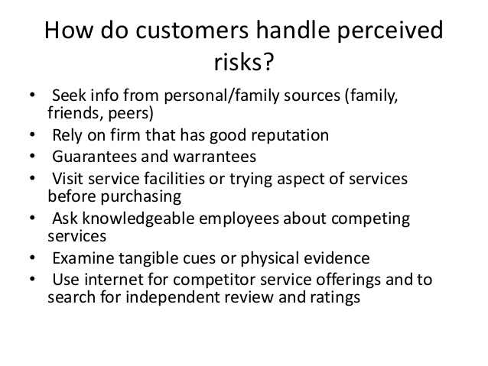

Slide 19
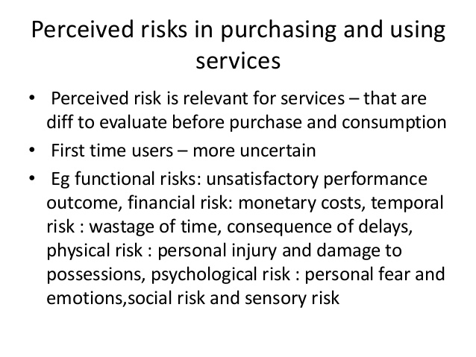

Slide 20
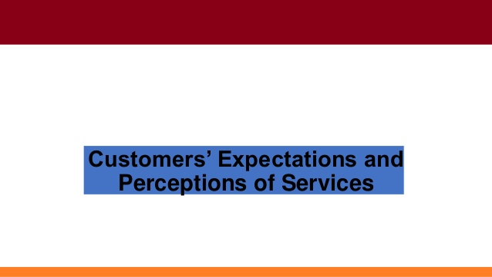

Slide 21
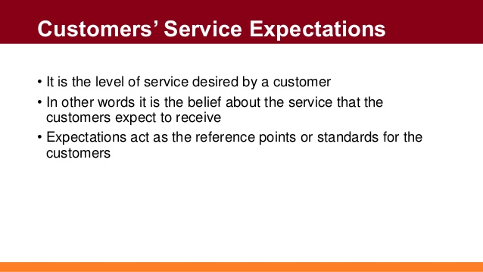

Slide 22
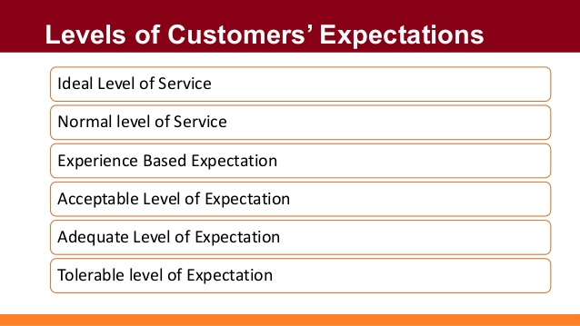

Slide 23
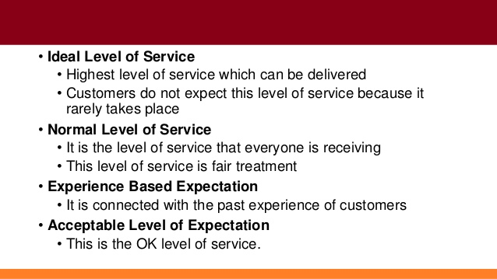

Slide 24
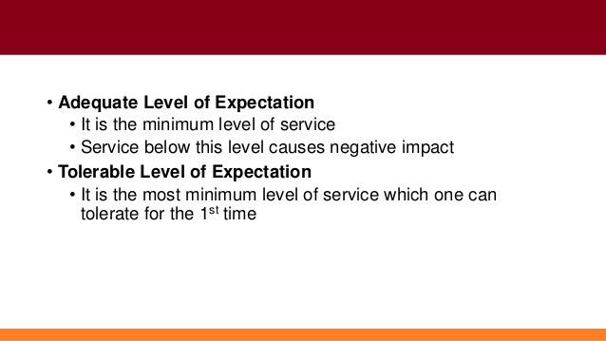

Slide 25
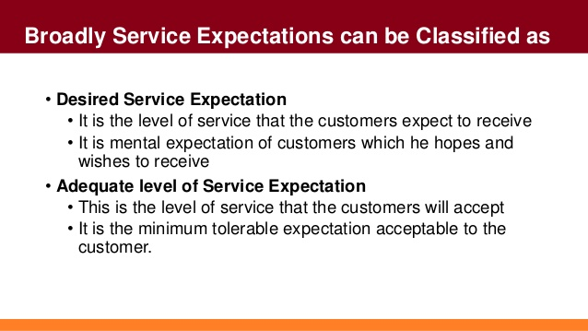

Slide 26
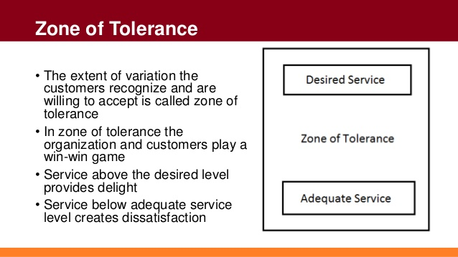

Slide 27
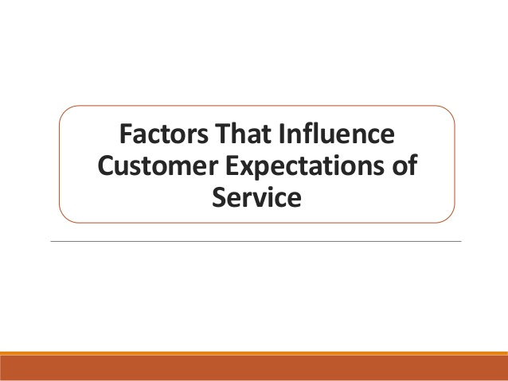

Slide 28
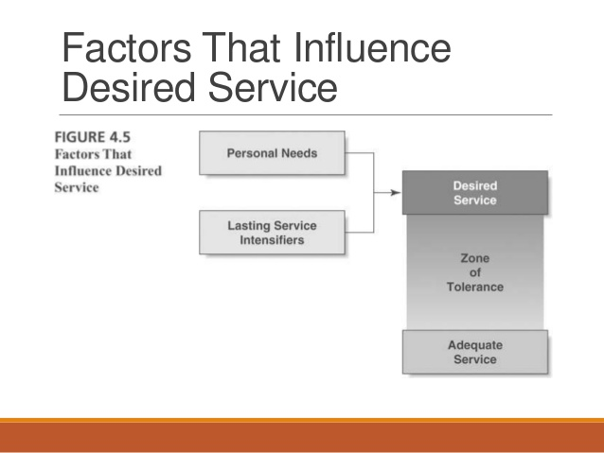

Slide 29
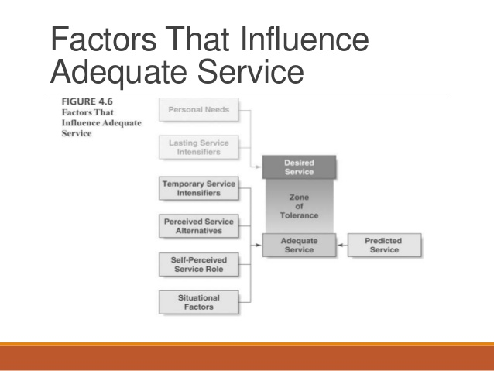

Slide 30
FACTORS INFLUENCING CONSUMER EXPECTATION
ECONOMIC FACTORS
SOCIAL FACTORS
IMPACT OF TV ADVERTISEMENT
EXPECTED SERVICE QUALITY
SITUATIONAL FACTOR INFLUENCE
FINANIAL POSITION AND SPENDING CAPACITY.

Slide 31
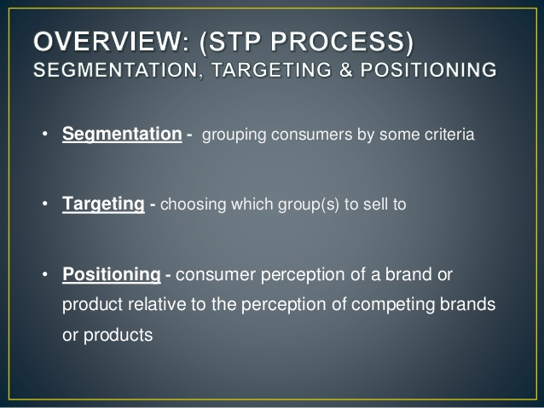

Slide 32
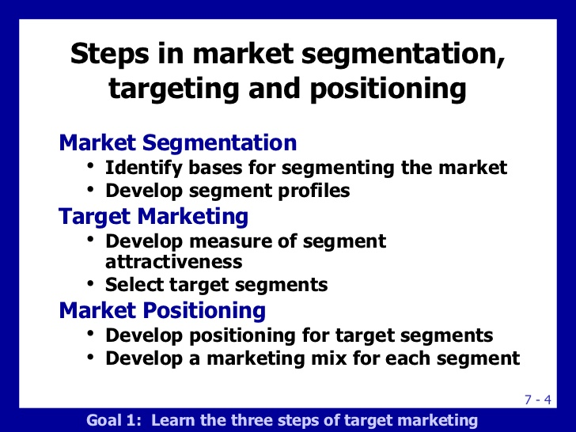

Slide 33
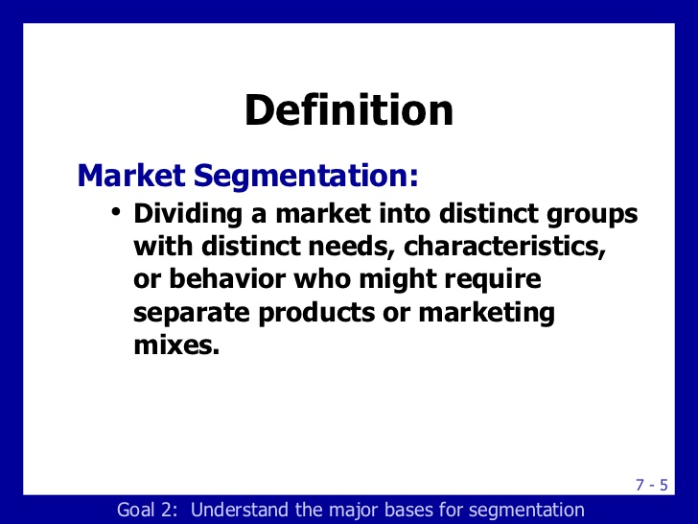

Slide 34
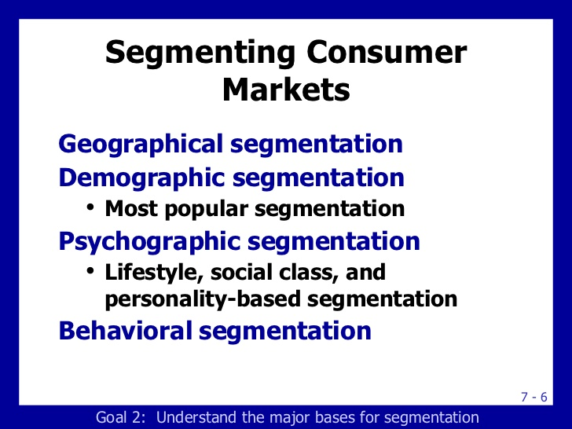

Slide 35
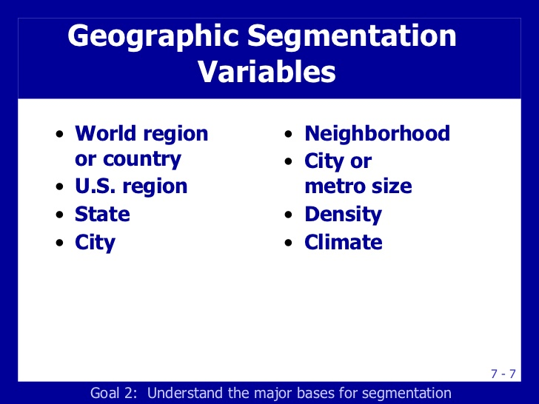

Slide 36
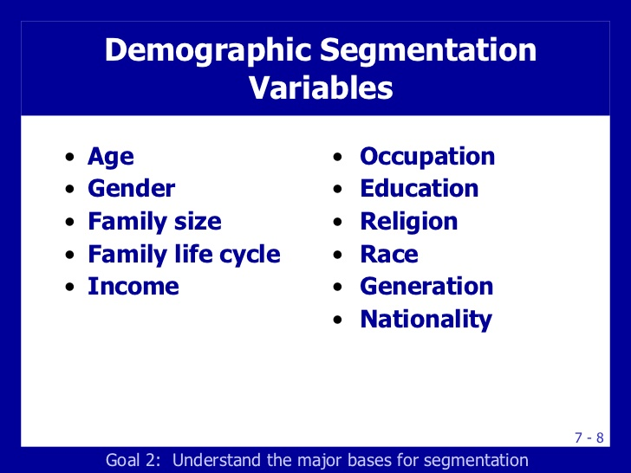

Slide 37
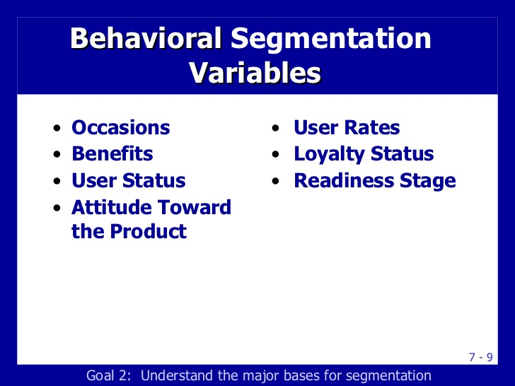

Slide 38
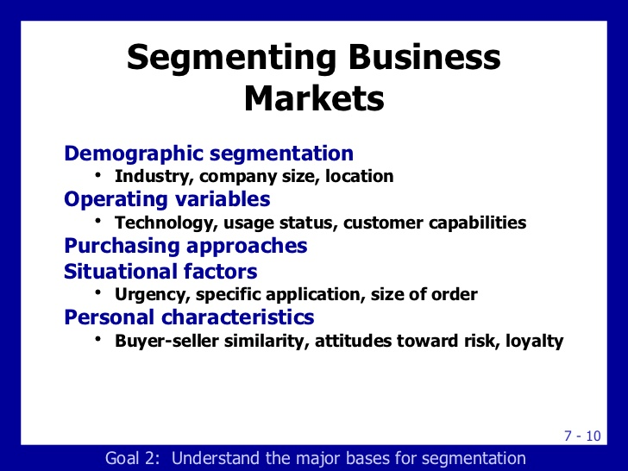

Slide 39
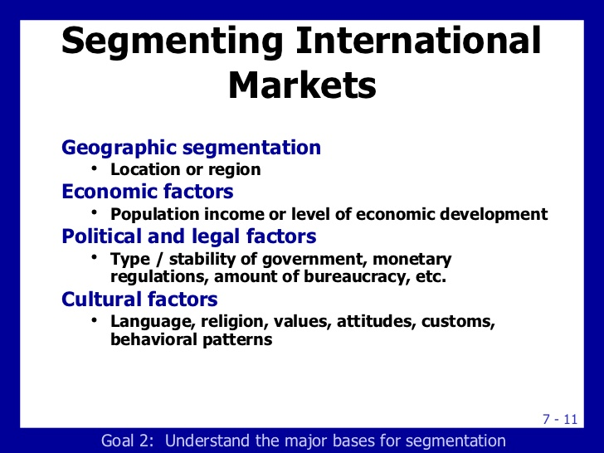

Slide 40
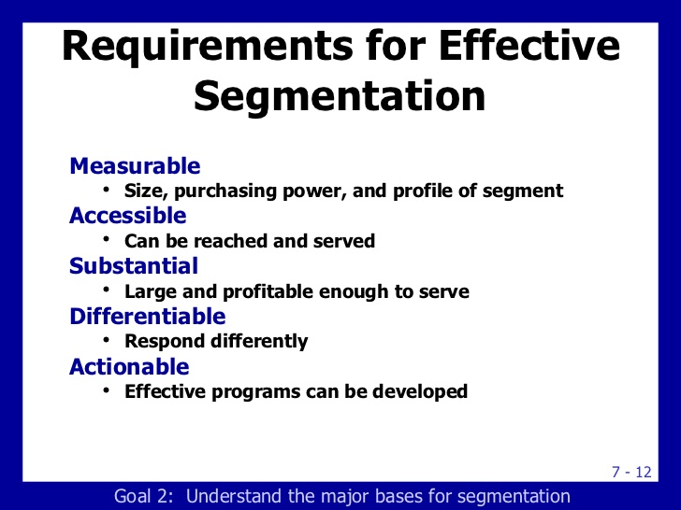

Slide 41
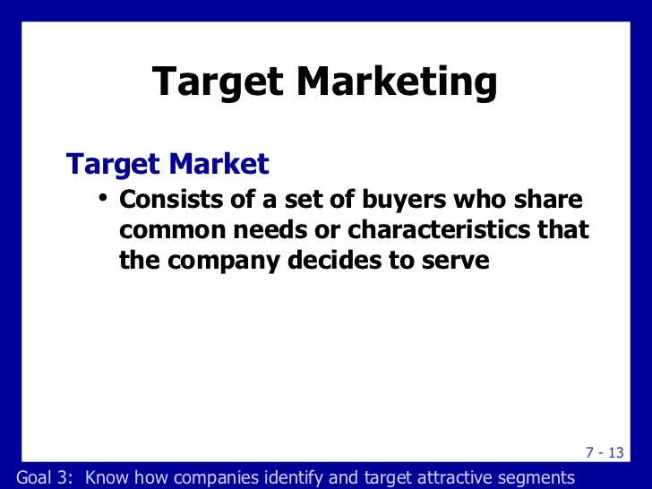

Slide 42
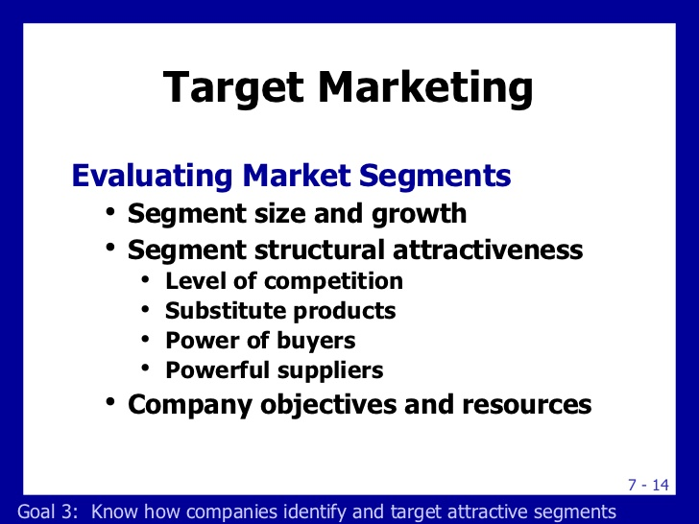

Slide 43
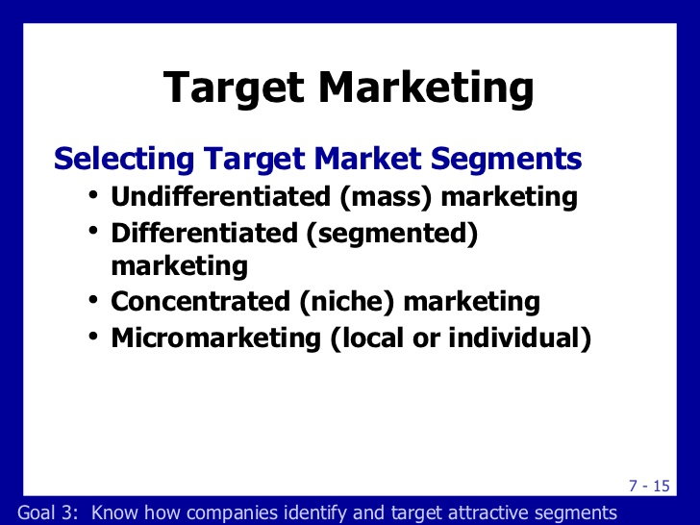

Slide 44
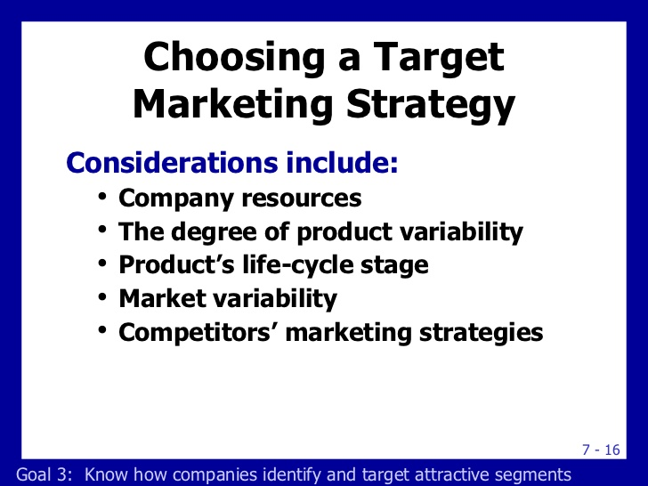

Slide 45
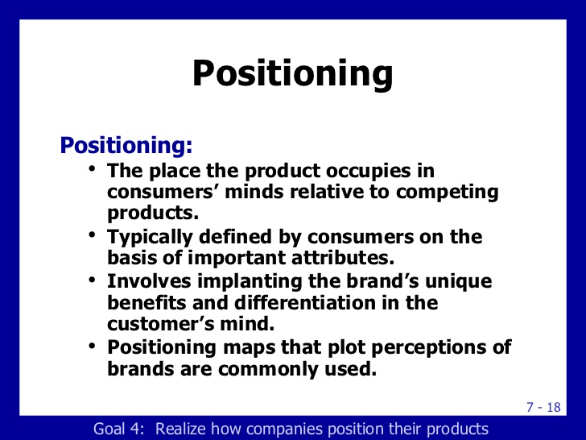

Slide 46
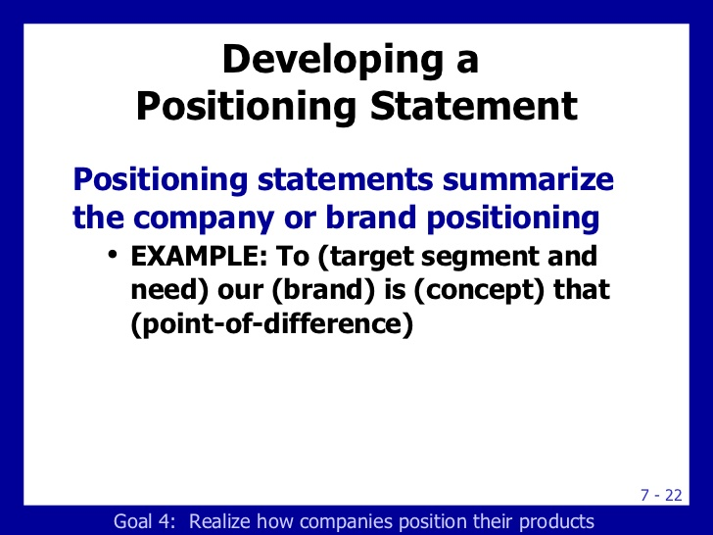

Slide 47
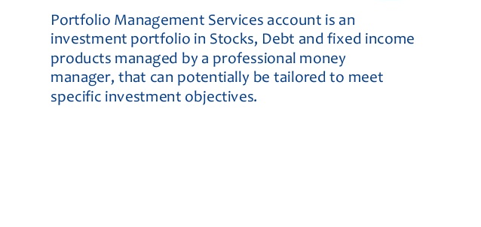
PORTFOLIO SERVICE MARKETING

Slide 48
PORTFOLIO SERVICE MARKETING
These are those services which are offered to investors with a great responsibility to maximise return. It is a service provided to the investors wherein the agency takes the responsibility of using the fund effectively for maximum result.
Service is given by registered merchant banker.(SEBI)
The portfolio is valued and reviewed periodically in the light of the changing market condition.

Slide 49
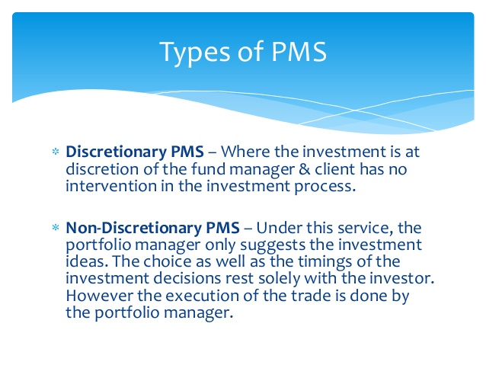
TYPE OF PMS

Slide 50
Non discretionary PMS
Delegated Investment Management: here client leave the management of portfolio to the firm.
Optional: here the firm starts with non discretionary PMS and as they gain expertise they provide several additional service such as tax consulting, borrowing against securities etc.

Slide 51
SERVICE MARKETING IMPLICATION IN PMS
In order to create a distinction in the market, portfolio manager has to perform 3 major task.
Design service strategy
Tangibalisation of service
Developing service system

Slide 52
Designing service strategy
It satisfies two major expectation :
Credibility
Professional relationship
Credibility is built over a period of time. It is based on the performance of PMS on various factors like ROI, satisfaction of the info need etc.
The professional relationship requires that the provider of the service should be well trainedat portfolio mgmt. and also in communication and behavioural skill.

Slide 53
Tangibalisation of PMS
This can happen in following ways:
A well equipped information processing technology which can focus on the info need of the client.
In service where customers are not aware or are uncertain of the process, some kind of assurance build trust
Provide membership identity to the clients.
Pleasant looking décor of the premise gives confidence and also make service delivery system convenient.
In a competitive market, PMS need to be differentiated,

Slide 54
Delivery service system
The service system consists of two parts
Operating and
Delivery System

Slide 55
OPERATING SYSTEM
RESEARCH AND ANALYSIS
CLIENTS
BROKER
PORTFOLIO MANAGER
CUSTODY FUNCTION

Slide 56
DELIVERY SYSTEM
Success of the delivery system depends on people, equipment and technology. The final quality of service is tested at MOMENT OF TRUTH.
The expertise and the attitude of portfolio manager is an asset in such situation.
no service system is complete without efficient recovery system.
Any complaints should be positively taken and considered as a scope of improvement

Slide 57
Models of service

Slide 58
SERVICE DELIVERY FUNCTION
To provide service to the users.
To provide the resources necessary for service.
To maintain service to a standard that can be used by all the members
To balance the need of service users with the need of the service and the need of the community.
To share on skills resources where needed.

Slide 59
Service model
While a service provider operates within its own model of care, each community that the service operates within is based on a model that loosely describes its function or role within the society. 3 broad models are:
SOCIAL
PROFESSIONAL
SCIENTIFIC

Slide 60
SOCIAL MODEL
Concerned with who we are and how we socialise with each other. Families, ethnic or social groups, hobby clubs are all about how the members interact with each other and how the environment affects the members as a group. The purpose of community is less formal with less defined roles.

Slide 61
Professional Model
It is concerned with providing an environment that accommodates the particular profession or the activity of the profession. The members have to fit in to structured environment that are less accommodating to the needs of the individual members and how they interact with each other. The purpose of the community are formal with clearly defined roles of its members. Records are kept on budgets, expenses, care plans, progress notes, medical histories etc.

Slide 62
Scientific model
It is concerned with research, facts and figure. The community is highly structured around a set of standard, procedures and principles that do not allow for individuals. Focus is on objective systemic enquiry of patterns of behaviour, interactions time and resources, balance sheets and budgets.

Slide 63
conclusion
Communities are generally mixture of 3 types. Social groups need to have freedom to socialise, but also need some order or structure to coordinate activities and work within budget etc. work place need formal structure and environment to achieve the desired goals, but there also need to be some flexibility to allow for individual need. Scientific community study measure and analyse the behaviour, performance and the environment of individual and group. They also need to have some flexibility to allow for individual need.

Slide 64
Customer satisfaction
Satisfaction is customer fulfilment response. It is a judgement that a product or service feature or the product or service itself, provides a pleasurable level of consumption related fulfilment.
Satisfaction is the consumer evaluation of the product or service in terms of whether that product or service has met the customer’s need and expectation.

Slide 65
Factors determining customer satisfaction
Product and service feature.
Consumer emotion
Attribution for service success or failure
Perception of equity or fairness.
Other consumer, family members and co workers

Slide 66
Relationship value of customer
Relationship value of customer is a concept or calculation that looks at customers from the point of view of their lifetime revenue and or profitability contribution to the company.

Slide 67
Factors influencing relationship value
Estimating customer lifetime value.
Linking customer relationship value to firm value.

Slide 68
Customer profitability index
Profitability tiers
PLATINUM
GOLD
IRON
SILVER

Slide 69
CUSTOMERS VIEW OF PROFITABILITY TIERS
Customer do not like to be categorised in less desirable segment.
Though it make perfect business sense but customer view it as discriminatory and give poor marks for quality.
It is important for the firm to communicate with customer and made them aware of the level of service they can receive at each level.
It also questions privacy of the customer.

Slide 70
Structural bond
Integrated information system
Financial bond
Volume and frequency reward
Social bond
Continuous relationship
Customisation bond
Anticipation/innovation
Stable pricing
Bundling and cross selling
Personal relationship
Social bond among customers
Mass customisation
Customer intimacy
Joint investment
Shared processes and equipment

Slide 71
RELATIONSHIP DRIVERS
OUTCOME
SWITCHING BARRIER
Customer Inertia
Switching Cost
CUSTOMER BENEFIT
Confidence benefit
Social benefit
Special treatment benefit
CORE SERVICE PROVISION
Satisfaction
Perceived service quality
Perceived value
STRONG CUSTOMER RELATIONSHIP( BOND)
FIRM BENEFIT
Economic benefit
Customer behaviour benefit
HRM Benefit
RELATIONSHIP BONDS
Financial bonds
Social Bonds
Customisation bond
Structure bond

