Slide 1
Module - 4
New Trends

Slide 2
New E-Commerce Technology Trends:
Technological advancements have had a huge impact on the ecommerce world, transforming the way consumers connect with brands and empowering them to shop more effectively.
Driven by the convenience of getting products delivered at home, ecommerce has now become an integral part of everyday life.
Strategic plans, competitive marketing, and a skilled workforce, all need to be accompanied by the latest technologies.
These technological advancements have enabled ecommerce companies to meet people's purchasing needs with ease and speed.
Customers can get anything at the click of a button, all thanks to the latest available technology.

Slide 3
1. The necessity of Omni channel presence and support
Modern shopping habits involve a process of cross-channel research, consideration, and purchase.
Indeed the statistics show that 90 percent of customers expect smooth interactions across multiple channels and devices, highlighting the importance of Omni channel readiness for today’s businesses.
Making use of the right technology means providing customers with not only what they want when they want it, but where they want it too.

Slide 4
Here are some methods and technologies that work well in an interconnected customer journey:
Video Chat allows your business to interact face-to-face with customers creating a personalized, cross-channel, visually demonstrative and consultative experience.
Co-Browsing is a visual engagement system bringing your agents and customers together on the same page, at the same time, allowing agents to seamlessly guide your customers through complex procedures.
Screen Sharing is a method of interacting where your customers share their screen with your agents to resolve difficulties filling forms, completing transactions, etc.
Document Interaction provides a platform for your agents to interact with your customers’ documents safely and includes e-signature technologies for enhanced security.

Slide 5
2. The need for extensive personalization
Personalization is the biggest trend in ecommerce right now.
Consumers have come to expect a relevant shopping experience based on their personal preferences
Effective personalization comes from understanding customers’ preferences and behavior.
Fortunately, ecommerce technology has now evolved to provide that level of insight.
Nearly every user action online is captured and stored, creating a vast pool of information known as big data.

Slide 6
Artificial Intelligence (AI) and machine learning analytics drive customer behavior patterns, whilst simultaneously interpreting this data, meaning businesses are provided with a cycle of desires and expectations, creating endless possibilities.
Big data, machine learning, and AI have made personalization the norm, with businesses catering their support and services to reflect this.

Slide 7
3. The shift to mobile
Mobile platforms have increased in importance, so much so that m-commerce has emerged as a concept in its own right.
Failing to provide a mobile-oriented shopping experience will certainly not help you win potential customers that place high importance on mobile.
Equipping yourself with mobile-friendly technology is crucial in maximizing your chances of future success.

Slide 8
Consider:
Ecommerce mobile apps. Apps offer customers continuous engagement with your brand and the chance for your customers to familiarize themselves with new and relevant purchasing opportunities.
Location-based marketing. Use your customers’ geographical whereabouts to market products relevant to their specific location.
VR/AR guidance. Integrating VR and AR technologies provides an immersive mobile shopping experience for your customers, connecting them with your brand in a deeper and more meaningful way.
Internet of Things (IoT). The IoT stems from the desire to better understand consumer trends across a range of connected devices. The scope it provides for delivering personalized mobile shopping experiences to your customers is almost limitless.

Slide 9
4. The rise of conversational marketing
Traditional marketing channels flow only in one direction.
The new concept of conversational marketing has opened up two-way communication, creating numerous opportunities for ecommerce success.
Getting information directly from customers makes more sense than attempting to predict it.
You can establish a personalized, real-time, one-on-one conversation on the back of this, safe in the knowledge you truly understand your customers’ needs.

Slide 10
Below are some of the most efficient technologies for nurturing customer conversations:
Chabot's. Chatbots are excellent conversational marketing tools, capable of handling multiple conversations at any one time. They provide your customers with answers, drawing on knowledge pooled from multiple channels, whilst maintaining a consistent tone for your brand.
Live chat. Live chat allows your support teams to communicate with customers through live messaging. You can initiate a preemptive chat invitation to particular customers based on their behavior.
Mobile messaging. Smartphones are another way for your business to reach out to customers. With potential fatigue from the onslaught of promotional emails, talk with them through mobile messaging apps instead.

Slide 11
5. The implementation of AI and chatbots into customer communications
Artificial Intelligence plays an important role in everyday life, having a major impact on how we live and work. There are several examples of AI and automation tools with customer service applications for your business, including voice-powered assistants such as Apple’s Siri, Google’s home and Amazon Echo.
Chatbots and virtual assistants represent the future for businesses. Some are already integrating chatbots in their systems to improve their customers’ experience and boost brand image.
With the help of chatbots you can order food, check in luggage at the airport, book a hotel room, schedule your flight, and get recommendations for almost anything you can think of.

Slide 12
6. The importance of image search
Ecommerce businesses are integrating image search technology on their websites so customers can easily photograph products they are interested in and find similar examples on other sites that may be offering better deals.
Imagine someone sees a beautiful couch, but it costs too much for them. If your business offers similar products at a more reasonable price, integrating image search into your website will allow you to potentially pick up on this sale, creating an extra revenue stream.

Slide 13
7. The efficiency of checkout processes
Cart abandonment is the most frustrating reason for losing a sale because it means a user was considering buying your product, only to change their mind at the last minute.
One of the main reasons customers abandon their carts is the checkout procedure itself.
No matter how well the lead has been nurtured, inefficient checkout processes raise the chances your users will abandon their cart.

Slide 14
Therefore, if you want your ecommerce company to be successful, embrace technology that provides quick and efficient checkout solutions, such as:
Speedy mobile payment solutions, including Apple Pay and Android Pay.
Enabling your customers to save card details, streamlining repeat purchases.
Providing one-page, hassle-free checkouts.
Offering a range of payment options.

Slide 15
Broadband Technologies
Broadband is a broad bandwidth data transmission having the capacity to concurrently transmit numerous signals as well as website traffic types.
This technology is either coax , fiber optics, radio transmission or twisted pair.
Due to the fact that a large band of frequencies offered, info is multiplexed in addition to being transmitted on various frequencies or channels inside the band simultaneously, permitting vast amounts of data to be transferred in a provided block of time.

Slide 16
The consumer has the difficult choice between various broadband technologies many of which have the capacity to transmit a multitude of signals and also internet traffic to millions of websites.
Some of the answers could be determined by a number of factors including:
  1. Whether you live in a city or rural area
  2. How the broadband service is packaged with other services including telephone or television entertainment
  3. Pricing and availability in your area

Slide 17
Types:
Wired broadband technologies - Include copper cable (xDSL), coaxial cable (e.g. HFC), broadband over power lines (BPL) and optical fibre cable (FTTx).
Wireless broadband technologies - Include mobile radio solutions (e.g. HSPA, LTE), fixed radio solutions (e.g. WiMAX) and satellite solutions.

Slide 18
Wired broadband technologies
Copper wires
Copper wires are defined as “legacy telephone unshielded copper twisted pair”, providing broadband connections by using xDSL-technologies, such as ADSL/ADSL2+ (max. 24/3 Mbps down-/upstream rate within max. 0,3 km efficiency range) or VDSL/VDSL2/VDSL2-Vplus/VDSL2 vectoring/G.fast (with vectoring max. 300/100 Mbps down-/upstream rate within 0,2 km efficiency range).

Slide 19
Pros:
They require relatively low investment needed for passive infrastructure (a copper telephone line is already present in most households) and are least disruptive for the end users.
Cons:
The high (download) speeds depend on the length of copper line.
The xDSL technology is heavily asymmetrical: upload speeds are generally much lower than download speeds; this may hamper new services.
Higher investment is needed in active equipment (with a life-time of 5-10 years).

Slide 20
Coaxial cables
The classical cable connection would be the two wires of a telephone line (‘twisted pair’), most prone to disturbance effects such as interferences.
Broadband internet via coaxial cable is usually offered to customers via the existing cable TV (CATV) network.
The coaxial cable consists of a copper core and a copper-shielding coat.
The TV cable networks are therefore much more efficient than the traditional telephone networks.

Slide 21
Pros:
Low investment needed for passive infrastructure.
Least disruptive for the end users.
Offers slightly more opportunities to deliver higher broadband speeds than on telephone lines.
Ultra-fast speeds are possible
Cons:
The bandwidth is shared among several users reducing its availability during peak traffic periods of the day.

Slide 22
Broadband over power line (BPL)
Broadband can be delivered over existing low and medium voltage electric power distribution networks.
BPL speeds are comparable to those of xDSL and coaxial cables.
Pros: It is not necessary to deploy new infrastructure as existing power lines can be used. BPL has great future potential as power lines exist nearly everywhere.
Cons: In low populated areas, the technology is only economically viable for the end user if 4 to 6 homes are equipped with transformers to make broadband available over power lines. Otherwise, end user prices for internet access surpass those for xDSL and coaxial cable solutions.

Slide 23
Optical fibre
Optical fibre lines consist of cables of glass fibre connected to end-users’ homes (FTTH), buildings (FTTB) or street cabinets (FTTC).
They allow for very high transmission rates of 100 Gbps and more within very wide (10-60 km) efficiency range.
This is the most future-oriented solution, but requires high investment in passive infrastructure.
Pros: Extremely high level of transmission rates and symmetry, less susceptible to interference and hardly any power drop at larger distances.
Cons: High investment costs in passive infrastructure due to the high costs of civil engineering for excavation and piping; deployed infrastructure is not locatable and requires exact documentation.

Slide 24
Wireless broadband technologies
Antenna sites for wireless connections
A terrestrial wireless broadband connectivity is usually provided by WiMAX (up to 60 km efficiency range), Wi-Fi (up to 300 m efficiency range) or 4G/LTE/LTE Advanced (up to 3-6 km efficiency range) solutions.
Further improvements will focus on new standards with additional features and the provision of additional frequency spectrums (5G).
Whenever the upgrade of the wired infrastructure is not possible, and funds for FTTB/FTTH are not available for a certain area, an option is to build infrastructure for terrestrial wireless broadband, mainly antenna sites for point-to-multipoint connections (e.g. WiMax, Wi-Fi, 4G/LTE).

Slide 25
Pros:
First mile wire connections are not needed.
The infrastructure can be used for commercial mobile services as well.
Cons:
Since the bandwidth can be shared among several users, peak traffic periods of the day will reduce the available bandwidth for each user.
Signal strength decreases fast with distance, and is affected by weather; disturbed line-of-sight may reduce signal quality.

Slide 26
Satellite broadband
Also referred to as internet-by-satellite, is a high-speed bi-directional internet connection established via communications satellites located in the geostationary orbit.
The end customer sends and receives data via a satellite dish located on the rooftop.
Pros: It requires low investment for passive infrastructure as regional backbone and area networks are not needed. It is easy to connect users scattered over a relatively large area
Cons: Limited total number of users can be covered in one region. Its inherently high signal latency due to the propagation time to and from satellite hampers certain applications. A relatively high investment for active end-user equipment is necessary. Bad weather and limited line-of-sight may reduce the signal quality. Data traffic is typically capped monthly or daily in current commercial offers.

Slide 27
Affiliate marketing
What is affiliate marketing?
Affiliate marketing is an online sales tactic that lets a product owner increase sales by allowing others targeting the same audience—“affiliates”—to earn a commission by recommending the product to others.
At the same time, it makes it possible for affiliates to earn money on product sales without creating products of their own.
Simply put, affiliate marketing involves referring a product or service by sharing it on a blog, social media platforms, or website.
The affiliate earns a commission each time someone makes a purchase through the unique link associated with their recommendation.
Done well, this performance-based opportunity can become an important part of your business by netting you a healthy income.

Slide 28
How does affiliate marketing work?
To participate in an affiliate marketing program, you’ll need to take these five simple steps:
  Find and join an affiliate program
  Choose which offers to promote
  Obtain a unique affiliate link for each offer
  Share those links on your blog, social media platforms, or website
  Collect a commission anytime someone uses your links to make a purchase

Slide 29
Commission rates vary dramatically, depending on the company and the offer.
On the low end, you’ll earn about 5% of the sale but, with some arrangements, you can earn as much as 50%, usually when promoting a class or event.
There are also affiliate marketing programs that provide a flat rate per sale instead of a percentage.

Slide 30
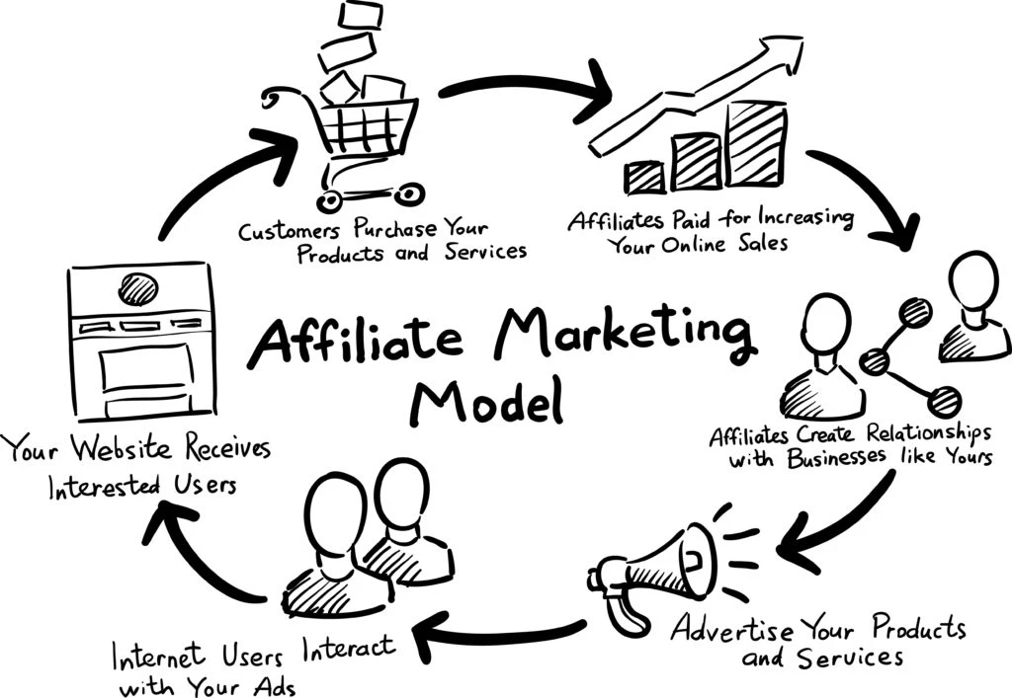

Slide 31
Benefits of the affiliate marketing
You don’t have to worry about the harder tasks, like developing, supporting, or fulfilling the offer.
Low risk.
You can start making money with an established affiliate product or service without any upfront investment.
Can generate relatively passive income through commission—the ideal money-making scenario.
Your existing work continues to generate revenue in the background.

Slide 32
Challenges:
Competition
No guarantees
Contracts between affiliates and merchants
It’s not as easy
Creating Content
Poor Sales
Confusing Affiliate Links and HTML Code

Slide 33
Content marketing
Content marketing is a strategic marketing approach focused on creating and distributing valuable, relevant, and consistent content to attract and retain a clearly defined audience — and, ultimately, to drive profitable customer action.
Content marketing is good for your bottom line — and your customers
Specifically, there are three key reasons — and benefits — for enterprises that use content marketing:
  Increased sales
  Cost savings
  Better customers who have more loyalty
Content is the present – and future – of marketing

Slide 34
Marketing is impossible without great content
Regardless of what type of marketing tactics you use, content marketing should be part of your process, not something separate.
Quality content is part of all forms of marketing:
  Social media marketing: Content marketing strategy comes before your social media strategy.
  SEO: Search engines reward businesses that publish quality, consistent content.
  PR: Successful PR strategies address issues readers care about, not their business.
  PPC: For PPC to work, you need great content behind it.
  Inbound marketing: Content is key to driving inbound traffic and leads.
  Content strategy: Content strategy is part of most content marketing strategies.

Slide 35
Why Content Marketing?
First we need to understand the four steps of the buying cycle:
Awareness. Prior to awareness a customer may have a need, but they are not aware there is a solution.
Research. Once a customer is aware there is a solution, they will perform research to educate themselves. For example, a car buyer will try to find out what different types of cars exist, and which one will fit their needs.

Slide 36
Why Content Marketing?
Consideration. At this point the customer starts comparing different products from different vendors to make sure they’re getting a high quality product at a fair price.
Buy. Finally, the customer makes their decision and moves forward with the transaction.
Content marketing taps into the first two stages of the buying process by raising awareness of solutions and educating consumers about a product they may have never considered before.

Slide 37
Benefits:
Faster sales.
Reduced marketing and sales overhead.
Low barrier to market entry.
Measurable, actionable results.
Higher search engine rankings.
More traffic.
Reputation management.

Slide 38
Challenges
Producing high-quality content
Generating content consistently
Prioritizing content expertise
Understanding different buyer personas
Producing content in suitable formats
Measuring content ROI
Creating buy-in among stakeholders
Aligning content with the buyer journey
Activating content effectively
Choosing the right channels

Slide 39
Key Performance Indicator (KPI)
What is a KPI?
A KPI is a type of measure that is used to evaluate the performance of an organization against its strategic objectives.
KPIs help to cut the complexity associated with performance tracking by reducing a large amount of measures into a practical number of 'key' indicators.
KPIs can be used to track the operational performance of departments, projects or individuals against targets or goals.
They can provide a management tool for gaining insight and decision making.

Slide 40
So what is the definition of KPI? What does KPI mean? What does KPI stand for? Here are a couple other definitions:
Oxford's Dictionary definition of KPI: A quantifiable measure used to evaluate the success of an organization, employee, etc. in meeting objectives for performance.
Investopedia's definition of KPI: A set of quantifiable measures that a company uses to gauge its performance over time.
Macmillan's Dictionary definition of KPI: A way of measuring the effectiveness of an organization and its progress towards achieving its goals.

Slide 41
What do KPIs look like?
Unlike simple Metrics that are used to monitor and present values, such as the number of visitors to a website. KPIs may incorporate one or many different metrics to track a business objective. For example, a KPI aligned to a strategic marketing objective may look like this:
Objective: Increase the website conversion rate to 20%.
Description: The current conversion rate has stalled at 12%. To be competitive the conversion rate needs to increase in line with our competitors.
Completion: By the End of the year.
Reporting Frequency: Monthly.
Visual:
Data Source: Number of Trials / Number of conversions.
Owner: Product Manager.

Slide 42
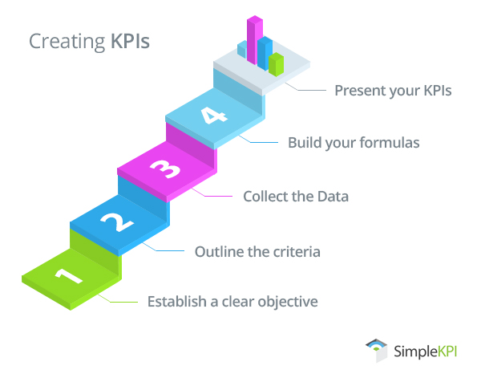
How to create KPIs in 5 simple steps
Developing meaningful KPIs that track, and clearly visualize performance takes some planning.
Each KPI needs to address a specific business objective, and provide timely, accurate information to assess progress towards goals.
Essentially, creating successful KPIs comes down to understanding the aspirations of the business using a clear, structured process for crafting KPIs.

Slide 43
Here's how to create a KPI:
Establish a clear objective.
If a goal of the business is to be the 'market leader', then a KPI objective maybe to 'increase revenue by 10% this financial year' or 'Expand our product lines to 20'. State clearly, and in simple terms the purpose of the KPI. This provides guidance for anyone viewing the KPI to interpret the data in the correct context.
Outline the criteria for success.
What will the target be? Is it attainable? when should it be accomplished? and how will progress be monitored? Targets should be realistic, changes to business processes take time to implement. In the initial stages of KPI monitoring it's best to focus on long-term targets with midterm monitoring.

Slide 44
Collect the data.
Investigate the availability and accuracy of the data. Data may be available automatically from existing systems or hidden in reports and databases. This data will all need to be pulled together at regular intervals for reporting in one central place.
Build the KPI formula.
Some KPIs contain but a single metric or measure. However most rely on a combination brought together under a single calculated formula. For example, a KPI that measures productivity in revenue by machine would look like this: Total Revenue divided by the total number of machines. Build formulas and create calculations with test data to see if the results are what you would expect.

Slide 45
Present your KPIs.
To efficiently communicate your KPIs you'll need to translate the data into understandable visuals such as graphs and charts. Dashboards for Operational KPIs, or Reports for Strategic KPIs offer a convenient way to create, track and distribute your KPIs.
Additionally, as business objectives change, it will be necessary to revisit your KPIs periodically to tweak, adjust or replace as needed.

Slide 46
What are Leading and Lagging KPIs
When you're looking to implement KPIs to improve a business process, you will often hear the terms “leading” or “lagging” indicators.
Lagging KPIs - are used to determine the result of past performance, such as production, volume or a result. They are easy to measure as they are typically a simple value that is used to understand how well a process is performing.
Leading KPIs - are used to predict or influence future performance. They are more difficult to set up as they rely more on external actions to impact outcomes, such as changes in process or investments in infrastructure.

Slide 47
KPIs fall into two main categories:
Operational KPIs clearly articulate detailed and timely information that is used to make day to day decisions, or take corrective actions on performance or a process. These KPIs are usually complex in nature as they use formulas with data from multiple sources.
Strategic KPIs are focused on long term objectives derived from an organizations goals. They help identify if a strategy is working and if it is on target. As such these KPIs are sometimes referred to as High Level KPIs.

Slide 48
Complex server
Complex Servers are typically mission-critical enterprise servers that are highly fault tolerant and use specialized hardware with low failure rates and CPU, memory, power and cooling redundancy to maximize system uptime.
Complex servers are only compatible with their original manufacturer hardware platforms.
An enterprise server provides consolidated connections, a choice of broadcast, TCP/IP or multicast, as well as user-defined tools for conflation and hibernation, resulting in improved network and desktop performance.

Slide 49
An enterprise server is a computer server that includes programs required to collectively serve the requirements of an enterprise instead of an individual user, unit or specific application.
Traditionally, mainframe-sized computer systems were used as enterprise servers, although they weren't initially referred to as such.
Due to their ability to manage enterprise-wide programs, UNIX-based servers as well as Wintel computers are also generally labeled enterprise servers.
Some examples of enterprise servers include Sun Microsystems' servers with Linux or UNIX-based Solaris systems, IBM iSeries systems, Hewlett-Packard (HP) systems, and so on.

Slide 50
The key features of an enterprise server include:
Sensible Data Conflation and Hibernation: This leads to a decrease in desktop and network traffic by around 75 percent when compared with conventional data delivery methods
Connectivity: Supports managed network, private circuit, or Internet connections among redundant data centers and the main and remote sites.
Flexible Topology: Facilitates streaming data connections by means of UDP broadcast, TCP/IP and IP multicast technologies. This minimizes bandwidth demands and ensures compatibility with network policies.

Slide 51
IT Productivity: Allows organizations to make the most of limited IT resources
Manageability: Creates better control and manageability over devices
Enhanced Security Features: Better security ensures data integrity and confidentiality
Fault Tolerance: Enhanced fault tolerance results in maximum reliability
Productivity: Results in increased user productivity

Slide 52
Network Infrastructure
Network infrastructure is the hardware and software resources of an entire network that enable network connectivity, communication, operations and management of an enterprise network.
It provides the communication path and services between users, processes, applications, services and external networks/the internet.
Network infrastructure is typically part of the IT infrastructure found in most enterprise IT environments.
The entire network infrastructure is interconnected, and can be used for internal communications, external communications or both.

Slide 53
A typical network infrastructure includes:
Networking Hardware:
  Routers
  Switches
  LAN cards
  Wireless routers
  Cables
Networking Software:
  Network operations and management
  Operating systems
  Firewall
  Network security applications
Network Services:
  T-1 Line
  DSL
  Satellite
  Wireless protocols
  IP addressing

Slide 54
Main Challenges Surrounding Network Infrastructure?
There are a number of challenges in regards to running a network infrastructure model.
Some of the top three network infrastructure challenges are:
  Centralizing traffic
  Dealing with duplicate data
  Sending the right data to the right tool

Slide 55
1. Centralizing Traffic
Within an organization, there are often multiple different subnets and locations or sites.
Without a centralized hub, network visibility, monitoring and management can become near impossible.
Many companies use network infrastructure solutions to centralize traffic to better understand and monitor the data traversing their networks.
This enhances their security posture and helps network operations teams address performance issues.

Slide 56
2. Dealing with Duplicate Data
In some cases, duplicate data can comprise 50 – 66 percent of network traffic.
Removing duplicate data is critical, particularly when it comes to the effectiveness of network security solutions.
If the security solutions get too much duplicate data, they may be slowed down and less effective in detecting threats.

Slide 57
3. Sending the Right Data to the Right Tool
Many organizations use a number of different cyber security tools and providers.
Many security providers often charge based on how much data they need to process.
As such, sending the right type of data to the right tool is a critical aspect of infrastructure networking.
Sending data from many different sources all to the same tool might be ineffective and costly, particularly if one tool is best suited to one type of data and another tool to another type.

Slide 58
Transitioning to Virtualization
Virtualization is the "creation of a virtual (rather than actual) version of something, such as a server, a desktop, a storage device, an operating system or network resources".
In other words, Virtualization is a technique, which allows to share a single physical instance of a resource or an application among multiple customers and organizations.
It does by assigning a logical name to a physical storage and providing a pointer to that physical resource when demanded.
OS virtualization is the use of software to allow a piece of hardware to run multiple operating system images at the same time.
The technology got its start on mainframes decades ago, allowing administrators to avoid wasting expensive processing power.

Slide 59
What is the concept behind the Virtualization?
Creation of a virtual machine over existing operating system and hardware is known as Hardware Virtualization.
A Virtual machine provides an environment that is logically separated from the underlying hardware.
The machine on which the virtual machine is going to create is known as Host Machine and that virtual machine is referred as a Guest Machine

Slide 60
Virtual Machines Explained
A virtual computer system is known as a “virtual machine” (VM): a tightly isolated software container with an operating system and application inside.
Each self-contained VM is completely independent.
Putting multiple VMs on a single computer enables several operating systems and applications to run on just one physical server, or “host.”
A thin layer of software called a “hypervisor” decouples the virtual machines from the host and dynamically allocates computing resources to each virtual machine as needed.

Slide 61
Key Properties of Virtual Machines
VMs have the following characteristics, which offer several benefits.
1. Partitioning
Run multiple operating systems on one physical machine.
Divide system resources between virtual machines.
2. Isolation
Provide fault and security isolation at the hardware level.
Preserve performance with advanced resource controls.
3. Encapsulation
Save the entire state of a virtual machine to files.
Move and copy virtual machines as easily as moving and copying files.
4. Hardware Independence
Provision or migrate any virtual machine to any physical server.

Slide 62
How virtualization works
Virtualization describes a technology in which an application, guest operating system (guest OS) or data storage is abstracted away from the true underlying hardware or software.
A key use of virtualization technology is server virtualization, which uses a software layer -- called a hypervisor -- to emulate the underlying hardware.
This often includes the CPU's memory, input/output (I/O) and network traffic.
Hypervisors take the physical resources and separate them so they can be utilized by the virtual environment.
They are able to sit on top of an OS or they can be directly installed onto the hardware.

Slide 63
With the help of the hypervisor, the guest OS, normally interacting with true hardware, is now doing so with a software emulation of that hardware; often, the guest OS has no idea it's on virtualized hardware.
While the performance of this virtual system is not equal to the performance of the operating system running on true hardware, the concept of virtualization works because most guest operating systems and applications don't need the full use of the underlying hardware.
This allows for greater flexibility, control and isolation by removing the dependency on a given hardware platform.
While initially meant for server virtualization, the concept of virtualization has spread to applications, networks, data and desktops.

Slide 64
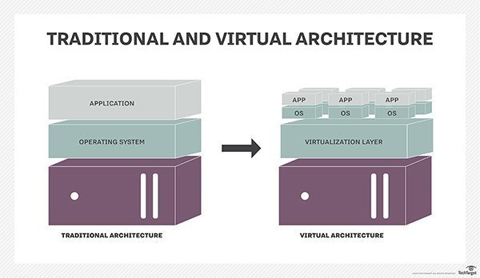

Slide 65
The virtualization process follows the steps listed below:
Hypervisors detach the physical resources from their physical environments.
Resources are taken and divided, as needed, from the physical environment to the various virtual environments.
System users work with and perform computations within the virtual environment.
Once the virtual environment is running, a user or program can send an instruction that requires extra resources form the physical environment. In response, the hypervisor relays the message to the physical system and stores the changes.

Slide 66
Types of virtualization
Network virtualization is a method of combining the available resources in a network by splitting up the available bandwidth into channels, each of which is independent from the others and can be assigned -- or reassigned -- to a particular server or device in real time. The idea is that virtualization disguises the true complexity of the network by separating it into manageable parts, much like your partitioned hard drive makes it easier to manage your files.

Slide 67
Storage virtualization is the pooling of physical storage from multiple network storage devices into what appears to be a single storage device that is managed from a central console. Storage virtualization is commonly used in storage area networks.
Server virtualization is the masking of server resources -- including the number and identity of individual physical servers, processors and operating systems -- from server users. The intention is to spare the user from having to understand and manage complicated details of server resources while increasing resource sharing and utilization and maintaining the capacity to expand later

Slide 68
Data virtualization is abstracting the traditional technical details of data and data management, such as location, performance or format, in favor of broader access and more resiliency tied to business needs.
Desktop virtualization is virtualizing a workstation load rather than a server. This allows the user to access the desktop remotely, typically using a thin client at the desk. Since the workstation is essentially running in a data center server, access to it can be both more secure and portable. The operating system license does still need to be accounted for as well as the infrastructure

Slide 69
Application virtualization is abstracting the application layer away from the operating system. This way, the application can run in an encapsulated form without being depended upon on by the operating system underneath. This can allow a Windows application to run on Linux and vice versa, in addition to adding a level of isolation.

Slide 70
Advantages
Lower costs
Easier disaster recovery.
Easier testing.
Quicker backups
Improved productivity
Benefits
Single-minded servers.
Expedited deployment and redeployment.
Reduced heat and improved energy savings
Better for the environment
Easier migration to the cloud.
Lack of vendor dependency.

Slide 71
Limitations
The necessary investment in virtualization software, as well as hardware that might be required to make the virtualization possible, can be costly.
There are also software licensing considerations that must be taken into account when creating a virtualized environment.
Implementing and controlling a virtualized environment demands each IT staff member to be trained and possess expertise in virtualization.
The chances of experiencing a data breach significantly increase while using virtualization.

Slide 72
Why Transitioning to Virtualization
  1. Cheaper implementation
  2. Business doesn’t stop
  3. Higher availability and uptime
  4. Speedy Installations
  5. Corporate directives

Slide 73
Benefits of Transitioning to Cloud Computing
High Availability
Infrastructure will be highly available in the Cloud with fewer outages experienced and less downtime. Applications will exist across a number of disparate Cloud Data Centers and can auto recover or terminate and restart if performance drops enabling continued quality of services.
Flexibility –
The enterprise will have access to the full range of programming models, operating systems, databases and architecture with which they are familiar as well as new services available through the market place. The enterprise will not be locked into infrastructure purchases and will have more freedom of choice.

Slide 74
Self Service Self Provisioning –
A Cloud environment will allow for greater adoption of self-service and provisioning, particularly in the research space. Graphical user interfaces and Cloud tools can be set-up to allow users to run their own workloads and have visibility of the costs and metrics associated.
Automation and Ease of Management –
Platform and application automation will enable greater ease of management across patching, security, provisioning, testing, deployment and logging. These operational areas become integrated into the service that the University consumes allowing quicker deployment of services.

Slide 75
Scalability –
Movement of workloads to Cloud will allow the enterprise to instantly scale up or down in line with employees demands. This will allow the enterprise to maintain quality services as it grows and accounts for volatile or seasonal application usage.
Greater Security Controls –
Cloud environments keep track of all changes made through logging and can make use of the latest firewalls and security features to reduce the likelihood and impact of cyber attacks and internal mistakes.

Slide 76
Use of fully or partially outsourced it support
1. Lower operational and labour costs:
It may seem to to be counter-intuitive but outsourcing your IT services can reduce overall costs. If this is executed properly you can reduce costs directly and indirectly through staff and investments in technology.
2. Increased expertise:
Many service-based IT outsourcing partners have continuous training and development programmes that allow you to take advantage of additional skills you may not have internally. These could include; network, telephony, software support, and web development.
3. Improved business focus:
Organizations that outsource their IT support, consultancy and system maintenance can focus management time on core business issues including business development and growth.

Slide 77
4. Risk
By utilizing an outsourced IT partner, businesses can reduce the risks associated with technology. Outsourced partners typically have industry certifications and standards that aren’t easily achieved inside a business that is not IT focused.
5. Expand resource
IT support and outsourced technology partners predominantly have more resource available to provide support and consultancy. Rather than a small internal team, an outsourced IT partner could have 10 / 15+ consultants allowing you to expand and contract your support as the business dictates.
6. Efficiency
Reduce the need for an internal resource to manage day to day IT issues and allow staff to focus on their real job. Your outsourced partner should be able to provide management services as well as transactional frontline services.

Slide 78
7. Agility
A technology partner should be aware of current technology trends and what is available in the marketplace. Make use of the expertise and embrace new ideas and ways of working. Re-engineering systems and workflow, quickly and efficiently rather than the traditionally time-consuming process.
8. Compliance
Offload the burden of compliance to an experienced support provider. If chosen correctly they should be aware of Cyber Essentials and ISO standards around data and security management helping you keep tight control of your environment.
9. Improved response times
Utilize the providers IT helpdesk to improve support response times.

