Slide 1
Let’s Revise previous lecture...
Functions of Management
(POSDCORB)
Planning
Organizing
Staffing
Directing
Decision Making
Controlling
Coordination
Reporting
Budgeting

Slide 2
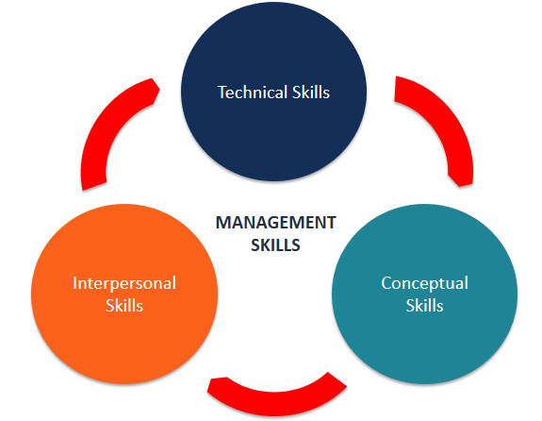
Managerial Skills and
Competencies

Slide 3
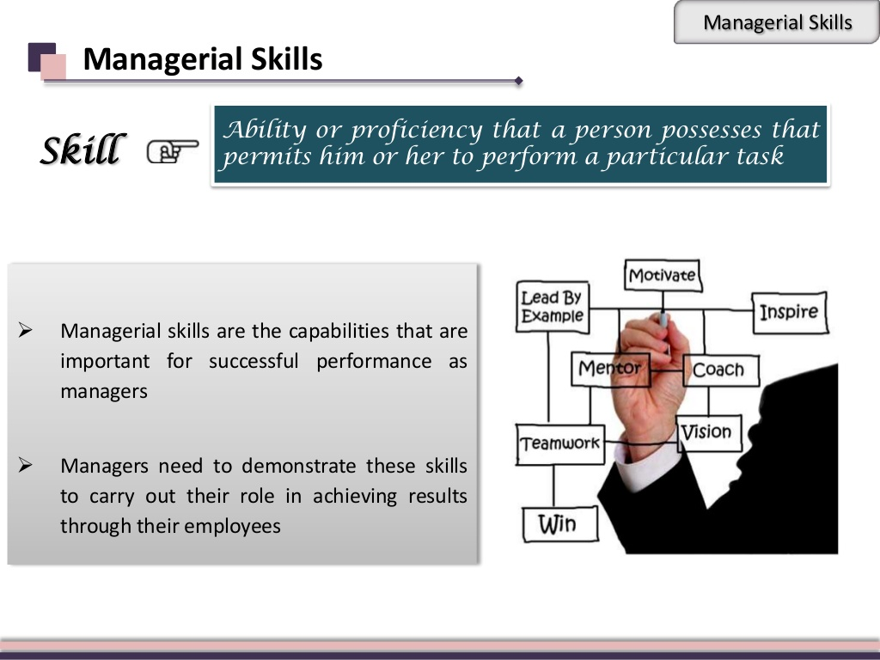

Slide 4
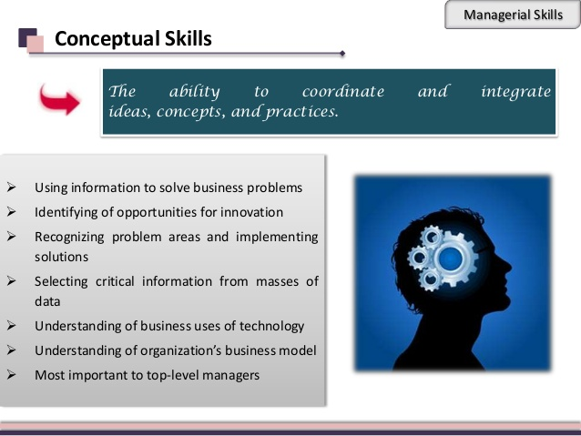

Slide 5
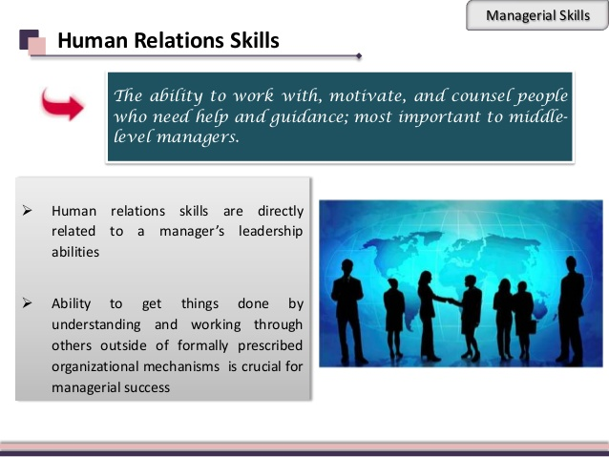

Slide 6
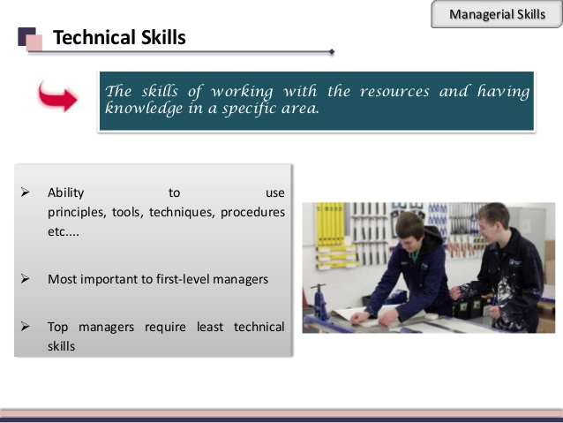

Slide 7
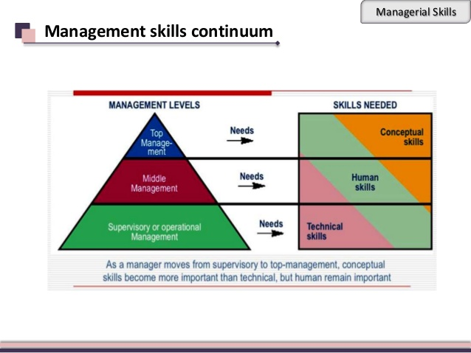

Slide 8
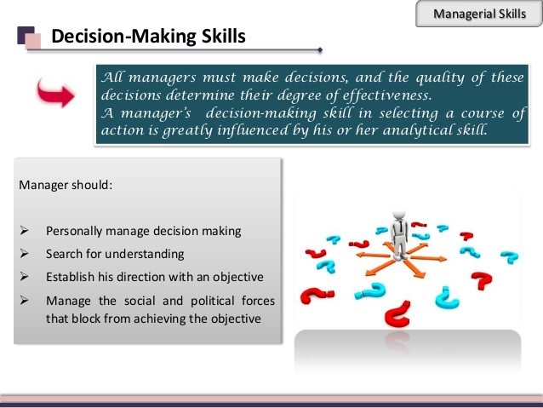

Slide 9
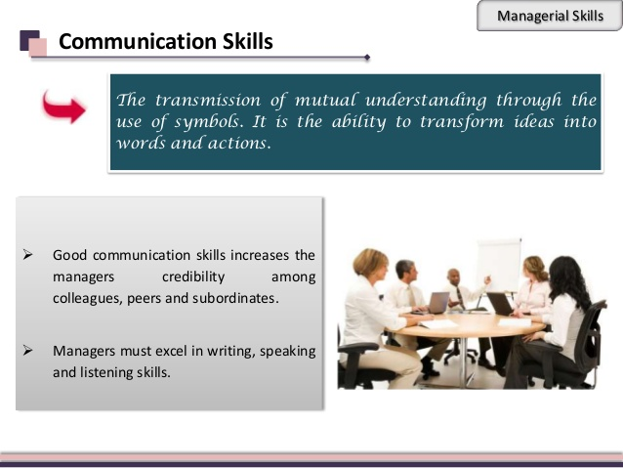

Slide 10
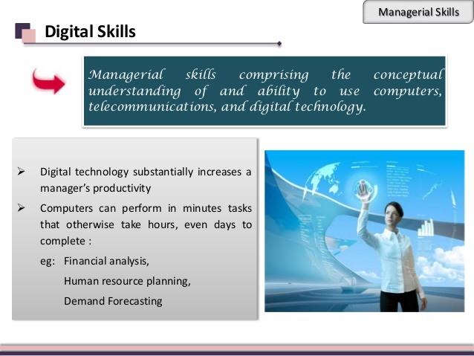

Slide 11
Other Skills
Problem Solving
Leadership Skills
Negotiating Skills
Administrative skills

Slide 12
SUMMARY
Capabilities to perform managerial duties
Management Skills
Conceptual Skill
Human Skill
Technical Skill
Decision Making Skill
Communication Skill
Digital Skill
Problem Solving
Leadership Skill
Negotiation Skill
Administration Skill

Slide 13

For any query message me on : 9892349293

