Slide 1
Media & Identity
Presented by
Deepak Kumar Tiwari

Slide 2
The definitions of Identity
One’s personal characteristics, or the sense of who one is, as perceived by the person or by others- Dictionary.com
The fact of being who or what a person or thing is- Lexico.com

Slide 3
Topics to be covered
Feminism
Racism
Ethnicity
Caste Representations
Class Representations
Tribal Representations
Queer representation

Slide 4
FEMINISM

Slide 5
Women WERE/ARE CONSIDERED…
Soft/Graceful
Emotionally Weak/Mood Swings
Complex-None can understand her, what’s there in her mind
Problematic
Dumb/less intelligent
Dependent on Man (Father/Brother/Husband/Son)
Anything else you recall?

Slide 6
Some more STEREOTYPES
They are bad drivers
They can not bear the sight
Teachers and nurses are women, and that pilots, doctors, and engineers are men.
A woman must have compromised to get on that powerful post

Slide 7
What is Feminism?
Feminism is the belief in social, economic, and political equality of the sexes.
Throughout most of Western history, women were confined to the domestic sphere, while public life was reserved for men.
In medieval Europe, women were denied the right to own property, to study, or to participate in public life.

Slide 8
At the end of the 19th century in France, they were still compelled to cover their heads in public, and, in parts of Germany, a husband still had the right to sell his wife.
Were not allowed to vote or conduct business without male represenative.
Women not allowed for Haj yatra alone, not allowed in certain temples

Slide 9
The FOUR WAVES of FEMINISM
The first wave (1830’s – early 1900’s): Women’s fight for equal contract and property rights
The second wave (1960’s 1980’s): Broadening the debate]
The third wave (1990’s – early 2000’s): The “micropolitics” of gender equality
The Fourth Wave

Slide 10
The first wave (1830’s – early 1900’s)
Women’s fight for equal contract and property rights
Right to Vote
Their political agenda expanded to issues concerning sexual, reproductive and economic matters.

Slide 11
The second wave (1960’s 1980’s):
The second wave of feminism focused on the workplace, sexuality, family and reproductive rights.

Slide 12
The third wave (1990’s – early 2000’s):
The movement got further subdivided-
Radical feminism- Eliminate the concept of Gender, finding technology that will allow babies to be grown outside of a woman's body, traditional family structure should be rejected
Socialist Feminism- Socialist feminism calls for an end to capitalism, men are more willing to share their power and money with other men, which means that women are continually given fewer opportunities and resources. This keeps women under the control of men.
Cultural Feminism- Cultural feminism is a movement that points out how modern society is hurt by encouraging masculine behavior, but society would benefit by encouraging feminine behavior instead.

Slide 13
The fourth Wave
#metoo
The demand for equality, rights, equal pay is brought to the public eye at record highs- highlighted by marches across the country, social media campaigns.
High-profile women taking a strong stance. Example-PM of NewZeland

Slide 14
medIA Defining Women
What they should wear
How should women behave
Women are hot, sexy, bomb, glamorous, petite and what not….
Girls are cute, vulnerable, sweet
If not married, then there is some problem
A woman cant bear another woman, they are too jealous
Women dress up and do make up to get attention from men

Slide 15
medIA Defining Women
No means Yes
Tota, Maal, Patakha, Item, Tavka, Chavi
Saas- Bahu- Saazish
Anything else do you recall???

Slide 16
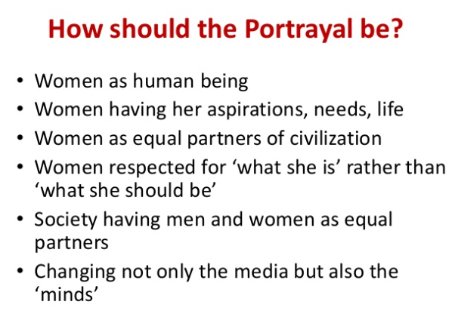

Slide 17
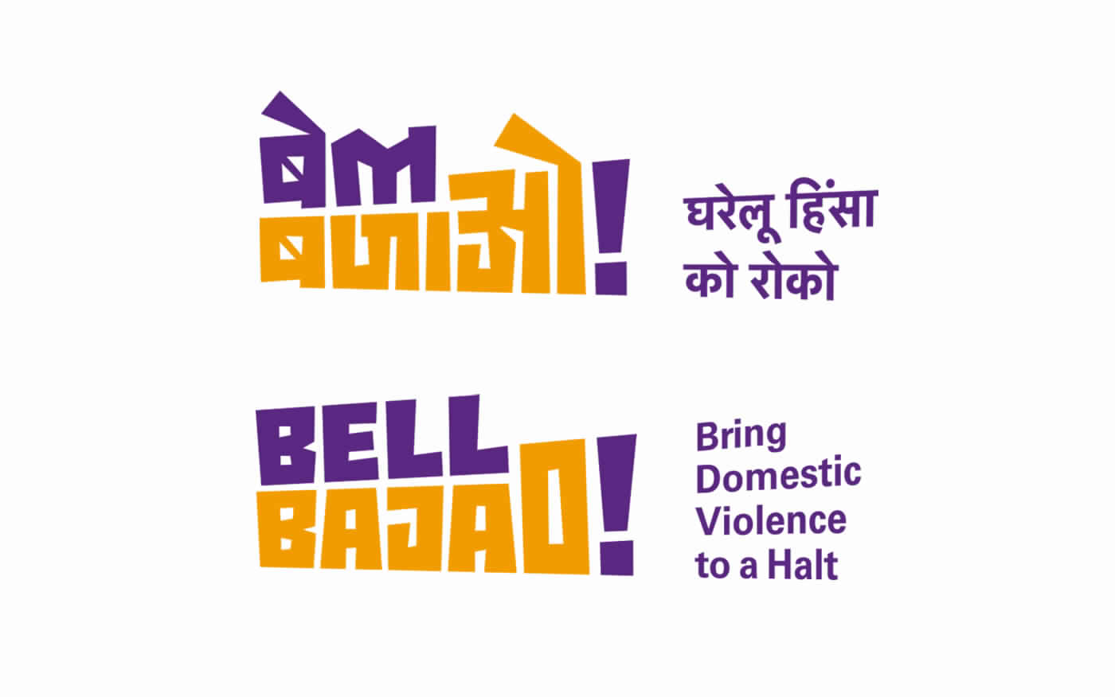
Feminism-India- Campaigns
Bell Bajao- Bell Bajao, or ring the bell, was a campaign by Breakthrough India in 2008, aimed at addressing the issue of domestic violence.

Slide 18
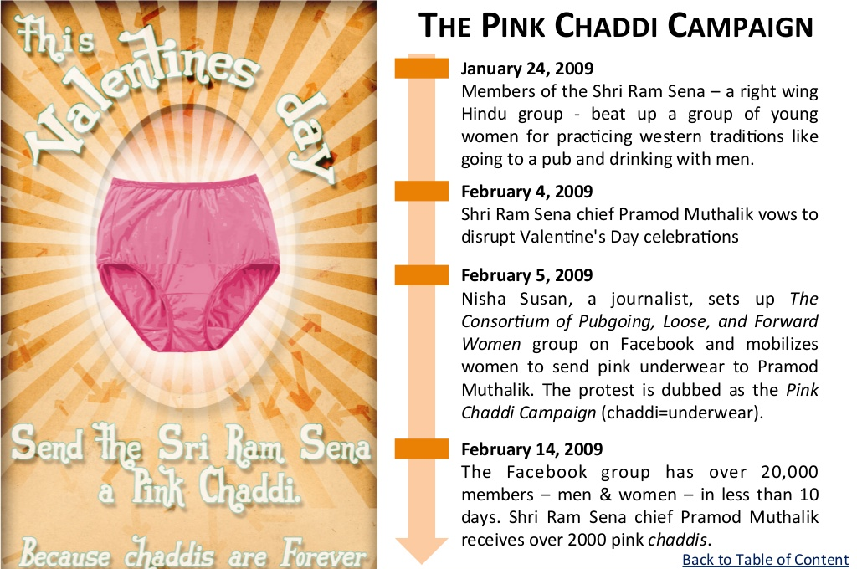
Pink Chaddhi Campaign

Slide 19
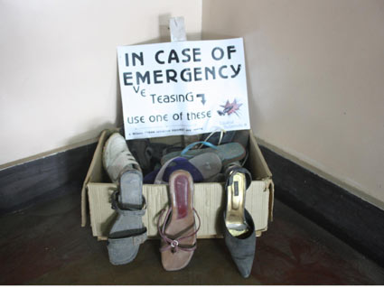
Chappal Marungi

Slide 20
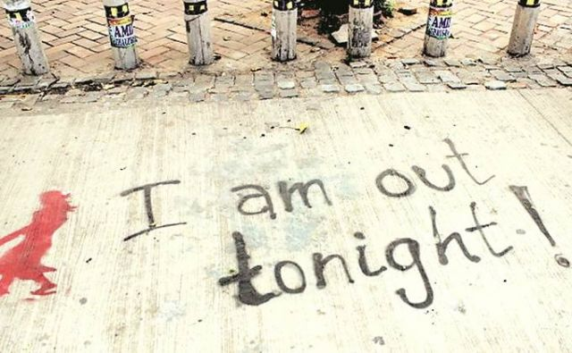
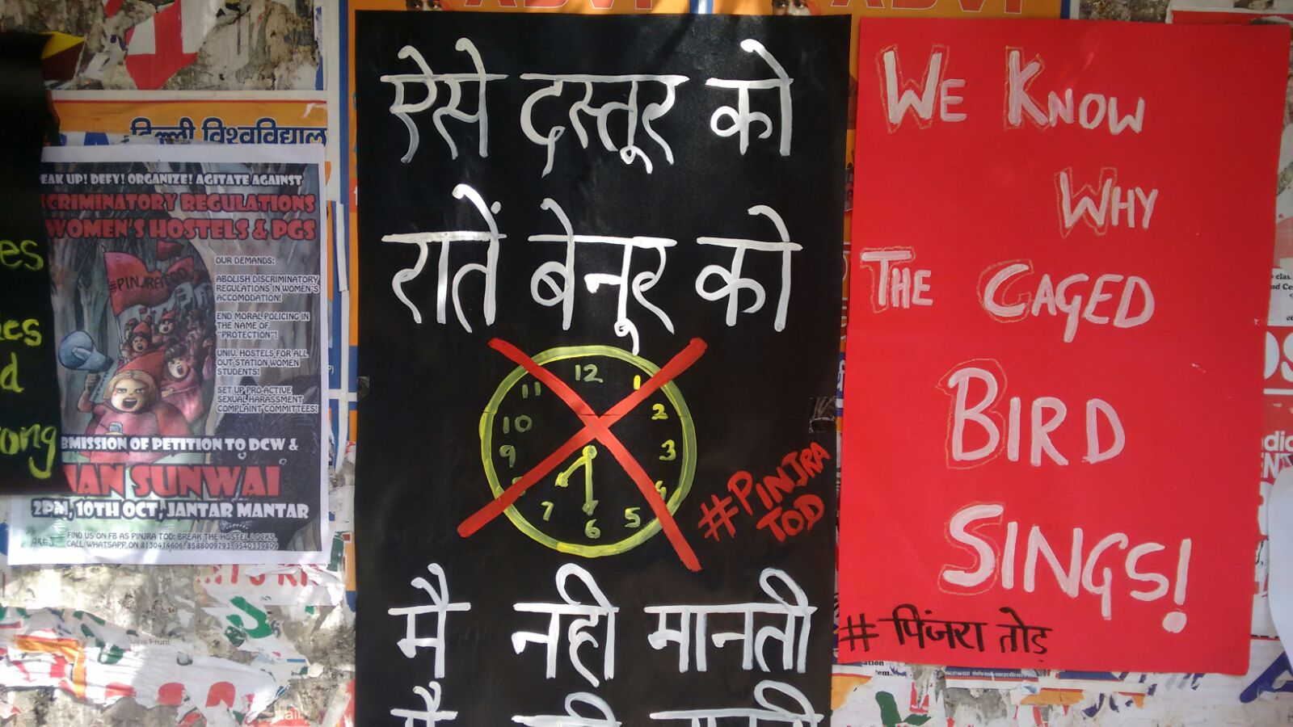
Pinjra Tod

Slide 21
Racism

Slide 22
Racism, also called racialism, the belief that humans may be divided into separate and exclusive biological entities called “races”.
A belief that some races are innately superior to others.

Slide 23
Blumenbach's taxonomy of 1795 divided all humans into five groups, defined both by geography and appearance —
The Caucasian variety- light-skinned people of Europe and adjacent parts of Asia and Africa
The Mongolian variety- the other inhabitants of Asia, including China and Japan
The Ethiopian variety- the dark-skinned people of Africa
The American variety- the most native populations of the New World(Brazil, Cuba)
The Malay variety- the Polynesians and Melanesians of the Pacific and for the aborigines of Australia.

Slide 24
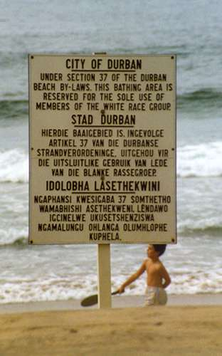
In North America and apartheid-era South Africa, racism dictated that different races (chiefly blacks and whites) should be segregated from one another.
They they should have their own distinct communities and develop their own institutions such as churches, schools, and hospitals; and that it was unnatural for members of different races to marry.

Slide 25
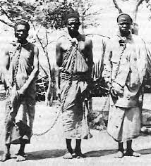
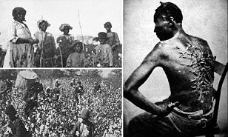
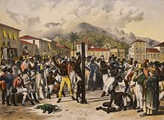
Racism was at the heart of North American slavery and the colonization and empire-building activities of western Europeans

Slide 26
The idea of race was invented to magnify the differences between people of European origin and those of African descent.
Exploitation, slavery, forcing in lower and menial jobs had become a norm in eighteenth century.
Dehumanization

Slide 27
By the 19th century, racism had matured and spread around the world.
Those seen as the low-status races, especially in colonized areas, were exploited for their labour, and discrimination against them became a common pattern in many areas of the world.

Slide 28
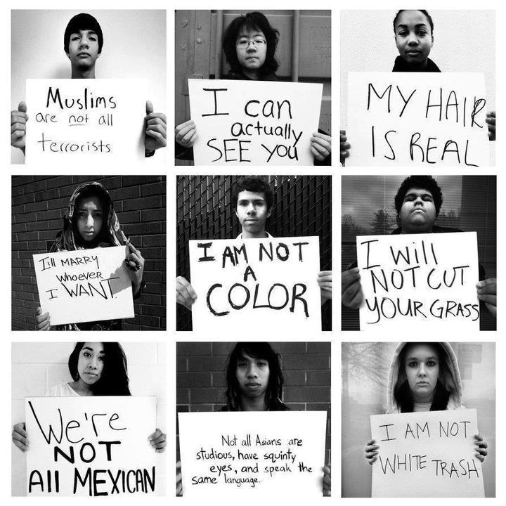
Racism and Media

Slide 29
Bias, disempowerment and discrimination in regards to race have been longstanding issues mainstream media, including television news, entertainment, and advertising.
During this beginning era of television, the population of those who worked in advertising, news and entertainment was predominantly White.

Slide 30
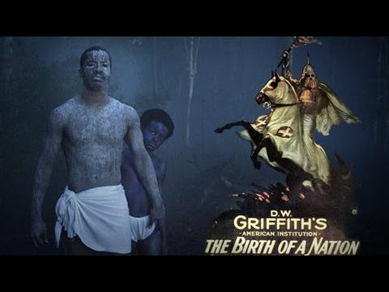
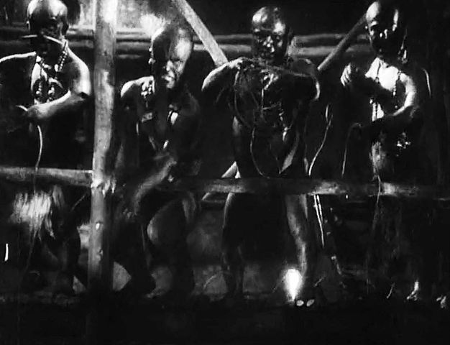
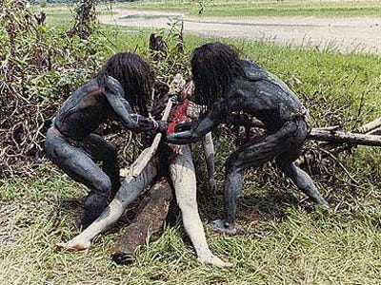
In very early films, such as Birth of a Nation from 1915 (which was originally called The Clansman) and the Tarzan series from 1932, African Americans were represented in the films as "savage, ignorant, thieves, interlopers and potential rapists"

Slide 31
Even early film distortions, such as African Americans being played by White people who painted themselves to look Black, sent strong symbolic messages.
These symbolic messages conveyed that Black people were not “good enough” to represent themselves

Slide 32
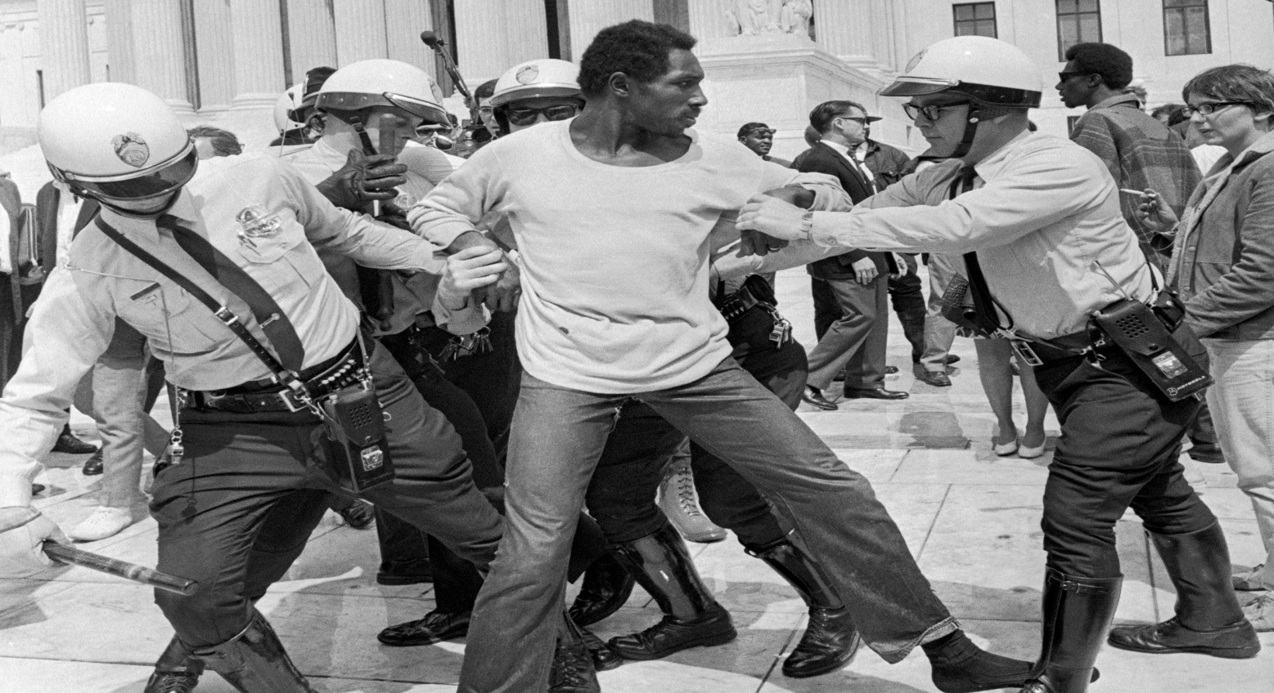
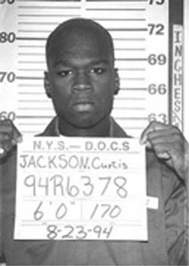
Crime reporting in broadcast media has been controversial since its conception due to conflicts of racial bias.
accused Black criminals were usually illustrated by glowering mug shots or by footage of them being led around in handcuffs, their arms held by uniformed White policemen.

Slide 33
Black activists often appeared pleading the interests of the Black community, While white leaders were much more frequently depicted as representing the entire community.
News about Blacks who acted politically conveyed the notion that they spoke and behaved more than whites to advance "special interest" against public interest.

Slide 34
Read this, Has it happened with you AS WELL?
16-year-old Sruthi, the class monitor was carrying a pile of assignment sheets collected from her classmates to the teachers’ room to get evaluated over the weekend. As she was about to leave the room, she overheard her class teacher Taara, talking to another teacher about the selections for the dance competition in the inter-school youth festival. “Sruthi is a good dancer, I agree. But she is too dark to look good as the lead dancer, and would not look that great on stage.”

Slide 35
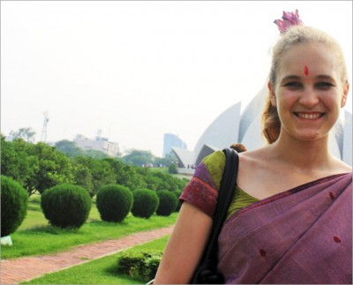
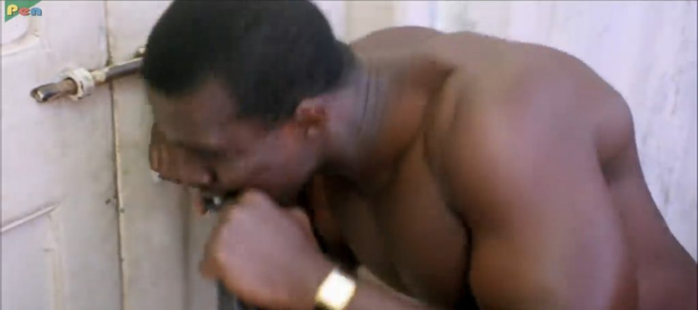
Case Studies from India- Media and Racism
African representation in the Indian entertainment industry - While their ‘white’ counterparts are always shown as being dim witted and innocently lost in the streets of Benaras or Delhi, African characters are rarely to be seen.
If there are any, they are depicted always as dealers, pimps and people with a violent or criminal nature – for example, the guy who broke locks with his bare teeth in Phir Hera Pheri.

Slide 36
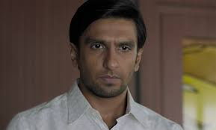
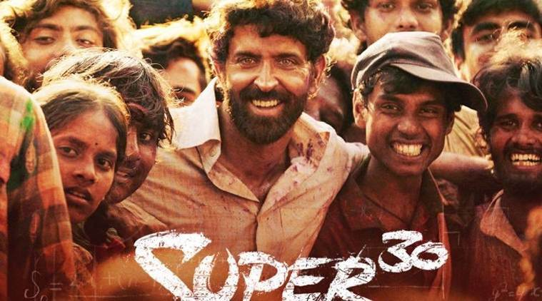
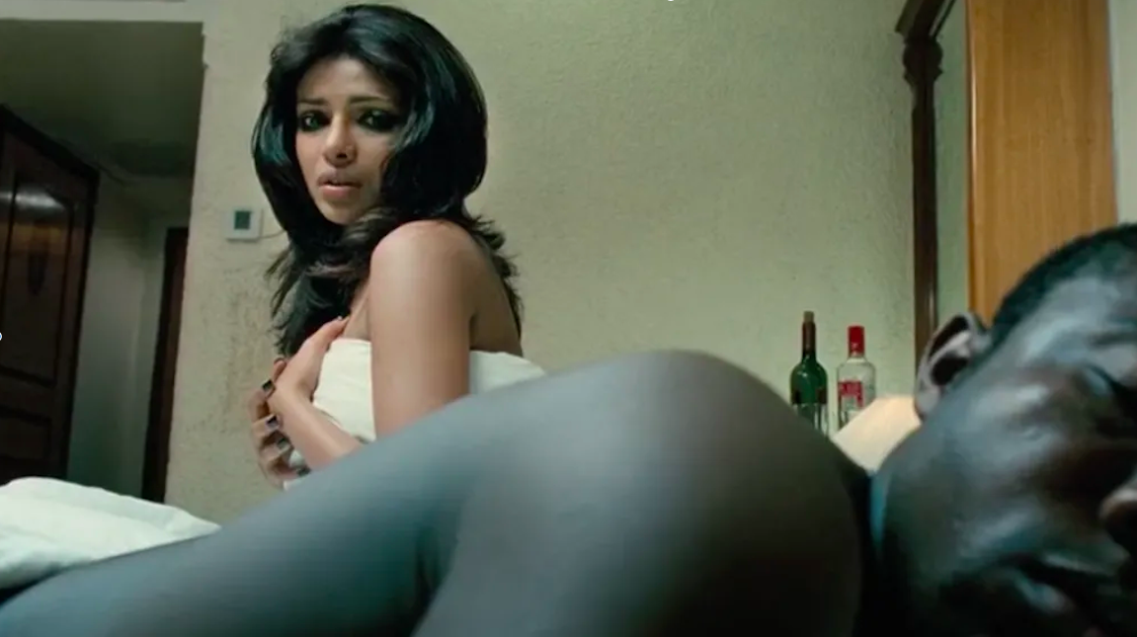
More Examples
The stereotype has always existed in cinema where a dark skin tone is associated with people who are on the lower rung of caste and class.
Examples- Hrithik in Super 30, Ranveer Singh in Gully Boy, Alia in Udta Punjab
In"Fashion", Priyanka Chopra plays a high-strung supermodel who is unable to cope with the rigours of fame and becomes an alcohol and a drug addict. But the turning point for her comes only when she wakes up to find herself next to a black man. It's only then that she realises the horror that her life has become.

Slide 37
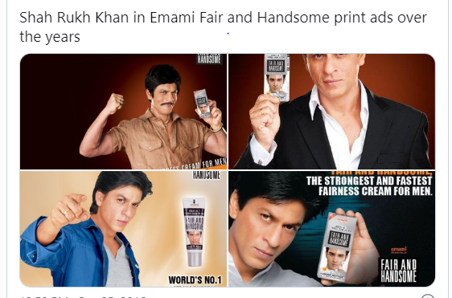
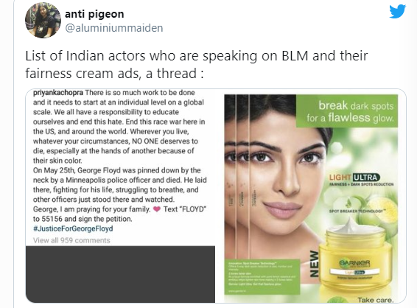
The fairness cream

Slide 38
Exceptions- The silver lining
In "Pad Man", for instance, a biopic on Arunachalam Muruganatham, a social entrepreneur from Tamil Nadu who introduced low cost sanitary pads, Akshay Kumar plays the title role with no artifice. He is as he is.
Movements like, “Dark is Beautiful” helmed by activist and actor Nandita Das opened avenues for people to at least address this as an issue.
The glowing and Lovely

Slide 39
Ethnicity

Slide 40
Ethnicity is the fact or state of belonging to a social group that has a common national or cultural tradition.
Ethnicity is usually an inherited status based on the society in which one lives.

Slide 41
Ethnicity refers to the identification of a group based on a perceived cultural distinctiveness that makes the group into a “people.”
This distinctiveness is believed to be expressed in language, music, values, art, styles, literature, family life, religion, ritual, food, naming, public life, and material culture.

Slide 42
CaSTE REPRESENTATION

Slide 43
India's caste system is among the world's oldest forms of surviving social stratification.
जाति जाती नहीं......

Slide 44
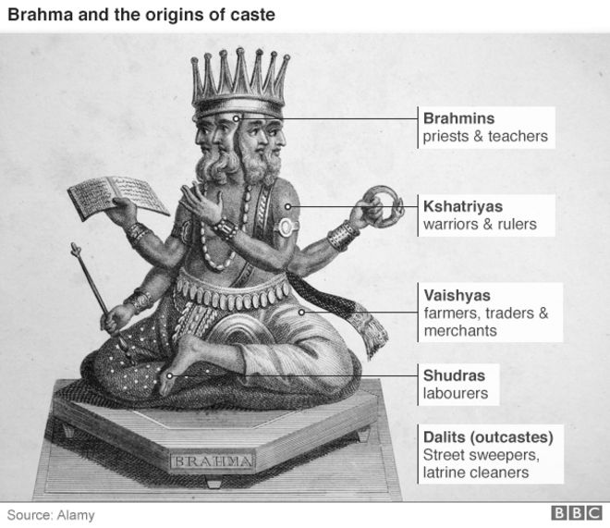
The system which divides people into rigid hierarchical groups based on their karma (work) and dharma (the Hindi word for religion, but here it means duty)

Slide 45
Manusmriti, widely regarded to be the most important and authoritative book on Hindu law and dating back to at least 1,000 years before Christ was born, "acknowledges and justifies the caste system as the basis of order and regularity of society".
The caste system divides Hindus into four main categories - Brahmins, Kshatriyas, Vaishyas and the Shudras.

Slide 47
The main castes were further divided into about 3,000 castes and 25,000 sub-castes, each based on their specific occupation.
The system bestowed many privileges on the upper castes while sanctioning repression of the lower castes by privileged groups

Slide 48
Rural communities have long been arranged on the basis of castes - the upper and lower castes almost always lived in segregated colonies, the water wells were not shared, Brahmins would not accept food or drink from the Shudras, and one could marry only within one's caste.

Slide 49
ThE DISCRIMINATION
Many Stories….

Slide 50
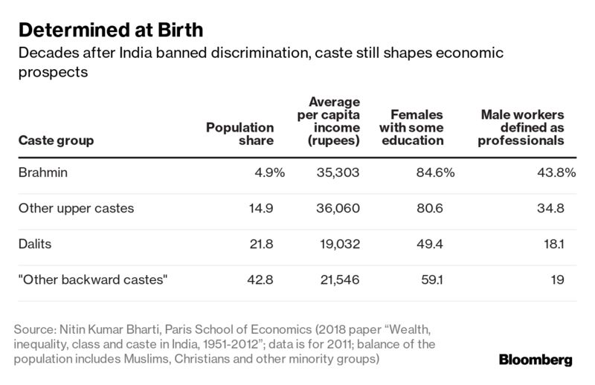

Slide 51
Caste and MEDIA
Dalits and caste discrimination have frequently been subjects in Indian cinema, from Achhut Kanya (1936) to Masaan, Sairaat and Article 15.
In Indian cinema, the body of the dalit (a person of the lowest caste)- male and female, presents a stereotype contrast to the body of the upper caste Hindus, Muslims and Christians. The female body, particularly the young dalit women is represented as sexually attractive and desirable, thereby, an object to be used and subjugated by the upper caste.

Slide 52
Indian cinema usually highlights the dalit only in terms of its relationship to caste society stems from Brahminical ideology. Dalit communities, like all other communities, would have conflicts of their own and also be rich in interpersonal relationships within, but this is not given expression to.

Slide 53
For years, B.R. Ambedkar was treated like an ‘untouchable’ by the casteist filmmakers of Bollywood. Forget about the foreground, he was erased from even the backdrop of scenes for a long time.
Portraits of political leaders from upper caste or savarna backgrounds, such as Mahatma Gandhi, Lokmanya Tilak, Jawaharlal Nehru, Lal Bahadur Shashtri, Subhas Chandra Bose, and even Swami Vivekananda, were predominantly featured as backdrops of Hindi films made by savarna producers and directors.

Slide 54
Even when Bollywood did tell stories about Dalits — which was anyway rare — Ambedkar was missing. A perfect example of this is Bimal Roy’s movie Sujata (1959), in which the Brahmin protagonist Adhir Chaudhary (Sunil Dutt) falls in love with an ‘untouchable’ Sujata (Nutan).
Adhir is ‘liberal’ enough to have photos of Rabindranath Tagore, Gandhi and Vivekananda in his house, but not Ambedkar.

Slide 55
India’s newsrooms are dominated by the upper castes – and that reflects what media covers

Slide 56
The study, conducted by the NGO Oxfam India and Newslaundry, a media-watch website, also noted that “three out of every four anchors (among a total of 40 anchors in Hindi channels and 47 in English channels) of debates are upper caste”.
In addition, “for over 70% of their primetime debate shows, news channels draw the majority of the panellists from the upper castes”.

Slide 57
– No more than 5% of all articles in English newspapers are written by Dalits and Adivasis. Hindi newspapers fare slightly better at around 10%
– Around 72% of bylined articles on news websites are written by people from the upper castes
– Only 10 of the 972 articles featuring on the cover pages of the 12 magazines under study are about issues related to caste.

Slide 58
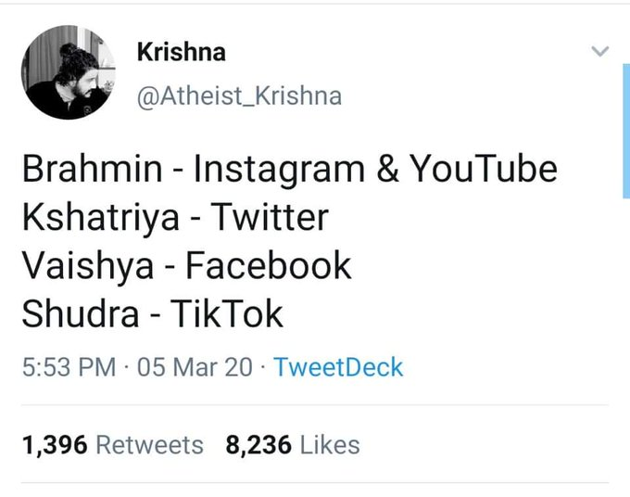
TikTokers dubbed ‘Shudras of internet’: Indians didn’t spare even social media from casteism

Slide 59
CLASS REPRESENTATION

Slide 60
Social class, also called class- a group of people within a society who possess the same socioeconomic status.
The term class first came into wide use in the early 19th century, replacing such terms as rank and order as descriptions of the major hierarchical groupings in society.

Slide 61
These dimensions include power, wealth, social status, education level, prestige of one’s occupation, social standing, and many others

Slide 62
Upper Class – Elite
Represent institutional leadership, heads of multinational corporations, foundations, universities
Capitalist elite – owners of lands, stocks and bonds and other assets – wealth derived from what they own

Slide 63
Upper Middle Class= Have both high incomes and high social prestige, Well-educated
Represent scientific and technical knowledge – engineers, accountants, lawyers, architects, university faculty, managers and directors of public and private organizations.
In India are those who can afford international air travel on a monthly basis, exclusive holidays or go to university in a foreign country; those who have guaranteed housing, running water, multiple servants, private healthcare, laptops, connectivity, cars and the latest mobile phones.
many people in this group have connections to political power, to the police and to law enforcement
.

Slide 64
Lower Middle Class
Clerical-administrative
Provide support for professionals
Engage in data collection., record-keeping
bank tellers, sales
Blue-collar workers in skilled trades

Slide 65
Working Class
Craft workers
Laborers in factories
Restaurant workers
Nursing home staff
Repair shops, garages
Delivery services

Slide 66
Poor
Working poor – work full-time at wages below poverty line
those spending over Rs. 32 a day in rural areas and Rs. 47 in towns and cities should not be considered poor. Currently 21.9% population of India is under BPL- An expert panel headed by former RBI governor C Rangarajan

Slide 67
ClaSS AND MEDIA
mass media representations of social class tend to celebrate hierarchy and wealth- Christmas, New Year Celebration, The Grand Indian Wedding
Newman (2006) argues that the media focus very positively on the concerns of the wealthy and the privileged. He notes that the media over-focuses on consumer items such as luxury cars, costly holiday spots and fashion accessories that only the wealthy can afford.
He also notes the enormous amount of print and broadcast media dedicated to daily business news and stock market quotations, despite the fact that few people in Britain own stocks and shares.

Slide 68
The middle class are over-represented on TV dramas and situation comedies.
middle classes of are shown generally anxious about the decline of moral standards in society and that they are proud of their identity and heritage.
Main aaj bhi fenke hue paise nahi leta. (Deewar)-
Roti-Kapada-Makaan,

Slide 69
Frustration of middle class- The angry Young man
Insaan ko dil de, jism de, dimaag de lekin yeh kambakht pet mat de ... usse pet deta hai toh usse bhook mat de ... usse bhook deta hai toh do waqt ki roti ka intezam karke bhej ... varna tujhe insaan ko paida karne ka koi haq nahi hai- Roti
(Kaun ho tum?) ... Kahi naam hai mere ... gareeb maa baap mujhe apna beta kehte hai, mazloom ladkiyan apna bhai ... besahare yateemon ka dost hoon aur zalimon ka dushman

Slide 70
Duniya ka koi insaan bura aadmi nahi hota ... koi aadmi apni maa ke pet se bura pehda nahi hota ... koi chor apni khushi se chori nahi karta ... koi daaku apni khushi se daaka nahi dalta ... koi tawaif apni khushi se apna jism nahi bechti ... waqt aur halaat insaan ko bura banne pe majboor kar dete hai
Gareeb ka gareeb se toh woh rishta hota hai ... joh bhai ka bhai se nahi hota ... bete ka baap se nahi hota

Slide 71
FILMS WHICH DEPICT poverty
Pather Panchali
Maanjhi The Mountai Man
Traffic Signal
Swades
Peepli Live
Nil Battey Sannata

Slide 72
Tribal Representation

Slide 73
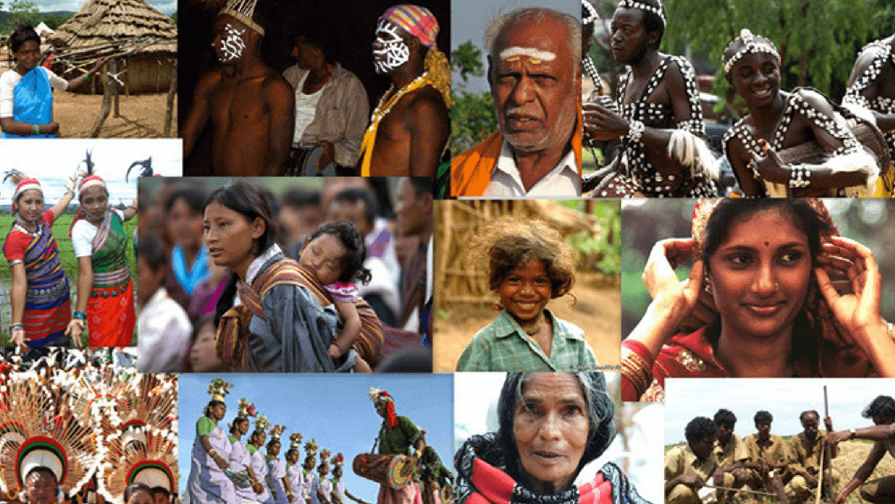
Tribe
A set of smaller groups ( also known as bands), defined by traditions of common descent, language, culture, and ideology

Slide 74
Tribes are also known by the name ‘Adivasis’ in India.
Constitution of India has recognized tribal communities in India under ‘Schedule 5’ of the constitution.
Hence the tribes recognized by the Constitution are known as ‘ Scheduled Tribes’.
There are around 645 distinct tribes in India.

Slide 75
The total population of Scheduled Tribes is 10.43 crore as per the Census 2011 which accounts for 8.6% of the total population of the country.
The share of the Scheduled Tribe population in urban areas is a meagre 2.8%.

Slide 76
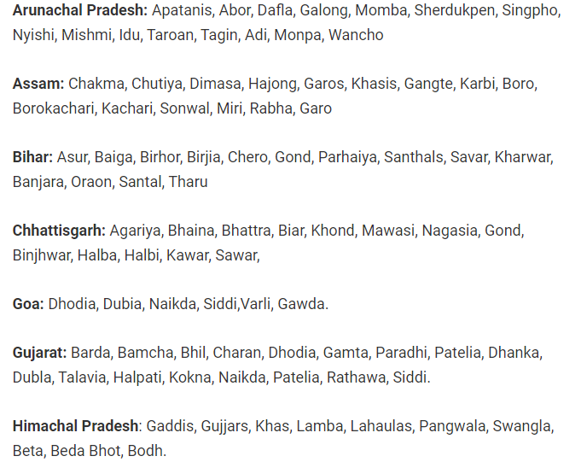

Slide 77
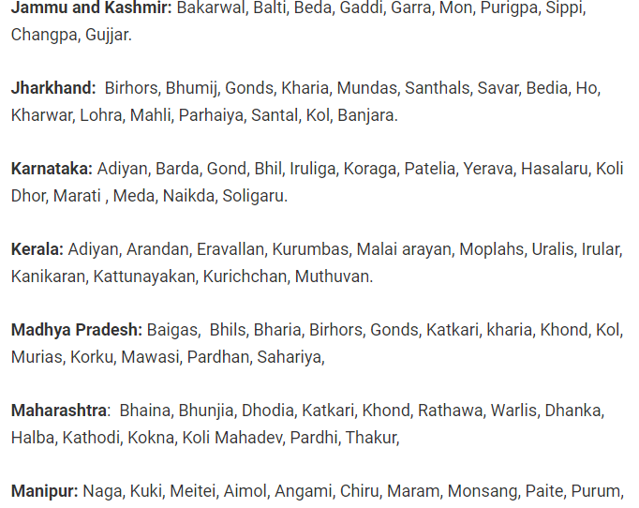

Slide 78
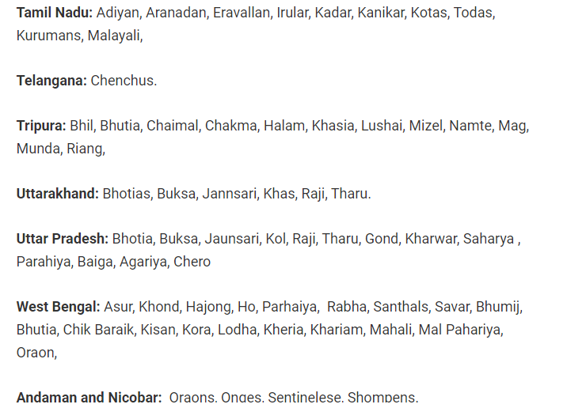

Slide 79
The tribal communities share a close relationship with nature- Jal, Jungle and Jamin have fostered Adivasis since time immemorial and Adivasis have in return, protected it.
They have always been viewed as the “other” with the need to being incorporated into the “civilised” and “progressive” world.
Fervour and strong approbation towards their religious views, cultural and social systems are seen as resentment toward modernisation and as being anti-national.

Slide 80
It is an undisputed fact that many tribals are not enjoying their human rights and fundamental freedoms.

Slide 81
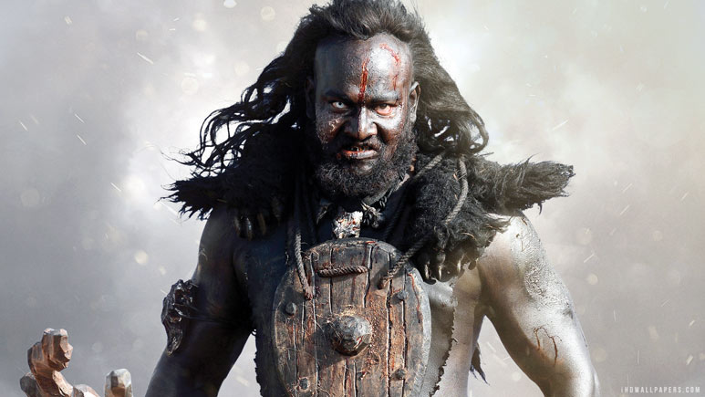
Tribals and Media- stereotypes
They are uncivilized
They are archaic
They are savages
Anti- Development
Jungleeeeee

Slide 82
Media is owned by rich and elite….. And they have vested interest in natural resources(land, Jungle, Mines) ….the reason of ignoring or underrepresenting the tribal.
Official data on all indicators of development reveal that India’s tribal people are the worst off in terms of income, health, education, nutrition, infrastructure and governance.

Slide 83
Around 40 per cent of the 60 million people displaced following development projects in India are tribals, which is not a surprise given that 90 per cent of our coal and more than 50 per cent of most minerals and dam sites are mainly in tribal regions.

Slide 84
Insensitivity TOWARDS TRIBALS-Examples
The negative publicity surrounding an age-old ‘women-only’ ritual has proved a roadblock for the tribal community in Vellakadai village, located 15 km from Yercaud, from practising their custom in a traditional manner.
Media persons got entry into tribal territories in Andaman and even photographed them in the nude against the law of the land. The aborigines were provoked to shoot arrows.

Slide 85
the existential crisis faced by tribals who are struggling with their identity is that, “Who is an Adivasi?”, “What do they look like?”, “Are you an Adivasi? You don’t look like one!” etc. are some other questions and statements that Adivasis and tribals in India have to face, sometimes on a daily basis.
In Andamans- TOURISTS THREW BANANAS AND BISCUITS TO THE TRIBES AT THE ROADSIDE, AS THEY WOULD TO ANIMALS IN A SAFARI PARK.

Slide 86
In 2013, the Supreme Court banned tourists from taking the Andaman Trunk Road (ATR) after a video shot by a journalist showed policemen forcing six Jarawa women to dance for tourists.
Jimna, an Adivasi woman speaks gibberish as a tribal language in television show Sajan re jhut mat bolo or remember Bahubali……

Slide 87
on the eve of International Indigenous People’s Day, people from the Scheduled Tribes of India held a press conference that had no takers from mainstream media.(August 09,2018)

Slide 88
Arun Oraon, a research scholar of JawaharLal Nehru University, recounted an old memory when an influential person (from the editorial department of a news channel that claims to be the largest channel of the nation) had advised the former to join the Indian Army rather becoming a journalist.
Arun had at the time been interning with the channel after passing out with a journalism degree from the Indian Institute of Mass Communication (IIMC), a premier institute of journalism in the country. Arun failed to find a suitable job in any mainstream media organistion

Slide 89
References
https://www.bbc.co.uk/bitesize/guides/z9fx39q/revision/1
https://www.hindustantimes.com/books/essay-on-kaala-a-film-on-racism-against-black-people-in-india/story-RhMGFmD5LtQyoInJdtSaXP.html
https://feminisminindia.com/2020/06/15/brown-racists-internalised-racism/
https://thewomenscode.com/how-does-media-portray-feminism/

Slide 90
References
tribalFaces.pdf
https://scroll.in/article/932660/in-charts-indias-newsrooms-are-dominated-by-the-upper-castes-and-that-reflects-what-media-covers
https://www.hindustantimes.com/columns/social-media-has-reshaped-caste-mobilisation/story-Hw1GIDJdCyZEWdliySowpJ.html
https://study.com/academy/lesson/classism-in-the-media.html

