Slide 1
Data analysis & interpretation
Business Research Methods – Unit III

Slide 2
Data Analysis
Analysis of Data is the process of re-arranging the collected data in a systematic manner for interpretation purposes
Characteristics :
Process of in-depth evaluation of organised data
Done after tabulation, prior to interpretation
Re-arranging data in suitable manner

Slide 3
Types of data Analysis
Data Analysis
Descriptive Analysis
Correlation Analysis
Causal Analysis
Inferential Analysis

Slide 4
Descriptive Analysis
Descriptive Analysis is concerned with finding out “What is”
Descriptive analysis deals with summary measures relating to the sample data.
The common ways of summarizing data are by calculating average, mean, median,, mode, range, standard deviation, frequency and percentage distribution.
The first thing to do when data analysis is taken up is to describe the sample.

Slide 5
Examples of Descriptive Analysis:
What is the average income of the sample?
What is the average age of the sample?
What percentage of sample respondents are married?
Is the level of job satisfaction related with the age of the employees?
Which TV channel is viewed by the majority of viewers in the age group 20– 30 years?

Slide 6
Inferential Analysis
inferences are drawn on population parameters based on sample results.
The researcher tries to generalize the results to the population based on sample results.
Inferential Analysis includes t-test, Analysis of Variance (ANOVA), regression analysis etc

Slide 7
Examples of Inferential Analysis:
Is the average income of population significantly greater than 25,000 per month?
Is the job satisfaction of unskilled workers significantly related with their pay packet?
Observation of Customers in a shopping mall – inferences can be drawn about satisfaction, ease of shopping, a welcome feeling from the smile of customers

Slide 8
Correlational Analysis
Developed by Karl Pearson,
Measures intensity or degree of linear relationship between 2 variables
Bivariate Analysis (2 or more variables)
Correlational Analysis is conducted by drawing a graph of 2 series – Scatter Diagram
Independent variable on horizontal & dependant on vertical axis
used to study the strength of a relationship between two, numerically measured, continuous variables (e.g. height and weight).
This particular type of analysis is useful when a researcher wants to establish if there are possible connections between variables

Slide 10
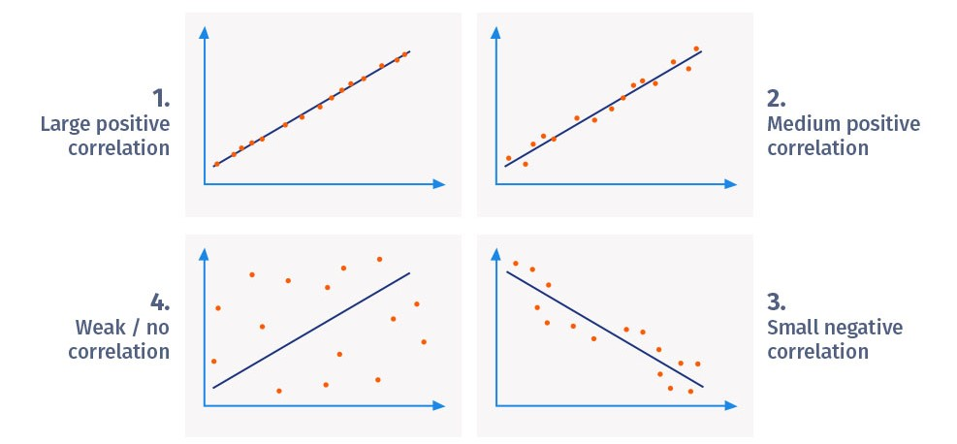

Slide 11
Example
Correlation between two variables can be either a positive correlation, a negative correlation, or no correlation. Let's look at examples of each of these three types:
Positive correlation: A positive correlation between two variables means both the variables move in the same direction. An increase in one variable leads to an increase in the other variable and vice versa.
For example, spending more time on a treadmill burns more calories.
Negative correlation: A negative correlation between two variables means that the variables move in opposite directions. An increase in one variable leads to a decrease in the other variable and vice versa.
For example, increasing the speed of a vehicle decreases the time you take to reach your destination.
Weak/Zero correlation: No correlation exists when one variable does not affect the other.
For example, there is no correlation between the number of years of school a person has attended and the letters in his/her name.

Slide 12
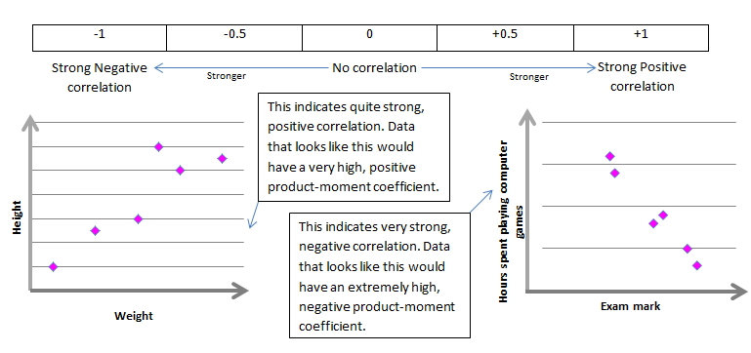

Slide 13
Data interpretation

Slide 14
Data INterpretation
Process of drawing inferences from collected facts
Adds meaning and significance to conclusions available from collected data
Aim od Data Interpretation
To find out precisely the meaning of statistical conclusion arrived at
Helps in making recommendations

Slide 15
Essentials of Data Interpretation
Consistent data
Reliable data
Accuracy
Avoid Biasness
Data should be homogeneous
Uniform data in terms of unit of measurement
Suitability
Adequacy of Data
Proper Generalisation

Slide 16
Importance of data processing

Slide 17
Data Editing
Accuracy of data
Data Coding
Facilitate classification
Data Classification
Data grouping & management
Completeness of Data
Uniformity of Data
Facilitate tabulation
Help data tabulation

Slide 18
Data Tabulation
Helps in analysis
Data Graphic Presentation
Visual display of information
Data Analysis & Interpretation
Draws inferences and conclusions
Ease of understanding data
Helps locate data
Helps in report writing
Condenses large data
Quick communication of the report
Helps understand relationship between variables
Helps in decision making & planning recommendations
Validates theory
Helps in making Models

Slide 19
Hypothesis testing

Slide 20
Hypothesis?
3
◆ Hypothesis is a predictive statement, capable of being tested by scientific methods, that relates an independent variables to some dependent variable.
◆ A hypothesis states what we are looking for and it is a proportion which can be put to a test to determine its validity
e.g.
Students who receive counseling will show a greater increase in creativity than students not receiving counseling

Slide 21
What is a Hypothesis?
A hypothesis is an assumption about the population parameter.
A parameter is characteristic of the population, like its
I assume the average weight of this class is 58 kg!
mean or variance.
The parameter must be identified before analysis.
© 1984-1994 T/Maker Co.

Slide 22
Characteristics of Hypothesis
4
◆ Clear and precise.
◆ Capable of being tested.
◆ Stated relationship between variables.
◆ limited in scope and must be specific.
◆ Stated as far as possible in most simple terms so that the same is easily understand by all concerned. But one must remember that simplicity of hypothesis has nothing to do with its significance.
◆ Consistent with most known facts.
◆ Responsive to testing with in a reasonable time. One can’t spend a life time collecting data to test it.
◆ Explain what it claims to explain; it should have empirical reference.

Slide 23
To test the validity of assumed or hypothetical value of population , we gather sample data and determine the difference between hypothesized value and actual value of the sample mean.
Then we judge whether the difference is significant or not.
The smaller the difference, the greater the likelihood that our hypothesized value for the mean is correct. The larger the difference, the smaller the likelihood.

Slide 24
 In hypothesis testing the first step is to state the assumed or hypothesized( numerical) value of the population parameter.
 The assumption we wish/ want to test is called the null hypothesis. The symbol for null hypothesis is H_{0.}

Slide 25
HYPOTHESIS TESTING
Null hypothesis, H₀
Alternative hypothesis,H_{A}
State the hypothesized value of the parameter before sampling.
The assumption we wish to test
(or the assumption we are trying to
reject)
E.g population mean µ = 20
There is no difference between coke and diet coke
All possible alternatives other than
the null hypothesis.
E.g µ ≠ 20 µ > 20
µ < 20
There is a difference between coke
and diet coke

Slide 26
The Null Hypothesis, H₀
State the Assumption (numerical) to be tested
Null Hypothesis is denoted by 𝐻₀
◆ If a population mean is equal to hypothesised mean then Null Hypothesis can be written as
𝐻₀: 𝜇 = 𝜇₀
e.g. The average weight of the semester 4 student is 58kgs
(H₀: 𝜇 = 58)
Begin with the assumption that the null hypothesis is TRUE.
(Similar to the notion of innocent until proven guilty)

Slide 27
Alternative Hypothesis
6
◆ The Alternative hypothesis is negation of null hypothesis and is denoted by 𝐻_{𝑎}
If Null is given as 𝐻₀: 𝜇 = 𝜇₀
Then alternative Hypothesis can be written as
𝐻_{𝑎}: 𝜇 ≠ 𝜇₀
𝐻_{𝑎} : 𝜇 > 𝜇₀
𝐻_{𝑎}: 𝜇 < 𝜇₀
eg. The average weight of the students is not equal to 58kgs. (H₁: μ ≠ 58)

Slide 28
Level of significance and confidence
7
Significance means the percentage risk to reject a null hypothesis when it is true and it is denoted by 𝛼. Generally taken as 1%, 5%, 10%
(1 − 𝛼) is the confidence interval in which the null hypothesis will exist when it is true.
Though any level of significance can be adopted, in practice we either take 5% or 1% level of significance .
When we take 5% level of significance(α= .05), then there are about 5 chances out of 100 that we would reject the null hypothesis.
In other words out of 100, 95% chances are there that the null hypothesis will be accepted i.e. we are about 95% confident that we have made the right decision

Slide 29
Step 1
Set up a hypothesis.
Step 2
Set up a suitable significance level.

Slide 30
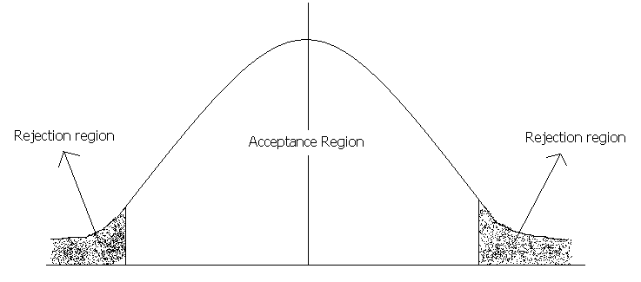


Critical value
Critical value

Slide 31
If our sample statistic(calculated value) fall in the non- shaded region( acceptance region), then it simply means that there is no evidence to reject the null hypothesis.
It proves that null hypothesis (H₀ ) is true. Otherwise, it will be rejected.
Step 3
Determination of suitable test statistic:
For example
Z, t Chi-Square or F-statistic.
Step 4
Determine the critical value from the table.

Slide 32
Step 5
After doing computation, check the sample result. Compare the calculated value( sample result) with the value obtained from the table.(tabulated or critical value)
Step 6
Making Decisions
Making decisions means either accepting or rejecting the null hypothesis.
If computed value(absolute value) is more than the tabulated or critical value, then it falls in the critical region. In that case, reject null hypothesis, otherwise accept.

Slide 33
Type I and Type II Errors
When a statistical hypothesis is tested, there are 4 possible results:
(1)The hypothesis is true but our test accepts it. (2)The hypothesis is false but our test rejects it. (3)The hypothesis is true but our test rejects it. (4)The hypothesis is false but our test accepts it.
Obviously, the last 2 possibilities lead to errors.
Rejecting a null hypothesis when it is true is called a Type I error.
Accepting a null hypothesis when it is false is called Type II error.

Slide 34
Type I and Type II Error
9
Situation | Decision
 | Accept Null | Reject Null
Null is true | Correct | Type I error ( 𝛼 𝑒𝑟𝑟𝑜𝑟 )
Null is false | Type II error ( 𝛽 𝑒𝑟𝑟𝑜𝑟 ) | Correct
www.shakehandwithlife.in

Slide 35




Two tailed test @
5% Significance level
10
Acceptance and Rejection
regions in case of a Two
Suitable When
𝐻₀: 𝜇 = 𝜇₀
𝐻_{𝑎}: 𝜇 ≠ 𝜇₀
tailed test
𝑅𝑒𝑗𝑒𝑐𝑡𝑖𝑜𝑛 𝑟𝑒𝑔𝑖𝑜𝑛
𝑇𝑜𝑡𝑎𝑙 𝐴𝑐𝑐𝑒𝑝𝑡𝑎𝑛𝑐𝑒 𝑟𝑒𝑔𝑖𝑜𝑛
𝑜𝑟 𝑐𝑜𝑛𝑓𝑖𝑑𝑒𝑛𝑐𝑒 𝑙𝑒𝑣𝑒𝑙
(1 − 𝛼) = 95%
𝐻₀: 𝜇 = 𝜇₀
𝑅𝑒𝑗𝑒𝑐𝑡𝑖𝑜𝑛 𝑟𝑒𝑔𝑖𝑜𝑛
/𝑠𝑖𝑔𝑛𝑖𝑓𝑖𝑐𝑎𝑛𝑐𝑒 𝑙𝑒𝑣𝑒𝑙
(𝛼 = 0.025 𝑜𝑟 2.5%)
/𝑠𝑖𝑔𝑛𝑖𝑓𝑖𝑐𝑎𝑛𝑐𝑒 𝑙𝑒𝑣𝑒𝑙
(𝛼 = 0.025 𝑜𝑟 2.5%)
www.shakehandwithlife.in

Slide 36
Left tailed test @
5% Significance level
11
Acceptance and Rejection
regions in case of a left tailed
Suitable When
𝐻₀: 𝜇 = 𝜇₀
𝐻_{𝑎}: 𝜇 < 𝜇₀
test
𝑅𝑒𝑗𝑒𝑐𝑡𝑖𝑜𝑛 𝑟𝑒𝑔𝑖𝑜𝑛
𝑇𝑜𝑡𝑎𝑙 𝐴𝑐𝑐𝑒𝑝𝑡𝑎𝑛𝑐𝑒 𝑟𝑒𝑔𝑖𝑜𝑛
𝑜𝑟 𝑐𝑜𝑛𝑓𝑖𝑑𝑒𝑛𝑐𝑒 𝑙𝑒𝑣𝑒𝑙 (1 − 𝛼) = 95%
/𝑠𝑖𝑔𝑛𝑖𝑓𝑖𝑐𝑎𝑛𝑐𝑒 𝑙𝑒𝑣𝑒𝑙
(𝛼 = 0.05 𝑜𝑟 5%)
𝐻₀: 𝜇 = 𝜇₀
www.shakehandwithlife.in

Slide 37
Right tailed test @
5% Significance level
12
Acceptance and Rejection
regions in case of a Right
Suitable When
𝐻₀: 𝜇 = 𝜇₀
𝐻_{𝑎}: 𝜇 > 𝜇₀
tailed test
𝑇𝑜𝑡𝑎𝑙 𝐴𝑐𝑐𝑒𝑝𝑡𝑎𝑛𝑐𝑒 𝑟𝑒𝑔𝑖𝑜𝑛
𝑜𝑟 𝑐𝑜𝑛𝑓𝑖𝑑𝑒𝑛𝑐𝑒 𝑙𝑒𝑣𝑒𝑙
(1 − 𝛼) = 95%
𝐻₀: 𝜇 = 𝜇₀
𝑅𝑒𝑗𝑒𝑐𝑡𝑖𝑜𝑛 𝑟𝑒𝑔𝑖𝑜𝑛
/𝑠𝑖𝑔𝑛𝑖𝑓𝑖𝑐𝑎𝑛𝑐𝑒 𝑙𝑒𝑣𝑒𝑙
(𝛼 = 0.05 𝑜𝑟 5%)
www.shakehandwithlife.in

Slide 38

















 |  | Procedure for Hypothesis ¹³ Testing
 |  | State the null (Ho)and alternate (Ha) Hypothesis |  | State a significance level; 1%, 5%, 10% etc. |  |  | Decide a test statistics; z-test, t- test, F-test. |  |  |  |  | Calculate the value of test statistics
 | Calculate the p- value at given significance level from the table
 |  |  | Compare the p-value with calculated value |  |  |  |  | P-value > Calculated value |  |  |  |  | Accept Ho
 |  |  |  |  |  | P-value < Calculated value |  |  |  |  | Reject Ho
www.shakehandwithlife.in

Slide 39
14
Hypothesis Testing of Means
Z-TEST AND T-TEST
www.shakehandwithlife.in

Slide 40
Z-Test for testing means
15
Test Condition
◆ Population normal and infinite
◆ Sample size large or small,
◆ Population variance is known
◆ Ha may be one-sided or two sided
Test Statistics
𝑋 −𝜇_{𝐻0}
𝑧 =
𝜎_{𝑝}
𝑛
www.shakehandwithlife.in

Slide 41
Z-Test for testing means
16
Test Condition
◆ Population normal and finite,
◆ Sample size large or small,
◆ Population variance is known
◆ Ha may be one-sided or two sided
Test Statistics
𝑋 − 𝜇_{𝐻0}
𝑧 = _{𝜎𝑝}
_{𝑛} ×
𝑁 − 𝑛 𝑁 − 1
www.shakehandwithlife.in

Slide 42
Z-Test for testing means
17
Test Condition
◆ Population is infinite and may not be normal,
◆ Sample size is large,
◆ Population variance is unknown
◆ Ha may be one-sided or two sided
Test Statistics
𝑋 −𝜇_{𝐻0}
𝑧 =
𝜎_{𝑠}
𝑛
www.shakehandwithlife.in

Slide 43
Z-Test for testing means
18
Test Condition
◆ Population is finite and may not be normal,
◆ Sample size is large,
◆ Population variance is unknown
◆ Ha may be one-sided or two sided
Test Statistics
𝑋 − 𝜇_{𝐻0}
𝑧 = _{𝜎𝑠}
× 𝑁 − 𝑛 𝑁 − 1
𝑛
www.shakehandwithlife.in

Slide 44
T-Test for testing means
19
Test Condition
◆ Population is infinite and normal,
◆ Sample size is small,
◆ Population variance is unknown
◆ Ha may be one-sided or two sided
Test Statistics
𝑋 −𝜇_{𝐻0}
𝑡 =
𝜎_{𝑠}
𝑛
𝑤𝑖𝑡ℎ 𝑑. 𝑓. = 𝑛 − 1
𝑋_{𝑖} − 𝑋
2
𝜎_{𝑠} =
(𝑛 − 1)
www.shakehandwithlife.in

Slide 45
T-Test for testing means
20
Test Condition
◆ Population is finite and normal,
◆ Sample size is small,
◆ Population variance is unknown
◆ Ha may be one-sided or two sided
Test Statistics
𝑋 − 𝜇_{𝐻}
𝑡 = _{𝜎}
0
𝑠
_{𝑛} × 𝑁 − 𝑛 𝑁 − 1
𝑤𝑖𝑡ℎ 𝑑. 𝑓. = 𝑛 − 1
𝑋_{𝑖} − 𝑋
2
𝜎_{𝑠} =
(𝑛 − 1)
www.shakehandwithlife.in

Slide 46
Hypothesis testing for difference between means
21
Z-TEST, T-TEST
www.shakehandwithlife.in

Slide 47
Z-Test for testing difference between means
22
Test Condition
◆ Populations are normal
◆ Samples happen to be large,
◆ Population variances are known
◆ Ha may be one-sided or two sided
Test Statistics
_{𝑋}
− 𝑋
_{𝑧 =} 1 2
_{𝜎}2 _{𝜎}2
𝑝1 ₊ 𝑝2
𝑛₁ 𝑛₂
www.shakehandwithlife.in

Slide 48
Z-Test for testing difference between means
23
Test Condition
◆ Populations are normal
◆ Samples happen to be large,
◆ Presumed to have been drawn from the same population
◆ Population variances are known
◆ Ha may be one-sided or two sided
Test Statistics
𝑋 ₁ − 𝑋 ₂
𝑧 =
_{𝜎}2
1 1
+
𝑝
𝑛₁ 𝑛₂
www.shakehandwithlife.in

Slide 49
T-Test for testing difference between means
24
Test Condition
◆ Samples happen to be small,
◆ Presumed to have been drawn from the same population
◆ Population variances are unknown but assumed to be equal
◆ Ha may be one-sided or two
sided
Test Statistics
𝑋 ₁ − 𝑋 ₂
𝑡 =
𝑛₁ − 1 𝜎² + 𝑛₂ − 1 𝜎²
𝑠2 ×
1 1
𝑛₁ 𝑛₂
𝑠1
+
𝑛₁ + 𝑛₂ − 2
𝑤𝑖𝑡ℎ 𝑑. 𝑓. = (𝑛₁ + 𝑛₂ − 2)
www.shakehandwithlife.in

Slide 50
Hypothesis Testing for comparing two related samples
25
PAIRED T-TEST
www.shakehandwithlife.in

Slide 51
Paired T-Test for comparing two related samples
26
Test Condition
◆ Samples happens to be small
◆ Variances of the two populations need not be equal
◆ Populations are normal
◆ Ha may be one sided or
two sided
Test Statistics
𝐷 − 0
^{𝑡 = 𝜎}𝑑𝑖𝑓𝑓.
𝑛
𝑤𝑖𝑡ℎ (𝑛 − 1) 𝑑. 𝑓.
𝐷 = Mean of differences
𝜎_{𝑑𝑖𝑓𝑓.} = Standard deviation of differences
𝑛 = 𝑁𝑢𝑚𝑏𝑒𝑟 𝑜𝑓 𝑚𝑎𝑡𝑐ℎ𝑒𝑑 𝑝𝑎𝑖𝑟𝑠
www.shakehandwithlife.in

Slide 52
Hypothesis Testing of proportions
27
Z-TEST
www.shakehandwithlife.in

Slide 53
Z-test for testing of proportions
28
Test Condition
◆ Use in case of qualitative data
◆ Sampling distribution may take the form of binomial probability distribution
◆ Ha may be one sided or two sided
◆ 𝑀𝑒𝑎𝑛 = 𝑛. 𝑝
◆ 𝑆𝑡𝑎𝑛𝑑𝑎𝑟𝑑𝑑𝑒𝑣𝑖𝑎𝑡𝑖𝑜𝑛 = 𝑛. 𝑝. 𝑞
Test statistics
𝑝 − 𝑝
𝑧 =
𝑝. 𝑞
𝑛
𝑝 = 𝑝𝑟𝑜𝑝𝑜𝑟𝑡𝑖𝑜𝑛 𝑜𝑓 𝑠𝑢𝑐𝑒𝑠𝑠
www.shakehandwithlife.in

Slide 54
Hypothesis Testing for difference between proportions
29
Z-TEST
www.shakehandwithlife.in

Slide 55
Z-test for testing difference between proportions
30
Test Condition
◆ Sample drawn from two different populations
◆ Test confirm, whether the difference between the proportion of success is significant
◆ Ha may be one sided or
two sided
Test statistics
𝑝 ₁ − 𝑝 ₂
𝑝 ₁𝑞 ₁ ₊ 𝑝 ₂𝑞 ₂
𝑛₁ 𝑛₂
𝑝₁ = proportion of success in sample one
𝑝₂ = proportion of success in sample two
𝑧 =
www.shakehandwithlife.in

Slide 56
31
Hypothesis testing of equality of variances of two normal populations
F-TEST
www.shakehandwithlife.in

Slide 57
F-Test for testing equality of variances of two normal populations
32
Test conditions
◆ The populations are normal
◆ Samples have been drawn randomly
◆ Observations are
independent; and
◆ There is no measurement error
◆ Ha may be one sided or two sided
Test statistics
_{𝜎}2
_{𝐹 =} 𝑠1
_{𝜎}2
𝑠2
𝑤𝑖𝑡ℎ 𝑛₁ − 1 and 𝑛₂ − 1 d. f.
_{𝜎}2
is the sample estimate for 𝜎²
𝑠1
𝑝1
_{𝜎}2
is the sample estimate for 𝜎²
𝑠2
𝑝2
www.shakehandwithlife.in

Slide 58
Limitations of the test of Hypothesis
33
◆ Testing of hypothesis is not decision making itself; but help for decision making
◆ Test does not explain the reasons as why the difference exist, it only indicate that the difference is due to fluctuations of sampling or because of other reasons but the tests do not tell about the reason causing the difference.
◆ Tests are based on the probabilities and as such cannot be expressed with full certainty.
◆ Statistical inferences based on the significance tests cannot be said to be entirely correct evidences concerning the truth of the hypothesis.
www.shakehandwithlife.in

Slide 59
Thank You
34

Slide 60



Shakehand with Life
Corporate Training and Management Education
35
www.shakehandwithlife.in , www.shakehandwithlife.puzl.com
Leading Training, Coaching, Consulting services in Delhi NCR for Managers at all levels,
Future Managers and Engineers in MBA and B.E. / B. Tech.,
Students in Graduation and Post-Graduation, Researchers, Academicians.
Training with MS-Excel for managerial decision making skills,
Working with MS-Excel to solve all mathematical and statistical problem.
Call Now
9468267324, 8684861131
E-mail: shakehandwithlife@gmail.com
WhatsApp
9468267324
www.shakehandwithlife.in

