Slide 1
Physical and Mental Disability
Disability

Slide 2
Disability
A physical, mental, cognitive, sensory, emotional or developmental condition that impairs, interferes with, or limits a person's ability to engage in certain tasks or actions or participate in typical daily activities and interactions.

Slide 3
Physical Disability
A physical disability is a substantial and long-term condition affecting a part of a person’s body that impairs and limits their physical functioning, mobility, stamina or dexterity.
The loss of physical capacity results in the person having a reduced ability, or inability, to perform body movements such as walking, moving their hands and arms, sitting and standing as well as controlling their muscles.

Slide 4
A physical disability does not necessarily stop you from performing specific tasks but makes them more challenging. This includes daily tasks taking longer to complete, such as getting dressed or difficulty gripping and carrying things.
It is important to note that defining physical disability is not about the physical condition itself but how it impacts daily life, such as the ability to carry out work activities.
A person may be born with a physical disability or acquire it in life due to an accident, injury, illness or as a side effect of a medical condition.

Slide 5
Types
Musculoskeletal Disability: Musculoskeletal disability affects the joints, bones and muscles and includes loss or deformity of limbs, Osteogenesis imperfecta (brittle bone disease) and Muscular Dystrophy (muscle weakness). These disabilities result in an inability to perform movements of body parts due to deformities, diseases or degeneration affecting the muscles or bones.
Neuromusculoskeletal Disability: Neuromusculoskeletal disability, defined as the inability to move affected body parts due to diseases, degeneration or disorder of the nervous system, resulting in physical disability.

Slide 6
Cerebral Palsy: occurs in young children and is a group of non-progressive disorders that damage the brain, causing impairment of motor function. Including associated disabilities such as intellectual and behavioural, a person with cerebral palsy usually has problems with movement and co-ordination.
Spina Bifida : is when there are problems in the development of a baby’s spinal cord, resulting in a gap in the spine, causing spinal nerves to be exposed. The development defect of the spinal canal may cause paralysis of the lower part of the body. Additionally, the person may lose bowel and bladder control as a result.
Acquired Brain Injury: are due to damage to the brain after birth and can be caused by a wide range of factors, including stroke, head injury, alcohol, drugs, lack of oxygen or various diseases such as cancer. This can cause the person to find it difficult to move certain parts of their body and struggle with daily activities.

Slide 7
Spinal Cord Injury: can result in total or partial impairment of sensory and motor functions in the body and limbs. A spinal cord injury can lead to paraplegia and tetraplegia, also known as quadriplegia.
Epilepsy: is a neurological condition that causes a person to have a tendency of recurring seizures. There are many types of epilepsy which range in severity and each person with epilepsy experiences it differently.
Multiple Sclerosis (MS): is a condition affecting a person’s brain and spinal cord, causing a range of physical problems including movement, sensation and balance. Symptoms can include but are not limited to fatigue, loss of motor control, numbness and visual disturbances.

Slide 8
Visual Impairment:
Visual Impairment can be defined as a condition in which an individual’s capacity to see things are not normal. This means that the function of the eye for numerous reasons may become limited. Visual Impairment can be anything ranging from not being able to see near or far off things to partial or complete blindness. The ability of an individual to see objects clearly is termed as the visual acuity of the person and is a criterion for diagnosing an individual with Visual Impairment.

Slide 9
Types of Visual Impairments
Hypermetropia or far sightedness is a type of visual impairment where an individual is not able to see objects that far away from him or her.
Myopia or near sightedness another type of visual impairment in which an individual is not able to see clearly the objects that are near to him or her.
Complete blindness is a condition in which an individual is not able to see anything at all from both eyes.
Partial Blindness is a condition in which an individual is able to see to some extent from one eye
Impairment due to other medical conditions like diabetes causing diabetic retinopathy which damages the retina to an extent that the ability of an individual to see gets significantly affected.
Age related visual impairment such as macular degeneration in which as a result of natural wear and tear there is degeneration of the eyes resulting in a decreased ability of an individual to see.

Slide 10
Causes Visual Impairment
Eye Injury: A direct blow or injury to the eye while at work or in sports or in a motor vehicle crash may result in Visual Impairment, especially injuries to the cornea which are quite common.
Inherited Conditions: There are also some cases in which Visual Impairment is an inherited condition. One such medical condition which is an inherited Visual Impairment is retinitis pigmentosa
Eye Infections: There are certain eye infections such as German Measles which if transmitted from mother to child may result in visual impairment in the child. Trachoma of the eyes caused by a contagious microorganism known as Chlamydia Trachomatis tends to also affect the eyes. This infection is mostly seen in countries with poor hygiene and sanitary conditions.

Slide 11
Cataract: This is yet another common cause for Visual Impairment. This is a medical condition in which there is buildup of calcium in the lens of the eyes resulting in Visual Impairment. This is more seen in the elderly population and is mostly due to natural aging and wear and tear of the eyes. In the United States, cataract is one of the leading causes of blindness in the elderly population.
Diabetic Retinopathy: This condition is only seen in diabetics in which the blood sugar becomes significantly uncontrolled that the condition affects the retina of the eye causing Visual Impairment and ultimately leading to complete blindness in some cases.
Glaucoma: This is a medical condition which is caused by increased pressure on the optic nerves and thus damaging the optic nerve resulting in Visual Impairment. This condition is seen mostly in the elderly population but is also seen in babies who are born with this condition.
Macular Degeneration: This is a medical condition which develops as one ages and there is progressive loss of vision in one eye or both and is caused due to natural degeneration of the macula.

Slide 12
Hearing Impairments
An impairment in hearing, whether permanent or fluctuating, that adversely affects a child’s educational performance but is not included under the definition of deafness.

Slide 13
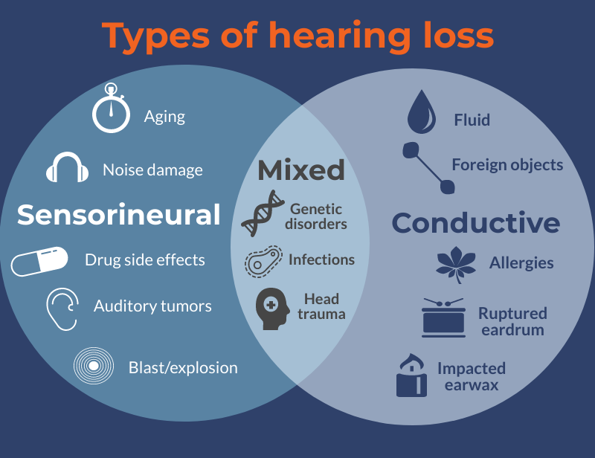
types of hearing loss

Slide 14
Causes of Hearing Impairment
Hereditary
Meningitis
Injuries of the Ear
Nerve Damage
Loud Noise
Medication

Slide 15
Mental Disorder
Any clinically significant behavioral or psychological syndrome characterized by distressing symptoms, significant impairment of functioning, or significantly increased risk of death, pain, or other disability. Mental disorders are assumed to result from some behavioral, psychological, or biological dysfunction in the individual. The concept does not include deviant behavior, disturbances that are essentially conflicts between the individual and society, or expected and culturally sanctioned responses to particular events.
Mental Retardation less than average general intellectual functioning that brings with it some degree of impaired adaptation in learning, social adjustment, or maturation, or in all three areas; it is now classified as a developmental disability. Mental retardation is a relative term. Its meaning depends on what society demands of the individual in learning, skills, and social responsibility. Many people who are considered developmentally challenged in the complex modern world would get along normally in a simpler society.

Slide 16
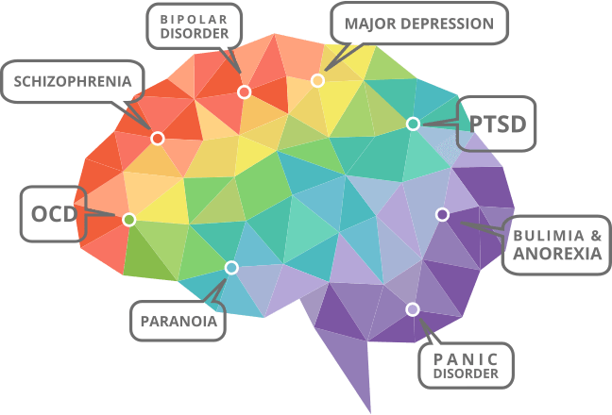
Types

Slide 17
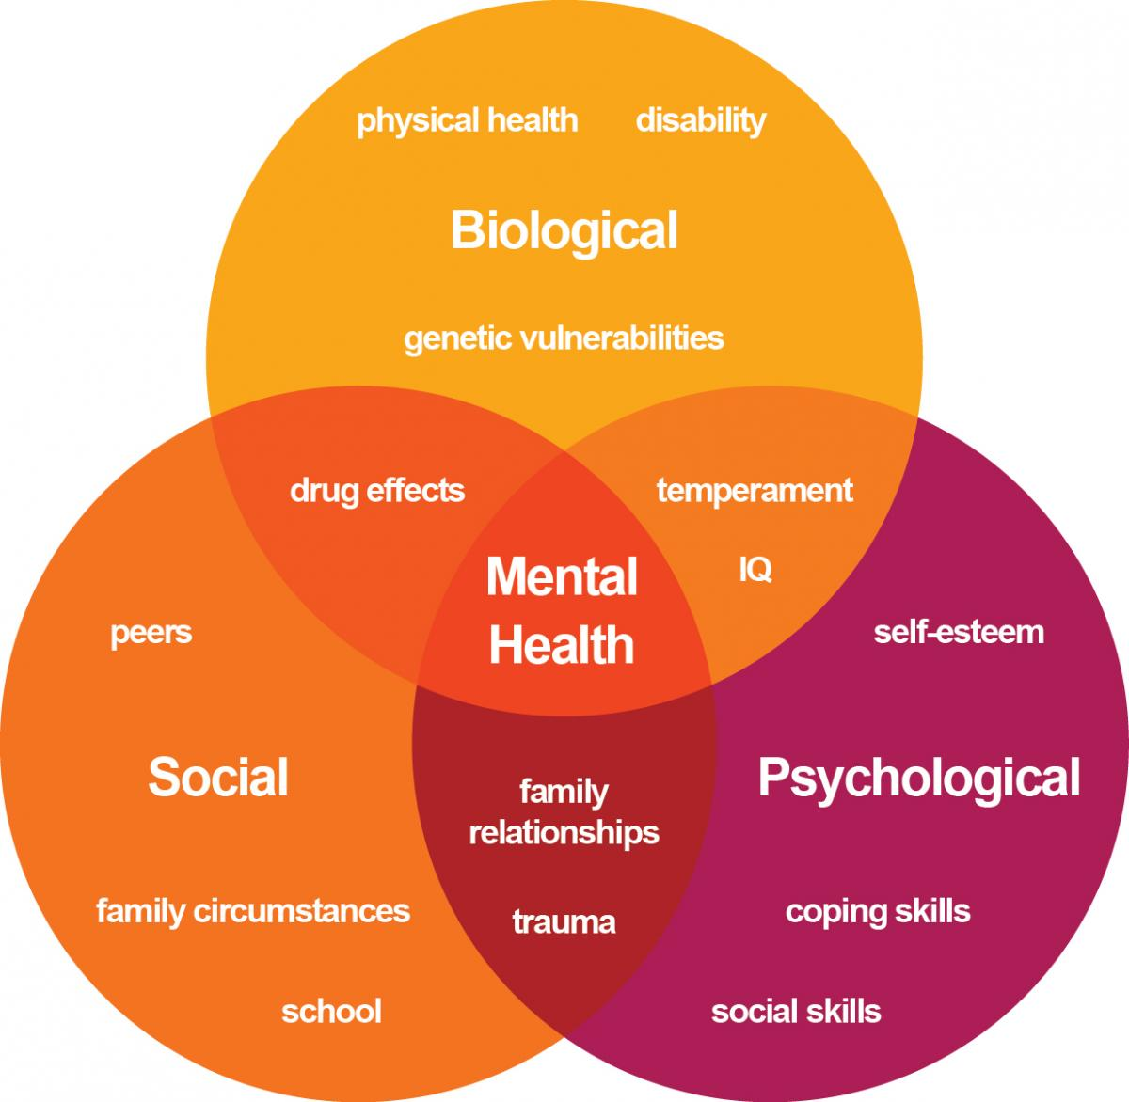
Causes

